Slide 1

Incluyeme.com
Zero Project Conference 2025 (#ZeroCon25)
Gabriel Marcolongo
CEO at Incluyeme.com
Digital training platforms and ecosystem building in inclusive employment
Wednesday March 05, 11:00
Notes:
Please add your notes here.
Title; First name, last name of speaker(s); Name of Organization, Name of Country, Name of Session (as written in Agenda)
#ZeroCon24
Day and Time of Session

Slide 2

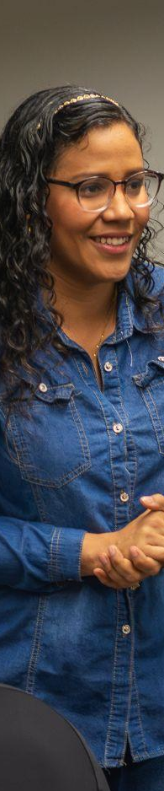

Why do we exist?
1.3 billion
people with disabilities globally. This represents 16% of the world’s population, or 1 out of every 6 people.
Source: WHO 2023
80%
of disabilities are acquired between the ages of 18 and 64.
Source: Valuable 500, 2021
50%
unemployment
More than half of the people with disabilities face barriers to employment.
Source: World Bank 2020
11%
Less income
Salary gap that perpetuates inequality and limits economic progress.
Source: World Bank 2020
Because disability is often rendered invisible by society, and these numbers reflect the reality and barriers that people with disabilities face.
25% over 60 years by 2050
By 2050, over 25% of Latin America’s population will be +60. Disability rates are highest among population over 60, especially in developing countries.
Source: CEPAL and OMS 2011

Slide 3

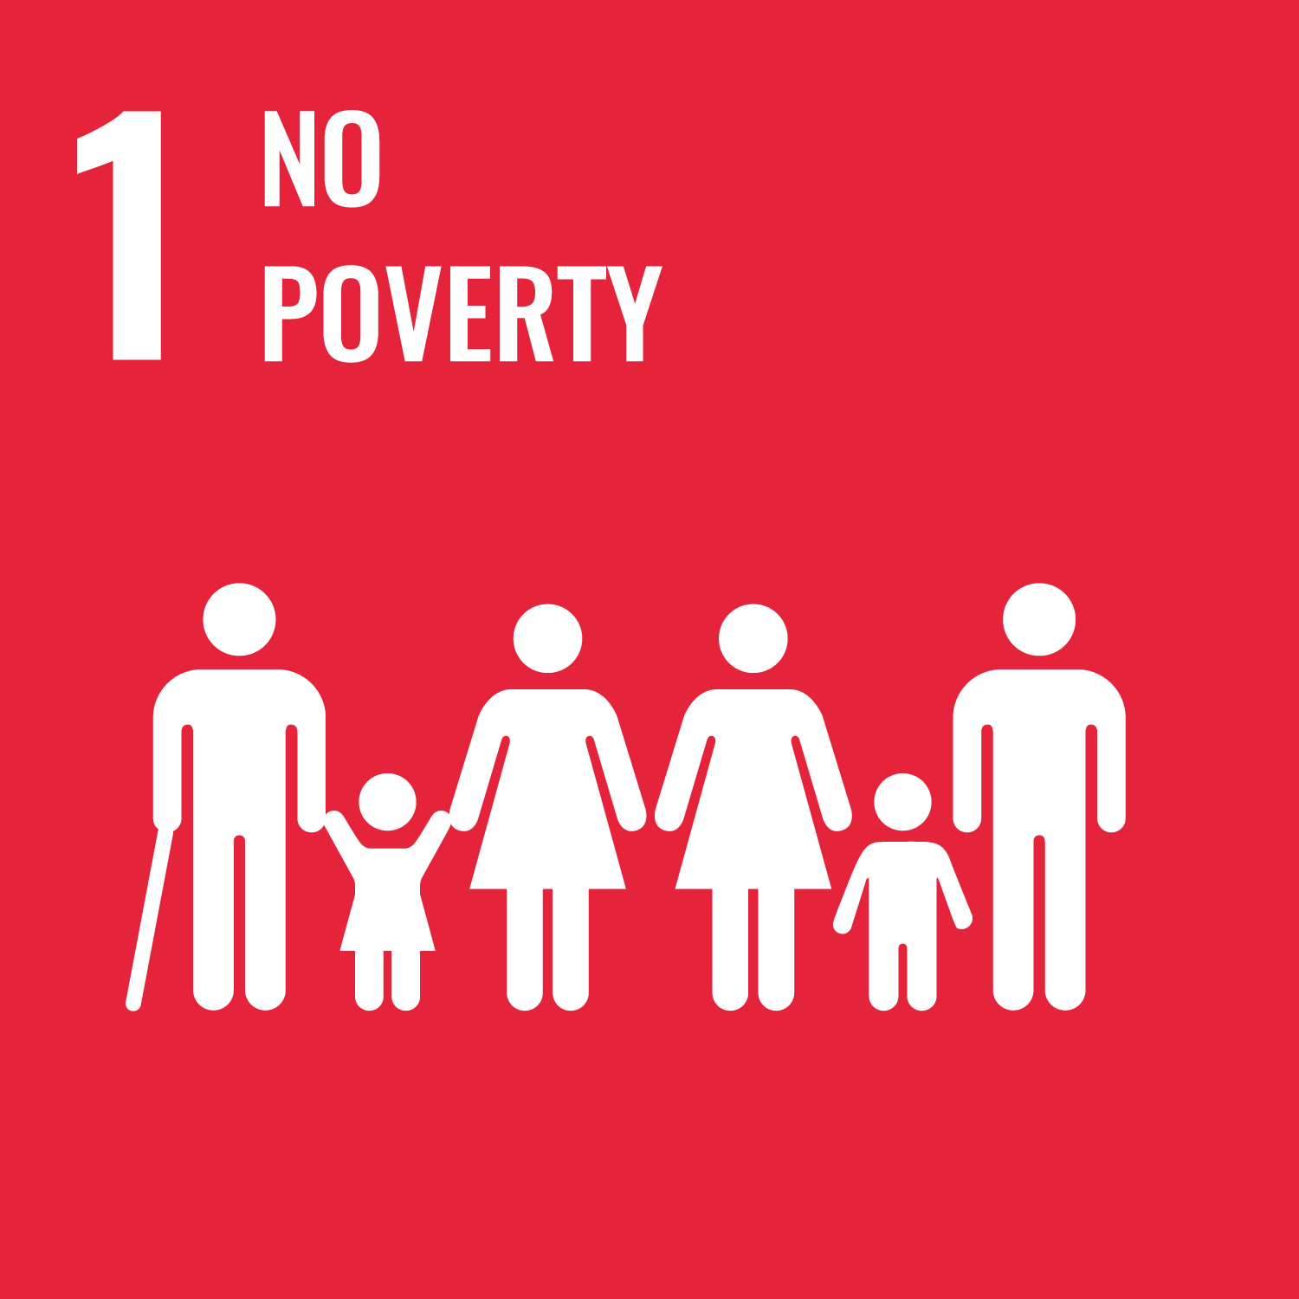



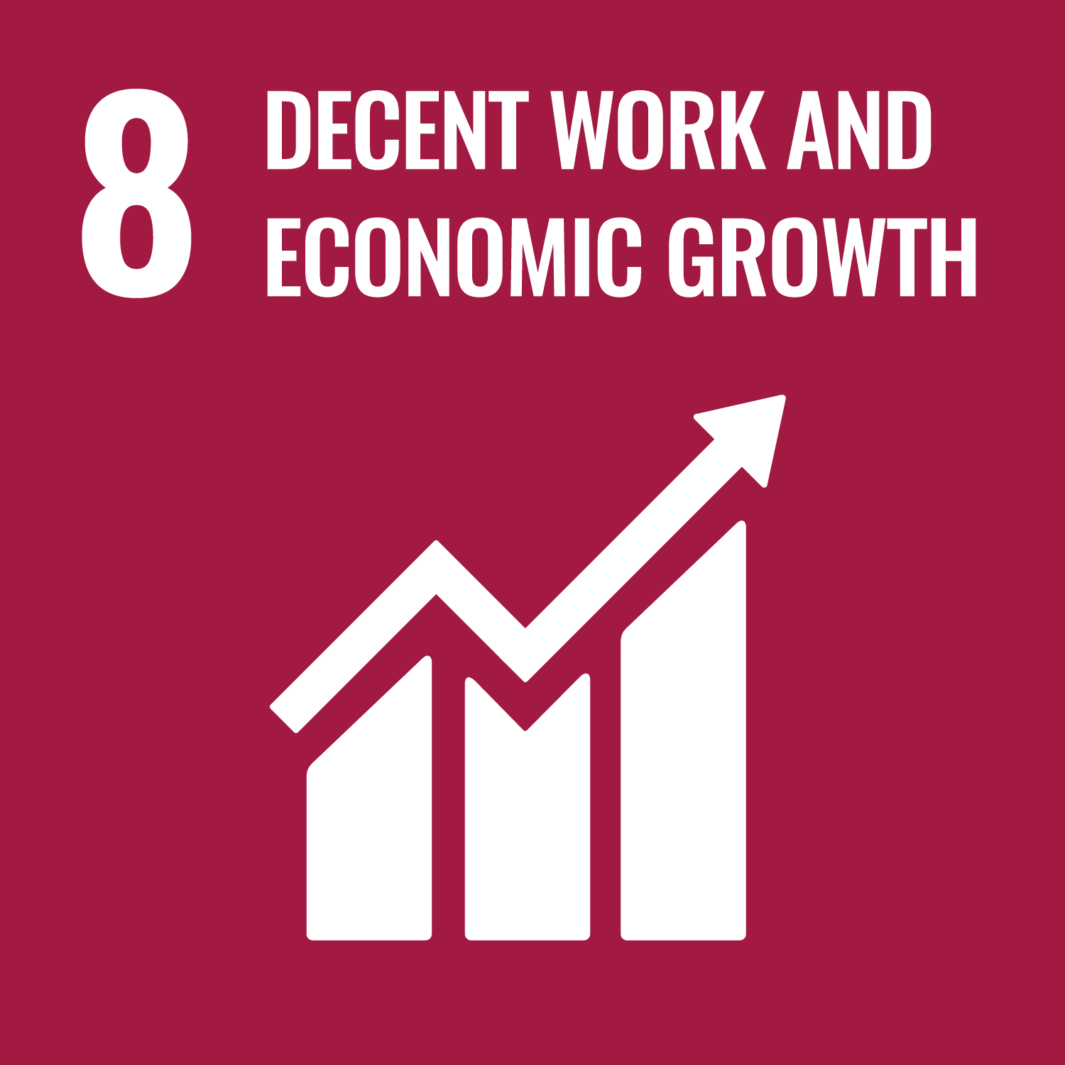

About Us
Alignment with Sustainable Development Goals
We are a social organization that has been working since 2013 for the socio labor inclusion of people with disability
(SDGs)
We train people with disabilities in technology and soft skills to enhance and promote opportunities in the labor market.
We work with companies to create inclusive work environments. Our consulting transforms organizational cultures and hiring practices.
Our Purpose
We strive to be part of a more equitable and inclusive society. We believe in the value of diversity.
We are the only organization working in Latam at a regional level with all types of disabilities.

Slide 4

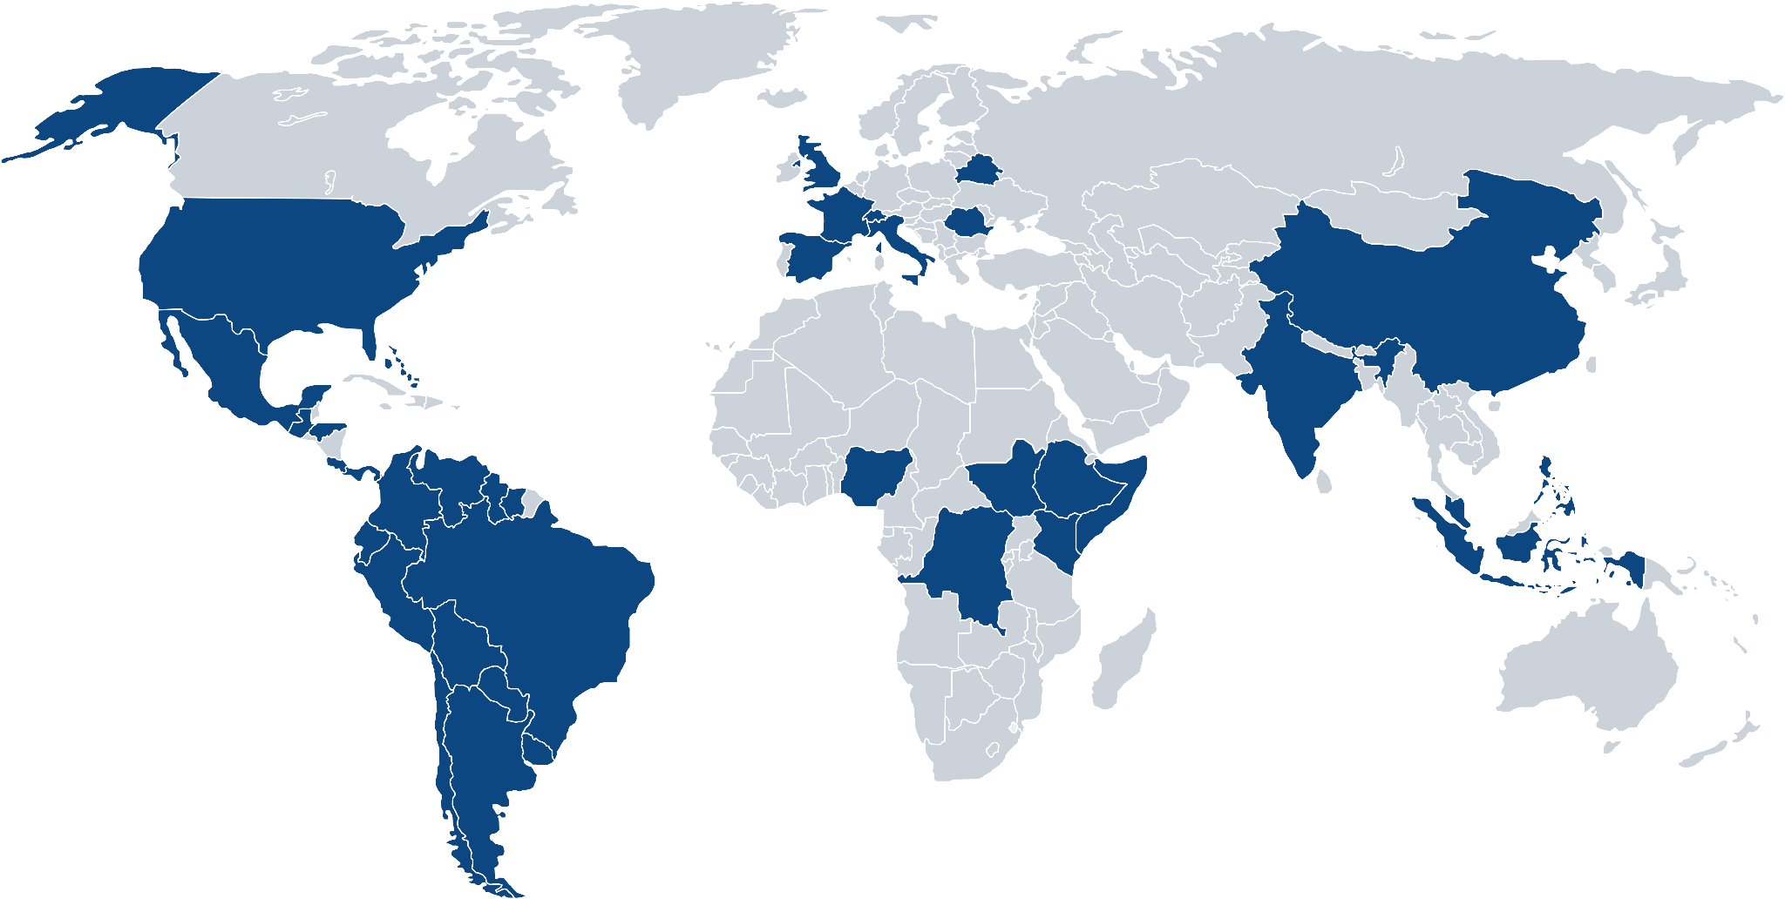
We work globally focusing our efforts in developing countries

Slide 5

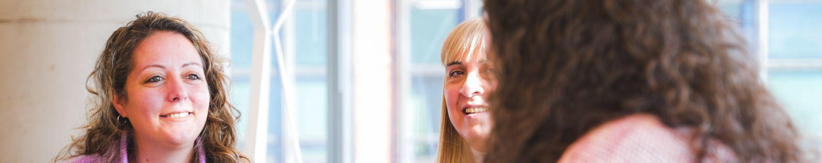
Our
Impact
+240,000
people with disabilities registered in our job portal
+12,000
people with disabilities trained
+3,900
people with disabilities got a job
+700
companies have trusted us
We enhance the employability of people with disabilities and support companies in implementing inclusion strategies.
+6,500
training workshops implemented in companies
+40,000
employees trained

Slide 6


Some of the companies that trust us

Slide 7











Empowering our impact alongside incredible organizations

Slide 8
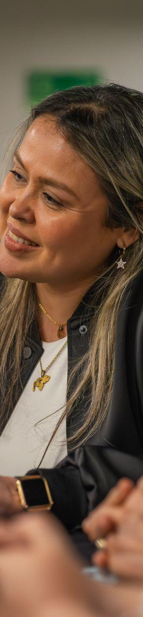
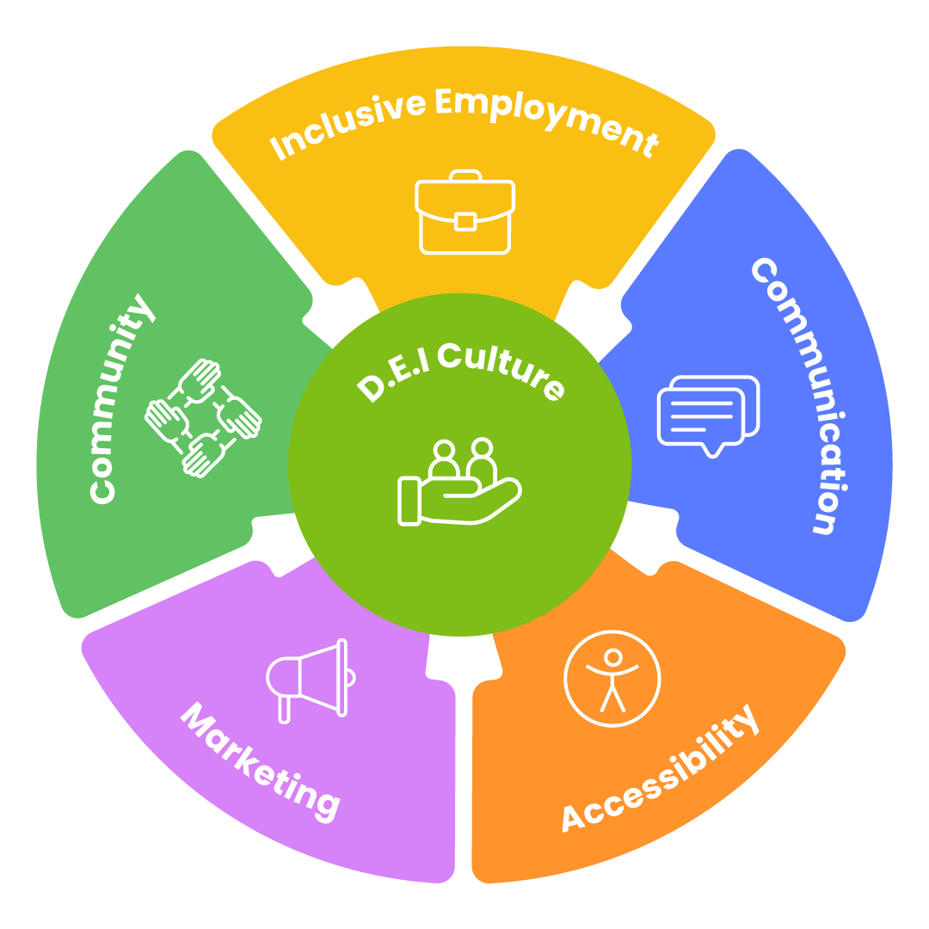
How do we do it?
We created a model to measure, guide and define the level of socio-labor inclusion of people with disabilities in an organization.
We work with data, not perceptions.
This approach allows us to implement concrete strategies and provide tools to contribute to the development of a diverse and inclusive organization.

Slide 9
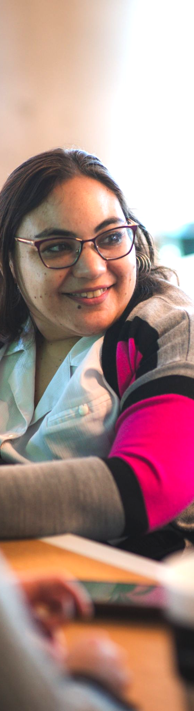






Components
Culture
Accessibility
We work on actions and strategies based on data that strengthen a diverse and inclusive organizational culture, ensuring that every person feels part and protagonist of the organization.
Cultural diagnosis and Disability KPIs
Training
ERG’s and committees
We provide guidance and support for a comprehensive transformation to help companies improve accessibility in physical and digital environments.
Universal accessibility evaluations
Web and app accessibility
Accessibility training
Employment
Marketing
We aim to make all talent attraction processes inclusive and accessible, allowing the participation and hiring of people with disabilities.
Job Board
HR support
Prefilters and profile selection
We support the organization by identifying the needs and preferences of the market to comprehensively include customers with disabilities.
Marketing inclusive content
Usability and accessibility testing
Training for marketing teams
Communication
Community
We strive to make communication accessible and inclusive to reduce existing barriers.
Internal communication diagnosis
HR support
Consulting
We co-create meeting spaces with the community to continue contributing to the development of a more inclusive society.
Volunteer Programs
Academies and Bootcamps
Mentorships with impact

Slide 10
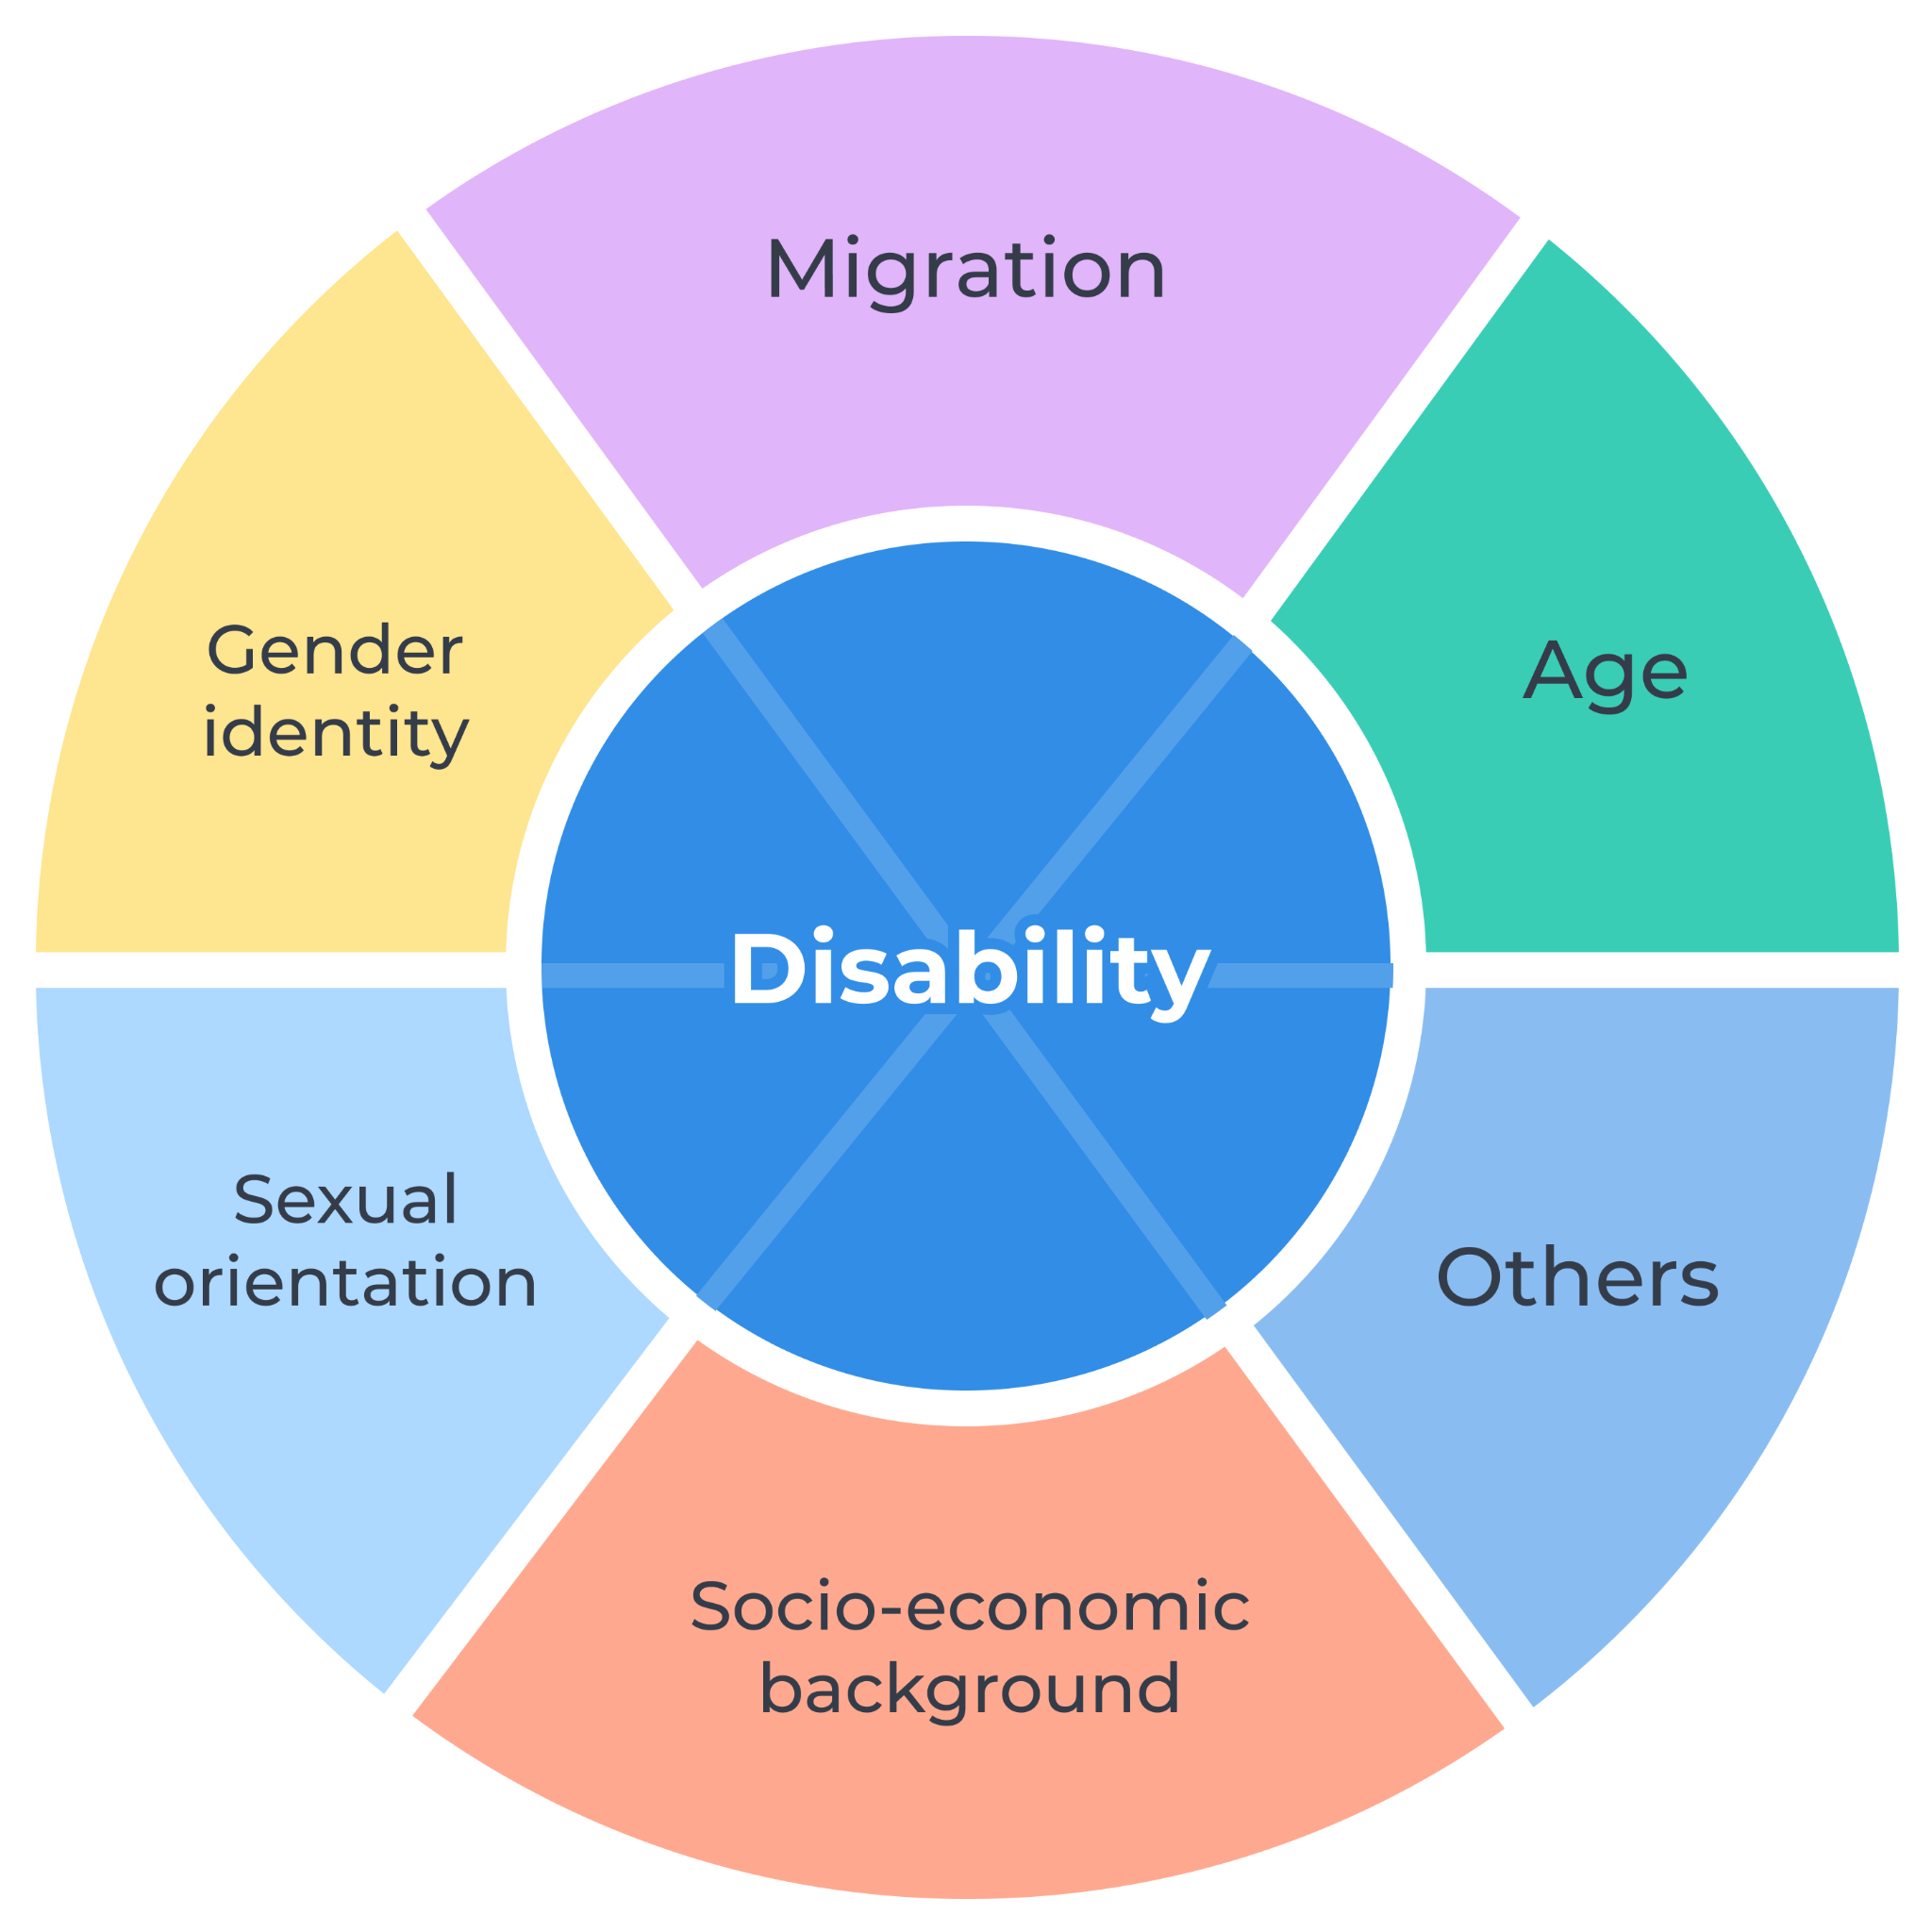
We have an intersectional approach
Focusing on the different social factors that, together, can hinder socio-labor inclusion.

Slide 11

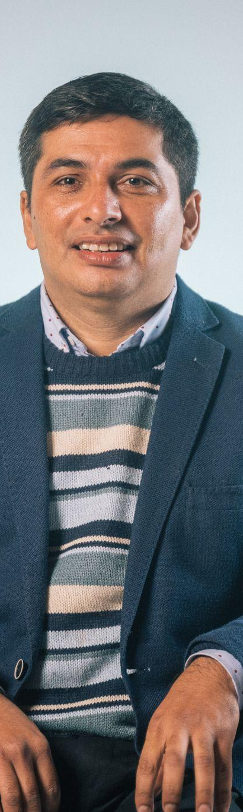



Develop Your Future
Project activities:
+4,300
people with disabilities trained in technology.
25
bootcamps in technology: Full Stack, Software Tester, Graphic Design, Community Management, Digital Marketing, SQL, Agile Project Management, UX/UI, among others.
13
MOOCs: Introduction to Programming, Financial Education, Accessibility Web Tester, Full Stack, Excel, among others.
563
people with disabilities acquired a job after they graduate from our training program.
Upskilling for people with disabilities
1:1 Vocational Guidance sessions to design an academic and professional path for our students.
Since 2020 we’ve been offering trainings in technology for people with disabilities to enhance and promote their socio laboral inclusion.
Multiple Soft skills workshops to improve their job profiles: assembly of CV, recommendations for interviews, vocational guidance, agile methodologies, etc.
Personalized monitoring through an artificial intelligence chat!
Notes:
Ene 22: migrantes identificados 212, capacitados 173, contratados 20

Slide 12






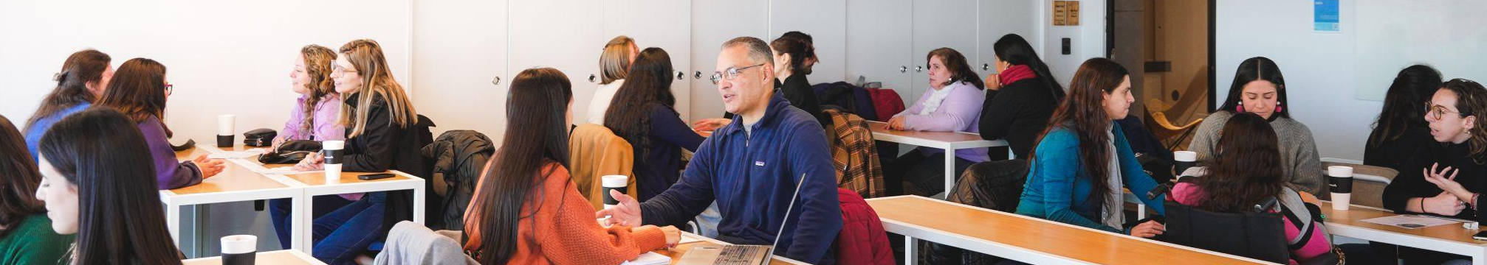
Entrepreneurs and Freelancers Empowerment
Since it’s lunch in August 2024 we have achieved:
+100 members in the community: the largest community of freelancers and entrepreneurs with disabilities in Latam!
The members are from +10 countries in Latin America
82% of women in the group
Virtual encounters in 2024: Workshops with specialist on multiple topics and “Coffee with Entrepreneurs” between members.
15 different types of businesses: Gastronomy, crafts, fashion, home decor, training, consulting, software development, graphic design, photography, digital marketing, community management, beauty, electronic products, financial services, professional services, among others.
The community seeks to support people with disabilities who want to develop as entrepreneurs or freelancers.
This network aims to be a space for support, learning and dissemination of the work of its members and to offer workshops, tools and relevant information for participants.
“At Incluyeme.com I found a community that made me feel accompanied and supported on my path as a digital entrepreneur.”
Being part of the community opened the way for me to meet people with the same goals as me and exchange ideas. We help each other.
José V.
Verónica C.
Notes:
Ene 22: migrantes identificados 212, capacitados 173, contratados 20

Slide 13

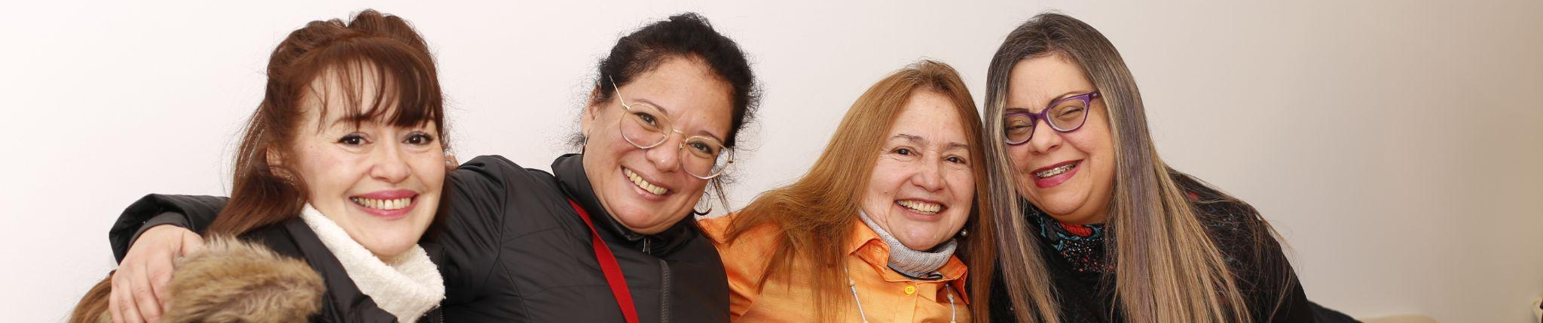








Migrants With Disabilities
Project activities:
Diagnoses and mystery shopper studies to understand the reality of the migrant population with disabilities and make it visible
Job guides for migrants and employers
More than 7 million Venezuelans left their country in the last years: the majority of those migrants live in Latin American countries and have to face specific challenges.
Training in technology and soft skills to improve their job profile
Connect them with companies and introduce them to freelance work platforms
Impact:
208
migrants with disabilities trained in technology and soft skills
94
migrants with disabilities employed or earning income
12
migrants being part of our entrepreneurs and freelance community
Notes:
Ene 22: migrantes identificados 212, capacitados 173, contratados 20

Slide 14

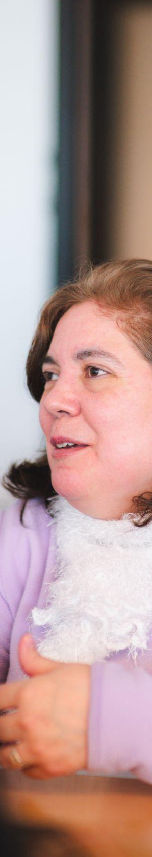
Women With Disabilities In Tech
Project activities:
Train women with disabilities in technology and soft skills.
Connecting graduates with potential employers and freelance work platforms.
Identification of barriers faced by women with disabilities to take advantage of technology for their employability (ELADis).
Incluyeme.com was selected among 8,000 projects from the GOOGLE IMPACT CHALLENGE FOR WOMEN AND GIRLS to promote the training and employability of women with disabilities in STEM.
Impact:
+2,600
Women with disabilities were trained in technology bootcamps
+1,500
Women with disabilities were trained in MOOCs in technology
+900
participated in soft skills training
+400
Participated in mentoring to support women with disabilities in their training and employability process
+300
are generating income
Notes:
Ene 22: migrantes identificados 212, capacitados 173, contratados 20

Slide 15
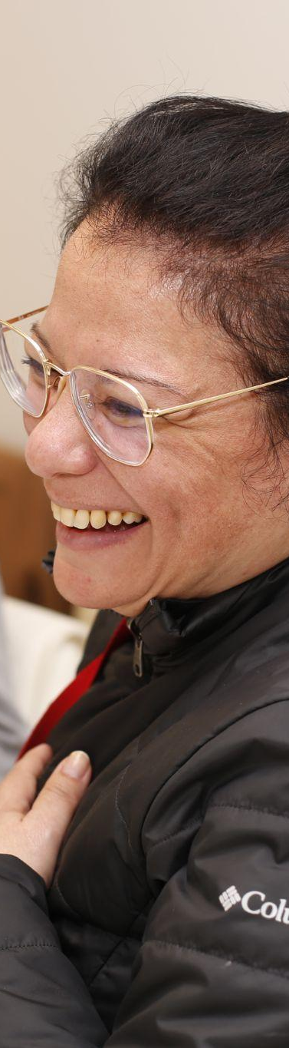




Silver Inclusion
Diagnostic stage:
User experience diagnosis
Digital accessibility diagnosis
Physical accessibility diagnosis
Skills development stage:
Training for customer service areas and bank employees
Training for elderly people with disabilities by corporate volunteers.
Financial inclusion of people +60 with disabilities
By 2,050, over 25% of Latin America’s population will be +60, disability rates are highest among population over 60, especially in developing countries.
The project seeks to improve and expand the financial inclusion of people with disabilities over 60 years old in 4 banks of Argentina and Mexico.
Expected impact:
+100
employees will participate in corporate volunteering with elderly people with disabilities.
+600
employees in customer service areas will be trained to improve their services with a focus on disability and the elderly.
+300
customers +60 of the banks will receive training in financial education, use of the banks' digital channels and access to banking services.
+3,000
Bank employees will be trained in disabilities and older adults
The beneficiaries will be the banks' employees as well as elderly people with disabilities who are current or future customers of the banks.
Notes:
Ene 22: migrantes identificados 212, capacitados 173, contratados 20

Slide 16

hola@incluyeme.com • www.incluyeme.com

