Slide 1
Disability Led Climate Justice and Humanitarian Action
Marcie Roth
World Institute on Disability and Global Alliance for Disaster Resource Acceleration
United States
Forum on Climate Change and Humanitarian Crises
Thursday, 22 February 2024
Notes:
Please add your notes here.
Title; First name, last name of speaker(s); Name of Organization, Name of Country, Name of Session (as written in Agenda)
#ZeroCon24
Day and Time of Session

Slide 2

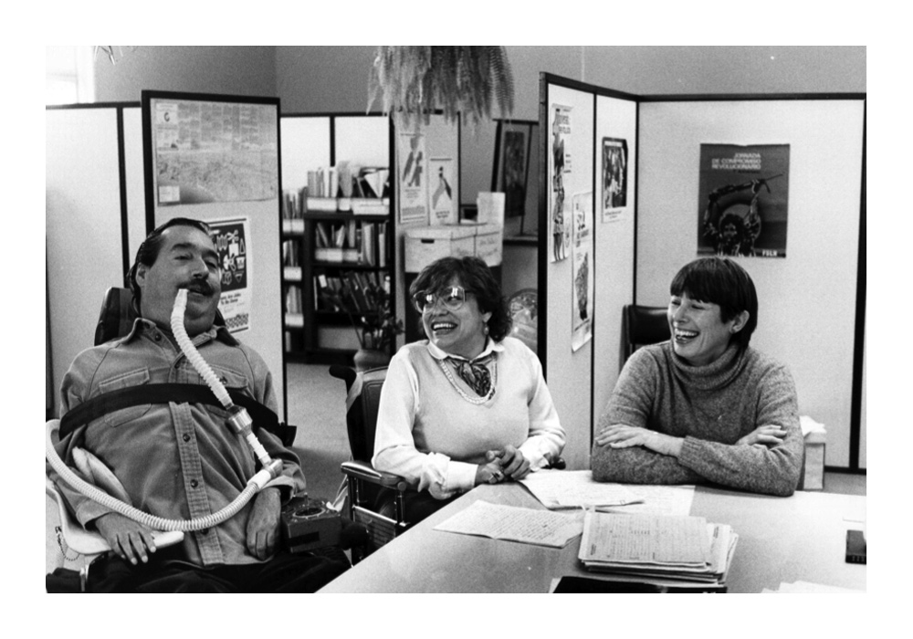
WID’s global mission is to continually advance the rights and opportunities of over one billion people with disabilities.
We do this through our core services:
Accessibility and Universal Design Solutions
Emergency Preparedness, Disaster Risk Reduction and Climate Resilience
Policies, Tools and Services for Global Community Living
Our vision is a world in which people with disabilities live freely where access, inclusion, equity, and resilience are embedded throughout every global community

Slide 3





Disability-Led: Valuing lived experience, with 51% or more of our Board and Staff identifying as people with disabilities.
Accelerating Inclusion: Leading a global effort to eliminate barriers and advance policies that eliminate exclusion and drive inclusion.
Our
Guiding
Principles
Pan-Disability Movement Solidarity: Pursuing equality, inclusion, and accessibility for all people with any disability.
Intersectional and Cross-Cultural Competency: Including the full spectrum of identities and the range of privilege, marginalization, and oppression that impact how disabled people are treated.
Ethics, Integrity, and Accountability: Directing our focus and uncompromising standards to the needs of everyone with disabilities, especially people who are most marginalized.
Advancing Human Rights and Supporting Disability Justice Across the Lifespan: Securing and enhancing independent and interdependent livelihoods for the whole community.

Slide 4
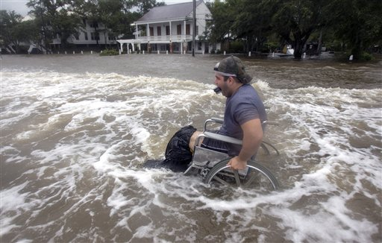
Extreme Weather, Conflict, Public Health Emergencies and Disasters
The frequency, intensity, duration and impact of disasters is growing exponentially, driven by climate change, public health emergencies, conflict, and other threats.

Slide 5
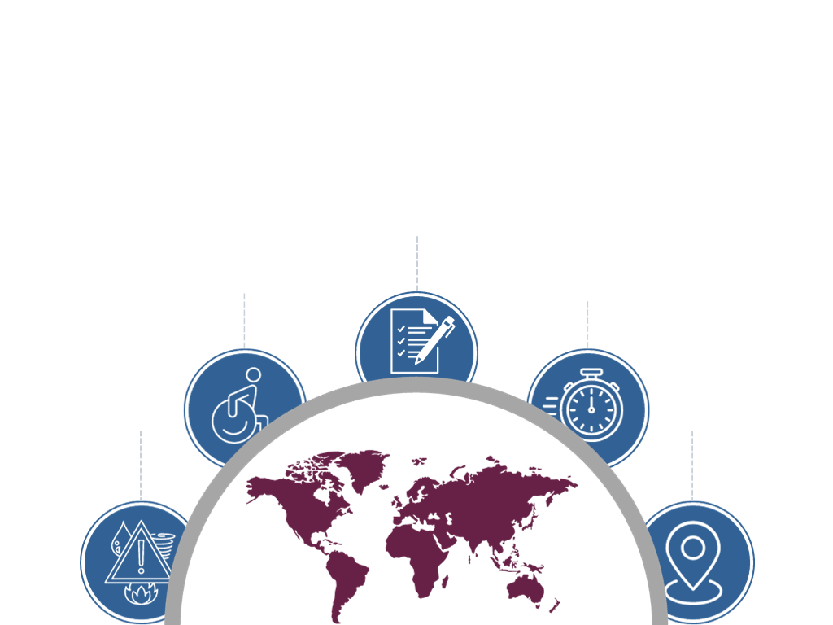
Emergency Preparedness, Disaster Risk Reduction, and Climate Resilience
How?
Who?
WID SME create scalable, accessible, and innovative solutions that remediate systemic barriers and build inclusive communities.
When?
People with disabilities are up to 4 times more likely to be injured or die in an emergency or disaster than those without disabilities.
Resilient and sustainable communities result from partnerships and planning with disability-led organizations before a disaster event.
Why?
Where?
Emergencies, disasters and crises create and exacerbate barriers and inequities requiring inclusive strategies across the disaster life cycle.
WID’s SME consult with private sector corporations, non-profit representatives, governments, the UN, and global leaders around the world.

Slide 6

An alliance of disability-led organizations, foundations, corporations, and humanitarian actors collaborating to accelerate solutions for disaster impacted disability organizations and the disabled people they serve.
Providing an alternative to the traditional model where very little, if any reaches disability-led organizations
Maximizing on the expertise of disability-led organizations in their communities
Creating partnerships instead of charity

Slide 7

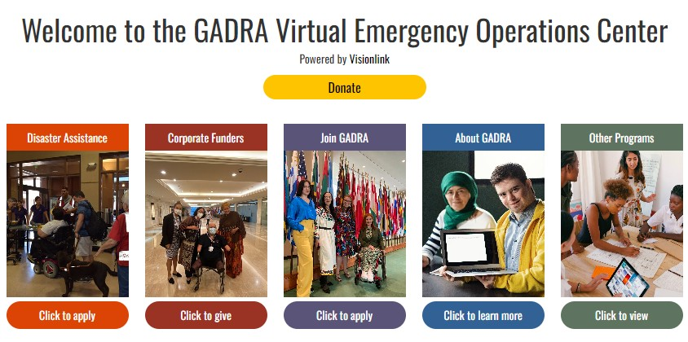
Global Alliance for Disaster Resource Acceleration
Pursuing disability equity in disaster response, risk reduction, and recovery
Disability leaders, organizations, corporations, and foundations accelerating solutions for disability-led organizations and disaster-impacted communities
A leadership model not the charity model
Supporting local disability-led expertise
Using accessible technology for global connections
Proven outcomes in multiple concurrent responses to disasters and crises
Support Disability-Led Organizations:
GADRA Virtual EOC: www.gadra.communityos.org
Email: GADRA@wid.org
Steering Team:
World Institute on Disability, The Partnership for Inclusive Disaster Strategies, & ONG Inclusiva

Slide 8


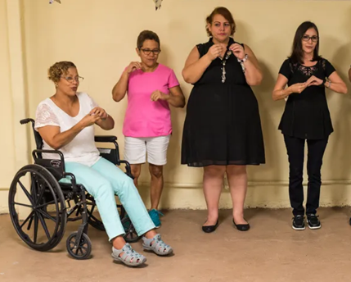
2020-2021
November 2020 Hurricane Iota - Colombia
Colombian National Organization of the Blind, Colombian National Council of Persons with Disabilities
Technology, DME, accessible housing materials
August 2020 Hurricane Isaias – Puerto Rico
Movimiento para el Alcance de Vida Independiente (MAVI) Puerto Rico Center for Independent Living
Communication, training, long-term recovery fundraising partner
February and April 2021 – Southern USA
Living Hope Wheelchair Association, Texas Governor’s Committee for People with Disabilities, Houston Mayor’s Office for People with Disabilities, and Trach Mommas of Louisiana
Consumable medical supplies, medication, water, financial assistance

Slide 9

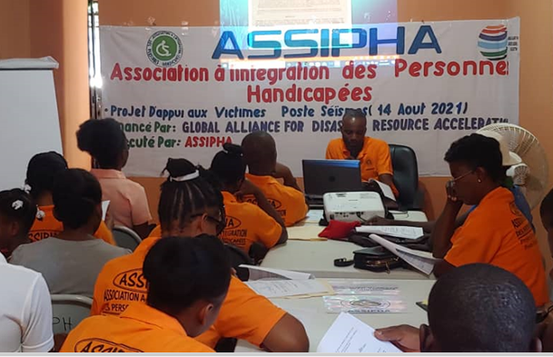
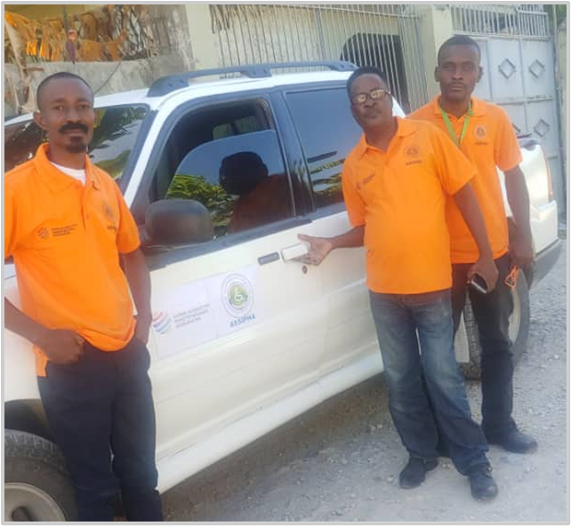
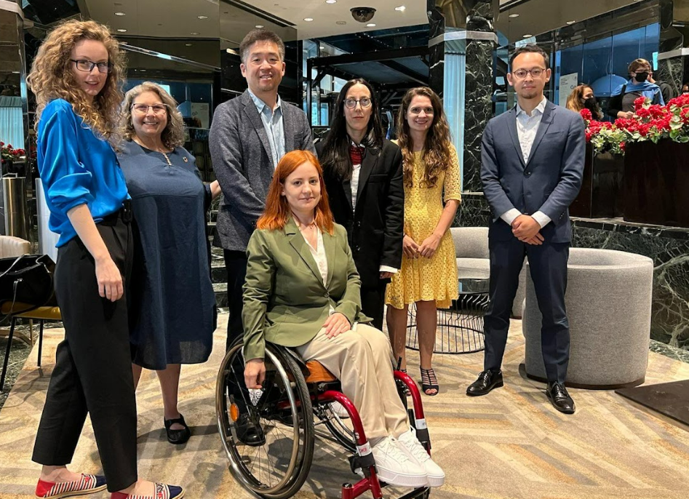
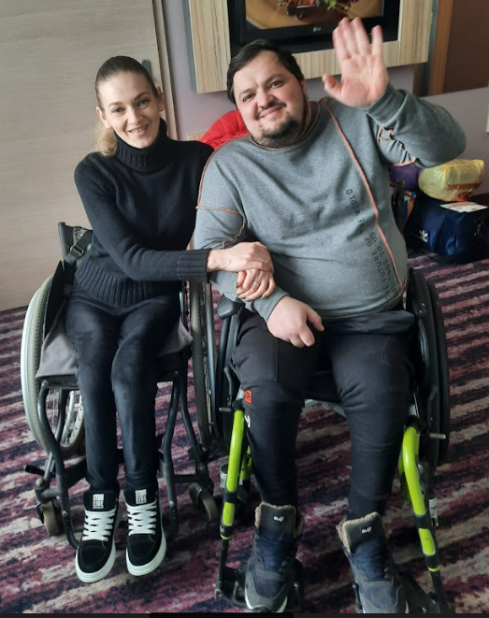
2021-2022
November 2021 Earthquake in Haiti
Association d’Integration des Personnes Hadicappees
Continuity of operations, administration, disability daily needs and training support, transportation, funding partner
February 2022 Russian Invasion of Ukraine
Fight for Right
Administrative and organizational operations, case management and information management tools, funding partners

Slide 10

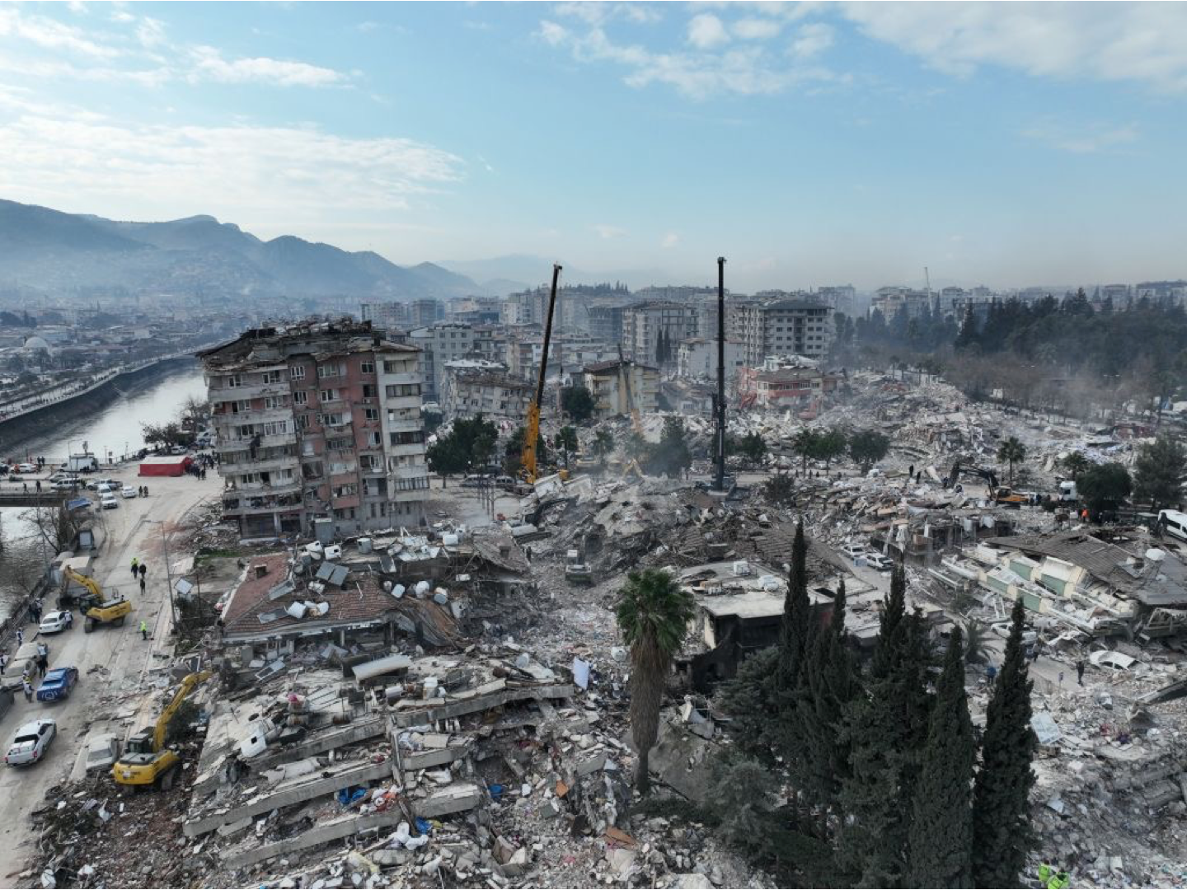
2023 - Current
February 2023 –Türkiye & Syria Earthquakes
DLOs:
Engelsiz Arsuz Gençlik Ve Spor Kulübü Derneği (Accessible World Foundation)
Almostakabal Association for the Physically Disabled
ALS-MNH DERNEĞİ
Türkish Beyazay Association
Engelliler ve Gençlik Eğitim Kültür Sağlık Spor ve Yardımlaşma Derneği (Disabled and Youth Education, Culture, Health, Sports, and Solidarity Association)
Engelsiz Bileşenler Federasyonu (Federation of Associations for Barrier Free Living)
Association of Women with Disabilities (Engelli Kadin Dernegi)
Needs:
Funding & Supplies donations
Public Awareness
In country partnerships
Training and technical assistance from experienced DLOs

Slide 11
Current/New Requests from Disability-Led Organizations
Location of DLO:
Afghanistan (Earthquake)
Libya (Flooding)
Morocco (Earthquake)
Mexico (Hurricane)
Gaza (Conflict)
Israel (Conflict)
Chile (Wildfire)
Needs:
Resources for maintaining/resuming continuity of operations
Financial Management
Gap Analysis
Staffing
Monitoring & Evaluation
Disability Equipment & Supplies
Communication Equipment & Technical Assistance
Accessible Transportation
Accessible Temporary & Permanent Housing
Public Awareness
In country partnerships
Language Access
Culturally Appropriate Mental Health
Training & technical assistance from experienced DLOs

Slide 12


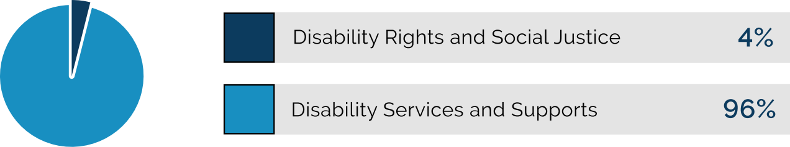

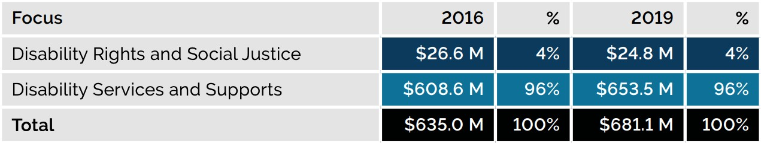
Foundation Giving for Disability-Led Organizations
One in four adult Americans and an estimated 1.3 billion people globally experience disability, but only one penny of every $10 USD in grantmaking goes to disability rights and social justice¹.
Figure 4. Activity focus of Foundation 1000 Giving for Disability in 2019
Historically, disability-led
organizations have been underfunded, with limited focus from philanthropic resources.
Further, giving trends show very little funding is invested in disability-led social justice.
Image description: A pie-chart displays 4% of foundation giving was assigned to Disability Rights and Disability Social Justice while 96% of foundation giving was assigned to Disability Services and Supports.
Table 1. U.S.-focused Foundation 1000 Giving for Disability Rights and Disability Social Justice and Disability Services and Support, 2016 and 2019
A table indicates that in 2016, 26.6 million (or 4% of giving) was allocated to disabiity rights and social justice, while 608.6 million (or 96%) went to disability services and supports. In 2019, 24.8 million (or 4%) went tot disabikity rights and social justice, and 653.5 million (or 96%) went to disability supports
¹Foundation Giving for Disability: Priorities and Trends, Disability and Philanthropy Forum

Slide 13

Contact the World Institute on Disability
Websites: www.wid.org/
https://gadra.communityos.org/
Email: Marcie@wid.org
Phone: +1 301-717-7447
Facebook: www.facebook.com/WorldInstituteonDisability
https://www.facebook.com/DisabilityGADRA/
Twitter: www.twitter.com/WID_org/http://twitter.com/disabilityGADRA
Instagram: @worldinstituteondisability/
LinkedIn: www.linkedin.com/company/world-institute-on-disability/

