Slide 1
Learning globally and regionally: ILO GBDN conference for Asia and the Pacific
Jürgen Menze
International Labour Organization (ILO)
Switzerland
Global Disability Conferences in 2025: Call to Action
Thursday, 6 March 2025
16:00 to 17:00
Notes:
Hybrid ILO GBDN regional conference for Asia and the Pacific; Jürgen Menze; International Labour Organization, Switzerland, Global Disability Conferences in 2025: Call to Action. Thursday, March 6, 2025, 16:00 to 17:00

Slide 2


ILO Global Business and Disability Network (GBDN)
Notes:
Background on the ILO Global Business and Disability Network. Who makes up the GBDN, what the network focuses on and promotes.

Slide 3
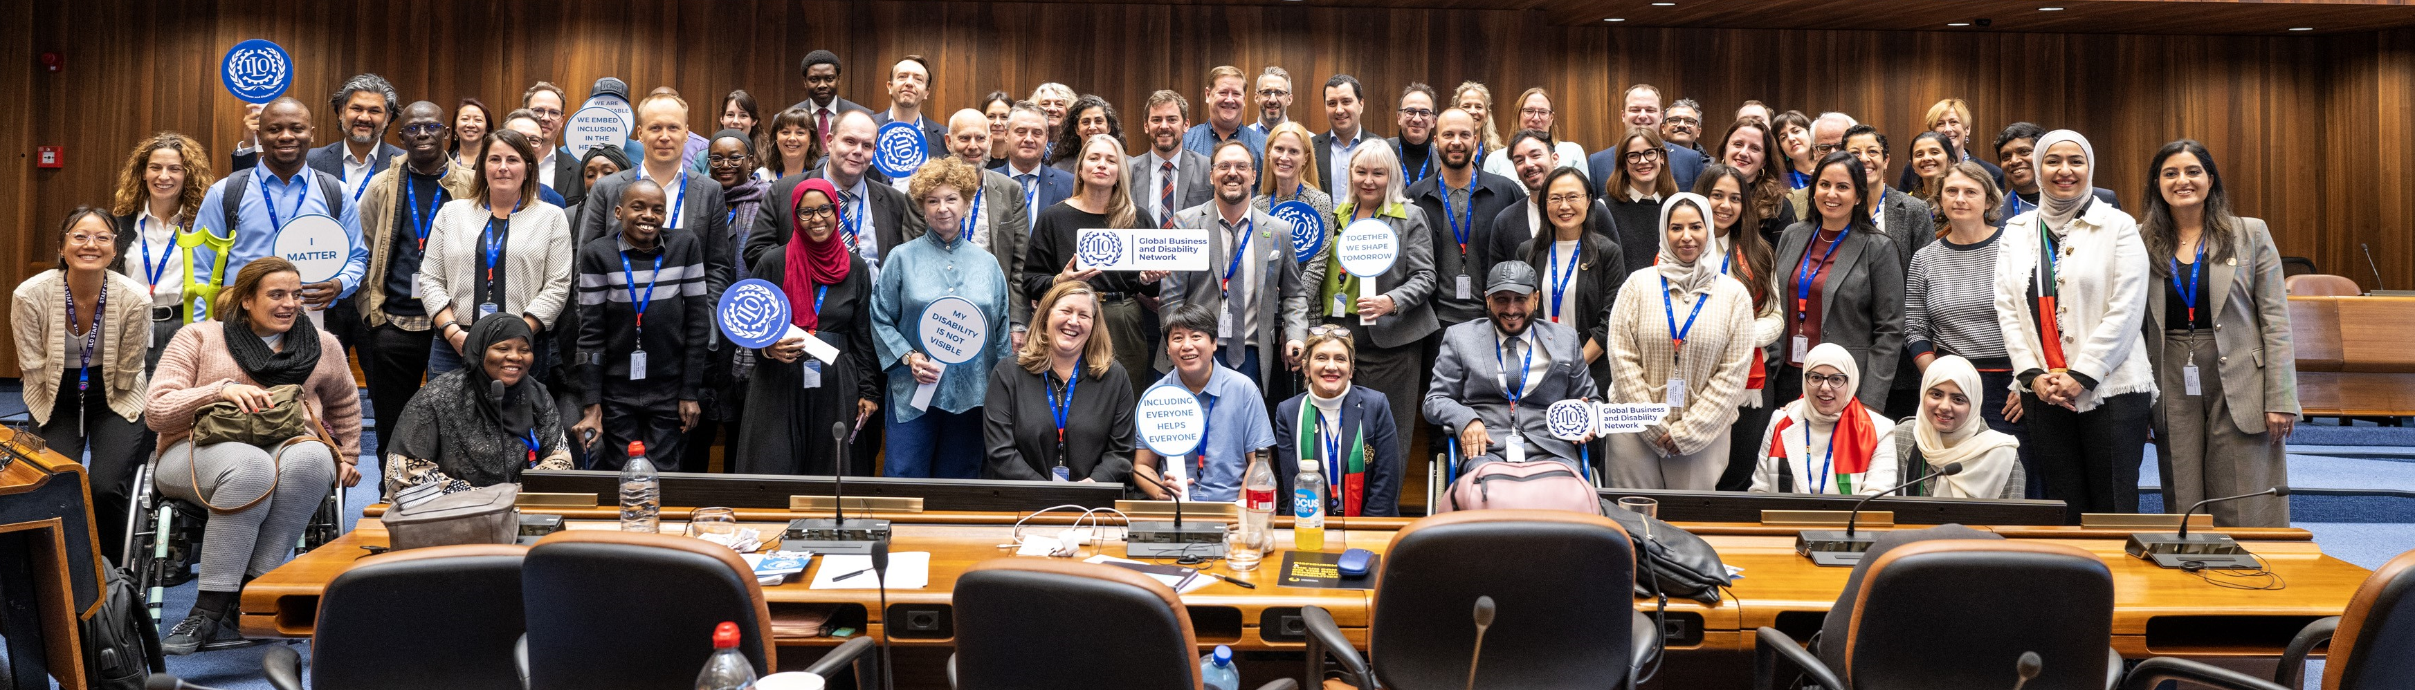
Global and regional ILO GBDN conferences
2024 – Latin America, Bogotá, Colombia (hybrid)
2023 – Arab States (virtual)
2022 – Africa (virtual)
2021 – Asia and the Pacific (virtual)
Notes:
Regional GBDN conferences rotating among regions starting in 2021.

Slide 4
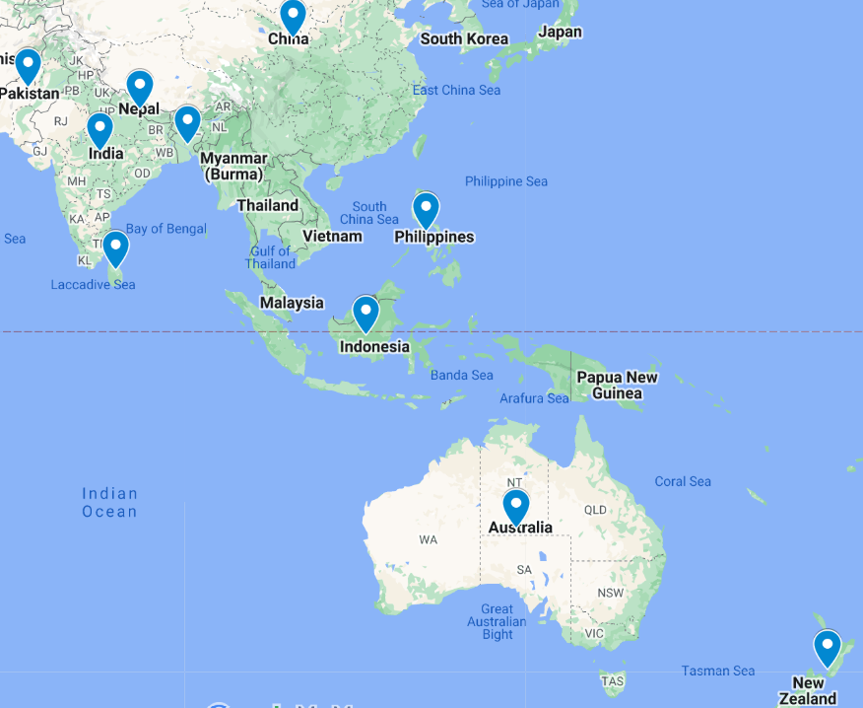
ILO GBDN conference for Asia and the Pacific
Mid-September, Singapore (hybrid)
Aligned with the Zero Project and its local partner SG Enable in the context of the Zero Project Asia Pacific Symposium
To share latest good corporate practices and lessons learned on the inclusion of persons with disabilities in private sector companies
To address the importance of business partnerships, e.g. with vocational skills training providers and organisations of persons with disabilities
Notes:
Summary of the ILO regional conference for Asia and the Pacific. Main purpose, what topics will be addressed.

Slide 5
How to engage
Subscribe to the ILO GBDN newsletter at businessanddisability.org
Follow the ILO GBDN LinkedIn page
Register for the conference once registration opens
Notes:
Opportunties to engage in the conference.

