Slide 1
Specialized Educational Assistance Center
Victor Martinez
Instituto Jô Clemente
Brazil
Integration strategies for mainstream schools and youth services
#ZeroCon24
Thursday 22.02.2024
12:20 - 13:40
Notes:
Please add your notes here.
Title; First name, last name of speaker(s); Name of Organization, Name of Country, Name of Session (as written in Agenda)
#ZeroCon24
Day and Time of Session

Slide 2
Organization - Instituto Jô Clemente
Instituto Jô Clemente (IJC) is a non-profit non-governmental organization that has promoted health and quality of life for people with intellectual disabilities, Autism Spectrum Disorder (ASD), and rare diseases;
In addition to supporting their social inclusion and defense of their rights, promoting knowledge through scientific research for over 62 years.
4 Pillars - Health Promotion and Prevention / Social Inclusion / Defense and Guarantee of Rights / Science and Innovation (from birth to old age)
Notes:
Sample Slide: presenting three points on our project and the relationship to this year’s theme of the Zero Project Conference. Point 1; Point 2; Point 3 connect together in this way.

Slide 3
Essence Job - Specialized Educational Service
Support to facilitate learning:
Specialized Educational ≠ Extra Class (Extra Tutoring)
Support in the classroom
Support and training for teachers:

Slide 4

Innovation in our Service
Family
Community
School
Government
Axel Honneth Critical Theory of Recognition

Slide 5
Impact and success factors - Specialized Educational Service
Evolution of service: average of thirty (30) preschool children, and currently, we assist more than 320 children;
Change of culture: Listening to development

Slide 6
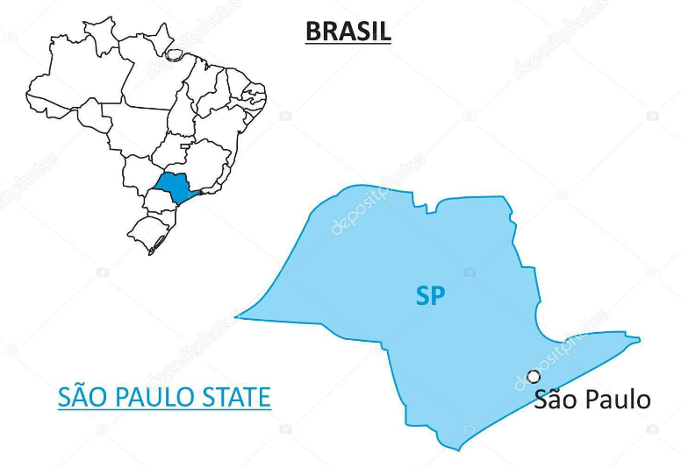
Next Steps - Specialized Educational Service
Supporting the training of other institutions and professionals interested in developing Specialized Educational Assistance

Slide 7
Education for All
Education is a right for all individuals, including those who need support the most…
We are all responsible for building a way to achieve it

