Slide 1

T365 Digital Books Project
Makayiko Kayimba
World Vision Malawi
Malawi
Innovative tech solutions enhancing sign language communication
Wednesday February 21
12:00 – 13:00
Notes:
Please add your notes here.
Title; First name, last name of speaker(s); Name of Organization, Name of Country, Name of Session (as written in Agenda)
#ZeroCon24
Day and Time of Session

Slide 2
Project Background
World Vision Malawi's Tiwerenge 365 Digital Books Project: leverages ICT by providing accessible digital books for children's literacy, including 60 with Malawian Sign Language, to improve inclusive education.
WVM equipped reading facilitators with devices and training to support 3,500 children, including 68+ children with print, learning, and hearing disabilities.
Working with the Malawi National Association of the Deaf (MANAD)
2023 the ICT solution (digital books shown via projectors) was extended to schools for children who are deaf (7) throughout the country.
Notes:
Sample Slide: presenting three points on our project and the relationship to this year’s theme of the Zero Project Conference. Point 1; Point 2; Point 3 connect together in this way.

Slide 3
Importance of the project
Printed books typically used by reading club facilitators are not accessible to all children especially those with disabilities.
Bringing accessible digital books improved inclusion in World Vision’s reading clubs, by removing these barriers, especially for children who are deaf or hard of hearing / blind or have low vision.
Increased the number and titles of contextualized accessible supplementary readers in the community.
Notes:
Sample Slide: presenting three points on our project and the relationship to this year’s theme of the Zero Project Conference. Point 1; Point 2; Point 3 connect together in this way.

Slide 4
Innovation
The books are loaded onto tablets for individuals and children in small groups to use during individual, small group or reading buddy time.
Connected to a rechargeable projector, digital accessible books can be used with an entire class or reading club.
To complement printed books, digital books can include human-narrated audio, sign language video, zoom, large font, and text highlighting to support ALL learners.
Parents can access the digital books on their phones, extending reading into homes.
Notes:
Sample Slide: presenting three points on our project and the relationship to this year’s theme of the Zero Project Conference. Point 1; Point 2; Point 3 connect together in this way.

Slide 5
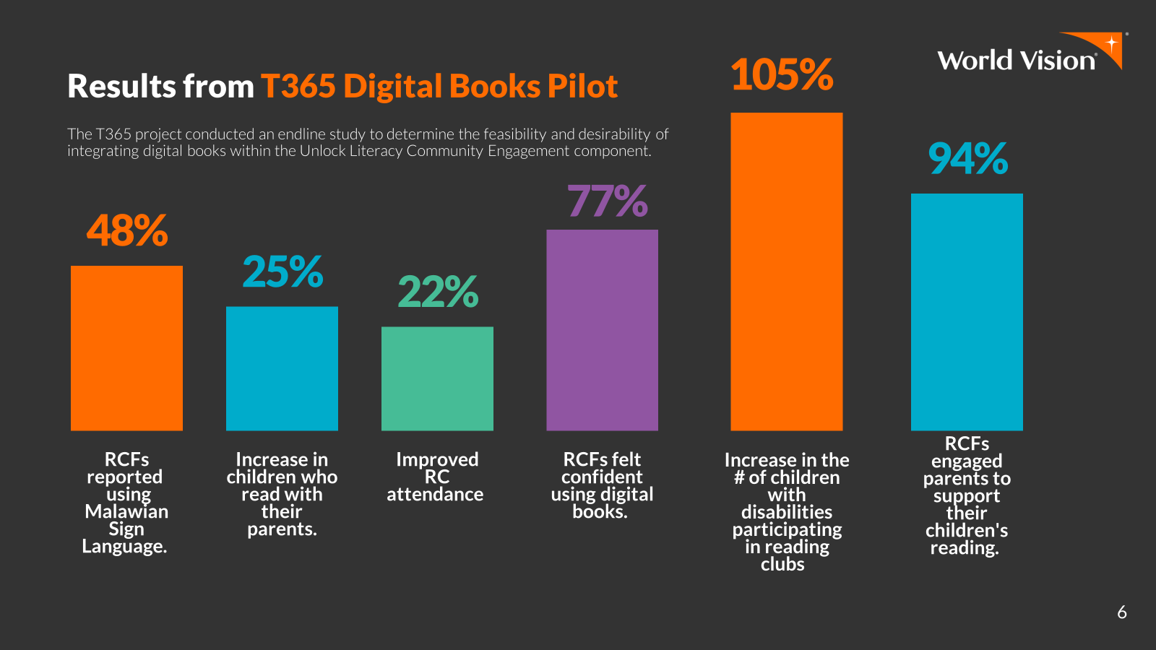
Impact
In total 3500 children from World Vision area programs benefited from 300 plus digitally accessible supplementary books.
Increased enrolment in community literacy centres.
7 schools including approximately 900 children who are deaf across the country are now using the Malawian Sign Language Storybooks.
Notes:
Sample Slide: presenting three points on our project and the relationship to this year’s theme of the Zero Project Conference. Point 1; Point 2; Point 3 connect together in this way.

Slide 6
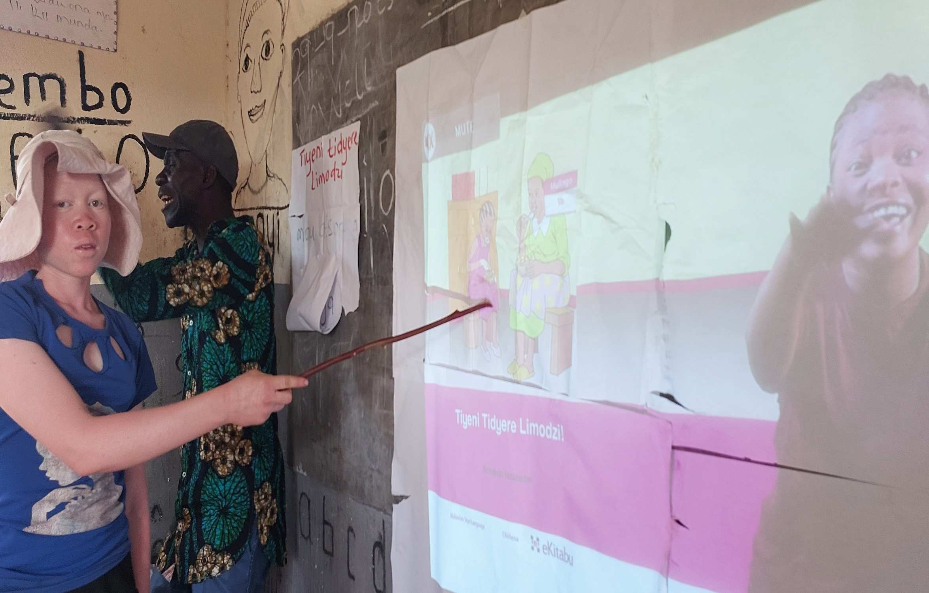
Success life story
“I am able to read without difficulties on the wall (projector) as the words are bigger than in books where you cannot change the size of the words. I struggle to see in books but this reading club in my village has books on a tablet which are shown on the wall and I enjoy reading here” narrated Ivy, 14
Notes:
Sample Slide: presenting three points on our project and the relationship to this year’s theme of the Zero Project Conference. Point 1; Point 2; Point 3 connect together in this way.

Slide 7
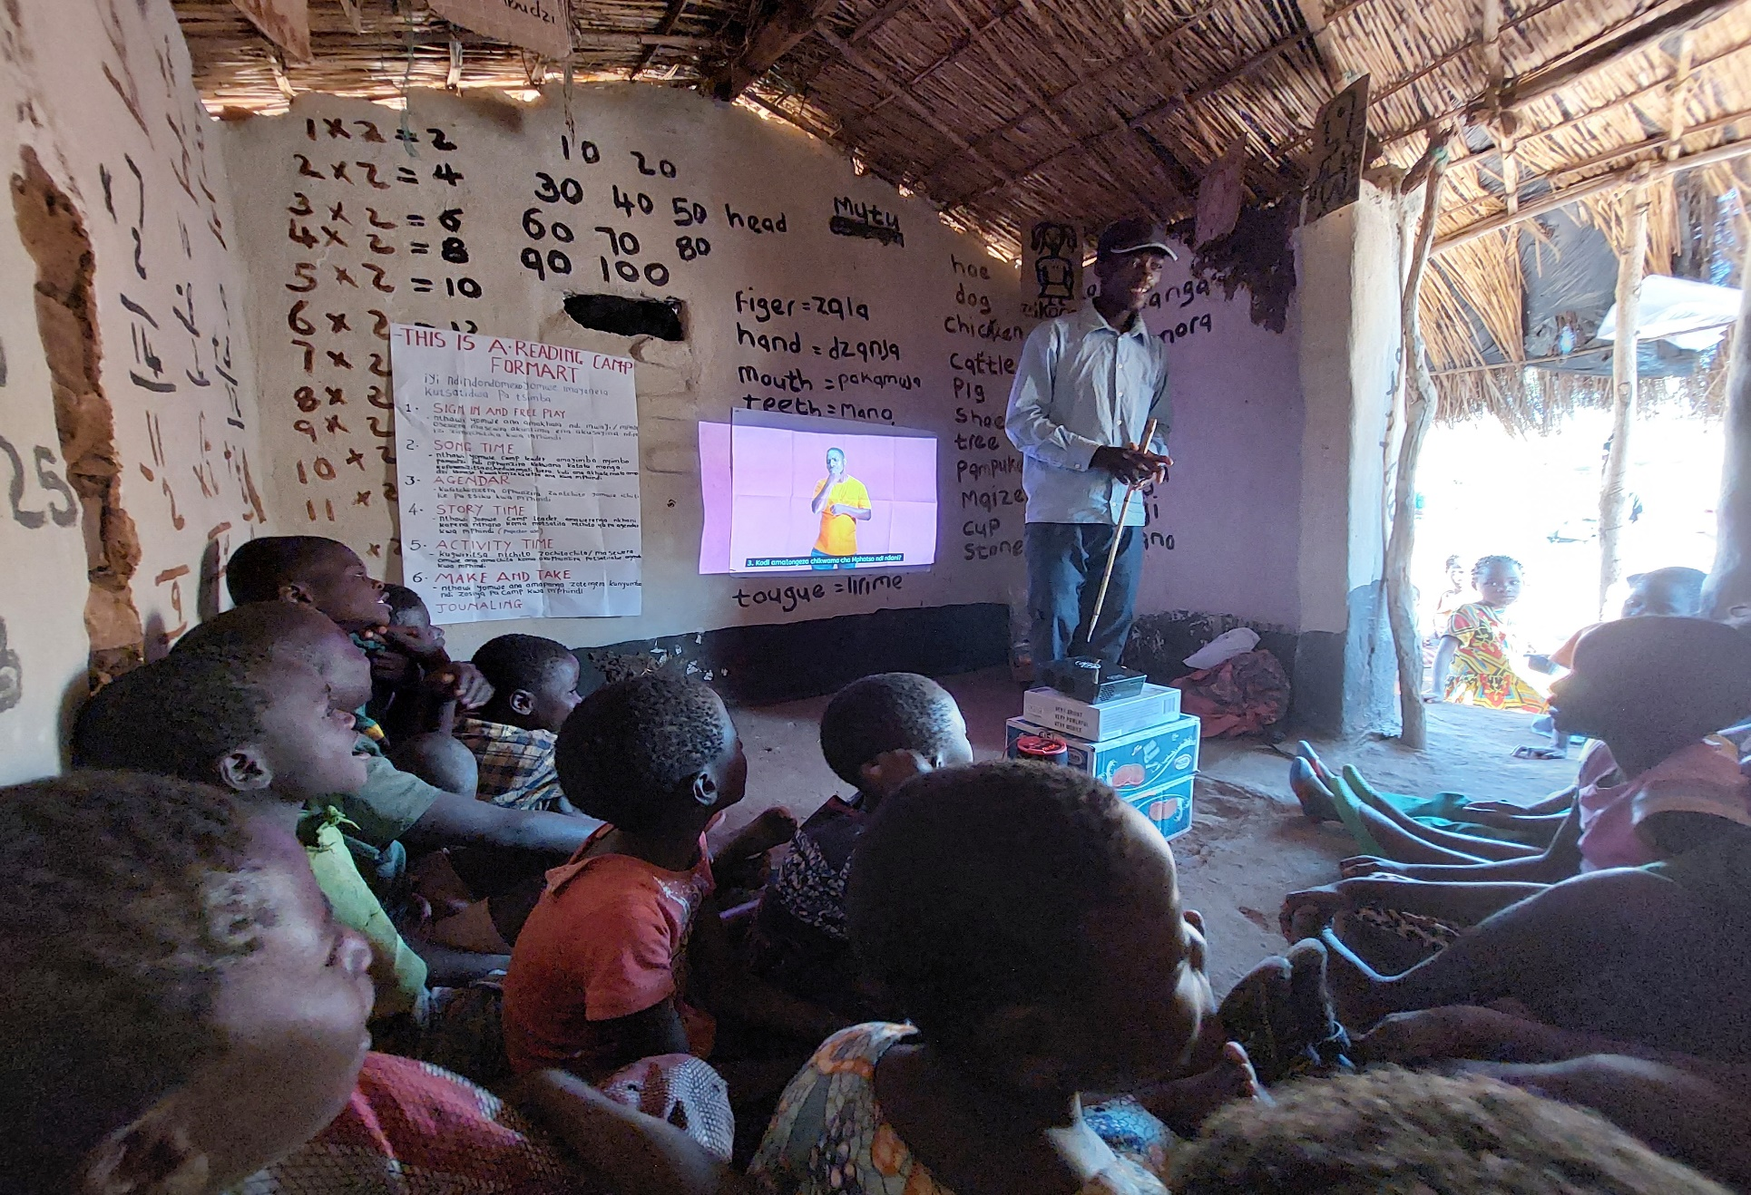
Financing
T365 Digital Books is financed by World Vision, which committed $78,000 to the initial rollout.
Notes:
Sample Slide: presenting three points on our project and the relationship to this year’s theme of the Zero Project Conference. Point 1; Point 2; Point 3 connect together in this way.

Slide 8
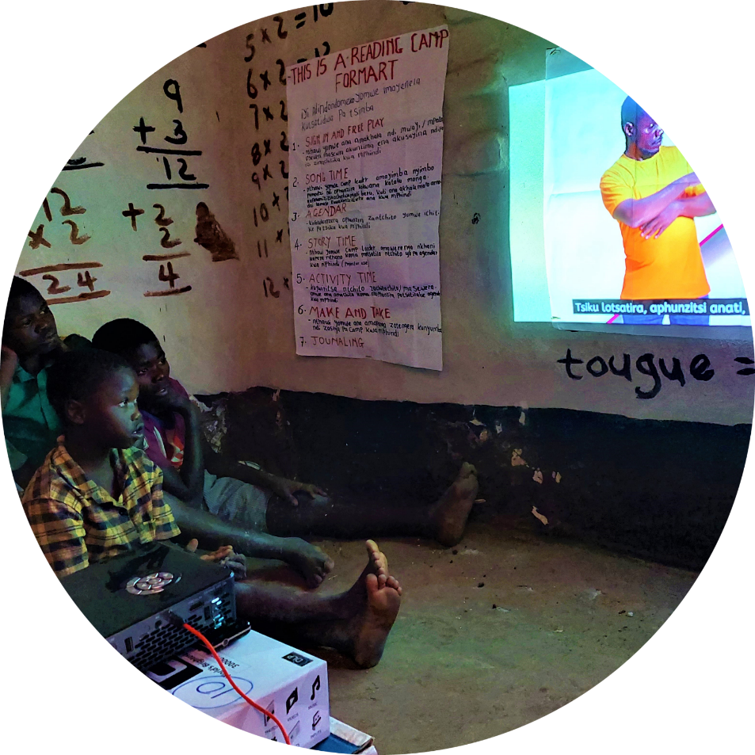
Sustainability and challenges
Mid-term monitoring reports showed high levels of satisfaction with the books, comfort with the devices, and increased attendance in reading clubs
Trained early-grade teachers continue to
coach and mentor community literacy
volunteers and parents on accessible digital books
Teachers can access new digital books
from Bloom library
Notes:
Sample Slide: presenting three points on our project and the relationship to this year’s theme of the Zero Project Conference. Point 1; Point 2; Point 3 connect together in this way.

Slide 9
Next steps for the project
Going forward, the project will be integrated into WVM’s mainstream education technical program
To improve transferability, all books are located on Bloom, a digital library, which provides easy adaptation and creation of new sign language storybooks.
WVM plans to reach 10,000 children with disabilities by 2027.
Notes:
Sample Slide: presenting three points on our project and the relationship to this year’s theme of the Zero Project Conference. Point 1; Point 2; Point 3 connect together in this way.

Slide 10
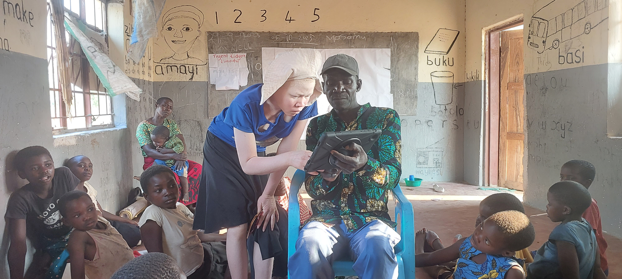
Photos
Notes:
Sample Slide: presenting three points on our project and the relationship to this year’s theme of the Zero Project Conference. Point 1; Point 2; Point 3 connect together in this way.

Slide 11
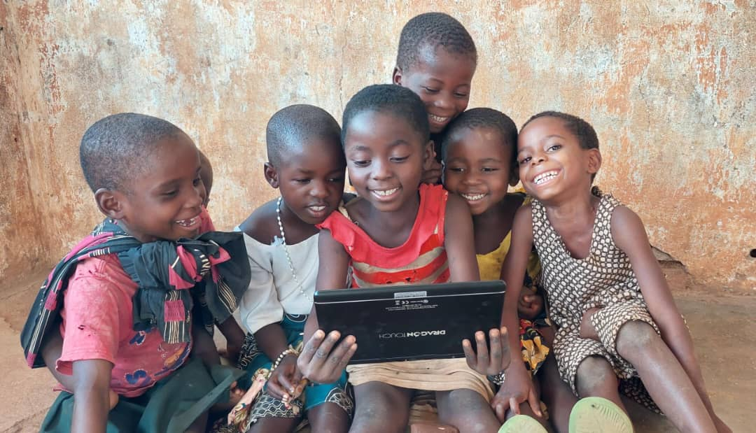
Notes:
Sample Slide: presenting three points on our project and the relationship to this year’s theme of the Zero Project Conference. Point 1; Point 2; Point 3 connect together in this way.

Slide 12
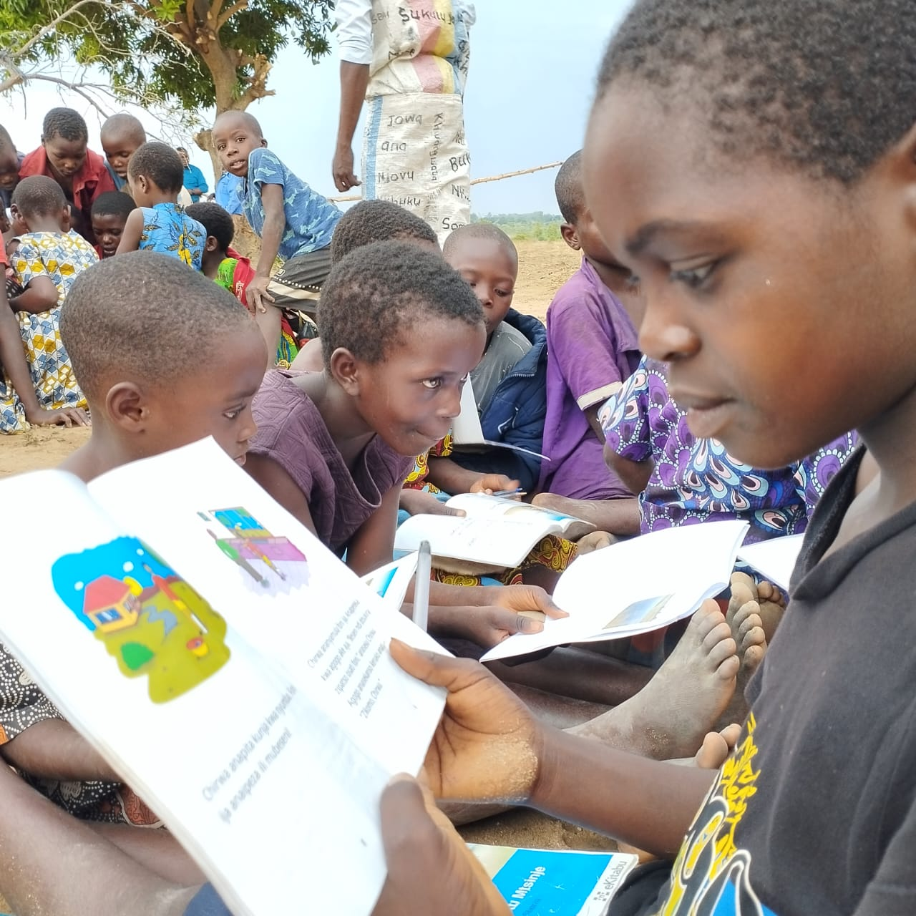
Notes:
Sample Slide: presenting three points on our project and the relationship to this year’s theme of the Zero Project Conference. Point 1; Point 2; Point 3 connect together in this way.

Slide 13
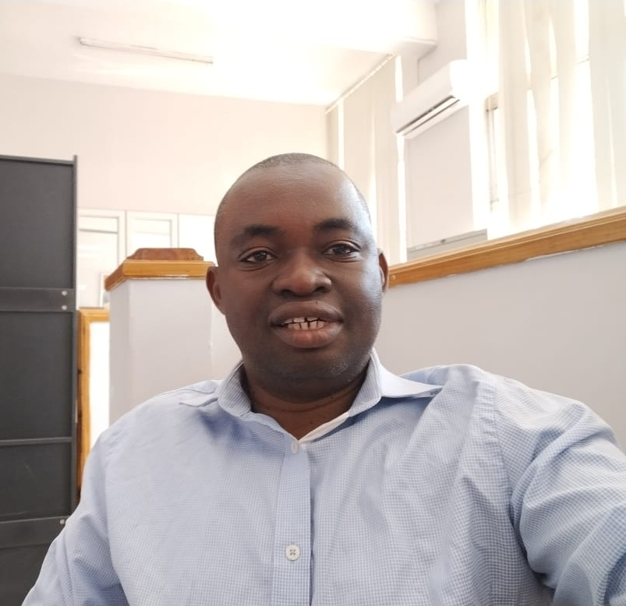
Makayiko Kayimba
Education Technical Coordinator,
World Vision Malawi
makayiko_kayimba@wvi.org

