Slide 1

Save and Invest for Bright Future
Odette Nyiransengimana, Christian Blind Mission
Emile Cadet Vuningabo, National Union of Disability Organisations in Rwanda (NUDOR)
Rwanda
Microfinance models by and for persons with disabilities
Wednesday 5 March 2025 | 16:00 - 17:00
Notes:
Title: Save and Invest for Bright Future
First name, last name of speaker(s): Odette NYIRANSENGIMANA and Emile Cadet VUNINGABO
Name of Organization: CBM and National Union of Disability Organisations in Rwanda
Name of Country: Rwanda
Name of Session: Microfinance Models by and with persons with disabilities
#ZeroCon25
Day and Time of Session

Slide 2
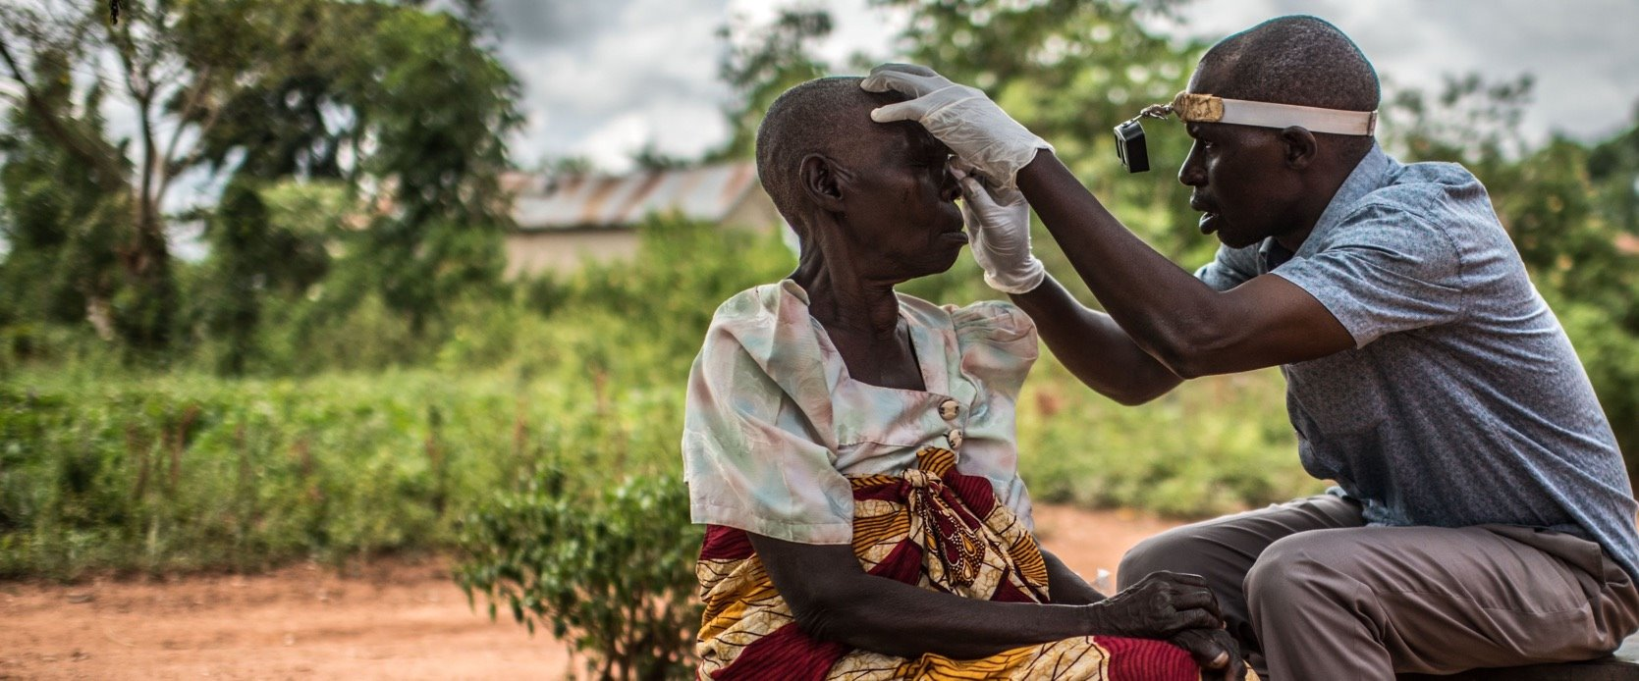

About CBM
About CBM
About CBM
CBM is an international Christian development organisation, committed to improving the quality of life of persons with disabilities in low and middle-income countries.
Our vision: an inclusive world in which all persons with disabilities enjoy their human rights and achieve their full potential.
Notes:
CBM is a global Christian development organization dedicated to enhancing the lives of persons with disabilities in low- and middle-income countries.
Vision: A fully inclusive world where persons with disabilities can enjoy their human rights and reach their full potential.

Slide 3

CBM Intervention Domains and Countries
CBM operates 311 projects in 36 countries in Central America, Asia and Africa
Inclusive Health (includes programmes to tackle neglected tropical diseases): 156 projects
Community Based Inclusive Development (including livelihood programmes): 160 projects
Inclusive Humanitarian Action: 62 projects
*Data from 2024. Some projects overlap two technical areas.
Notes:
CBM's Global Reach: Operates 311 projects across 36 countries in Central America, Asia, and Africa.
Inclusive Health: Implements 156 projects, including programs addressing neglected tropical diseases.
Community-Based Inclusive Development: Runs 160 projects, focusing on livelihood programs and community inclusion.
Inclusive Humanitarian Action: Leads 62 projects to ensure accessibility and support in crisis response.

Slide 4
CBM Partnership Principles
The CBM Partnership Principles underpin our understanding of work with partners. They guide our behaviours and attitudes in all our interactions with partners and those impacted by our work. Our partnership principles are as follows: complementarity of purpose, inclusiveness, responsiveness & flexibility, mutual responsibility & accountability, trust & respect, joint learning.
A shared approach to partnership ensures consistent programme standards, helps manage risk, enhances our global capacity in a cohesive way, and contributes to greater impact.
Partnership has been a long standing, foundational approach in pursuing our vision of a more inclusive world. Partnerships are central to our vision to develop complementary, appropriate, and sustainable programmes.
In CBM’s programme countries we seek, where at all possible, to work with local partners rather than implementing directly.
Notes:
CBM’s Partnership Approach: Partnerships are fundamental to achieving an inclusive world.
Guiding Principles: CBM's partnerships are based on complementarity of purpose, inclusiveness, responsiveness & flexibility, mutual responsibility & accountability, trust & respect, and joint learning.
Impact of Partnerships: A shared approach ensures consistent program standards, risk management, global capacity building, and greater impact.
Local Collaboration: CBM prioritizes working with local partners rather than direct implementation in program countries.

Slide 5
CBM roles and support to inclusive livelihoods through microfinance models by and for persons with disabilities in Rwanda
Funds mobilization
Technical support and capacity building
Information and communication
Advocacy and linkage with Government programme,other partners and stakeholders
CBM Partner complementarity to respond to additional VSLA needs in terms of health care and inclusive social protection sharing
Information and communication
Advice and monitoring visit to the partner and VSL groups
Evaluation, monitoring and learning
Notes:
Funds Mobilization: Securing resources to support programs.
Technical Support & Capacity Building: Strengthening partners' skills and knowledge.
Information & Communication: Ensuring effective knowledge sharing and coordination.
Advocacy & Linkages: Engaging with government programs, stakeholders, and partners.
CBM Partner Complementarity: Addressing additional VSLA (Village Savings and Loan Associations) needs in health care and inclusive social protection.
Advice & Monitoring Visits: Providing guidance and oversight to partners and VSLA groups.
Evaluation, Monitoring & Learning: Ensuring continuous improvement and impact assessment.

Slide 6
Rwanda: Financial inclusion
Financial inclusion has reached 96% (7.8 million) up from 93% in 2020, getting closer to the universal access of 100% set target. Despite a high financial inclusion rate, people with disabilities are less likely to be financially included than people without disabilities in formal banking compared to the informal sector.
93% of people with disabilities use formal financial products or informal services to meet their needs.
Mobile money (66%) and Umurenge SACCOs (34%) played a more significant role in pushing the boundaries of formal financial access for this group (sources: FINSCOPE 2024).
Notes:
Overall Financial Inclusion: Reached 96% (7.8 million people), nearing the 100% universal access target.
Disparity for Persons with Disabilities: Despite high financial inclusion, PWDs remain less financially included in formal banking compared to the informal sector.
Financial Access Among PWDs: 93% of PWDs use either formal financial products or informal services to meet their financial needs.
Key Drivers of Financial Inclusion for PWDs:
- Mobile Money (66%) – Major enabler of financial access.
- Umurenge SACCOs (34%) – Significant role in bridging financial gaps.
Source: FINSCOPE 2024 – Providing insights on financial access trends.

Slide 7
CBM Rwanda Country office
Contribution to VSLG greater impact by and for persons with disabilities
Working with NUDOR ( Umbrella of organisations of persons with disabilities (OPDs) is a key part of CBM’s work in Community Based Inclusive Development (CBID).
Since 2016, CBM started partnership with NUDOR for Inclusive livelihood projects. Up to date achievement :
    2,005 VSLG
    57,935 members (90% of members with Disabilities and 10% of members without disabilities)
    Among members:36% are youth with disabilities
    Among 57,935 members: 32,975 members are female while 24,960
With NUDOR, livelihood programme has brought long-term specific benefits and impact by and for the people with disabilities
CBM upcoming financial literacy:
We look at how a disability-inclusive livelihoods programme through Village and Saving Loan Group approach NUDOR and financial institution to enhance and scale up digital financial literacy and digital financial services access and usage for and by people with disabilities
Notes:
VSLG Impact for Persons with Disabilities:
Strengthening Village Savings and Loan Groups (VSLGs) to benefit PWDs.
Partnership with NUDOR:NUDOR, an umbrella of OPDs, plays a key role in CBM’s Community-Based Inclusive Development (CBID) work.
Since 2016, CBM has partnered with NUDOR on Inclusive Livelihood Projects.
Achievements to Date:
2,005 VSLGs established.
57,935 members, with 90% being PWDs and 10% non-PWDs.
36% of members are youth with disabilities.
Gender distribution: 32,975 women and 24,960 men.
Livelihood programs have led to long-term impact and benefits for PWDs.
Upcoming CBM Financial Literacy Initiatives:
Disability-inclusive livelihoods program through the VSLG approach.
Collaboration with NUDOR and financial institutions to enhance:
- Digital financial literacy.
- Access and usage of digital financial services for and by PWDs.

Slide 8
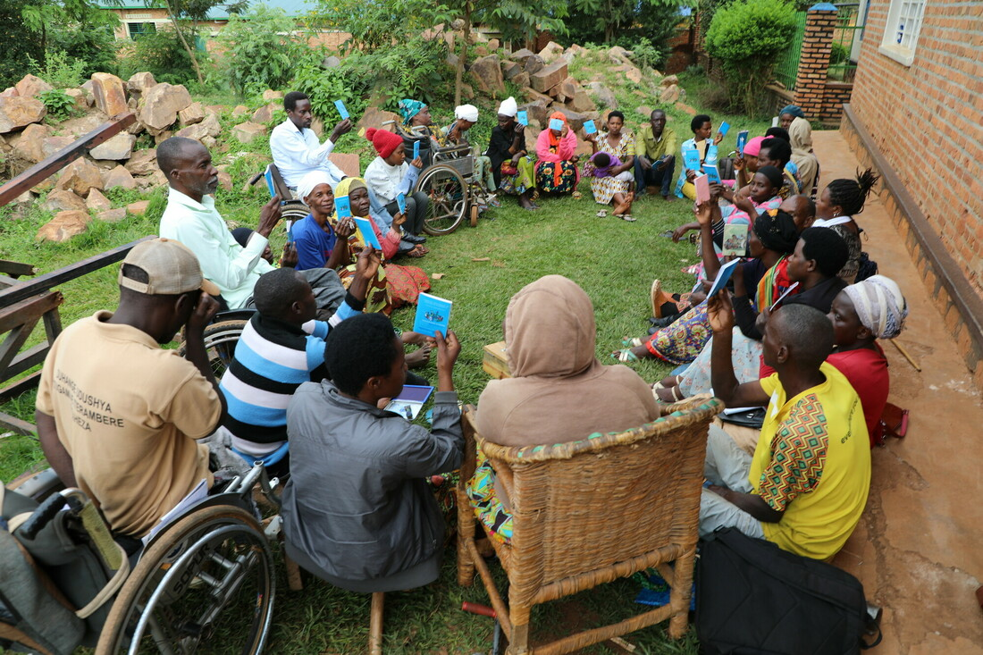

Introduction (NUDOR)
This presentation highlights the significance of access to financial services for persons with disabilities, focusing on the role of Village Savings and Loan Groups in fostering inclusion and economic empowerment.
Notes:
Key points will be mentioned in this presentation:
Access to financial services
The roles of the formed Village Savings and Loan Groups in fostering financial inclusion
Barriers faced by persons with disabilities

Slide 9
Financial Inclusion
Financial inclusion refers to the access and use of financial services, including banking, loans, and savings accounts.
It aims to ensure that individuals, particularly marginalized groups such as persons with disabilities, can participate fully in the economy.
Achieving financial inclusion involves removing barriers that prevent these individuals from obtaining financial resources and services that meet their need
Notes:
Speaker Notes on Financial Inclusion
Definition of Financial Inclusion
Financial inclusion refers to access and use of financial services such as banking, loans, and savings accounts.
Importance of Financial Inclusion
Ensures that all individuals, especially marginalized groups, can fully participate in the economy.
Critical for economic empowerment, particularly for persons with disabilities.
Challenges in Financial Inclusion
Barriers that prevent access to financial services (e.g., lack of accessible banking infrastructure, discriminatory policies).
Limited financial literacy among marginalized groups.
Solutions for Achieving Financial Inclusion
Removing barriers to access financial resources.
Designing financial services that meet the diverse needs of persons with disabilities.
Strengthening policies that promote accessibility and inclusion in the financial sector.
Call to Action
Advocate for inclusive policies and programs in financial institutions.
Encourage partnerships between governments, financial institutions, and disability organizations to promote financial inclusion.

Slide 10

Barriers faced by persons with disabilities
Persons with disabilities face numerous barriers in accessing financial services, including physical inaccessibility of financial institutions, lack of awareness about available services, and discriminatory practices.
Additionally, communication barriers and inadequate financial literacy programs may hinder their ability to utilize financial services effectively, making it essential to address these issues.
Notes:
Speaker Notes (Summary)
Challenges in Accessing Financial Services
Physical barriers in financial institutions.
Lack of awareness about available financial services.
Discriminatory practices that limit access to financial opportunities.
Additional Barriers
Communication barriers, including inaccessible banking platforms.
Limited financial literacy programs, preventing effective use of financial services.
Call to Action
Advocate for accessible financial institutions.
Promote inclusive financial literacy programs.
Ensure equal opportunities in financial decision-making for persons with disabilities.

Slide 11
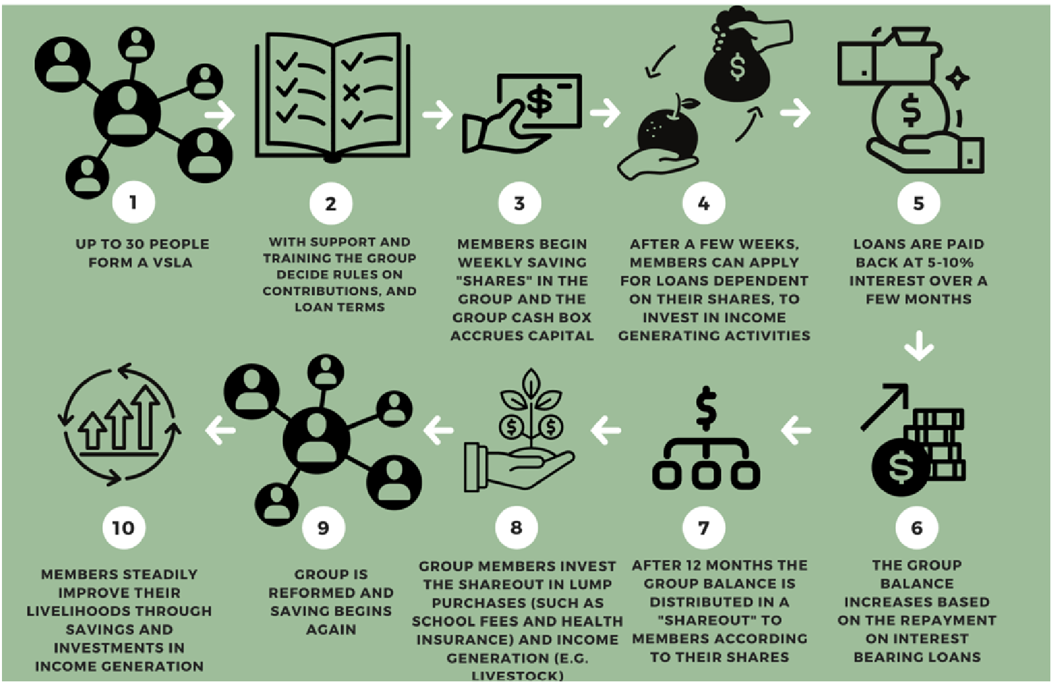
NUDOR VSLGs operation process
Notes:
Group Formation: Up to 30 members form a Village Savings and Loan Group (VSLG).
Rules & Training: Sector business mentors provide training, and members set rules on contributions and loan terms.
Savings Begin: Members make weekly savings, and the group's cash box grows.
Loan Access: After a few weeks, members apply for loans based on their savings to invest in income-generating activities.
Loan Repayment: Loans are repaid with 5-10% interest over a few months.
Fund Growth: The group’s balance increases as members repay loans with interest.
Annual Shareout: After 12 months, savings plus profits are distributed to members based on their shares.
Investments: Members use the shareout funds for school fees, health insurance, or business investments.
Reformation: The group reforms, and saving restarts.
Sustained Livelihood Improvement: Over time, members increase their financial stability through continued savings and investments.

Slide 12
VSLGs formed from 2016 to 2024
Number of VSLGs | VSLGs Members |  | Youth With Disabilities | Members with Disabilities | Members without Disabilities
 | Female | Male
2,005 | 32,975 | 24,960 | 20,857 | 52,142 | 5,793
Notes:
2,005 VSLGs established.
57,935 members, with 90% being PWDs and 10% non-PWDs.
36% of members are youth with disabilities.
Gender distribution: 32,975 women and 24,960 men.

Slide 13
Financial performance
Total Savings in USD | Total Loan Outstanding in USD | Total Social Fund in USD
679,074 | 540,768 | 43,645
79.6% of the total savings has been used as loan by members.
Notes:
Total Savings in USD: 679,074
Total Loan Outstanding in USD: 540,768
Total Social Fund in USD: 43,645

Slide 14
Economic empowerment and investment trends
Notes:
44.97% of members regularly save and invest in productive assets and businesses, while 64.4% improved their economic status, contributing to household expenses. Additionally, 36.19% of members have significantly improved their livelihoods by engaging in activities like agriculture, retail, and mobile money services.

Slide 15
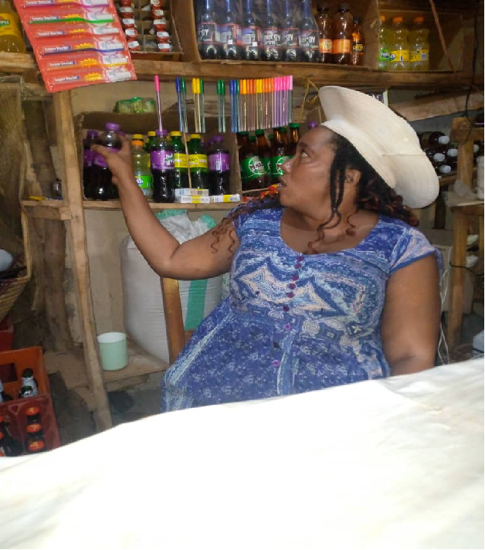
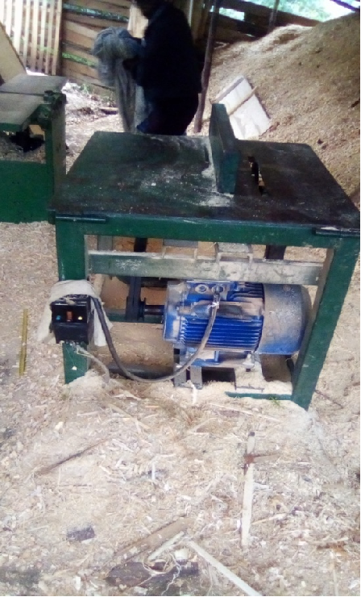
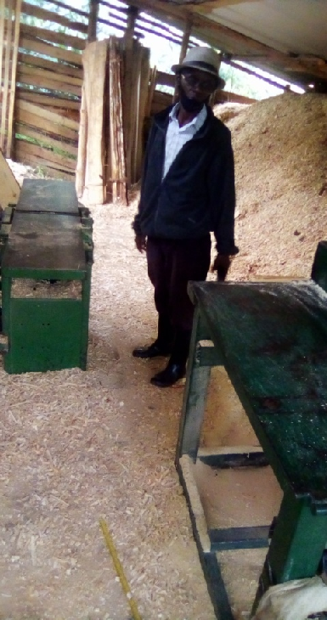
Change among persons with disabilities
Persons with disabilities gain access to necessary financial services through formed VSLGs that would otherwise be unavailable.
Notes:
VSLGs members have been able to access financial services within their formed savings groups and other formal financial services to start diffenet business.

Slide 16
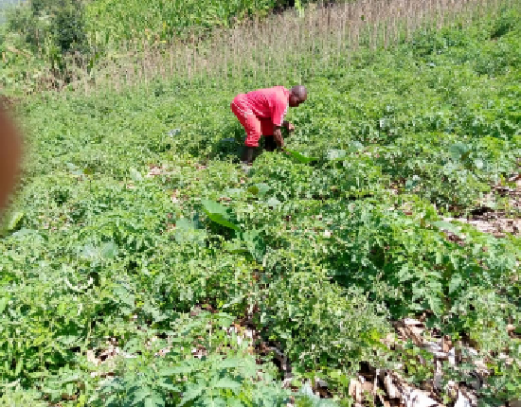
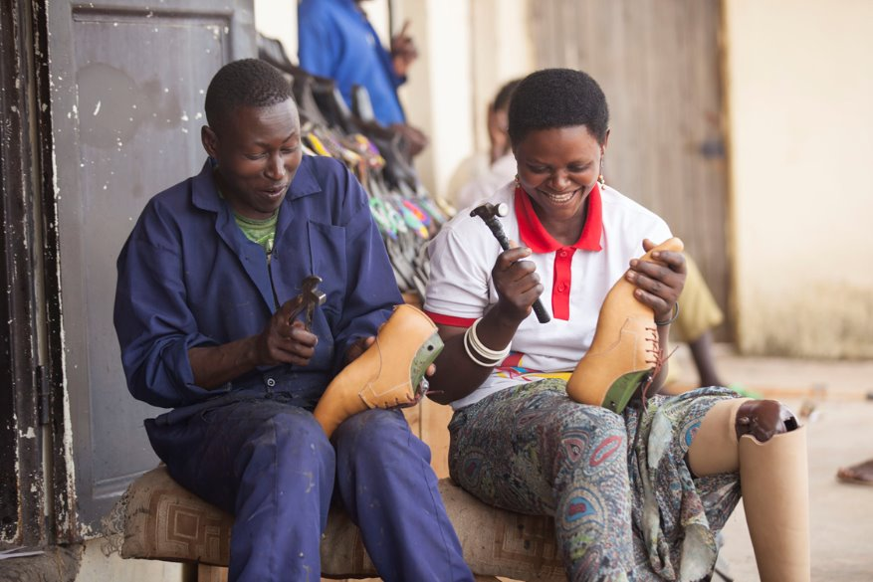
Change among persons with disabilities
The financial independence gained leads to improved self-esteem and social
inclusion, creating a ripple effect that benefits families and communities
as a whole
Notes:
Youth with disabilities were also engaged in the formed VSLGs and have been able to access financial services in both informal and formal financial institutions and started their own business.

Slide 17
Conclusion
Access to financial services through Village Savings and Loan Groups:
is vital for the inclusion and economic empowerment of persons with disabilities.
addresses barriers and provides tailored support
is instrumental in helping individuals achieve financial independence, contributing positively to their lives and communities.
Notes:
Access to financial services via Village Savings and Loan Groups is essential for empowering and including persons with disabilities, as these groups overcome barriers with tailored support, foster financial independence, and positively impact both individual lives and communities.

Slide 18
Thank you

