Slide 1
Women Entrepreneurs with Disabilities
Anushka Thachil
Youth4Jobs Foundation
India
Women entrepreneurs with disabilities
Thursday, March 6, 14:00 - 15:00
Notes:
Women Entrepreneurs with Disabilities
Anushka Thachil
Youth4Jobs Foundation
India
Women entrepreneurs with disabilities
Thursday, March 6, 14:00 - 15:00

Slide 2
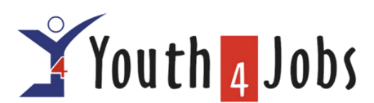
Launched at the Zero Project Conference 2023, at United Nations Offices, Vienna, WEDO is grounded in real needs, forging collaborative partnerships to amplify voices globally, driving inclusive entrepreneurship initiatives.
Enable Economic Independence and Address Gaps in Employment & LFPR
Change Community Mindsets & Build meaningful narratives About Women with Disabilities
Ensure a more inclusive and diverse entrepreneurship ecosystem
“If you get it right for women with disabilities, you get it right for all women”
Notes:
WEDO, the Women Entrepreneurs with Disabilities initiative, was launched at the ZERO Conference 2023 at the UN HQ in Vienna. It is built on real needs and partnerships to create a more inclusive entrepreneurial ecosystem. The initiative focuses on three key goals: enabling economic independence, shifting community mindsets, and fostering diversity in entrepreneurship. The core belief is that designing solutions for women with disabilities benefits all women.

Slide 3
THE GLOBAL LANDSCAPE
The Numbers Tell a Story
Population: Over 500 million women worldwide live with a disability.
Employment Disparity: In 51 countries, only 20% of women with disabilities are employed, compared to 53% of men with disabilities and 30% of women without disabilities. unwomen.org
Access to Assistive Technology: Available evidence suggests that women with disabilities have significantly lower access to assistive technologies, hindering their daily activities and participation.
Philanthropic Funding: Disability-related grants represent just 2% of total philanthropic giving, primarily directed towards services aiming to "fix" or "cure" disabilities, rather than empowering individuals. gih.org
Notes:
Women with disabilities make up over 500 million of the world’s population, yet they face significant barriers to employment. Across 51 countries, only 20% of women with disabilities are employed—far lower than men with disabilities and even women without disabilities. Access to assistive technology remains a challenge, limiting participation in daily life and work. Additionally, disability funding is minimal, making up just 2% of total philanthropic giving, and much of it is directed toward medical interventions rather than economic empowerment.

Slide 4
The global Landscape, continued
Missed Opportunity: Investing in women with disabilities can unlock economic growth, innovation, and diversity.
Lack of Representation: Women with disabilities remain underrepresented in global leadership and Diversity, Equity, and Inclusion (DEI) conversations.
Funding Priorities: The majority of disability funding focuses on medical and rehabilitation efforts, with minimal investment in economic empowerment and leadership initiatives.
Notes:
Ignoring women with disabilities is a missed opportunity. Investing in them can drive economic growth and innovation, yet they remain underrepresented in leadership and DEI efforts. Disability-related funding prioritizes medical solutions rather than economic inclusion and leadership development. Shifting these priorities could unlock untapped potential and foster more equitable global progress.

Slide 5
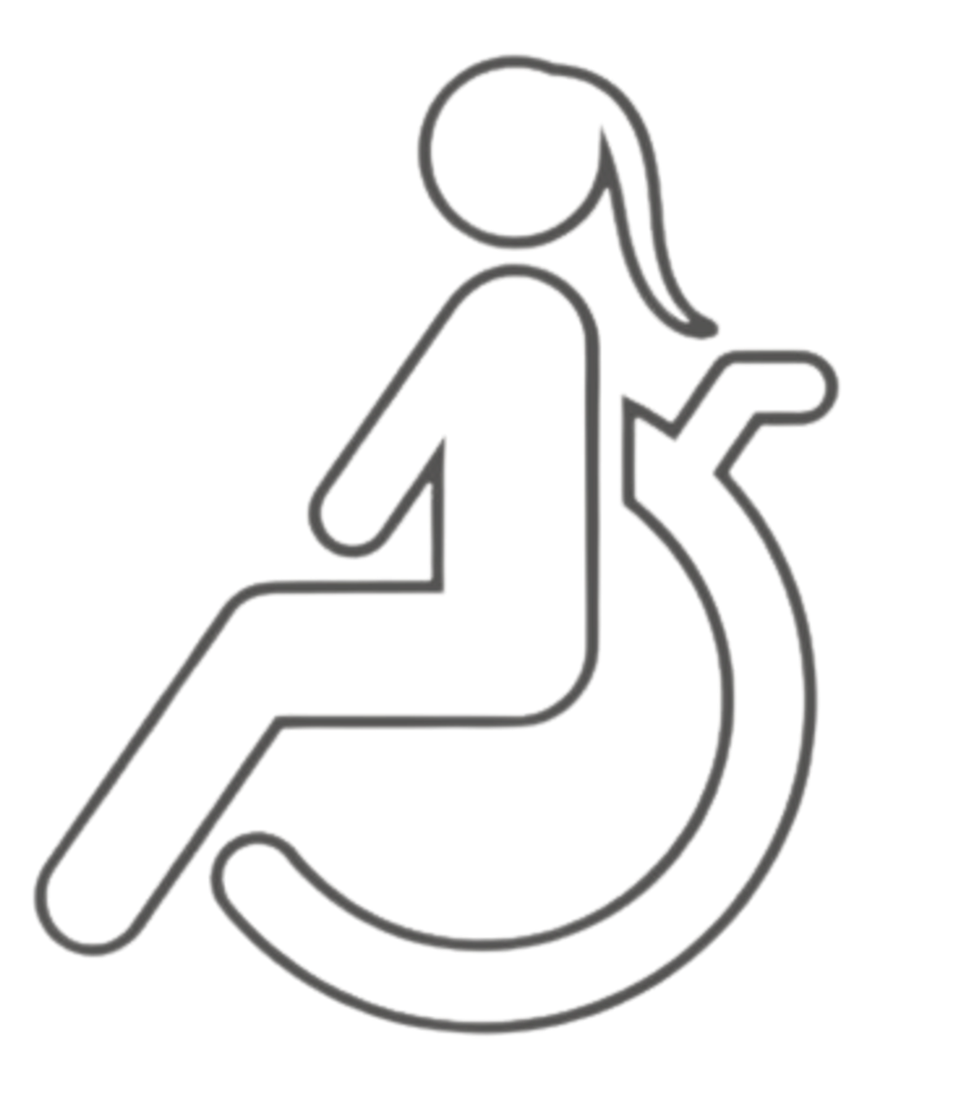

The Challenges for Women with Disabilities
1. Systemic Exclusion & Barriers
  Lack of accessible infrastructure, inclusive policies, and interpreters.
2. Impact of Crises Like COVID-19
  Women 7x more likely to lose jobs during crises like COVID-19.
  Though women make up 36% of the workforce, they receive only 18% of labor income.
3. Double Discrimination
  Vulnerability to Abuse & Exploitation even at home.
  25% of women with intellectual disabilities are raped; 6% are forcibly sterilized.
4. Economic Impact of Exclusion
  Loss of 3-7% of GDP due to exclusion from workforce.
  Tapping into this potential can lead to economic gain.
Notes:
Women with disabilities encounter multiple systemic barriers: inaccessible infrastructure, lack of policy support, and exclusion from employment. They are disproportionately affected during crises like COVID-19, with job loss rates seven times higher than others. Double discrimination—both gender and disability—exposes them to higher risks of abuse and forced medical interventions. This exclusion has a tangible economic cost, reducing GDP by 3-7% in some countries. Addressing these issues is not just about equity but also economic progress.

Slide 6



WEDO, supported by the Zero Project
WEDO Booklets
Workshops & Roundtables
Podcasts
Advocacy
With an initial focus on India, we aim to build an alliance for women entrepreneurs with disabilities, globally
A Global Network
Creating & Scaling enterprises in rural and urban settings
Government Partnerships demonstrating success first in Karnataka and replicate in other states
On Ground Work
Notes:
WEDO operates through advocacy, a global network, and on-ground work. Advocacy efforts include WEDO booklets, workshops, and podcasts to shape narratives and policies. The global network aims to create an international alliance of women entrepreneurs with disabilities, starting in India and expanding globally. On-ground work focuses on building and scaling enterprises, with Karnataka serving as the first large-scale partnership with the government.

Slide 7
On Ground Work:
Partnership with State Government
MOU signed with the Karnataka State Rural Livelihoods Mission
Community-driven approach through Community resource persons who are part of the State Government Mechanism
The precursor to the on-field work is a study on the economic empowerment of women with disabilities.
This fits into the Agenda of the co-vulnerabilities (Dalits /women/climate-induced migration) study planned for India & global south.
Notes:
WEDO’s partnership with the Karnataka State Rural Livelihoods Mission is a significant step in creating sustainable entrepreneurship opportunities. The program uses a community-driven approach, integrating community resource persons within government systems to ensure long-term impact. This work is preceded by a study on the economic empowerment of women with disabilities, tying into broader research on vulnerable groups in India and the Global South.

Slide 8
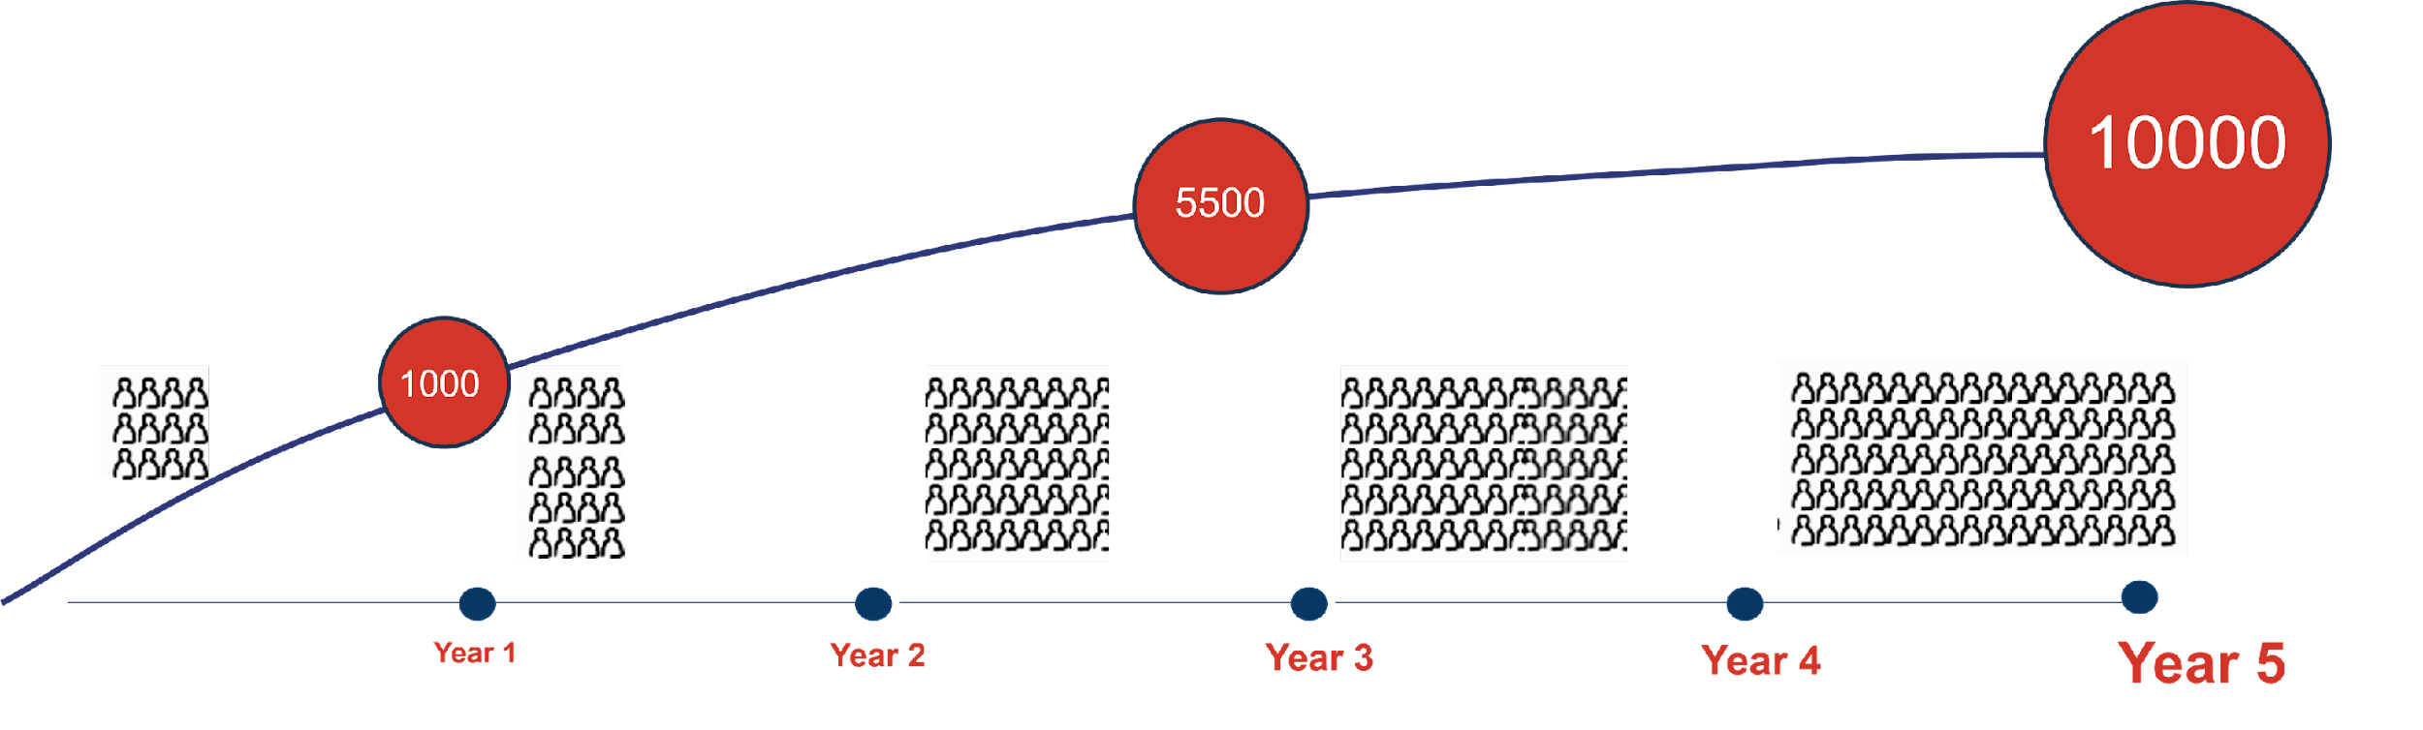
Our Expected Impact
Our Expected Impact
Change mindsets of 1.1 million households
Skill and nurture 10,000 women with disabilities
A Global Alliance of 35+ Countries
Notes:
WEDO aims to create large-scale change. The initiative will shift mindsets in 1.1 million households, equipping 10,000 women with disabilities with skills and resources to become entrepreneurs. Additionally, it seeks to build a global alliance spanning 35+ countries, fostering a truly inclusive and supportive ecosystem for women with disabilities worldwide.

