Slide 1
ErgasiaMou: Accessible job matching platform
Evangelia-Christina Andreadi
MARGARITA
Greece
Digital training platforms and ecosystem building in inclusive employment
Wednesday 5 March 2025 | 11:00 - 12:00
Notes:
Please add your notes here.
Title; First name, last name of speaker(s); Name of Organization, Name of Country, Name of Session (as written in Agenda)
#ZeroCon24
Day and Time of Session

Slide 2


MARGARITA & Supported Employment
We empower people with neurodevelopmental disorders to become active citizens in an inclusive society.
Supported Employment Department
Trains job seekers with neurodevelopmental disorders.
Supports and trains the employers.
Manages the requests of the platform ErgasiaMou.
Notes:
The vision of MARGARITA, the Supported Employment services we offer, and the link to the platform ErgasiaMou.
MARGARITA is an association based in Athens, Greece, that supports and trains people with neurodevelopmental disorders to become autonomous and active citizens within an inclusive society. Since 2023, we have established the Supported Employment department, which offers two fast-track training programs annually, focused on the development of the professional skills for people with neurodevelopmental disorders. We also provide training for employers to foster the inclusive integration of new employees. ErgasiaMou is one of the digital tools created and in use of our Supported Employment Department.

Slide 3
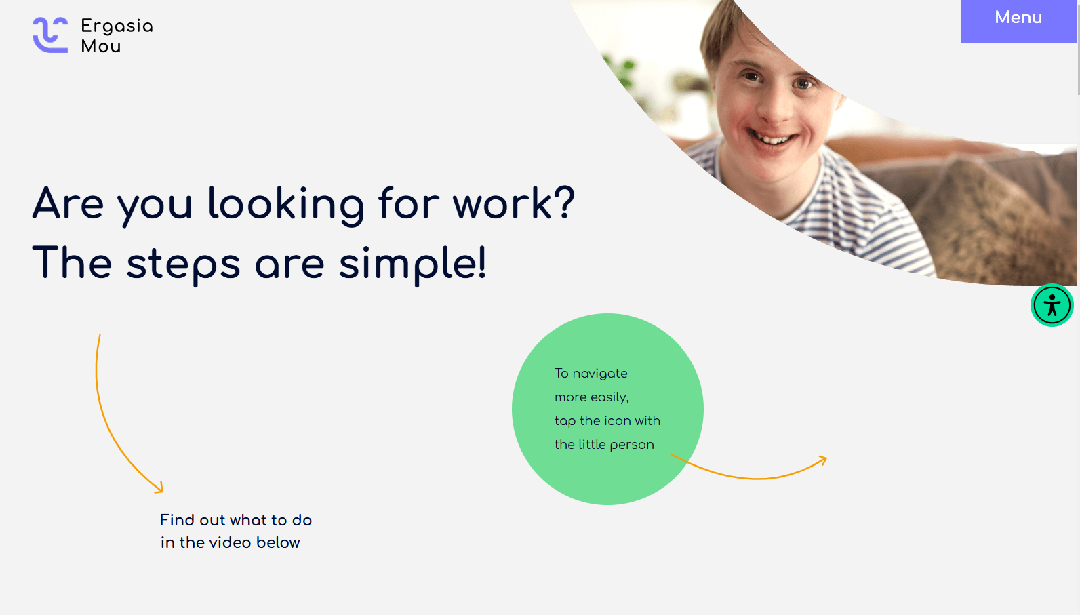
The platform ErgasiaMou
The first Greek digital platform for job matching for job seekers with neurodevelopmental disorders and employers.
Co-created by people with neurodevelopmental disorders, a graphic design company, and professional supporters.
Accessible and easily replicated.
https://ergasiamou.gr/en/
Notes:
Three points on our project and the relationship to this year’s theme of the Zero Project Conference.
Point 1; The first Greek digital platform for job matching for employers and job seekers with neurodevelopmental disorders.
Point 2; Co-created and piloted by people with neurodevelopmental disorders.
Point 3; Accessible and easy to replicate

Slide 4
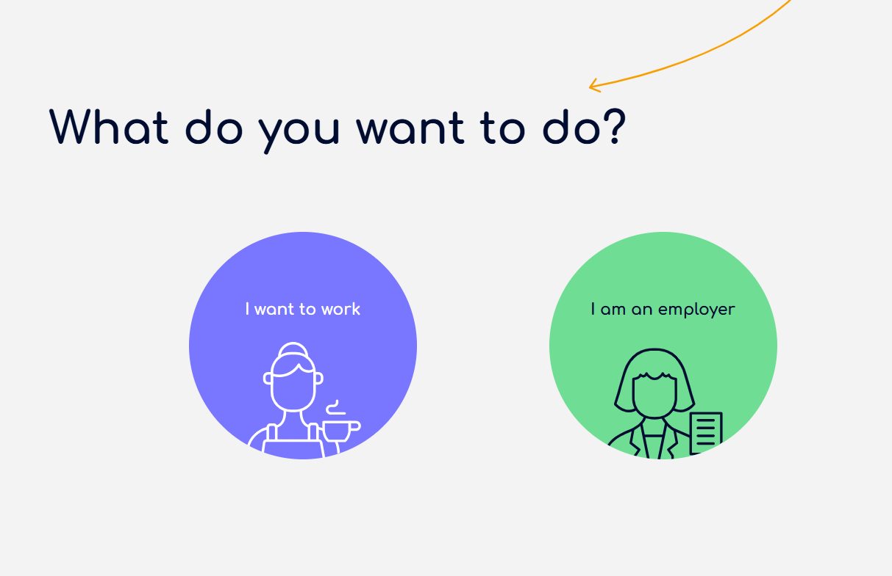
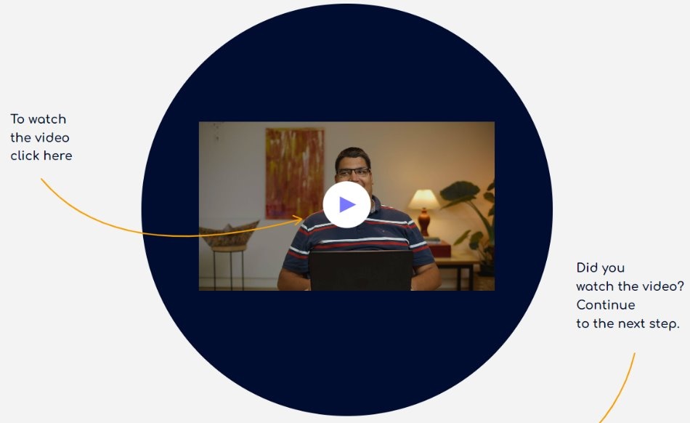
For job seekers & employers
Job seekers: Fill an online application by answering questions about their skills, preferences, and expectations of the job.
Employers: Fill an online application providing information about the job position.
MARGARITA’s Supported Employment Dept.:
job matching​
provides support before, during, and after recruitment.
Notes:
Innovative aspect: It is an accessible platform that both employers and job seekers can use.
The job seekers create a short online cv, by answering questions in easy-to-read format and submitting their answers in a form of an online application. They can find information on how to navigate in the platform from the video in which Aris describes the steps in order.
The employers submit a different online application, providing information about their company, the job position, and the level of possible cooperation with the Supported Employment Department.
MARGARITA’s Supported Employment Dept. manages the applications to match the candidates with the employers.

Slide 5
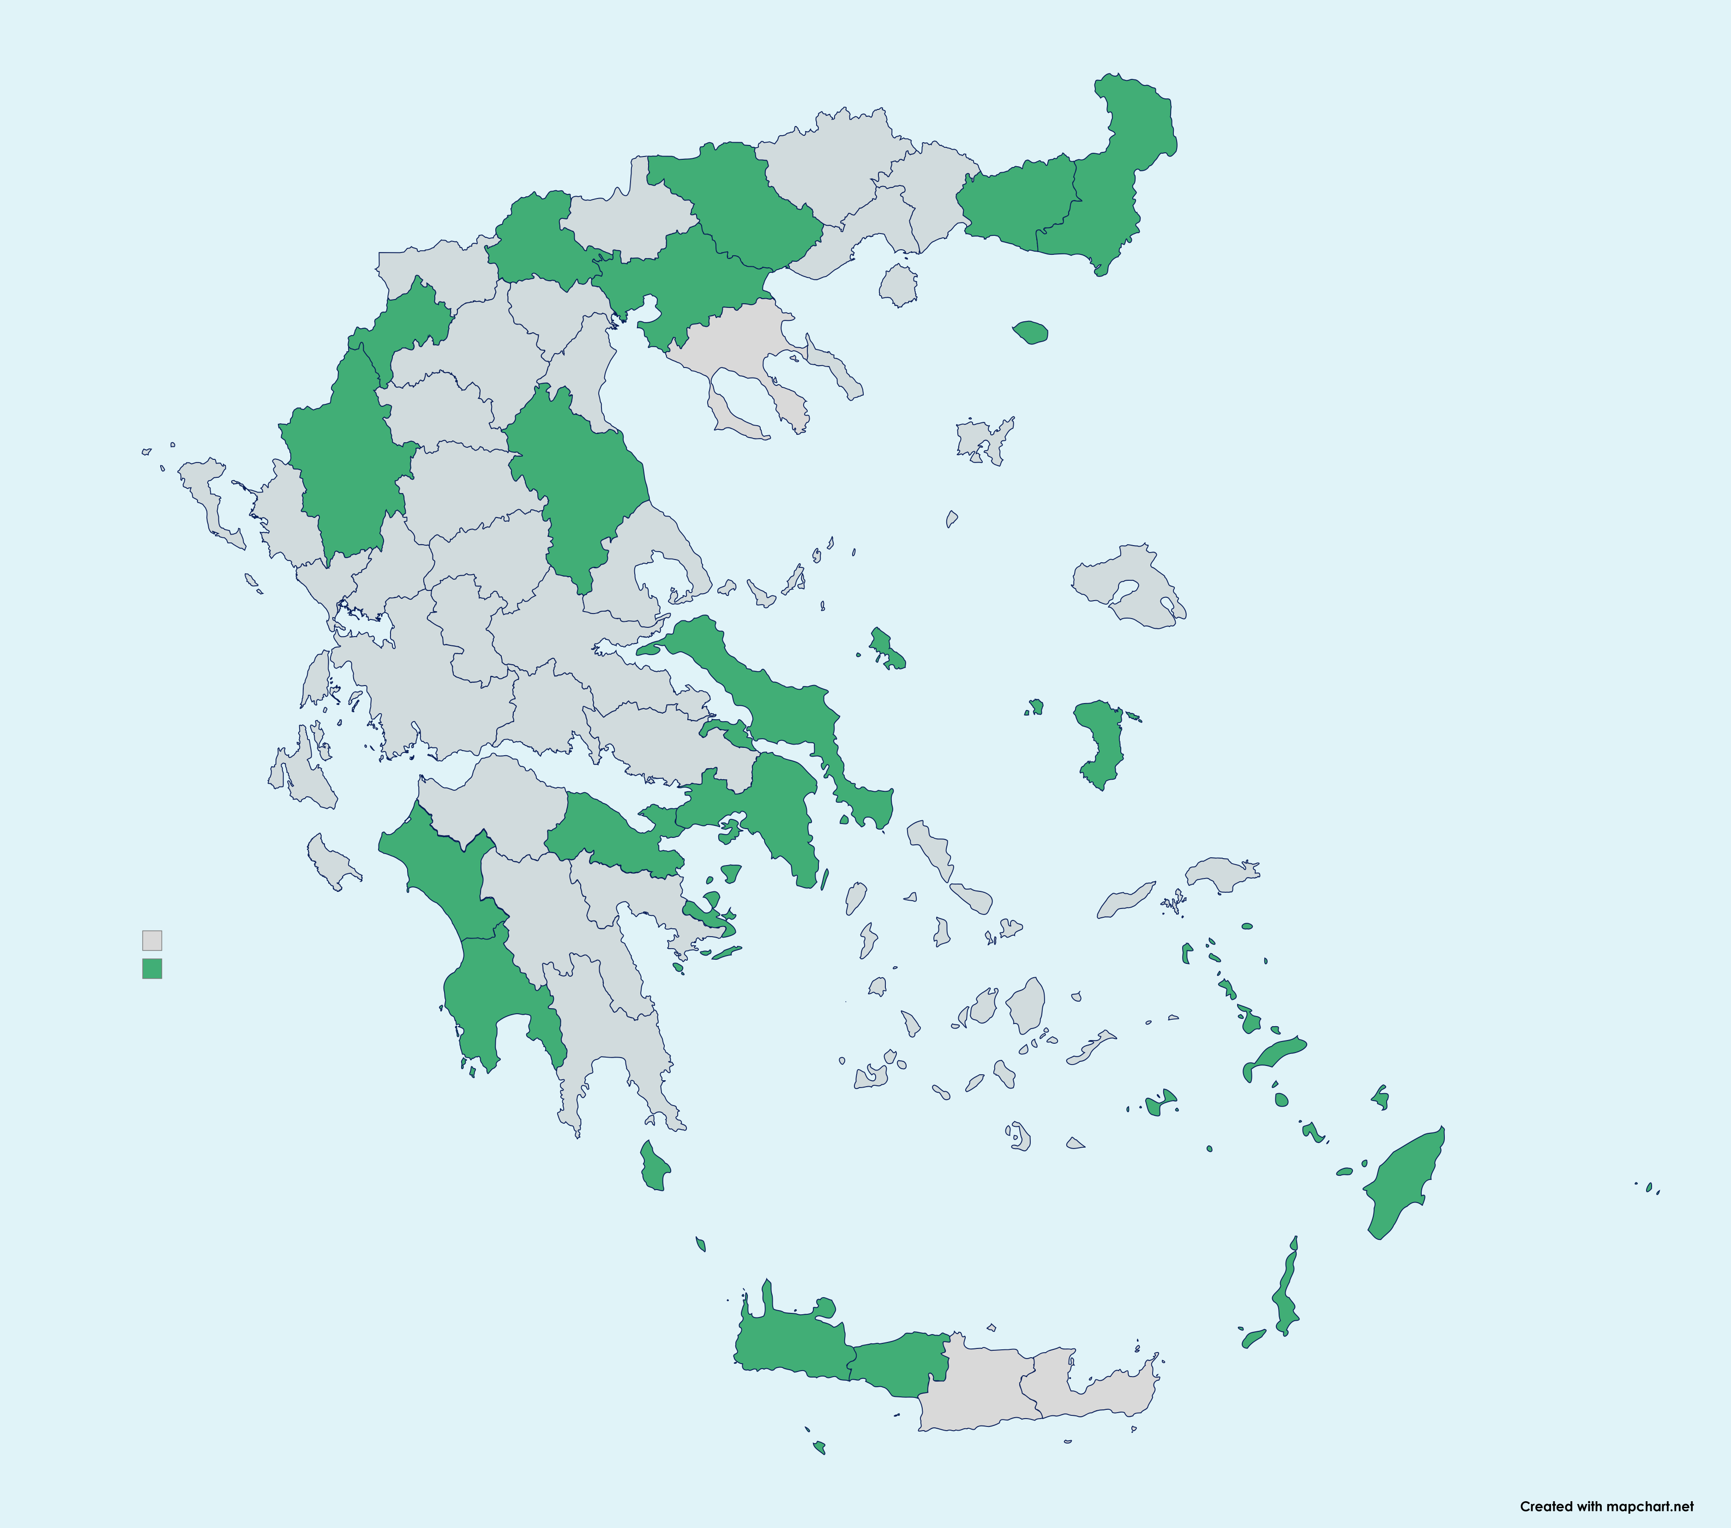
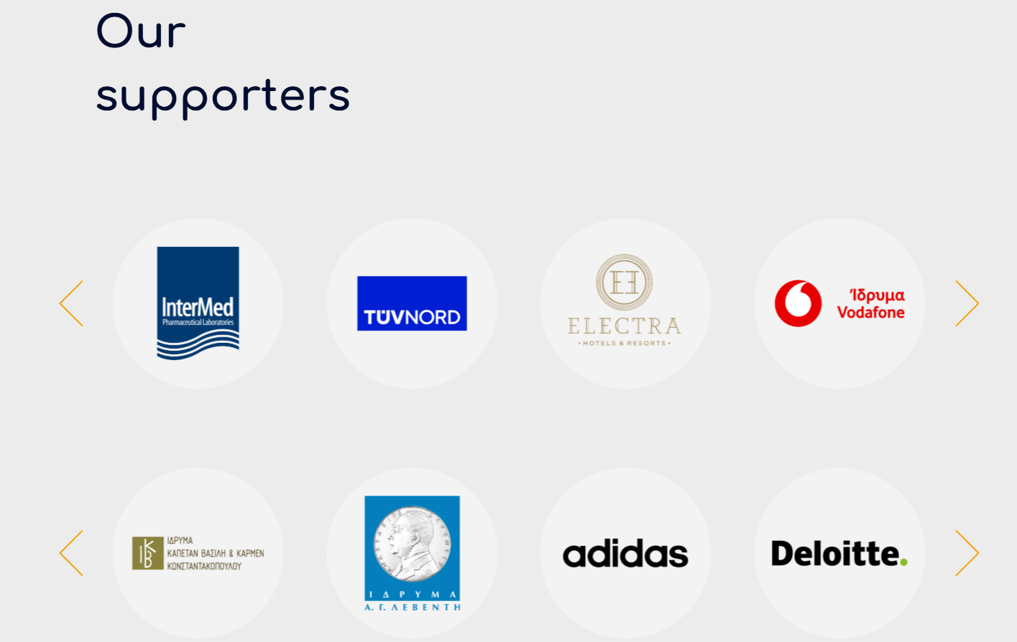
The impact
Increase the employment of people with disabilities through the provision of full supported employment services.
Boosting the confidence of job seekers.
Improvement of the companies’ productivity and culture.
Enhancement of the corporate image of the companies.
Tool for policy making → MARGARITA’ signature of a Memorandum of Cooperation with the Greek Public Employment Services.
Notes:
Impact created: Increase the employment for people with disabilities through the provision of full supported employment services, as after submitting their request, they get enrolled to the training program of the Supported Employment Dept.
Boosting the confidence of job seekers as they create an online cv. By stating their preferences and skills, they have more opportunities to be matched with an employer.
Improvement of the companies’ productivity and culture, as they recruit from a diverse pool with strong will to work with the support of the professionals. They are also open to new opportunities for the development of the culture company, as participating in the Job Shadowing activities the Supported Employment organizes.
Enhancement of the corporate image of the companies, their communication strategies, their corporate innovation and their commitment to social inclusion.
Tool for policy making, as we have measurable data from all the different regions of Greece about the need for employment for people with neurodevelopmental disabilities in decentralized areas. The platform increased the visibility of our services and was one of the factors that led to the signature of a MoC with the Greek PES.

Slide 6
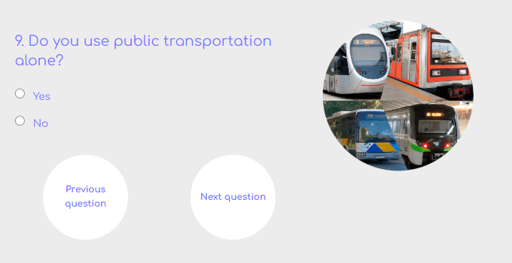
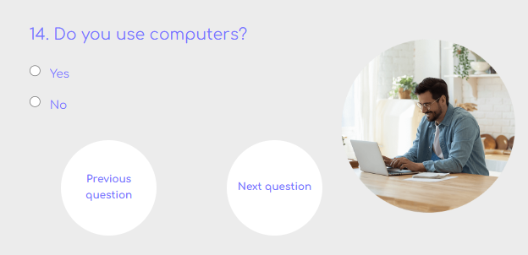
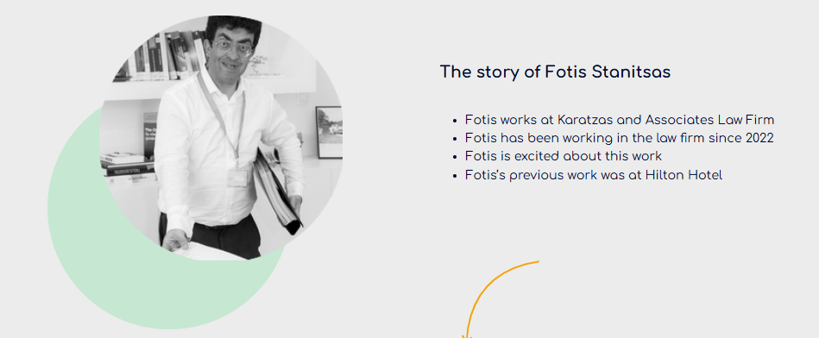
Success factors
Bridging the gap.
The co-creation methodology.
Short CV of the job seeker.
Videos:
- Success stories
-How to navigate
The engagement of the companies.
Notes:
Success factors:
It’s the first Greek tool bridging the gap between job seekers with neurodevelopmental disorders and employers.
The Co-creation methodology, led to an accessible and user-centric platform.
The opportunity for a job seeker to create their first short online CV, that brings out their hard and soft skills.
The platform includes the logos of the employers so they can feel seen and engaged. More employers feel motivated to apply to the platform, as they are also bound by a quota system.
The success stories in videos presented in the platform showcase the everyday life and work of employees, which can inspire both job seekers and employers to use it.
The video “How to navigate” in the platform by one of the co-creators of the platform.

Slide 7
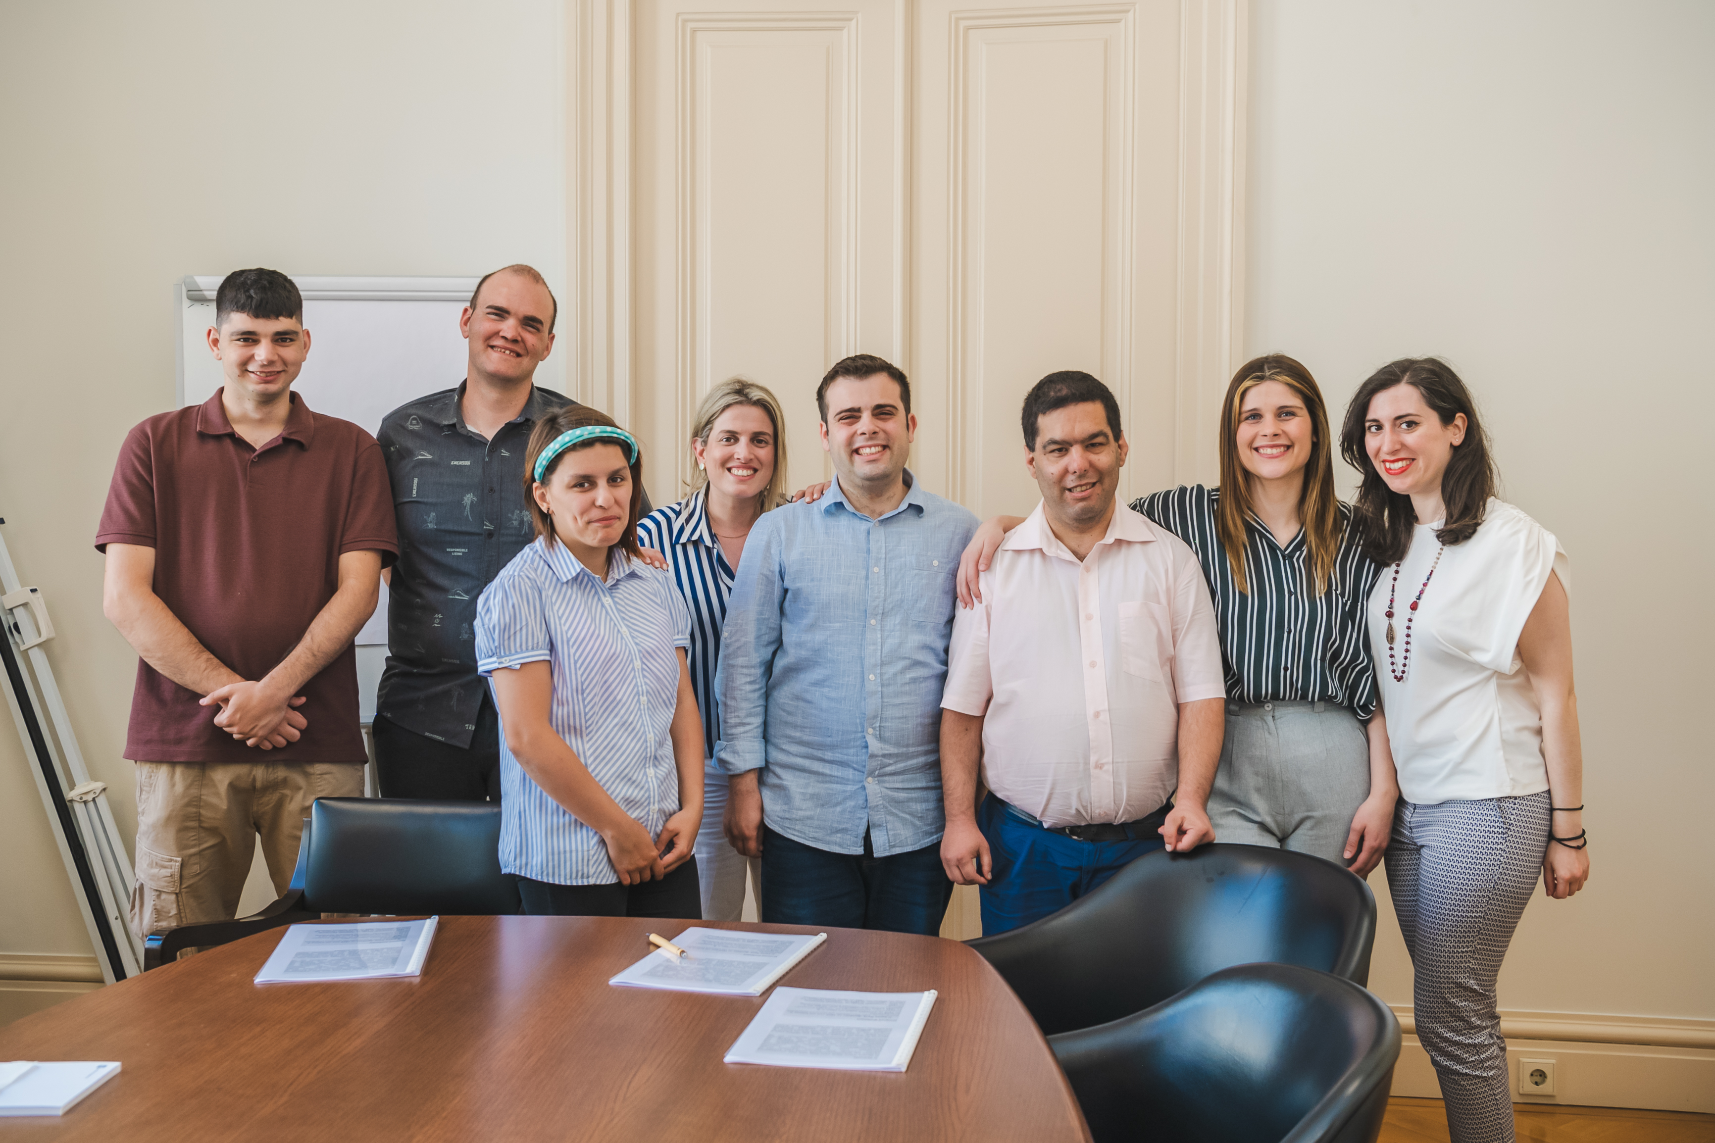
Sustainability & Challenges
Sustainability:
“World of Difference” Programme of the Vodafone Foundation.
Hellenic Responsible Business Awards.
Private foundations funding the translation and preservation of the platform.
Challenges:
More than 130 requests from decentralized regions of Greece.
Lack of legal framework for Supported Employment.
Notes:
Sustainability:
Challenges:

Slide 8

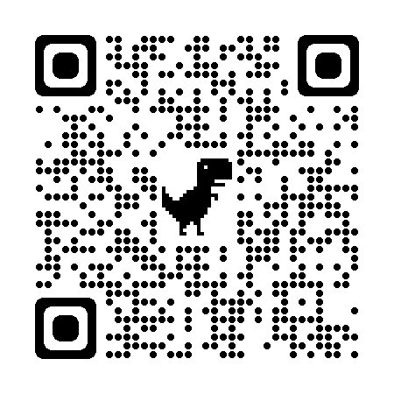
Next steps
Active collaboration with the Greek Public Employment Services.
Digital community of Supported Employment service providers.
Accessible to more job seekers from vulnerable groups (e.g. mental health).
Collaborations with universities to elaborate on advanced AI. ​
Notes:
Memorandum of Cooperation with Greek Public Employment Services, to make the platform ErgasiaMou a mainstream accessible tool for other service providers as well. The job towho are on the unemployment registers would use the platform to apply for jobs and create their online profiles.
To make the platform useful for service providers in national level, to create an active network of service providers of Supported Employment in Greece.
To make it accessible to service users of other vulnerable groups e.g. from mental health service providers. Social enterprises for mental health have already approached us to cooperate in the filed of Supported Employment in Greece.
To collaborate with universities to elaborate on advanced AI.

Slide 9
Thank you!
Contact Us:
Evangelia-Christina Andreadi
Research, Development and Innovation Dept.
e.andreadi@eeamargarita.gr
research.development@eeamargarita.gr
Notes:
Thank you! Contact us and visit our platform by scanning the QR code.

