Slide 1

Diana Vincent,
Fourth Wave Foundation
India
www.fourthwavefoundation.org
Early childhood interventions tailored for
low-income and rural settings
#ZeroCon24
21 February 2024
13:20 – 14:40
#ZeroCon24
1

Slide 2






Success Factors of the project
ACCESS TO EDUCATION
The program facilitates enrolment of children with disabilities into mainstream school.
INDIVIDUALISED EDUCATION PLAN (IEP)
A carefully planned individualised plan is developed focusing on learning, nutrition, hygiene, social interaction and physical activity.
ACCESS TO THERAPY
Through the program, children with disabilities receive health care and therapies for better quality of living.
MAINSTREAMING
Through the program, children with disabilities are equipped to transition into mainstream schools.
TECH ENABLED LEARNING
The program uses assistive technology and state-of-the-art infrastructures to cater to the learning needs of children with disabilities.

Slide 3







Individualised Education Plan (IEP) based on 5 areas
5 KEY AREAS COVERED UNDER THE IEP
HYGIENE
NUTRITION
SOCIAL
INTERACTIONS
ACTIVE
LEARNING
PHYSICAL
ACTIVITIES
#ZeroCon24
3

Slide 4
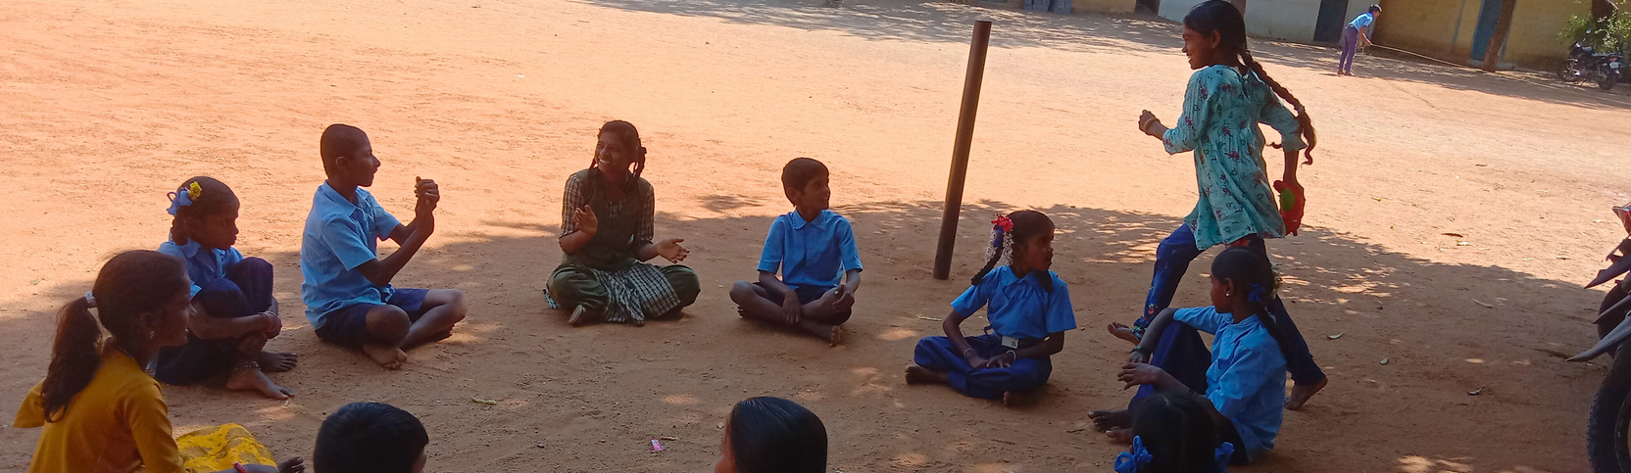
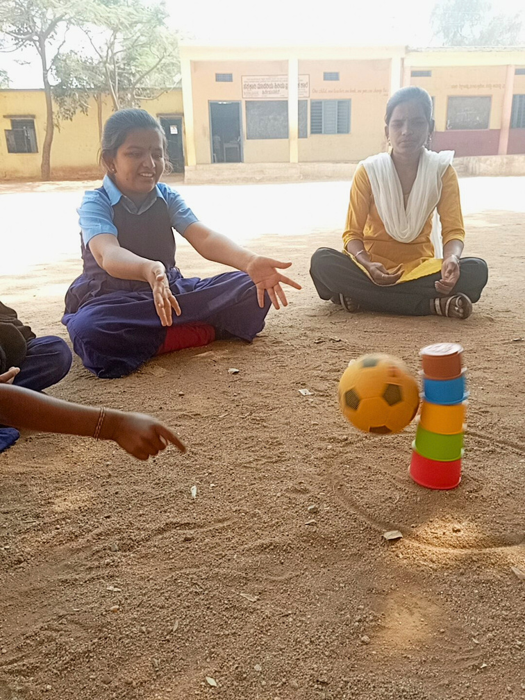
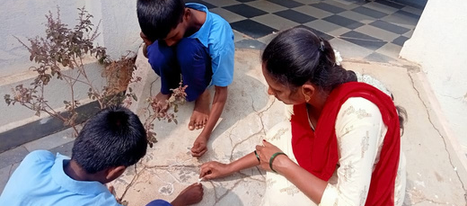
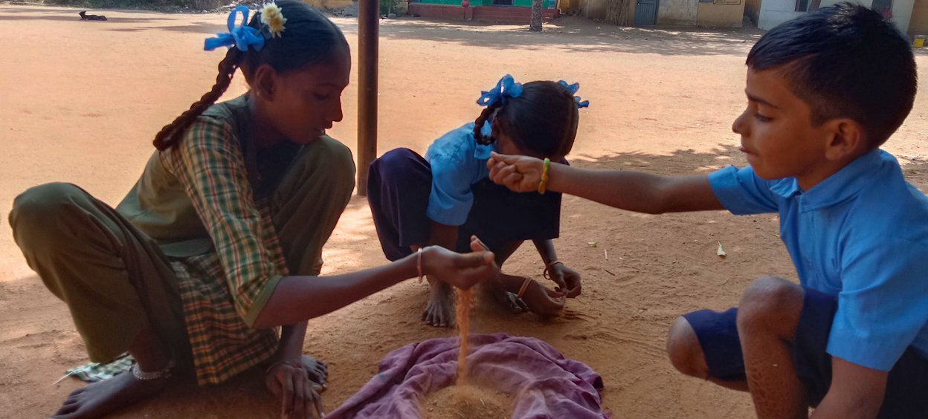
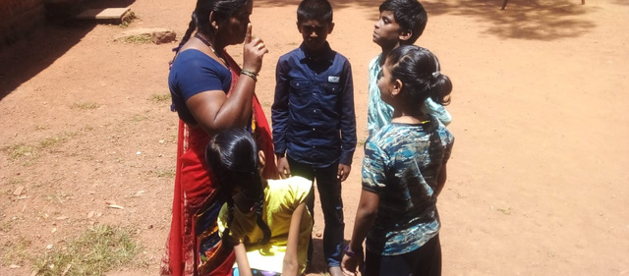
Philosophy
#ZeroCon24
Curriculum that promotes learning beyond classrooms
#ZeroCon24
1

Slide 5
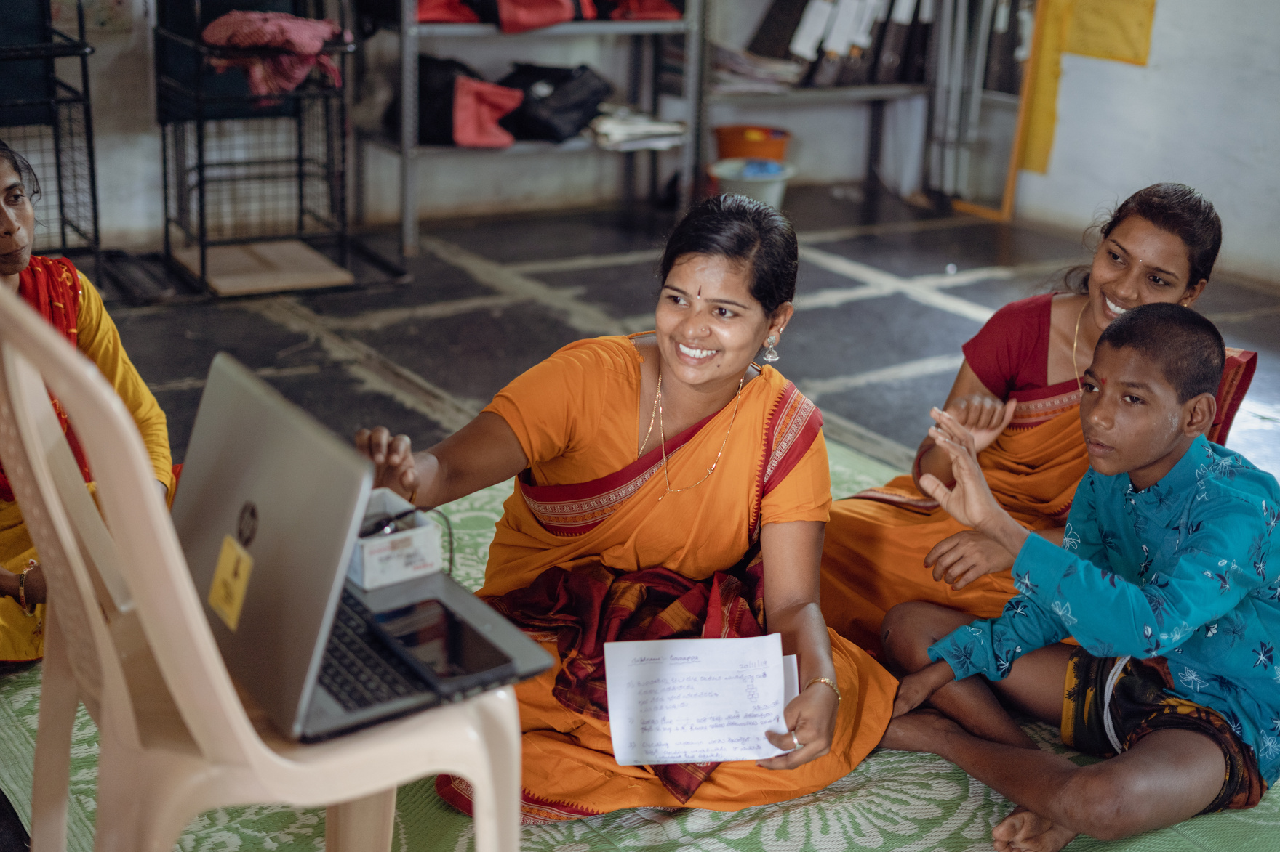
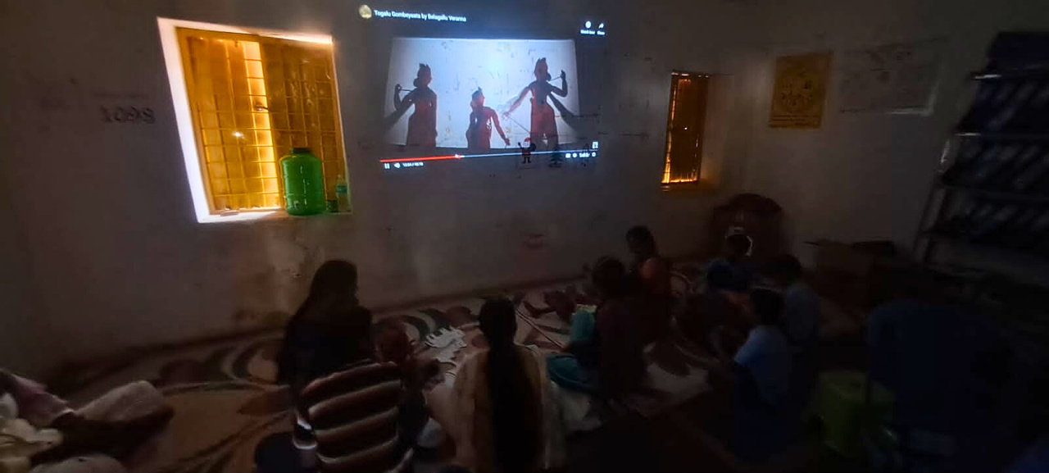
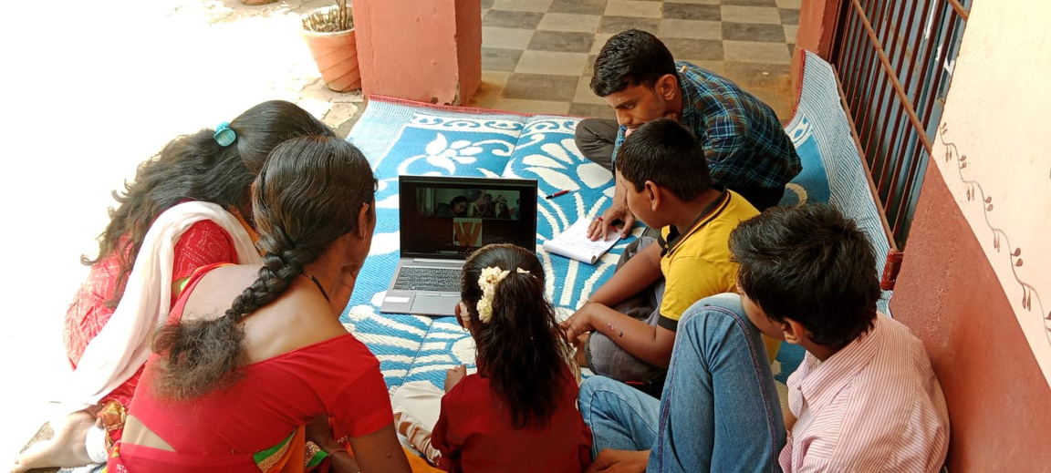
Bridging the rural-urban divide
#ZeroCon24
Tech enabled remote consultation and therapy
Through the program children with disabilities receive health care and therapies for better quality of living.
Tech enabled learning
The program uses assistive technology and state of the art infrastructures to cater to the learning needs of children with disabilities.
#ZeroCon24
1

Slide 6
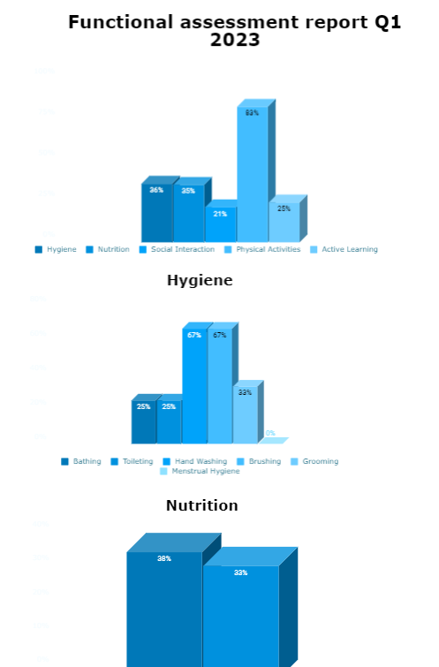
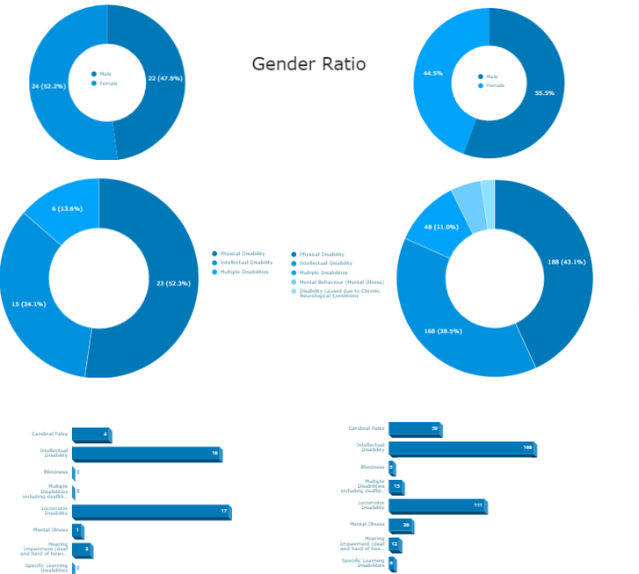
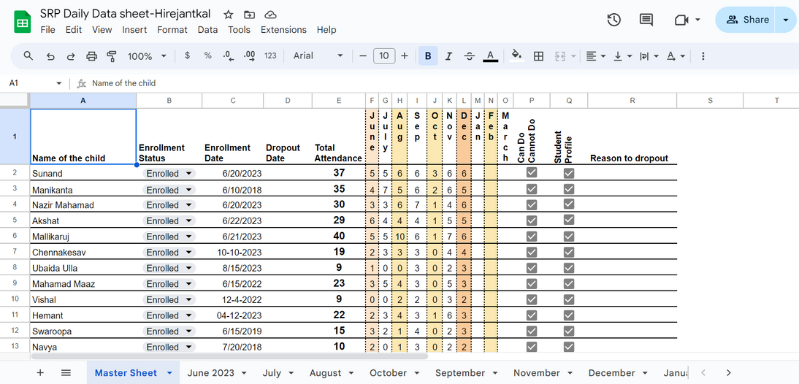
Mapping tools to monitor lifecycle needs
Child health, nutrition, learning and welfare
#ZeroCon24
4
Notes:
Sample Slide: presenting three points on our project and the relationship to this year’s theme of the Zero Project Conference. Point 1; Point 2; Point 3 connect together in this way.
4

Slide 7
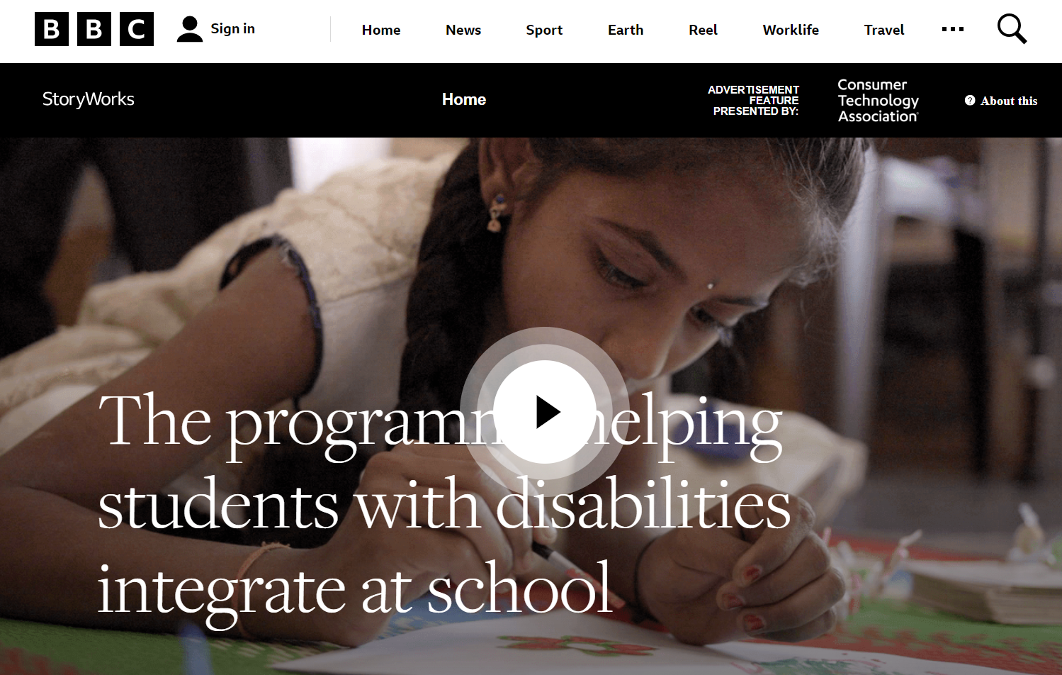


The project has showcased high success rates of Children completing Highschool
#ZeroCon24
4

Slide 8

#ZeroCon24
6
Notes:
Sample Slide: presenting three points on our project and the relationship to this year’s theme of the Zero Project Conference. Point 1; Point 2; Point 3 connect together in this way.
6

