Slide 1
Humanos 3D and Mobile Clinics: Innovation that Transforms Lives
Hugo Esteban Rojas
Humanos 3D
Colombia
Quality prosthetics becoming globally available and affordable
Thursday 6 March 2025 | 12:00 - 13:00
Notes:
Please add your notes here.
Title; First name, last name of speaker(s); Name of Organization, Name of Country, Name of Session (as written in Agenda)
#ZeroCon24
Day and Time of Session

Slide 2
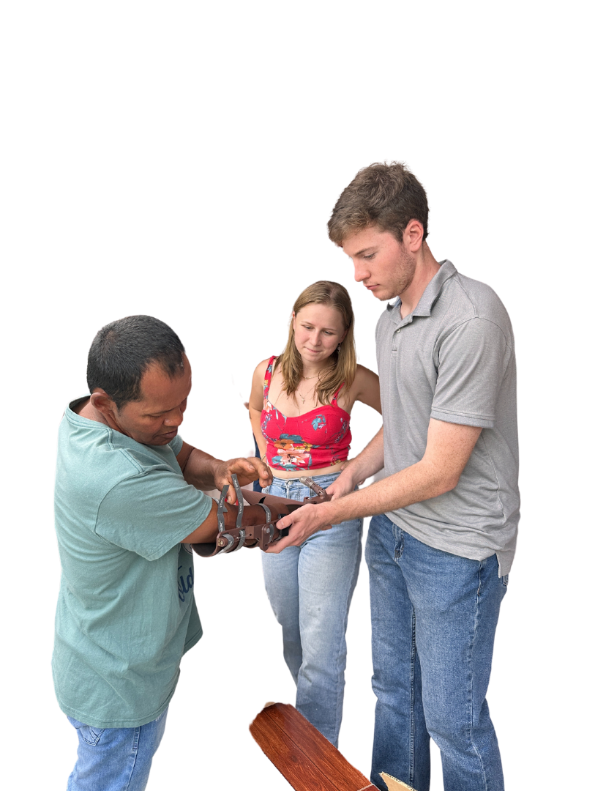

H3D is a place where we create a bridge between disability and possibility.
Notes:
Sample Slide: presenting three points on our project and the relationship to this year’s theme of the Zero Project Conference. Point 1; Point 2; Point 3 connect together in this way.

Slide 3



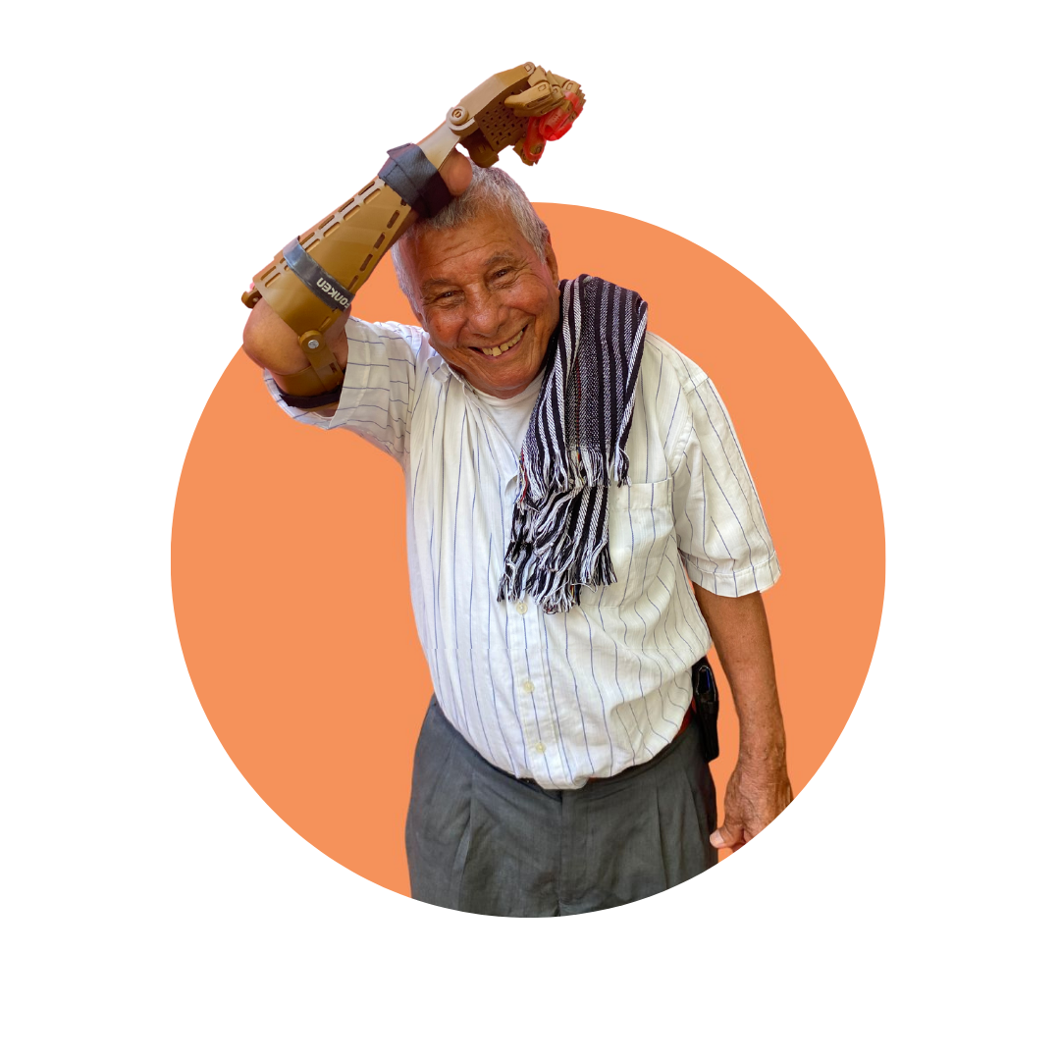

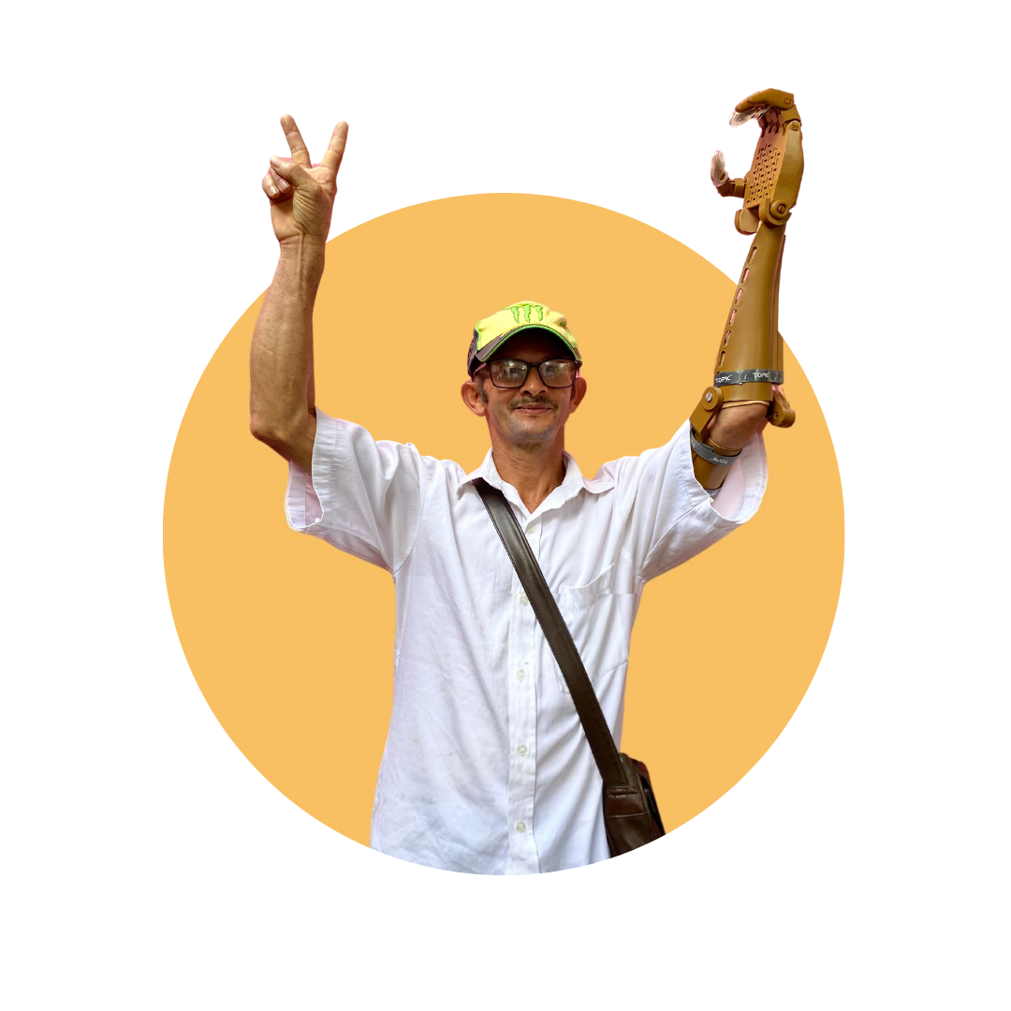
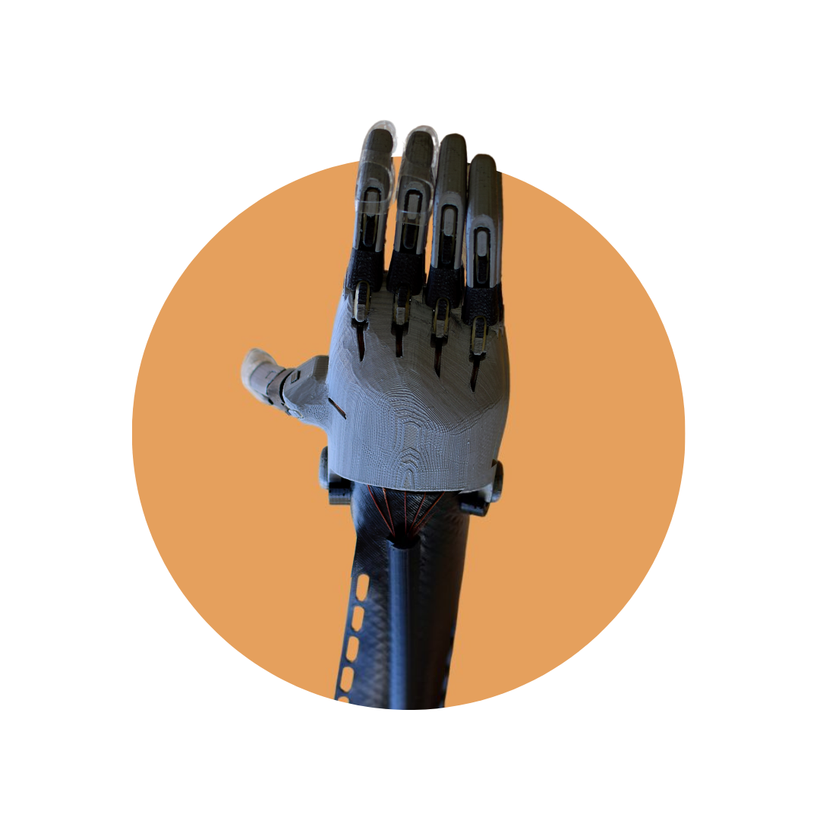

Mobile Clinics
We educate communities
We conduct personalized assessments.
We design and deliver custom prosthetics.
We engage new partners.

Slide 4



Innovative aspects
3D printing technology
Decentralized care model
Multisector collaboration
Innovation is not only in the product, but in the distribution model.
Notes:
Sample Slide: presenting three points on our project and the relationship to this year’s theme of the Zero Project Conference. Point 1; Point 2; Point 3 connect together in this way.

Slide 5
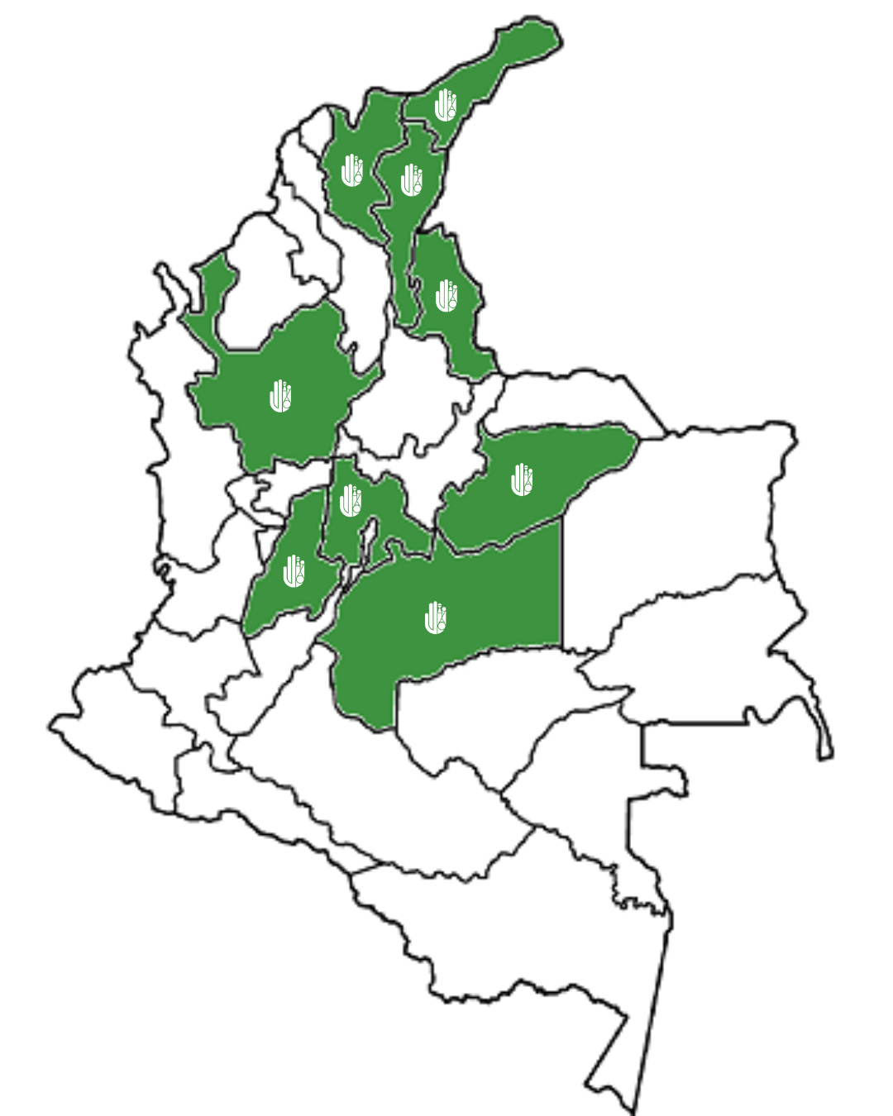
Our Impact
423
people have benefited
prostheses have been delivered
+500
municipalities have received our services
33
Notes:
Sample Slide: presenting three points on our project and the relationship to this year’s theme of the Zero Project Conference. Point 1; Point 2; Point 3 connect together in this way.

Slide 6
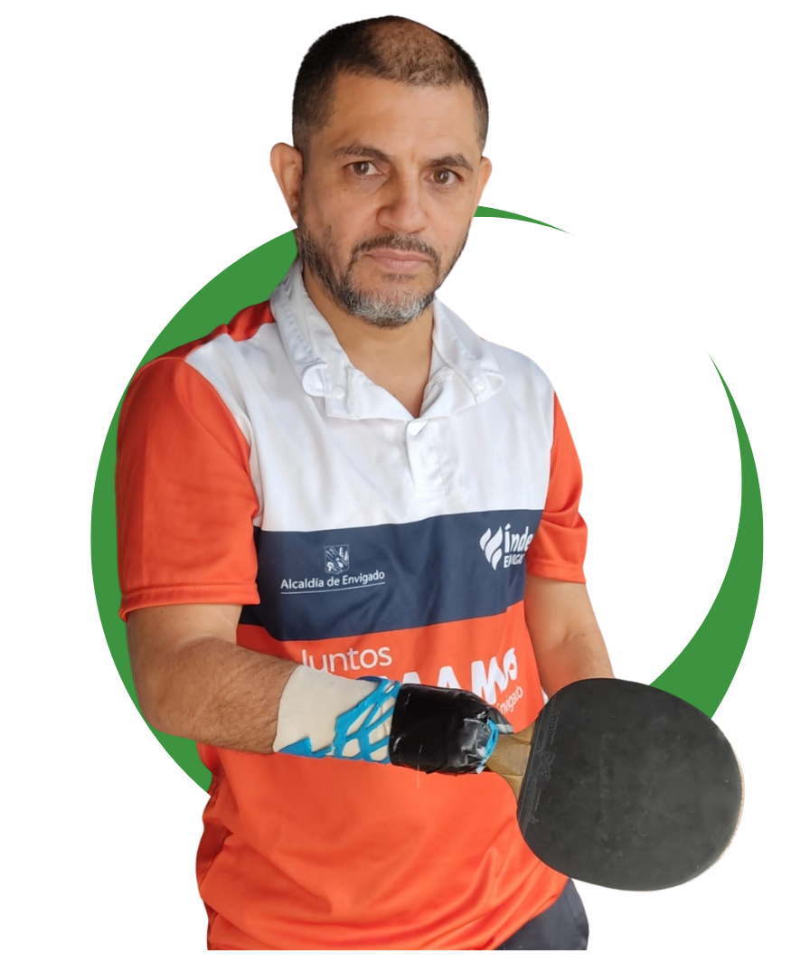
He is
Rigoberto Ortiz
Professional tennis player from Medellin, Colombia, international champion of Invictus Game
Notes:
Sample Slide: presenting three points on our project and the relationship to this year’s theme of the Zero Project Conference. Point 1; Point 2; Point 3 connect together in this way.

Slide 7



Other Success Factors
Connection with national and international allies
Operational flexibility
Human stories
Notes:
Sample Slide: presenting three points on our project and the relationship to this year’s theme of the Zero Project Conference. Point 1; Point 2; Point 3 connect together in this way.

Slide 8
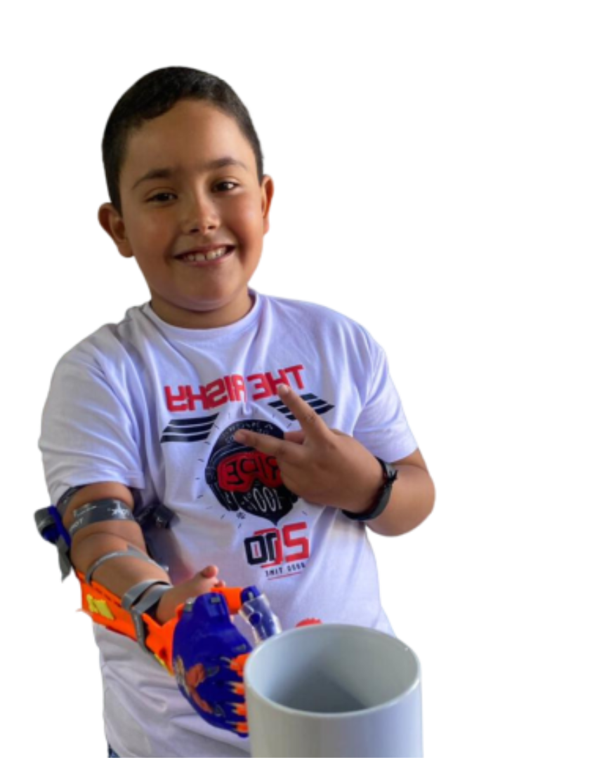




Financing, Sustainability and Challenges
Logistics in remote areas
Scalability without compromising service quality
Raising awareness and educating communities about the importance of assistive devices
Public and private funds and in-kind
Business revenue
Inclusion
Notes:
Sample Slide: presenting three points on our project and the relationship to this year’s theme of the Zero Project Conference. Point 1; Point 2; Point 3 connect together in this way.

Slide 9

Next Steps
International expansion
Integration of new technologies
Education and awareness
Generation of global alliances
More Volunteers
Notes:
Sample Slide: presenting three points on our project and the relationship to this year’s theme of the Zero Project Conference. Point 1; Point 2; Point 3 connect together in this way.

Slide 10
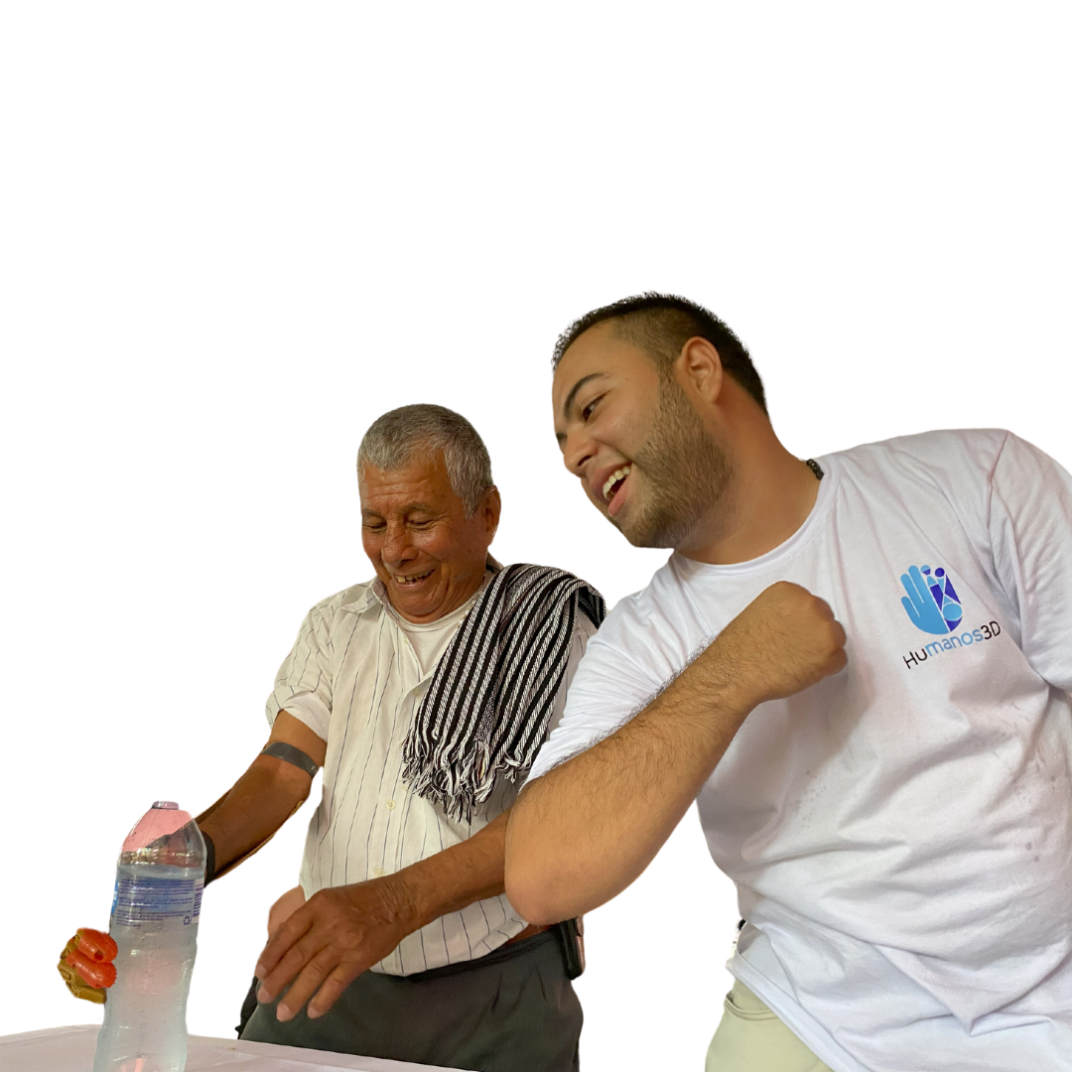

Thank You
We are
Notes:
Sample Slide: presenting three points on our project and the relationship to this year’s theme of the Zero Project Conference. Point 1; Point 2; Point 3 connect together in this way.

