Slide 1
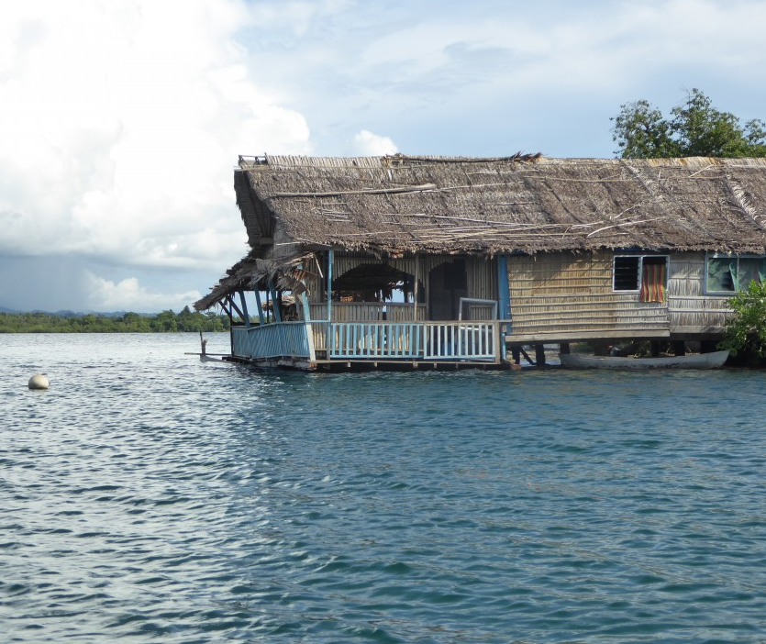
Disability Inclusion in the Private Sector
“
Recently we had a sea swell
for three days. There are no warnings for sea swells.
It damaged the lagoons, where some people with disabilities live. They had to be relocated and resettled urgently.
Three islands in Loa Lagoon
and Langa Langa
Lagoon are now under water.
- Casper, People with Disability Solomon Islands
”
— Vicky Tsang, Pacific Region.
International Finance Corporation (IFC)
10-11am CET, Thursday 22 February 2024
Notes:
Disability Inclusion in the Private Sector
Vicky Tsang, International Finance Corporation (IFC)
Pacific Region
Forum on Climate Change and Humanitarian Crises​
#ZeroCon24
10-11am CET, 22 February 2024

Slide 2

A quick introduction
The International Finance Corporation (IFC) is the private sector development arm of the World Bank. We aim to improve the lives of people in developing countries by investing in private sector growth and by creating inclusive economic opportunities.
The IFC Gender and Economic Inclusion Department works to reduce gaps between men and women in the private sector, enabling companies and economies to improve their performance.
We provide advisory services to companies, produce tools and reports to build the business case for inclusion, and integrate a gender lens in our investments.
Notes:
Introduce IFC and GEID
Introduce the types of work we do
Inclusion can lead to substantial economic gains.
A “business case” might explore Inclusive Banking, highlighting emerging practices that foster economic inclusion for people with disabilities.
And example is: in Nepal, where the inclusion of people with sensory or physical impairments into schools was estimated to generate wage returns of 20%. (Portulans Institute.)

Slide 3
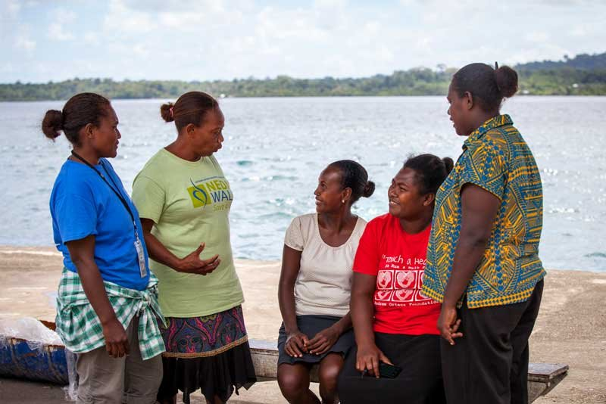
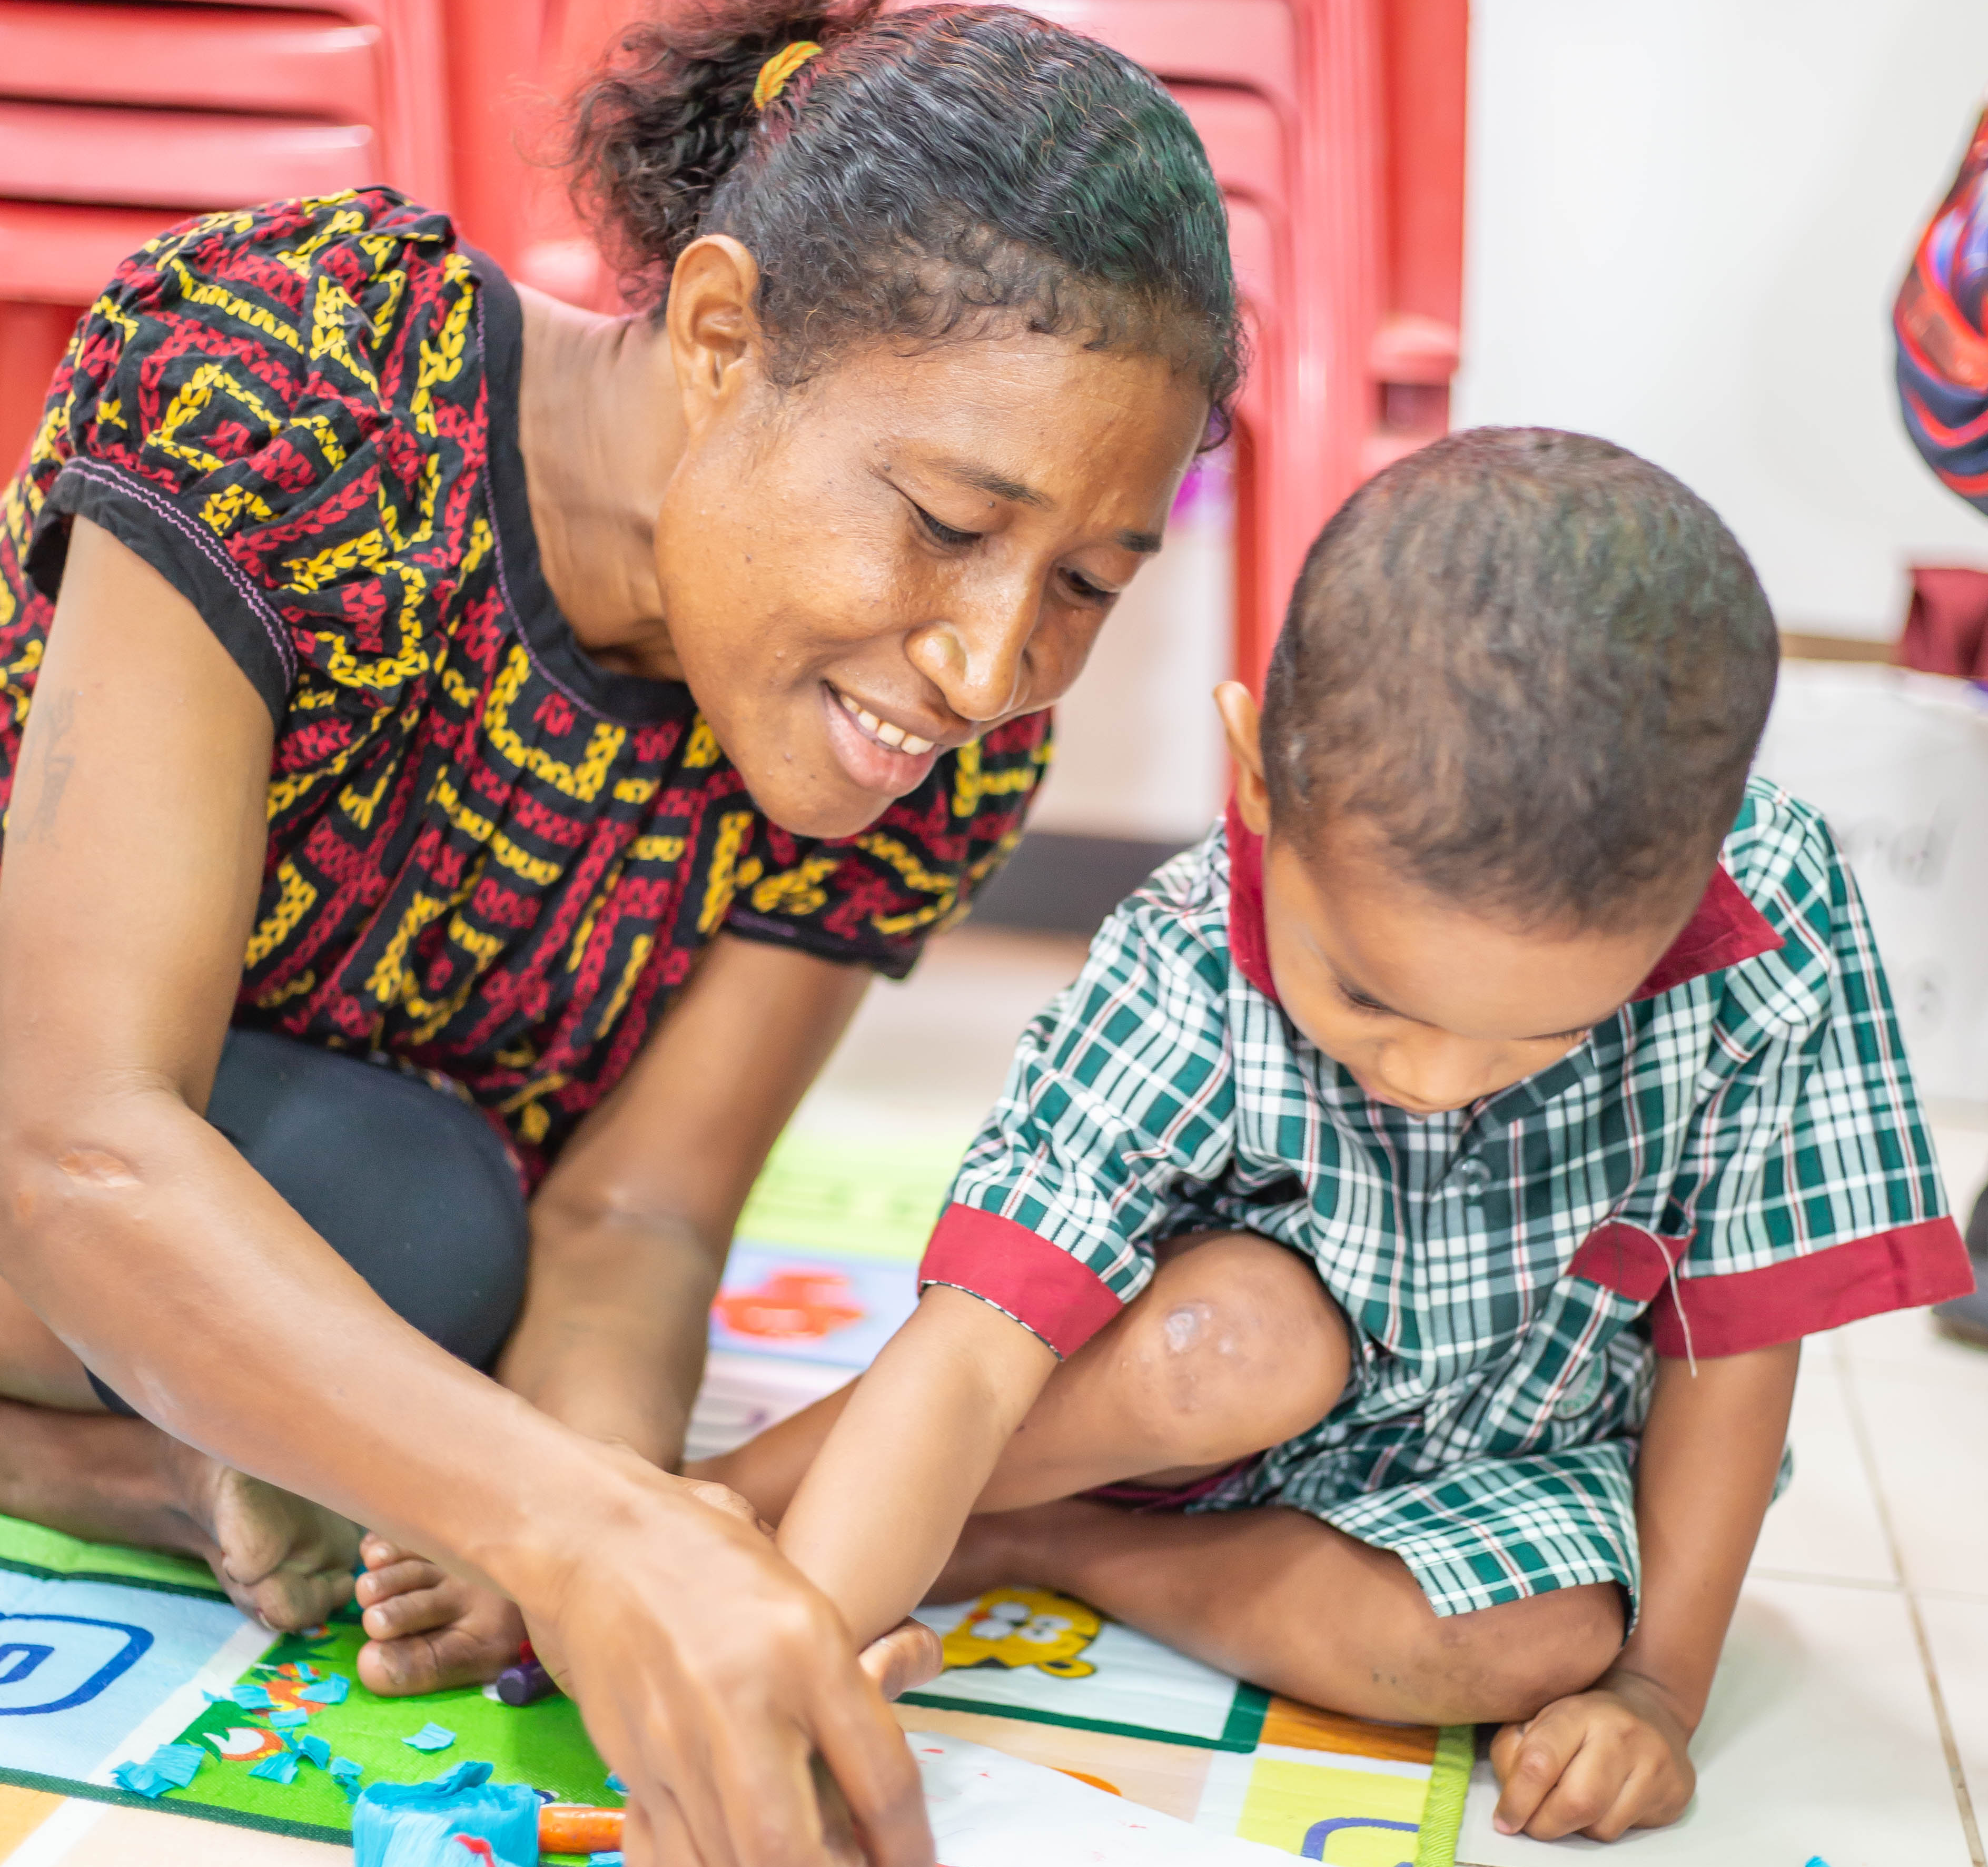
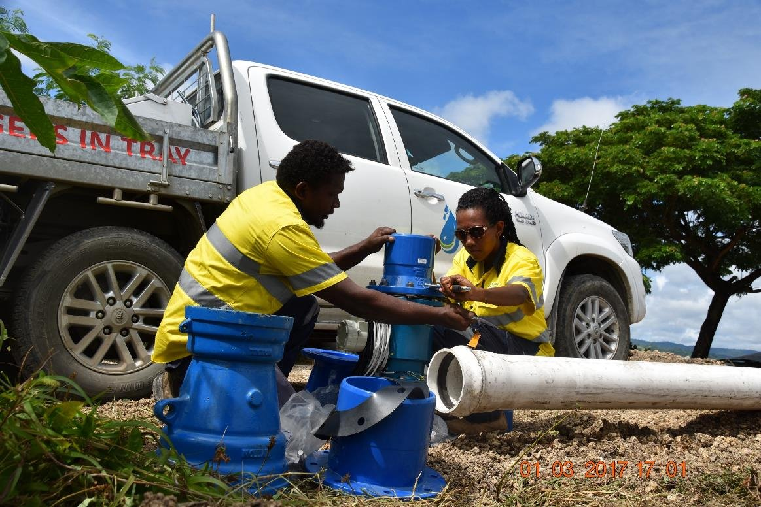
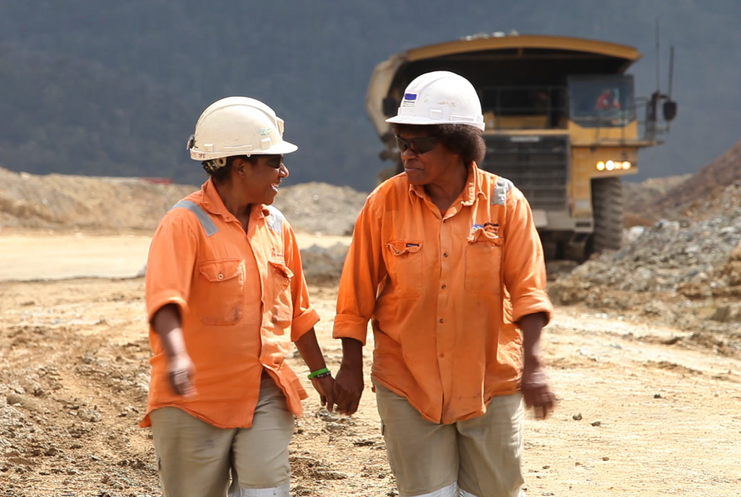
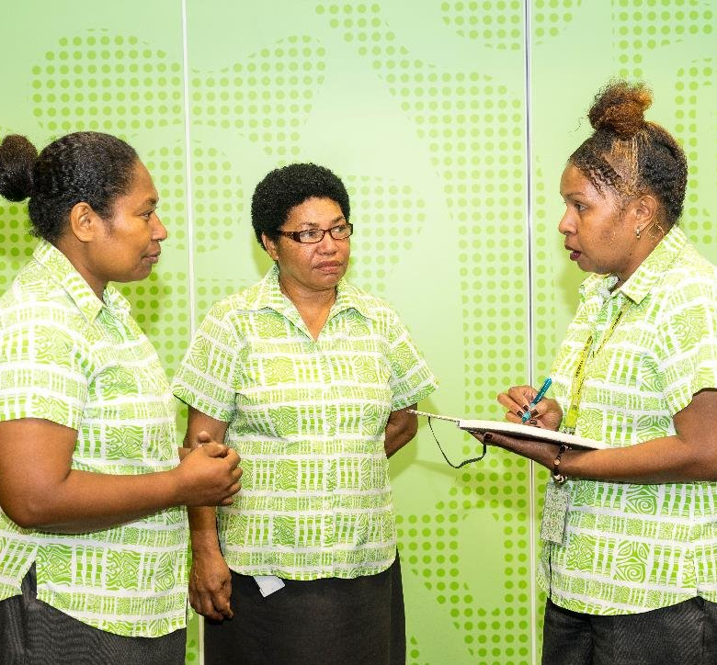
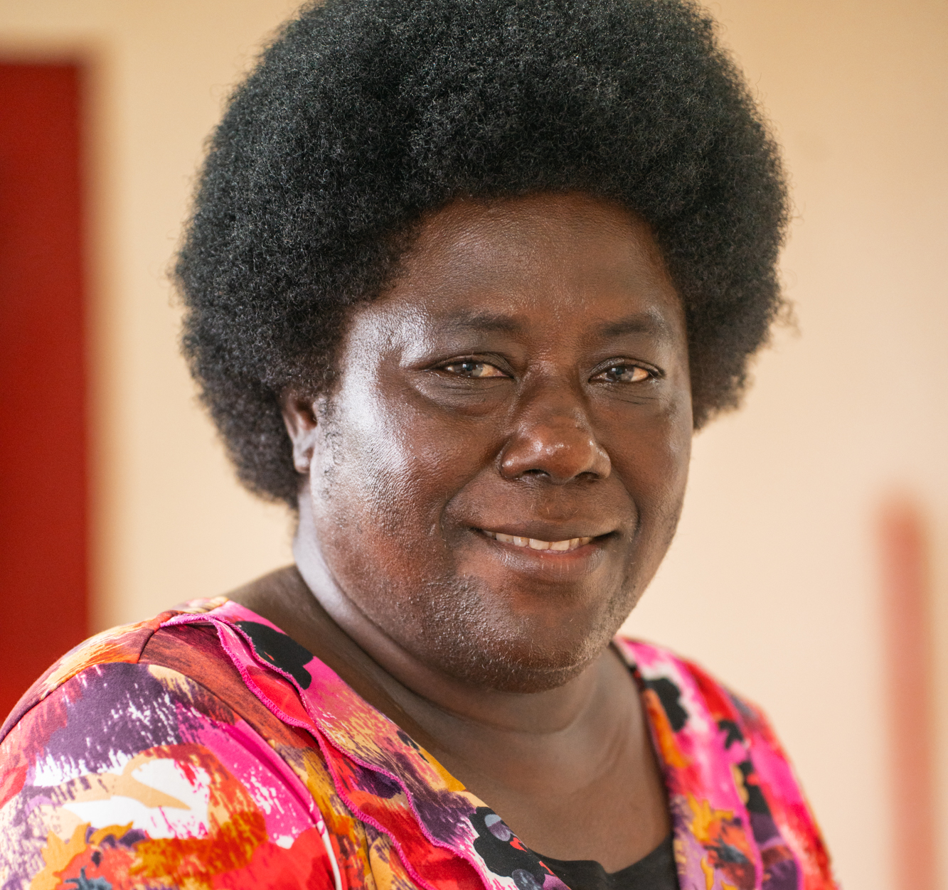
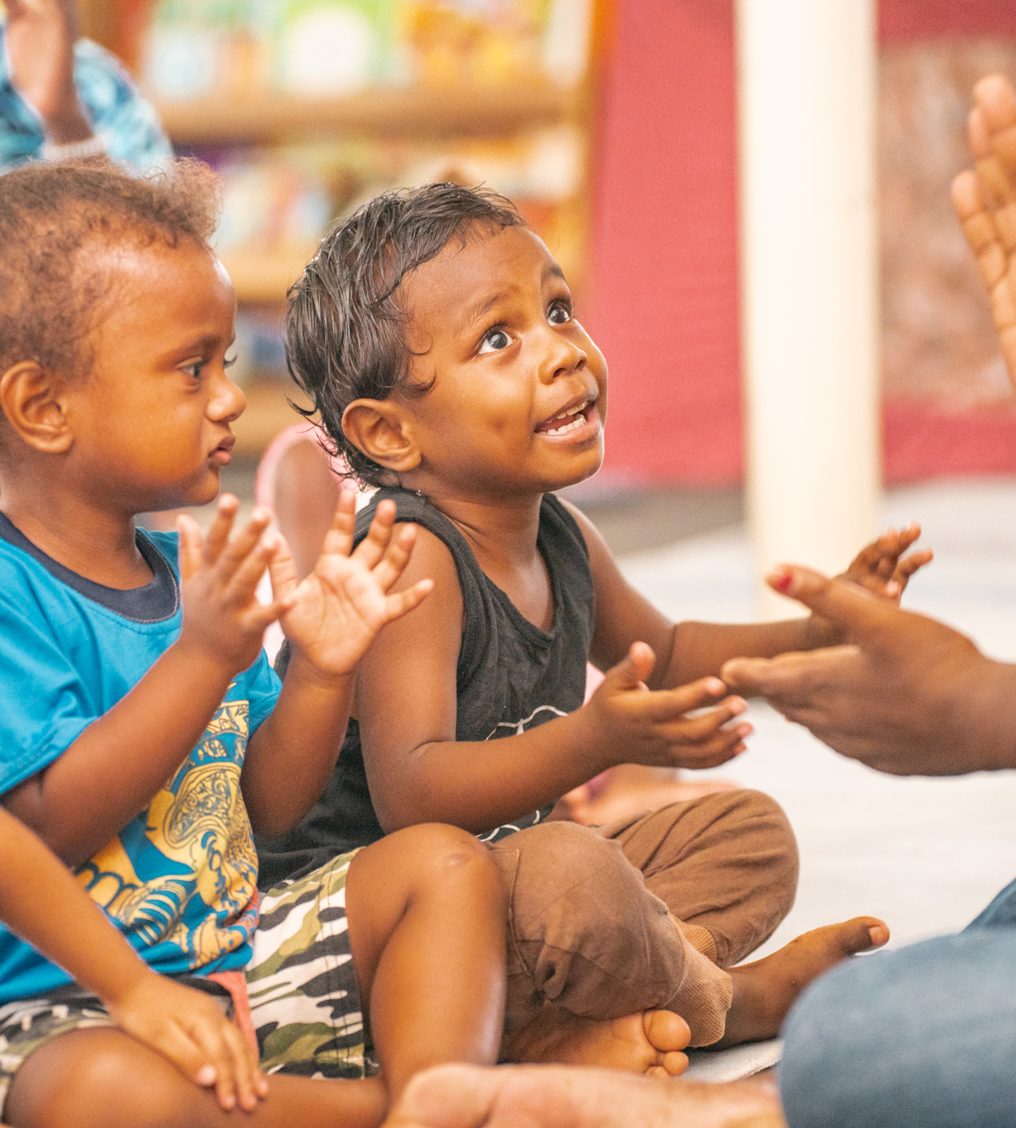
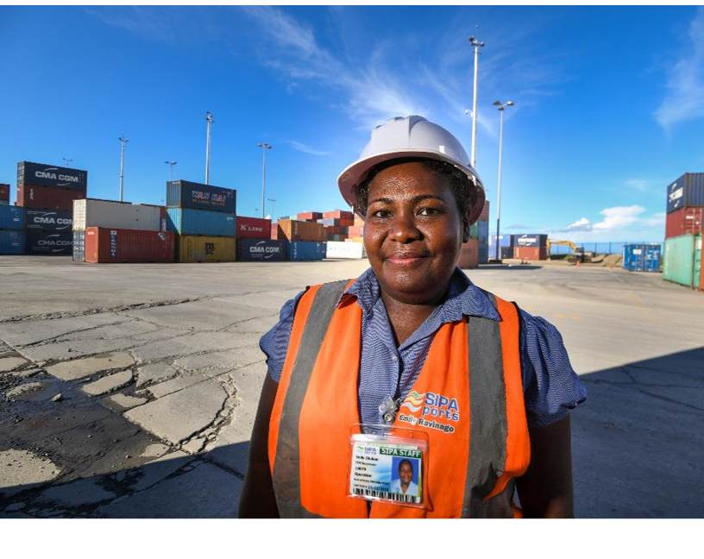
The business case for inclusion
Notes:
The areas of focus today are the Pacific Island Nations of the Solomon Islands, Vanuatu, Papua New Guinea and Fiji
These photos show some of the people benefitting from our work with private sector clients in the Pacific.
From women’s employment and safety, to childcare research and support, trades, leadership positions.

Slide 4
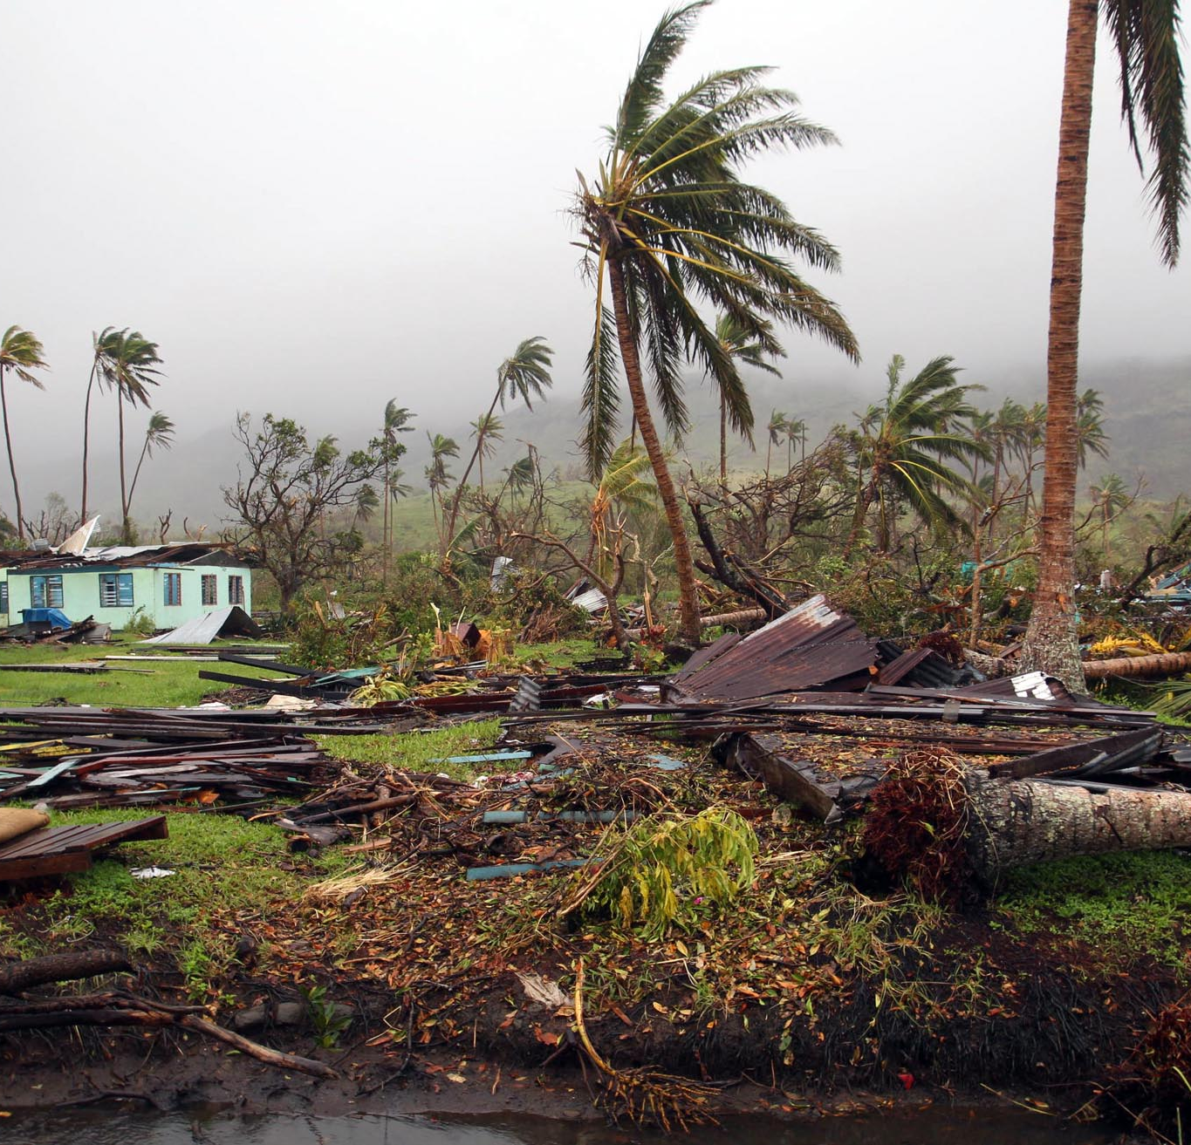
The Pacific and Climate Change
Islands in the Pacific are extremely vulnerable to climate change.
The most substantial impacts of climate change include:
Loss of coastal infrastructure and land
More frequent/ more intense cyclones and droughts
Failure of subsistence crops and coastal fisheries
Loss of coral reefs and mangroves
The spread of certain diseases*
*Source: South Pacific Regional Environment Programme (SPREP)
Notes:
Pacific Islanders are on the front line of experiencing climate change.
Impacts of climate change include reef, mangrove, infrastructure and agricultural losses, more intense weather and disease.
These events both create vulnerability and increase existing vulnerability.
People with disabilities have their situation exacerbated by low resource settings and exclusion.

Slide 5

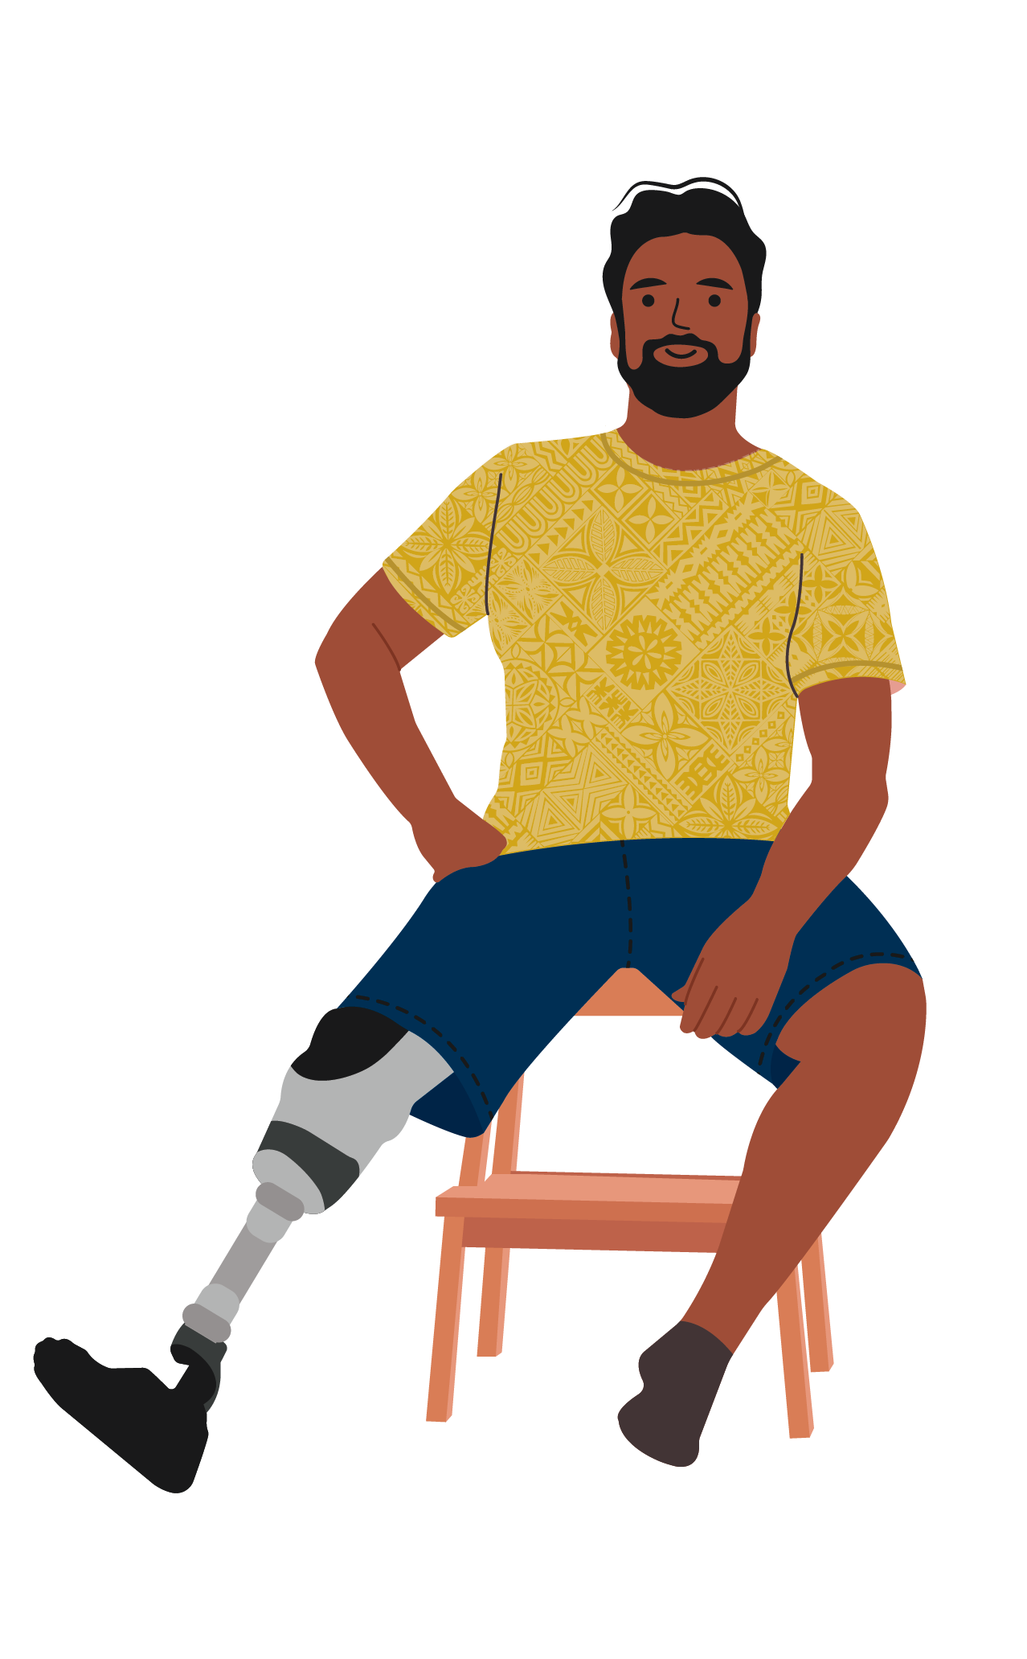
Disability in the Pacific
On average in Asia Pacific, persons with disabilities are 2 to 6 times less likely than persons without disabilities to be employed (UNESCAP 2021).
of the Pacific population (approx. 1.7 million people) have a disability (SPC 2020)
Est.
15%
Diabetes prevalence in adults is high in the Pacific, (between 17% to 40%), and it is estimated that 17% of people with diabetes will require amputation(s).
In 2019, diabetes related amputations in Fiji accounted for 40% of all hospital operations.
Notes:
Statistics on disability in the Pacific, including diabetes.
In the Pacific, persons with disabilities are more likely to face other health risks, such as premature death - up to 20 years earlier (not due to underlying health conditions) and are more than twice as likely as persons without disabilities to develop other health conditions ​
Climate change = more and more intense disasters in the Pacific, resulting in a disproportionate impact on persons with disabilities, who are up to 4x more likely to be injured or to die during a disaster (UNESCAP 2017).​
What is IFC doing about this?
With funding support from the Australian and New Zealand governments, IFC conducted a scoping study in 2023 to understand the current state of inclusion in the private sector in the Pacific. The study covered four countries – Fiji, Papua New Guinea, Solomon Islands, and Vanuatu

Slide 6
What we found in our research:
The foundations are there, but the private sector have a nascent understanding of disability.
Company managers we interviewed don’t have broad knowledge of what disability is, viewing it in general through a charity model.
None of the companies interviewed had workplace policies specifically addressing disability, but almost all have employed or are employing persons with disabilities.
We found that almost all companies interviewed have employed or are employing persons with disabilities, and all have provided accommodations in the workplace out of recognition of need.
Notes:
The foundations are being laid for an Enabling Environment -
All four countries have ratified the United Nations Convention on the Rights of Persons with Disabilities (UNCRPD), with Solomon Islands the most recent, ratifying the treaty on 22 June 2023.
People with Disabilities Solomon Islands is advocating for the development of an Inclusive Education Act and Disability Act.
Only Fiji has harmonized it into legislation, through government-led inclusive education initiatives and education mainstreaming.
However, outside Fiji, there is an absence of mainstream education for persons with disabilities.
Managers are overwhelmingly open to disability inclusive employment because they see how it could potentially bring in benefits, despite widespread attitudinal barriers for people with disabilities in the Pacific

Slide 7
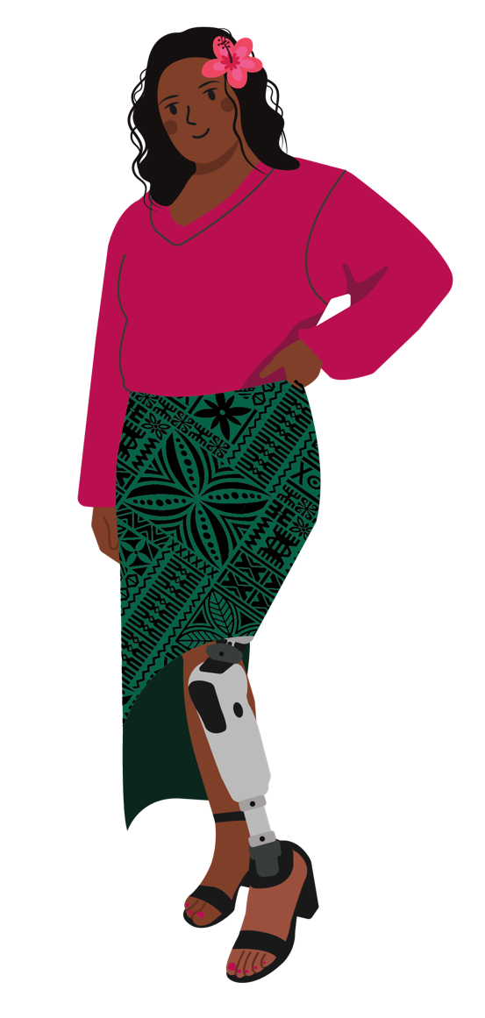
Further findings
Some companies interviewed were vaguely aware of the business benefits of disability inclusion (e.g. retention rates), and are open to taking steps towards disability inclusive employment.
Companies also told us that they would need support (e.g. training and guidelines) on how to design and implement disability inclusive practices and offer inclusive products and services.
Examples of good practice on disability inclusion in employment exist, mostly due to successful partnerships that prepares both the employee and the employer; there were also some useful lessons learned from unsuccessful initiatives.
Notes:
challenge attitudes and increase understanding of disability
draw from the widest possible pool of talent
secure high-quality staff who are skilled, loyal and hard working
improve employee morale and commitment by demonstrating fair treatment

Slide 8

The opportunity for the Private Sector
Organizations for Persons with Disabilities (OPDs) told us they have not really considered engaging with the private sector, whether on employment and talent development, or on the design of products and services.
The OPDs interviewed had varying levels of capacities, but almost all have a total reliance on volunteers and donor funding. This potentially limits the ability for OPDs to partner meaningfully with other organizations/ companies.
Beyond humanitarian and emergency responses, it is important for the private sector to play a lead role in designing solutions for building more resilient communities.

Slide 9
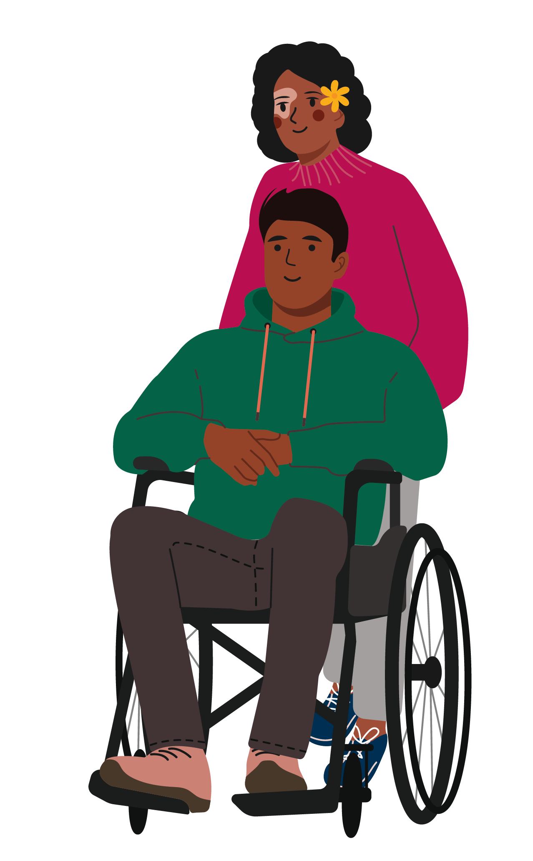
What's Next:
Peer Learning Platforms for private sector firms
In partnership with the Solomon Islands Chamber of Commerce and Industry, IFC will bring companies together to test and design solutions to enhance employment opportunities for people with disabilities.
IFC will support these companies to implement their commitments, policies and practices toward building respectful workplaces, offer reasonable accommodations, and increase the recruitment, retention and promotion of women and people with disabilities.
The design outcomes have potential replicability in other developing country contexts.
Notes:
The PLP will help firms Design and test solutions
Support for commitments and actions: Companies will attend periodic workshops, supported with guidance on their action plans and commitments, and be able to share knowledge and practices with each other.
Replicability: IFC will also help People with Disabilities Solomon Islands build capacity to offer training to companies.

Slide 10

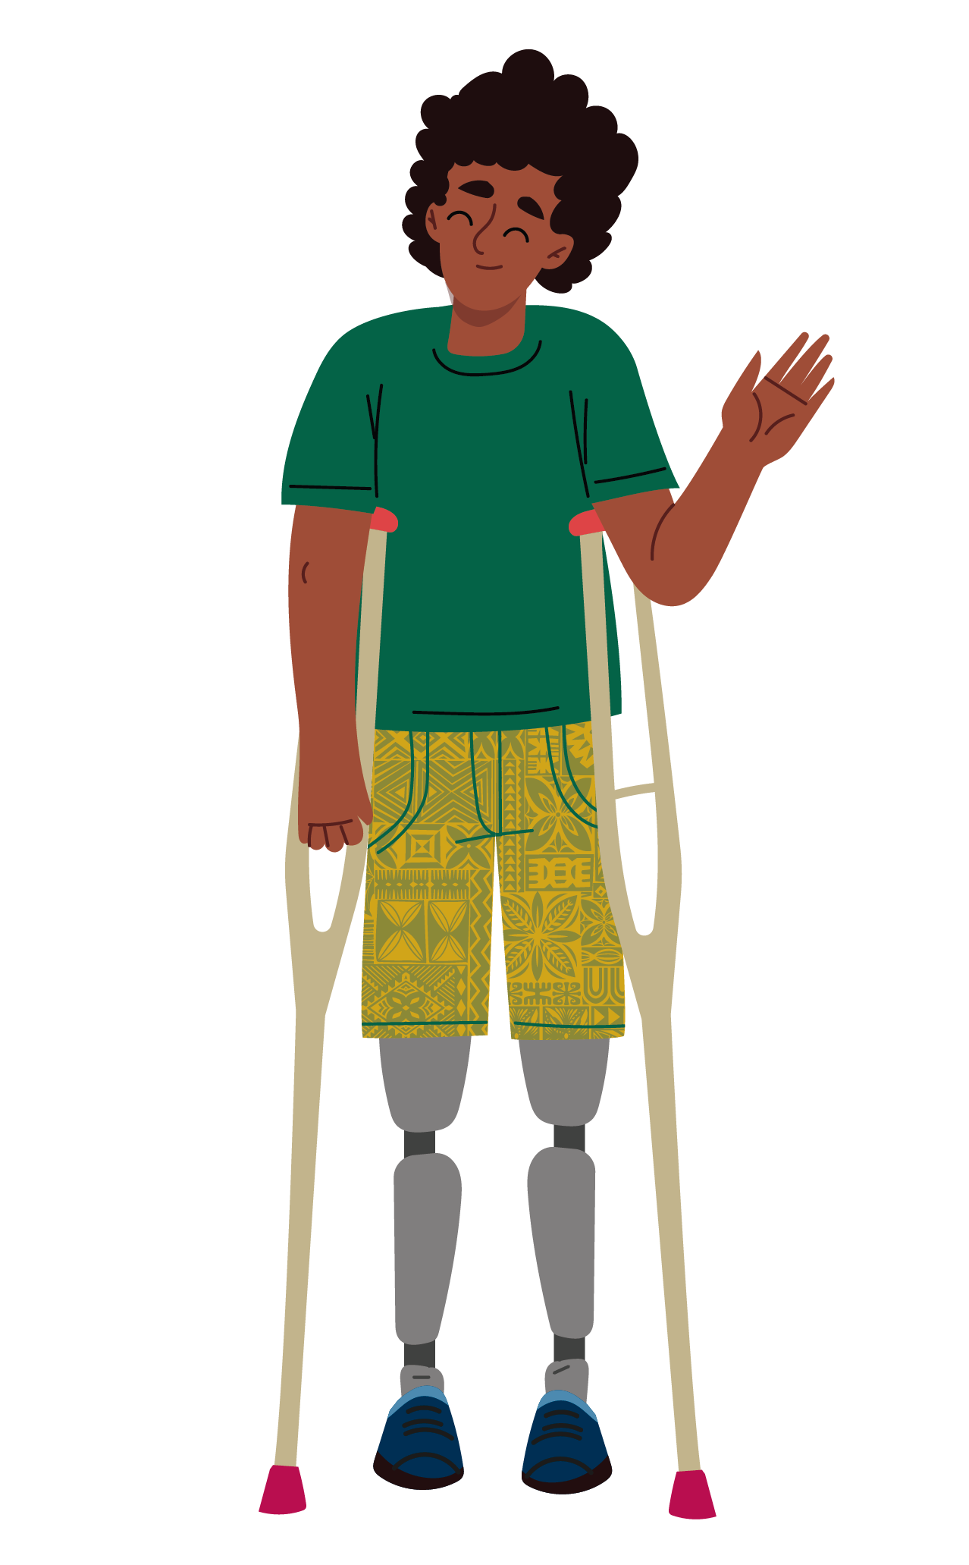

Summary
In the face of extreme weather and increasing natural disasters, strengthening the resilience and adaptability of disabled persons within pacific communities – through economic inclusion - is key.
The private sector plays an important role in creating economic inclusion.
Introducing the right tools, concepts, and policies to local firms will advance employment opportunities for people with disabilities in the Solomon Islands, building resilience and developing adaptability in the face of a changing climate.

Slide 11

Thank You
Vicky Tsang
Pacific Coordinator,
Gender and Economic Inclusion Department
International Finance Corporation (IFC)
wtsang@ifc.org

