Slide 1
Inclusive Africa Conference
Irene Mbari-Kirika
inABLE
Kenya
Global Disability Conferences in 2025
Thursday, March 6, 2025
Time:16:00 to 17:00
Notes:
Inclusive Africa Conference
Irene Mbari-Kirika
inABLE
Kenya
Global Disability Conferences in 2025
Thursday, March 6, 2025
Time:16:00 to 17:00

Slide 2
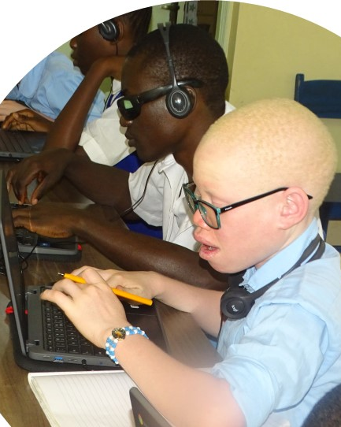

inABLE's mission is to empower African youth with disabilities through technology.
Notes:
inABLE's mission is to empower African youth with disabilities through technology.

Slide 3
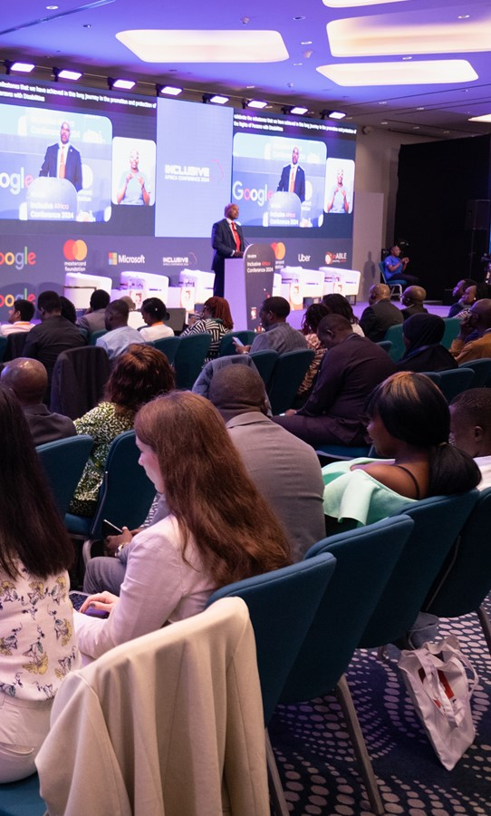
Inclusive Africa Conference.
Held annually since 2020 to promote assistive technology, and digital accessibility focusing on African youth with disabilities.
Engages regional and international policymakers, innovators, researchers, civil society, and private sector leaders.
Convene to share knowledge, best practices, and collaborate towards an inclusive digital future in Africa.
Notes:
Annual conference (since 2020) promoting assistive technology and digital accessibility for African youth with disabilities. Brings together regional/international policymakers, innovators, researchers, civil society, and private sector. Facilitates knowledge sharing, best practices, and collaboration for an inclusive digital future in Africa.

Slide 4
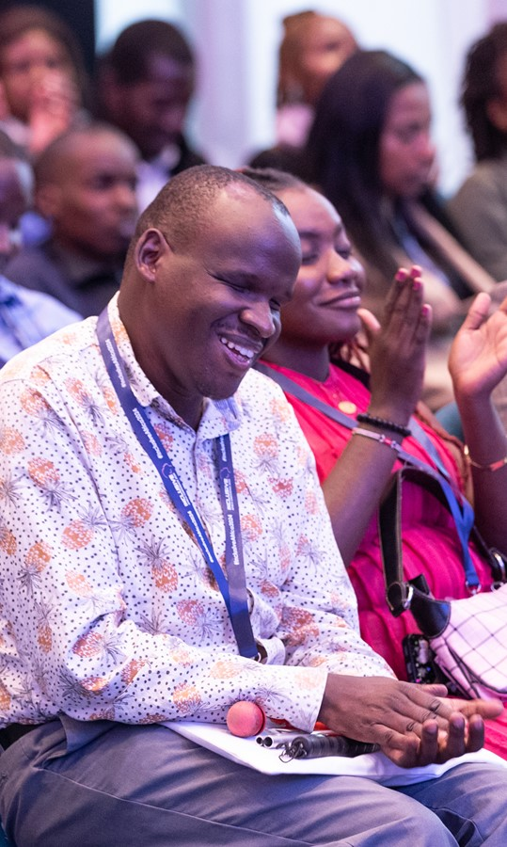
Conference Highlights
Host in person and virtual
Host live watch parties in 20 African countries​
Showcases 20 Assistive Technology innovations by Young Africans
Notes:
Conference Highlights
Host in person and virtual
Host live watch parties in 20 African countries​
Showcases 20 Assistive Technology innovations by Young Africans

Slide 5
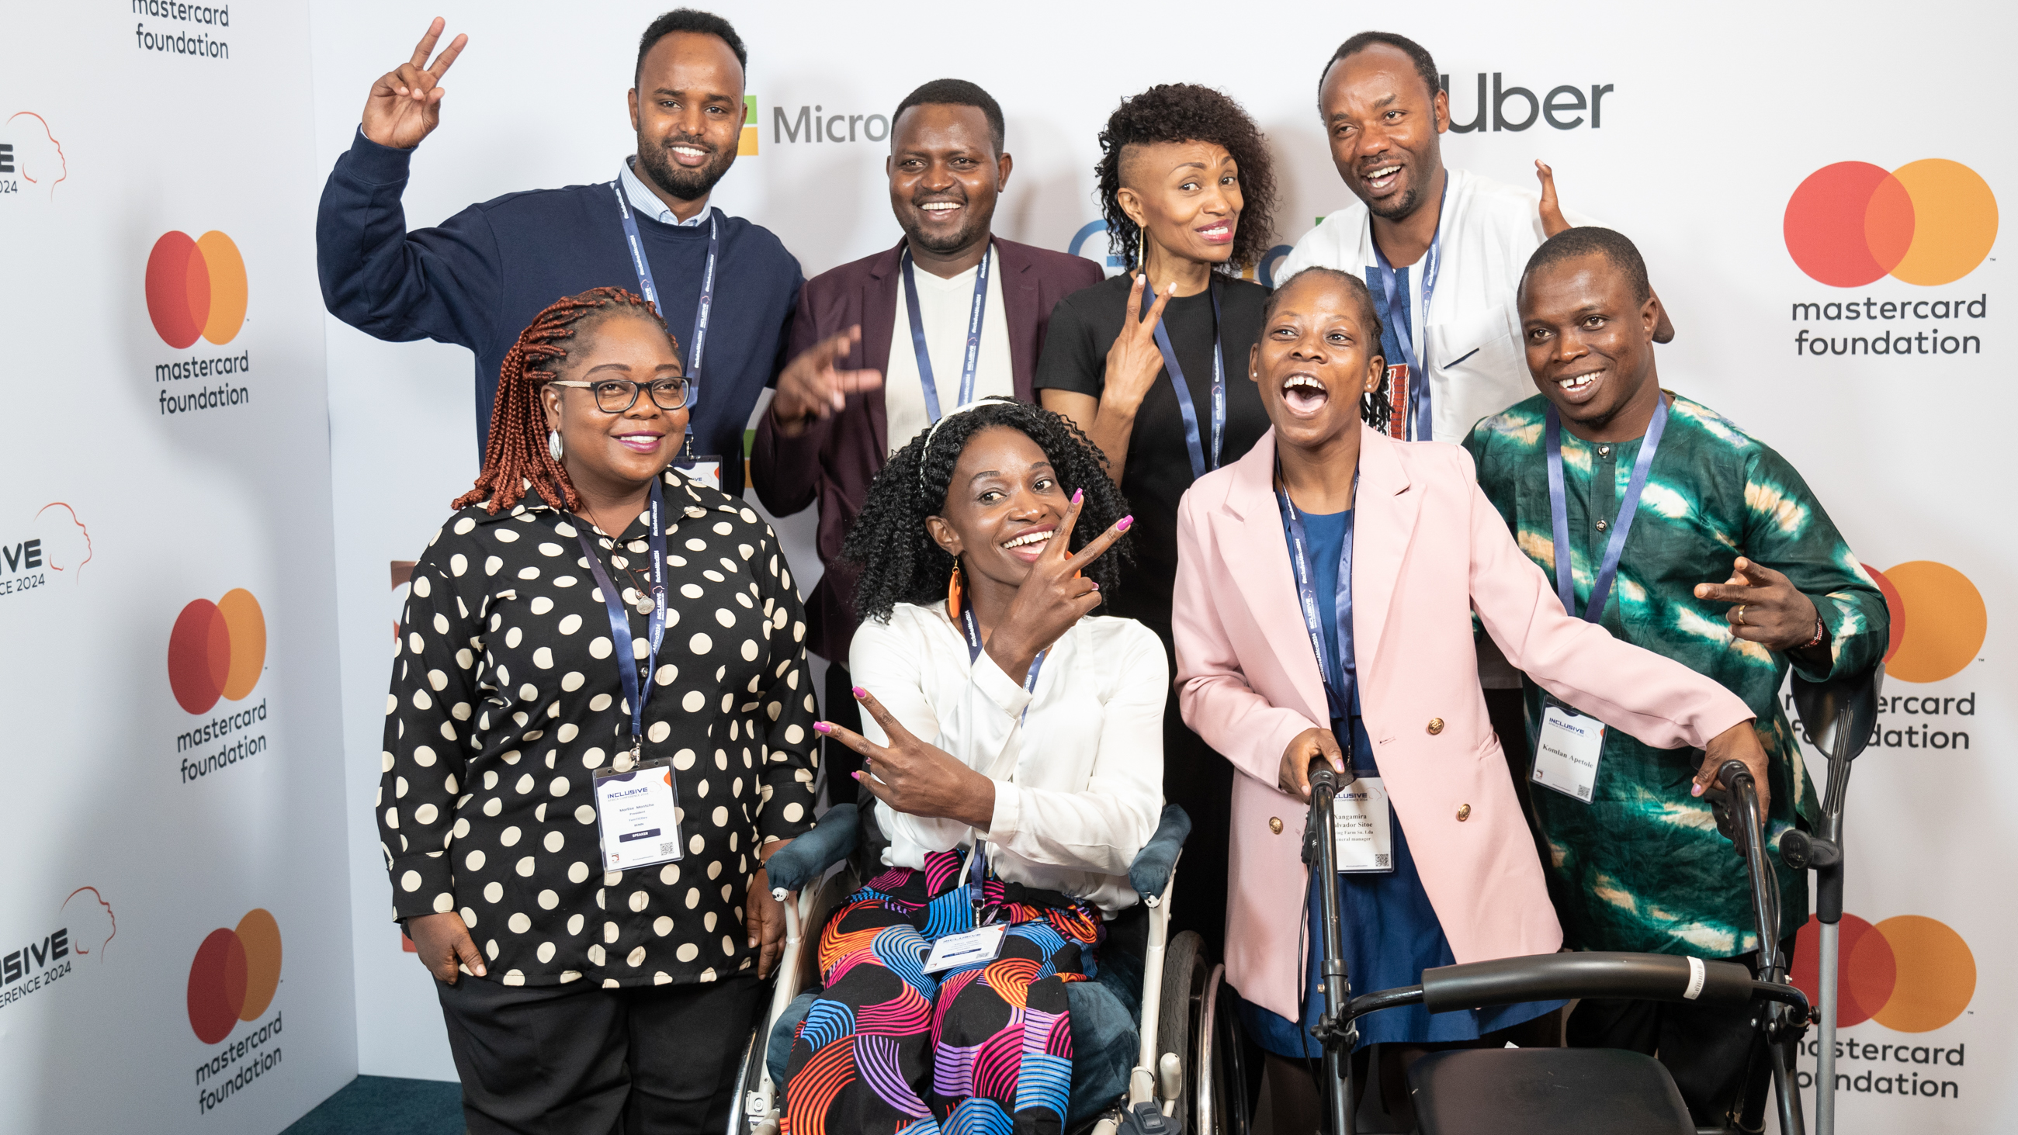

Break Slide
Notes:
A Group Photo of Youths With Diverse Disabilities Posing for a Photo With Ms Irene Mbari Kirika

Slide 6

Thank You
www.inclusiveafrica.org

