Slide 1
AI at the Zero Project
Michael Fembek
Essl Foundation – Zero Project
Austria
How to build AI that works for your organization
Friday 7 March 2025 | 10:00 - 11:00
Notes:
AI at the Zero Project
Michael Fembek
Essl Foundation – Zero Project
Austria
How to build AI that works for your organization
Friday 7 March 2025 | 10:00 - 11:00

Slide 2
Zero Project AI Assistant
Leveraging the Zero Project's unique treasure trove of data
Notes:
With the Zero Project AI Assistant, the Zero Project's vision is to support global decision-makers and opinion leaders in innovating and scaling disability-inclusive solutions to implement the CRPD.
The Zero Project AI Assistant opens the wealth of knowledge on successful innovating and scaling processes to everyone – a wealth developed by the Zero Project Network since 2013 accessible as a public resource. In partnerships, the Zero Project will constantly develop new tools supporting decision-making and collaboration globally and for all sectors of society.

Slide 3
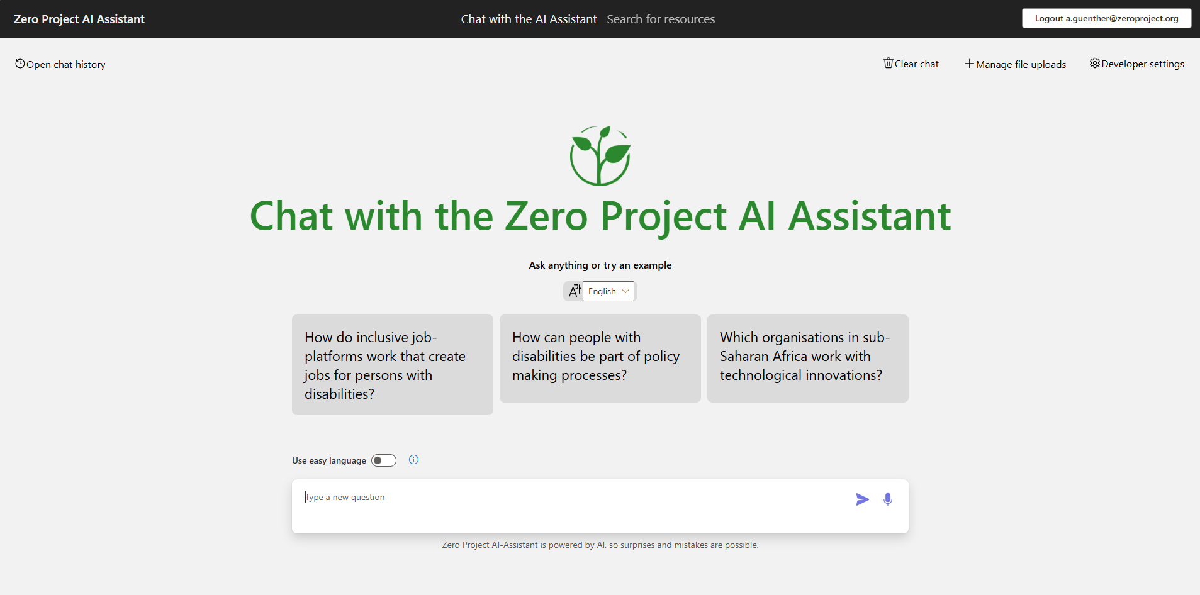
Chat with the Zero Project AI Assitant
Notes:
A screenshot of the Zero Project AI Assistant homepage. The interface features a large green heading that says 'Chat with the Zero Project AI Assistant' along with the Zero Project logo. Below, there are three example questions related to inclusive job platforms, policymaking for people with disabilities, and technological innovations in sub-Saharan Africa. A language selection dropdown, an easy language toggle, and a text input box for asking new questions are also visible. The top right corner shows options to clear chat, manage file uploads, access developer settings, and log out.

Slide 4
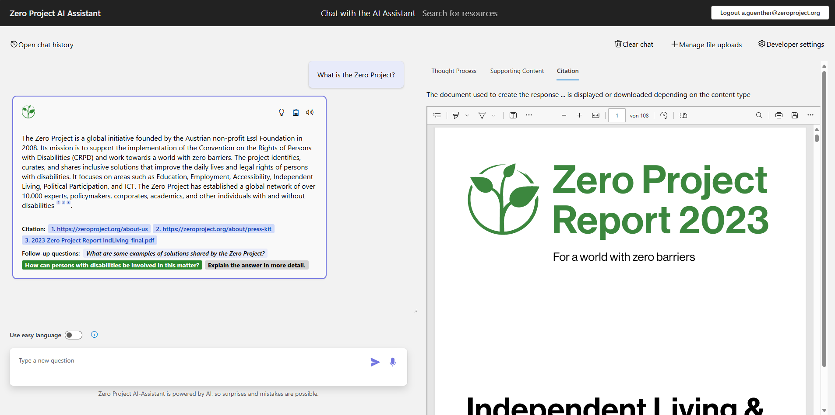
All data sources just one click away
Notes:
A screenshot of the Zero Project AI Assistant interface. On the left, a chat panel displays a response to the question 'What is the Zero Project?' with information about the initiative, citations, and follow-up questions. On the right, a document viewer shows the cover page of the 'Zero Project Report 2023' with the tagline 'For a world with zero barriers.'

Slide 5
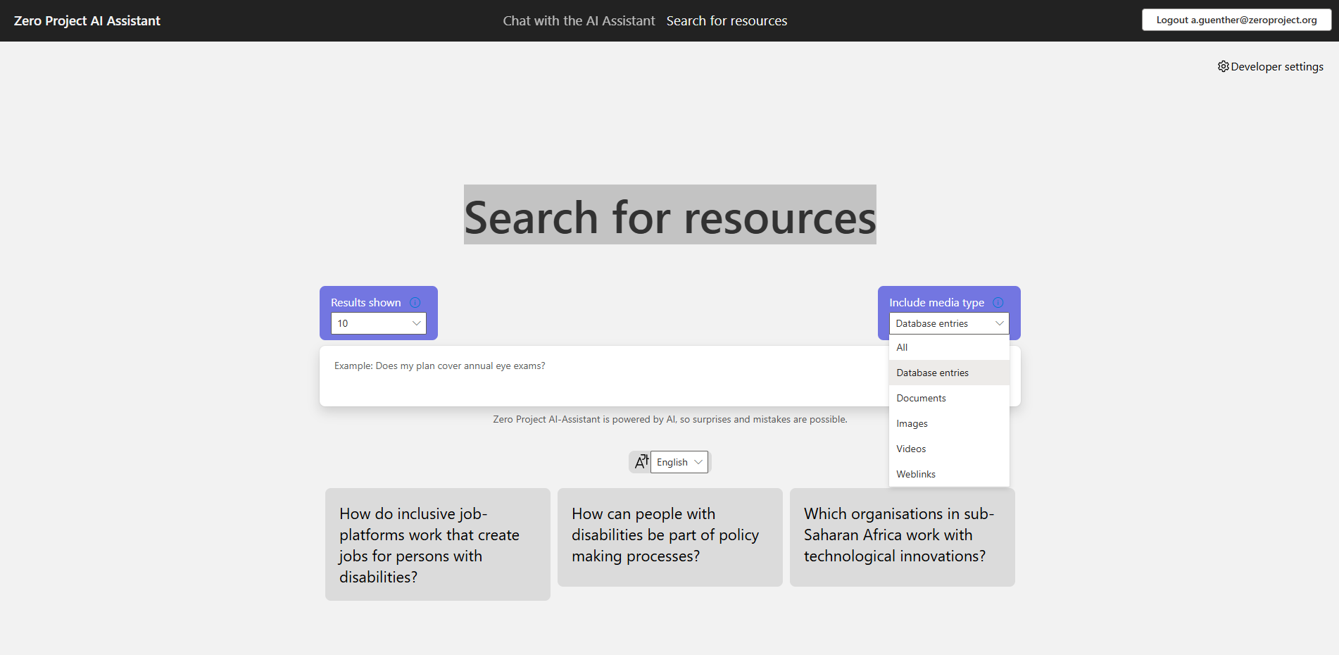
Search for resources
Notes:
A screenshot of the Zero Project AI Assistant homepage. The interface features a large grey heading that says, 'Search for resources'. There are two drop downs: one for selecting how many results are shown and one for selecting the media types. Below is a text input box for asking new questions. On the bottom, there are three example questions related to inclusive job platforms, policymaking for people with disabilities, and technological innovations in sub-Saharan Africa. The top right corner shows options to access developer settings and log out.

Slide 6
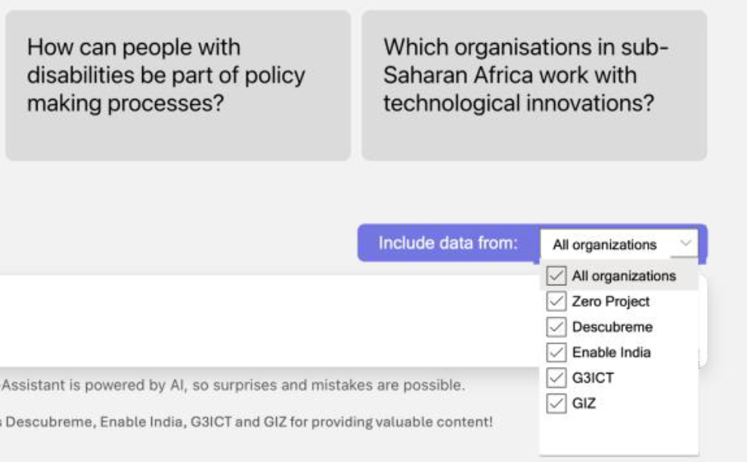
Partnertool of the AI Assistant
Notes:
A screenshot of the Zero Project AI Assistant homepage showing a user interface with two questions in gray boxes:
"How can people with disabilities be part of policy-making processes?"
"Which organisations in sub-Saharan Africa work with technological innovations?"
Below the questions, there is a dropdown menu labeled "Include data from:" with a purple background. The dropdown is expanded, revealing multiple checkboxes for selecting data sources. The options listed are: "All organizations“, "Zero Project“, "Descubreme“, "Enable India“, "G3ICT“, "GIZ"

Slide 7
#ZeroCon25 Infobot
Get instant answers to make the most of your conference experience
Notes:
The #ZeroCon25 Infobot provides instant answers to make the most of your Zero Project Conference 2025 experience!

Slide 8
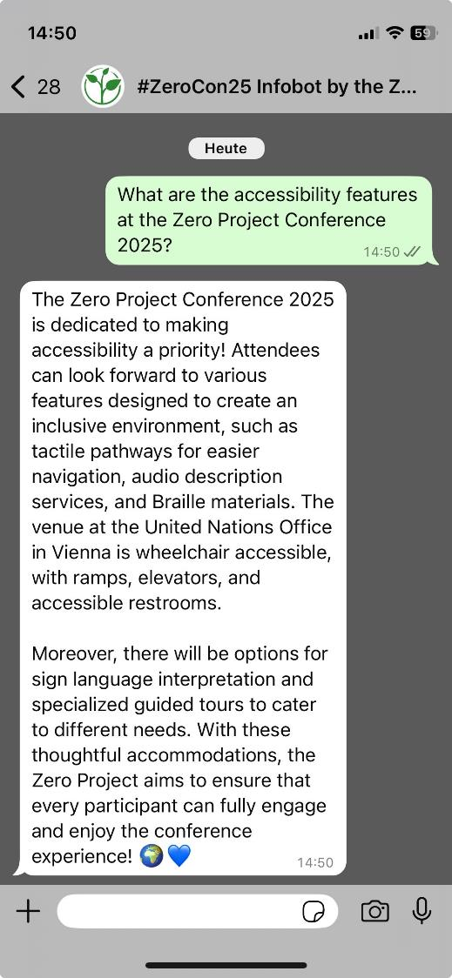
Chat with the #ZeroCon25 Infobot
ASK ABOUT: Session schedules, Accessibility features, Speaker bios, ...
AVAILABLE ON WHATSAPP:
at +43 664 99462054
Notes:
Participants can ask about:
• Session schedules
• Accessibility features
• Speaker bios
• Inclusive sightseeingin Vienna
• The Zero Project and its activities worldwide
Available on WhatsApp at +43 664 99462054.

Slide 9
Equitable AI Alliance
AI experts from the global Zero Project Network share insights at events globally
Notes:
The Equitable AI Alliance places experts with direct experience of disability and technology at the heart of influential debates about opportunities and risks related to artificial intelligence. In line with the Zero Project’s mission of creating a world with zero barriers for persons with disabilities, the Alliance’s objective is to steer decision-making in critical developments that are poised to fundamentally change our society.

Slide 10
About the Equitable AI Alliance
The global Zero Project Network of more than 10,000 experts is uniquely positioned to provide expertise at the intersection of disability inclusion, innovation, and artificial intelligence (AI).
In line with the Zero Project’s mission of creating a world with zero barriers, the Alliance’s objective is to steer decision-making in critical developments that are poised to fundamentally change our society.
It liaises with conference organizers and places experts at the heart of influential debates about opportunities and risks related to AI.

Slide 11
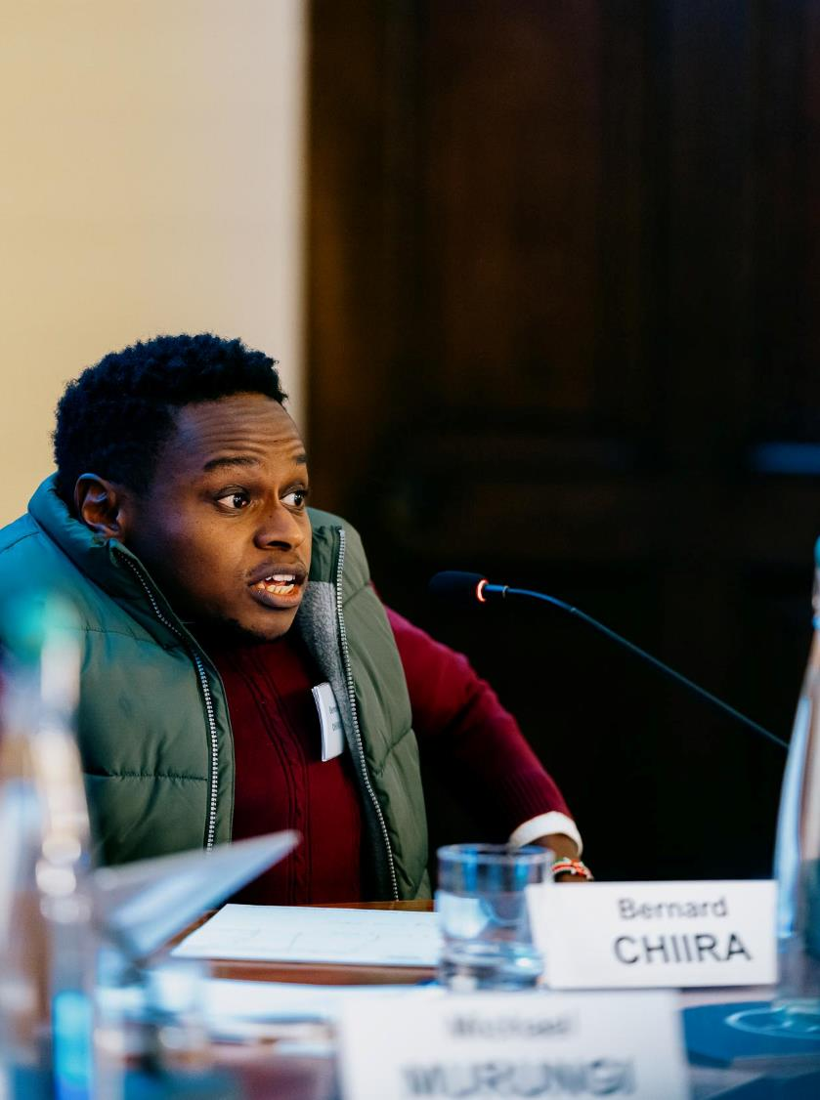
How to engage
CONFERENCES: Reach out for inroads in mainstream AI-related conferences.
EQUITABLE AI KNOWLEDGE HUB: Find the resources you need for disability-inclusive AI Innovation (Link).
LINKEDIN GROUP: Join the discussion on ‘Disability-Inclusive AI’ (Link).

Slide 12
Learn more about how the Zero Project uses AI!
ai.zeroproject.org

