Slide 1
240 years of entrepreneurial inclusion
Hofer, Hannes
MVG
Austria
Government-led services
Wed, 5 Mar 2025, 16:30-17:30
Notes:
240 years of entrepreneurial inclusion
Hofer, Hannes
Monopolverwaltung GmbH
Austria
Government-led services
Wed, 5 Mar 2025, 16:30-17:30

Slide 2
Statement
“Every fifth day, on average, the MVG supports a person with disabilities in starting a business within our retail platform.”
Notes:
Statement: “Every fifth day, on average, the MVG supports a person with disabilities in starting a business within our retail platform.”

Slide 3
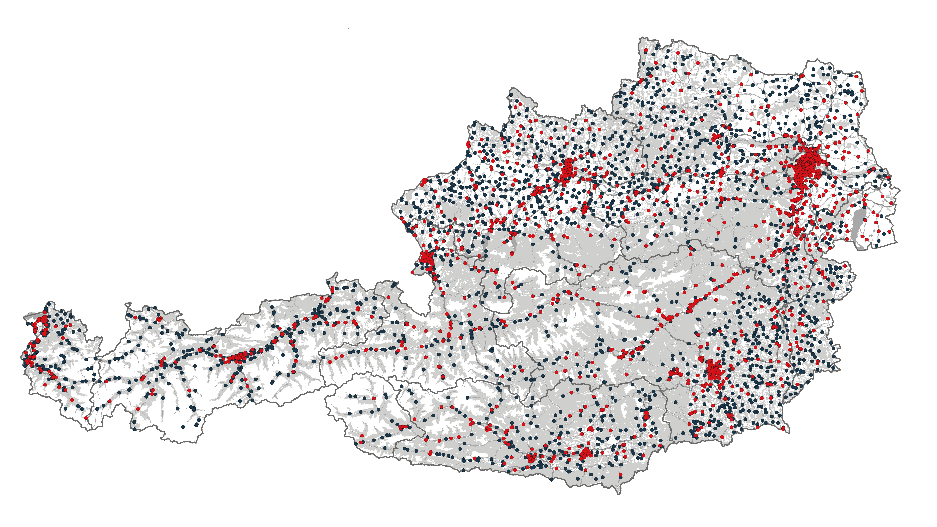
4,508 stores use our platform
Notes:
The map of Austria with the locations of the 4.508 stores shown graphically.

Slide 4
4,508 stores use our platform
2,161 tobacco retailer
2,347 groceries with tobacco
Notes:
The map of Austria with the locations of the 4.508 stores shown graphically.

Slide 5
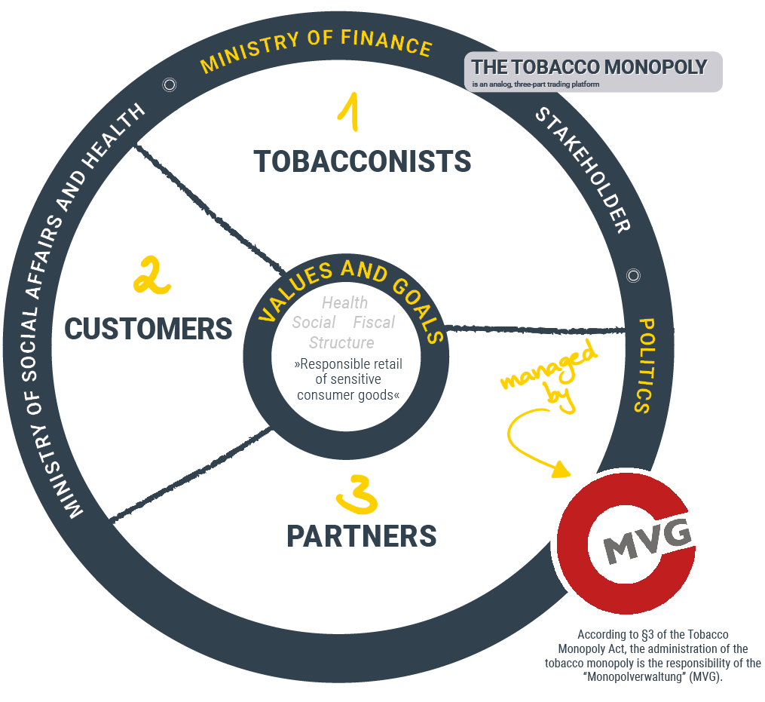
The Monopoly-Platform
The analog three-part trading platform
Shared goals and values
Clear rules and defined roles
Balanced distribution of revenues
Trust among platform-participants
Notes:
The analog three-part trading platform contains the following points:
- Shared goals and values
- Clear rules and defined roles
- Balanced distribution of revenues
- Trust among platform-participants

Slide 6
Strategies and goals of the MVG
Core Strategy and USPs
 | Health-Policy Goal | Social-Policy Goal | Fiscal-Policy Goal
Goals | Ensure the responsible trade of sensitive consumer goods. | Enable people with disabilites to establish an entrepreneurial livelihood. | Maintain an efficient tax system. Offset the external costs of smoking with tax revenues.
USP | The state monopoly is THE distribution platform for sensitive consumer goods. | The state monopoly, via tobacco retailer, has created the largest inclusive business network in Austria. | The monopoly platform (wholesale, tobacco outlets) is one of the largest taxpayers in the Republic of Austria.
STRATEGY | PRESERVE the unique selling proposition | INCREASE awareness for the social objective | EXPAND excise tax to NGPs
Notes:
Strategies and goals of the MVG – Core Strategy and USPs
Health-Policy Goal: ensure responsible trade of sensitive consumer goods / the state monopoly is THE platform for these goods / PRESERVE the unique selling proposition
Social-Policy Goal: enable people with disabilities to establish an entrepreneurial livelihood / largest inclusive business network in Austria / INCREASE awareness for the social objective
Fiscal-Policy Goal: maintain an efficient tax system and offset the external costs of smoking with tax revenues / largest taxpayers in Austria / EXPAND excise tax to NGPs

Slide 7

Thank you!
Notes:
Please find more information by clicking on the QR-Code to find our linktree. Thank you!

