Slide 1
ENIL and TVET programmes for all
Fionn Crombie Angus, Kamil Goungor
European Network on Independent Living
Belgium
Innovative TVET programmes with a focus on persons with intellectual disabilities
Wednesday, 21 February 2024 | 14:00 - 15:00
Notes:
Please add your notes here.
Title; First name, last name of speaker(s); Name of Organization, Name of Country, Name of Session (as written in Agenda)
#ZeroCon24
Day and Time of Session

Slide 2
European Network on Independent Living - ENIL
Network, cross-disability for Independent Living
Grassroots organisation
Values: Self-determination, Self-representation, De-institutionalisation, Choice and Control
Access to society - social services, personal assistance, barrier-free environment, housing options, technical aids, inclusive education, freedom of movement
Organisational and individual members in Europe and beyond
Active Youth Network
Notes:
Sample Slide: presenting three points on our project and the relationship to this year’s theme of the Zero Project Conference. Point 1; Point 2; Point 3 connect together in this way.

Slide 3
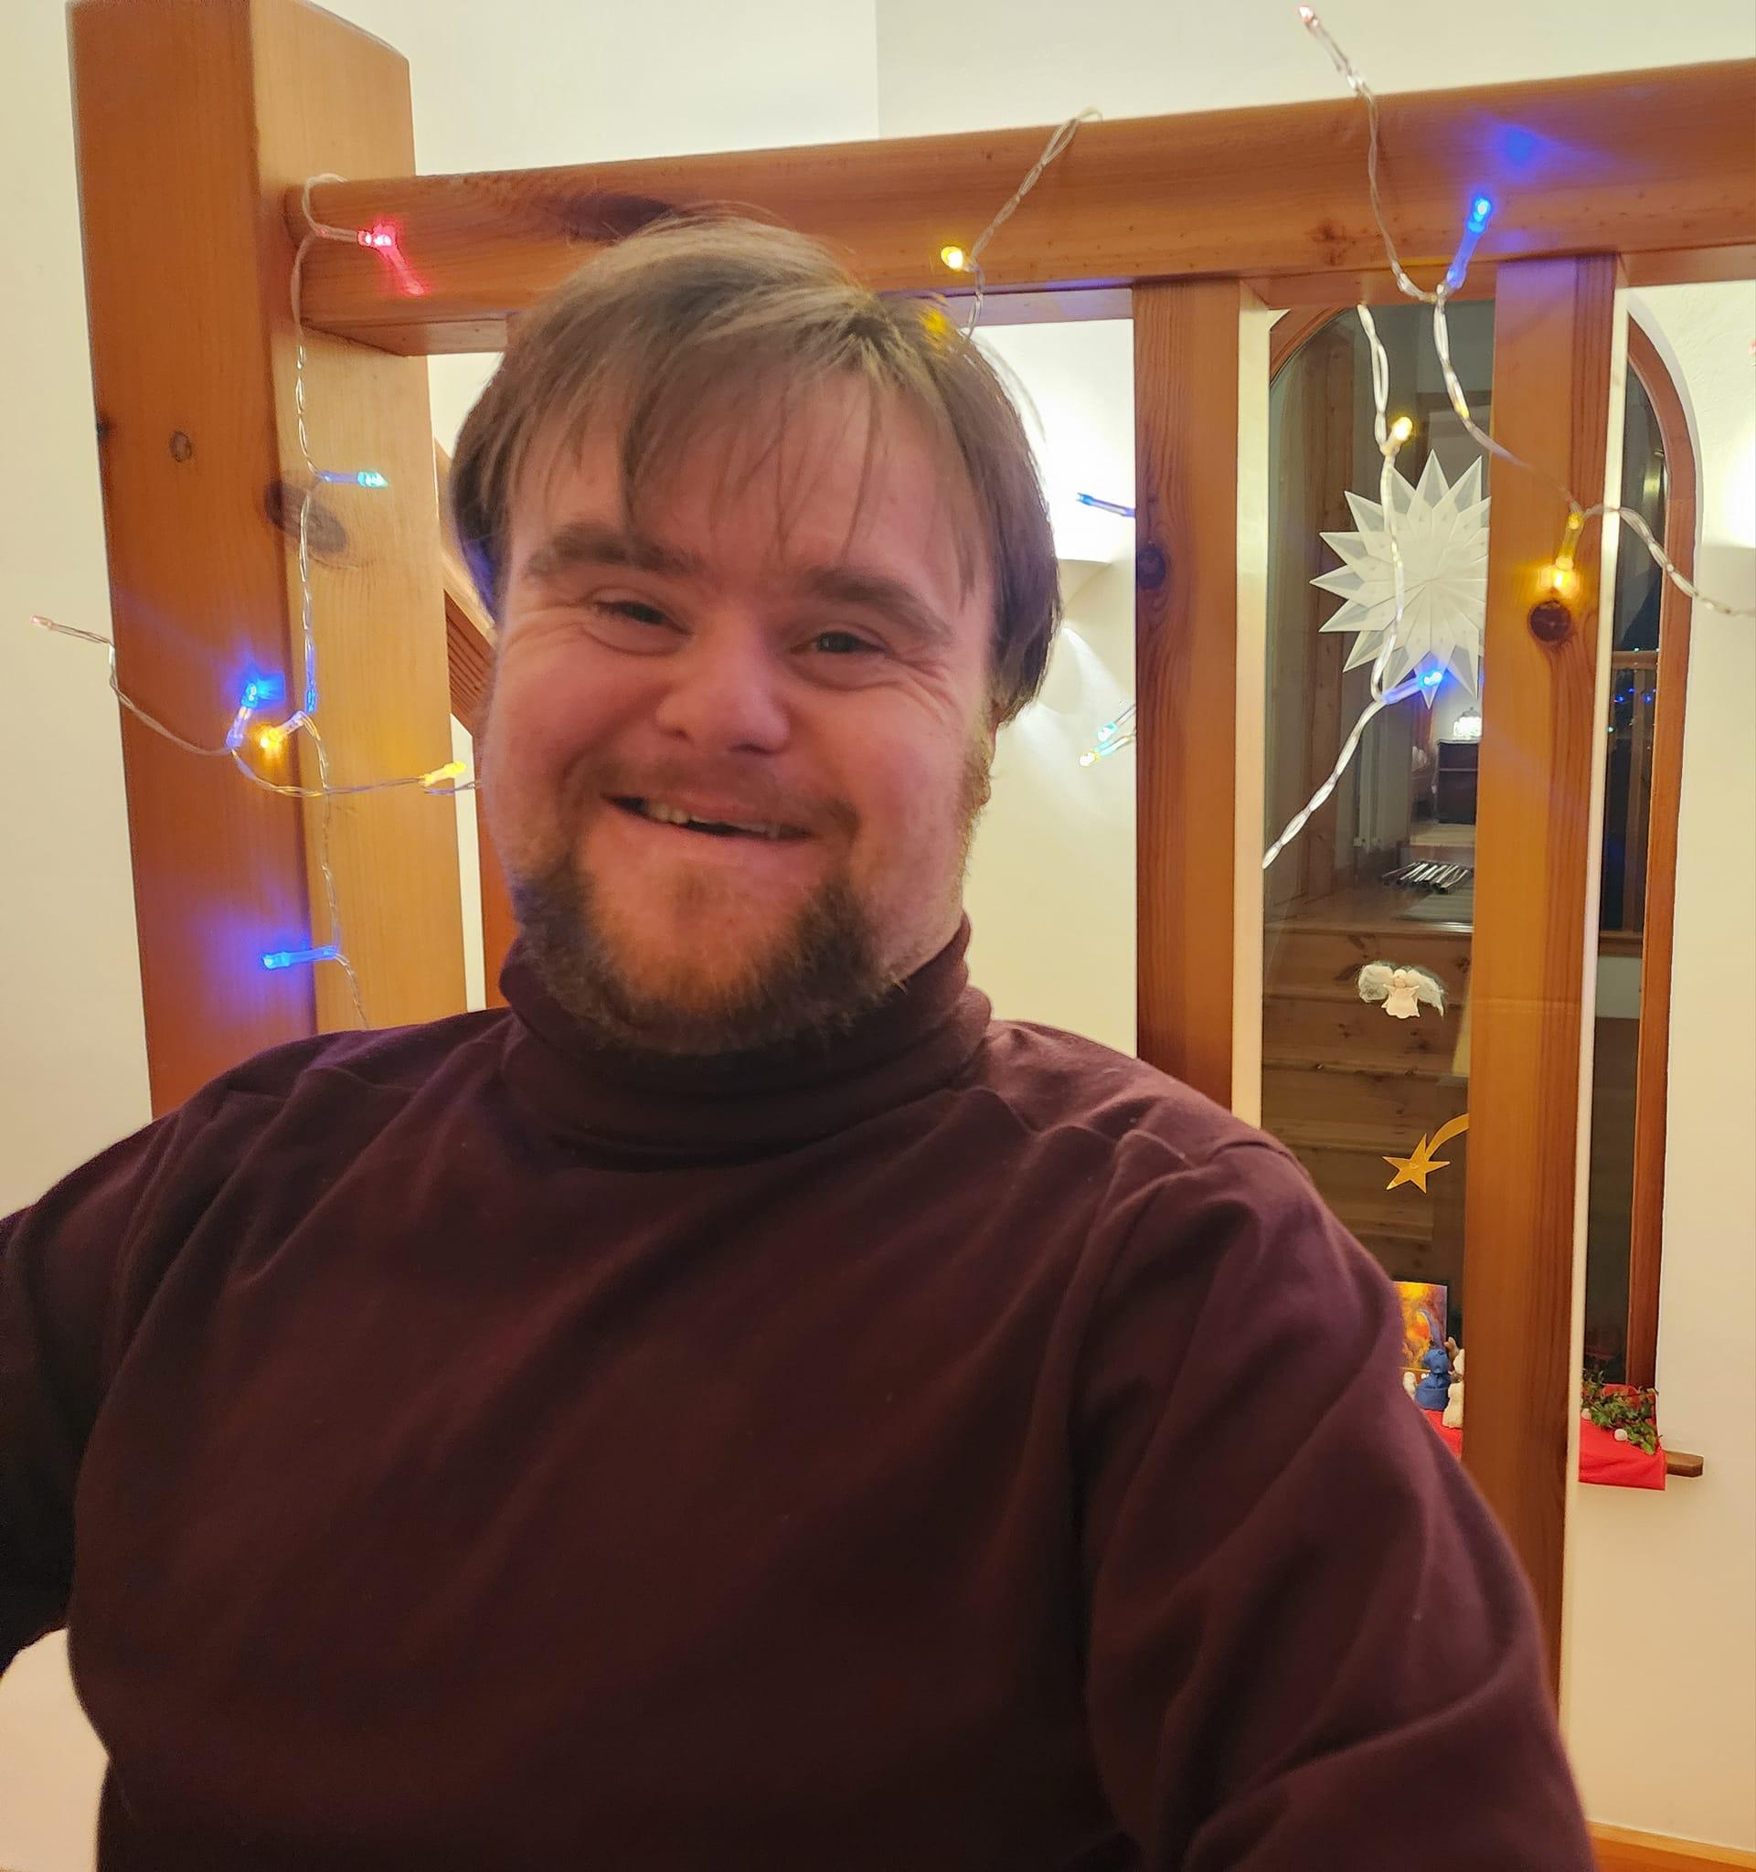
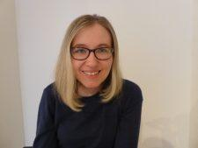
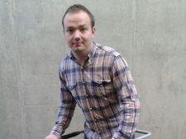
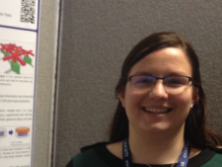
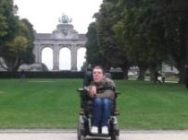
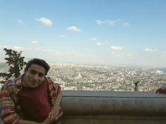
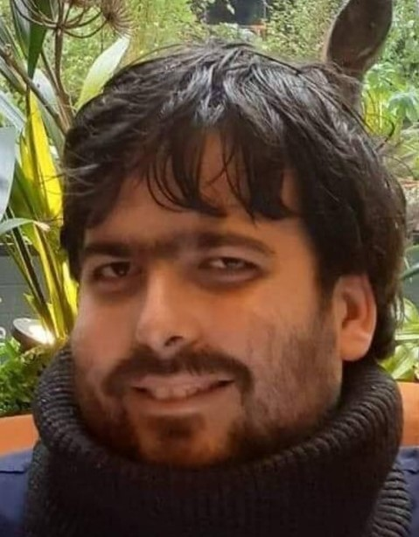
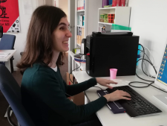

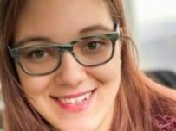
ESC (previously EVS) at ENIL
Our young volunteers
Notes:
Sample Slide: presenting three points on our project and the relationship to this year’s theme of the Zero Project Conference. Point 1; Point 2; Point 3 connect together in this way.

Slide 4
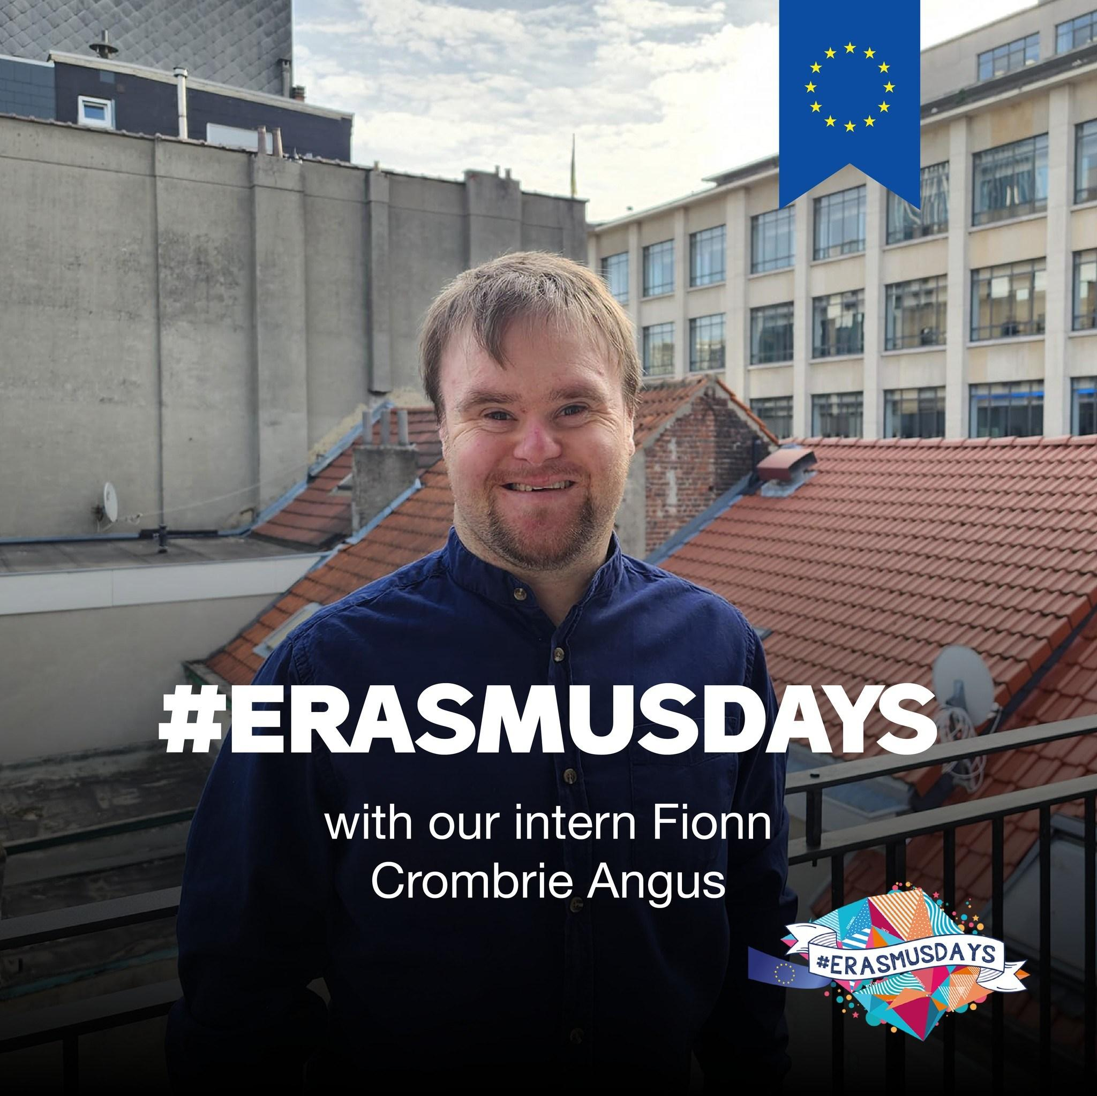
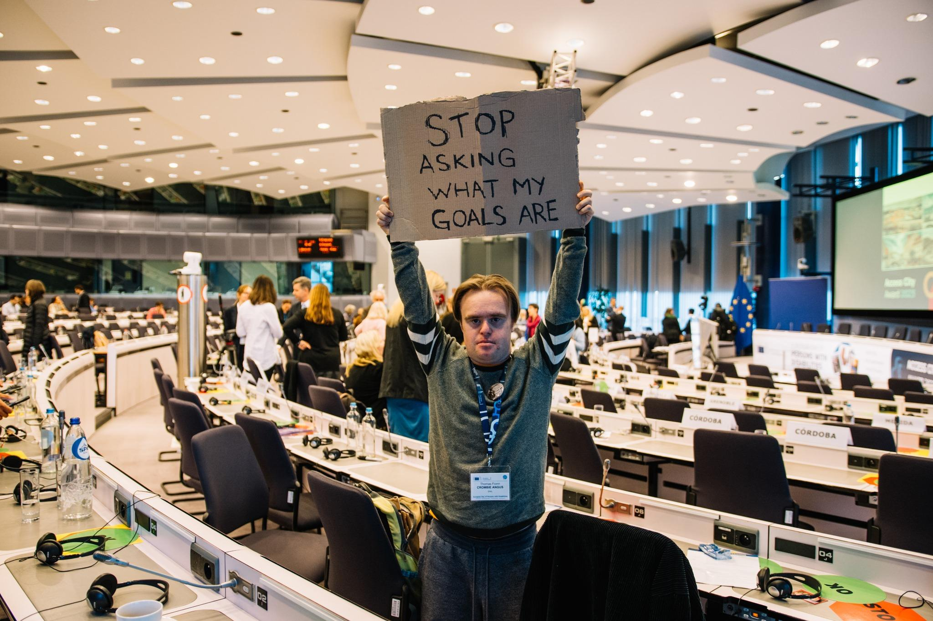
Fionn’s volunteering at ENIL
Notes:
Sample Slide: presenting three points on our project and the relationship to this year’s theme of the Zero Project Conference. Point 1; Point 2; Point 3 connect together in this way.

Slide 5

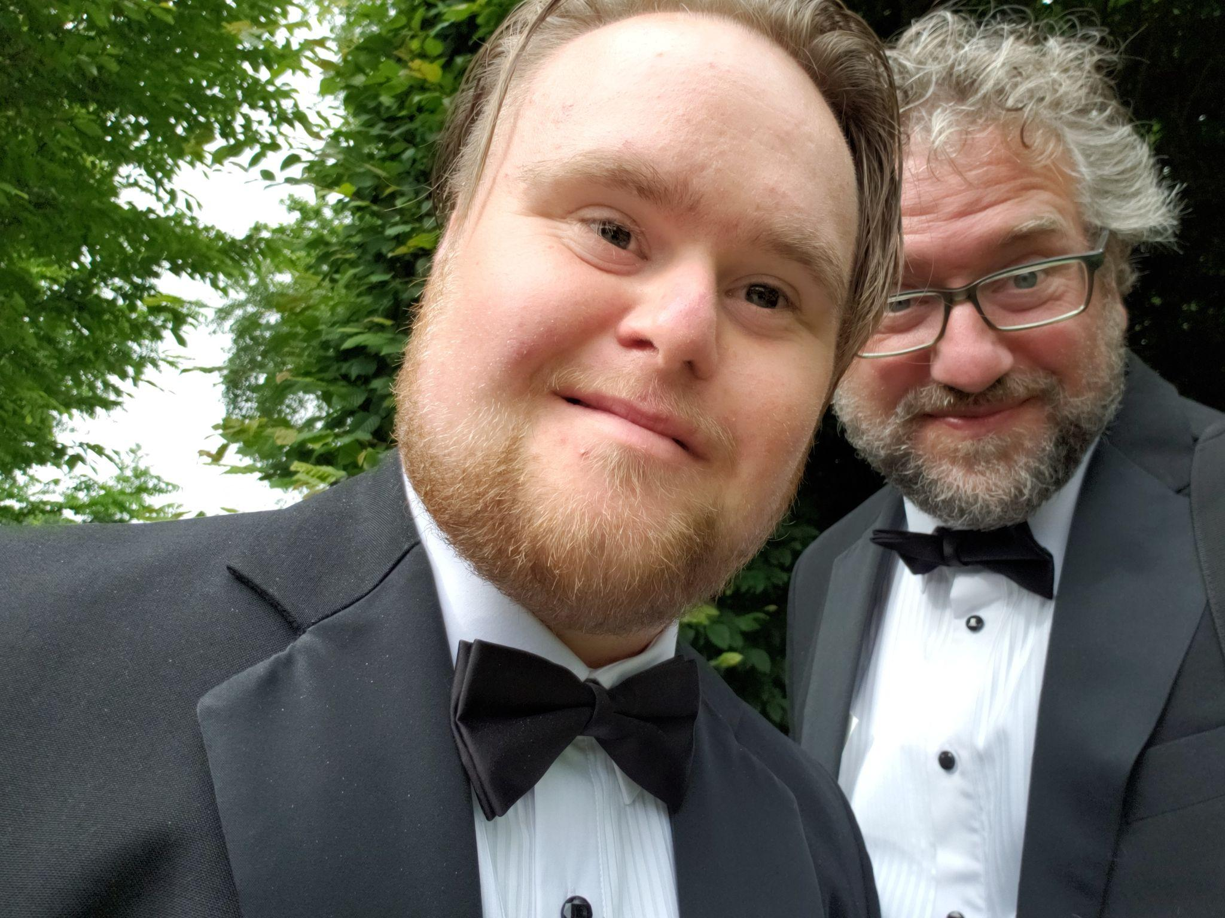
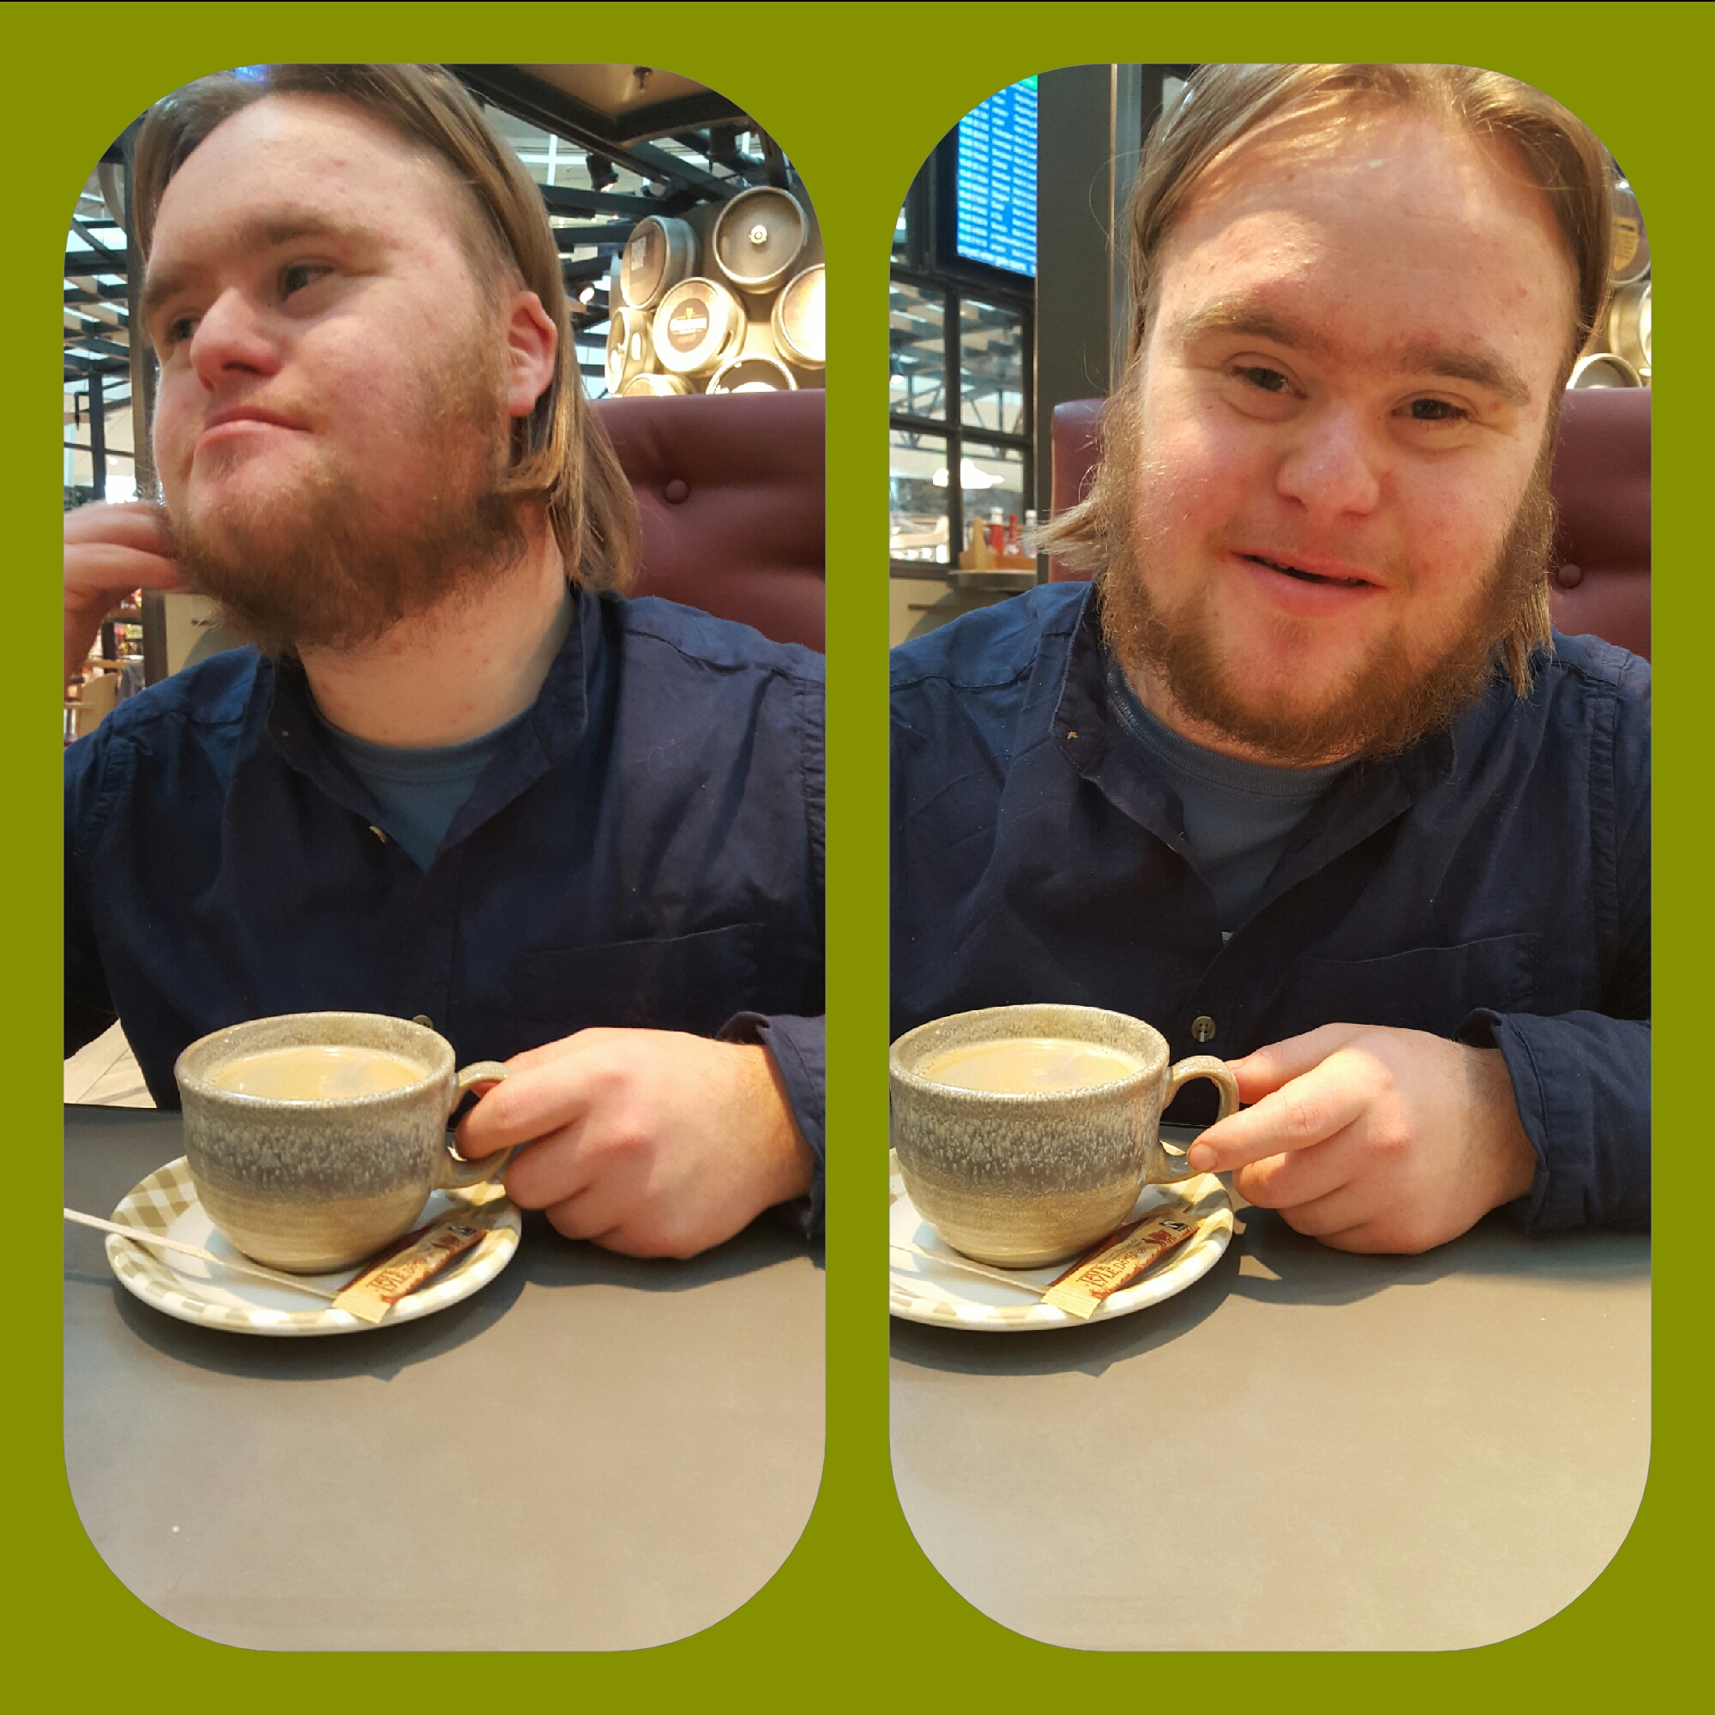
Starting a Social Enterprise
Notes:
Self Directed Supports; Employing J; Employing F

Slide 6
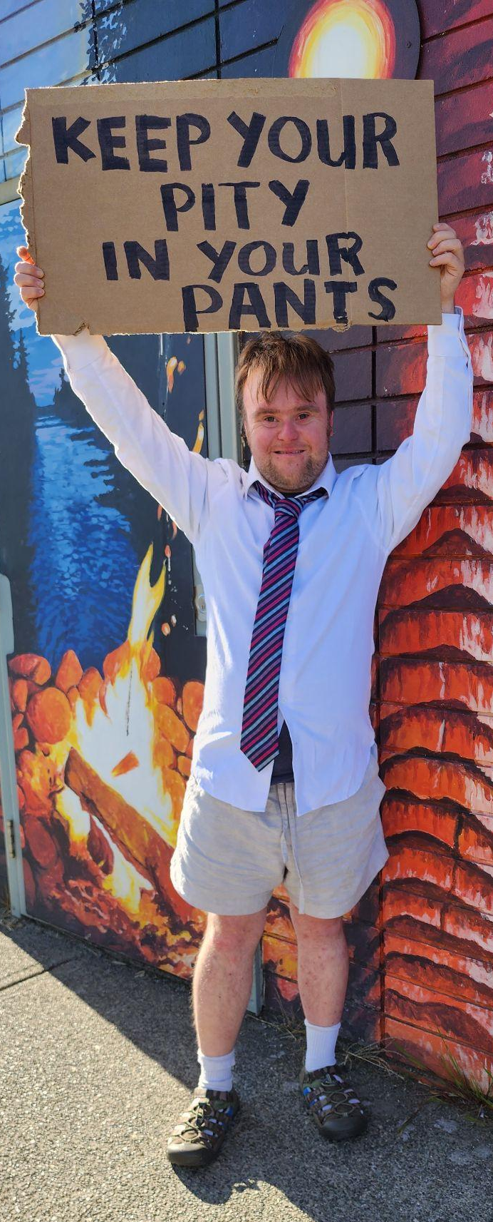
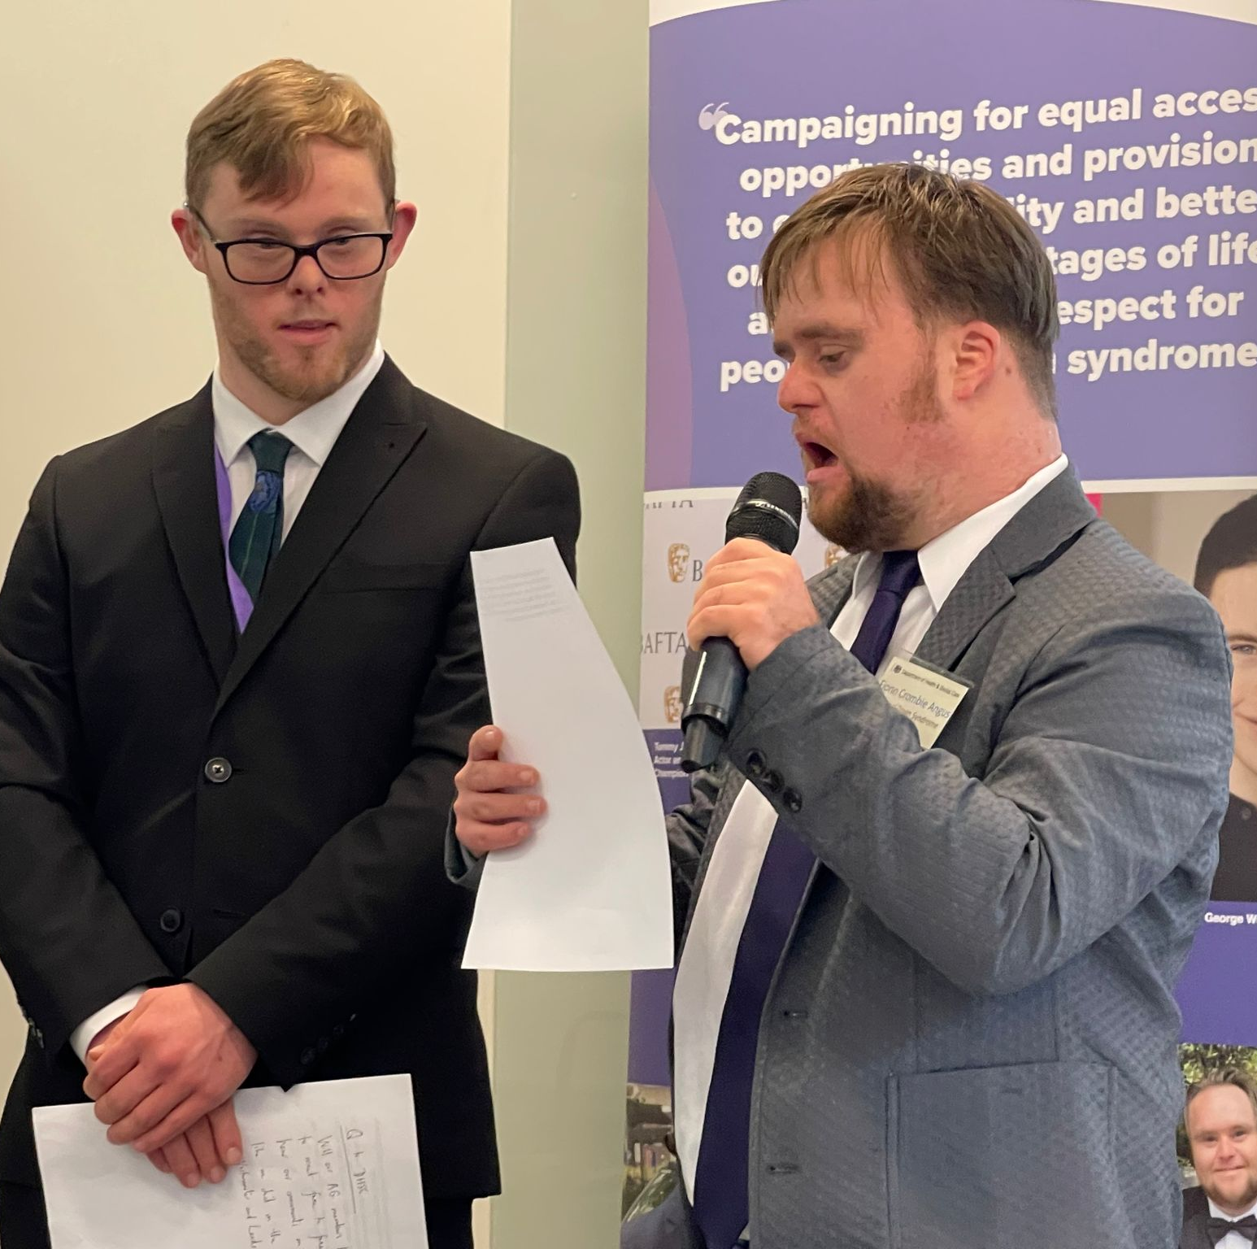
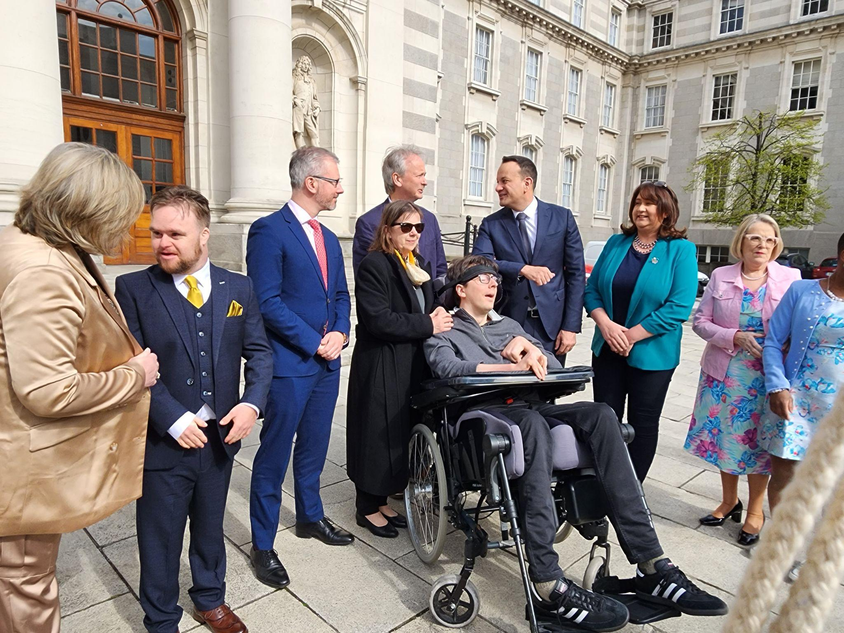
Teaching & Policy Experience
Notes:
DS Act; DSS; Advocacy

Slide 7



Research
Notes:
world wildlife; happiness project; NDA & many projects, IASSIDD Inclusive Research SIRG

Slide 8
Creative Approaches to Practical Community Advocacy
( CAPCA )
The Abundance Project
Notes:
Applying for the grant, 1, 2, 3: online course, art retreats, pitch event. eLearning, Abundance

Slide 9


www.enil.eu
Kamil.Goungor@enil.eu Thank you!

