Slide 1

Rob van de Ven | The Netherlands
Innovative ICT-based solutions
7th of March 12:00 - 13:00
Notes:
Happybots pitch; Rob van de Ven; Happybots, The Netherlands, Tech Forum
#ZeroCon25
4th of March 14:00 - 18:00

Slide 2

The problem
Notes:
Some of us need attention and guidance
to communicate
to form relationships
But….growing staff-shortages
overstressed healthcare systems
fully packed classrooms
social isolation
increasing psychological problems
🡪 growing need of care

Slide 3
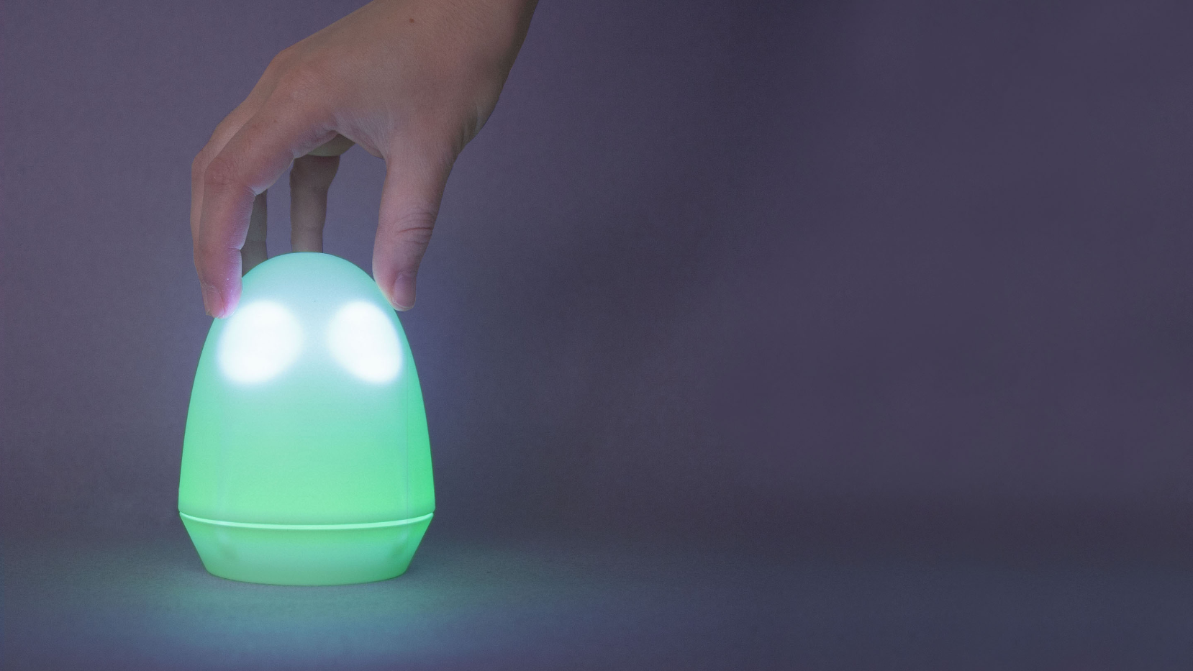

Notes:
Felix is a social robot that assists people in sharing their feelings. He is nice, friendly, has no mouth and will not judge you.
Using Felix helps to deal with mental problems and to be part of society.
With Felix mentors and teachers can support more effective, without administrative burden.
Felix helps relieving the pressure on healthcare systems and schools.
When you turn Felix, he changes colour and his eyes change. With that, he represents different moods or emotions. Press Felix to save this mood in a feeling calendar. You can see the input on our platform.

Slide 4
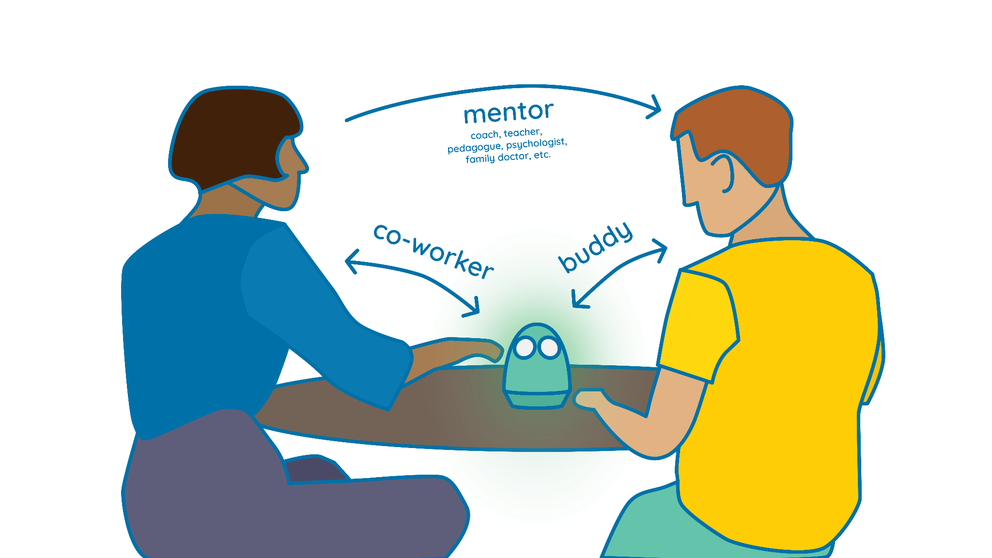
How it works
Notes:
Felix acts as a buddy for the Felix user and as a co-worker for the professional mentor, teacher or caregiver. You can either use Felix as a communication device in the room or use Felix (with the data in the online-platform) as a starting point for conversation and awareness. Or you can do both.

Slide 5
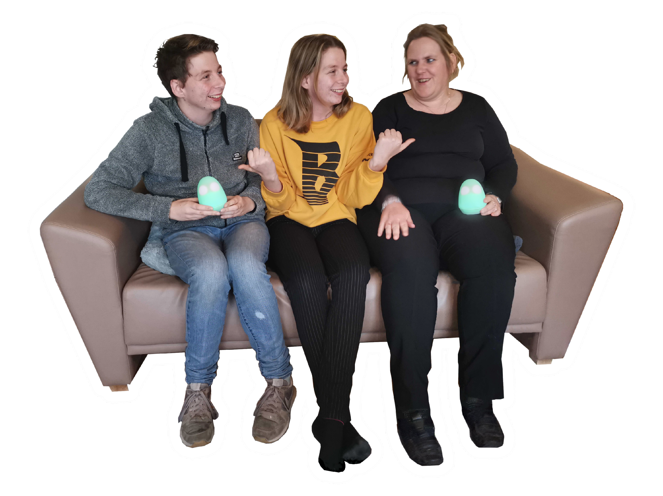
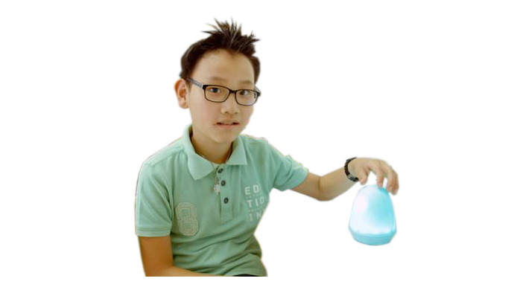
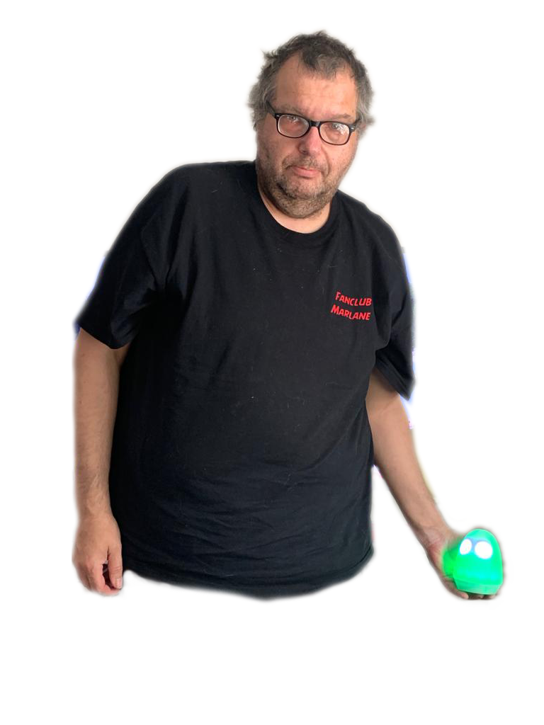
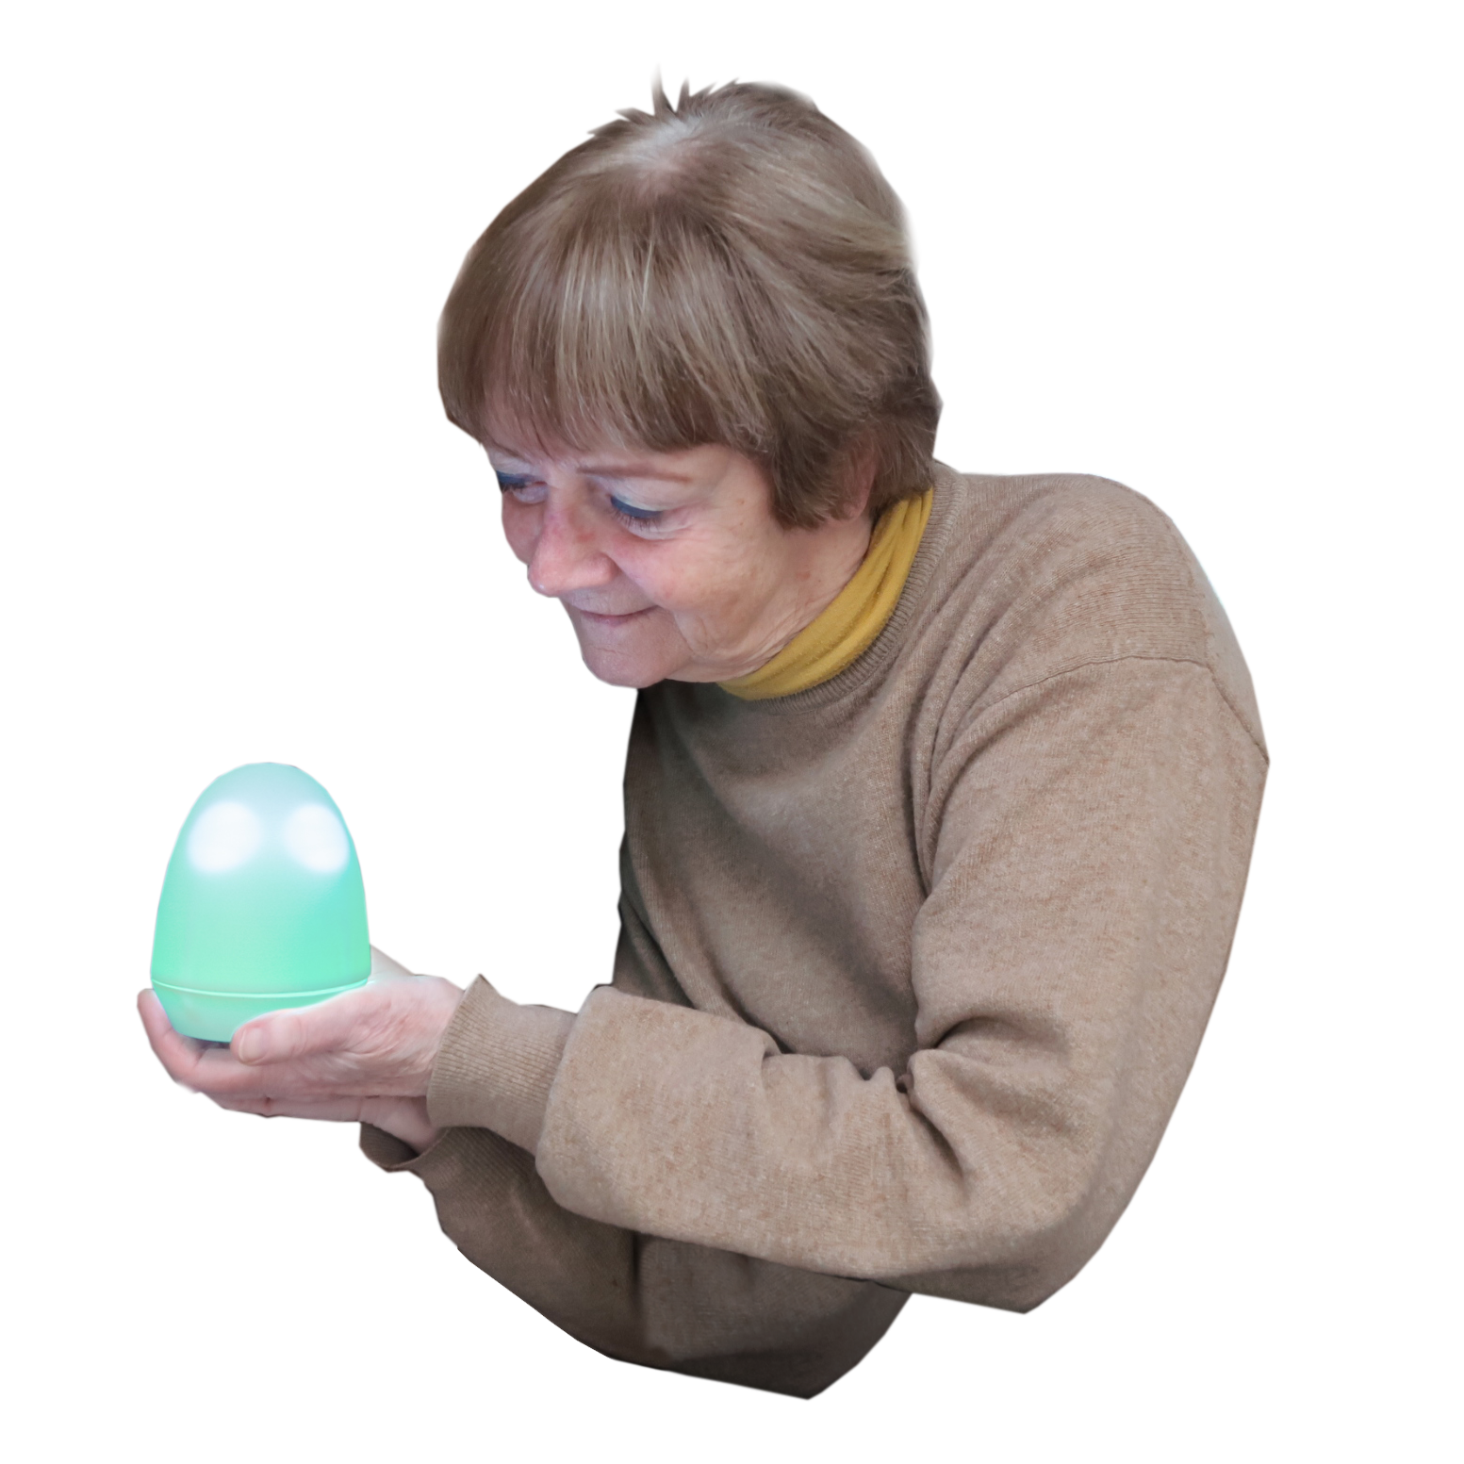
Felix users
Notes:
Felix is used by a lot of different target groups: young and old people with ASD, developmental language disorder, physical and mental disabilities, psychiatric problems, giftedness, depression, burn-out etc.

Slide 6
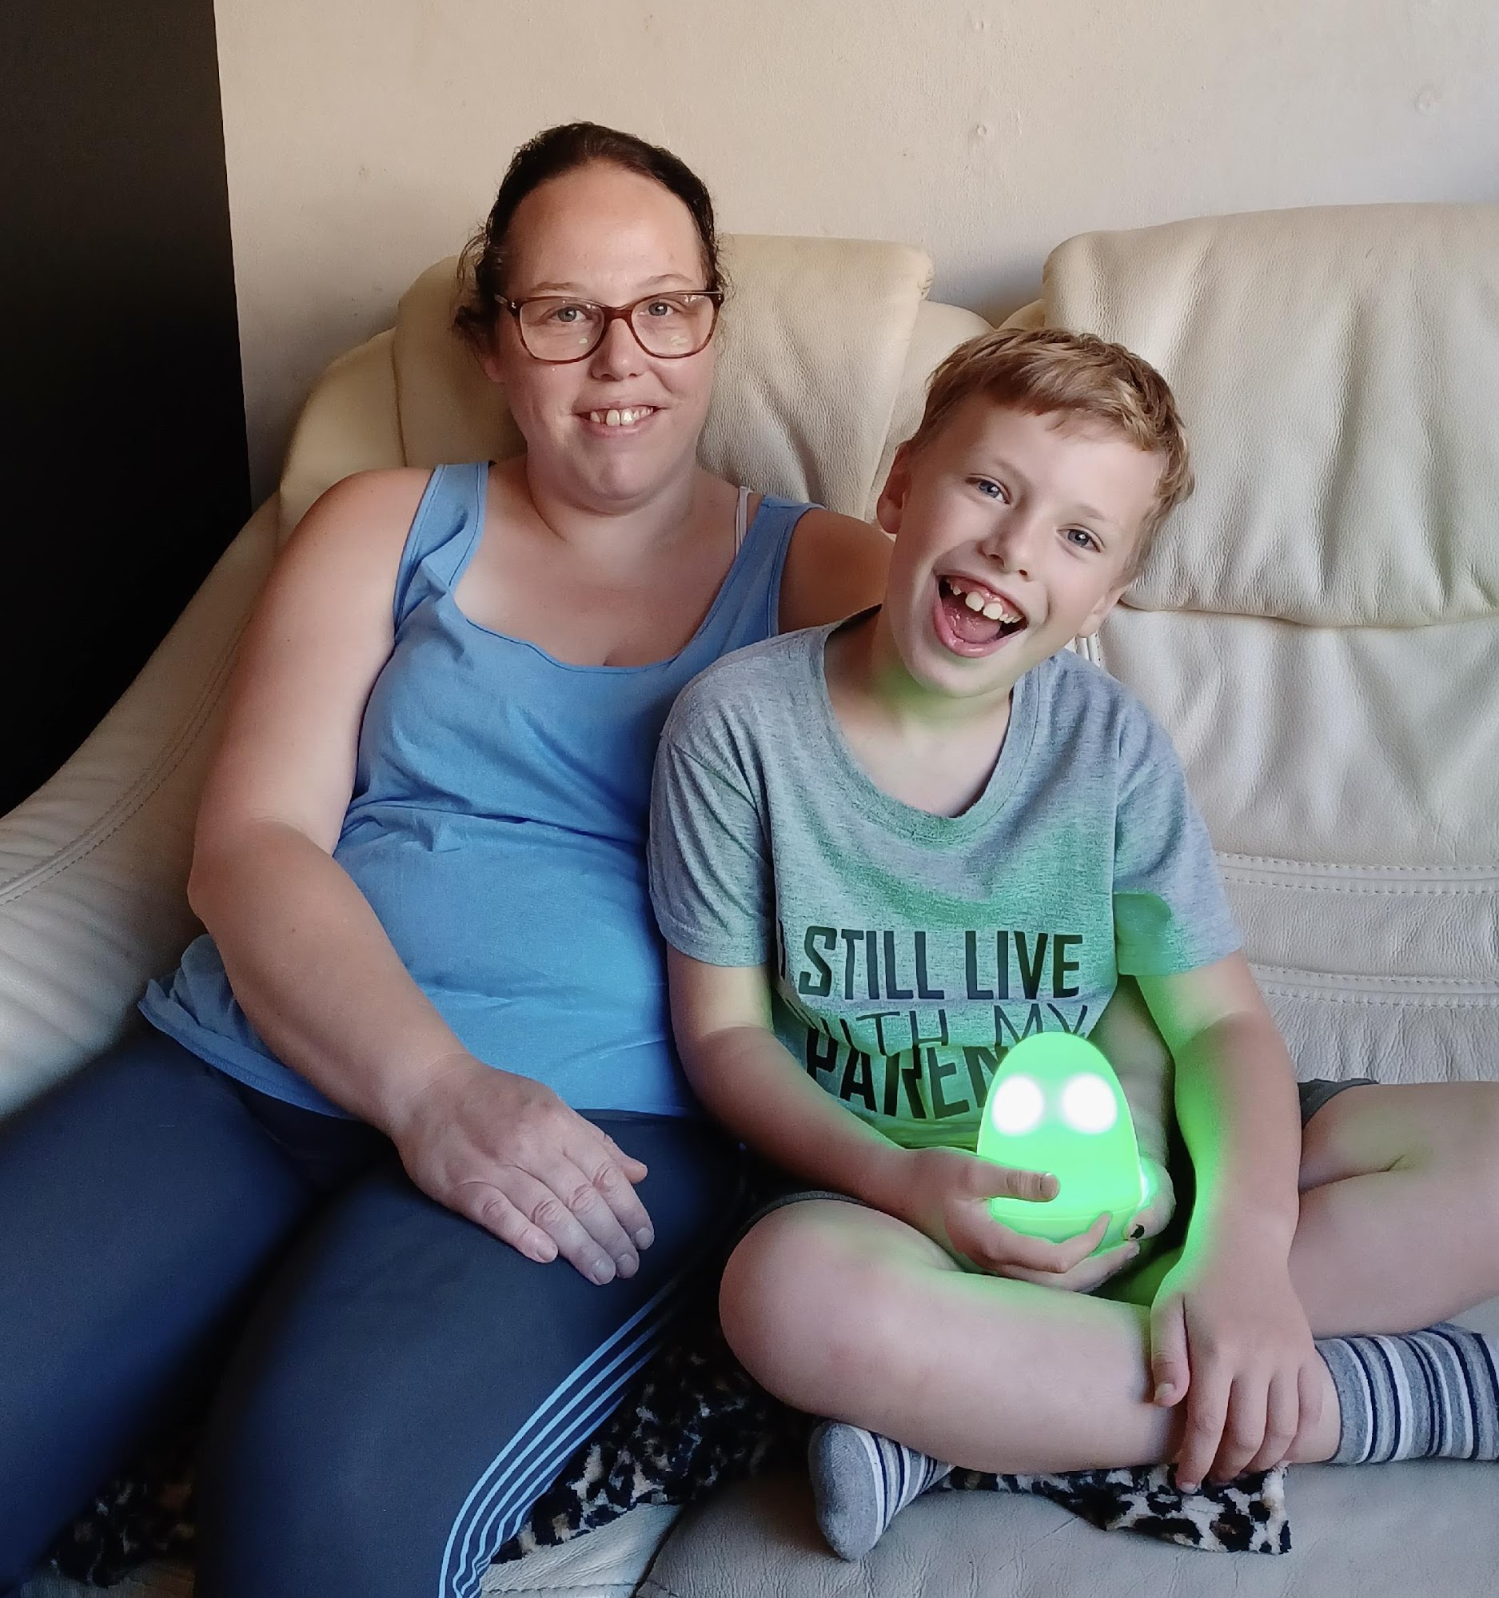

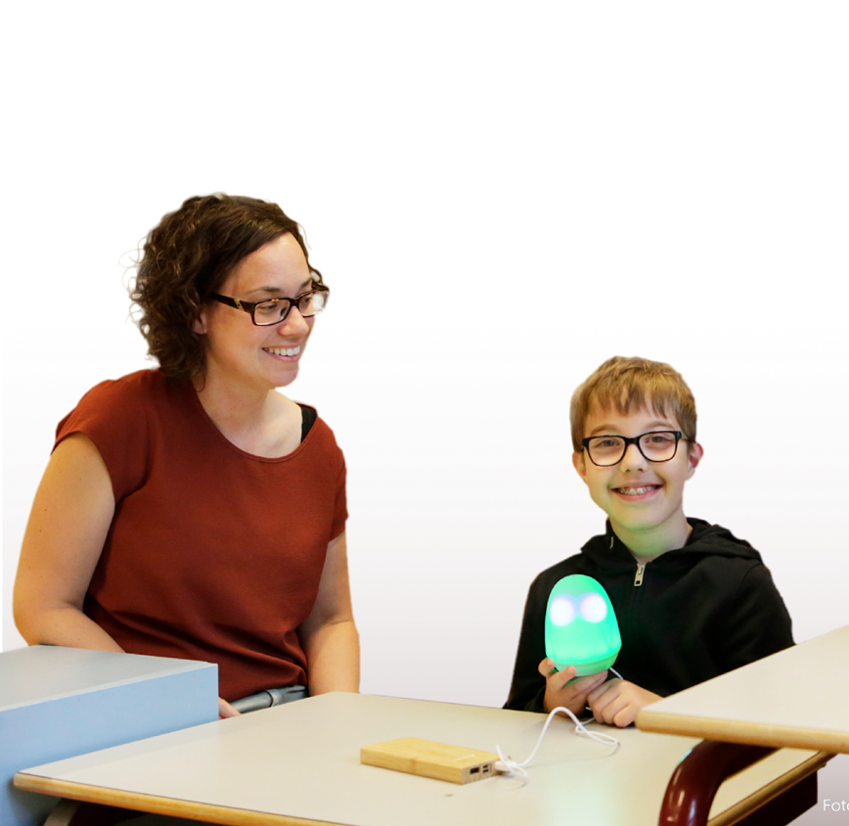
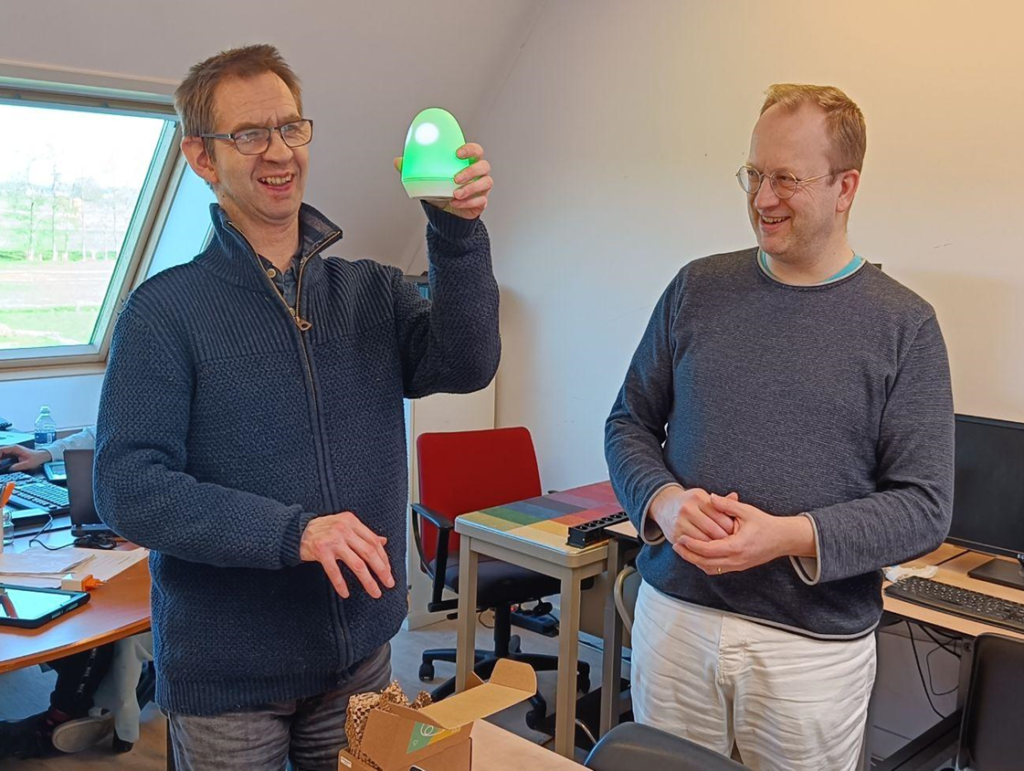
Work
School
Home

Slide 7
Impact
more understanding, improved relations
reduced stress levels, fewer escalations
improved self-confidence
less attention needed of professionals
improved quality of care
Notes:
Impact:
more understanding, improved relations
reduced stress levels, fewer escalations
improved self-confidence
less attention needed of professionals
improved quality of care

Slide 8
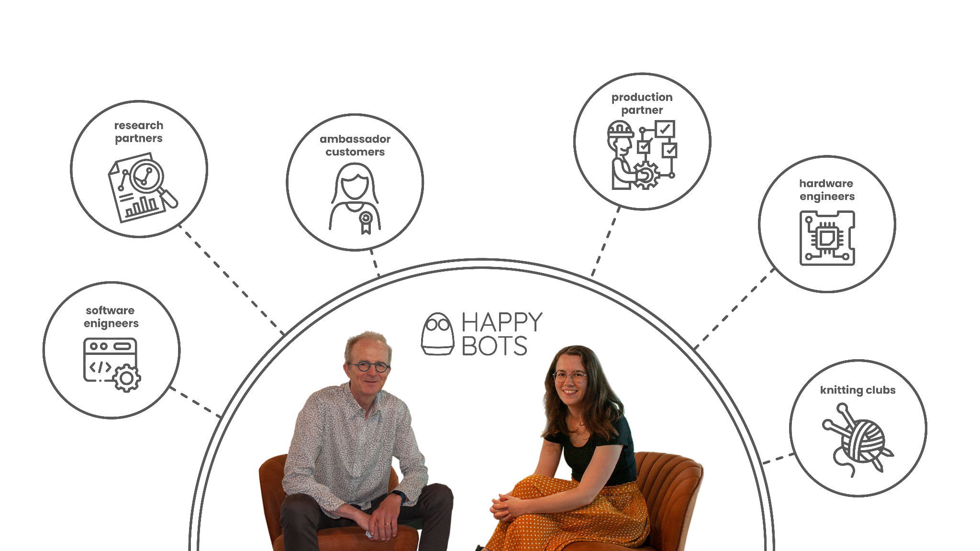
Team
Notes:
Team
Picture of Rob en Lola, the co-founders of Happybots surrounded by an illustration that shows all their partners: software engineers, research partners, ambassador clients, productions partner, hardware engineers and knitting clubs.

Slide 9




Where are we now? (Q1 2025)
250+
Felixes sold
60+ organisations in NL use Felix
200+
annual
subscription fee €125
100%
ownership
bootstrapped
until now
Notes:
Where are we now? (Q1 2025)
250+ Felixes sold
60+ organisations in NL use Felix
200+ subscriptions - €125 a year per subscription
100% ownership, bootstrapped until now

Slide 10
Our strategy
Increase social impact:
+ develop business model (sales 🡪 rentals)
+ product development (> interactions, AI?)
+ 50% yearly growth of ‘success’-users
+ 3-5 new countries
What do we need:
funding
local partnerships
expanding the team
Notes:
To increase our social impact:
Our goals:
+ develop business model (sales 🡪 rentals)
+ 50% yearly growth of turnover
+ 3-5 new countries & local partnerships
+ expanding the team
What do we need:
· funding
· local partnerships in new markets

