Slide 1
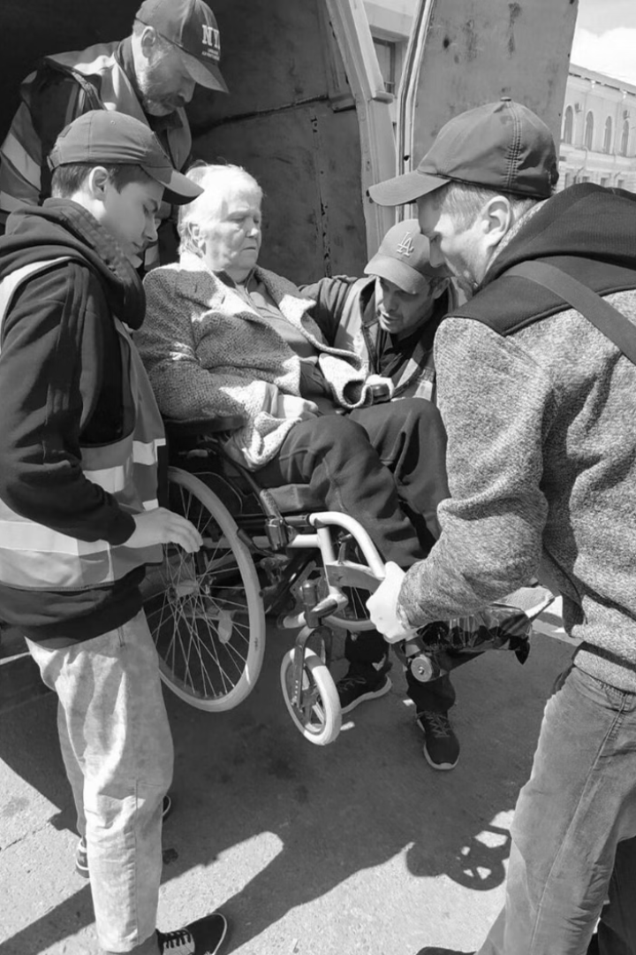

PURPLE VEST:
Leave No One Behind
Michal Rimon, CEO
Access Israel
Israel
Disability Inclusive Disaster Risk Reduction (DRR)
March 5th 12:40-13:10
Notes:
PURPLE VEST: Leave No One Behind
Michal Rimon, CEO
Access Israel
Israel
Disability Inclusive Disaster Risk Reduction (DRR)
March 5th 12:40-13:10

Slide 2
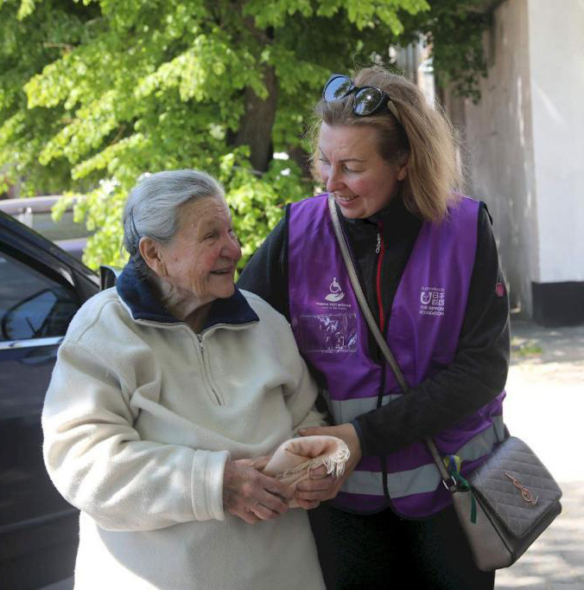
Our Mission
Ensure preparedness to accessibility in times of emergency leveraging on the human factor to ensure that no one is left behind.
Awareness
Trained Task Force
Real-Time Assistance
Ongoing Information
Notes:
What is our mission? Ensure preparedness to accessibility in times of emergency leveraging the human factor to ensure that no one is left behind.

Slide 3

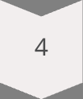



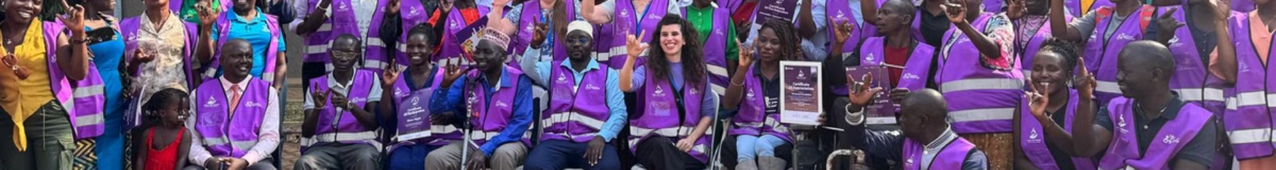
Global Implementation Model
Creating a Volunteer Network
National/ Organizational Partnerships
Local Facilitators
Ongoing Information and training
Establishing a Network of Local Cell Leader
Notes:
Global Implementation Model
1 National Partnerships: Engage with countries and local bodies.
2 Local Facilitators: Creating Local Infrastructure for Model Deployment
3 Establishing a Network of Local Cell Leader: Equip local cell leaders by comprehensive training and ongoing guidance
4 Volunteer Network: Create a community support system based on local volunteers
5 Ongoing Information: Maintain volunteer readiness

Slide 4
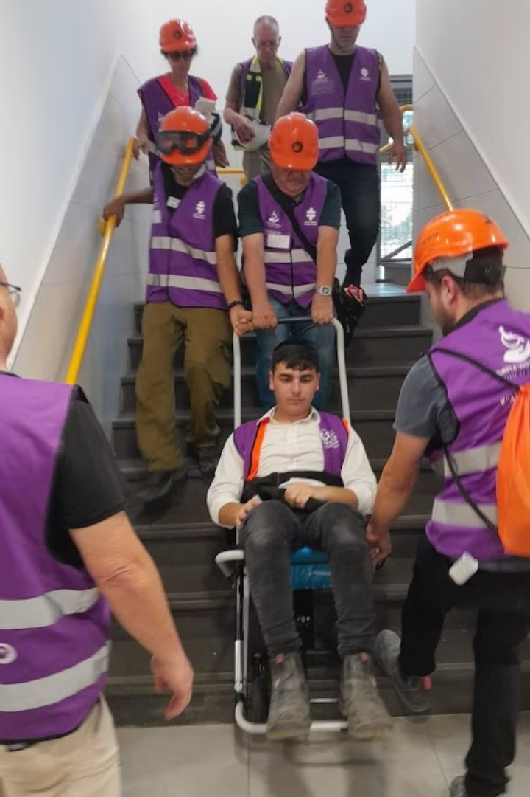
Purple Vest Training Curriculum
Disability Awareness
Emergency Challenges
Preparedness Steps
Workshops
Evacuation scenarios Practice
Accessible Assistance
Notes:
Purple Vest Training Curriculum
Disability Awareness - Understanding diverse disabilities.
Emergency Challenges - Identifying unique needs in crises.
Preparedness Steps - Learning practical preparation including working with other stakeholders.
Workshops - Writing personal evacuation plans
Evacuation scenarios Practice - Including practicing on evacuation means
Accessible Assistance - Providing support for people with disabilities.

Slide 5

The Model's Unique Strengths
Globally Applicable
Universally Relevant
Local Task Force
Bridges Existing Gaps
Global Community
Notes:
The Model's Unique Strengths
1. Globally Applicable - Can be implemented anywhere
2. Universally Relevant - Benefits everyone in the community
3. Local Task Force - Relies on area experts
4. Bridges Existing Gaps - Addresses emergency response shortfalls
5. Global Community - Connects members via the Purple Vest app

Slide 6
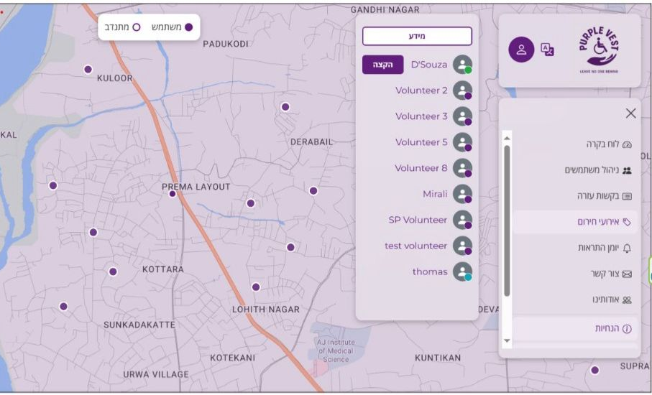
The Purple Vest App
Connects volunteers with people with disability and elderly needing help.
Enables aid requests during emergencies.
Activates volunteer alerts during incidents.
Facilitates personal connections.
Offers customized disaster management tools.
A unique tool for emergencies, tailored to the location.
Notes:
The Purple Vest App
Connects volunteers with people with disability and elderly needing help.
Enables aid requests during emergencies.
Activates volunteer alerts during incidents.
Facilitates personal connections.
Offers customized disaster management tools.
A unique tool for emergencies, tailored to the location.

Slide 7


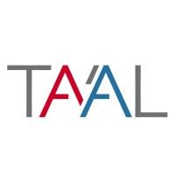






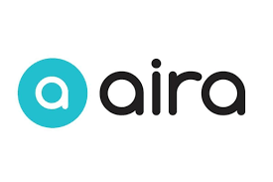
The Purple Vest Mission
Bridging between Technologies and Emergencies
Notes:
The Purple Vest Mission: Bridging between Technologies and emergencies.
Tikkun Olam Makers
TA'AL
Airobotics – Trusted Autonomous Drones
relaxelf.io
Bettear
Right Hear – App for Visually Impaired & Blind People
Siri – Apple
Step hear – Accessibility in 123
Google Translate
App Review: Aira Explorer - Sight Support

Slide 8
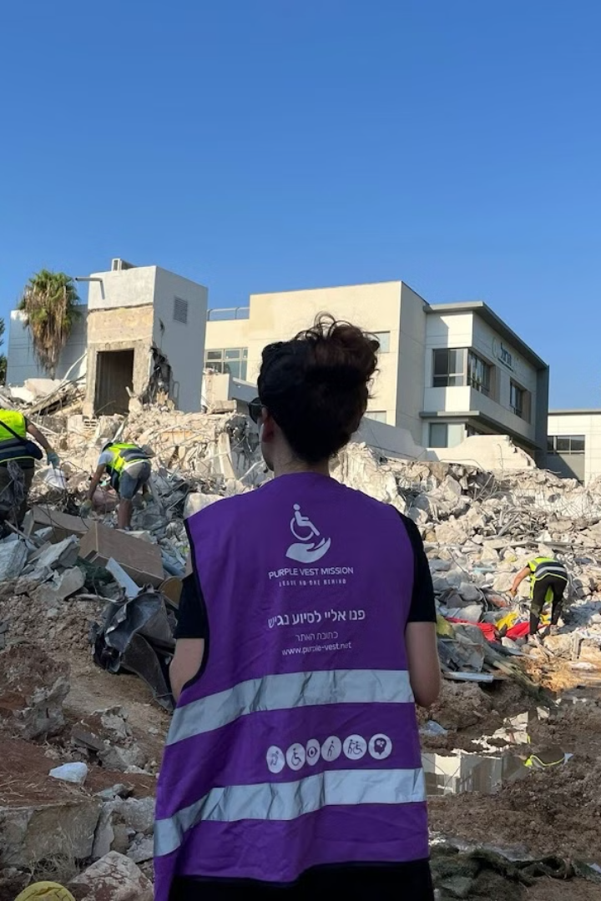
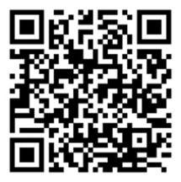
Stay Updated
Tailored trainings, ToT, courses for groups (volunteers, communities, students, organizations, service providers, employees etc.,)
Updated information in the PV website: Purple-vest.net
Email us at PVM@AISRAEL.ORG

