Slide 1

Aerosol monitoring for a better understanding of Climate impact from municipalities and industries
GRASP Earth
Eliot Llopis
Head of Communication

Slide 2
Aerosols direct inference on Climate impact
Aerosols affect surface temperature, precipitation, and extreme weather.
Policymakers in municipalities should include aerosol impacts in NDCs and NAPs.
As with GHG, global collaboration is needed for pushing aerosol integration in climate plans.
World Health Organization. (2021). WHO global air quality guidelines: Particulate matter (PM2.5 and PM10), ozone, nitrogen dioxide, sulfur dioxide and carbon monoxide. Geneva: World Health Organization. https://www.who.int/publications/i/item/9789240034228

Slide 3
Current Aerosol monitoring limitations
Model-based solutions
  What? Use generalized environmental models
  Positive: Cover gaps from ground sensors data, extending the coverage.
  Negative: It is based on assumptions. May inaccurately estimate pollution levels by 30-50% missing small but significant emission sources.
Ground-based solutions
  What? Use of ground stations to capture real data
  Positive: Data is accurate
  Negative: Expensive method, limited scalability. Covers less than 5% of a city’s area. Usually complemented by low reliable low-cost sensors and models based on assumptions.

Slide 4
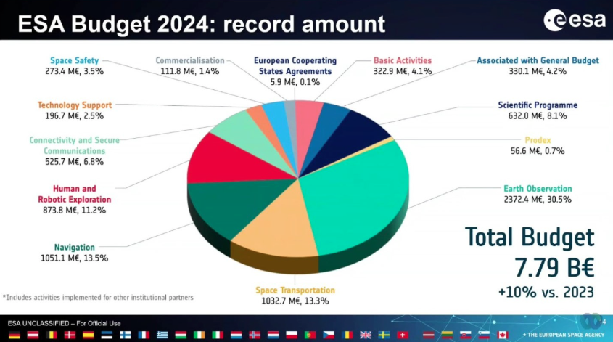
Space is the answer
https://thenextweb.com/news/european-space-agency-esa-budget-2024

Slide 5

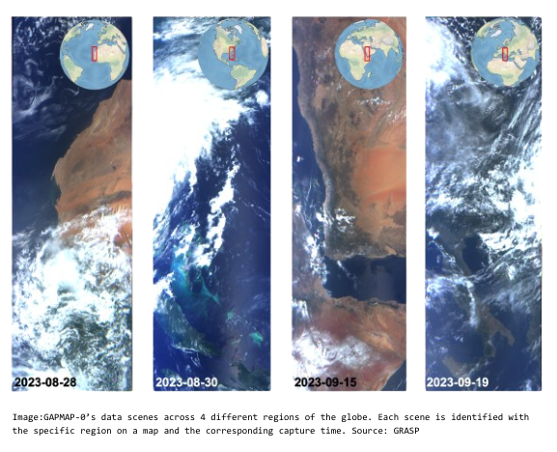
Our mission

Slide 6
The outcome
COVERAGE
100% global and spatial full atmospheric column coverage. No assumptions
RELIABLE
Based on 30 years of atmospheric r&d and proven Space technologies.
RoI
Up to 70-75% cheaper than existing methods with a very high Return on Investment.

Slide 7
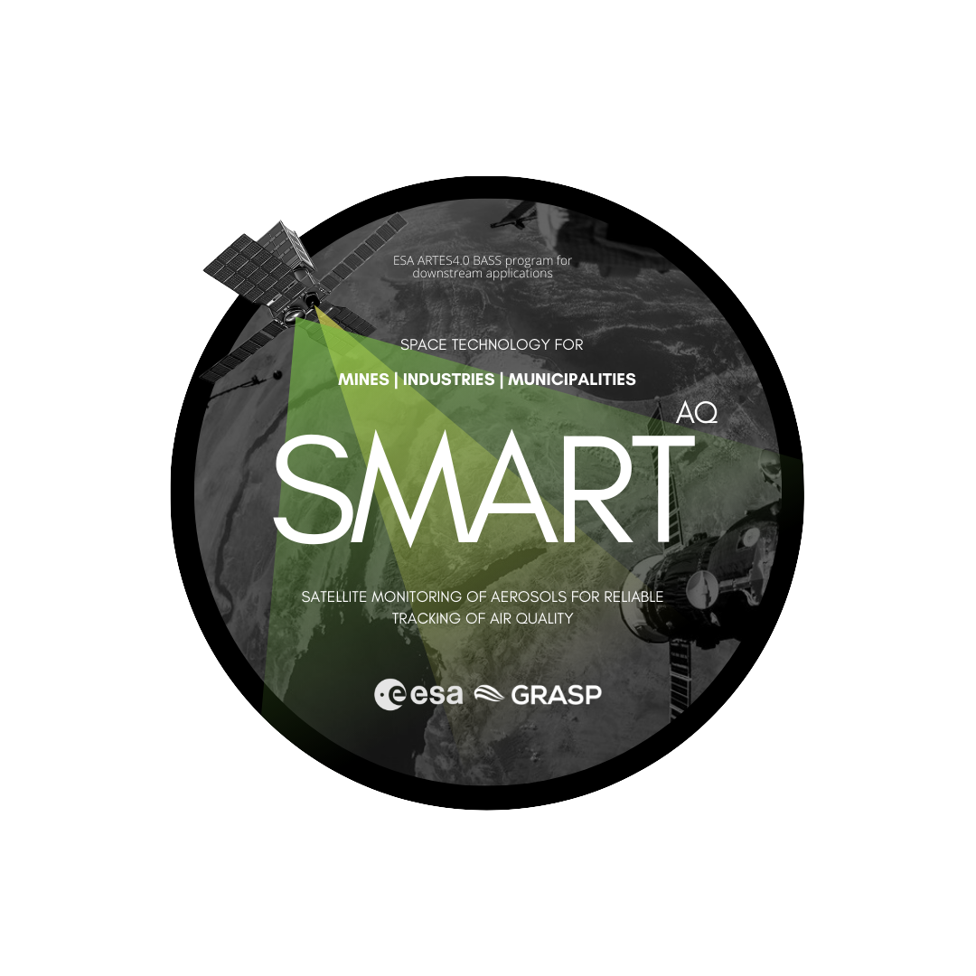

Slide 8
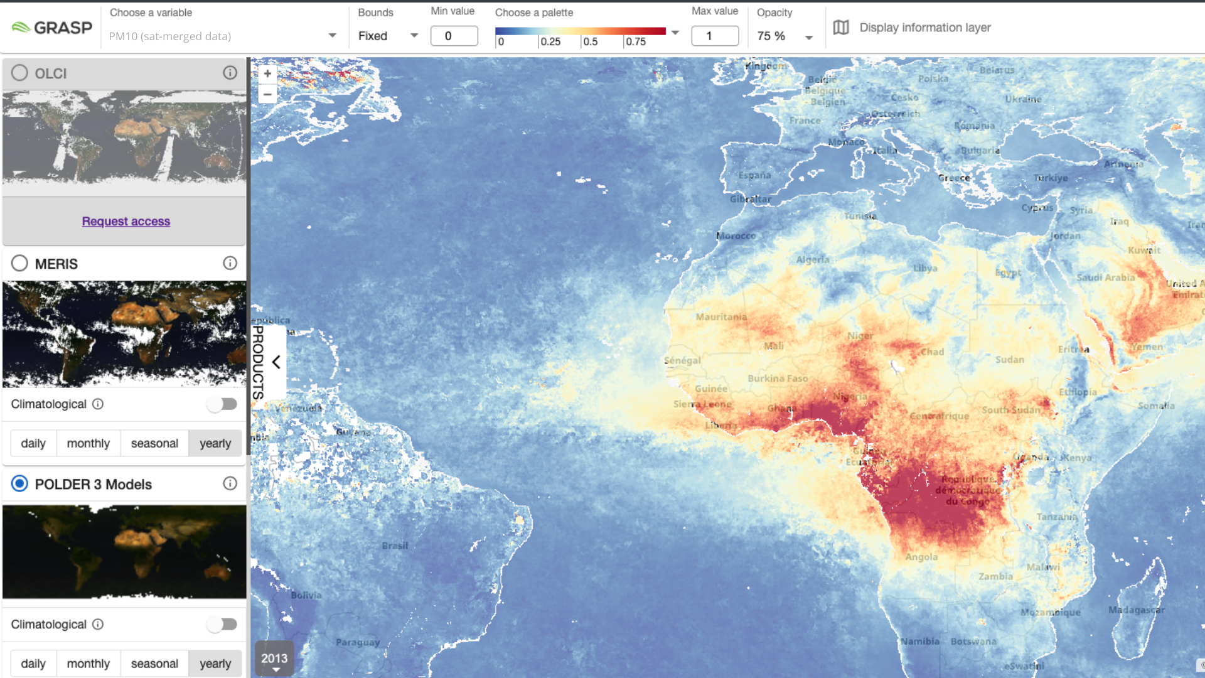
Test your aerosol impact today
PM10 map from POLDER 3 satellite data merge. Source: GRASP-Open

Slide 9
Book a meeting with:
GRASP Earth
Eliot Llopis
Head of Communication
eliot.llopis@grasp-earth.com

