Slide 1
Better Work Leads to Better Lives
Donna Bungard
Indeed
United States of America
Entrepreneurship and leadership development for young people with disabilities
Thursday, 22 February 2024 | 14:40 - 16:00
Notes:
Good afternoon. My name is Donna Bungard, and I’m a 40-something woman with dark hair and glasses. My pronouns are she/her.
As the Sr. Accessibility Program Manager at Indeed, I've dedicated my career to advocating for inclusivity and accessibility in the workplace. Through my role as a Global Advisor for Billion Strong, I work to amplify the voices of individuals with disabilities. I am a member of the disability community.
I am deeply honored to be the chair of this session, titled “Entrepreneurship and leadership development for young people with disabilities,” as it aligns perfectly with my passion for fostering opportunities and equity. Possibilities, goals, and actionable plans that will help make aspirations a reality. Together we’ll go on a journey into what’s happening around the world that will impact the workplace wellbeing and progress of tomorrow.
[NOTE: talk track may change a bit but no unusual content is expected]

Slide 2
Themes
Notes:
So, in this session, we will dive into the critical topics of entrepreneurship and leadership development for young people with disabilities, exploring avenues for innovation and progress. As we navigate through the discussion, we'll uncover powerful themes that resonate with the core values that will connect us to the projects and each other.
[NOTE: talk track may change a bit but no unusual content is expected]

Slide 3
Opportunities
Themes
Notes:
Opportunities: Opportunities for young people with disabilities to build the lives they want to live.
[NOTE: talk track may change a bit but no unusual content is expected]

Slide 4
Opportunities
Enablement
Themes
Notes:
Enablement: we’ll learn about a variety of ways in which initiatives and programs can enable and support youth with disabilities in achieving their goals, ensuring they have access to necessary resources and support systems.
[NOTE: talk track may change a bit but no unusual content is expected]

Slide 5
Opportunities
Enablement
Themes
Empowerment
Notes:
Empowerment: Our discussion will highlight the importance of empowerment, emphasizing the significance of respecting the autonomy of young people with disabilities to create their own pathways to success – however they choose to define it- and showcasing the many of possibilities available to them.
[NOTE: talk track may change a bit but no unusual content is expected]

Slide 6
Opportunities
Enablement
Themes
Empowerment
Dignity
Notes:
Dignity: Central to our conversation is the principle of dignity and respect for the autonomy and independence of thought of youth with disabilities as they learn and grow.
[NOTE: talk track may change a bit but no unusual content is expected]

Slide 7
Opportunities
Enablement
Themes
Empowerment
Dignity
Sustainability
Notes:
And Sustainability: Lastly, we will delve into the critical importance of implementing sustainable practices within our programs and initiatives. We aren't merely seeking a few individuals to succeed; rather, this work is about constructing robust systemic change that enable opportunities year over year.
[NOTE: talk track may change a bit but no unusual content is expected]

Slide 8


Lean in!
Notes:
I encourage you to lean in and engage with the presentations. Recognize more than the individuals leading them today but also at the leaders they are nurturing through the projects they're showcasing. Let's delve into these presentations together and extract valuable insights from the experiences and lessons they offer.
[NOTE: talk track may change a bit but no unusual content is expected]

Slide 9
Today’s speakers
Antony Helenraj Selvaraj
Senior Manager
Enable India
Kriszta Zsiday
Professional Manager
Salva Vita Foundation
Elif Cansu Gayretli
President of Değiştiren Adımlar Derneği
Değiştiren Adımlar Derneği
Sharon Kumar
Head of Programs
Australian Disability Network
Jéssica Mendes
Photographer
Escola de Gente - Comunicação em Inclusão
Notes:
Our speakers will introduce themselves in full, but I wanted to take a moment to say how excited I am to have with us:
Antony Helenraj Selvaraj Senior Manager at Enable India
Elif Cansu Gayretli President of Değiştiren Adımlar Derneği at Değiştiren Adımlar Derneği
Jéssica Mendes A Photographer at Escola de Gente - Comunicação em Inclusão
Kriszta Zsiday Professional Manager at the Salva Vita Foundation and
Sharon Kumar Head of Programs at the Australian Disability Network
[NOTE: talk track may change a bit but no unusual content is expected]

Slide 10
Takeaways
Training by youth with disabilities
Leadership mentoring
Youth house services
Self-employment support
Student-led innovation in inclusion
Notes:
In the end, I hope we all come away with a better understanding of training organized and lead by youth with disabilities (they used to say in the US, nothing about us without us, but now…. It’s nothing without us!) Come away with new knowledge about leadership mentoring, youth housing services, self employment support and student-led innovation in inclusion.
[NOTE: talk track may change a bit but no unusual content is expected]

Slide 11
Preparing our youth for success
Notes:
It’s all going to come down to… this. Preparing our youth for success- neither because of nor to spite their disabilities - but with respect to their lived experiences, their talents, and their aptitude.
[NOTE: talk track may change a bit but no unusual content is expected]

Slide 12
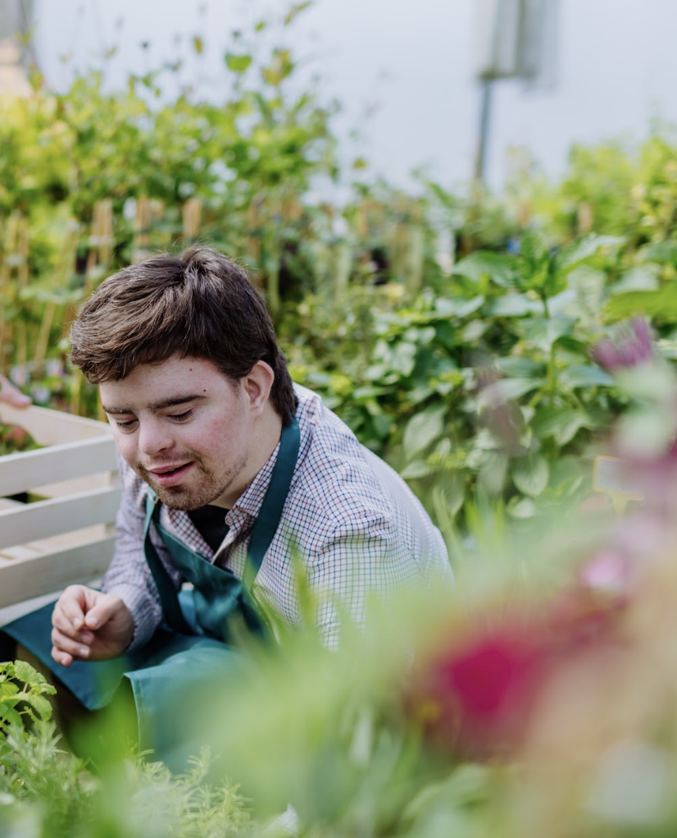

#ZeroCon24
Notes:
Getting our youth ready for what lies ahead, setting them up for a work-life that's satisfying, … that will impact everything they do in their lives. I believe in the power of programs like these. They're not just about making things a bit better; they're about tearing down obstacles, rewriting the script for people with disabilities, and changing the way the world works.
In my day to day we work hard to show how the world can work better and give both jobseekers and employers the tools to make it happen. Today, I’m just so excited to hear how these projects are working towards that same long-term goal.
[NOTE: talk track may change a bit but no unusual content is expected]

Slide 13
Let’s begin!
Notes:
But enough of me… let’s get going! Antony, are you ready to get us started?
[NOTE: talk track may change a bit but no unusual content is expected]

