Slide 1
Why Disaster Risk Reduction matters
Stefanie Dannenmann-Di Palma
External Relations Officer
United Nations Office for Disaster Risk Reduction
Disability Inclusive Disaster Risk Reduction (DRR)
Thursday, 6 March 2025 | 12:40 - 13:10

Slide 2
What is Sendai Framework for DRR?
Adopted in 2015 at the Third UN World Conference on Disaster Risk Reduction in Sendai, Japan
Aims: Substantial reduction of disaster risk and losses in lives, livelihoods, health, and assets
Four Priorities for Action:
Understanding disaster risk.
Strengthening disaster risk governance.
Investing in disaster risk reduction for resilience.
Enhancing disaster preparedness for effective response and "Build Back Better" in recovery
Notes:
What is Sendai Framework for DRR?
Adopted in 2015 at the Third UN World Conference on Disaster Risk Reduction in Sendai, Japan
Aims: Substantial reduction of disaster risk and losses in lives, livelihoods, health, and assets
Four Priorities for Action:
Understanding disaster risk.
Strengthening disaster risk governance.
Investing in disaster risk reduction for resilience.
Enhancing disaster preparedness for effective response and "Build Back Better" in recovery

Slide 3
Disability Inclusion in the Sendai Framework for Disaster Risk Reduction
Recognition: Persons with disabilities are often disproportionately affected by disasters
Inclusion: The framework emphasizes the need for inclusive disaster risk reduction strategies
Engagement: Persons with disabilities should be consulted and fully engaged in the development and implementation of national and local strategies
Data: Calls for the collection and dissemination of disaggregated data, including by disability
Notes:
Disability Inclusion in the Sendai Framework for Disaster Risk Reduction
Recognition: Persons with disabilities are often disproportionately affected by disasters
Inclusion: The framework emphasizes the need for inclusive disaster risk reduction strategies
Engagement: Persons with disabilities should be consulted and fully engaged in the development and implementation of national and local strategies
Data: Calls for the collection and dissemination of disaggregated data, including by disability

Slide 4
2023 Survey on Persons with Disabilities and Disasters
10-year follow-up to 2013 survey done by UNDRR: resulted in a total of 6,342 responses from 132 countries.
Limited Progress: The survey shows limited progress in disability inclusion in disaster risk reduction (DRR) over the past 10 years
Personal Preparedness: 84% of persons with disabilities reported not having a personal preparedness plan for disaster
Awareness of DRR Plans: Only 11% of persons with disabilities are aware of DRR plans at the national level
Dedicated Leadership role: 16% reported of dedicated leadership roles for disability inclusion in governance structures; However, personnel with disability expertise are often not assigned to these roles.
Notes:
Survey outcomes: https://www.undrr.org/report/2023-gobal-survey-report-on-persons-with-disabilities-and-disasters
2023 Survey on Persons with Disabilities and Disasters
10-year follow-up to 2013 survey done by UNDRR: resulted in a total of 6,342 responses from 132 countries.
Limited Progress: The survey shows limited progress in disability inclusion in disaster risk reduction (DRR) over the past 10 years
Personal Preparedness: 84% of persons with disabilities reported not having a personal preparedness plan for disaster
Awareness of DRR Plans: Only 11% of persons with disabilities are aware of DRR plans at the national level
Dedicated Leadership role: 16% reported of dedicated leadership roles for disability inclusion in governance structures; However, personnel with disability expertise are often not assigned to these roles.

Slide 5
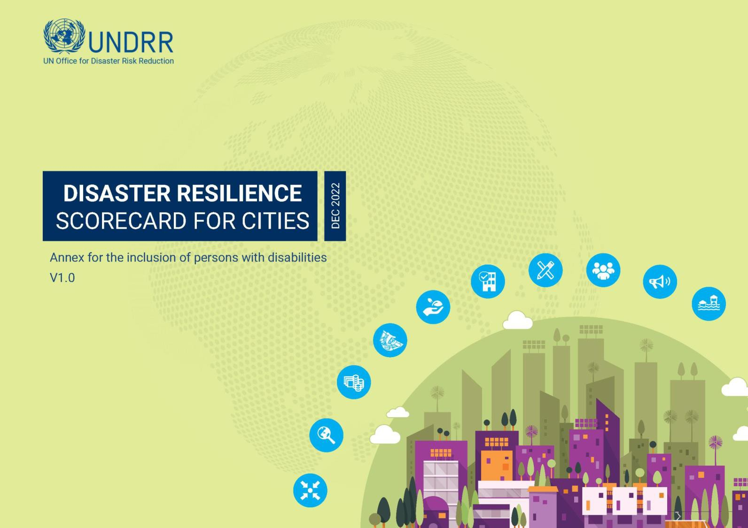
Disaster Resilience Scorecard for Cities – Disability Annex
Promote inclusion and accessibility in urban environment
Close consultation with persons with disabilities
Interactive scoring with pictograms showing analytical results for decision making
Source:https://mcr2030.undrr.org/disaster-resilience-scorecard-cities
Notes:
Disaster Resilience Scorecard for Cities – Disability Annex
Promote inclusion and accessibility in urban environment
Close consultation with persons with disabilities
Interactive scoring with pictograms showing analytical results for decision making

Slide 6
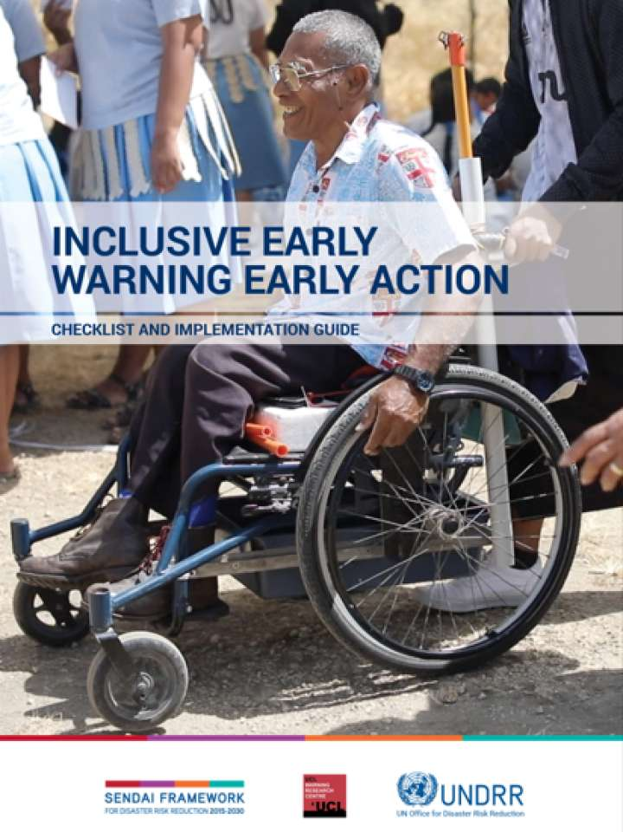
Gender and disability inclusive early warning early action: checklist and implementation guide
© UNDRR – United Nations Office for Disaster Risk Reduction, Source: https://www.undrr.org/publication/inclusive-early-warning-early-action-checklist-and-implementation-guide
Notes:
The purpose of the checklist and implementation guide is to ensure that the key elements of early warning systems (governance; disaster risk knowledge; detection, monitoring, analysis, and forecasting; dissemination and communication; and preparedness to respond) are gender-responsive and disability-inclusive. They provide support and direction for systematically integrating and monitoring gender and disability inclusivity across all actions related to warnings.

Slide 7
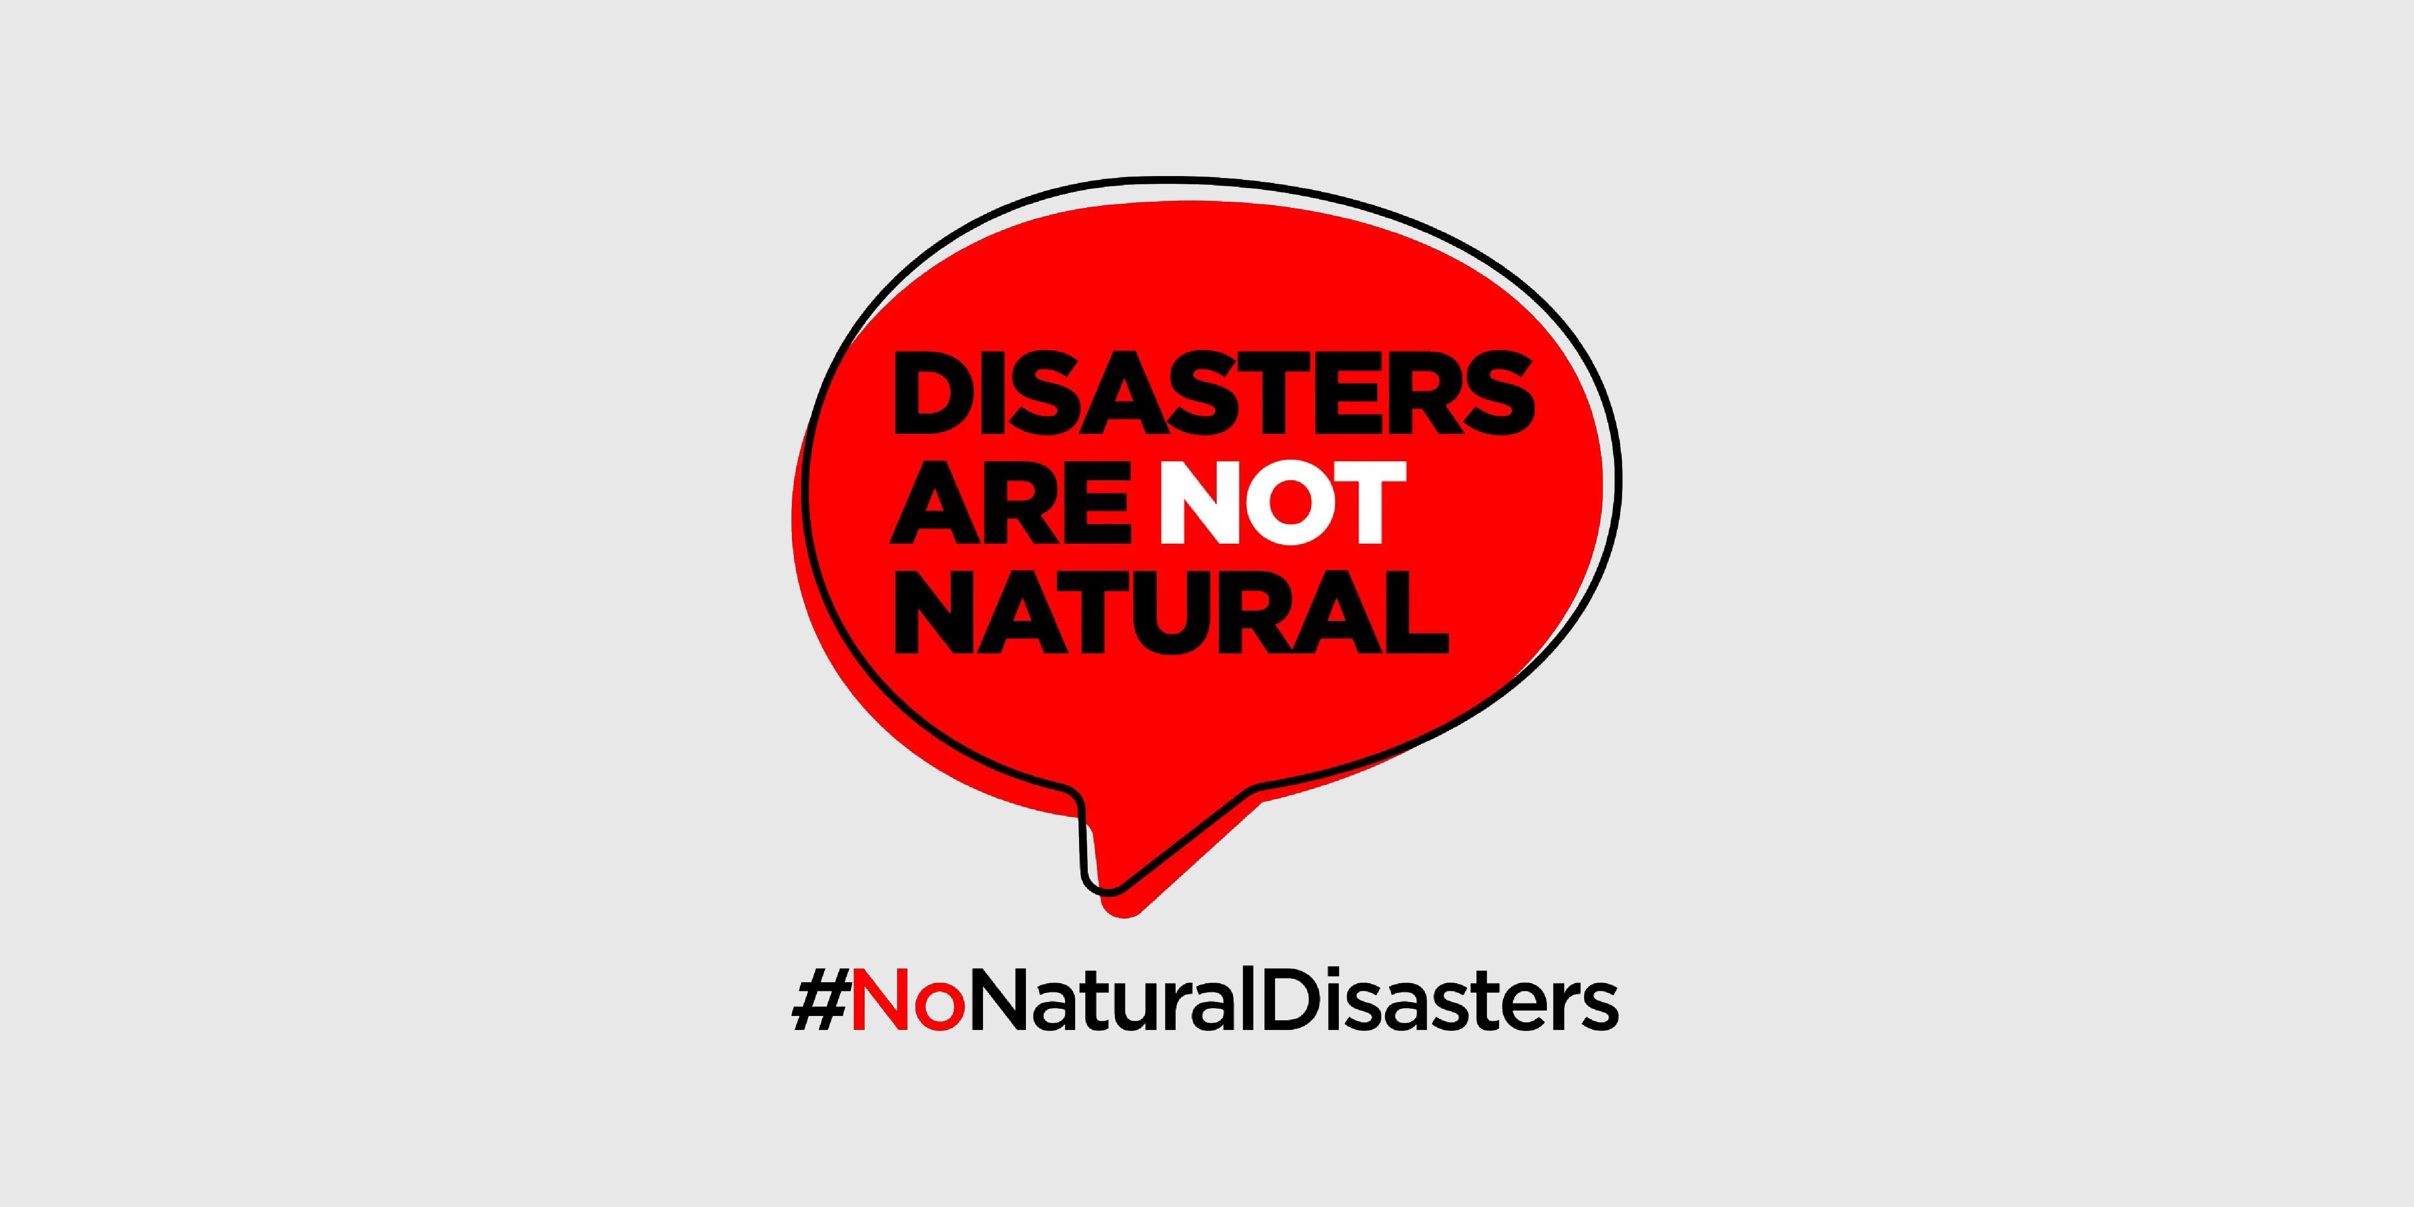
Disasters are not natural
Instead of using natural disaster just use disaster!

Slide 8



Thank you
For more information, please contact dannenmann@un.org
https://www.undrr.org/partners-and-stakeholders/disability-inclusion-disaster-risk-reduction

