Slide 1


Mike Buckley
CEO

Slide 2
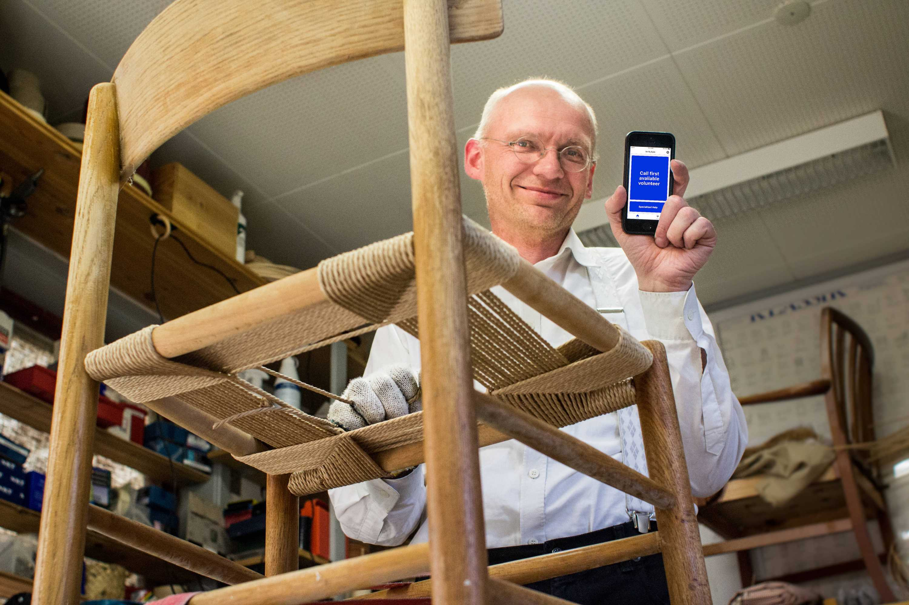
Notes:
Started 10 years ago by HJW, a furniture craftsman in Denmark who was losing his eyesight
Began as a simple service on smartphones to connect blind users with a network of sighted volunteers
It exploded and in first few weeks there were tens of thousands of blind users and volunteers with the app installed

Slide 3
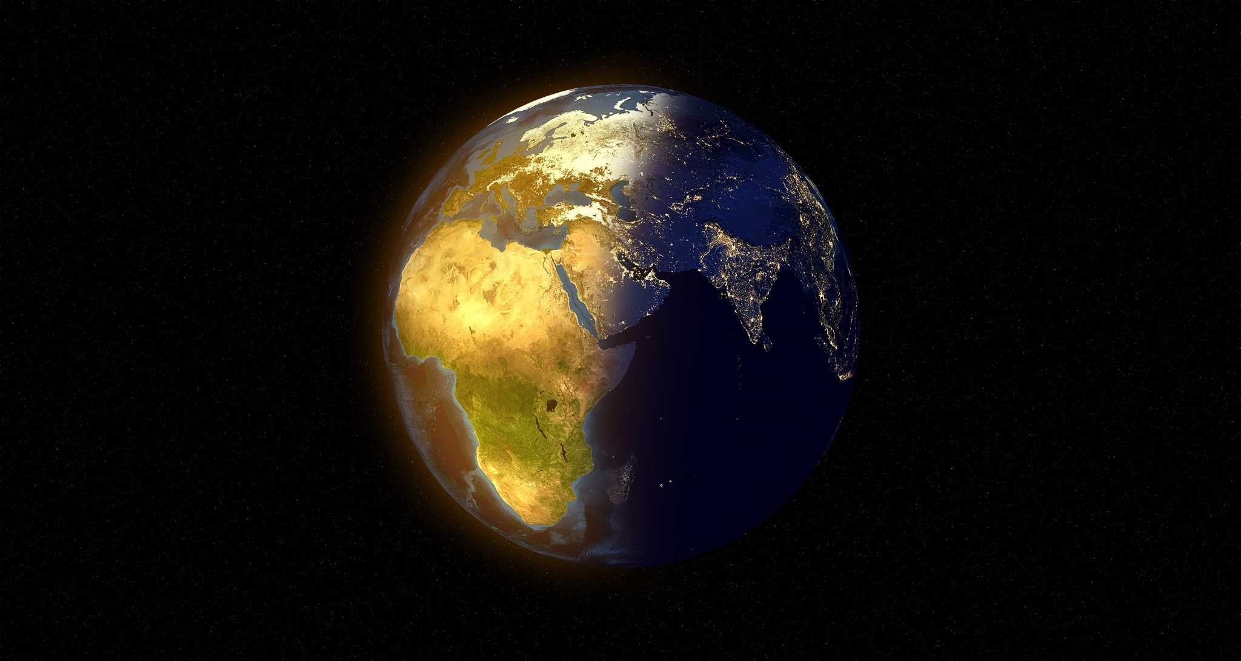
800,000
150
Countries
Blind & low
vision users
8.5 m
185
Volunteers
Languages
Notes:
Today we have 800k blind and low vision users, and 8.3 million volunteers across 150 countries and in almost every language there is
And now we also integrate advanced “visual AI” to interpret what is in front of the user’s smartphone camera
Part of our North Star is to provide our services for free to the end user - because we think accessibility is a human right not a premium product for a minority

Slide 4
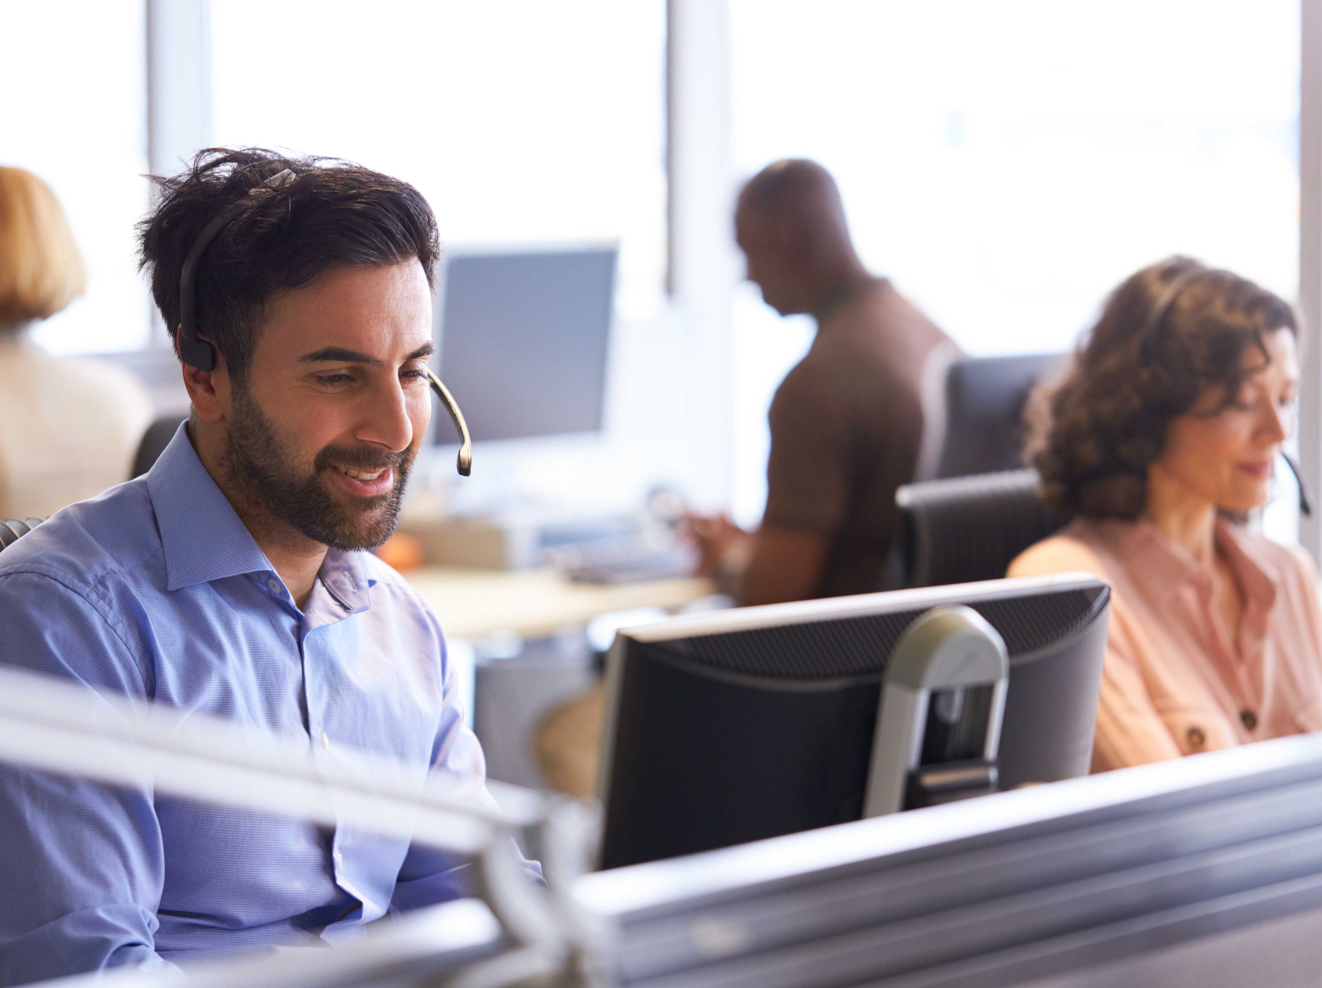
Service Connect™
powered by AI
Notes:
That is one of the reasons that we are now also so focused on selling our services to businesses
a) to keep free for end users and
b) so businesses value the impact that inclusivity delivers
Calls through our platform can be routed through to trained disability agents in company call centres, or even answer automatically with advanced AI
Real example is MS who now front their Disability Answer Desk (DAD) with BME - it halves their call times ad increases customer satisfaction levels

Slide 5
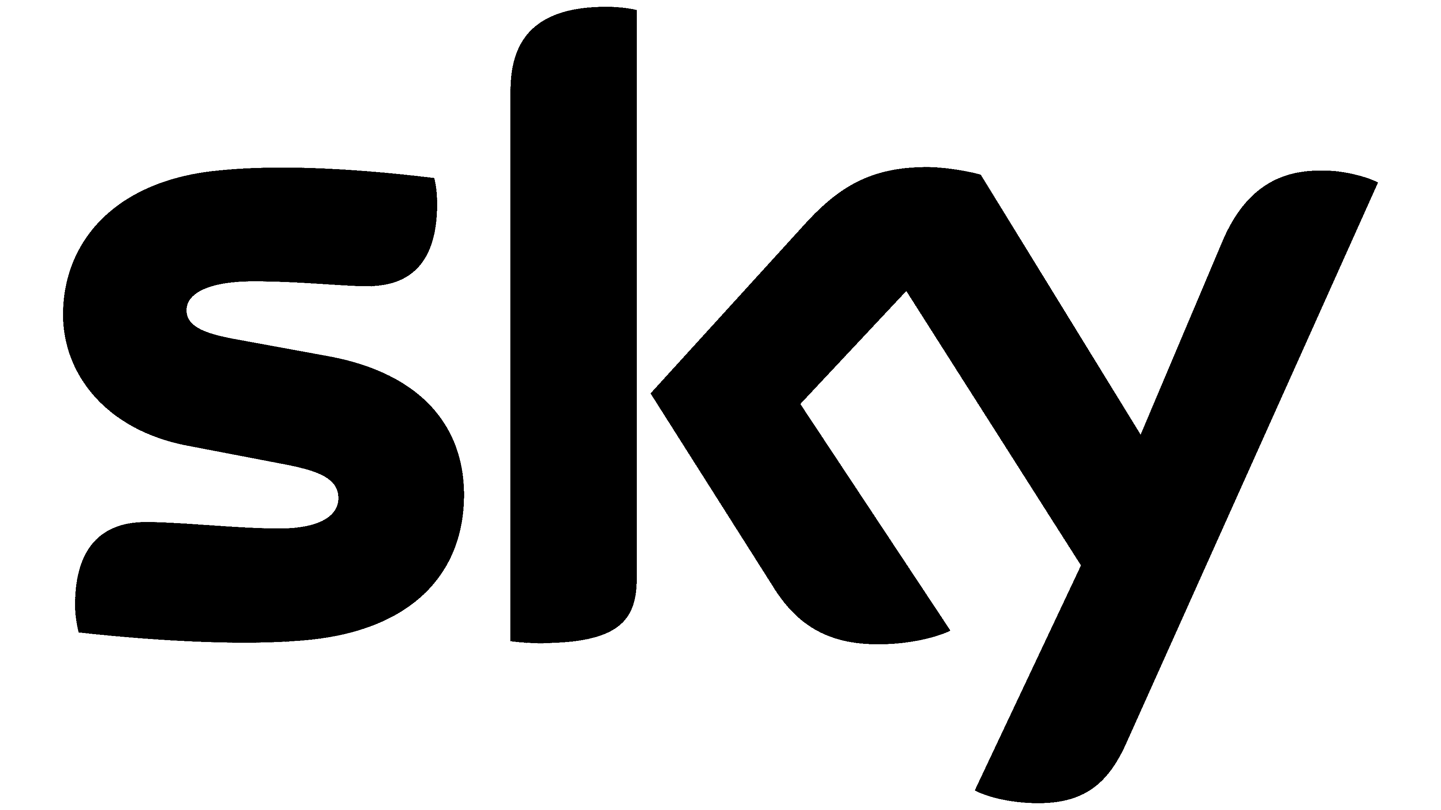
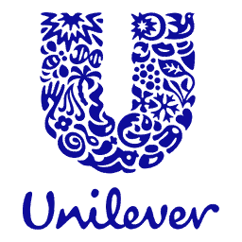
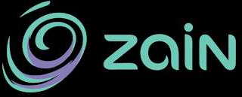

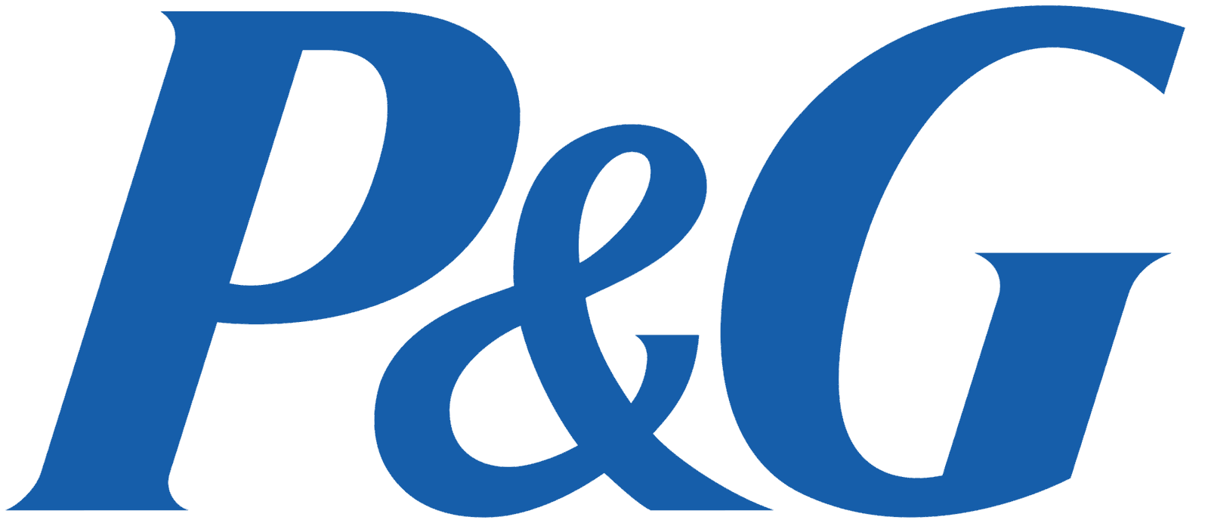


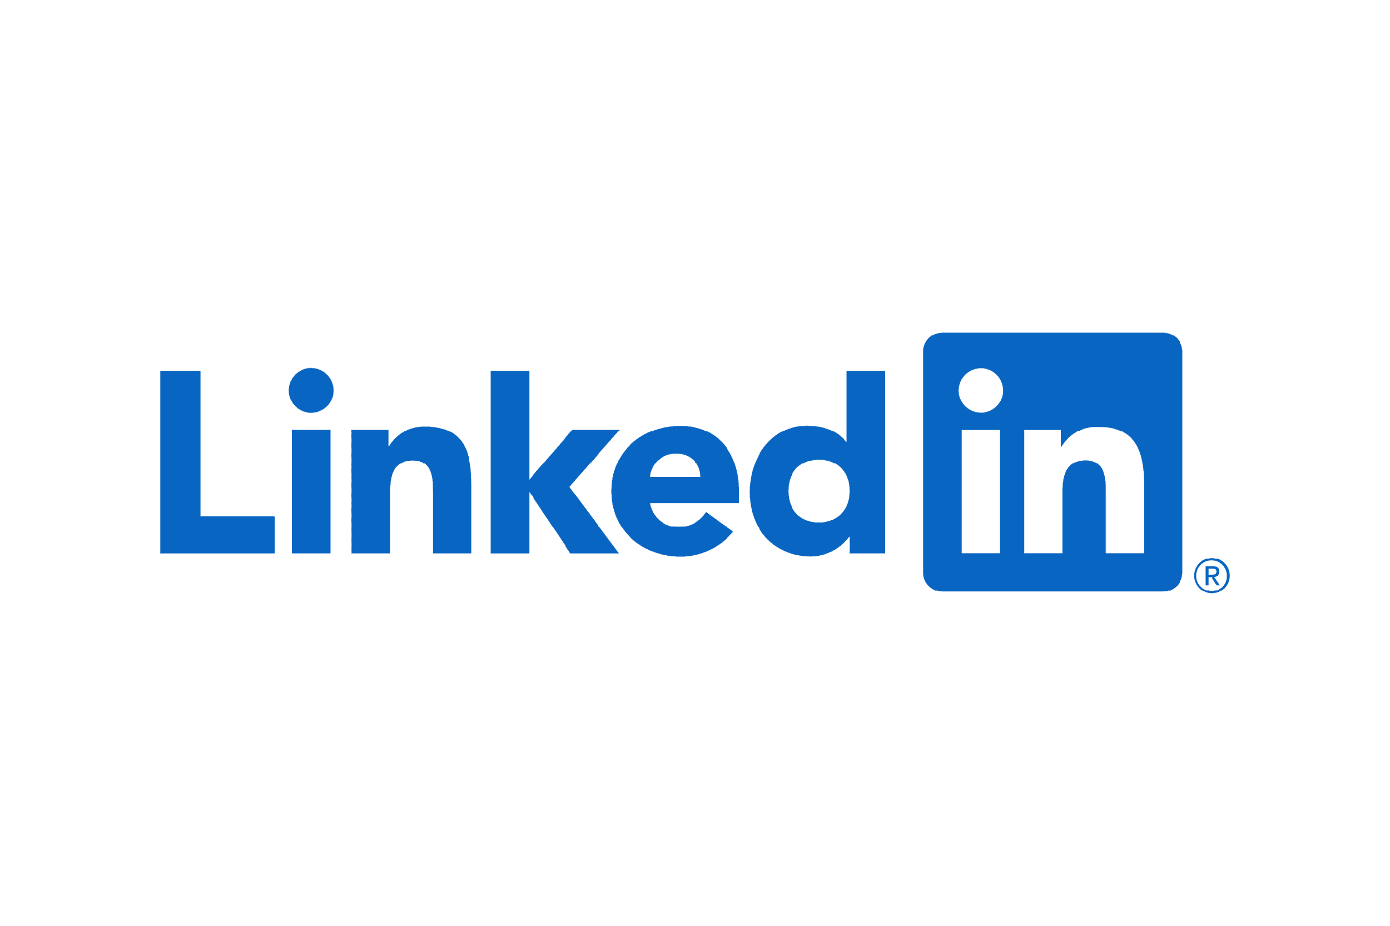
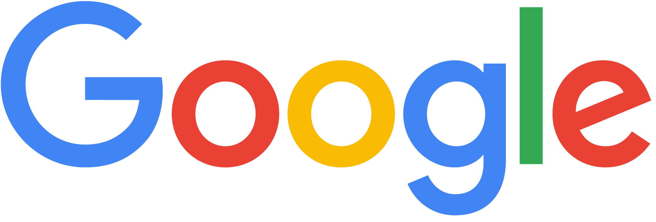



Notes:
And there are more like that such as Google, Hilton, Spotify, Sony, P&G, Unilever, Emirates and dozens of others
I don't raise this to brag, If I've learned anything leading this organization over the last two years it's humility. And I fail at something every day. But those customer relationships - and the proven ROI we've developed, gave us an inroad to other large enterprises.

Slide 6
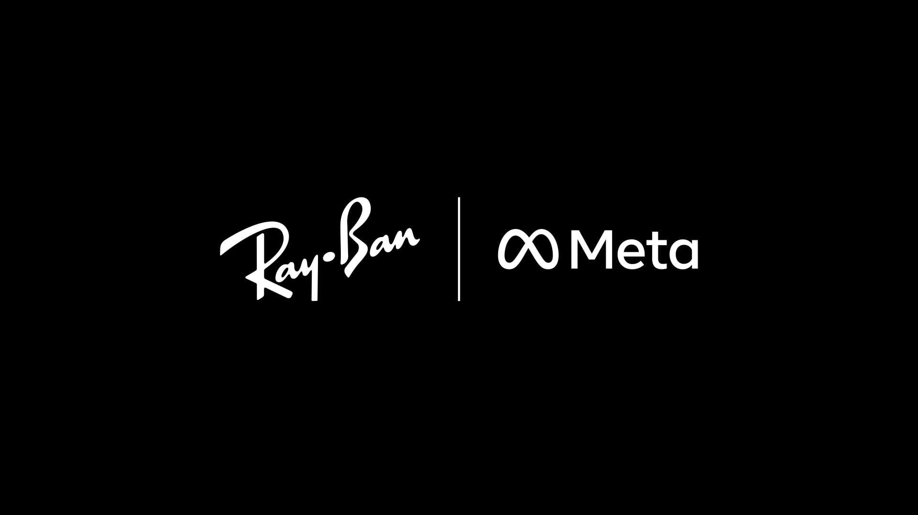
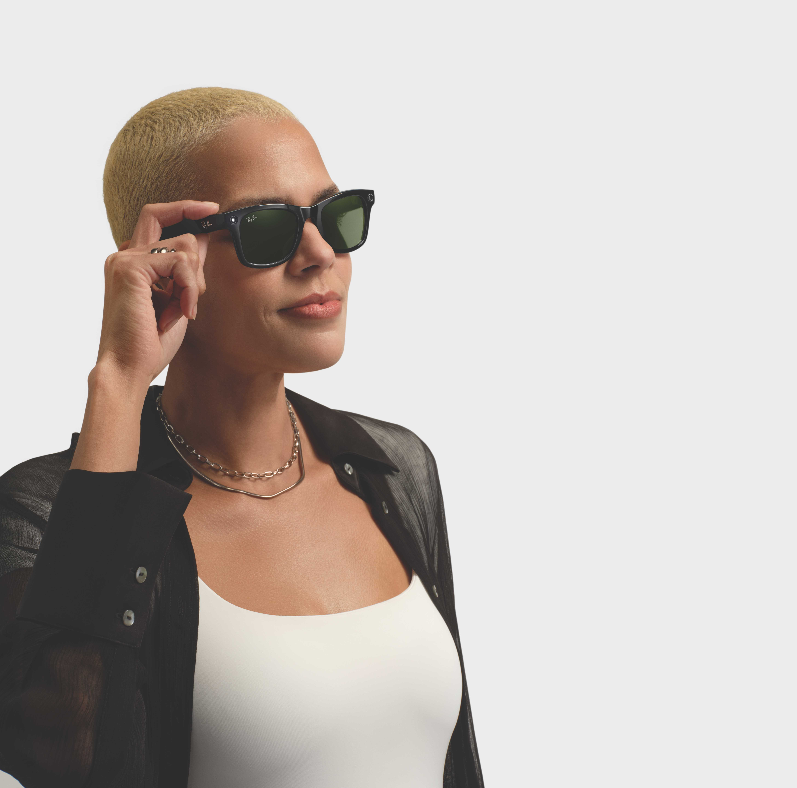
Notes:
An example is Meta and our work with them - engineer to engineer - to develop the first and only accessibility product natively integrated with their Ray-Ban Meta smart glasses.
Why is this important? Wearables such as RBM mean "Hands-free”, which to a blind person who might be juggling a service dog or a white cane, means the world.

Slide 7
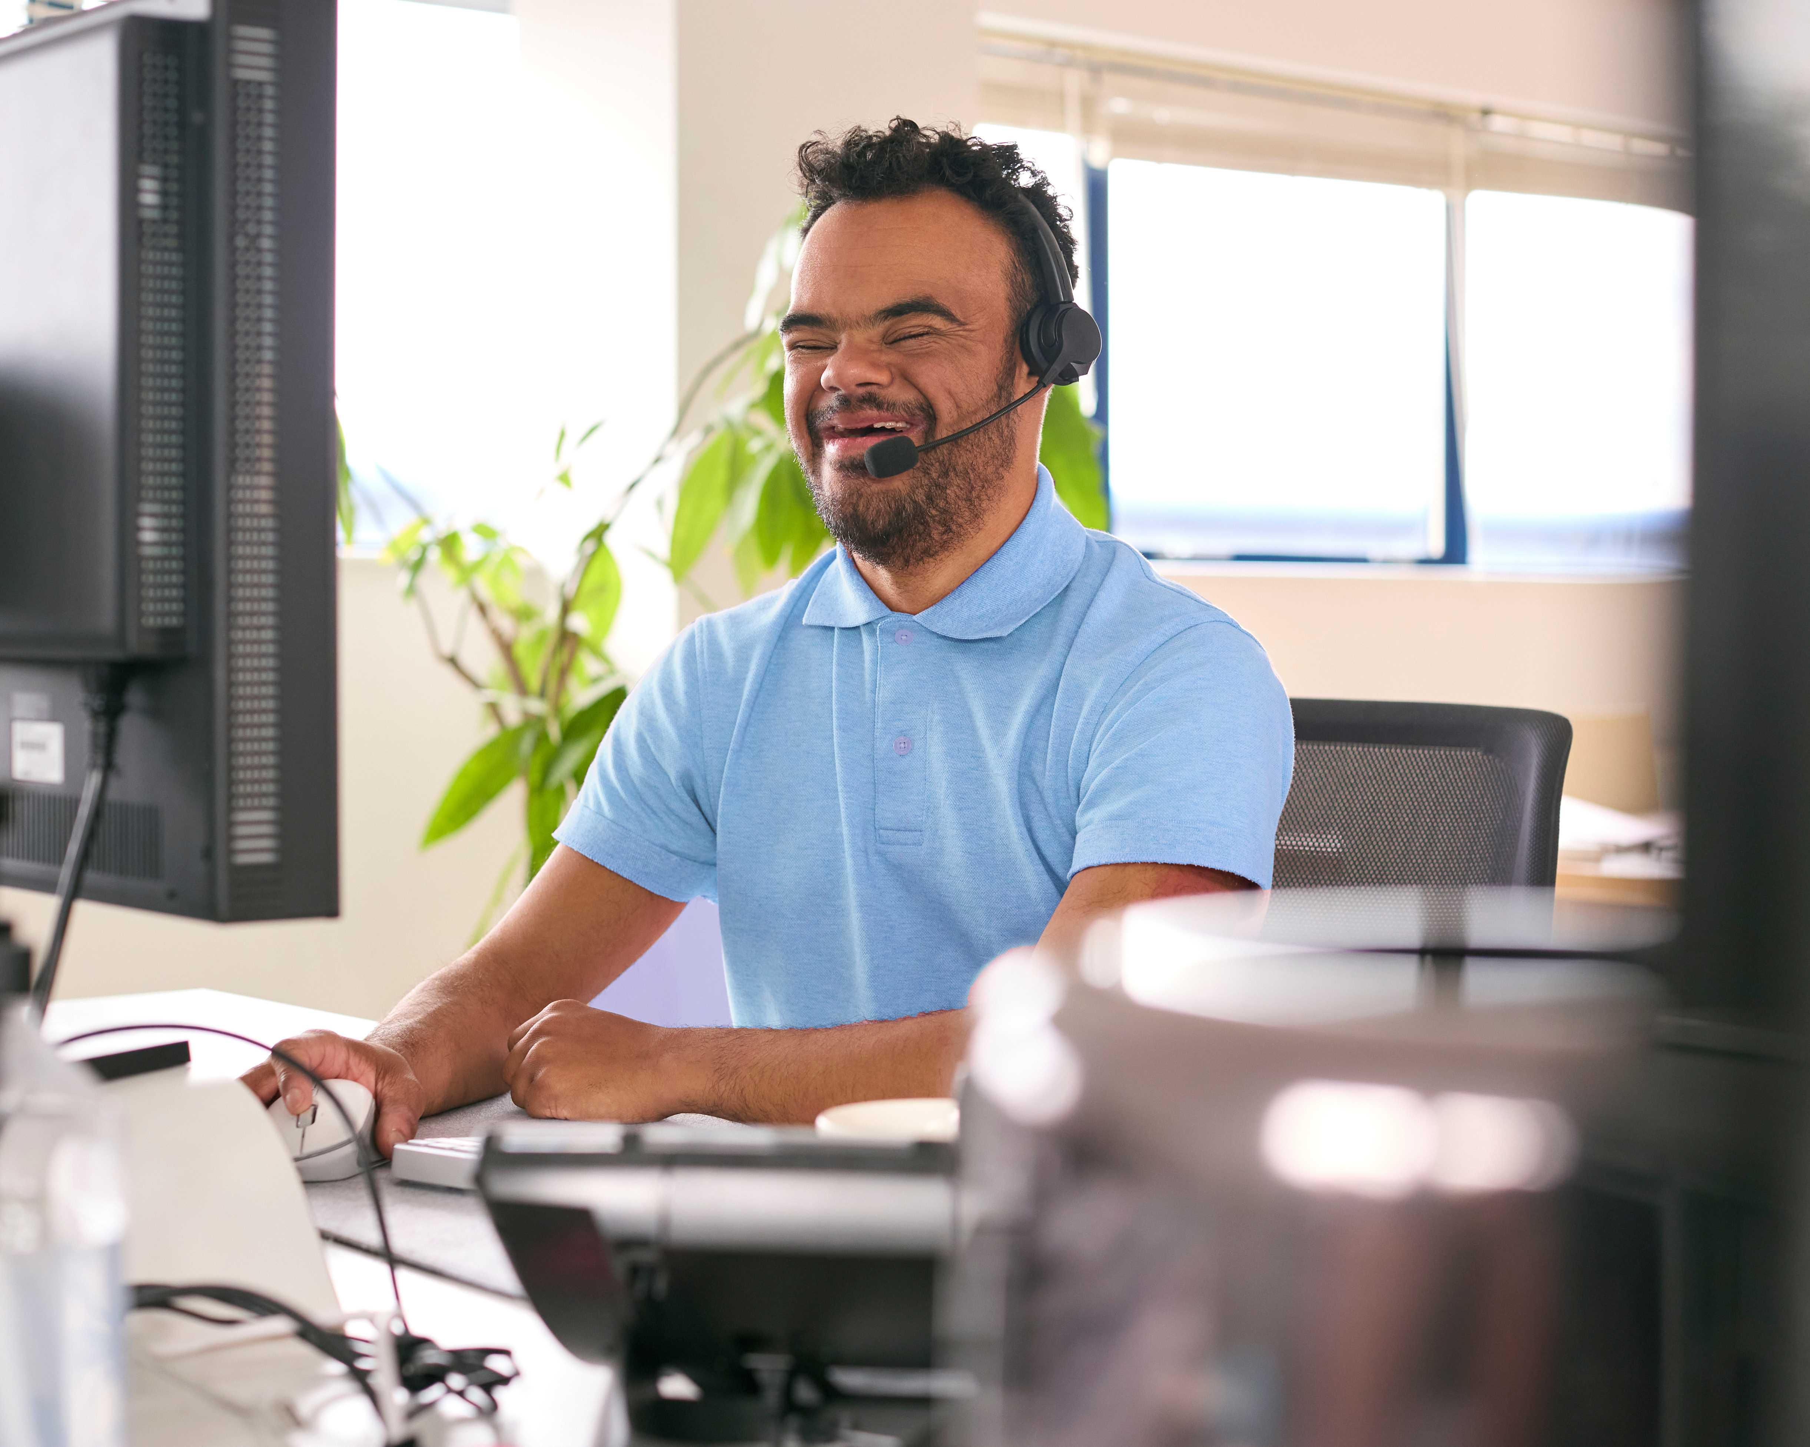
BME
WorkPlace™
Notes:
Most recently we have pivoted more towards the workplaceand are beginning to deliver game-changing technology for blind and low vision employees
Being blind is not being woke; and there are still way too many obstacles in the way for real inclusion of BLV in the workplace. We aim to change that forever.
What started as a hackathon project where we built a version of Be My Eyes for desktop Windows - now gets 2,500 downloads of it every month
So we know there is interest
We are now busy building “BME Workplace” which will function as a Meta layer of software - making other software programs more accessible; it will have the option of voice navigation, integrated AI, trusted colleague calling and enterprise-class secrity - all available through hands-free smart glasses
We've already got major corporations lined up as beta partners including Hilton, Microsoft and organizations in the UK and Canada - and soon in Brazil.

Slide 8
Mike Buckley
CEO
Notes:
So what started 10 years ago as a personal project of our blind founder is now set to change workplace accessibility for ever.Thats a legacy to have.

