Slide 1
Putting the I in ESG
Beatriz Bastião
International Labour Organization (ILO)
Switzerland
ESG, Circular Economy, and Disability-Inclusion
Wednesday 5 March 2025 | 17:00 - 18:00
Notes:
Please add your notes here.
Title; First name, last name of speaker(s); Name of Organization, Name of Country, Name of Session (as written in Agenda)
#ZeroCon24
Day and Time of Session

Slide 2

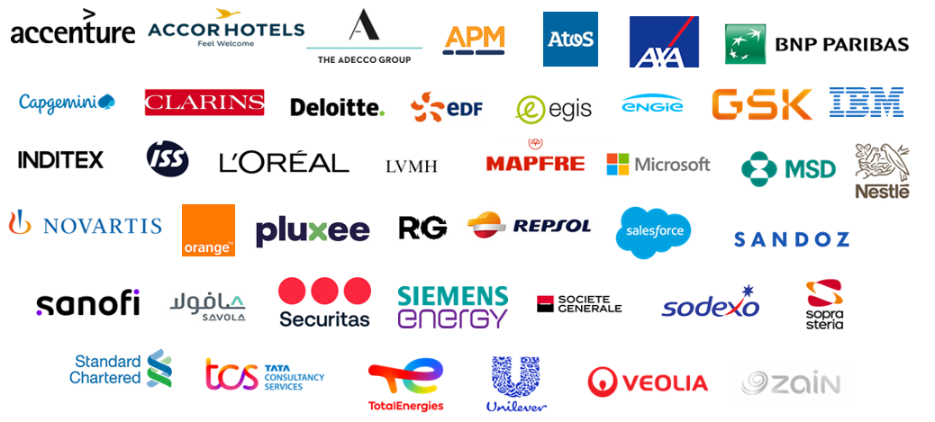
ILO GBDN: a network for companies, by companies (1/2)
    43 Multinational Enterprises

Slide 3
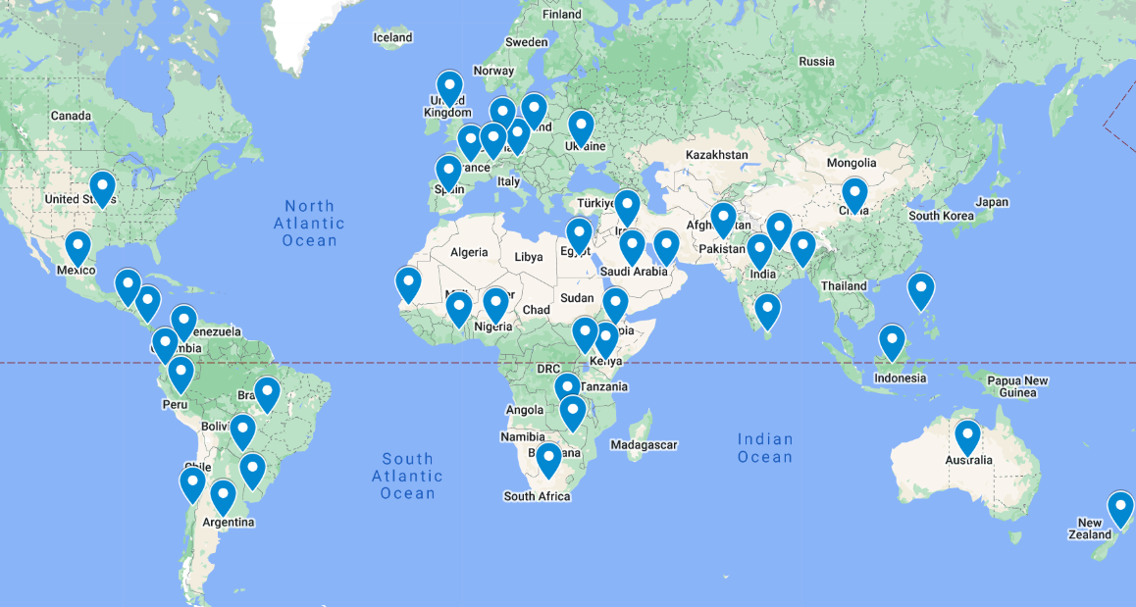
ILO GBDN: a network for companies, by companies (2/2)
    44 National Business and Disability Networks
World map indicating countries with National Business and Disability Networks

Slide 4

Business Leaders’ Pledge on Disability-Inclusive Sustainability
Practices & technical guide
Signed by leaders, including two CEOs, of nine ILO GBDN company members
Six objectives
  Leadership and Governance for Inclusion
  Inclusive Practices and Materiality Assessments
  Empowerment and Career Advancement for Employees with Disabilities
  Accessible Environments and Products
  Supplier Diversity
  Reporting and Continuous Improvement
Cover page of the ILO GBDN guide "Putting the I in ESG: Inclusion of Persons with Disabilities as Strategic Advantage of Sustainability Practices for Corporates and Investors"
Notes:
Committing to ongoing improvements towards the following objectives, we commit to: Leadership and Governance for Inclusion • Foster corporate leadership and governance structures that prioritize inclusion, with a focus on disability inclusion as a governance priority. Inclusive Practices and Materiality Assessments • Incorporate disability inclusion into ESG materiality assessments, with the goal to prioritize the inside-out and outside-in impact of disability inclusion to the business (double materiality). Empowerment and Career Advancement for Employees with Disabilities • Expand equitable hiring practices to include employee empowerment, mentorship, and career advancement opportunities, with progress tracked via Diversity, Equity, and Inclusion (DEI) Key Performance Indicators (KPIs). Accessible Environments and Products • Apply universal design principles for physical and digital accessibility, ensuring inclusive innovation across all products and services, and track progress. Supplier Diversity • Promote supplier diversity by prioritizing engagement with disability-inclusive and disability-owned businesses and track the percentage of procurement spend dedicated to diverse suppliers in ESG disclosures. Reporting and Continuous Improvement • Incorporate comprehensive, data-driven reporting on disability inclusion initiatives and outcomes in our annual ESG and other sustainability reports, with clear objectives, progress metrics, and areas for continuous improvement.

Slide 5
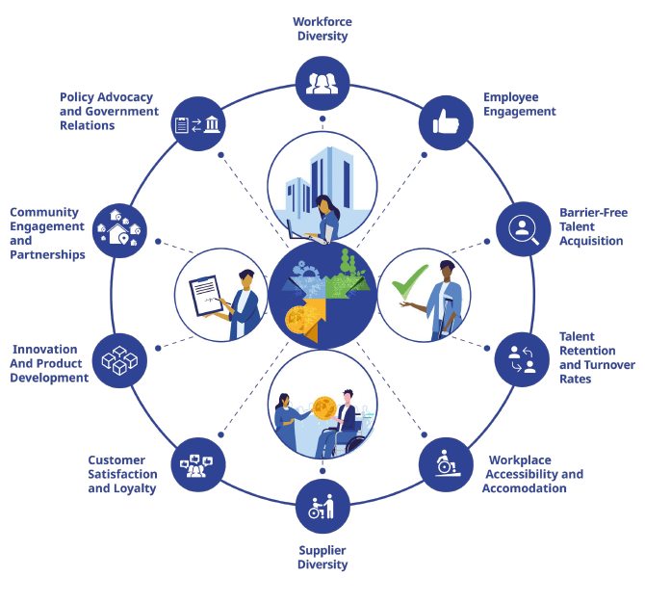
Ten KPI areas of the ILO GBDN guide
Notes:
Framework for defining and reporting disability inclusion in ESG. The framework has 10 key areas: workforce diversity, employee engagement and satisfaction, barrier-free talent acquisition, talent retention and turnover rates, workplace accessibility and accommodations, supplier diversity, customer satisfaction and loyalty, innovation and product development, community engagement and partnerships, advocacy and government relations.

Slide 6
Thank you!

