Slide 1
Small Social Enterprises to Employ Persons with Intellectual Disabilities Outside Sheltered Workshops
Silke Watzenig-Mellitzer
Diakonie de La Tour
AUSTRIA
Small Organizations as Inclusion Champions
05.03.2025, 14:00 – 15:00
Notes:
Please add your notes here.
Title; First name, last name of speaker(s); Name of Organization, Name of Country, Name of Session (as written in Agenda)
#ZeroCon24
Day and Time of Session

Slide 2

Why did we Start with Small Social Enterprises?
A history of more than 150 years of assisting persons with intellectual disabilities
We mostly support them in sheltered workshops where they only receive pocket money
Our vision is to gradually replace these workshops with employment relationships
Notes:
The Diakonie de La Tour is a non-profit organization in southern Austria. Sheltered workshops are separated and not part of the social networks and communities. People who work there are only co-insured and have no social security like a pension or health insurance.

Slide 3
Wages instead of Pocket Money
Employment relationships in Austria includes:
Wages
During illness
During holidays
Health insurance
Pension insurance
Earning their own money allows people with intellectual disabilities to be financially independent.
Notes:
Our goal is to give all our clients the opportunity to earn their own money and to be included in the social securitiy system.

Slide 4
Our Small Enterprises
2021 – The first small inclusive enterprises started with six people with intellectual disabilities
By 2024 – Three businesses were operating in sectors such as kitchen, catering and adult education and had created 20 jobs
The employees are working in a team with people without disablities and are supported by an assistant during onboarding and beyond
Notes:
Assisting people give our employees individual support when needed and teach them further competencies in their workplace. One assistant supports six employees with intellectual disabilities. They work in a big kitchen called the „Küche:Waiern“, in a small Café and bistro called „gernda“ and adult education called „Akademie de La Tour“.

Slide 5
The Impact
Earning their own money can:
support the employees by finding their place in society
Strengthens their sense of belonging
makes them financially independent
helps them to decide for themselves where they want to live
Let´s get to know our employees - VIDEO

Slide 6
Funding & Next Steps
Our small enterprises are part of Carinthia´s 2020 plan to implement the UN Convention on the Rights of Persons with Disabilities
The project is publicly funded – the Carinthian government covers all employment and assistance costs
In the next two years two more businesses are planned in the fields of peer counselling and facility management

Slide 7
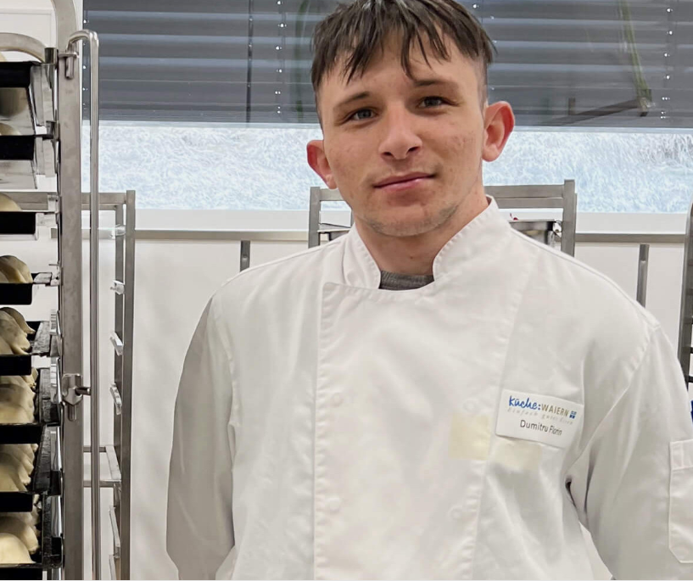
„I‘ve always wanted a real workplace. I wanted to work directly in the kitchen and now I´ve achieved that. It´s going great.“
Florin Dumitri, Employee

