Slide 1
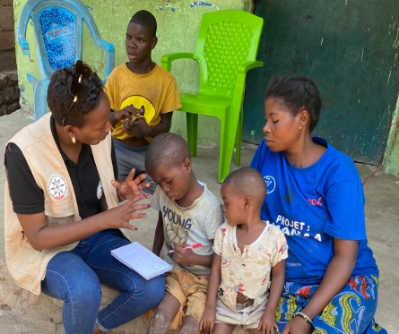

TUNAFASI
We all have a place
Gilbert Mututsi Ruturtsa
ADED – Support for the Development of
Children in Distress
Democratic Republic of Congo
Session: M1
Thursday February 22 - 2024 - 10.20 AM
Notes:
Title project: TUNAFASI – we all have a place
Name: Gilbert Mututsi Ruturtsa
Name of Organization: ADED – Support for the Development of Children in Distress
Name of Country: Democratic Republic of Congo
Name of Session: M1
Day and Time: Thursday February 22, 10.20

Slide 2






Project TUNAFASI – we all have a place
Mission: improving the socio-economic conditions of children and youth with disabilities through education and employment.
Approach: Child Center Community-Based Approach (CBR) & Self-Help Groups
Pathways:
Push governors to be more accountable, education actors to be more involved
Fight against negative socio norms towards disability in the community
1. Education
2. Health
3. Child Protection
4. Vocational Training
5. Self/wage employment
Notes:
Mission: a positive environment, sustainable self-reliance and equal opportunities
Disability prevention and rehabilitation program
Goal: improve position for children and youth with disabilities in communities
Positive environment
Sustainable self-reliance
Equal opportunities
Community-based Rehabilitation (CBR)

Slide 3
Core of TUNAFASI
Project inspired by I2C Model from Karuna Foundation Nepal
Incorporates Children’s Development Plans & CBR activities into the official Health Care System
Clear Exit strategy – after 4 years
Learning by doing, with a focus on the child and the power of parents and community
Targets:
Vulnerable children &
youth with/without
disabilities
Parents
Teachers and school
directors
Educational managers
Members of the Parents
and Teachers
Association (PTA)
Notes:
Inspired by I2C Model from Karuna Foundation Nepal
Follows policy and plan Government DRC – National CBR Strategy. Improve and incorporate children’s development plan and CBR activities package into State and community’s primary health care.
Clear exit strategy, after 4 years
Learning by doing, with a focus on the child and the power of parents and the community

Slide 4
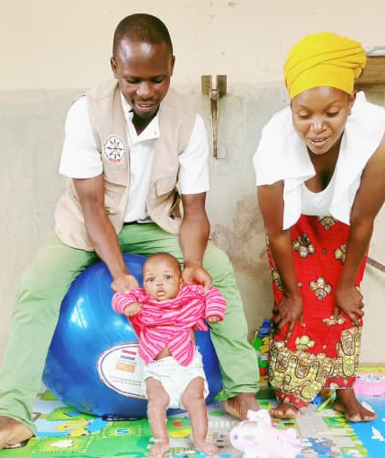
How TUNAFASI is Innovative
National CBR Strategy - Embedded in National State policies and plans (Laws and Education System)
Integrated in existing public services (public schools, health care)
Sustainable program, continues after exit strategy
Holistic approach
Empowerment parents and other care takers
Multi-Stakeholder Approach – children, families, community, state
Use existing service providers – high quality and low costs

Slide 5




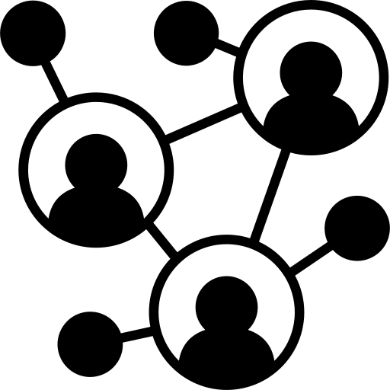
Success Impact TUNAFASI
1. Improved livelihoods children with disabilities & families
Improved health care and rehabilitation (safe pregnancy, safe delivery, safe infancy
Care, love and acceptance
2. Increase school participation
3. Increase inclusive schools
5. Strong Networks
4. Disability Inclusion
Increase participation from:
5% to 69%
Saint Pierre Primary School:
Strong support and engagement community
Self-help Groups
Increase education inspection
Strengthening relation family and community
Increased voluntarism for home-based education.
Increase employment of trained youth with disabilites
Accesible infrastructure
Inclusive teaching methods
Lobby & advocacy to integrate disability inclusion in education
Creation of disability focussed organizations and network
Increase awareness and recognition key issues of inclusion and inclusive education
Created SHGs are performing
Strong networks parents, community and stakeholders

Slide 6
Challenges TUNAFASI
Extreme poverty marginalized population due to crises
→ limited capacity to participate CBR program
Violence, conflict, environmental disasters
→ displacement
Insufficient monitoring, evaluation, learning and research system
Lack knowledge on disability, reinforcing negative socio norms against disability
→ Education exclusion
Lack inclusive education materials and assistive devices & inaccessible education environment
Lack State contribution to complete exit strategy

Slide 7
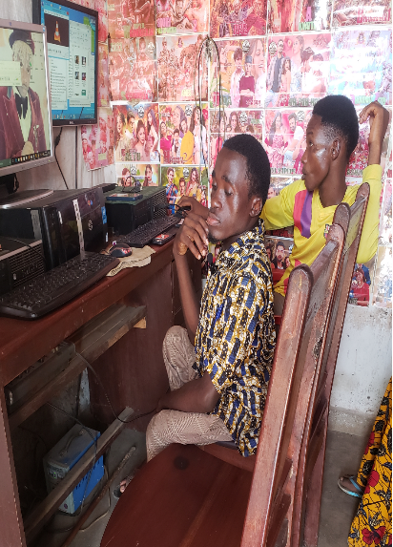
Financial Sustainability TUNAFASI
Salaries CBR workers through State
Improvement income families through Self-Help Group
Collaboration ICRC, BEZEV Germany and IMPACTION Netherlands
Use existing service providers – cost effectiveness
Program embedded in national Health Care System
Strong network Self-Help Groups and Organizations of Persons with Disabilities
Notes:
Sustainable project, carried by state and community

Slide 8



Lessons learned & Future Steps TUNAFASI
1. Strengthen Inclusive Education
Long process inclusive education
2. Inclusion & Accessibility
3. Rehabilitation
5. CBR Approach
4. Entrepreneurial Capacity
Barrier people to embrace inclusive education
Increase support for children with disabilities and families
Limited choices of opportunities for youth
Strenghten CBR approach and rehabilitations in education
Need strong involvement all stakeholders from family to government
Need of technologies
Increase accessibility to increase school participation
Some need special care before entering school
Need to change attitudes and values in society
Reinforce capacity parents to increase income
Improve adaptive training technologies
Notes:
1. Strenghten Inclusive Education
Inclusive education is a long process that cannot be completed in one yearr
Inclusive education requires the involvement of different stakeholders, from family to government (educational offers, education system, teachers, parents, etc.);
Need of technologies (software/digital as a solution for people with disabilities) to learn
2. Inclusion & accessibility
People are hesitant to embrace inclusive education because they think that bringing disabled and non-disabled students together in the same class is not possible
Inclusion often requires a change in attitudes and values ​​on the part of individuals.
Also, the need to increase accessibilty to increase school participation
3. Rehabilitation
Increase support for children with disabilities and families
Some need special care before entering school
4. Entrepreneurial capacity
Limited choices (diversification of TVET opportunities) of vulnerable children when selecting TVET,
Low capacity of young people in functional analysis and choice of promising professions and unavailability of adaptive (digital) training technologies,

Slide 9
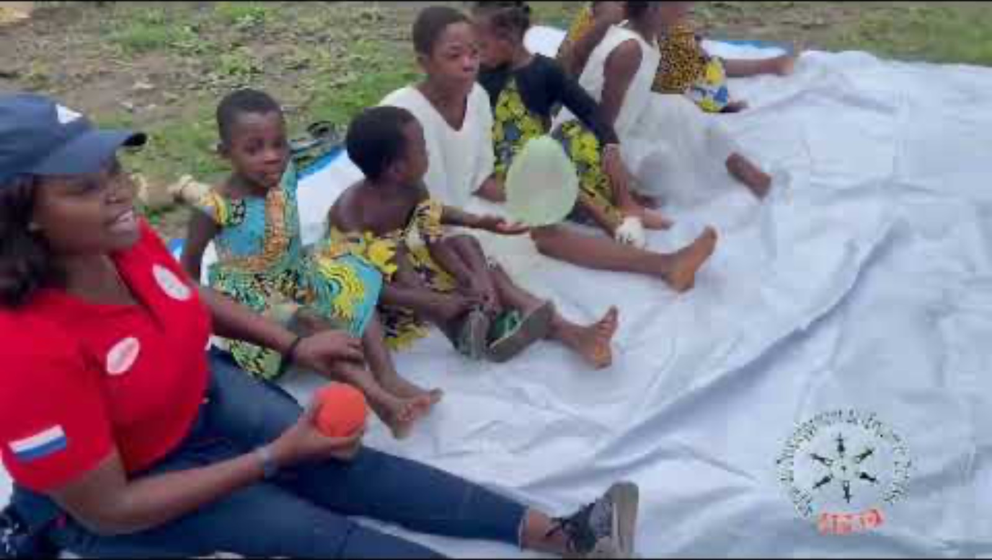
Video TUNAFASI
Notes:
Link video: https://www.youtube.com/watch?v=-f5MfXLJP_0

Slide 10
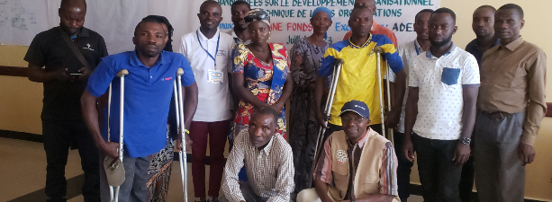
Thanks for your attention!

