Slide 1

Theresa Shearer FRSE
Enable
Scotland
Job creation for persons with intellectual disabilities
Thursday 6th March 2025, 1600 - 1700
Notes:
Please add your notes here.
Title; First name, last name of speaker(s); Name of Organization, Name of Country, Name of Session (as written in Agenda)
#ZeroCon24
Day and Time of Session

Slide 2
Time for Change
Between 2014 and 2022 in the EU27 the employment gap between people with and people without disabilities sat on average around 22% - but in some countries this was considerably higher.
Scotland disability employment gap – 30.3%
UK disability employment gap – 27.4%
The EU’s Employment Equality Directive requires all member states to ensure that people with disabilities have equal access to employment – but what does this look like in reality?
Notes:
Sample Slide: presenting three points on our project and the relationship to this year’s theme of the Zero Project Conference. Point 1; Point 2; Point 3 connect together in this way.

Slide 3
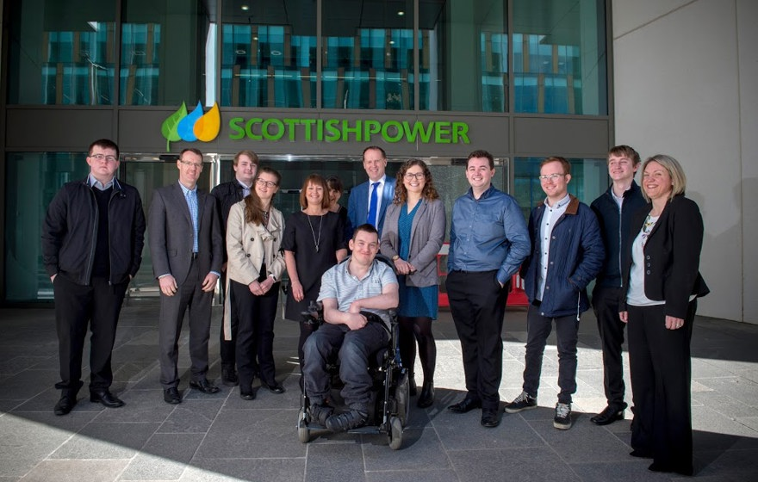
#ZeroCon25
Notes:
Sample Slide: presenting three points on our project and the relationship to this year’s theme of the Zero Project Conference. Point 1; Point 2; Point 3 connect together in this way.

Slide 4
Pathways for the Future
Change is possible and essential
At Enable we deliver Enable Works, Breaking Barriers and inclusive approaches to finding rewarding careers.
In this session we will hear more about that impact in Scotland from Matthew Gallery, and about Zero Project supported projects Chance B here in Austria with Michael Longhino and Prof Matthias Morfeld on his team’s work in Germany
Change requires collaboration between sectors; innovative and groundbreaking new partnerships; and courage to give people a chance to shine
Notes:
Sample Slide: presenting three points on our project and the relationship to this year’s theme of the Zero Project Conference. Point 1; Point 2; Point 3 connect together in this way.

Slide 5
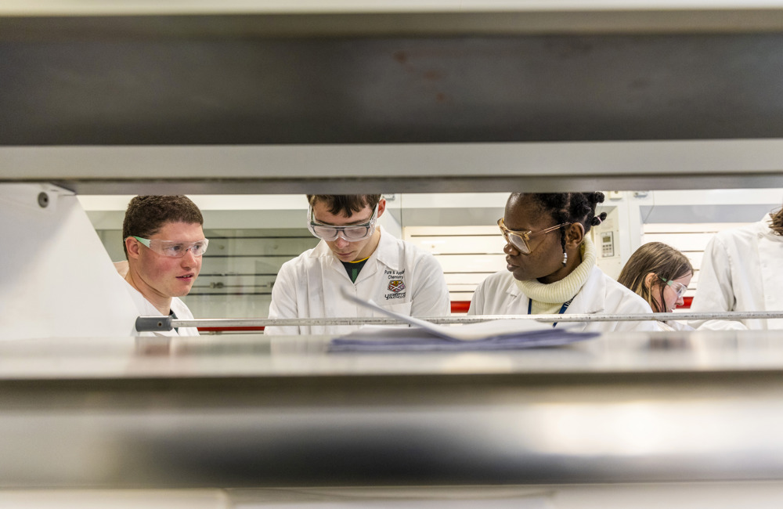
#ZeroCon25
Notes:
Sample Slide: presenting three points on our project and the relationship to this year’s theme of the Zero Project Conference. Point 1; Point 2; Point 3 connect together in this way.

