Slide 1
“Promoting technology & independent living for VI Persons”
Kwai Nan
Living Dignity For The Blind
Myanmar
Leveraging social media, gaming, radio, and YouTube for education, networking, and employment
Day - February 22, 3023.
Time - 9:40am to 11am
Notes:
Please add your notes here.
Title; First name, last name of speaker(s); Name of Organization, Name of Country, Name of Session (as written in Agenda)
#ZeroCon24
Day and Time of Session

Slide 2
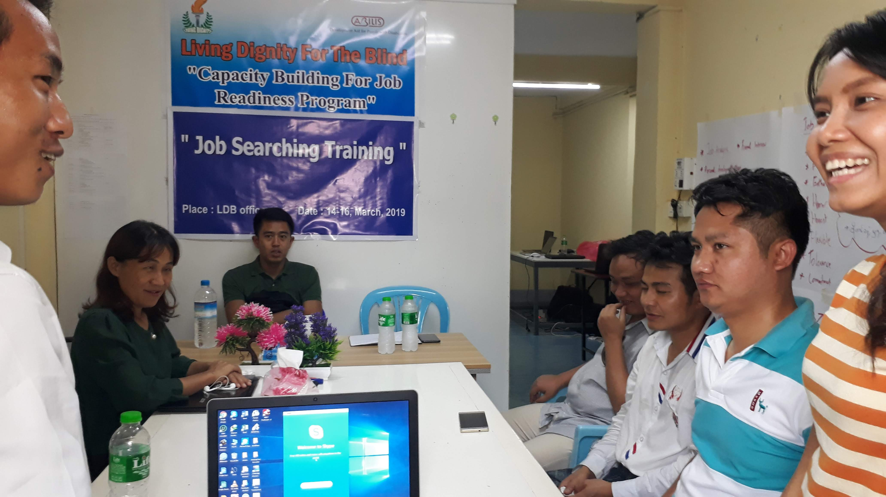
Working team background:
Our team was founded in 2019 with the purpose of working on capacity building and removing barrier by technology solution for VI persons toward employment.
VI youths are remain in hopeless after graduation from university since massage is the only job opportunity in our country.
Less than 10 VI persons were able to use smart phone because of language barrier.
Therefore, we were organized to find out the way for catching up wider opportunity to be independent.

Slide 3
What we have done to find the solution:
Developed local language TTS Android version by collaborating with Sao Mai team, Vietnam.
https://play.google.com/store/apps/details?id=org.saomaicenter.myanmartts
Developed money reader App, since our bank notes are not obvious to select for VI persons.
https://play.google.com/store/apps/details?id=com.tpo.banknotereader
Developed on line platform computer training
https://enhancingldb.org/
Provided job skill trainings via zoom during and after Covid pandemic.
Developed fully access Myanmar keyboard

Slide 4
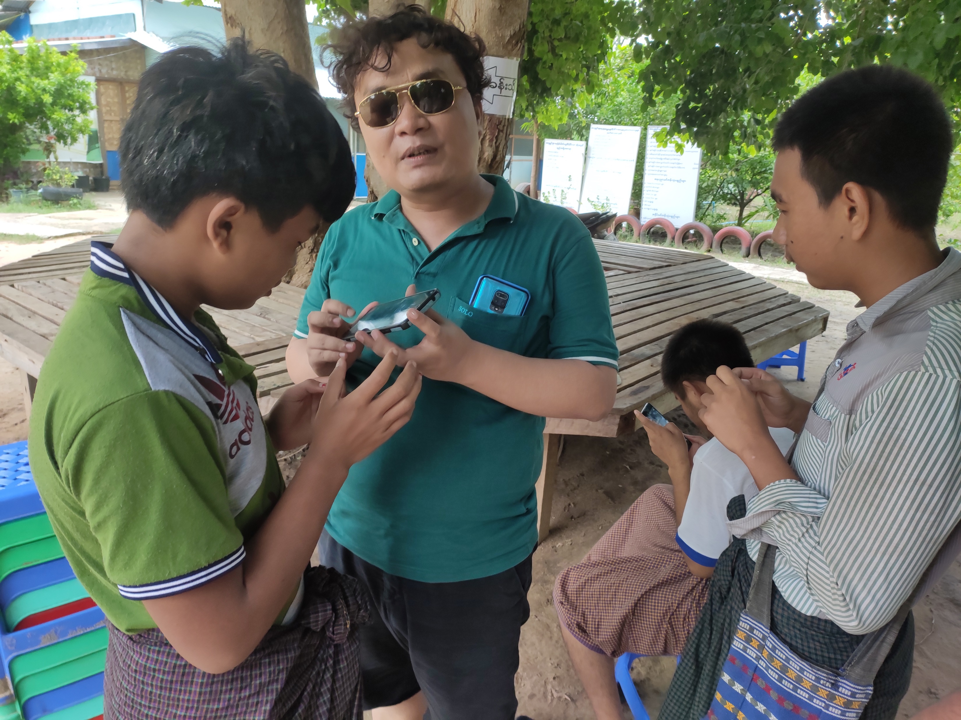
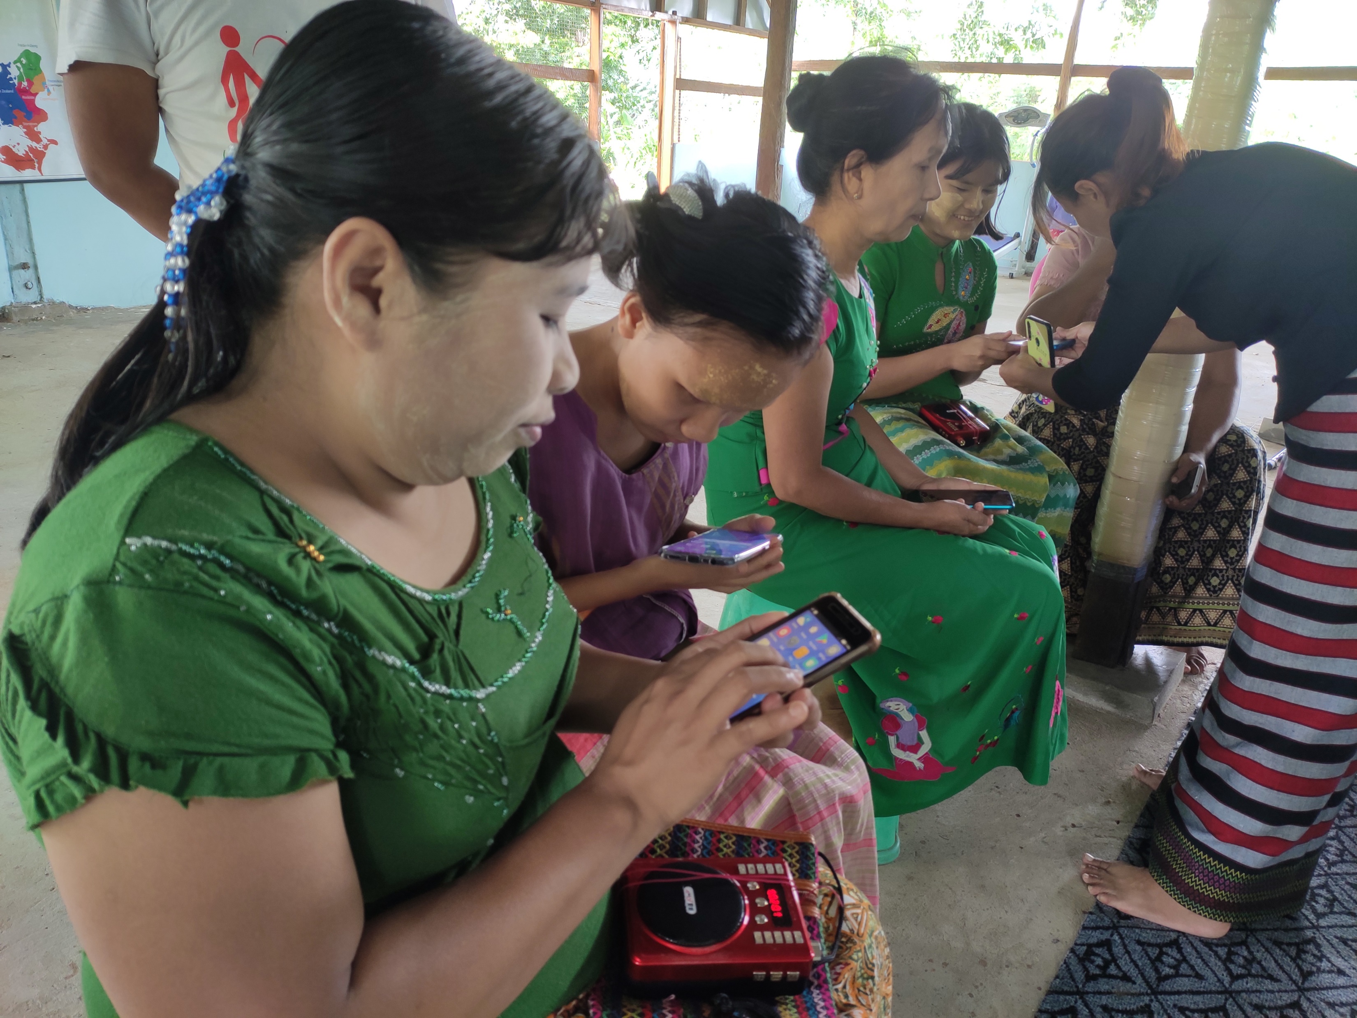
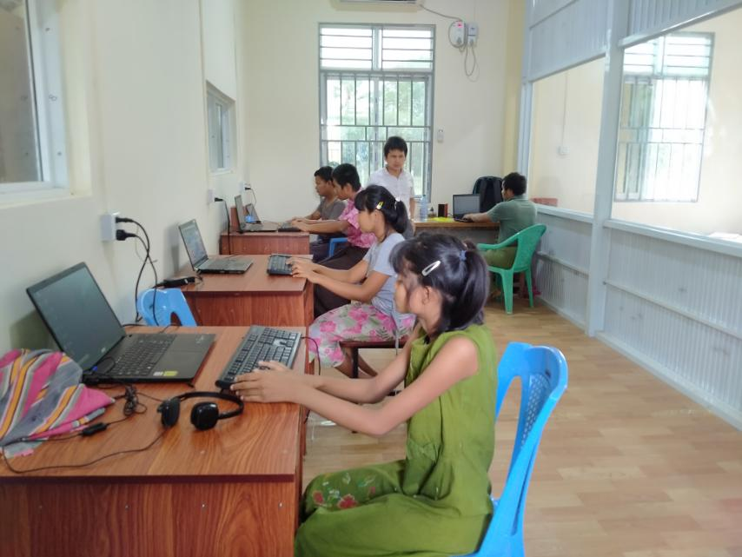
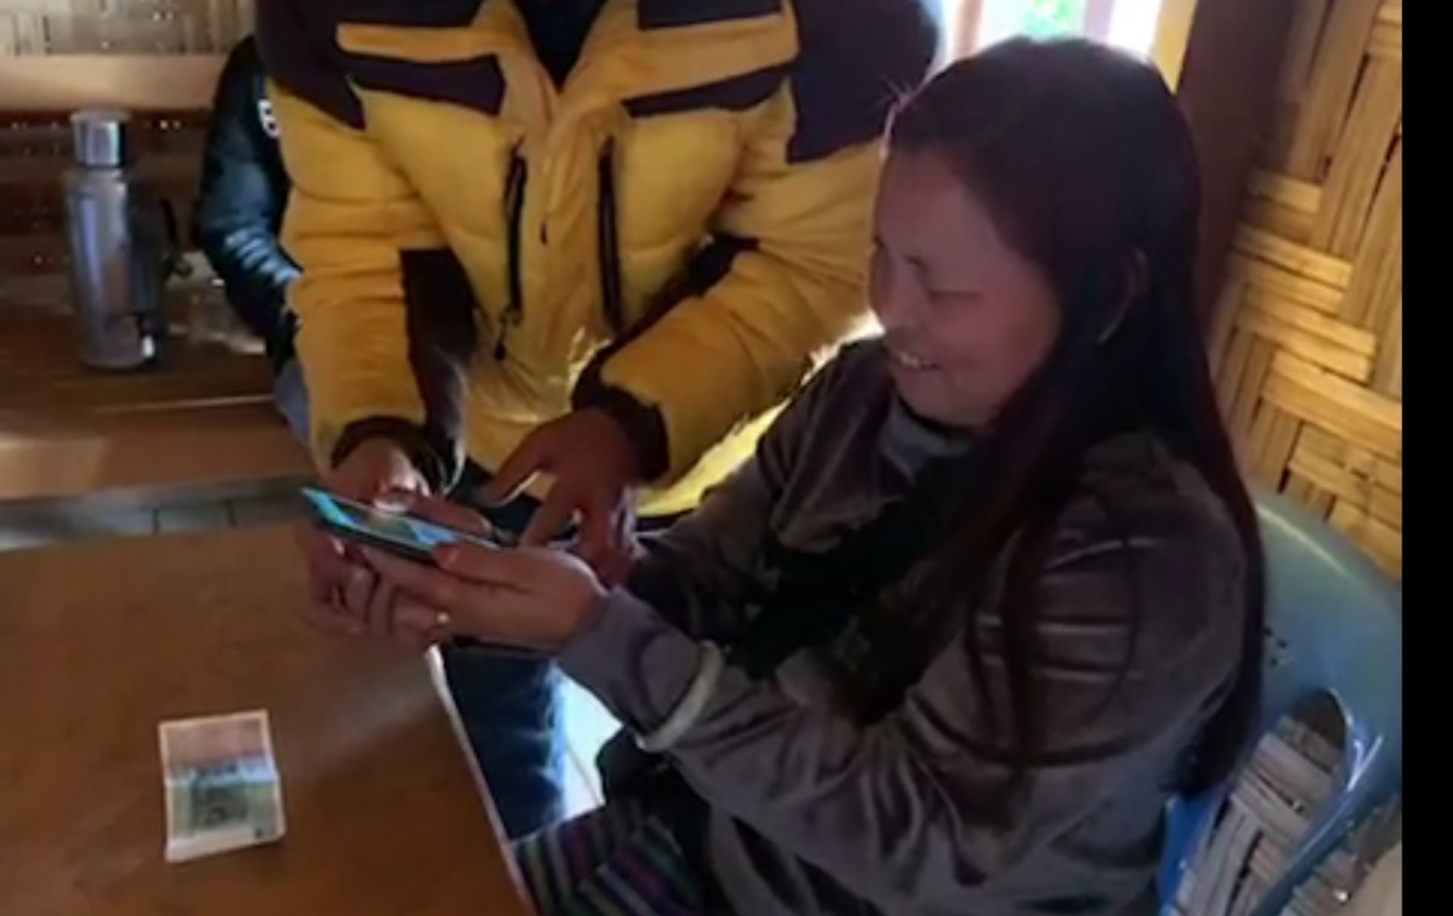
Conducted smartphone using and computer training based on blind schools around the country, and borrowing devices.

Slide 5
Our work success:
More than 80 VI persons have been learning computer from on line platform and more than 200 received skill trainings and knowledge sharing during pandemic lockdown period.
By 2023, a Thousand of VI persons are using smartphone. Nearly 100 VI persons are using computer and gaining education and job skill trainings via online.
VI students in university are relieve as they could access public trainings even though their schooling was pause since Covid pandemic and follow by the political crisis.

Slide 6
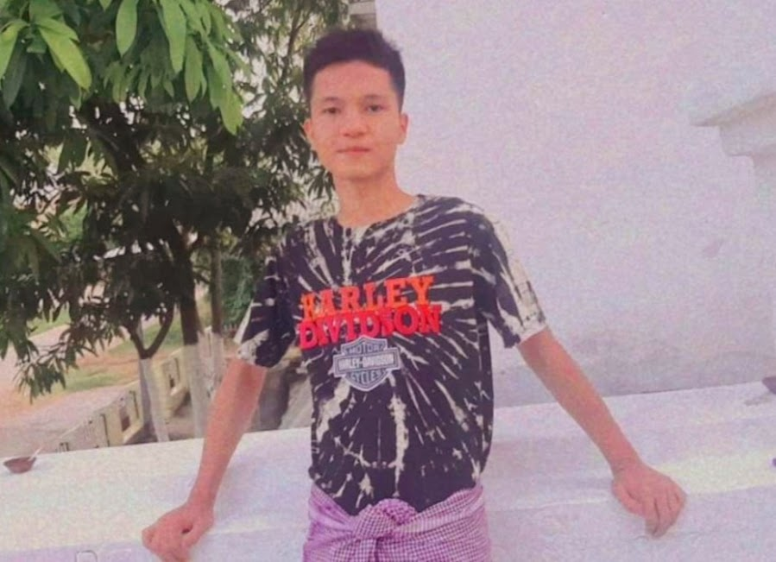
Mr. Soe Thar Aung
Mr. Soe Thar Aung is the first VI student having chance attending at
teacher's training college in our country. It is private institution.
We are so much delighted for this initial step to provide quality
education to VI children.

Slide 7
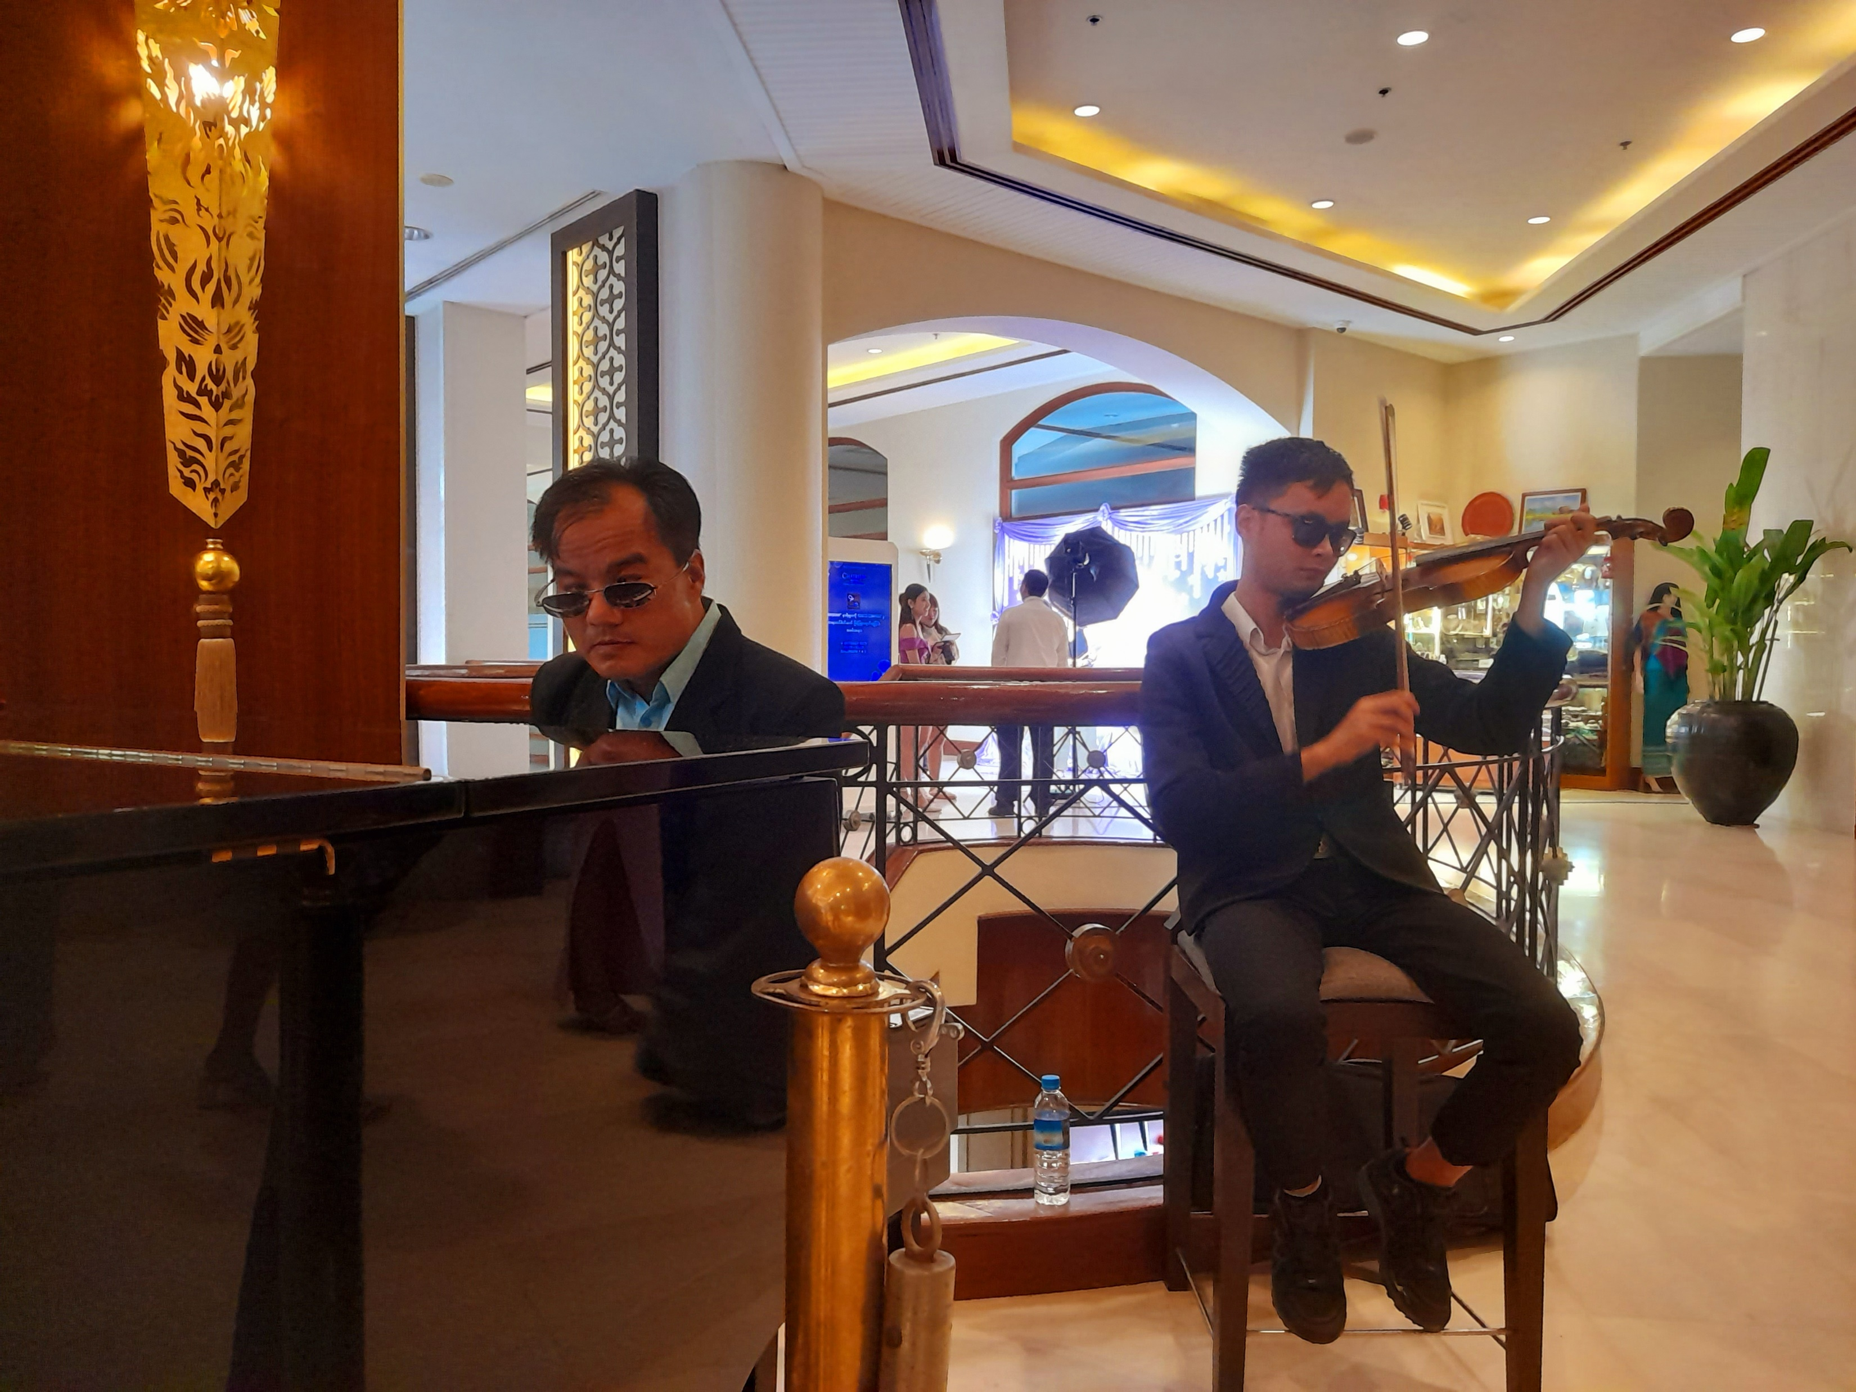

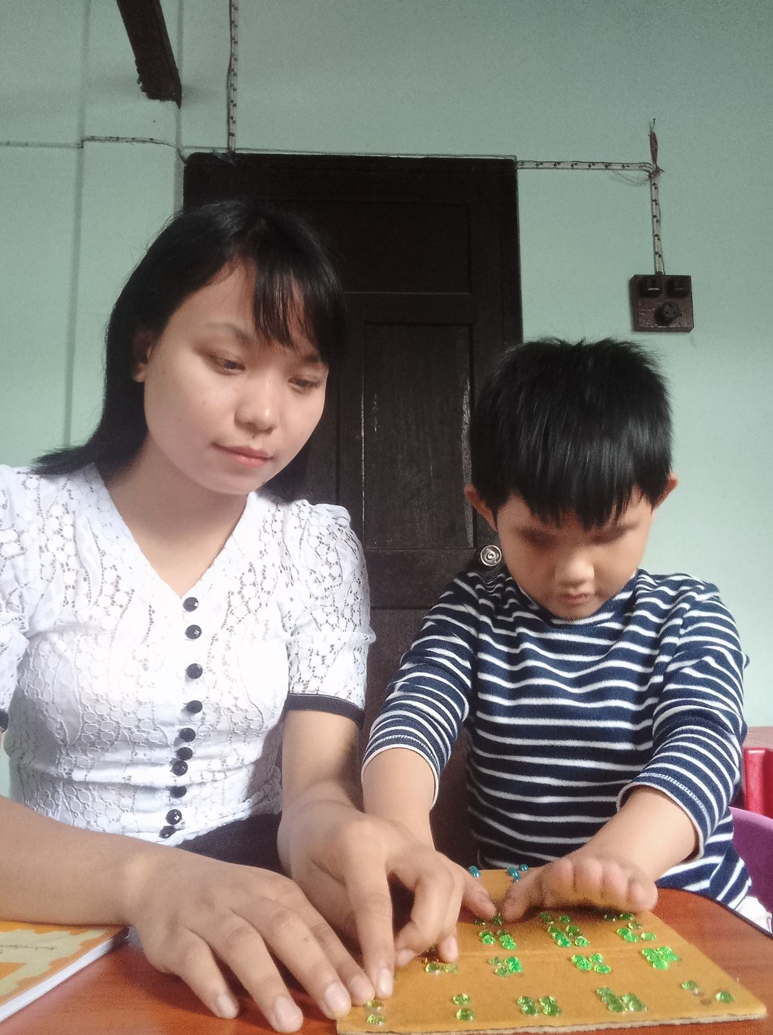
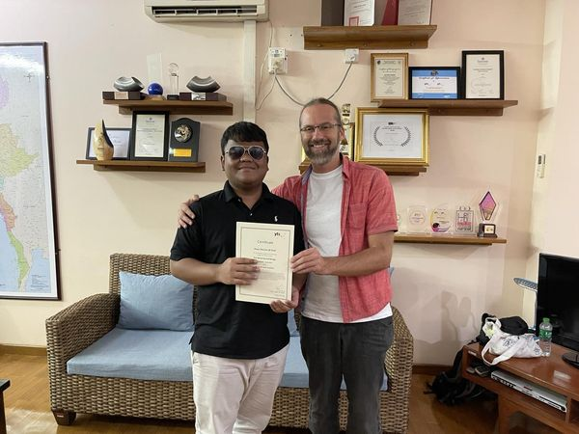
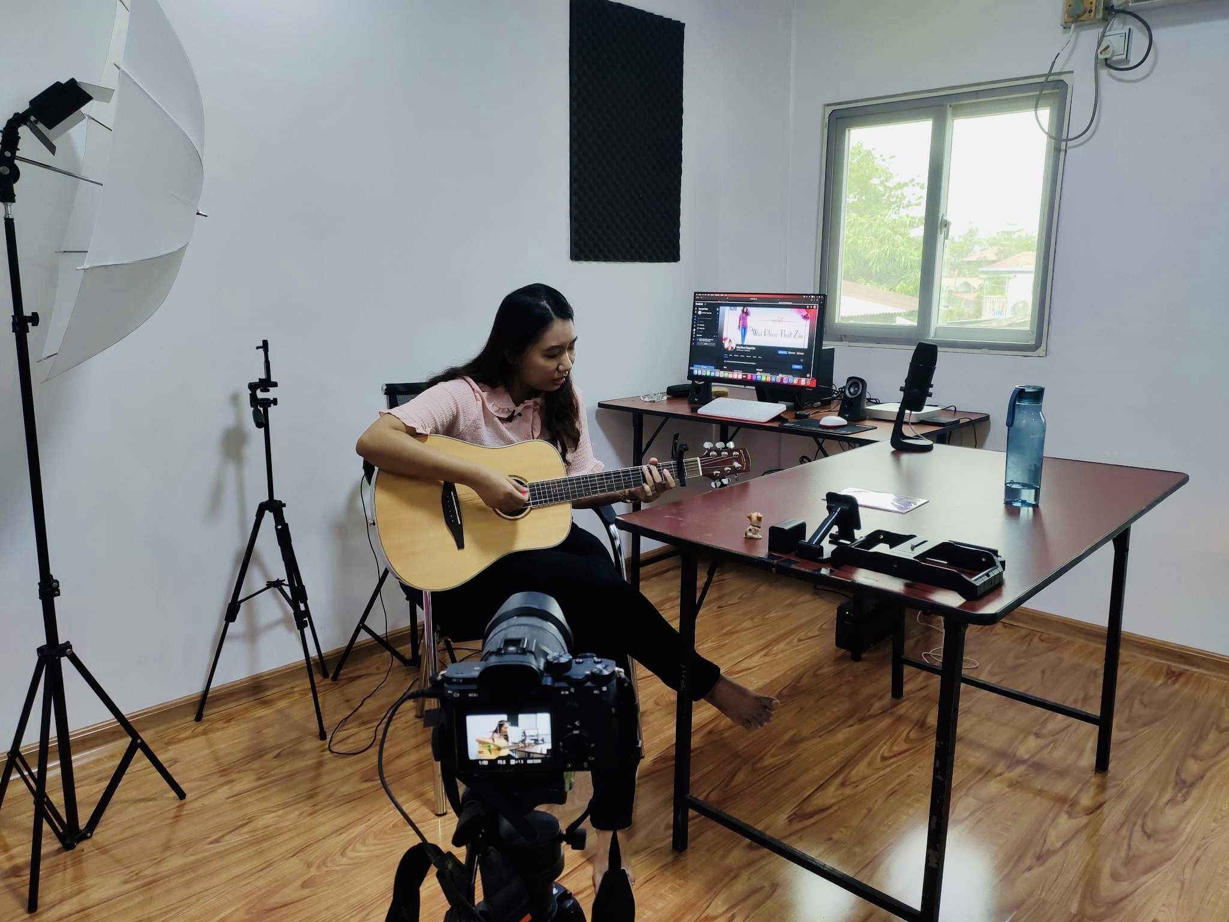
Some VI youths are self employed by our project support skilling up

Slide 8
Project impact
Business and communication trend in our country shifted to online during and after pandemic. That made open the door for our VI persons to society and we have got prepared to step in.
VI persons in mass come to realize the value of assistive technology. Many of those hiding at home have chance to enjoy in social media by our IT service support. They are comfort from miserable living.
Our community begin to acknowledge VI person’s ability by the technology support.

Slide 9
Financing and challenges:
Fund raising opportunity is closed at current situation in our country.
It is in crucial need to upgrade our TTS to be compatible with
constantly upgrading Android version.
We could not imagine to be left behind.

Slide 10
Next step:
To upgrade our language TTS.
To Acquire advance training on technology to be able to handle our
needs
To acquire resources to open up education opportunity for VI
children with special needs.
To build up our team toward social enterprise company.

