Slide 1
MentorAbility Canada
Mary Beshai, Director MentorAbility Canada
Canadian Association for Supported Employment (CASE)
Canada
Disabled Peoples Organizations as 360° Facilitators
Friday 7 March 2025 | 13:40 - 15:00
Notes:
Visual Description:
MentorAbility Canada. Mary Beshai, Director MentorAbility Canada. Canadian Association for Supported Employment (CASE). Canada. Disabled Peoples Organizations as 360° Facilitators. Friday 7 March 2025 | 13:40 – 15:00.
Content Overview:
Cover slide with session details.
Speaking Notes:
Welcome. I’m Mary Beshai and I’m the Director of MentorAbility Canada with the Canadian Association of Supported Employment or CASE. I am thrilled to be here today! I am a middle aged woman with dark curly hair, and am wearing xxx. During this session, I'll explain how a national network of employment service providers across Canada are raising awareness about workplace disability inclusion and are connecting job seekers who experience disability and employers through the MentorAbility Canada initiative.

Slide 2



Canadian Association for Supported Employment (CASE)
National association for the supported employment sector in Canada
Provides services and supports for persons experiencing disability who want competitively paid employment in their communities
We work with employment service providers, employers, community allies, and advocates towards workplace inclusion.
Notes:
Visual Description:
The CASE logo, MentorAbility logo, and the wordmark for the Government of Canada.
Content Overview:
The Canadian Association for Supported Employment (CASE) is a national association for the supported employment sector in Canada.
Speaking Notes:
MentorAbility is a mentoring initiative of CASE. CASE is a national association for supported employment service providers in Canada. Supported employment provides services and supports for persons experiencing any type of disability so that they can find and retain competitively paid, purposeful employment. CASE facilitates opportunities for service providers to increase workplace disability inclusion.
We work and collaborate with employment service providers, employers of all sizes, industry associations, community organizations, and persons experiencing disability toward increased employment or self-employment.

Slide 3
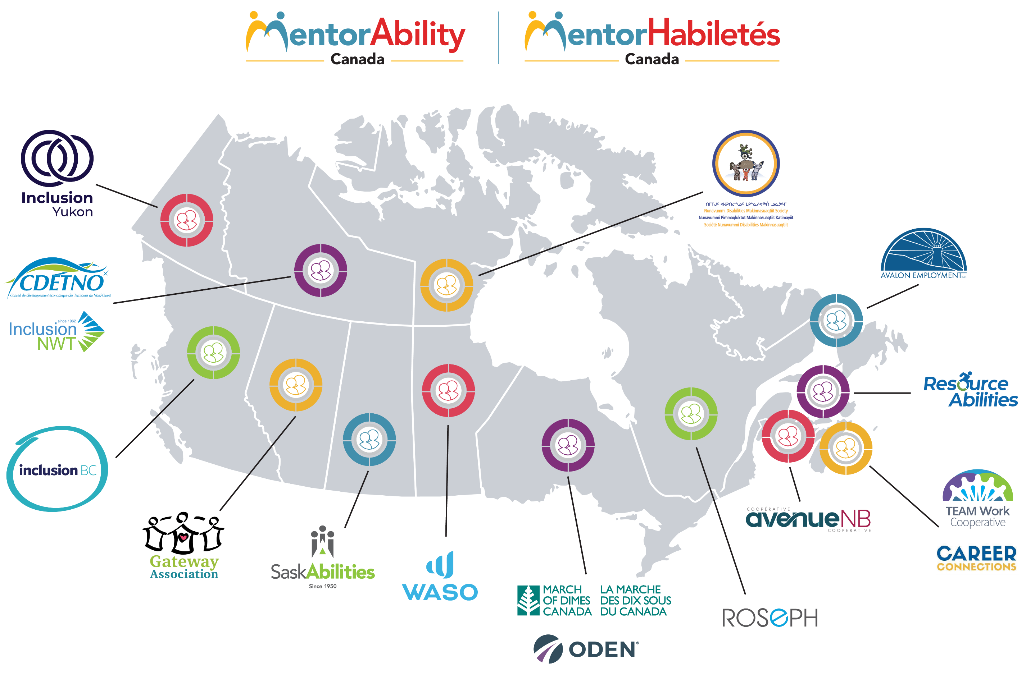
Map of MentorAbility Hubs in Canada
MentorAbility promotes the recruitment, employment, and advancement of persons experiencing disability.
Notes:
Visual Description:
Map of Canada with the name/logo of each MentorAbility Hub in their respective province or territory.
Content Overview:
MentorAbility Canada promotes employment for persons experiencing disability and is coordinated nationally by CASE in collaboration with partners across Canada.
Speaking Notes:
MentorAbility promotes the recruitment, employment, retention and advancement of persons experiencing disability. MentorAbility Canada is coordinated nationally by CASE with funding from the Government of Canada. Initially, we started as a pilot project in two provinces and have now scaled up across the country.
We work in collaboration with implementing partners called MentorAbility Hubs, with one Hub in each province and territory. The hubs work with community-based partners and local employers. We also collaborate with national and international organizations on research and to share best practices. Altogether, this is the MentorAbility network.

Slide 4

More than a Mentoring Initiative
Host Networking and Learning Events
Raise Awareness through Social Media
Research and Share Evidence-Based Practices
Notes:
Visual Description:
Circle contains Facilitate Mentorships with text on side: Host Networking and Learning Events, Raise Awareness through Social Media, Research and Share Evidence-Based Practices.
Content Overview:
MentorAbility is more than a mentoring initiative, which is one of the reasons this program is so effective.
Speaking Notes:
MentorAbility is about much more than mentoring, which is one of the reasons this program is so effective. While our main activity is facilitating mentorships, we also host networking and learning events to share knowledge about workplace disability inclusion and to bring together service providers and employers.
Awareness about disability inclusion is created through social media campaigns. And we conduct research around disability mentoring with our partners and share the resulting evidence-based practices.

Slide 5


Every MentorAbility Experience Is Unique
Promotes employment or self-employment
Personalized, short (1-hour to 1-day) experiences
Virtual or in person
Facilitated by local experts in disability inclusion
Format: job shadowing, workplace tour, work-based experience, exploratory conversation
Mentee and Mentor in airport – MentorAbility Yukon
Notes:
Visual Description:
Photo of a mentee and mentor in high visibility vests standing next to each other in front of a luggage belt and a wall with Air North.
Content Overview:
Every mentorship experience is tailored to the unique needs of the mentee and mentor as well as the region.
Speaking Notes:
Another factor that contributes to strengthening outcomes is that every MentorAbility experience is unique. Every experience is personalized for the unique needs of the mentee and the mentor. Together, they choose the format and length of the mentorship - which is kept short for busy employers - and whether it’ll be virtual or in person. Virtual mentorships allow mentees to access a Mentor anywhere in the country.
In addition, the MentorAbility Hubs can adapt the program to meet their regional needs, for instance to offer culturally adapted community engagement as well as supports for Indigenous clients.

Slide 6
Reciprocal Learning and Benefits
Each participant contributes to and learns from the experience.
Their organizations benefit too!
Mentorship Facilitators – new tool and expanded network
Mentees – career confidence, self-advocacy skills, clarifies career path
Mentors and their Organizations – leadership development, inclusion skills, expanded talent pipeline
Facilitator
Mentor
Mentee
Notes:
Visual Description:
In a circle with arrows joining them are the words: Mentor/Employer, Mentee, Mentorship Facilitator/Community Partner.
Content Overview:
Each of the MentorAbility participants – the mentee, the mentor and their organization/the employer, and the mentorship facilitator and their organization/the community partner – have unique knowledge to share and will learn from the experience.
Speaking Notes:
The participants include the mentees, the mentors and their organizations, who are the employers, and the mentorship facilitators, who are with a MentorAbility Hub or a community partner. Every participant has a unique perspective and knowledge to contribute to the mentorship and will also learn from this experience. And the organizations also benefit too.
The Mentorship Facilitators gain a new career exploration tool and they have a very unique role to connect the mentees and the mentors and to offer new learning opportunities…
…to the Mentees who gain career confidence, advocacy skills, and self-determination.
…and to the Mentors and their Organizations who gain professional development and improve their inclusion knowledge and local connections to a new talent pipeline.

Slide 7
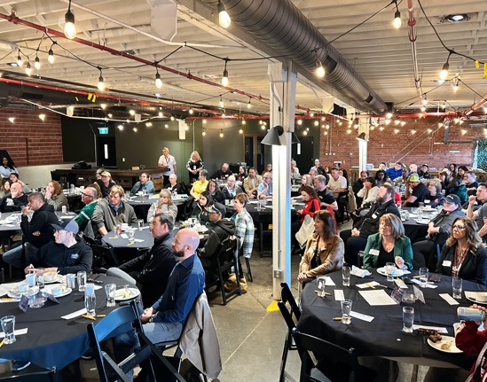

Meaningful Connections Facilitate Inclusion
1,300+ Mentorships in urban and rural communities
in each province/territory
170+ Mentorship Facilitators active across the country
500+ events organized since April 2024
Every connection creates opportunities for successful job outcomes.
Local employer event, MentorAbility Saskatchewan
Notes:
Visual Description:
No visual.
Content Overview:
The MentorAbility initiative has facilitated more than 1,300 mentorship experiences and gained 170-plus mentorship facilitators across Canada.
Speaking Notes:
Since MentorAbility started in 2019, more than 1,300 mentorship experiences have been facilitated in urban and rural communities in every province and territory, which is saying a lot for a country as vast and diverse as Canada. That’s why program flexibility has been essential for the success of the program.
And we now also have more than 170 mentorship facilitators across the country who can facilitate mentorship matches.

Slide 8
Positive Outcomes
Supports career exploration
Confirms next steps to meaningful employment or self-employment
Helps employers gain more understanding of disability and inclusion
Hearing people’s stories helps us to keep grounded and sensitive to the needs of others with disabilities.
– Employer who participated in MentorAbility​
Notes:
Visual Description:
No visual.
Content Overview:
MentorAbility supports the career development of persons experiencing disability and helps employers learn about disability inclusion in their workplace.
Speaking Notes:
Overall, we've learned that MentorAbility is effective at supporting the career exploration of persons experiencing disability so that they have a better sense of the next steps to take on the path to meaningful, long-term employment or self-employment.
And mentorship experiences help employers to gain a better understanding of disability and what disability inclusion can look like in their workplace.

Slide 9


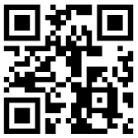
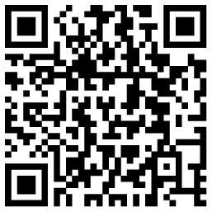
Mark's Story
Video of Mark telling his story:
Read more stories:
Mentee and Mentor in bakery – MentorAbility Manitoba
Notes:
Visual Description:
Photo of a mentor and a mentee wearing aprons and working on a large table in a commercial kitchen. Includes a QR code.
Content Overview:
The story of Mark, an immigrant experiencing disability who had a successful mentorship experience in a local bakery.
Speaking Notes:
I'd like to share the personal story behind one of these numbers. As a new immigrant who also experienced disability, Mark faced many barriers to employment. Mark was interested in the food industry, so the mentorship facilitator matched him with a local chocolate bakery. The mentorship experience provided the information Mark needed to decide that he did enjoy working in the food industry and in a bakery. And it allowed the bakery owners to see the potential in a worker experiencing disability. This match was so successful that the owners hired Mark as an employee. You can scan the QR code for a video of Mark telling his story.
Employment opportunities sometimes occur with the employer who did the mentorship, but they can also occur shortly after the mentorship with another employer due to the mentee’s increased confidence and career awareness, strengthened professional networks, and other benefits.
You can read more MentorAbility stories on the CASE website by scanning this QR code. (wait 2-3 seconds)

Slide 10
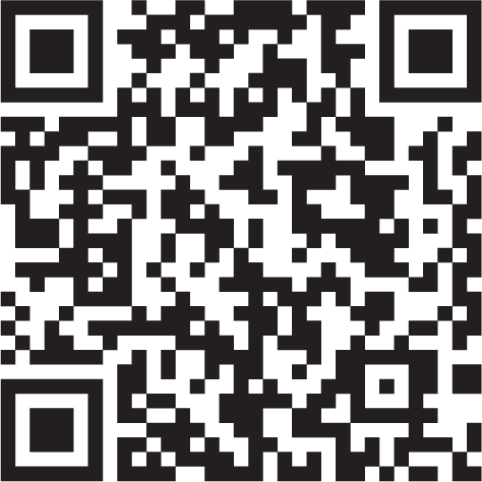

Continued mentoring for improved workplace inclusion
More info:
MentorAbility
Partners continue to :
Leverage MentorAbility practices and resources
Use networks and collaborations to strengthen relationships and capacity
Access research findings and CASE complimentary learning offerings
CASE website
Notes:
Visual Description:
No visual. Includes two QR codes.
Content Overview:
Phase 2 of MentorAbility is currently in progress and steps are being taken to ensure the program and products can continue to be leveraged in communities in the long term.
Speaking Notes:
Phase 2 of MentorAbility is now in the works and includes preparing existing and new partners, including community organizations and employers, for long-term success. While a national coordinating team is essential to establish the initiative, community-based work can continue at program completion.
After phase 2, we anticipate that organizations will continue to leverage mentoring practices for recruitment and onboarding, either using the MentorAbility framework or an adapted version that fits their needs. The program is replicable and adaptable. Existing resources, networking, and collaborations will continue to strengthen community relationships and organizational capacity.
Service providers and employers can continue to take complimentary learning offerings through CASE. And the research products will remain available and will continue to inform mentoring programs and employer disability inclusion practices.
For more information about MentorAbility, you can access our website using this QR code or go to supportedemployment.ca. And that’s it for our presentation.

