Slide 1

EnableMe Ukraine: enabling Ukrainians with disabilities
Oleksandra Zhurakhivska, EnableMe Ukraine Country Leader
Michael Lorz, Managing Director EnableMe Foundation
Switzerland
Forum on Climate Change and Humanitarian Crises
Thursday, February 22, 2024
10:00 am – 11:00 am CET
Notes:
Please add your notes here.
Title; First name, last name of speaker(s); Name of Organization, Name of Country, Name of Session (as written in Agenda)
#ZeroCon24
Day and Time of Session

Slide 2
Ukrainians with disabilities and the war
2.7 million people with disabilities were in Ukraine in 2021. There were 163,900 children among persons with disabilities.
After the war started in Ukraine in 2022, 4.2 million Ukrainians became a refugee. 23% of whom are persons with disabilities: 1 million persons.
As a result, the number of people with disabilities is increasing rapidly – both among the combatants and civilians who suffer from shelling, bombing, and other injuries caused by military actions. In the short-term perspective, the number of people with disabilities who will need inpatient care will also increase dramatically.
In 2024 there are 3.1 million Ukrainians with disabilities.
In 2022-2023 this number increased by approximately 400,000.
Notes:
Sample Slide: presenting three points on our project and the relationship to this year’s theme of the Zero Project Conference. Point 1; Point 2; Point 3 connect together in this way.

Slide 3
Needs of Ukrainians with disabilities and EnableMe Ukraine
EnableMe Ukraine conducted research to identify Ukrainians with disabilities basic needs both abroad and on the territory of Ukraine. The research data is updated monthly.
TOP-5 needs of Ukrainians with disabilities abroad:
  Relocation to refuge country from Ukraine
  Official confirmation of disability abroad
  Psychological support
  Job search in EU countries
  Education in EU countries for people and especially children with disabilities
  Return to Ukraine from refuge country
Notes:
Sample Slide: presenting three points on our project and the relationship to this year’s theme of the Zero Project Conference. Point 1; Point 2; Point 3 connect together in this way.

Slide 4
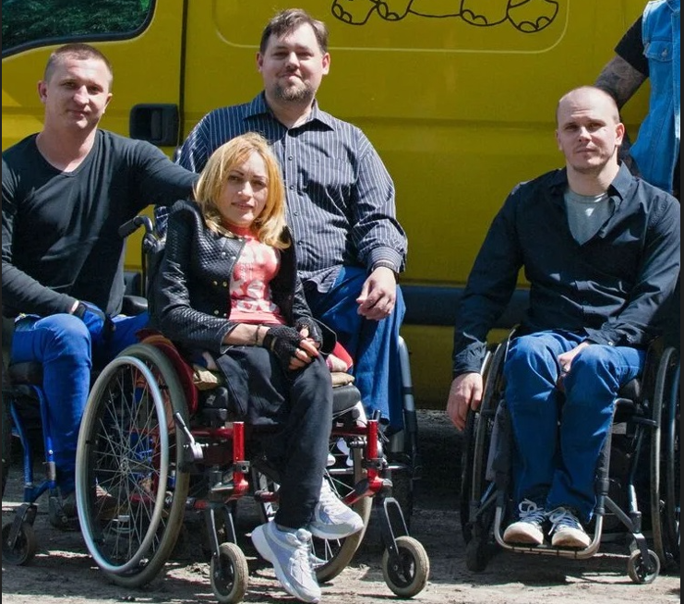
Needs of Ukrainians with disabilities and EnableMe Ukraine
TOP-5 needs of Ukrainians with disabilities in Ukraine:
  How and where to get medicine or special equipment (wheelchair, prosthetics, shoes)
  Psychological support
  Reconstruction of the destroyed housing
  Housing for displaced persons
  Job search
Notes:
Sample Slide: presenting three points on our project and the relationship to this year’s theme of the Zero Project Conference. Point 1; Point 2; Point 3 connect together in this way.

Slide 5
Needs of Ukrainians with disabilities and EnableMe Ukraine
April 2022 - EnableMe launched the EnableMe Ukraine information portal and online Community.
Via our information and online services people with disabilities:
  got information on how to handle war related disabilities,
  knew where to find a pharmacy,
  found friends & supporters in foreign countries,
  received information for refugees in more than 10 countries and also orientation of where & what when being displaced in Ukraine,
  got information on how to register a status of person with disability in Ukraine and EU countries & how and where injured militaries can get rehabilitation and prosthetics.
Notes:
Sample Slide: presenting three points on our project and the relationship to this year’s theme of the Zero Project Conference. Point 1; Point 2; Point 3 connect together in this way.

Slide 6
EnableMe Ukraine: Impact since launch in April 2022
Since our launch in April, EnableMe Ukraine had 3,150,000+ unique users within our content and community page in Ukrainian and Russian
  950+ Community Members
  2700+ Questions & Answers & Discussions
  300+ Content pieces were created
  EnableMe Ukraine has an official partnership with the National Assembly of persons with disabilities of Ukraine:
    “The stories of war” - an inspirational stories of Ukrainian heroes
    Information portal for Ukrainians with disabilities.
Notes:
Sample Slide: presenting three points on our project and the relationship to this year’s theme of the Zero Project Conference. Point 1; Point 2; Point 3 connect together in this way.

Slide 7
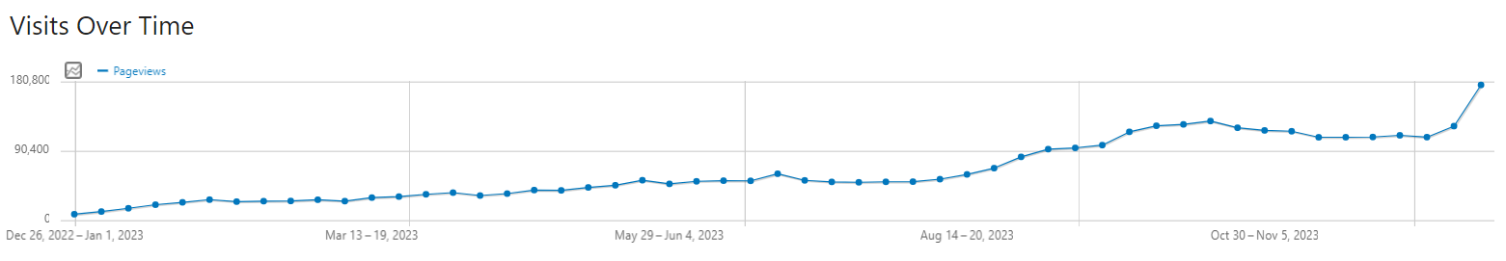
Strong Data Analytics for Measuring Impact
2022-2023: 3,150,000 unique users
People that read articles fully: 42,87% = 1,350,405
People who evaluate the articles as helpful: 75% = 1,012,803
EnableMe Ukraine was able to help 1,012,803
Ukrainians in 2022-23
Unique Users over Time
Notes:
Sample Slide: presenting three points on our project and the relationship to this year’s theme of the Zero Project Conference. Point 1; Point 2; Point 3 connect together in this way.

Slide 8
2023: Problems Ukrainians with disabilities were facing
A Ukrainian military man needs prosthetics because of the amputation of his arm. He applies to the community if there is still a promotion for free prosthetics. Also the man has questions if he will be able to work with a prosthesis and where can he learn more about hand prostheses?
  The volunteers welcomed the man warmly and provided him with the full information and the latest articles.
  The man found a lot of useful information for militaries and disabilities he could not find elsewhere
A Ukrainian woman asked to help with information about registration of disability for a non-militarian, who became a person with disability because of war in Ukraine. Also woman was asking about the rehabilitation and getting prosthetics abroad.
  EnableMe Ukraine volunteers provided the woman with contacts of organizations that help with rehabilitation and prosthetics abroad
  EnableMe Ukraine experts consulted on disability registration in Ukraine
Notes:
Sample Slide: presenting three points on our project and the relationship to this year’s theme of the Zero Project Conference. Point 1; Point 2; Point 3 connect together in this way.

Slide 9
Outlook 2024
In 2024 EnableMe Ukraine aims to:
  Support people (children, youth with disabilities, militaries) who have been injured by the war with digital content and experts.
  Create a digital community of experts and like-minded peers to help members resolve their queries.
  Support people with disabilities and those living with chronic conditions by providing information on where and how they can find a job or get special education.
  Reinforce partnerships with refugee agencies in several EU countries to ensure that displaced people with disabilities get the support they need to overcome life’s challenges. Reinforce the efforts of public structures like the National Assembly of Persons with disabilities in Ukraine.
  Create a network of European and Ukraine organizations which support Ukrainians with disabilities in all spheres of their life (separate focus is on the rehabilitation of those who were injured in war actions - both soldiers and civil).
  Cater specifically for intellectual disabilities with specific content in easy language.
Notes:
Sample Slide: presenting three points on our project and the relationship to this year’s theme of the Zero Project Conference. Point 1; Point 2; Point 3 connect together in this way.

Slide 10
Your support is extremely important!
EnableMe Ukraine makes a unique and significant contribution to awareness, reintegration and empowerment for people with disabilities and/or chronic illnesses both in Ukraine and the EU countries.
Each 1 euro of donations is changing somebody‘s life!
Please help us to enable Ukrainians with disabilities!
www.enableme.org
Contact us: Oleksandra.zhurakhivska@enableme.com.ua

