Slide 1
Finance Without Barriers: Microfinance for an Inclusive Future
John Alex
CSR Head of Equitas Small Finance Bank
Program Director Equitas Development Initiative Trust
India
Microfinance models by and for persons with disabilities
Day and Time of the Session
Notes:
Please add your notes here.
Title; First name, last name of speaker(s); Name of Organization, Name of Country, Name of Session (as written in Agenda)
#ZeroCon24
Day and Time of Session

Slide 2
About Us
Since 2007, Equitas has empowered 15+ million beneficiaries across 10 states
Inclusive Finance Impact: 1,79,105 women with disabilities have received microfinance loans
Disability Breakdown:
Notes:
Sample Slide: presenting three points on our project and the relationship to this year’s theme of the Zero Project Conference. Point 1; Point 2; Point 3 connect together in this way.

Slide 3
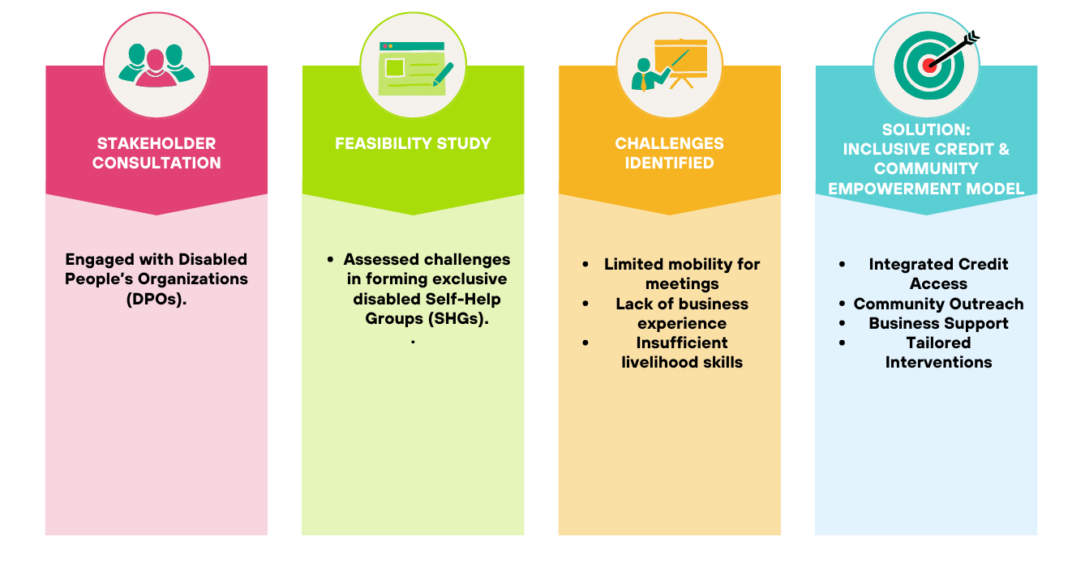
How did we bring about disability inclusion?
Notes:
Inclusive Credit & Community Empowerment Model
Integrated Credit Access:
Disadvantaged groups access credit through the main program.
Community Outreach:
Local groups identify persons with disabilities in their neighborhoods.
Business Support:
Community members help pinpoint viable business opportunities and support startups.
Tailored Interventions:
Equitas offers loans and skill development training.
Local groups provide ongoing moral support.

Slide 4
Leveraging Community & Infrastructure for Inclusion
Opportunities | Challenges | Impact & Benefits
Community groups identify persons with disabilities. Support in business selection & startup. Equitas provides loans & skill training. Ongoing moral and peer support. | Gaining buy-in from the board & organization. Convincing and motivating field staff. Building trust with existing group members. Encouraging groups to identify and mentor target individuals. Boosting confidence among persons with disabilities. | Direct Benefits: Stronger support mechanisms for the target segment. Other Benefits: Increased social capital at the group level. Enhanced staff alignment with the company’s philosophy

Slide 5
Progressing Inclusion: Actions Taken
📝 Training & Sensitization of Loan Officers
Dispelling disability myths & promoting inclusive etiquette
Practical training to identify clients with disabilities.
Integrated disability awareness into loan officer certification.
🏦 Building Inclusive Systems & Processes
Conducted Disability Access Audit at branches
📘Accessible banking services
Basic sign language training for loan officers
Tactile markings on passbooks.
Home visits for clients with mobility challenges

Slide 6
Impact of Financial Inclusion (UNITUS REPORT)
Economic Growth
Increased business income after availing the loan.
Higher savings from business earnings.
Social Empowerment
Clients are more socially active post-loan.
Greater social engagement compared to non-clients.
Improved esteem & recognition from family and neighbors.
Increase in Assets
Mobile phones & LPG stoves are the most purchased consumer durables in the last six months.

Slide 7
Roadmap for inclusive finance
Expanding Financial Services
Extend financial support to family members (mothers, wives, sisters) of persons with disabilities.
Conduct an in-house impact study to develop a sustainable long-term strategy.
Share best practices with other financial institutions to scale disability-inclusive microfinance models.
Reaching More Clients Through DPO Partnerships
Collaborate with Disabled People’s Organizations (DPOs) to identify eligible clients.
DPOs select & share profiles of suitable clients with Equitas.
Equitas staff & group leaders engage with identified clients to integrate them into mainstream financial inclusion.

Slide 8
Resilience & Opportunity: The Power of Inclusive Finance
Navnath Randive: A Vision Beyond Sight
Kavitas’s Journey: Overcoming Adversity
Lost vision due to an acid attack; confined at home for years
Faced rejection from banks & government schemes
Received a microfinance loan of ₹25,000 from Equitas to restart her life
Small support measures (reciting MFI pledge, assisted mobility) enabled participation
Used ₹10,000 seed capital from Equitas to start his business
Shop value doubled to ₹20,000, earning ₹10,000/month
A model of financial independence through skill & support
100% visually impaired, trained in assembling LED lights & solar panels

Slide 9
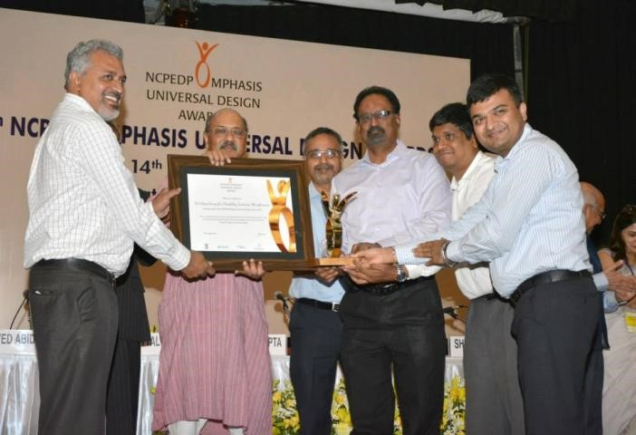
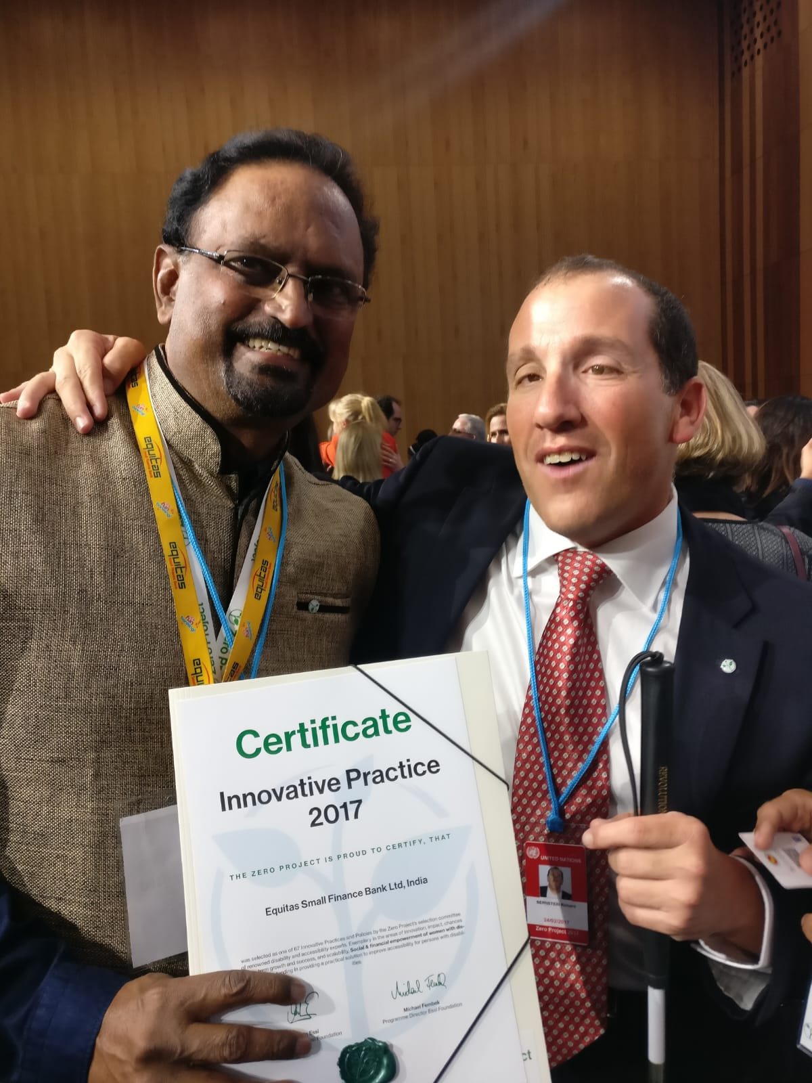
Awards and Accolades
Zero Project Award for Innovative Practice-Recognized for empowering women with disabilities at the UNO, Vienna ( Feb. 2017). The award was presented by Michigan Supreme Court Justice Richard Bernstein
2014 NCDEDP Award for working group

Slide 10
The Way Forward: Building a Truly Inclusive Future
Scaling Inclusion: Expand financial services to more persons with disabilities & their families
Strengthening Impact: Conduct impact studies to refine and improve initiatives
Collaborative Growth: Share best practices with other financial institutions
Empowerment Beyond Finance: Continue integrating skills training & community support
Microfinance is not just about loans—it’s about dignity, independence, and equal opportunity. By ensuring fair and transparent financial access, we can create a world where inclusion is a reality for all

