Slide 1
Steps Project
Jamil Derbashi
Deema Juneidi
Palestinian Center for Communication and Development Strategies “PCCDS”
Palestine
Educational and support strategies during humanitarian crises
Wednesday, 21 February 2024 | 16:00 - 17:20
Notes:
Please add your notes here.
Title; First name, last name of speaker(s); Name of Organization, Name of Country, Name of Session (as written in Agenda)
#ZeroCon24
Day and Time of Session

Slide 2
Short background of our organization and project
A Palestinian non-governmental organization co-founded by representatives of people with hearing and visual disabilities that aims primarily to protect human rights based on international and national law and the goals of the Sustainable Development Plan “Fourth Goal”
PCCDS holds the following awards
King Abdullah Award for Youth Creativity and Achievement
Award from the League of Arab States
Ashoka International Award
Saudi Ministry of Foreign Affairs Award
Notes:
Sample Slide: presenting three points on our project and the relationship to this year’s theme of the Zero Project Conference. Point 1; Point 2; Point 3 connect together in this way.

Slide 3
About the Project
Steps project
Improving the achievement and social integration of students with hearing and visual disabilities in UNRWA refugee camp schools in the West Bank, which number 19 camps and have 62 schools. The number of targeted students who suffer from hearing and visual disabilities is 1,900 male and female students, who suffer from a decline in achievement and integration and high dropout rates. Because of disabilities, as indicated by the records of the targeted schools

Slide 4
•The essence of our project
Activities that were implemented during the project journey
Preparatory study to determine the target groups and their needs
Forming a project team consisting of specialists in hearing, vision and education for people with disabilities
Comprehensive field examinations within schools using the latest technological means
Providing students with 743 glasses and 211 hearing aids
Training teachers on the mechanisms of inclusive education, emotional education, and active education to transfer experiences while working with the targeted students
Training counselors on mechanisms for community integration for students with hearing and visual disabilities
Active learning activities to raise the achievement rate
Community integration activities in the school, classroom and community
Final evaluation

Slide 5
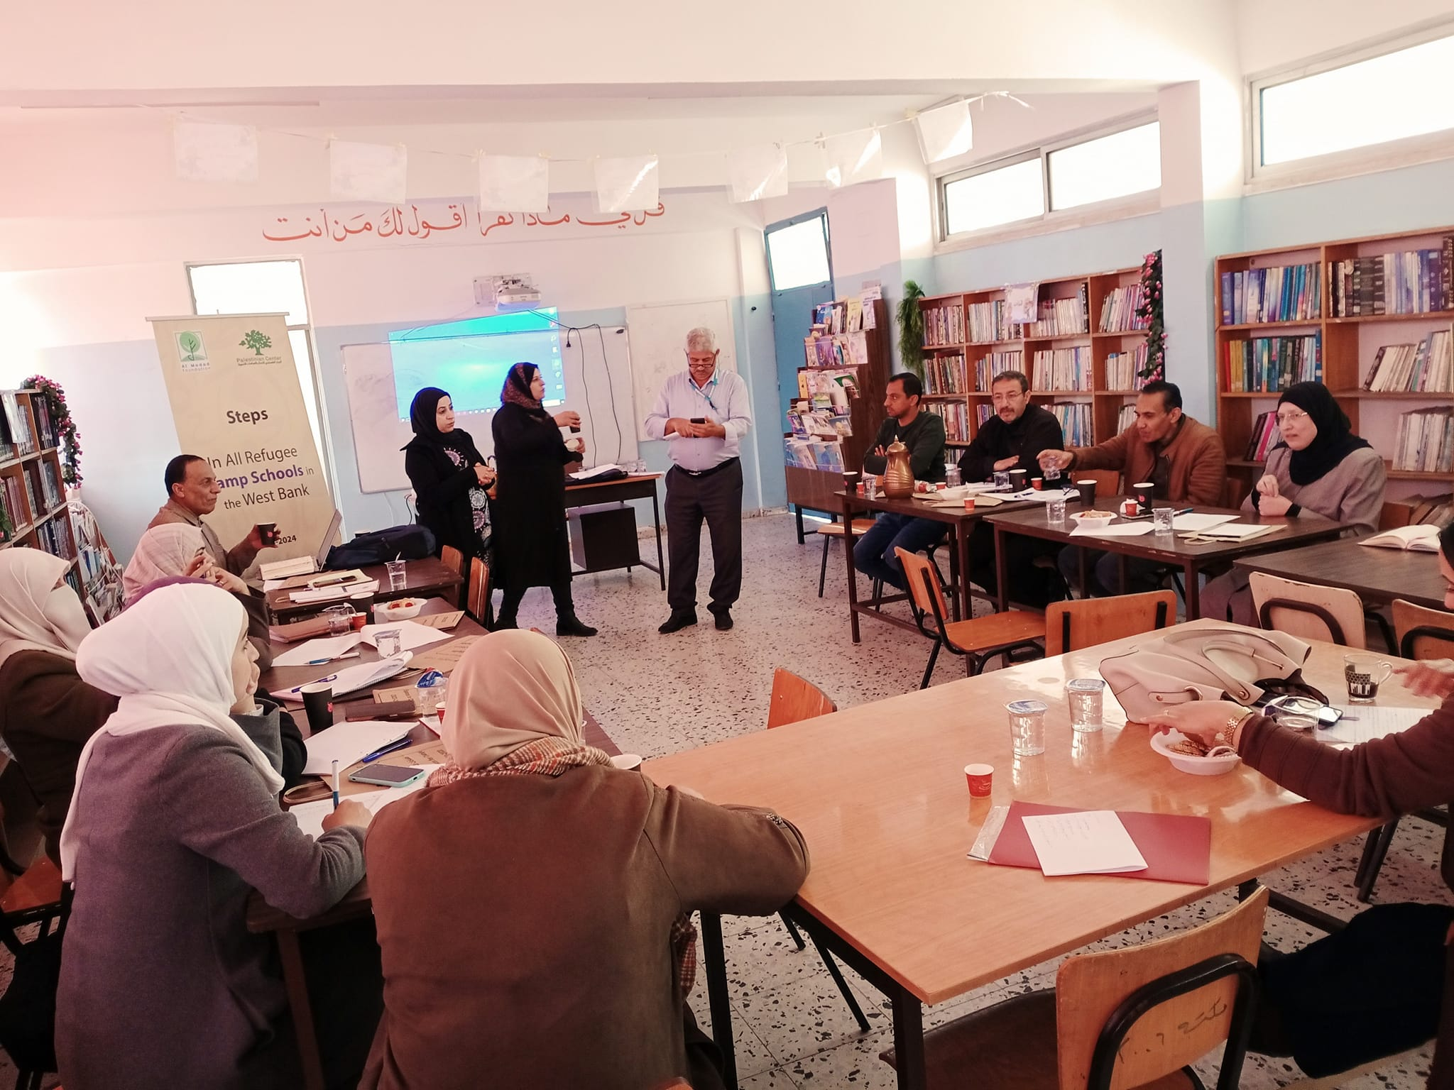
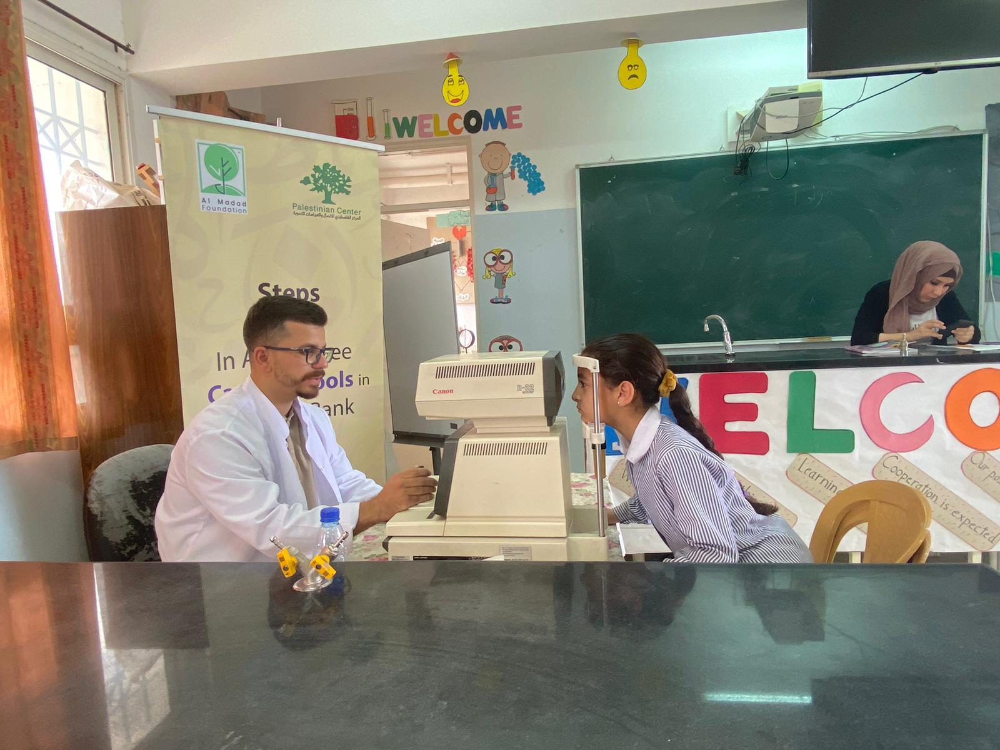
Photos

Slide 6
The innovative aspect
Launching the first mobile eye and ear health clinic that operates in refugee camp schools and is equipped with the latest technologies necessary to conduct examinations.
Conducting examinations for students within their schools, which contributed to raising the participation rate
Giving students opportunities to choose the appropriate eyeglass frame, knowing that we prepare more than 100 types of frames for each school
Providing students with glasses and headphones according to the highest quality standards from the Palestinian Ministry of Health
Rehabilitation of gardens equipped with all the games used in integration activities and improving achievement, “a garden in every complex.”

Slide 7
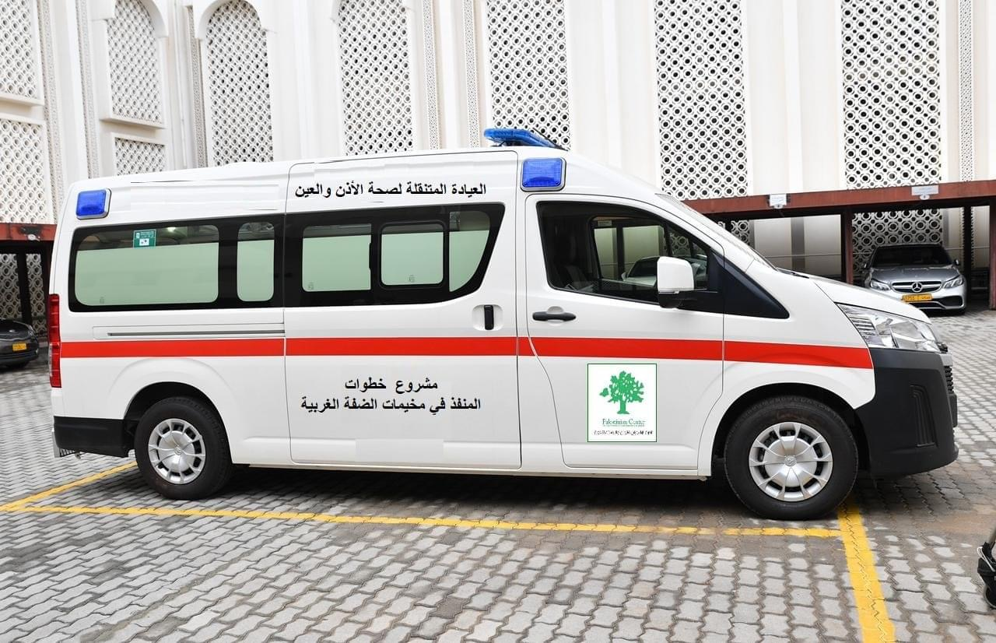
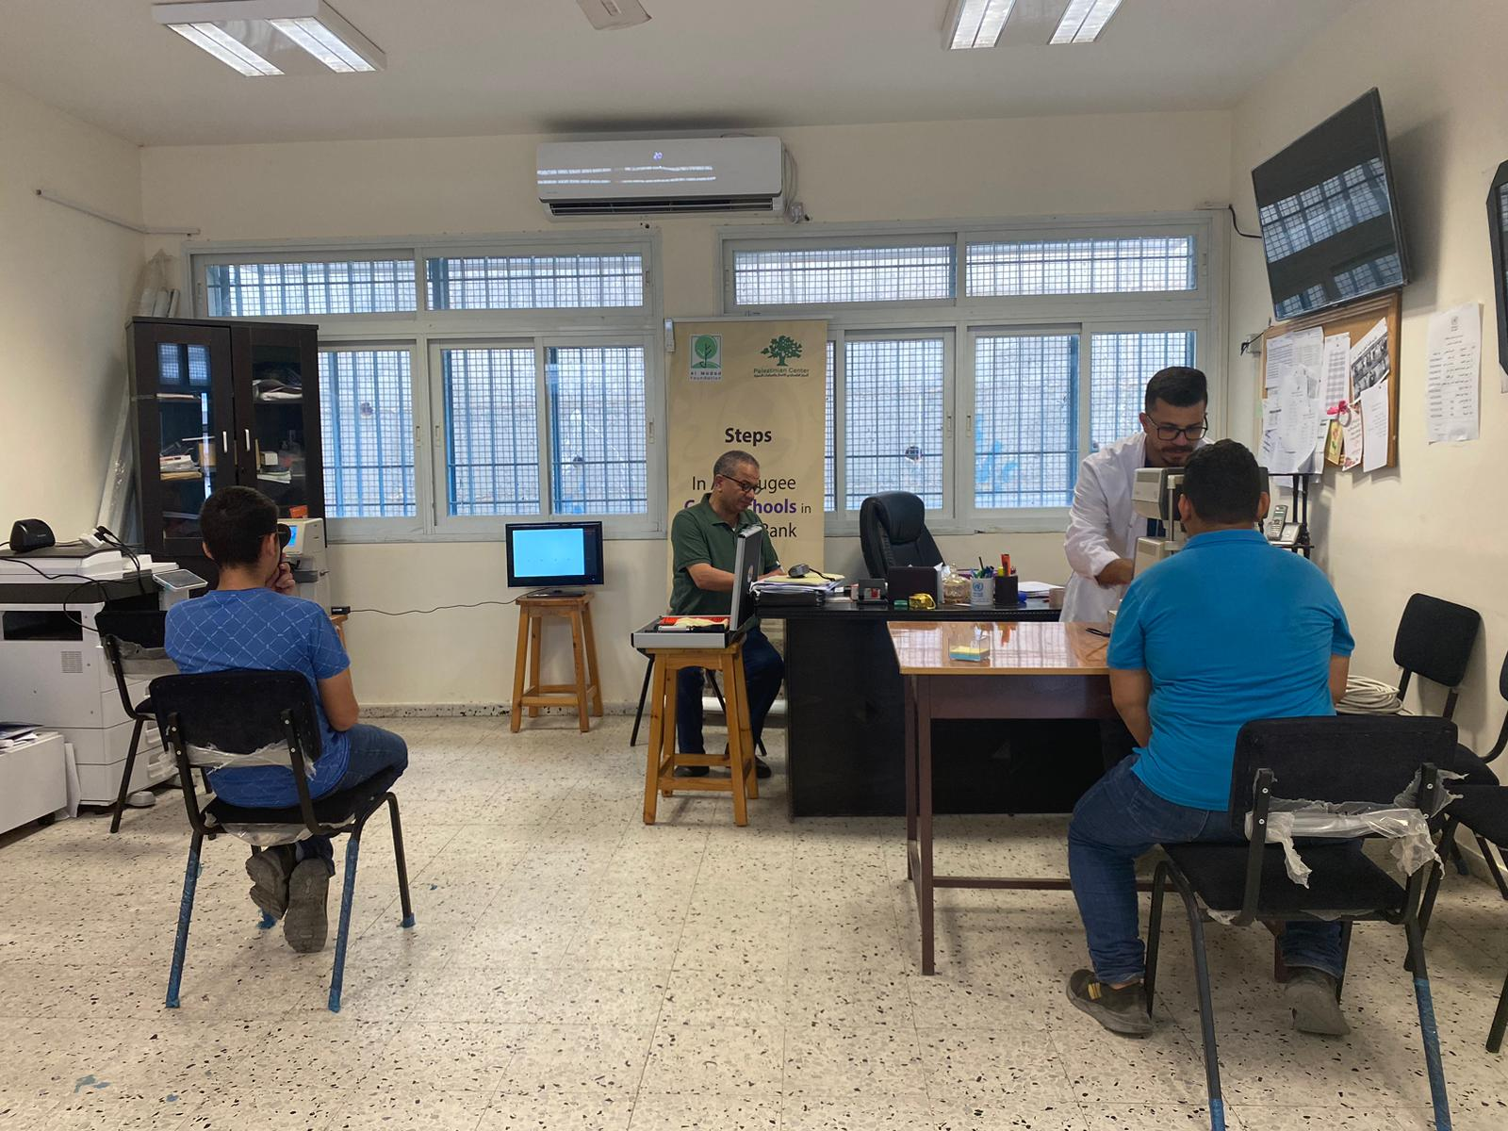
Photos

Slide 8
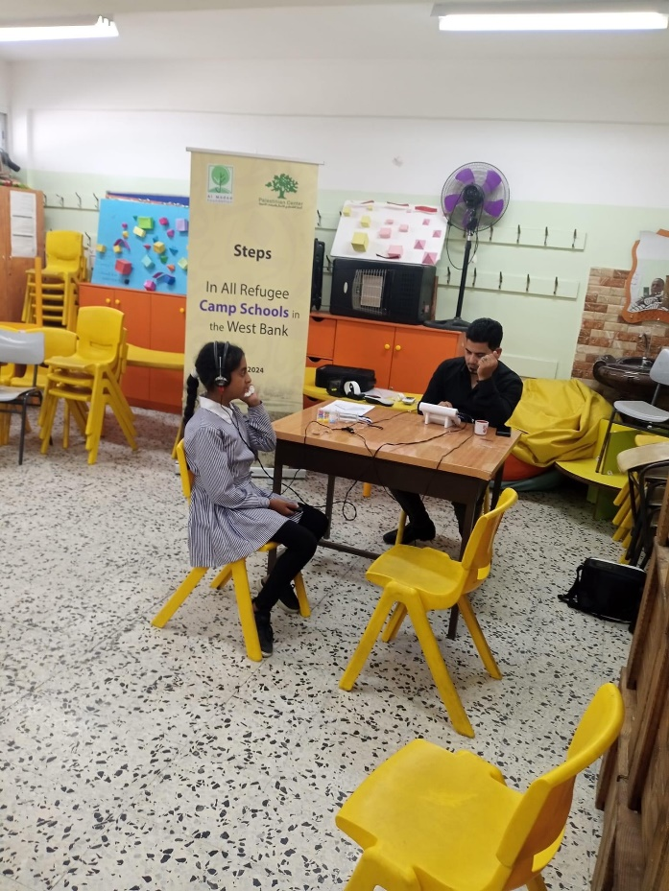
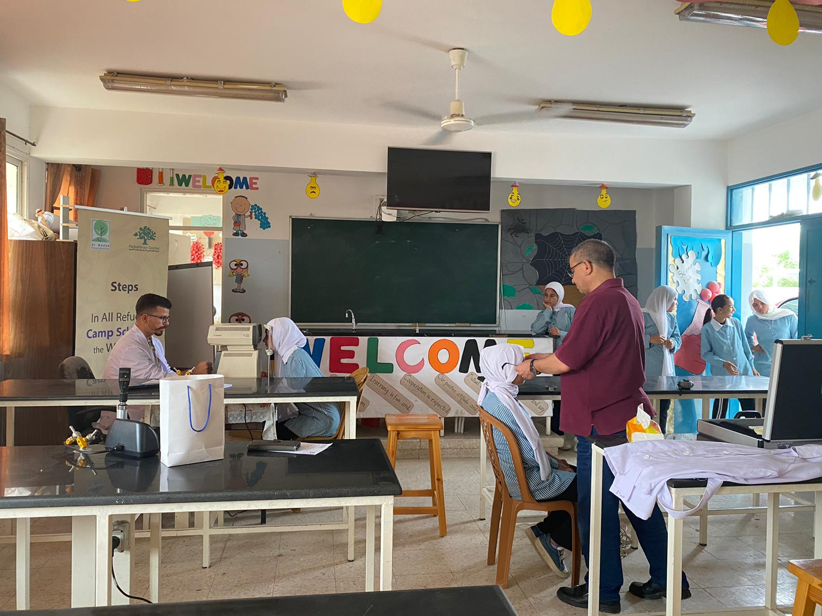
Photos

Slide 9
• The impact created
Raising the achievement rate of targeted students with hearing and visual disabilities from 27% to 56% so far.
Raising the integration rate of students in school and society from 16% to 67% so far
Reducing dropout among students with hearing and visual disabilities.
Adopting an inclusive education approach in the targeted schools

Slide 10
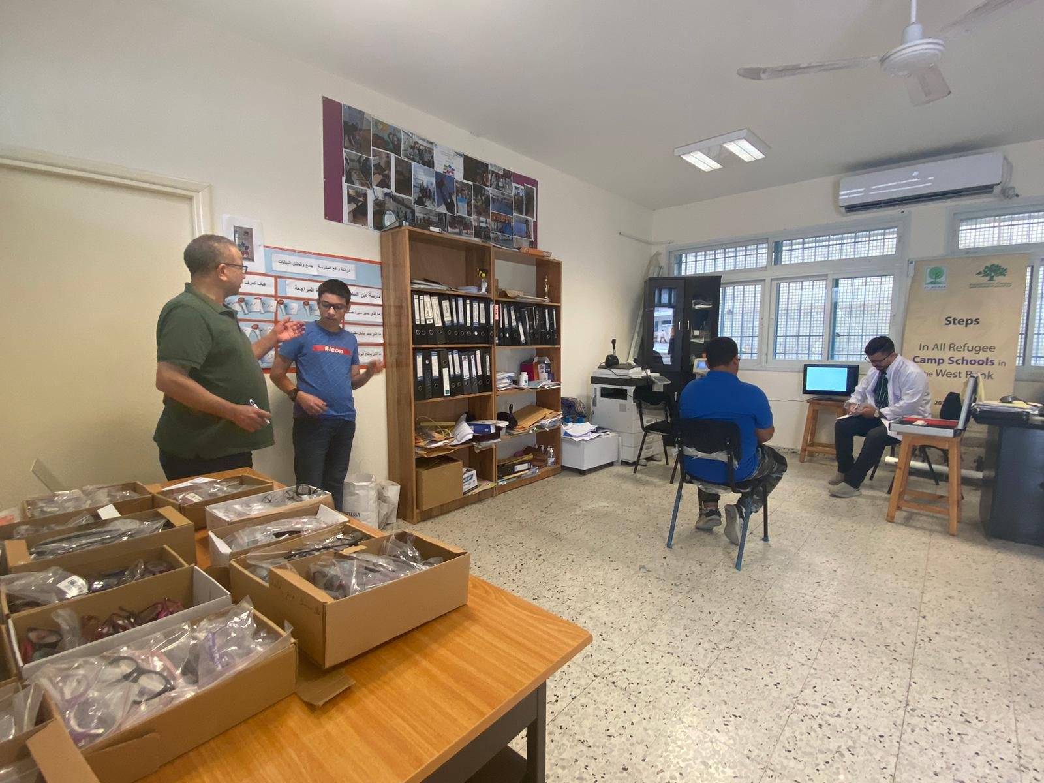
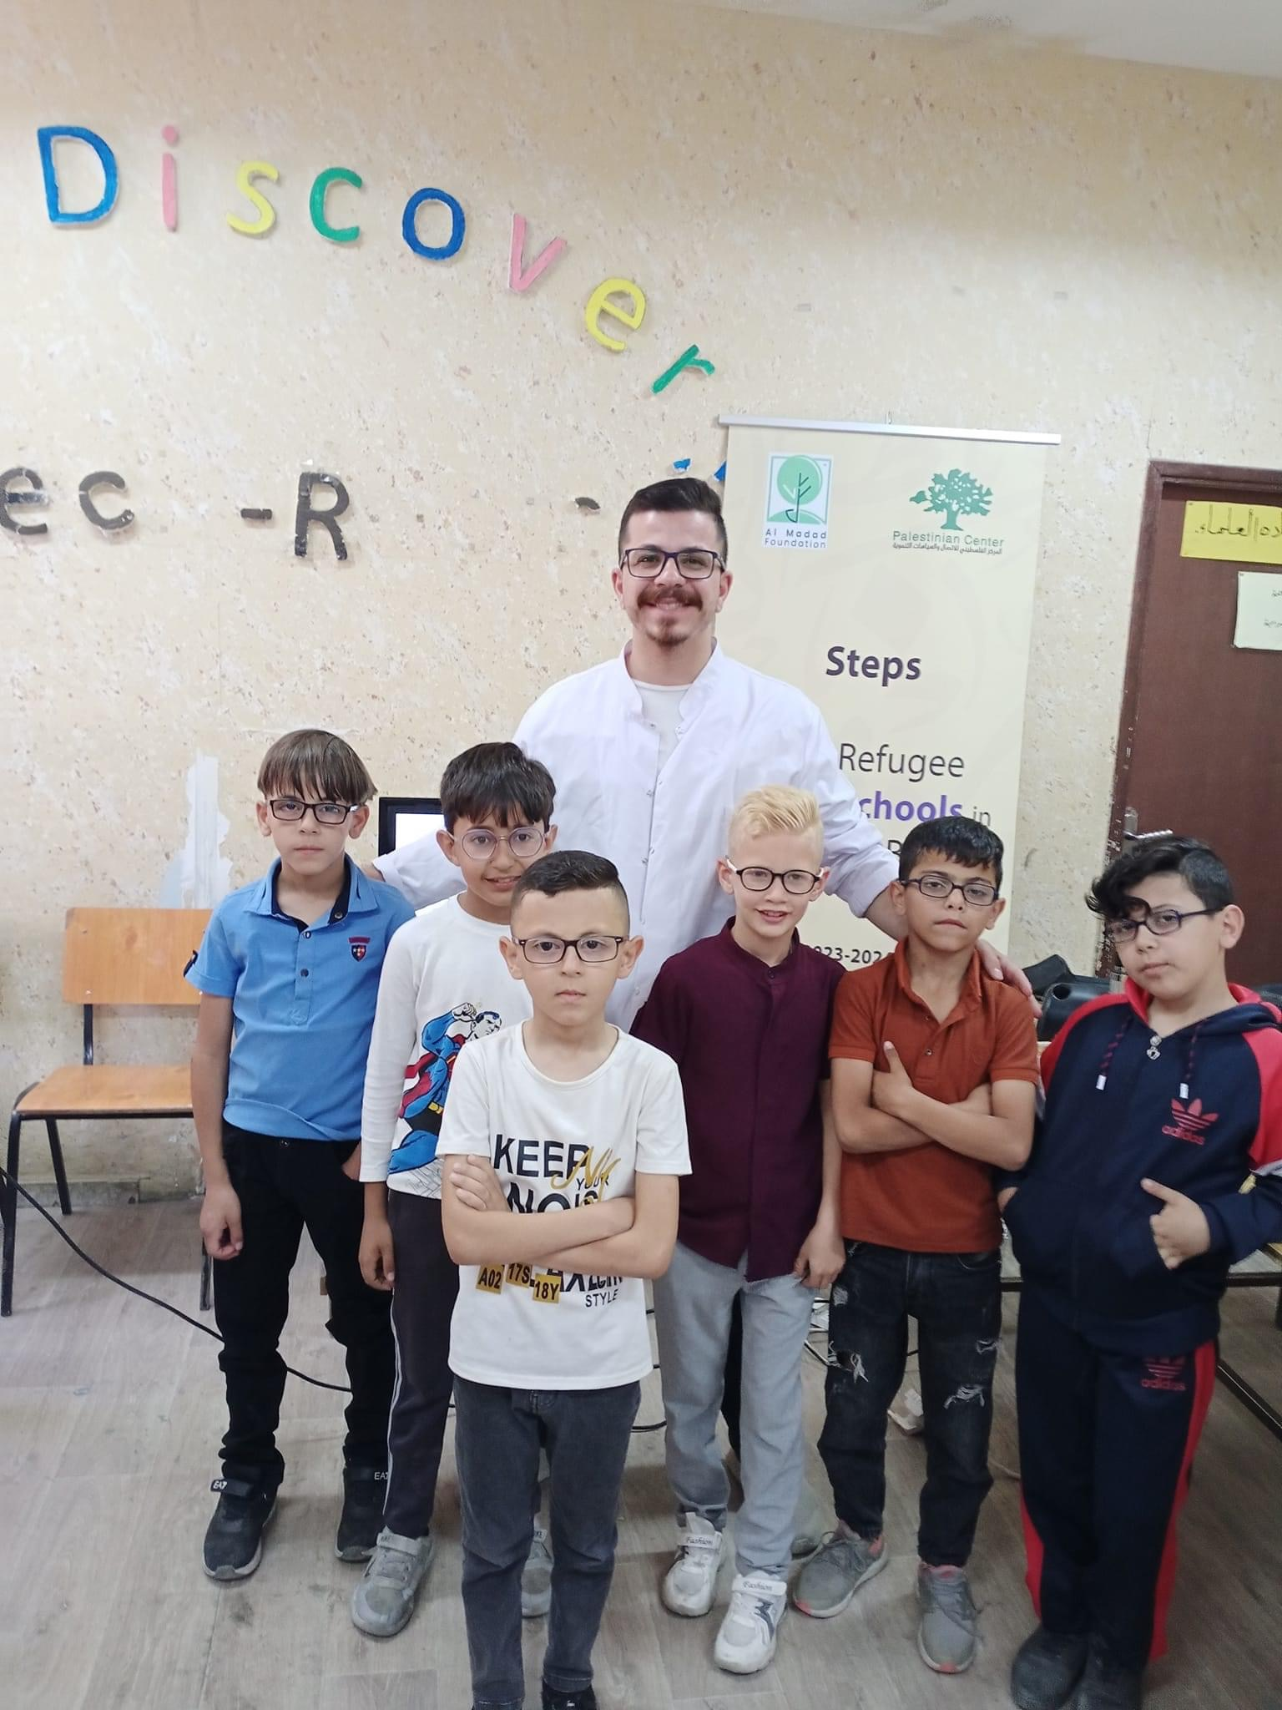
Photos

Slide 11
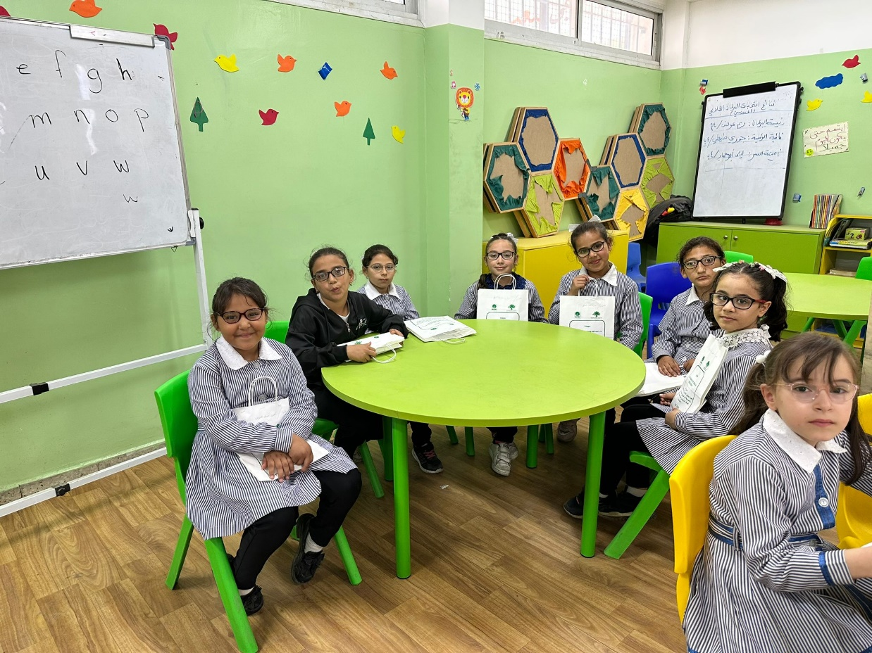
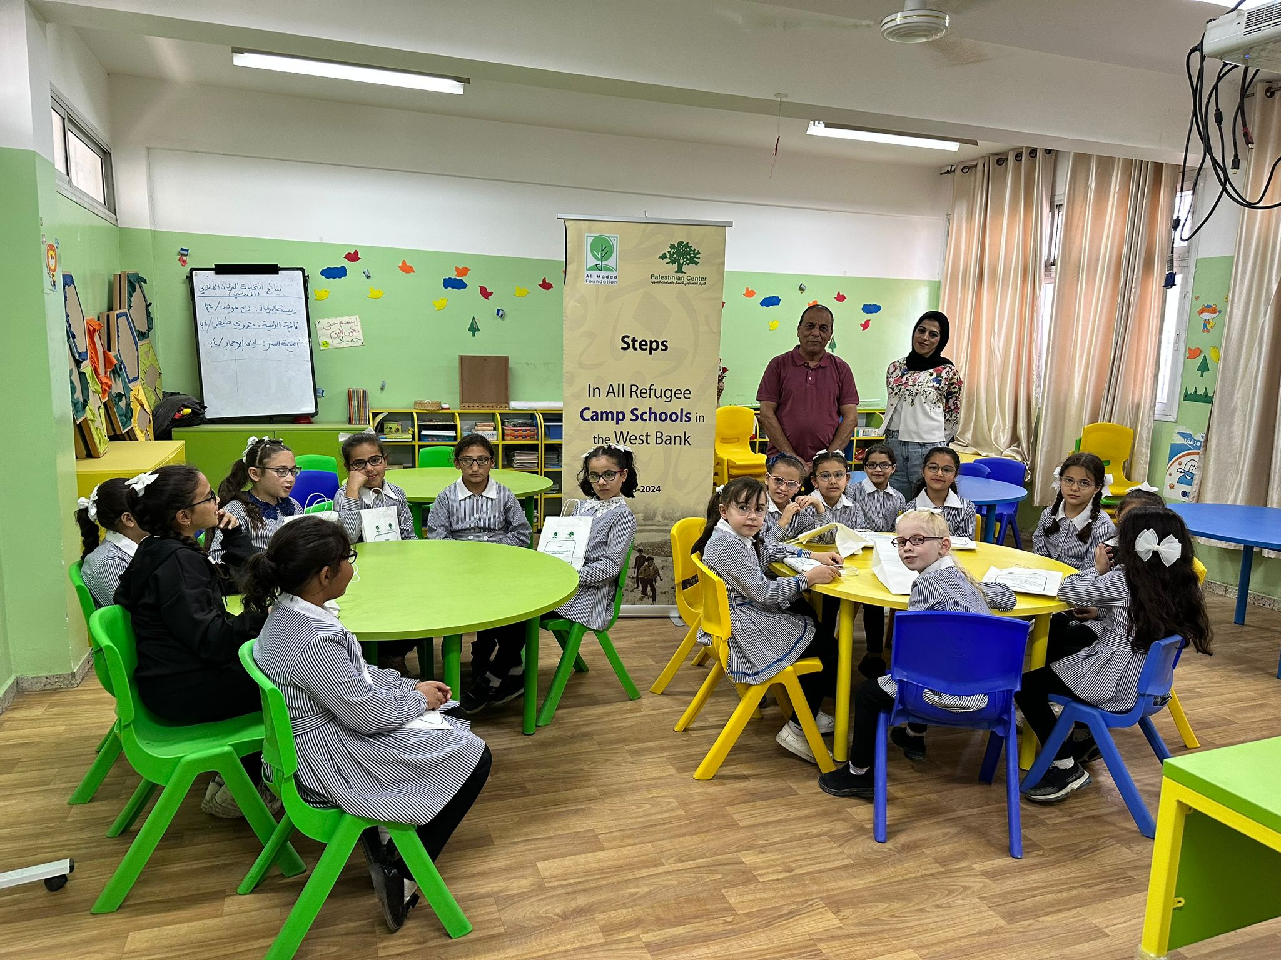
Photos

Slide 12
The success factors:
Building a strong relationship with the Education Department of the International Relief Agency
The relationship with school principals and teachers
There is a dire need for this service in camp schools
Parents’ cooperation
Extensive experience of the project crew
The presence of Al-Maddad Foundation as a main partner in the project

Slide 13
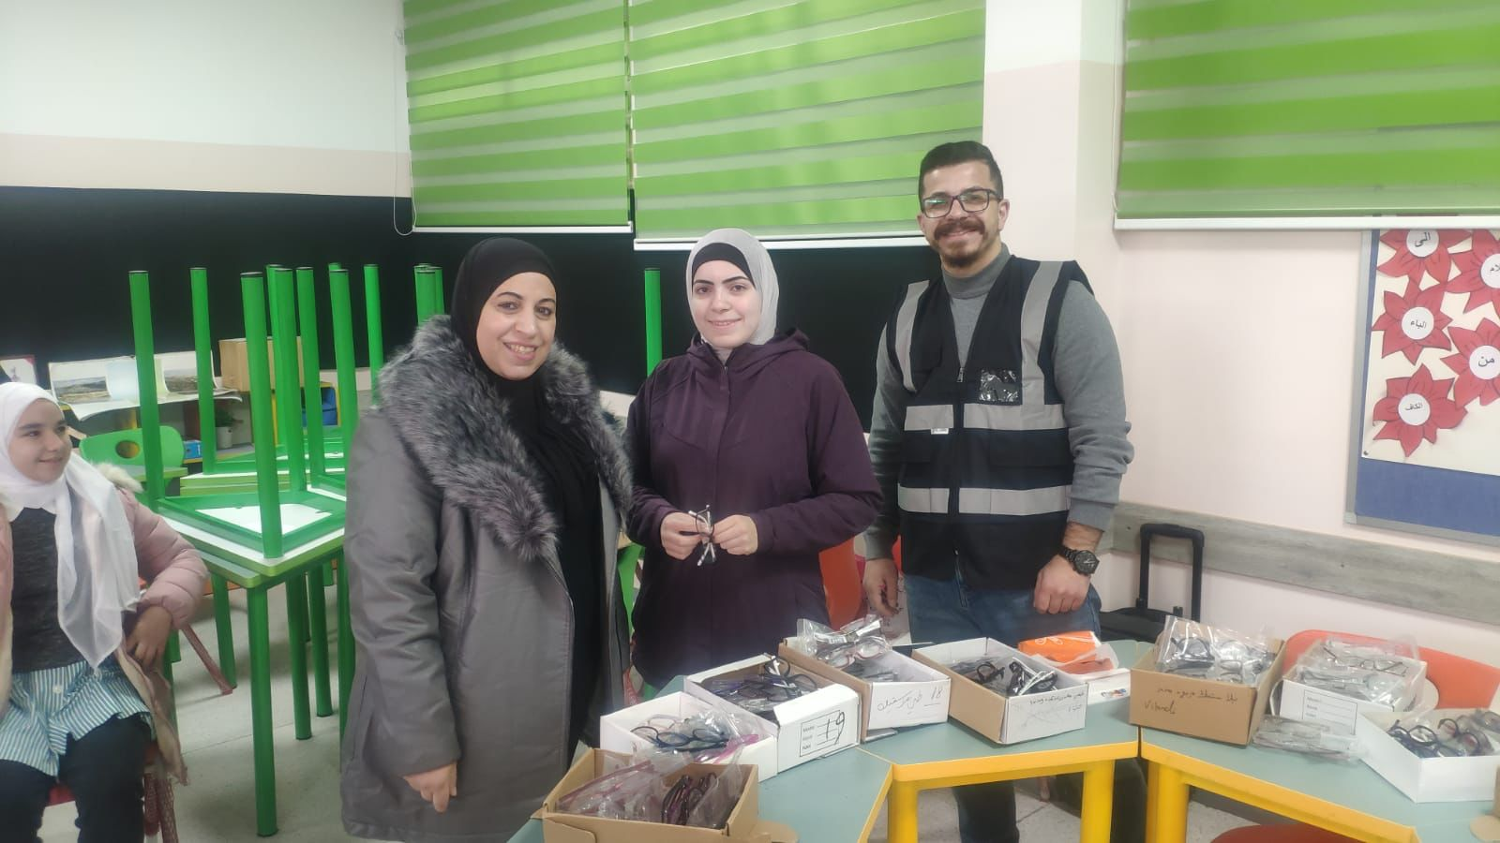
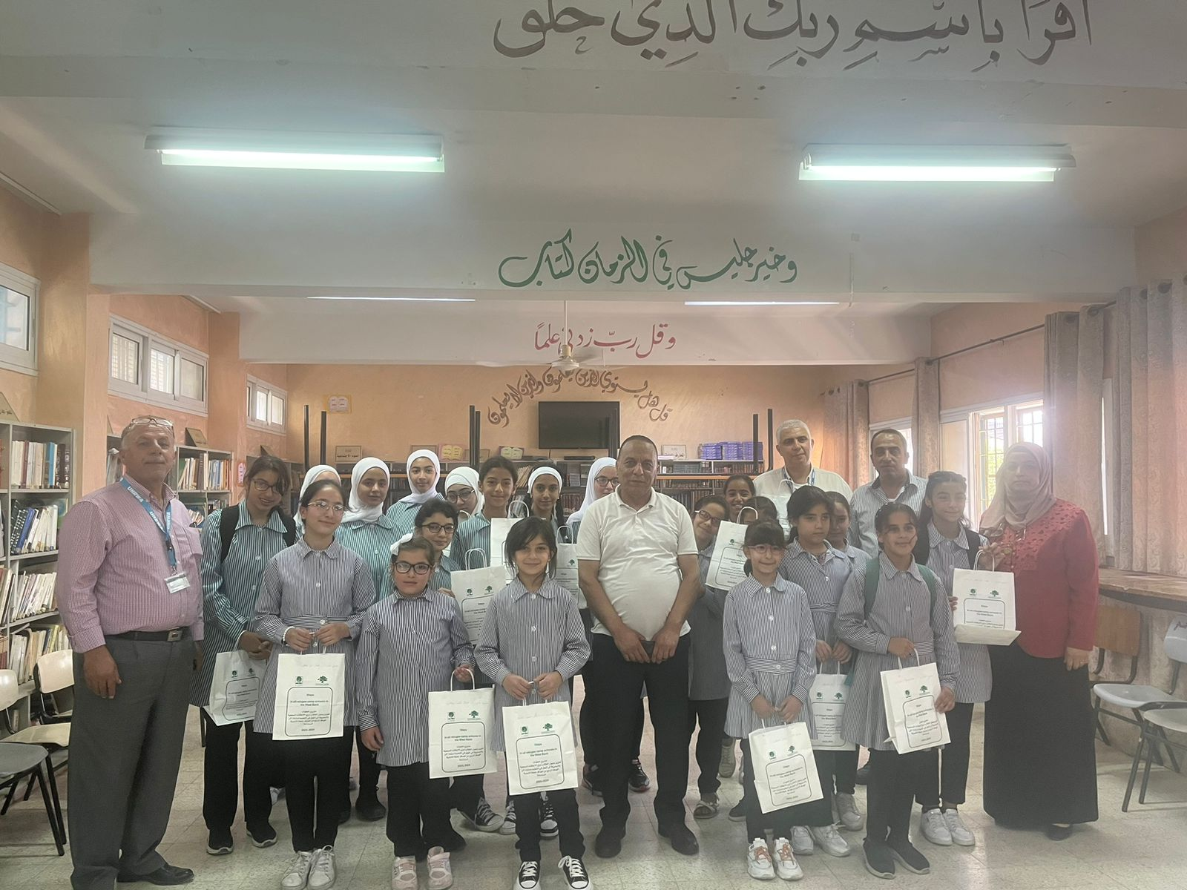
Photos

Slide 14
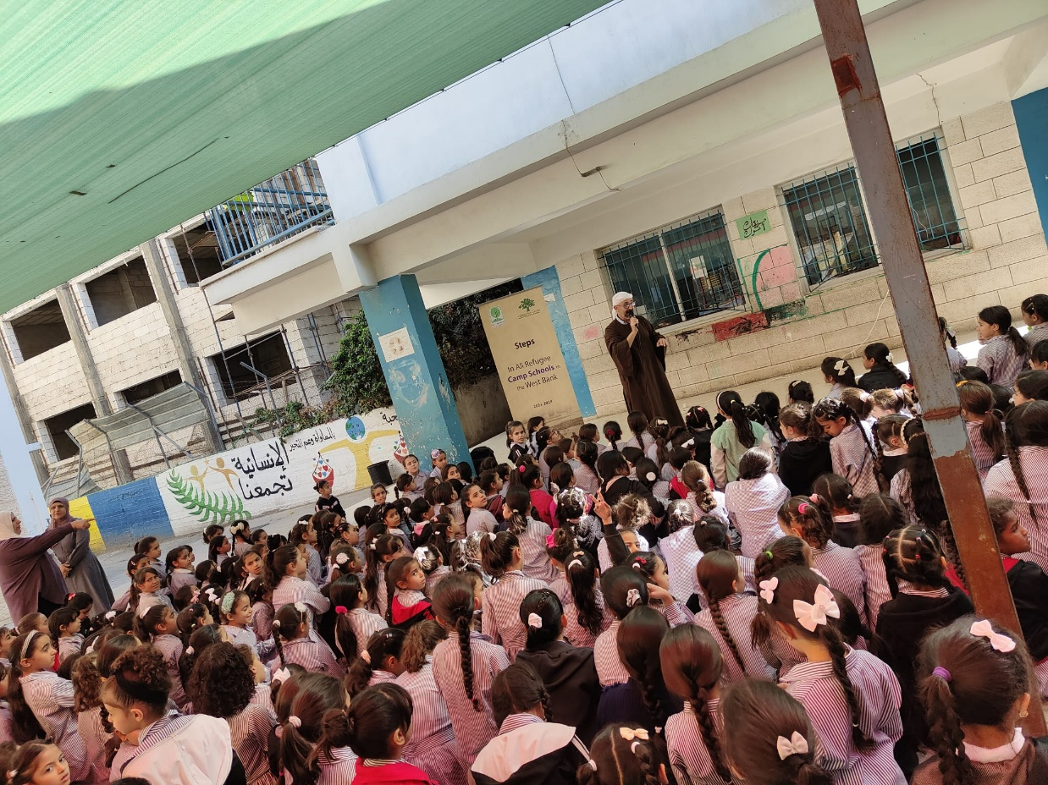
Photos

Slide 15
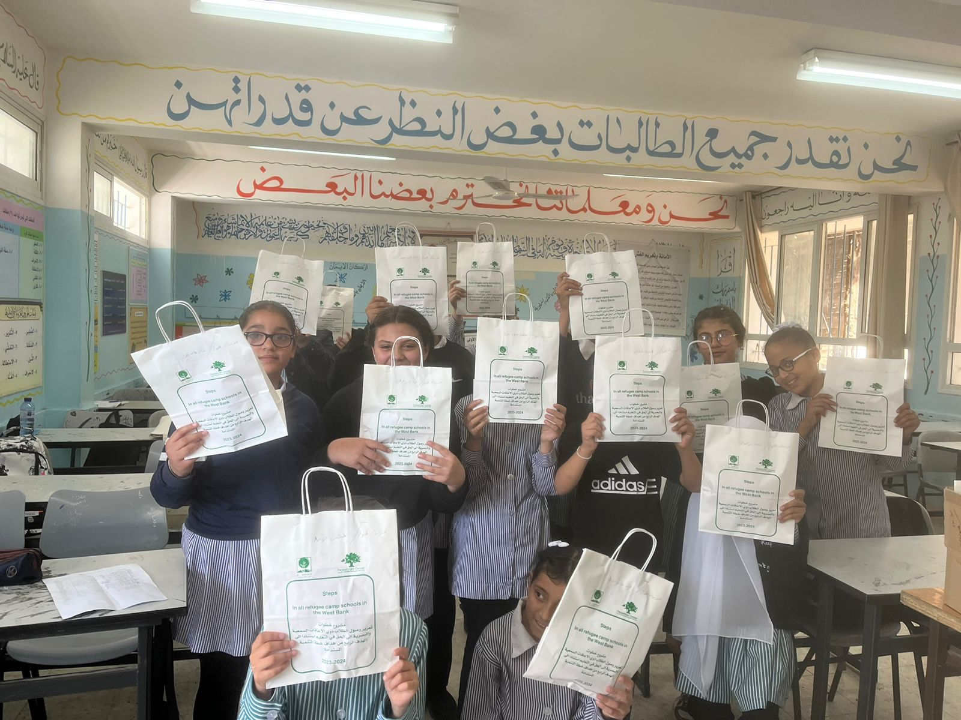
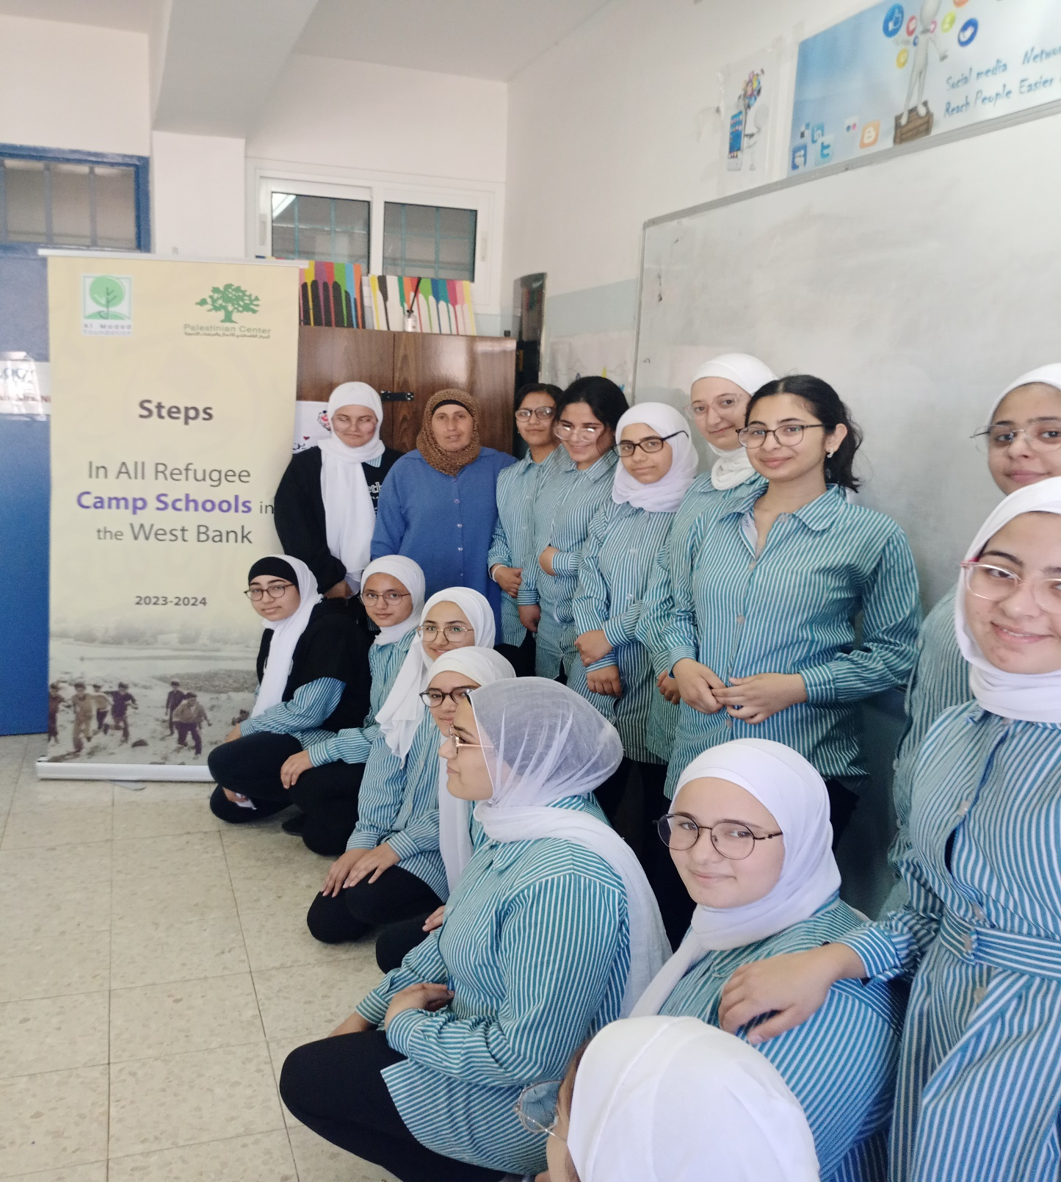
Photos

Slide 16
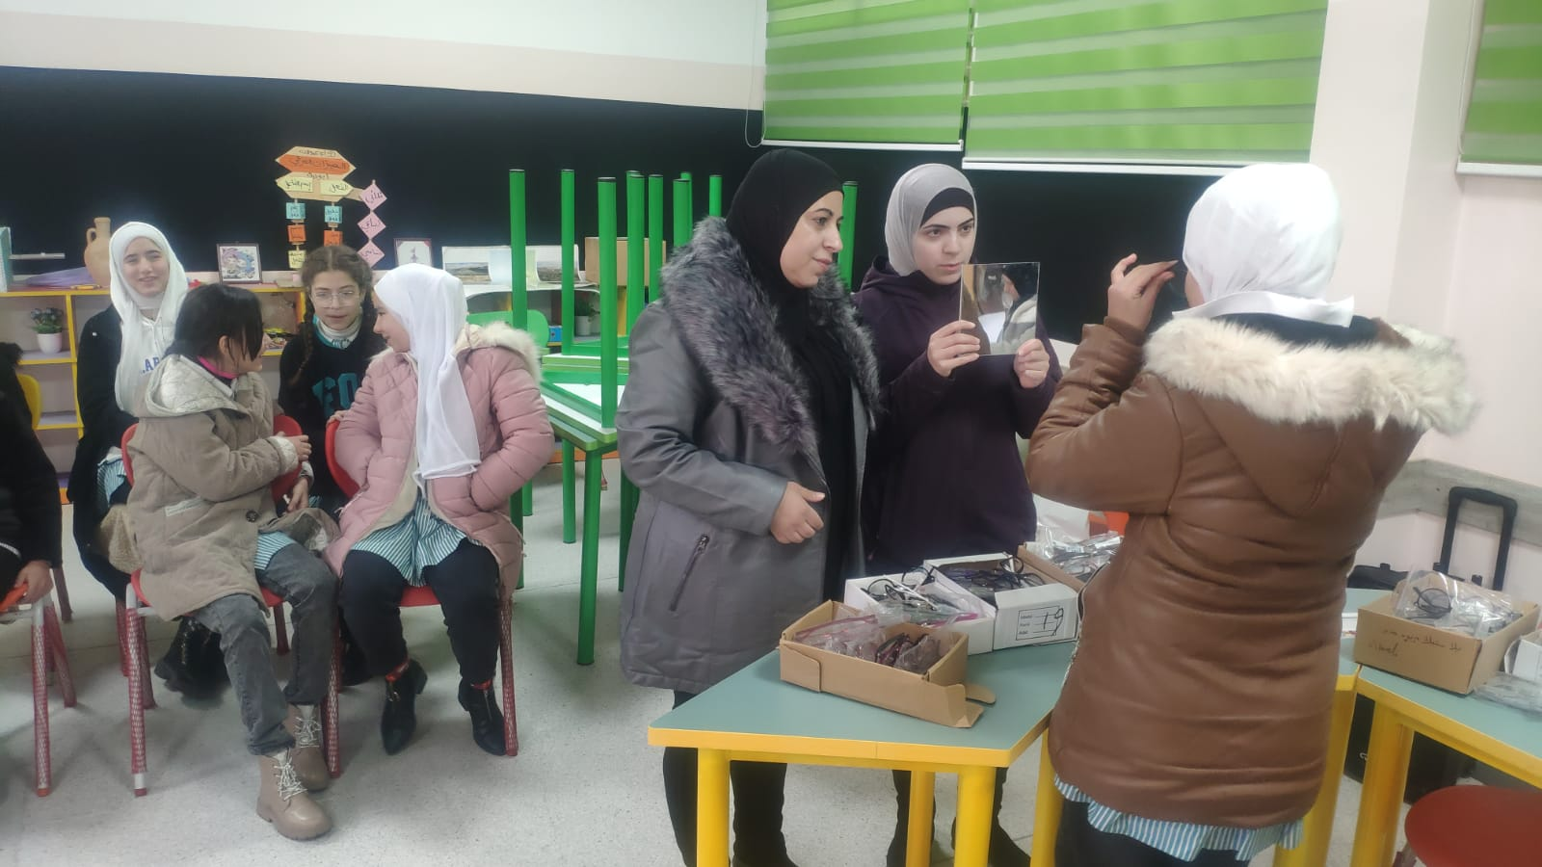
Photos

Slide 17
Financing, sustainability, challenges
Funding: We obtained a grant from the Al-Maddad Foundation in London in the amount of 90,000 pounds to implement the project for two consecutive years.
Sustainability: We submitted another proposal for sustainability to the Solidarity Fund and the OPEC Fund with the aim of sustainability and expanding the scope of the project in the Gaza Strip camps.
Challenges
The widespread need in refugee camps, especially regarding glasses, as a result of the excessive use of social media devices.
The difficult security conditions inside the targeted Palestinian camps in the West Bank and the inability of the work team to move in the project’s target areas.
Repeated closures in West Bank schools

Slide 18
• The next steps for the project
Improving education for students in refugee camps in the Gaza Strip and replicating the project methodology after it has proven its effectiveness and achieved results
Establishing the first school for teaching the deaf in Palestine, which will be located in the city of Hebron

