Slide 1

Inclusion makes the difference
The A.C.C.E.S. Program
Estera Anghelescu
Kaufland
Romania
Inclusive employment strategies of large companies
March 5, 2025 3:00 – 4:30 p.m.

Slide 2
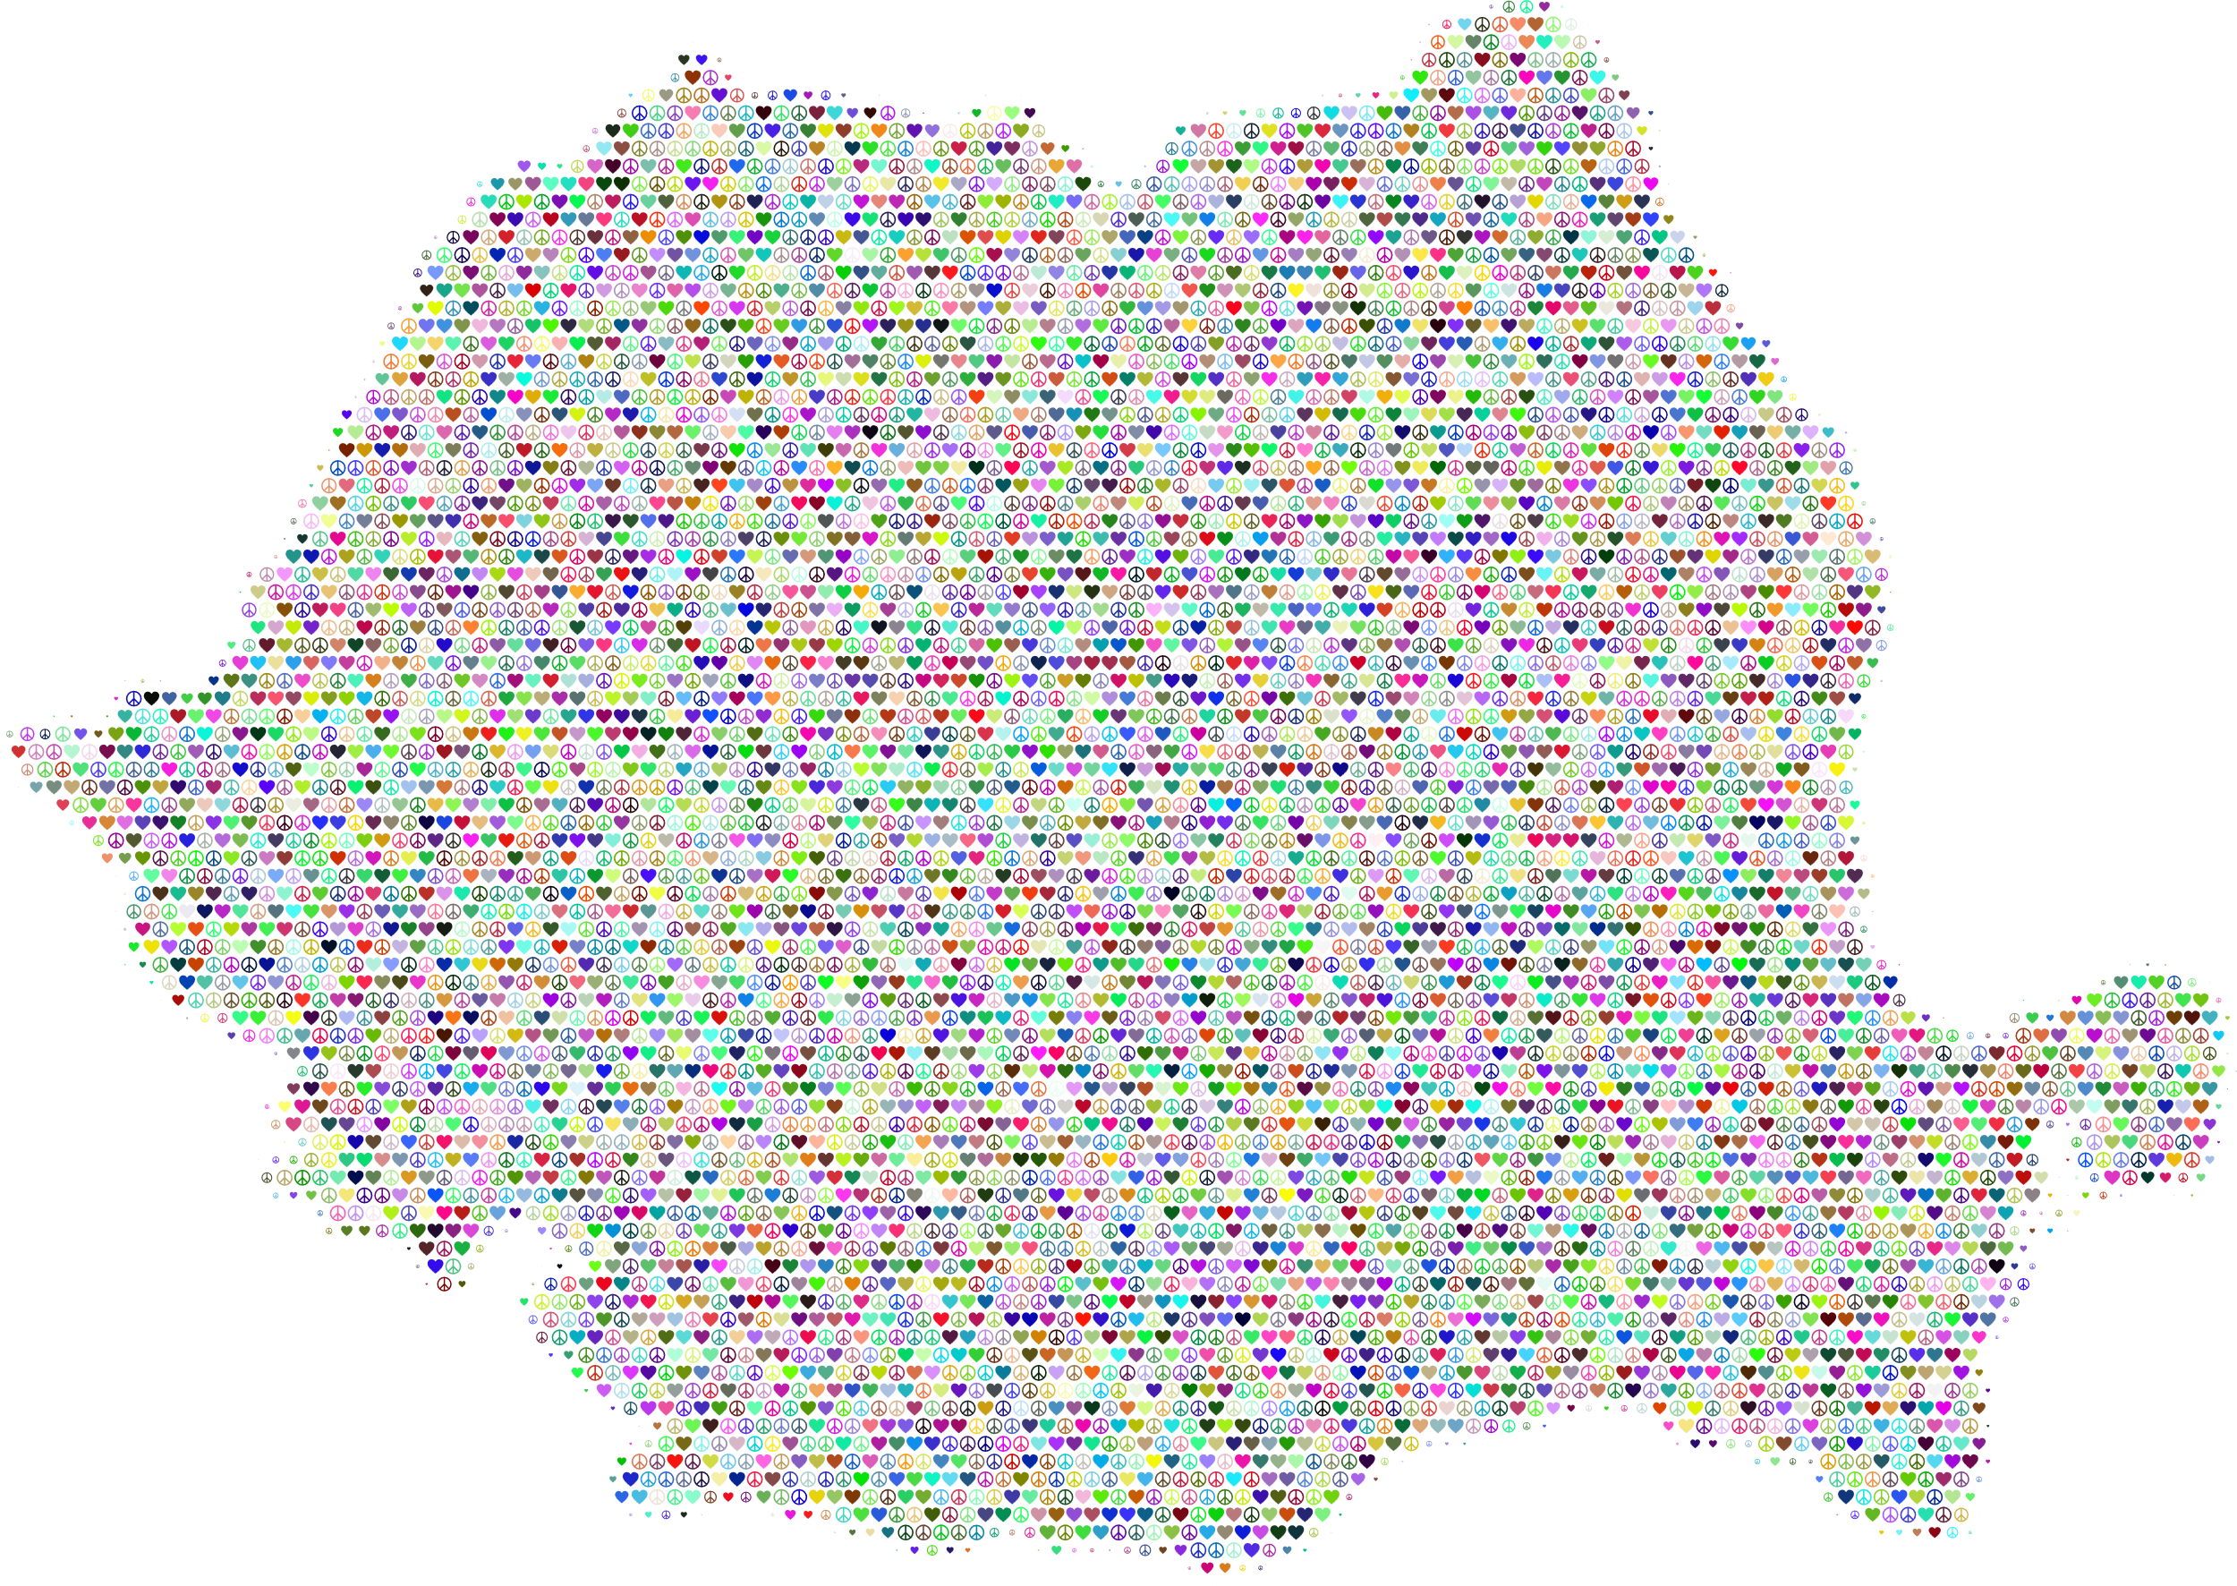
National Context
In Romania there are over
850.000 people with disabilities,
54% of them having the right to work.
In the EU, the average employment quota for people with disabilities lies at 47,8%, while in Romania it is at only 11%.
Notes:
Sample Slide: presenting three points on our project and the relationship to this year’s theme of the Zero Project Conference. Point 1; Point 2; Point 3 connect together in this way.

Slide 3
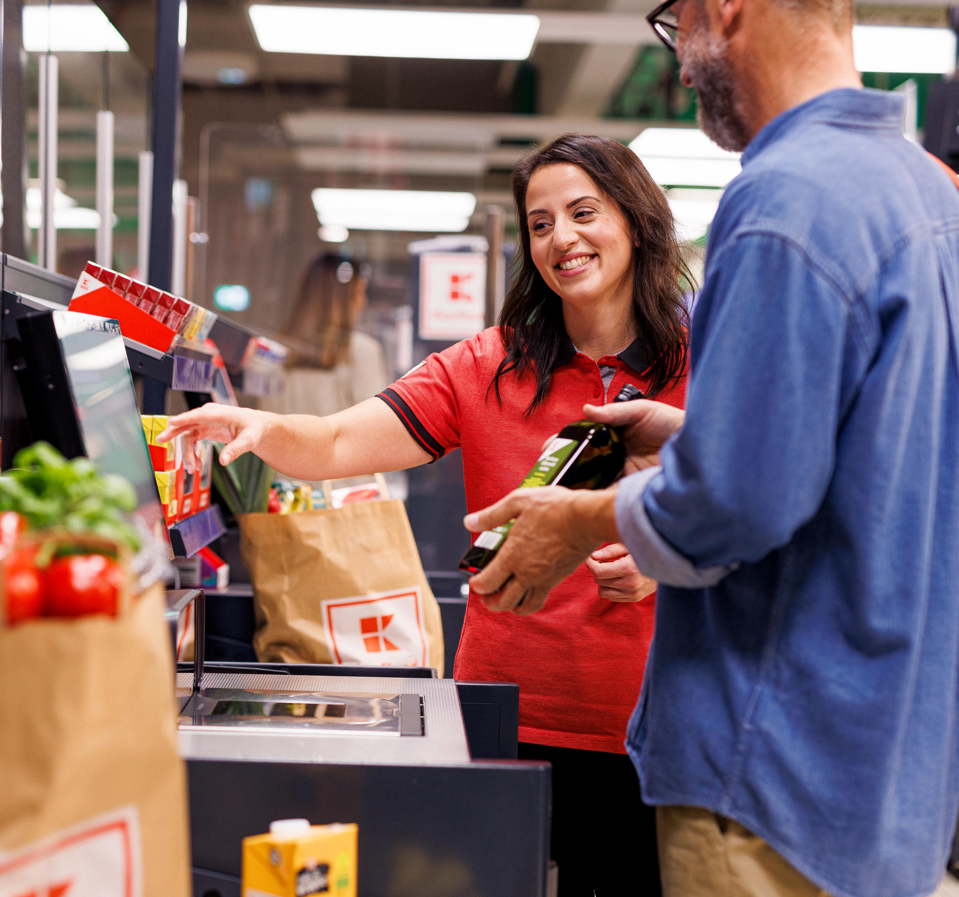
Business Context
10-15 new Kaufland stores are opened yearly
with an average of 100 new colleagues
a turnover rate specific to the trade of 30%,
the disability fund paid by the company, money that is no longer invested by the state for this target group.
All of this, together with the social context, made us want to hire people with disabilities.

Slide 4
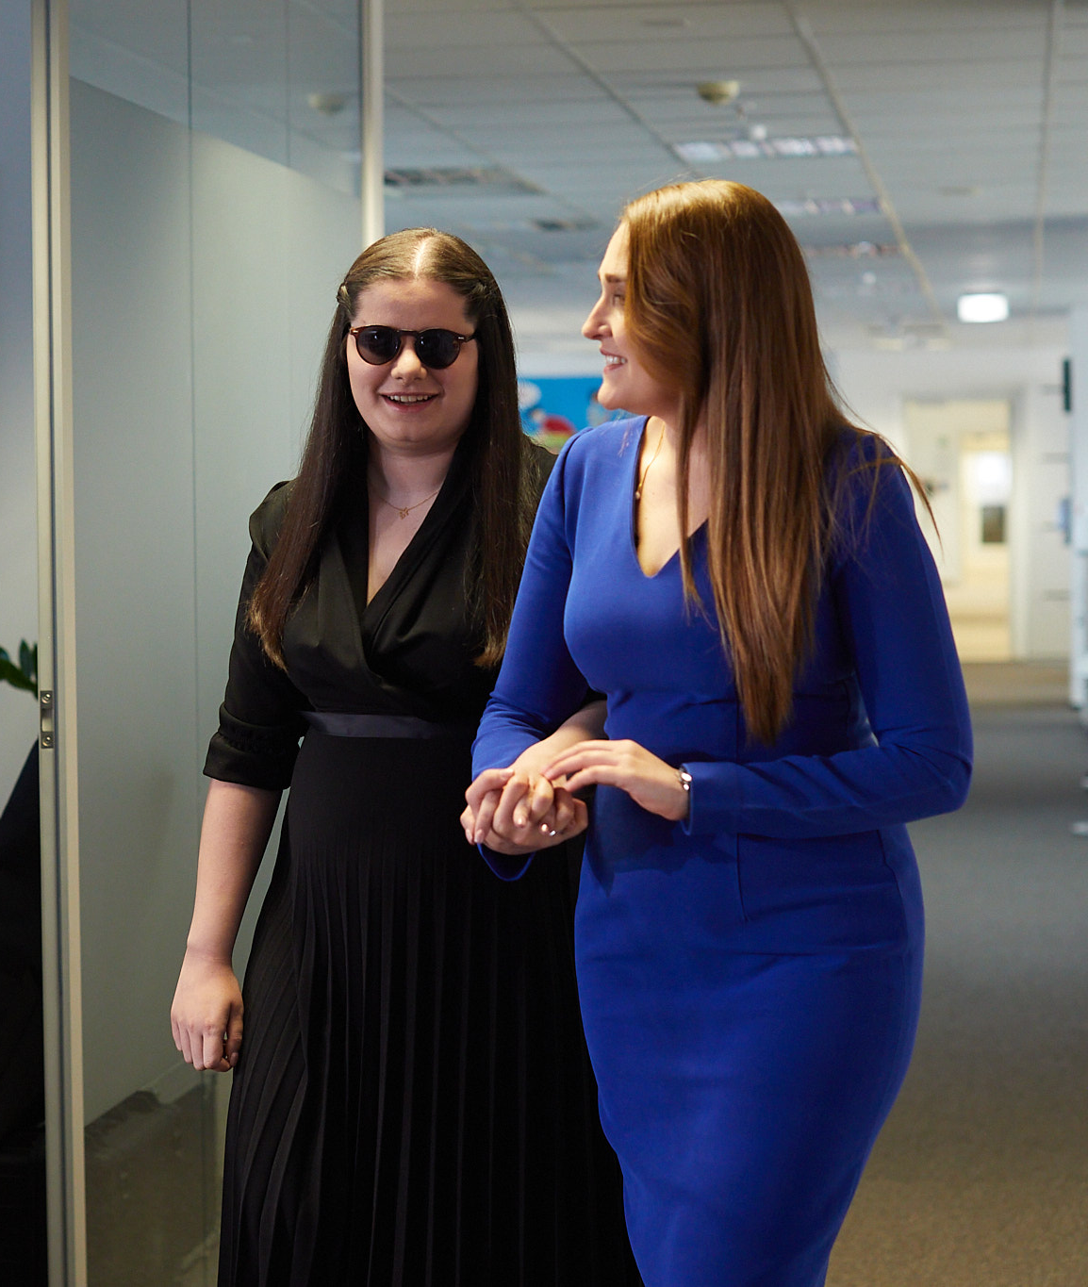
What we wanted and why?
We wanted to ensure ACCES to normality, a social life, a team and financial independence.
Due to the lack of best practices for employing people with disabilities in Romania, Kaufland, the largest private employer locally, wanted to set an example.
So, we launched the Kaufland A.C.C.E.S. Program in 2019. The goal was to employ people with disabilities at Kaufland and integrate them into the labor market, as well as to make Kaufland known as a model of inclusive employment.

Slide 5
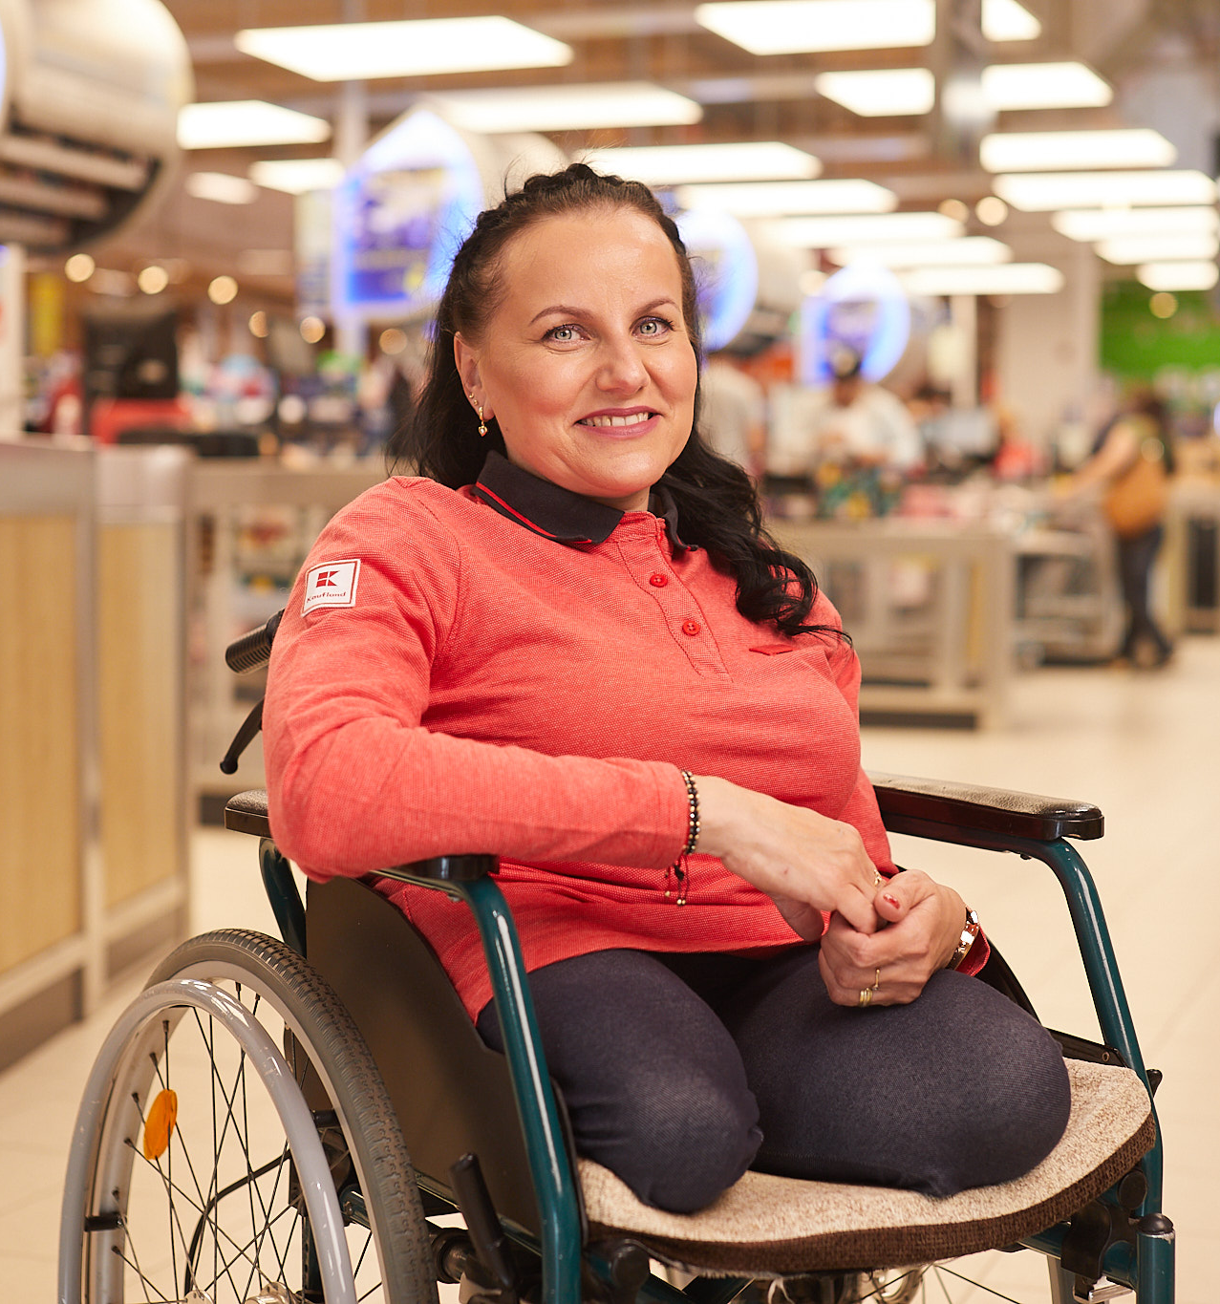
A.C.C.E.S. in numbers
500 jobs in 180 stores, 2 logistics warehouses and HQ
60 candidates with disabilities on average
over 1.500 interviews to date
500 colleagues with disabilities (out +17,000 colleagues)
24 cash registers with extra space for colleagues in wheelchairs
over 400 special shopping carts for customers
66 stores with priority cash registers for customers with disabilities
77 lower cash registers, adapted for customers in wheelchairs
At least 1 colleague with a disability per workplace
In 2023, the program was expanded to the Republic of Moldova

Slide 6

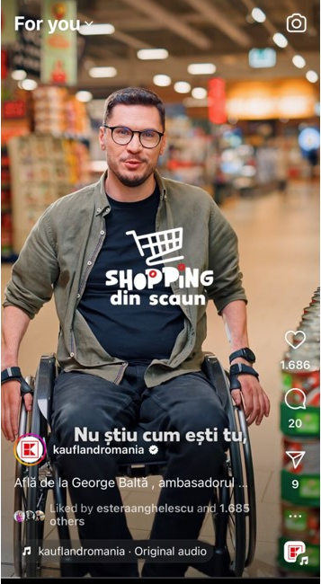
Employer Branding Projects
Accessibility Hackathon
Awareness Videos with our team members
Kaufland Dance Talk
Diversity Shopping Carts
A.C.C.E.S. Caravan
Wheelchair Shopping TikTok series
The Valuable 500 Global Partnership
5 Year Anniversary Immersive Event
Sponsorship of Sports Events

Slide 7
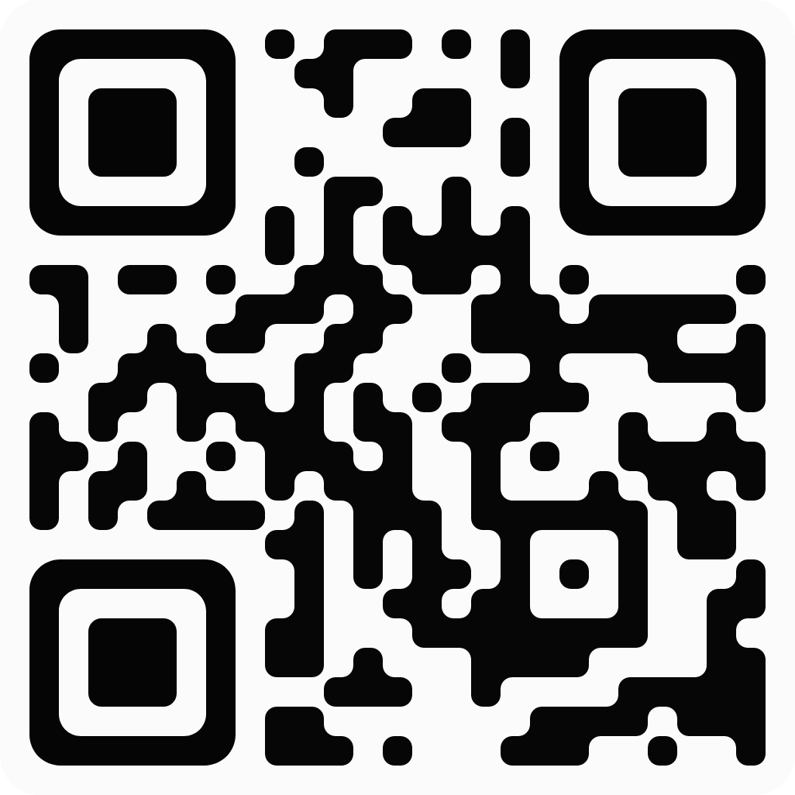
Thank you!
Estera Anghelescu
Recruiting & Employer Branding Director at Kaufland Romania
Connect with me:

