Slide 1
Enabling Inclusive teaching and learning environment in the classroom through Pedagogical and Psychological Support services.
Susanna Tadevosyan
NGO “Bridge of Hope”
Armenia
Integration strategies for mainstream schools and youth services
Thursday, 22 February 2024
12:20 – 13:40 of the Session
Notes:
Title: Enabling Inclusive teaching and learning environment in the classroom through Pedagogical and Psychological Support services. Speaker: Susanna Tadevosyan
NGO “Bridge of Hope”
Armenia
Name of Session: Integration strategies for mainstream schools and youth services
#ZeroCon24
Day and Time of Session: Thursday, 22 February 2024; 12:20 – 13:40 of the Session

Slide 2

NGO Bridge of Hope
Founded in 1996
Notes:
“Bridge of Hope” is an Armenian NGO founded in 1996. The organization is dedicated to promoting social inclusion and the dignified lives for children and young people with disabilities in Armenia.

Slide 3
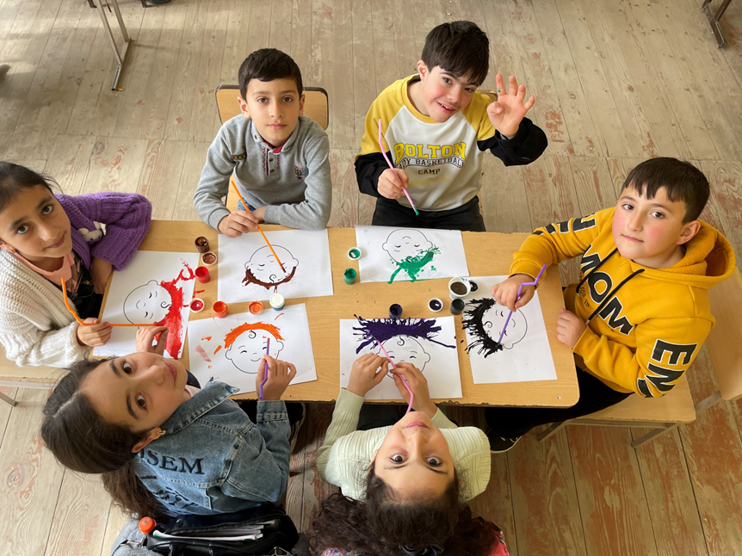
Provision of Pedagogical and Psychological Support Services to Children in Tavush Marz
The services at schools:
IEPs development and implementation;
assessment of child's progress, participation, and engagement in lessons;
guidance and technical assistance to teachers;
Organize various inclusive social activities and events to promote positive peer interactions and friendships among students of all abilities.
The services at “Bridge of Hope” centers:
speech and language development,
life skills training and recreational activities,
psychological counseling and family support
Notes:
The pedagogical psychological support services are provided both at schools and at community-based centers of BoH. In both cases the services are provided to children after school hours. All children are enrolled in the main classrooms and if the child needs support in the classroom the teacher’s assistant is there to support.

Slide 4
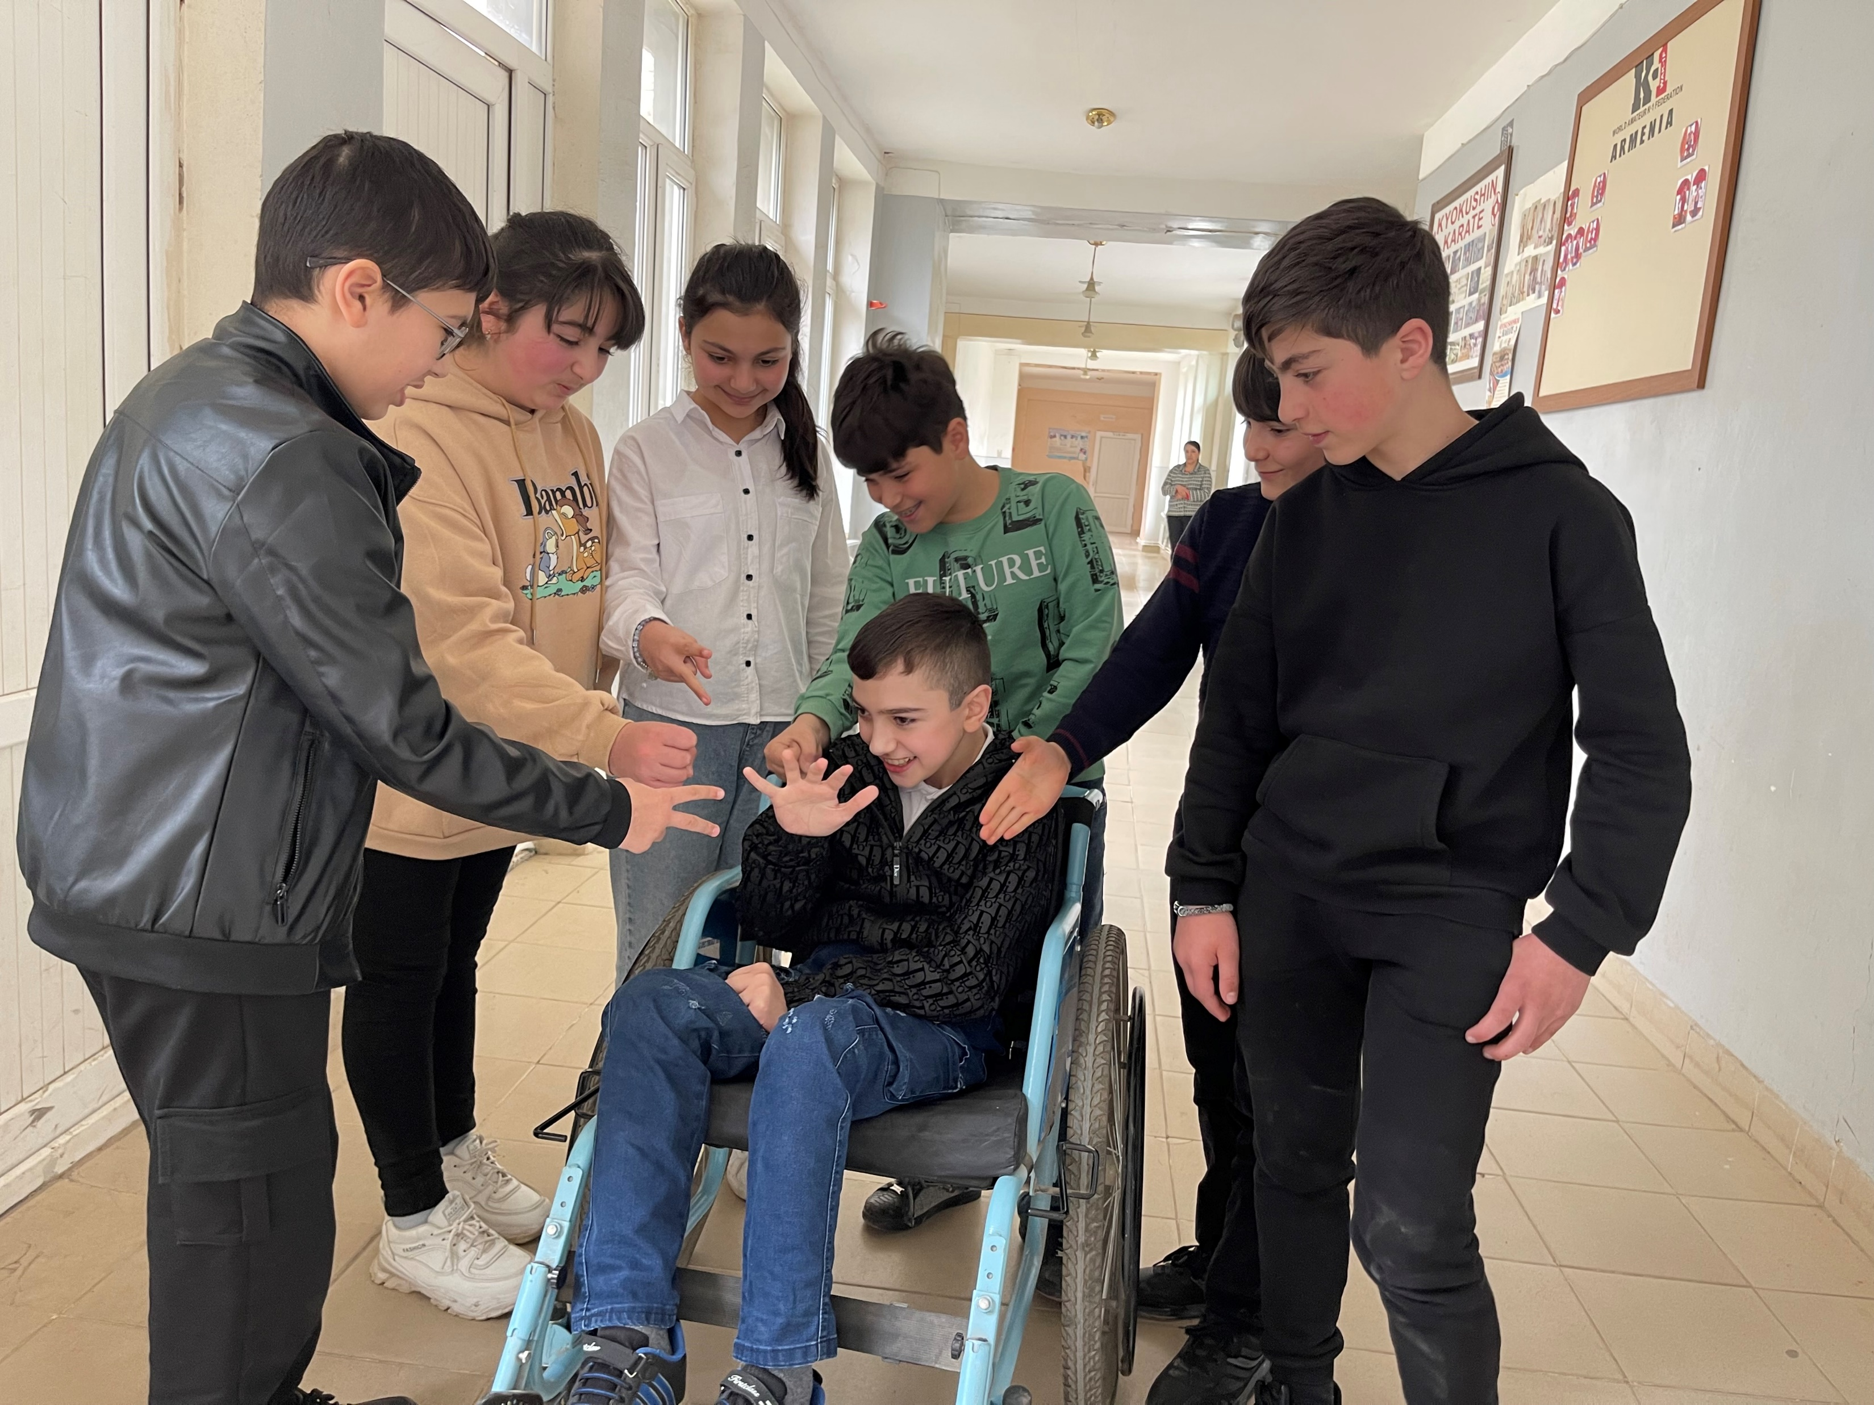
Achieved Results
Enrollment Growth: 550 CWDs enrolled in 53 preschools, 82 secondary, and 6 VET schools.
Teacher Training: 2500 teachers trained in inclusive education practices.
Family Empowerment: 550 families actively engaged and empowered to advocate for their children's rights.
Policy Influence: Model adopted in the entire mainstream education system, transforming special schools into PPS centers.
Notes:
550 children with disabilities (CWDs) enrolled in 53 preschools, 82 secondary, and 6 VET schools in Tavush Marz. 2500 teachers are trained in inclusive education practices. Families are actively engaged in education of their children. The practice is adopted in the entire mainstream education system, transforming special schools into PPS centers.

Slide 5
The success factors
Collaborative Partnerships: with national and local authorities, NGOs and families.
Tailored Support Services
Empowered Families engaged through education, support, and advocacy.
Teacher Training and Capacity Building in inclusive education practices.
Community Sensitization to promote positive peer interactions.
Policy Advocacy for inclusive policies at local and national levels.
Notes:
Partnerships: with national and local authorities, NGOs and families, the tailored support services to children, empowerment of families, the teacher training and capacity building in inclusive education practices, the community sensitization and policy advocacy for inclusive policies at local and national levels are the main factors of success.
.

Slide 6
Financing, Sustainability, Challenge
Financing and Sustainability
Ministry Funding: through a grant scheme.
Comprehensive Coverage: funding encompasses PPSS, teacher training, parent workshops, and awareness campaigns, ensuring a holistic and sustainable approach.
Sustainability through State Funding: Reliance on state funding establishes a sustainable foundation for the project's continued success, fostering long-term impact and inclusivity in education.
Challenges
Dominance of Medical Model of Disability: Focus on impairments rather than capabilities.
Deficit-Based Approach to Education: Persistent reliance on deficit-based approaches.
Poor Understanding of Human-Rights Based Approach: Across authorities, teachers, service providers, families, and community members hindering equitable access to education.
Impact on Policies and Practices: Contribute to exclusion, hinders the creation of inclusive learning environments.
Notes:
Project is financed By the ministry of education and the reliance on state funding establishes a sustainable foundation for the project's continued success, fostering long-term impact and inclusivity in education. However, the major challenge remains the old mindsets reinforcing the medical model and deficit-based approach to education of children with disabilities.

Slide 7
The innovative aspect
Creating inclusive and supportive environments;
Promoting positive attitudes
Fostering a sense of acceptance,
Prioritizing the development of a sense of belongingness and self-esteem.
Notes:
By creating inclusive and supportive environments, promoting positive attitudes, and fostering a sense of acceptance, the practice aims to enhance the overall well-being and self-confidence of these children, contributing to their holistic development and educational success.

Slide 8
The next steps for the project
Accessible and inclusive vocational learning environments: Implement UDL principles to create accessible and inclusive vocational learning environments that cater to the diverse needs of all students, including those with disabilities and special needs.
Reasonable accommodations: Advocate for and ensure the provision of reasonable accommodations in vocational education settings, enabling students with disabilities to fully participate and succeed in vocational training programs.
Collaboration and partnerships: Foster collaboration and partnerships with stakeholders, including employers, industry representatives, parents, and students, to collectively work towards creating inclusive vocational education environments.
Notes:
Provide comprehensive training and capacity building programs for vocational educators, focusing on Universal Design for Learning (UDL) and the application of its principles in vocational education as well as foster collaboration and partnerships with stakeholders, including employers, industry representatives, parents, and students, to collectively work towards creating inclusive vocational education environments.

Slide 9
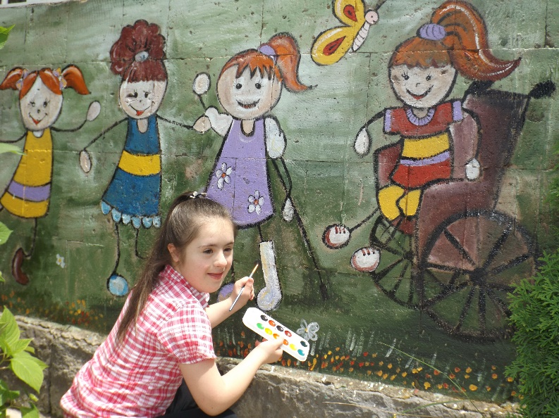
Tatyana’s Success Story
Tatyana, a 13-year-old from Ijevan. Teachers, classmates, and the school community have become her extended family, illustrating the positive impact of inclusive education. Tatyana's educational story highlights the transformative potential of inclusive schooling, showcasing her growth, artistic achievements, and the supportive community that recognizes every child's right to belong and succeed.
Supporting the child to learn, succeed and enjoy the sense of belonging to a group is the most rewarding part of our work!
Notes:
Tatyana is a 13-year-old girl from Ijevan, a city in Tavush Province in the Northeast of Armenia. Her inspiring life story has touched many people. Tatyana's life continues at school—an inclusive school that has welcomed her with open arms. Here, she has thrived both emotionally and intellectually. Teachers, classmates, and the entire school community have become her extended family.

Slide 10
Thank you
THANK YOY!
Notes:
Thank you!

