Slide 1
SOFAN
A model that breaks down barriers
Carolina Saavedra
Servicios Audiovisuales SOFAN SpA
Chile
Entrepreneurship support programmes for persons with disabilities
Thursday 6 March 2025 | 15:40 - 16:40
Notes:
Please add your notes here.
Title; First name, last name of speaker(s); Name of Organization, Name of Country, Name of Session (as written in Agenda)
#ZeroCon24
Day and Time of Session

Slide 2
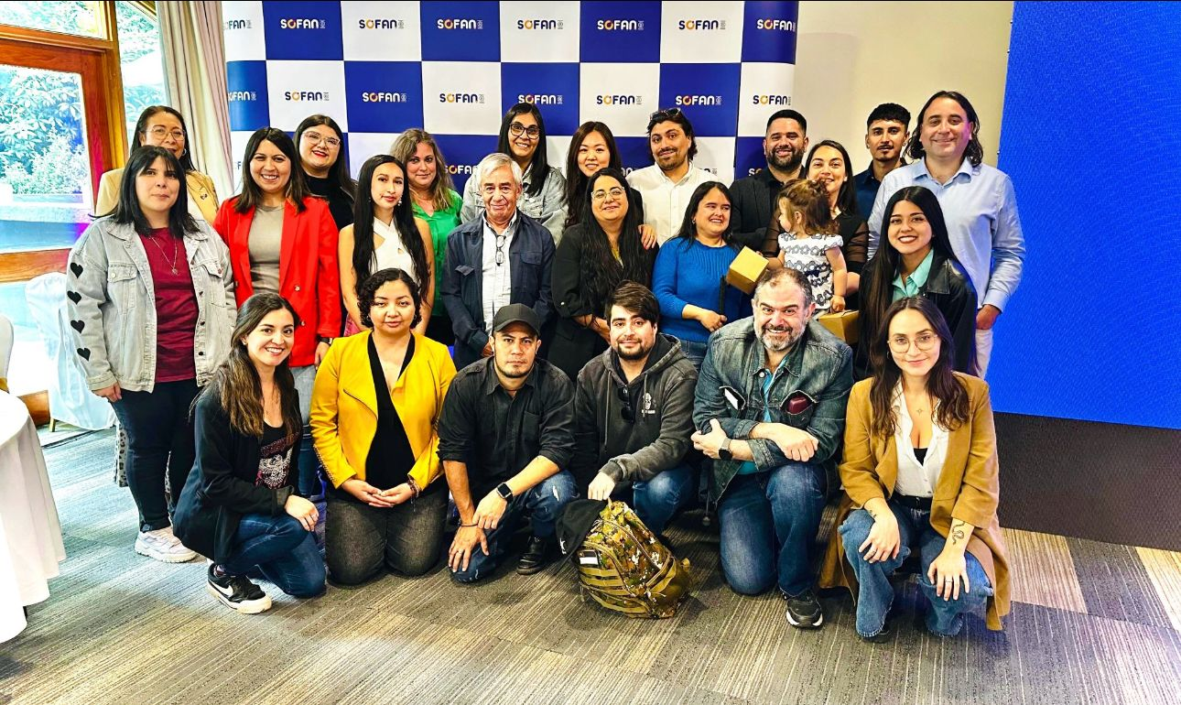
We are SOFAN SpA
Our company was founded with a strong conviction: communication is the first step towards inclusion.
Notes:
Presentation and photography of the Sofan team

Slide 3
A model that breaks down barriers
Programa SOFIA
✅ Accessible technology
✅ Free training of digital and socio-occupational skills
✅ Personalized accompaniment
Notes:
Main features of the SOFIA program

Slide 4
Our commitment with inclusion begins at home
For every person at SOFAN, 8 people with disabilities receive support to change their future in other companies.
Notes:
For every person at SOFAN, 8 people with disabilities receive support to change their future in other companies.

Slide 5
The pillars of our success
1️⃣ Focus on people.
2️⃣ We eliminate barriers.
3️⃣ Strategic partnership.
Notes:
The pillars of our success
1️⃣ Focus on people.
2️⃣ We eliminate barriers.
3️⃣ Strategic partnership.

Slide 6
Stories that inspire
📌 José Luis, a young 28 year old with visual disability.
📌 Constanza, a deaf 27 year old mother.
Notes:
2 Stories that inspire SOFAN's work

Slide 7
Sustainability and challenges
We don’t want SOFIA to depend on goodwill, but rather to be a model that can be replicated by companies, governments, and international organizations.
Notes:
We don’t want SOFIA to depend on goodwill, but rather to be a model that can be replicated by companies, governments, and international organizations.

Slide 8
The future: AI for inclusion
We will develop the artificial intelligence designed to facilitate the occupational inclusion of people with disabilities. A system that
identifies barriers,
proposes solutions, and
connects talents with real opportunities.
Notes:
Project proposal to improve the labor inclusion of people with disabilities

Slide 9
A call to action
What would happen if every company, regardless of its size, committed to hiring or financing occupational inclusion programs?
Imagine the impact.
If we, from a small company in the south of Chile, have been able to change lives, so can you.
Notes:
A call to action
What would happen if every company, regardless of its size, committed to hiring or financing occupational inclusion programs?

Slide 10
Do you accept the challenge?
Notes:
Do you accept the challenge?

