Slide 1
Technology Transfer for 3D-Printed Prosthetics to Ukraine
Noriko Takahashi and Eduardo Moreira
UNIDO
Austria
Making Quality Prosthetics Globally Accessible and Affordable
6 March 2025 | 12:00 - 13:00
#ZeroCon25
Notes:
Technology Transfer for 3D-Printed Prosthetics to Ukraine; Noriko Takahashi and Eduardo Moreira; UNIDO, Austria,
Making Quality Prosthetics Globally Accessible and Affordable
6 March 2025 | 12:00 - 13:00

Slide 2
About UNIDO
A specialized agency of the UN with a unique mandate to promote industrial development through Inclusive and Sustainable Industrial Development (ISID)
UN Sustainable Development Goal (SDG) 9: Build resilient infrastructure, promote inclusive and sustainable industrialization and foster innovation
Implements the UN Disability Inclusion Strategy and a member of the Inter-Agency Working Group on Gender and Disability Inclusion and VIC Disability and Inclusion Network
Notes:
About UNIDO: Presenting UNIDO’s role in the UN system and its activities on disability inclusion at the organization level.

Slide 3
Our Project Approach
Understanding the Local Context
Leveraging Cutting-Edge Technologies
Adapting Technologies and Business Model to Local Needs
Building the Capacity of Existing Institutions and Professionals
Strengthening Local Production and Innovation
Notes:
Our Project Approach : Presenting our strategy for implementing 3D-printed prosthetics project in Ukraine ensuring local adaptation. Understanding the local context; adopting cutting-edge technologies; building the capacity and strengthening local production and innovation.

Slide 4
Emergency Assistance for 3D-Printed Prosthetics & Job Creation in Ukraine
(Ongoing since March 2023)
CONTEXT:
The war in Ukraine since 2022 led to a sharp increase in the number of persons with disabilities (PwD).
STRATEGY:
Partner with a private company to transfer prosthetic technology through training and equipment provision.
EXPECTED RESULTS:
PwD gain mobility and self-reliance.
Notes:
Emergency Assistance for 3D-Printed Prosthetics and Job Creation : Presenting the project’s response to war-related disabilities and its goal of empowering PwD. Rising number of amputations; technology transfer through private-sector training; improving mobility and self-reliance enhancing the quality of life for PwD.

Slide 5
Innovative Aspects of the Project
Supporting Private Sector Development
Focus on B2B Technology Transfer
Leveraging Digital Technology & AI
Training with Real-World Application
Notes:
Innovative Aspects of the Project: Presenting the unique aspects of our project and how they support its goal of effective prosthetic solutions. B2B technology transfer; leveraging AI and digital tools; private-sector involvement enabling sustainable, scalable solutions.

Slide 6
Why 3D-Printed Prosthetics for Ukraine?
Advantages:
Increasing the production efficiency
Leveraging on Ukraine’s ICT infrastructure and human capital
More Accessibility & Affordability
Challenges:
Shortage of Skilled Professionals
Perception of Product Value
Predominance of Traumatic Amputations
Long Technology Adoption Time
Notes:
Why 3D-Printed Prosthetics for Ukraine? : Presenting the rationale for choosing 3D printing and its objective of improving prosthetic access. Increased efficiency; IT sector synergy; affordability ensuring innovative and cost-effective assistive technology.

Slide 7
Success Factors?
Capitalizing on Existing Systems
Working though International & Local Partners
Transparency & Realistic Expectations
Holistic Thinking & Pragmatic Approach
Contextualized Technology Integration
Notes:
Success Factors: Presenting key factors for project success and their role in achieving sustainable implementation. Transparent partnerships; holistic and pragmatic planning; technology integration into existing systems creating long-term impact.

Slide 8
Financing & Sustainability?
Challenges in mobilizing funding to support the local private sector
Short-term programs undermine sustainability
Need for long-term financial support and commitment by the international community and the government
Notes:
Financing and Sustainability : Presenting challenges in financial sustainability and the goal of securing long-term investment. Short programs; difficulty mobilizing private-sector funding highlighting the need for sustainable support models.

Slide 9
Next Steps: Global Program for Promoting Disability Inclusion in Industry
Establishing a Global Approach
Scaling Proven Solutions
Focus on Supporting Institutional Capacity
Improving Accessibility to Assistive devices and Workplace Accommodations
Promoting Inclusive Employment & Training
Notes:
Next Steps: Global Program for Promoting Disability Inclusion in Industry : Presenting the future direction of the project and its goal of scaling disability-inclusive industry solutions. Expanding proven solutions globally; improving accessibility and workplace accommodations; advocating for inclusive policies promoting systemic change.

Slide 10
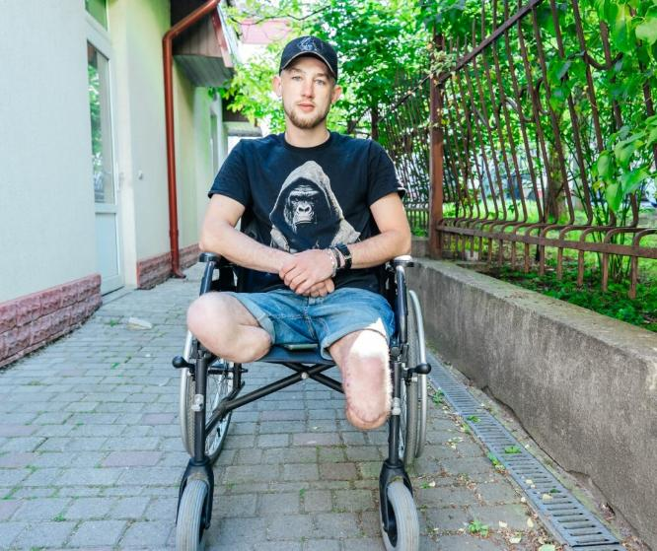
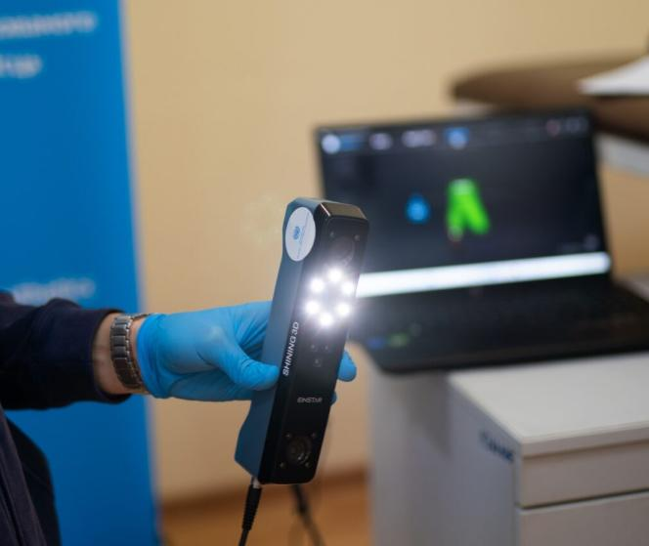
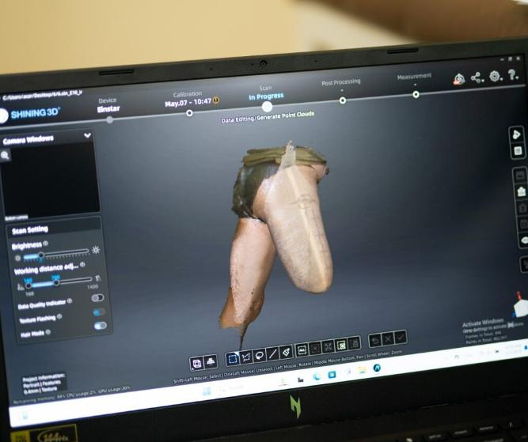
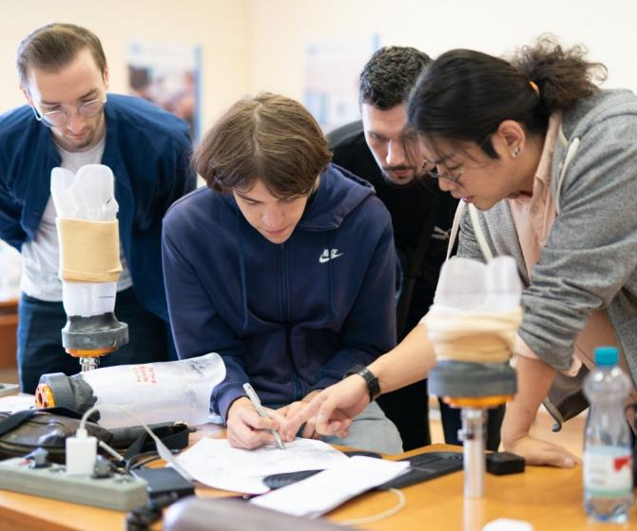
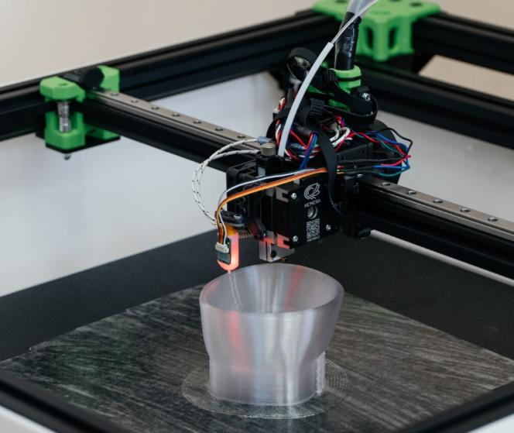
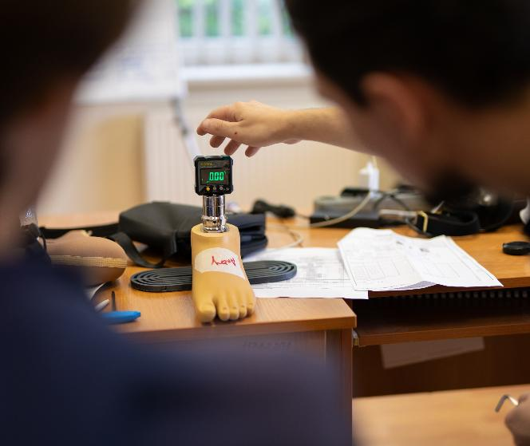
#ZeroCon25
Notes:
Photos: Presenting six Photos of the Project

