Slide 1
Beppu Inclusive City Initiative
Makoto, Wada
The Nippon Foundation
Japan
Champions of Inclusive Spaces
Wednesday 5 March, 12:00 - 13:00
Notes:
Beppu Inclusive City Initiative
Makoto, Wada
The Nippon Foundation
Japan
Champions of Inclusive Spaces
Wednesday 5 March, 12:00 - 13:00

Slide 2
Beppu Inclusive City Initiative
What is this Initiative?
1.Implementation of “a model case” projects by the Nippon Foundation in Beppu City
2.Rather than being a project for individual persons with disabilities or an organization, this initiative aims to create “a model case” that can serve as a reference for many.
3.“A model case” for the social inclusion of people with disabilities will be shared both domestically and internationally.
Notes:
Outline of this Initiative:
The Nippon Foundation will implement “a model case project” in Beppu City.
Social advancement of people with disabilities and disseminate them domestically and internationally.
The project will not be a project for individual persons with disabilities or a single organization, but will create a model case that many people can use as a reference.

Slide 3
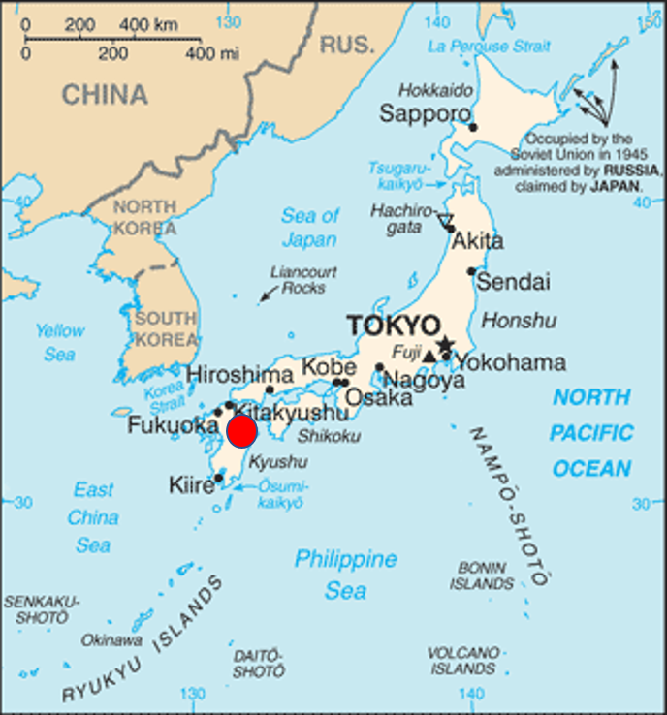
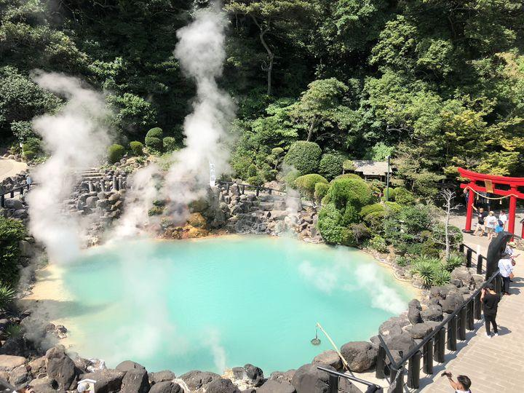
Beppu City 1
Notes:
Beppu is located in the south of the Japanese archipelago and is famous in Japan for its hot springs. Although the population is about 100,000, the number of tourists is estimated to be 7 million, and recently there have been many foreign tourists.

Slide 4
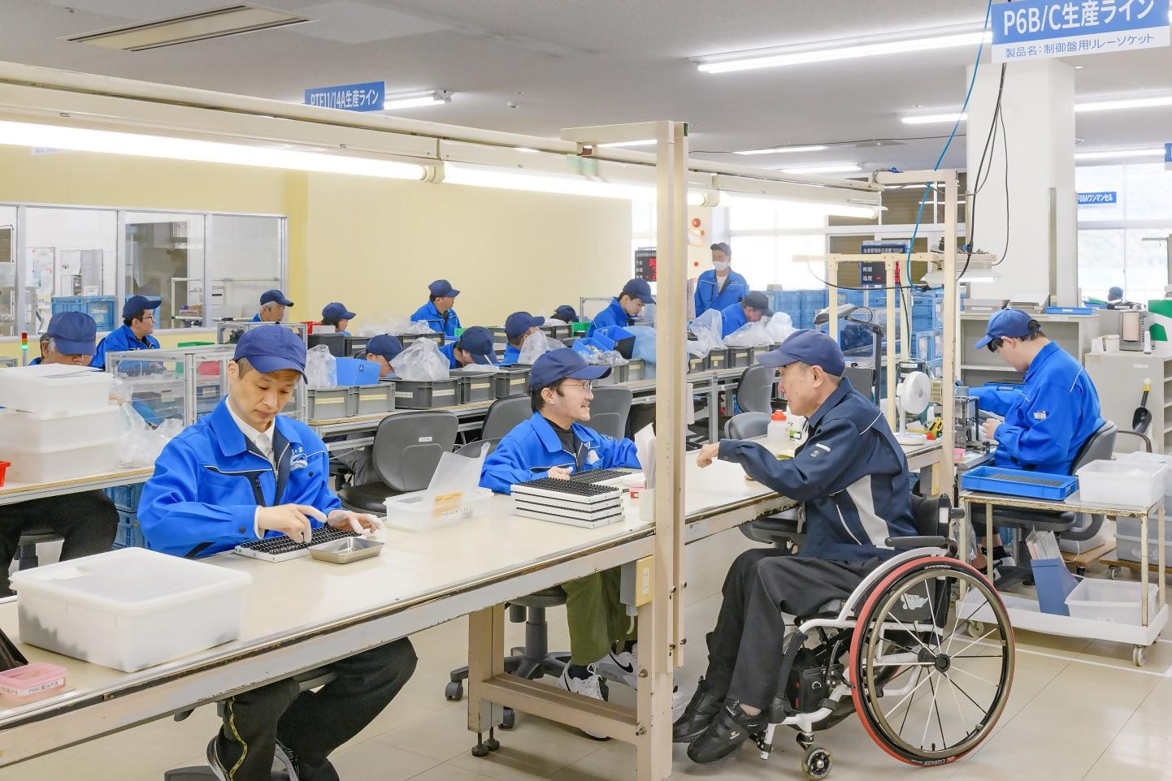
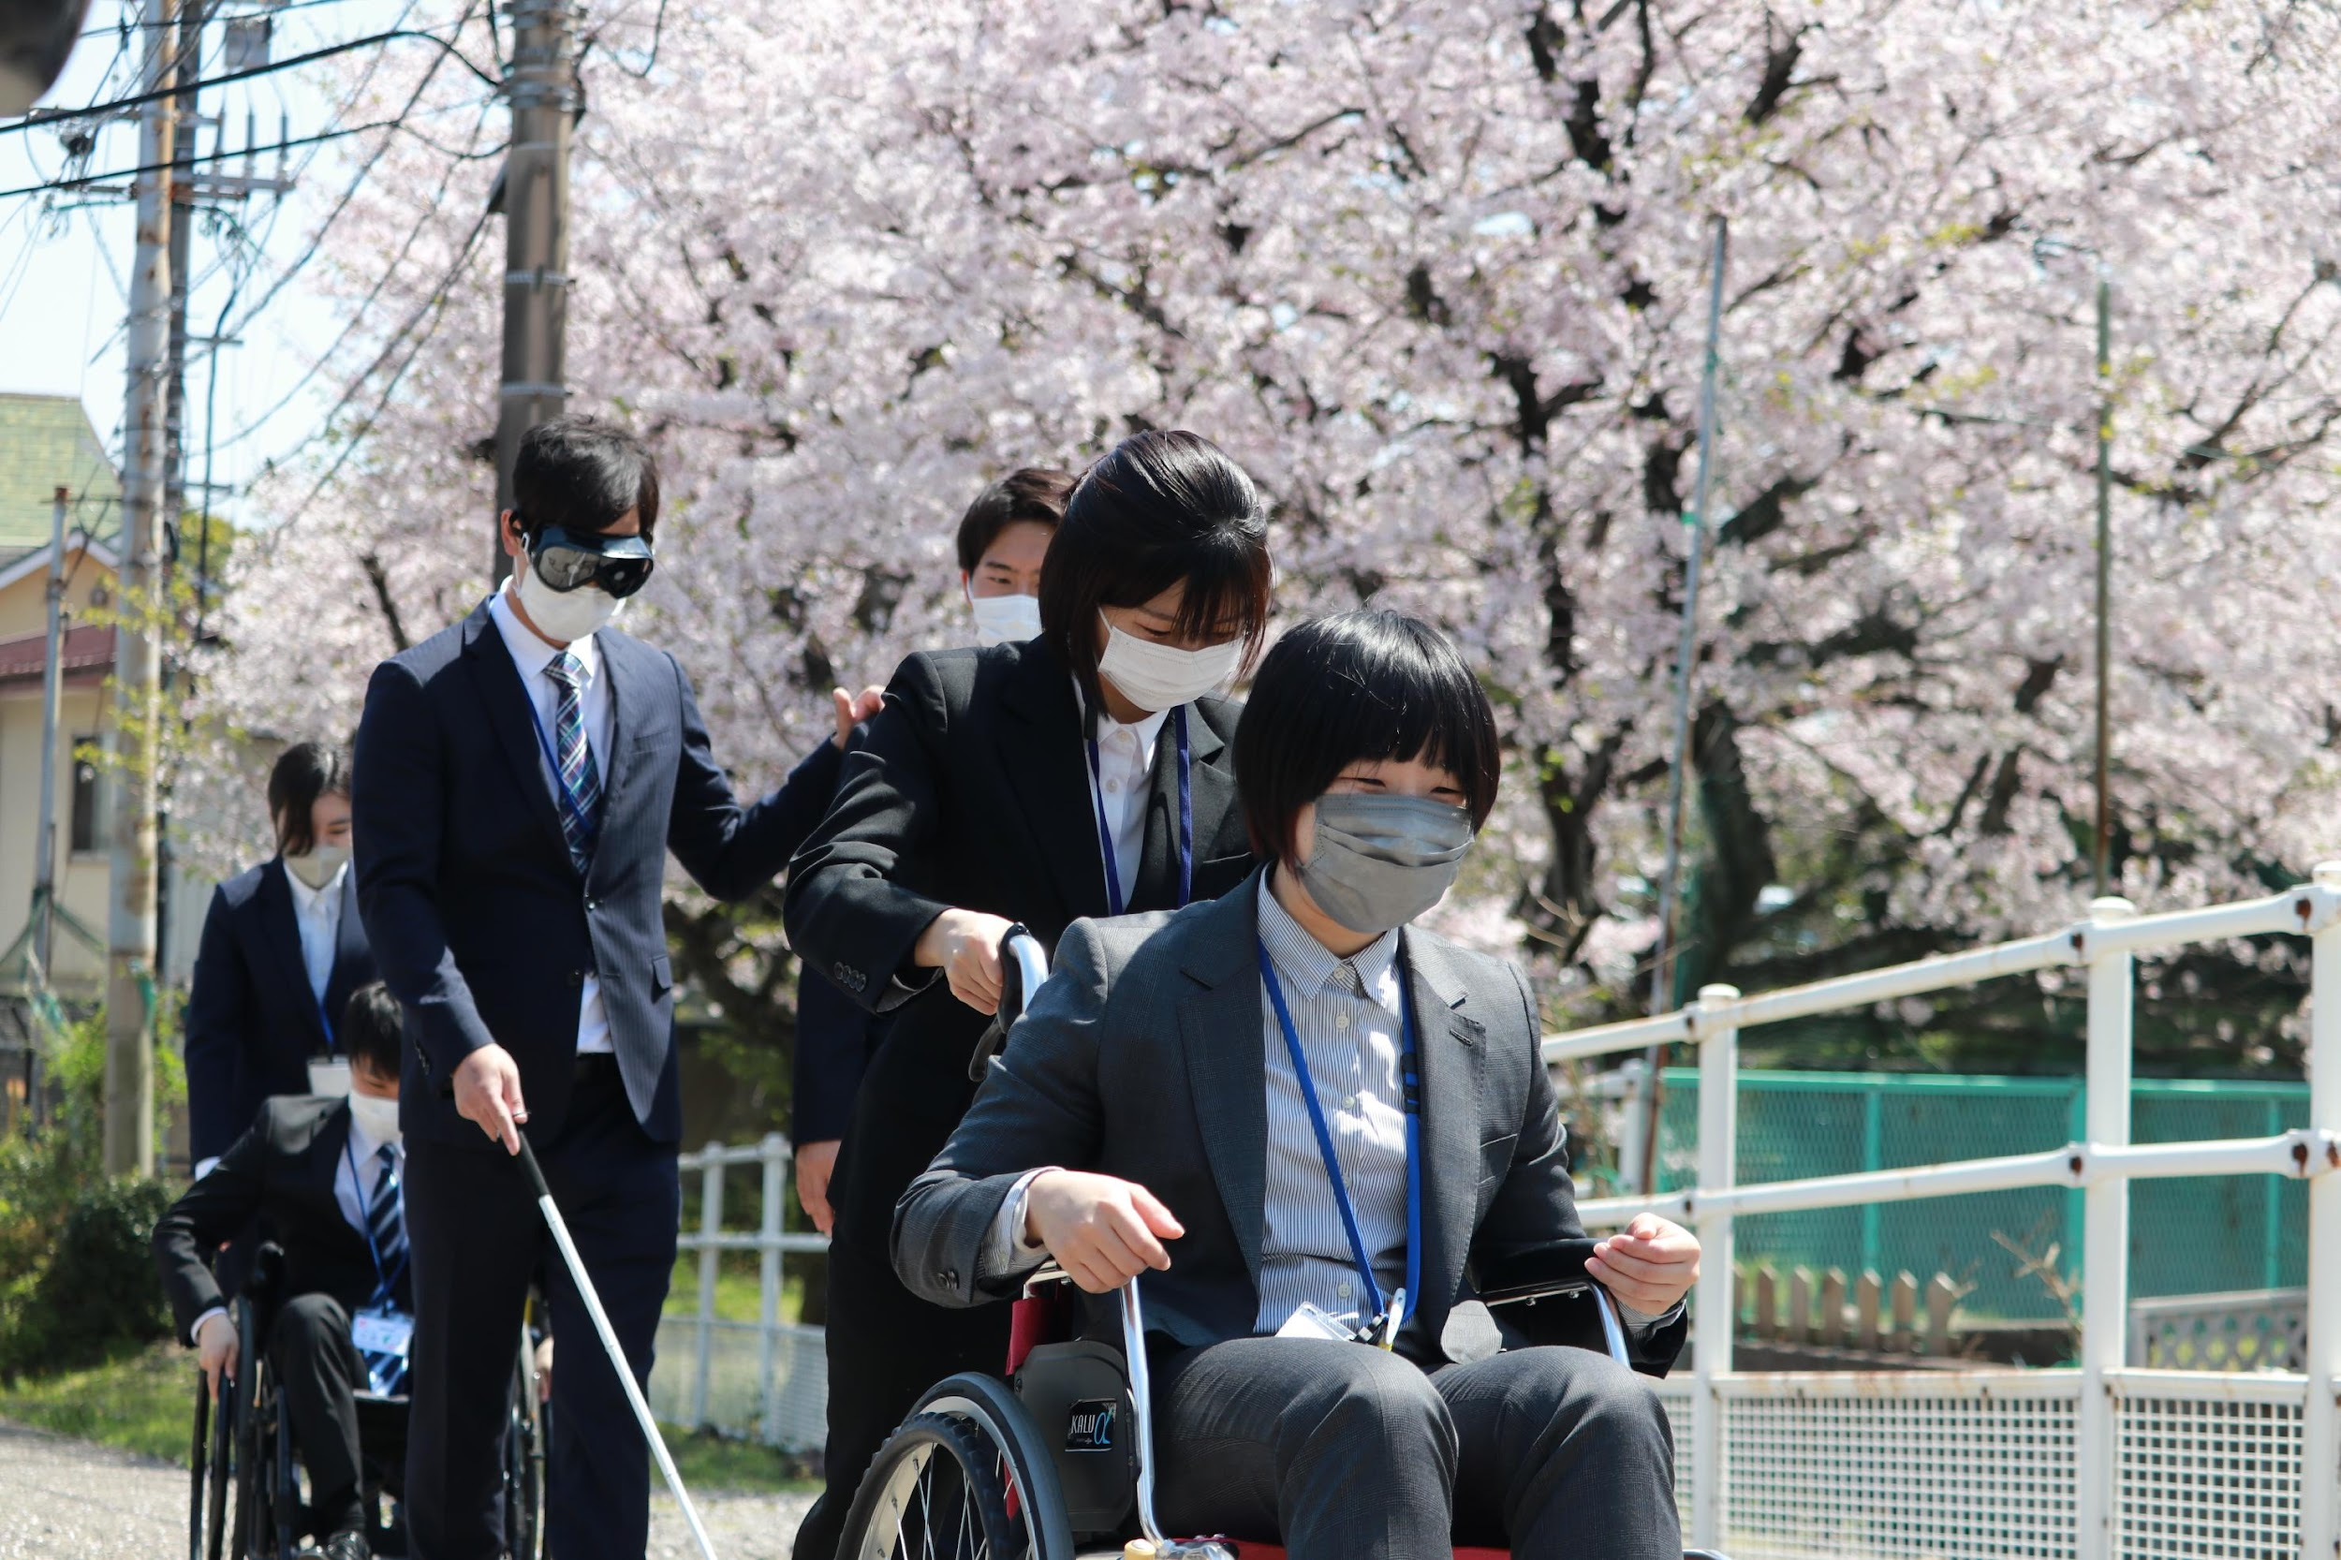
Beppu City 2
Notes:
Beppu City is famous not only as a tourist destination, but also as a welfare city. A social welfare corporation in Beppu has invested in subsidiaries of Honda and Sony, and they work for the same payment as able-bodied people. The companies provide equipment for the differently abled. Although the percentage of disabled people in Beppu City is not large, my impression is that I often see wheelchairs and disabled people in town. Accordingly, the company is enthusiastically providing training for city employees.

Slide 5
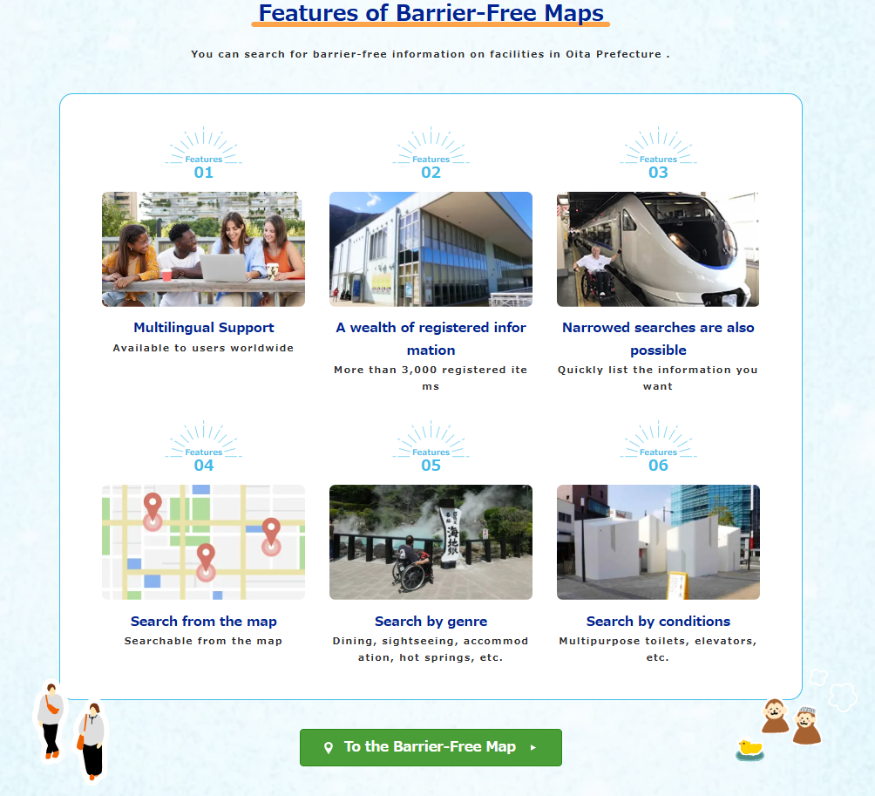
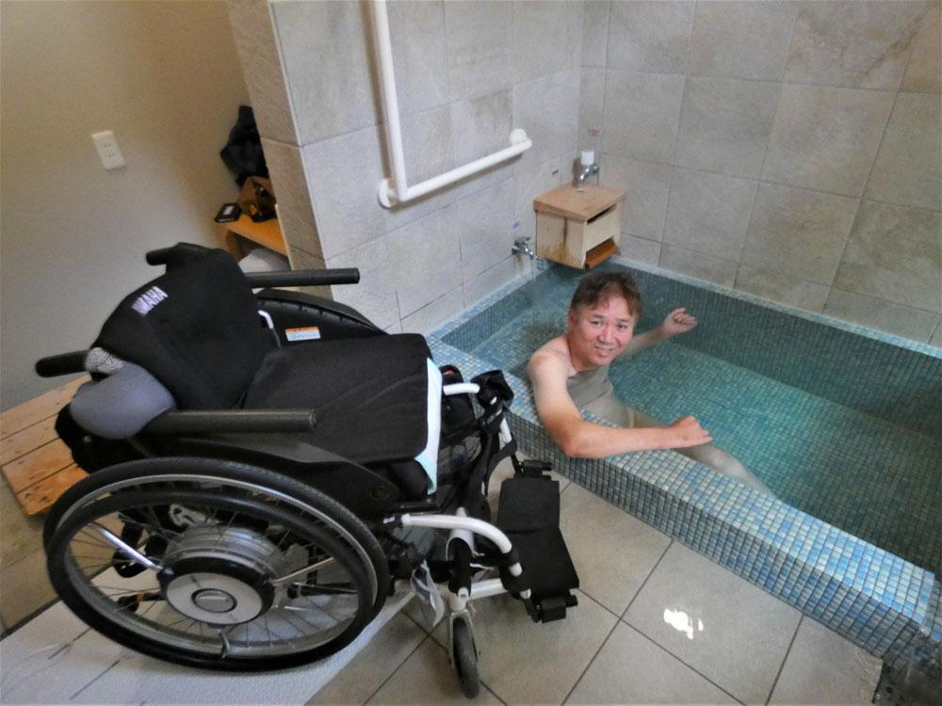
Beppu City 3
Notes:
In Beppu City, there is no problem at all for people with disabilities to enter restaurants and other facilities. As shown in the photo, the hot springs are also designed so that wheelchair users can bathe in them. There is also a map created by people with disabilities. The disabled themselves are promoting tourism, and have created a website with barrier-free tourism information.

Slide 6
Beppu Initiative 1
What this initiative will do?
Supporting universal tourism, barrier-free mobility, barrier-free impact analysis, etc.
What is the goal?
To ensuring that results are utilized globally and to promote activities for the realization of a more inclusive society.
Notes:
What will we do with this initiative?
We are looking at several projects: universal tourism, barrier-free transportation, analysis, etc.
What are the goals?
The goal is to create a model. We will verify the projects and publish the results. We want other organizations and governments to use the results of our projects to create a more inclusive world.

Slide 7
Beppu Initiative 2
Why TNF does this Initiative?
1.We want to share “a Japan-originated model” to the world.
2.We aim to redefine the role of a Grant-Making Foundation and lead other supporting organizations.
Notes:
Why does the Nippon Foundation do this?
We would like to present this project as a good example from Japan.
The Nippon Foundation is a grant-making organization, but there are things we can do with limited resources. By communicating a model, we hope that people will follow it and create a better inclusive society.

Slide 8
Beppu Initiative 3
What we expect from you?
1.Please visit Beppu and share your feedbacks!
2.Let us know if there are any area/technologies which you could utilize.
3.Let us know any relevant communities or opportunities to present this initiative.
Notes:
What we expect from you
Please come to Beppu, and we want others to tell us about the good and the bad.
Please let us know if there are any points or techniques that you think you could be involved in this project.
We would like to know where we can present other reference areas and Beppu projects to the public. I want this project to be communicated more and more so that more people can understand it and use it as a model. Such opportunities are what I am seeking.

