Slide 1
Disability Inclusive Development Inclusive Futures programme
Daniel, Musango
Sense International
Kenya
Entrepreneurship support programmes for persons with disabilities
Thursday 6 March 2025 | 15:40 - 16:40
Notes:
Disability Inclusive Development Inclusive Futures programme
Daniel, Musango
Sense International
Kenya
Entrepreneurship support programmes for persons with disabilities
Thursday 6 March 2025 | 15:40 - 16:40

Slide 2
Sense International
Our Vision
Our vision is of a world in which all people with deafblindness can be equal and active members of society.
Our Mission
We work in partnership with others across the globe - people with deafblindness, their families, carers and other professionals to ensure anyone facing challenges because of deafblindness has access to advice, guidance and support.
Notes:
Introduction:
This slide presents the vision and mission of Sense International Kenya.
Sense International is a global organization dedicated to supporting individuals with deafblindness.
Vision:
Our vision is to create a world where all individuals with deafblindness are treated equally and can fully participate in society.
This means advocating for inclusivity, accessibility, and empowerment in all aspects of life, including education, employment, and social engagement.
Mission:
We work collaboratively with various stakeholders, including:
Individuals with deafblindness
Their families and caregivers
Professionals in healthcare, education, and social services
Our aim is to ensure that people with deafblindness receive the necessary advice, guidance, and support to overcome challenges they face.
We engage in programs that enhance their communication, education, and livelihood opportunities.
Sense International Kenya is committed to improving the lives of individuals with deafblindness.
By working together, we can create a more inclusive and supportive society for all.

Slide 3
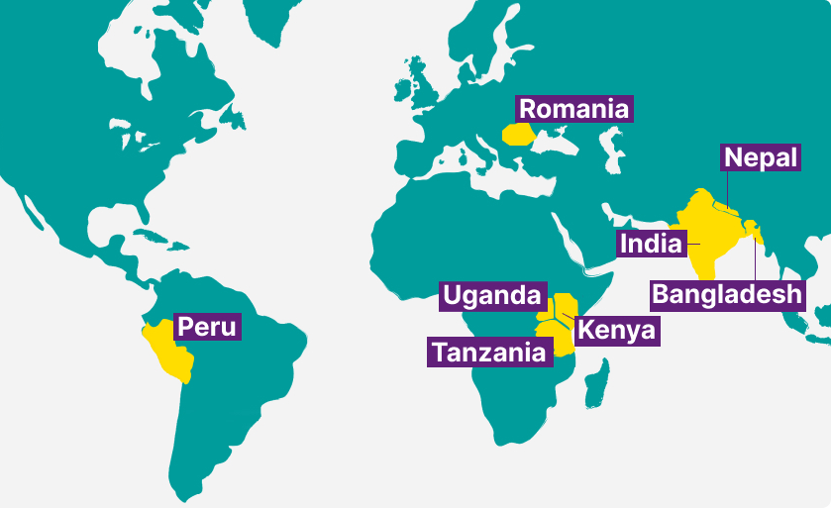
Where we work in the world
Notes:
A map of the world showing the countries in which Sense International works - Peru, Romania, Uganda, Tanzania, Kenya, India, Nepal and Bangladesh,

Slide 4
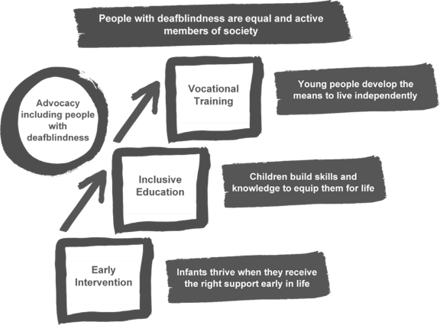
Life cycle approach
Notes:
Diagram of Sense International's 'life cycle approach’.
Diagram shows how Sense International work in
Early Intervention: To ensure that infants thrive when they receive the right support early in life.
Then support children as they transition to...
Inclusive Education: To ensure that children build skills and knowledge to equip them for life.
Then support young people as they transition to...
Vocational training: To support young people develop the means to live independently
Sense International also demonstrate and advocate for inclusion of people with deafblindness in all these areas.
The principle aim is to ensure that people with deafblindness are equal and active members of society.

Slide 5
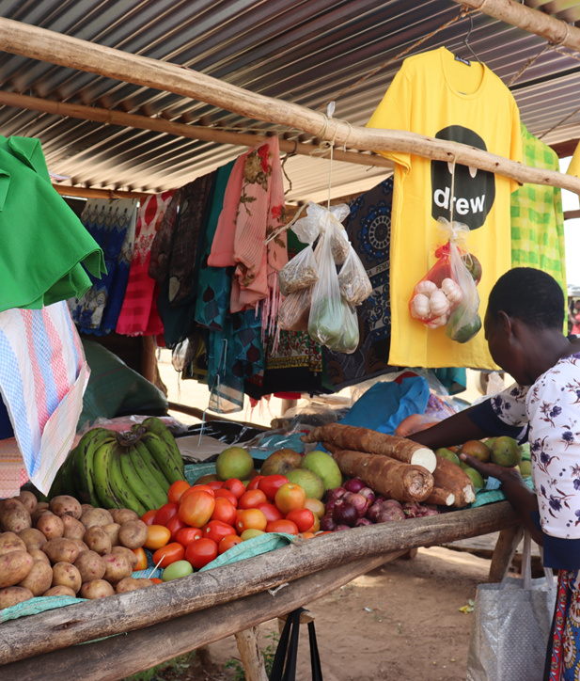
InBusiness Programme - Kenya
Implemented in a consortium with Light for the World and Humanity and Inclusion.
Pilot project (2019 – 2020), scaled in 2021 - 2025
Notes:
Consortium under the Disability Inclusive Development; Inclusive Futures programme.
This project is a collaborative initiative that aims to facilitate business linkages between micro-enterprises run by people with complex disabilities and established small, medium, and large commercial enterprises.
It aims to build sustainable business relationships in the supply chains, that leverage on economies of scale for micro-enterprises owned by youth, women, and persons with complex disabilities. The initiative is implemented by Sense International Kenya (SIK), Light for the World (LFTW) and Humanity and Inclusion (HI).
The project aims to deliver the model for three different target groups; HI are supporting MEs in a refugee context (MEs with disabilities), LftW is supporting MEs with and without disabilities and a mix of MEs themselves and their caregivers. SI supports MEs with complex disabilities and their caregivers.
Geographical coverage: 8 Counties in Kenya; Kitui, Kwale, Kakamega, Kisumu, Homabay, Wasingisu, Kilifi, Nairobi.

Slide 6
Objectives
Business skills of micro- entrepreneurs improved (training and mentorship, Business Development Service provider (BDS) training, curriculum adaptation).
Business confidence of micro-entrepreneurs improved (self- advocacy and safeguarding training, growth kits, assistive devices, family involvement).
Micro-entrepreneurs’ access to procurement chains (PPI and DIF engagement, County advocacy).
Improved disability inclusion in procurement chains (inclusion at businesses and PPI workplaces, practices, language. )
Evidence collection and sharing (research, quarterly feedback, lesson sharing and review meetings).
Notes:
Business Development Service Providers (BDS Providers) Identification and Training
Five BDS providers have been identified by Sense International Kenya. Mostly teachers at Sikri and St Angela’s Vocational Training Centres – who both specialise in training for youth with deafblindness and other complex disabilities. Also, one Education Assessment Resource Centre Officer. They receive contracts to work on the project.
They support the MEs on a day-to-day basis – and remote monitoring. They were trained using the original BDS Providers Training Manual.
BDS providers are taken through an intensive training to understand the needs of MEs and use the curriculum they were trained with to train the MEs.
BDS providers receive a monthly stipend – they visit the MEs monthly and follow up via phone calls.
Adaptation of Training Curriculum
The curriculum (Business Development Service Providers Manual) was prepared by the consortium (LftW) but was too complex for MEs with complex disabilities. So, this has been adapted by Sense International Kenya, the BDS providers and the original curriculum development company (Inuka Leadership Africa). SIK maintained the four modules – but the mode of delivery was adapted and the language that was used (simplify the language) and the tools (record – balance sheet and record keeping tools) were made easier to use and understand by MEs with complex disabilities and their families.
MEs Identification
LftW had an online system for MEs to apply to be part of the project. Due to the complexities of the impairments of the MEs that Sense International Kenya works with this wasn’t possible. Instead MEs ‘applied’ through the BDS providers, so each BDS Provider presented a small pool of MEs. Cohort one had 40 applications and cohort2 32 applications. Sense International Kenya staff together with the BDS Providers reviewed and assessed the MEs against the set criteria.
All the MEs had completed their vocational training at either Sikri or St Angela Vocational Training Centres.
Sense International Kenya physically visited all the MEs and verified their businesses. To find evidence of the business – confirm it is a legal business. Minimum monthly turnover had to be KES 5,000. For other consortium members this was KES 10,000 / month.

Slide 7
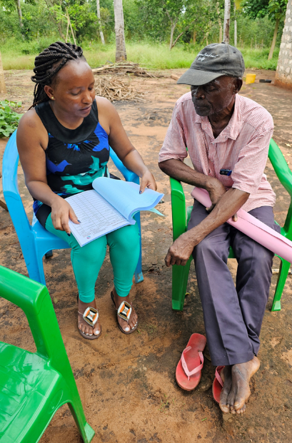
Successes
36 micro-entrepreneurs (MEs) graduated from cohort 1 and cohort 2.
Initial tracking of sales shows 27 MEs are recording increased sales.
Business Training curriculum was contextualized for MEs with complex disabilities.
Trained 79 caregivers on communicating the needs of micro-entrepreneurs.
Disability inclusion training to PPIs – led to mindset shift on disability.
Recruited and trained 5 BDS and 1 DIF.
Exhibitions by MEs led to increased awarenesses creation and sales.
Notes:
Identified and trained 5 BDS providers
Sense International Kenya identified, recruited and trained 5 BDS Providers across all Counties the project is running. This means that each BDS provider has multiple MEs to support within their geographical area.
Adaptation BDS training manual
As already mentioned, the curriculum (Business Development Service Providers Manual) was prepared by the consortium (LftW) but was too complex for MEs with complex disabilities. So, it was reviewed and then adapted by Sense International Kenya, the BDS Providers and the original curriculum development company (Inuka Leadership Africa).
SIK maintained the four modules – but the two main changes were 1) the language used – being made simpler, and 2) the mode of delivery was adapted to suits the needs of the MEs with complex disabilities.
Identified and trained 36 MEs and 54 caregivers
Trained MEs and their caregivers using the adapted curriculum, as well as additional sensitisation and safeguarding training for caregivers.
Success for MEs
Cohort 1 - 60% recorded more than double sales after the support they received.
Participation in Exhibitions
6 MEs, their caregivers and 3 BDS Providers participated in the 1st Kakamega International Investment Conference (KIICO). This event had a significant social impact not only on the MEs but also on the participants at the conference. It raised awareness of the existence of persons with deafblindness and complex disabilities and their capabilities. This was showcased through the display items that they had produced with their businesses, especially the hand-made items like mats and tablecloths.
The event provided excellent exposure for both the MEs and other participants, fostering engagement and learning opportunities. MEs and caregivers expressed they gain more confidence. They introduced themselves and their businesses, exchanged contacts, and engaged in basic business conversations with other participants at the conference. This experience proved instrumental in building and enhancing networking abilities, overcoming communication barriers, and contributing to a more connected and collaborative business community.
Our OPD member Empowerment of the Disabled Development Organization (EDDO), based in Kakamega has been doing a great job advocating at the County level. Together with the other BDS providers from the Western and Nyanza region, they worked hard to ensure the success of the event. The KIICO conference event had registration and attendance fees but due to advocacy the organisation waved these expenses. The expo booths were also given to the MEs at no cost. This was in the spirit of disability inclusion, which in turn enabled our MEs to sell their products to the participants and at the same time creating awareness of their abilities.

Slide 8
Learning
Business training module contextualization was key.
Family involvement in training and running businesses.
Programme adaptation to suit micro-entrepreneurs with complex disabilities.
Growth kits are essential in supporting micro-entrepreneurs.
Connection to supply chains
BDS providers as trainers and mentors.
Notes:
Introduction:
This slide presents the key lessons learned from the implementation of the InBusiness Programme in Kenya.
These insights help improve future program design and ensure greater impact for micro-entrepreneurs with disabilities.
Key Learnings from the Programme:
Contextualization of Business Training Modules
Business training must be adapted to meet the specific needs of micro-entrepreneurs with disabilities.
Tailoring the curriculum ensures accessibility and better comprehension for entrepreneurs with complex disabilities.
Family Involvement is Crucial
The support of family members and caregivers significantly impacts the success of micro-entrepreneurs.
Training caregivers helps them provide better assistance in running businesses and making informed decisions.
Programme Adaptation for Entrepreneurs with Complex Disabilities
Adjustments to training approaches and business support services were necessary for entrepreneurs with multiple disabilities.
This includes flexible training schedules, assistive technology, and specialized mentorship.
Growth Kits are Essential for Business Development
Providing startup resources (growth kits) was key to helping micro-entrepreneurs establish and expand their businesses.
These kits included tools, equipment, or materials necessary for their specific businesses.
Connection to Supply Chains is Key
Linking micro-entrepreneurs to reliable supply chains increases their business sustainability.
This includes partnerships with wholesalers, retailers, and procurement institutions.
BDS Providers Play a Key Role in Training and Mentorship
Business Development Service (BDS) providers are essential for offering technical guidance and ongoing mentorship.
Their role ensures that micro-entrepreneurs receive professional business support beyond the training phase.

Slide 9
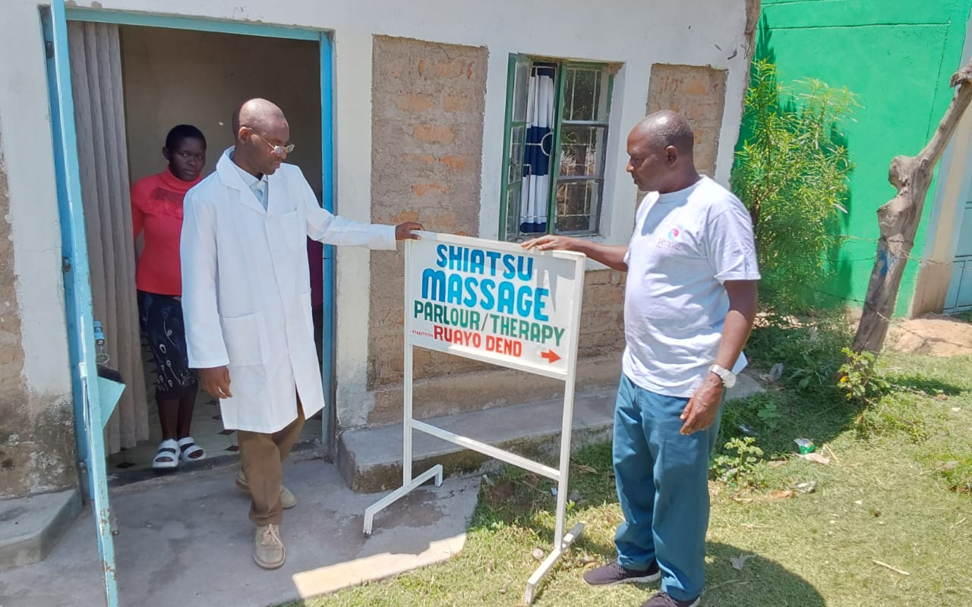
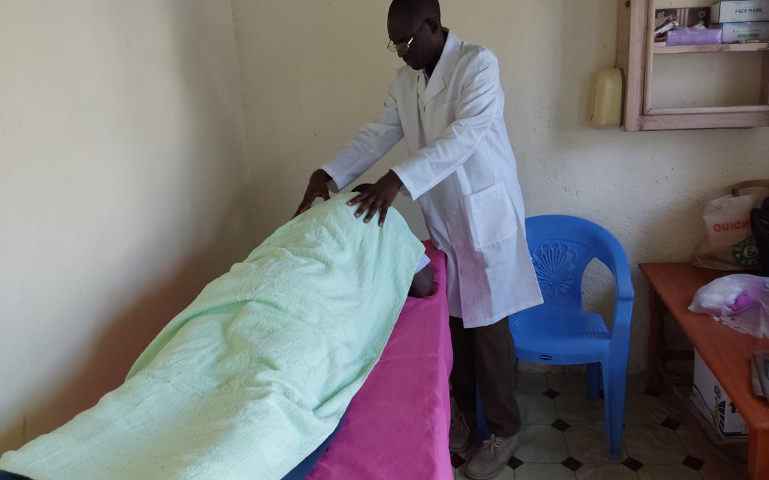
Story of Entrepreneur: Dennis
Dennis has deafblindness and offers Shiatsu massage services. The project transformed Dennis's life, providing him with a stable workplace and regular outreach calls to hospitals and homes. He can now adequately support his young family.
Notes:
Dennis is a small business owner of two businesses, one of which was set up with the support of Sense International Kenya which he runs with his wife.
Dennis is fully blind, whereas his wife has partial hearing and partial vision.
Before becoming a micro-entrepreneur under Sense International Kenya’s ‘inBusiness’ project, Dennis and his wife attended Sikri Technical & Vocational College for the Blind and Deaf where Dennis trained in traditional Japanese tactile massage. Through a Sense International Kenya inclusive education project, the Dennis received a tablet to help train and learn.
Dennis is now running his massage business and will receive a growth kit through the project to procure additional materials for his massage business.
Together, Dennis and his wife were supported to set up a fruit and vegetable stall.
They now receive mentorship and guidance from a Business Development Support provider who visits the two micro-entrepreneurs regularly and provides training for successfully running a business. They will also receive a growth kit to build a permanent structure for their stall and diversify their stock.
‘We are extremely excited to be part of this project to diversify and grow our businesses’.

Slide 10
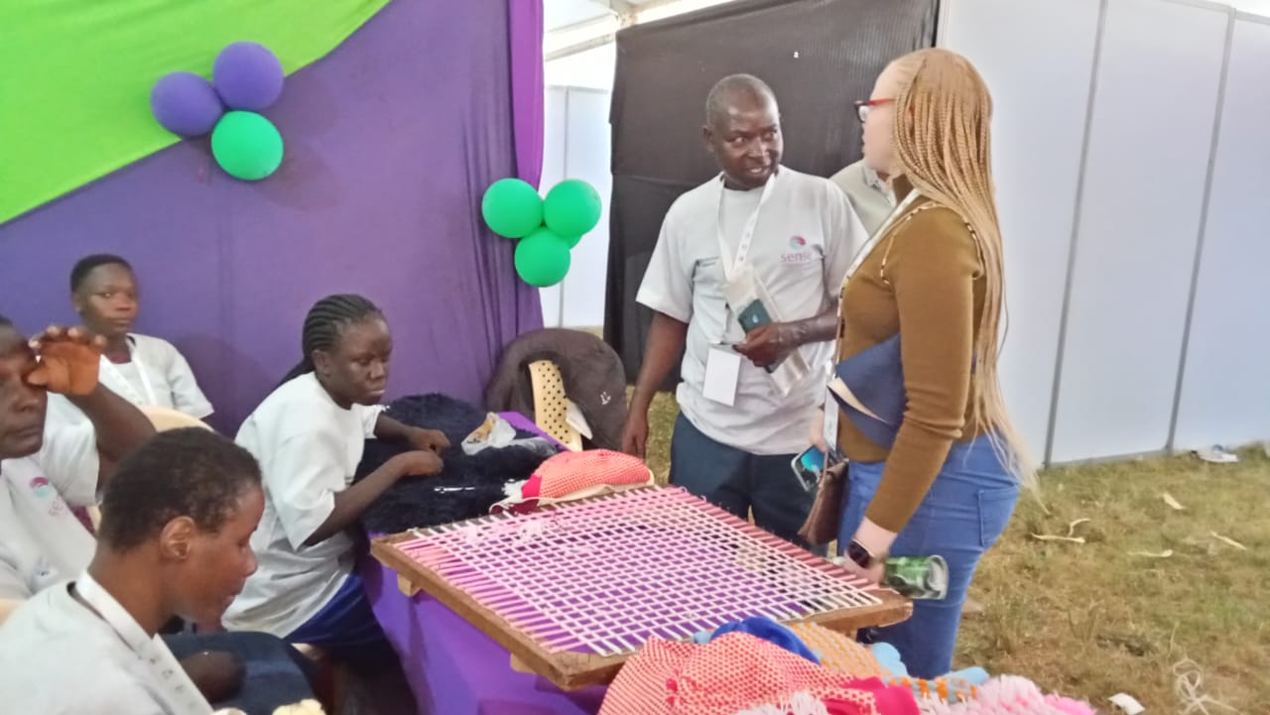
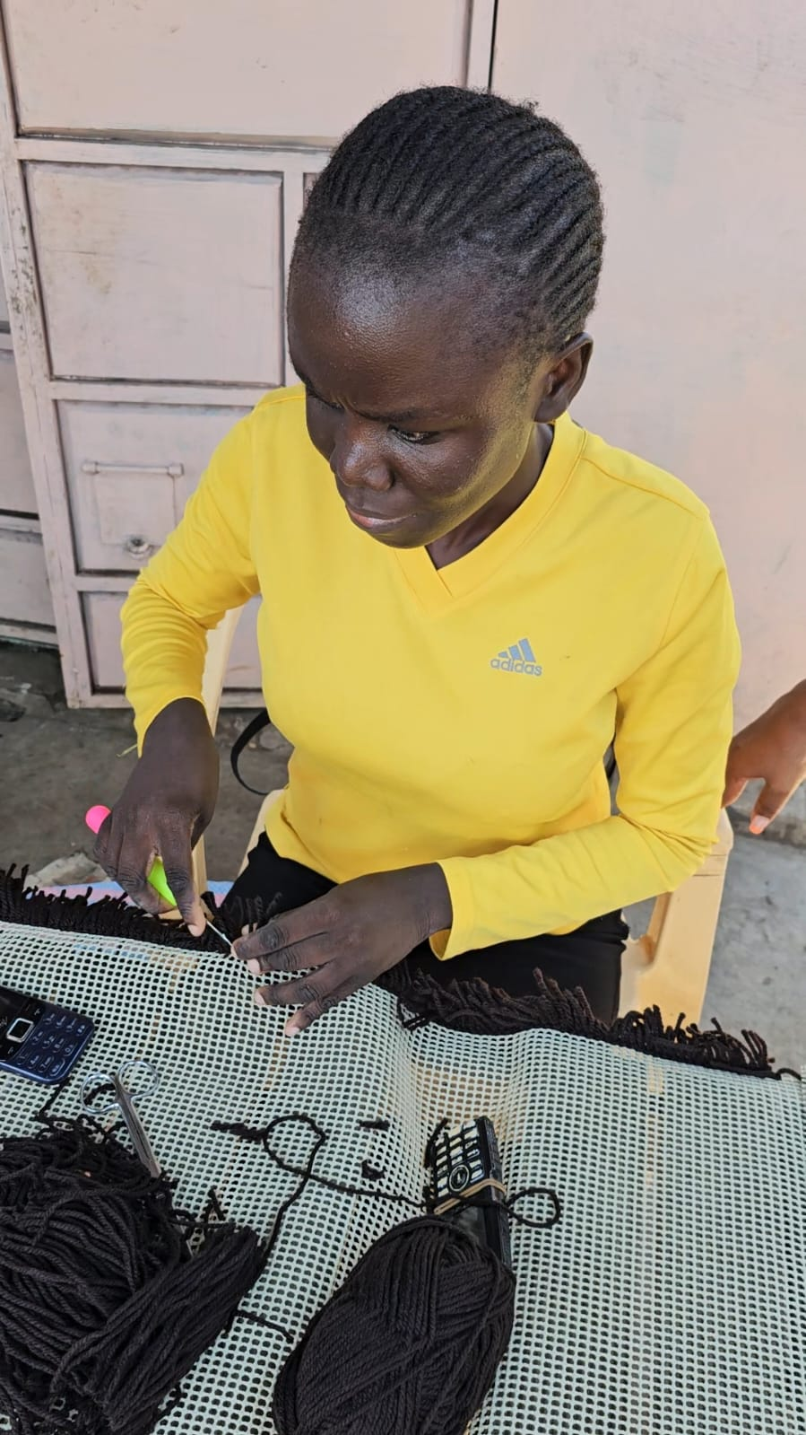
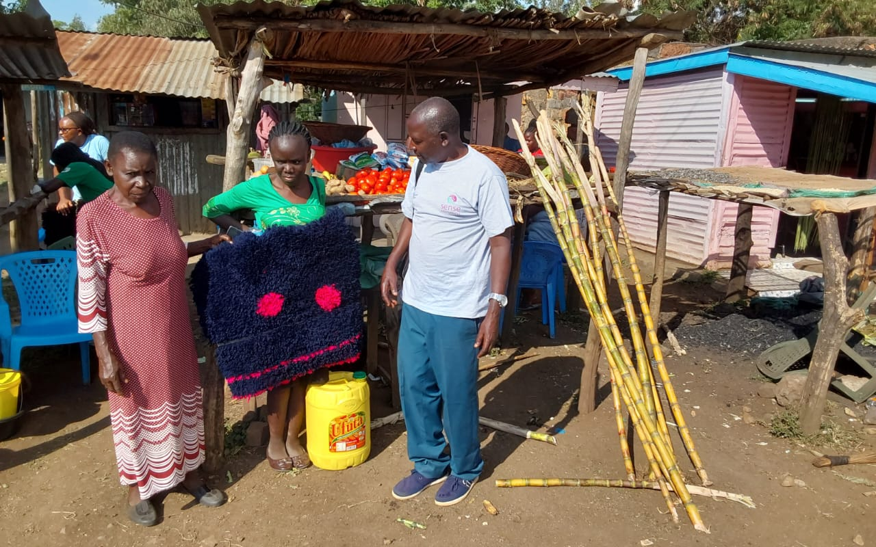
Story of Entrepreneur: Beryl
"My life has changed, and this has improved our standard of living back home. My mother has enough to feed my siblings, and I also have enough material to make more mats and meet the demands of my customers."
Notes:
Beryl’s journey highlights the impact of economic empowerment for persons with disabilities. Coming from a family where four of her siblings are blind, she is the only one who is deafblind. She lost her vision in third grade and later her hearing in sixth grade due to illness, making education and daily life challenging. Before joining the InBusiness Programme, she struggled to grow her business due to limited resources, market access, and financial support, making it difficult to earn a stable income for herself and her family.
Through the InBusiness Programme, Beryl received business training, mentorship, and a growth kit, equipping her with the skills and materials to expand her production. With family involvement and financial literacy, she now confidently manages her business. As a result, she has significantly increased her sales, improving her family’s living standards. Her success underscores the importance of inclusive entrepreneurship, family support, and targeted training in transforming the lives of persons with disabilities.

