Slide 1


Valueable: an inclusive European hospitality network
Paola Vulterini
Italian Association of People with Down syndrome (AIPD)
Italy - Europe
Encouraging employers with standards, data, and certification
Thursday March, 6 14.00-15.00
Notes:
Good afternoon. I am here on behalf of the Italian Association of People with Down Syndrome, the promoter of the Valueable network

Slide 2
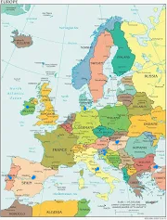




Valueable in a nutshell
  One brand & one network
  A range of facilitating tools
Notes:
The Valueable initiative is both a brand and a network.
FIRST The brand, registered in 2018 at the European Intellectual Property Office, the Valueable brand represents an employer’s commitment to the inclusion of people with intellectual disabilities in the workplace.
It is not a prize, but rather an acknowledgment of an employer's engagement in inclusion.
There are three levels of certification:
Bronze: For employers who host internships.
Silver: Requires a higher commitment—a minimum fixed-term (3 months) or permanent job for at least one worker.
Gold: Awarded to employers who hire at least one worker and act as ambassadors of the Valueable trademark.
All these commitments are outlined in a Code of Good Practice, which must be signed by prospective members.
The trademark is granted for two years and can be renewed.
SECOND Valueable is also a network of hospitality companies that hold the brand.
Currently operating in 8 countries (P,E,D,HU,IRL,It, HR, TK).
THIRD The network provides facilitating tools such as e learning and videotutorials are available on our website

Slide 3
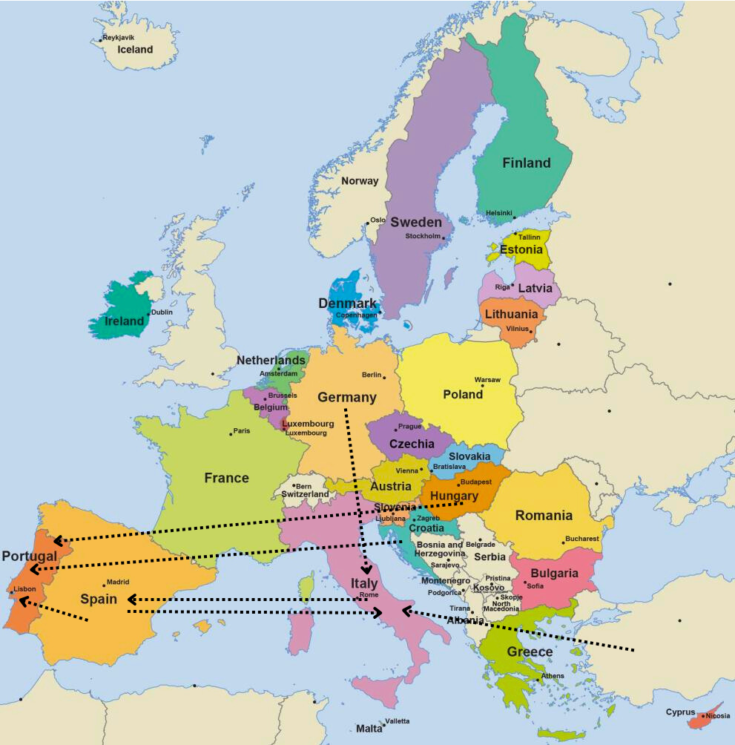
What makes Valueable unique?
Are we innovative?
  Brand + network
  International internships (48)
Notes:
I personally believe that the combination of a brand and a network is the most innovative aspect of Valueable
However, we are particularly proud of one achievement:
International Internships
We have been organizing three-week internships in Valueable-certified hotels in foreign countries.
The arrows on the map represent the internships conducted in November and December 2023.
Since 2018, 48 young people have gained international work experience thanks to Valueable.

Slide 4
Impact of Valueable Over 10 Years
360 people supported
46 training accredited
agencies
141 members
(hospitality companies)
6 hospitality chains involved
Notes:
360 workers and trainees have been supported
8 national training agencies are official network partners , acting as facilitators
46 training providers collaborate with us. As the main 8 partners alone cannot cover their entire national territory. However, training providers must first undergo an accreditation process.
141 hospitality companies are currently members
6 hospitality chains have signed a protocol of collaboration

Slide 5
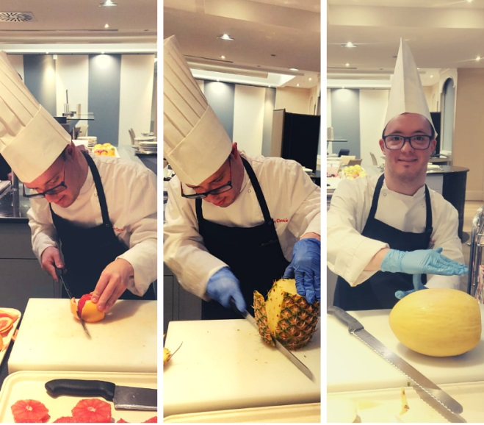
A success story: Daniel’s journey
Notes:
This is Daniel, a Portuguese cook assistant who was initially afraid of knives. During his three-week internship at the Melià Milano Hotel, he progressed step by step:
started with a small knife to cut a tomato, then a bigger one to cut a pineapple and , the third week a huge knife to slice a mellon!
Our success factors?
Valueable’s strenght lies in its unique combination of elements:
One European brand and a Europe-wide network
Focus on a highly disadvanaged group
Job placements exclusively in the open labour market within a specific sector: hospitality
Long lasting partnerships between expert training and placement agencies and companies.
Facilitating tools tailored for: persons with intellectual disabilities, hospitality managers and staff and training agencies.

Slide 6
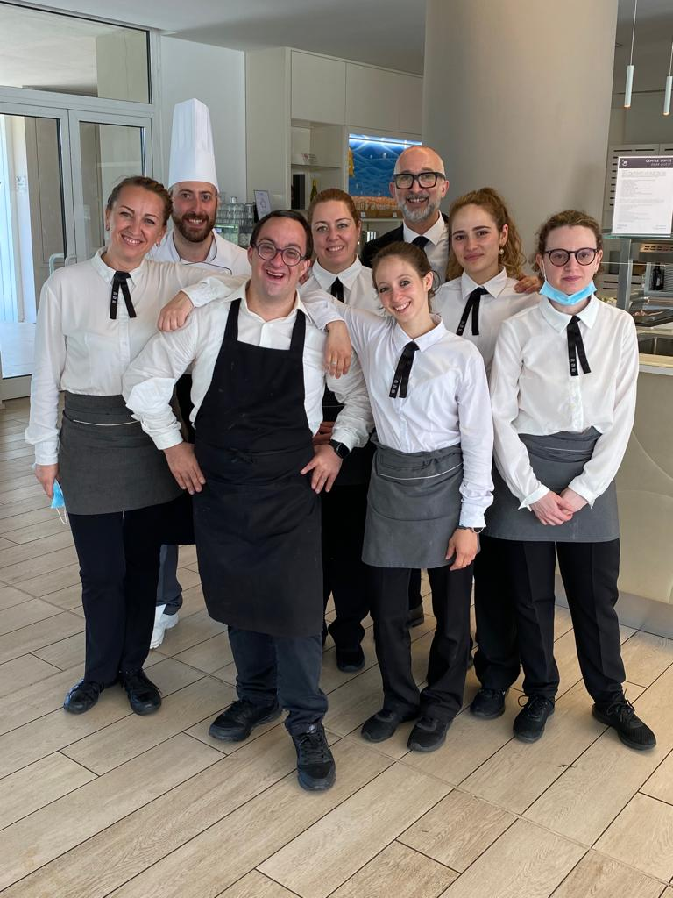
Sources of funding
Erasmus+ funds
In - kind and financial commitment from
hospitality chains
Partners’ self funding
Support from the Italian Ministry of Labour for
central coordination
Note
Individual company’s membership
and
VET accreditation
are free of charge
Notes:
For 10 years, Valueable has been funded by Erasmus+, through four consecutive grants. However, last year, these funds ran out.
To sustain our work:
Some hospitality chains, that signed the Valueable protocol, now provide in-kind and/or financial contributions.
Partners also contribute through self-funding.
Since May 2024, the Italian Ministry of Labour has been supporting the central coordination unit.
Note: Individual company membership and VET accreditation are free of charge

Slide 7
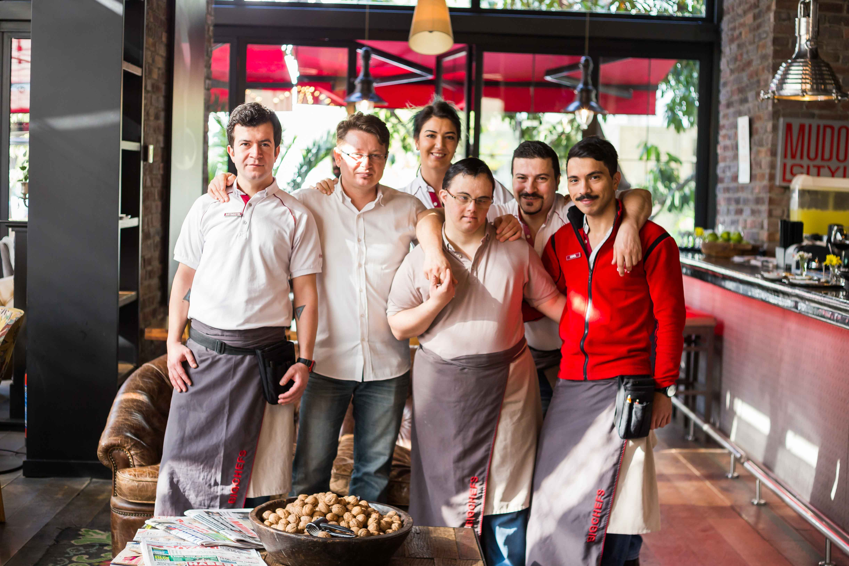
Challenges we face
Not all managers want to be publicy involved
Some members drop out
High turn over among senior managers
Considered«Not a priority» for businesses
Notes:
Some managers refuse the brand because they don’t want to publicly display their commitment. As a result, we are now developing a differentiated marketing strategy to address these concerns.
Some members leave the network due to internal reasons, such as the impact of COVID-19.
High turnover among hospitality managers makes long-term engagement difficult.
Many businesses do not prioritize inclusion.

Slide 8

What’s next?
DIFFUSION OF THE BRAND & EXPANSION OF THE NETWORK
More members
More countries
STRENGHTENING OF THE NETWORK
Additional benefits
DEVELOPMENT OF MICRO-CREDENTIALS
Notes:
What’s Next?
Expansion of the Brand & Network
More members
More countries
Strengthening the Network
Additional benefits beyond communication and co-branding.
Development of Micro-Credentials
We aim to introduce a certification system for specific job skills.
Often, people with intellectual disabilities cannot fully meet all the requirements of a standard job profile.
However, they can master specific tasks, such as cooking pasta

Slide 9

















Join Valueable! (www.valueablenetwork.eu)
Potential supporter?
Hospitality company or chain?
Disability association?
Training agency?
Notes:
Our Valueable Community
Here are the key players in Valueable:
8 partner organizations, each managing its own country.
Hospitality chains that signed our collaboration protocol.
Supporters and ambassadors who help spread our mission.
Join Us!

