Slide 1
Zero Project Conference 2025
How to build AI that works for your organization
Christopher Mierbach
RADIAITE
Friday 7 March 2025 | 10:00 - 11:00, M1

Slide 2

Start Your AI Journey: Practical Steps
Familiarize Yourself with AI
Identify a Specific Challenge
Inventory Your Existing Data
Notes:
Start with Action: 3 Steps
Experiment with AI tools
Leaders must learn AI themselves, don’t delegate
AI as a Thought Partner
Use AI for fresh perspectives and ideas
Stay in control; AI has limitations and biases
Tip: Ask AI to interview you with 5 questions to understand your situation.
Explore low-code/no-code AI tools for innovation
Identify a Specific Challenge
Focus on strategy first, then technology
AI adds value by:
Boosting productivity
Improving efficiency
Innovating products/services
Look for burnout/bore-out areas to start with AI in processes.
Data is Key: Fuel for AI
AI needs digital data; it can help organize and utilize it.
Stuck? Ask AI to Help You Start
If unsure, tell AI you don’t know where to begin
Let AI interview you to clarify next steps

Slide 3
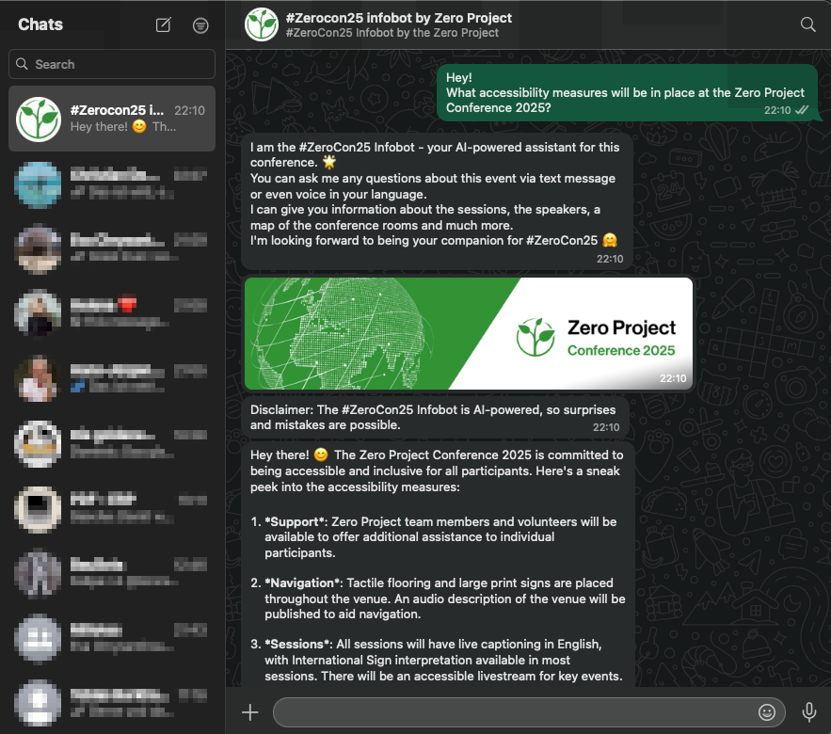
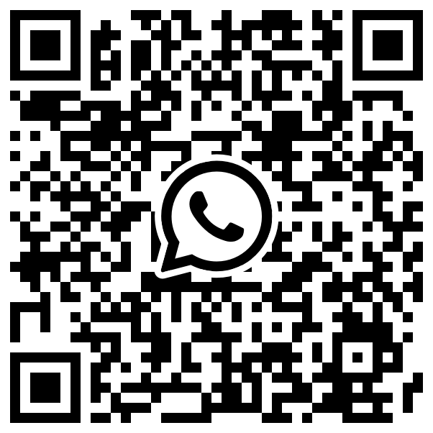
Real World Example: Accessible FAQ-Bot
The #ZeroCon25 Infobot:
AI-Agent in WhatsApp
Uses existing Zero Project conference information
Built rapidly & cost-effectively
Notes:
Real-World Example: #ZeroCon25 InfoBot
Event FAQ-Helper built for the conference
Provides info on agenda, speakers, logistics via WhatsApp
Try it by scanning the QR Code or visiting the AI Booth
How It Works
AI agent with a knowledge base on WhatsApp
Knowledge base powered by existing conference data (agendas, FAQs, etc.)
No need for new data creation; use what's already available
Rapid and Cost-Effective Development
Built in just 3 weeks (Designing, Testing, Optimization)
Leveraged existing platform solutions and cloud AI services
Approach: use existing resources to build something valuable
Key Takeaway
No need for big budgets or large teams to create impactful AI
Start small, be agile, and achieve real results with AI

Slide 4

Responsible AI - Pragmatic Recommendations
Consider the EU AI Act
Avoid Prohibited & High-Risk AI
Encourage AI Literacy. Safely.
Notes:
Responsible AI & EU AI Act
Ioana will cover this topic in more detail shortly
Focus on 3 pragmatic recommendations for starting your AI journey
Recommendation: Follow the EU AI Act
The EU AI Act is the emerging global standard for AI regulation
Don't ignore it as guidelines continue to develop
Recommendation 2: Avoid Prohibited AI Applications
Steer clear of banned uses (emotion recognition, social scoring, manipulation)
Avoid high-risk AI, like HR-AI and sensitive areas with potential bias
Start with lower-risk applications, consider consulting for high-risk areas
Recommendation 3: Encourage AI Literacy, Safely
Provide internal, data-privacy safe tools (e.g., locally hosted ChatGPT-like solutions)
Draft internal AI guidelines, define "must-not-do" rules for responsible use
Bonus: Use the EU AI Act Compliance Checker
If unsure about your compliance, use the EU AI Act Compliance Checker
It’s a helpful tool for assessing your AI idea's compliance and next steps

