Slide 1
QADER’s Experience in the Inclusion of Persons with Disabilities during Crisisin the Palestinian Labor Market
Dima Giacaman
QADER for Community Development
Palestine
Inclusive Training and Employment during Humanitarian Crises
Friday, March 7, 2025
Notes:
Cover page.
Economic Empowerment Program Officer; Dima Giacaman, QADER for Community Development, Palestine, Inclusive Training and Employment during Humanitarian Crises
#ZeroCon24
Friday, March 7, 2025

Slide 2
About QADER
Palestinian NGO, established in 2008, specialized in disability rights, protection, and inclusion. Guided by Human Rights Based Approach.
Aspires that Persons with Disabilities (PwDs) enjoy full citizenship and actively contribute to building a Palestinian society.
Invests in innovation and modeling.
Leads a twin-track approach, dedicated to:
1.The empowerment and protection PWDs from marginalization, discrimination, and all forms of disability and GBV.
2.Aligning societal, institutional, and policy contexts with the principles of “disability inclusion” and “leave no one behind” in Palestine.
Notes:
About QADER: QADER is a Palestinian NGO established in 2008; specialized in Disability rights, protection and inclusion.
Economic Empowerment Program Officer; Dima Giacaman, QADER for Community Development, Palestine, Inclusive Training and Employment during Humanitarian Crises
#ZeroCon24
Friday, March 7, 2025

Slide 3
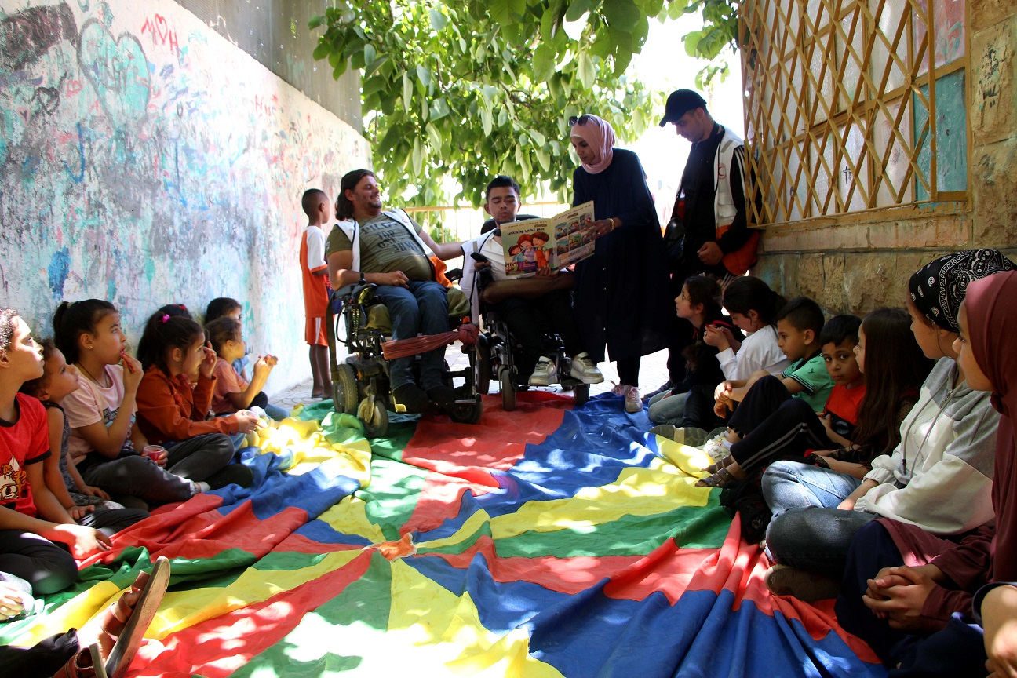
QADER’s Economic Empowerment Program
Promote labor market inclusion of youth and women with disabilities.
Q-HUB for Entrepreneurship and Skills Development.
Notes:
About QADER’s Economic Empowerment Program of Persons with Disabilities: the program main objective is to promote the inclusion of Persons with Disabilities in the Palestinian labor market
Economic Empowerment Program Officer; Dima Giacaman, QADER for Community Development, Palestine, Inclusive Training and Employment during Humanitarian Crises
#ZeroCon24
Friday, March 7, 2025

Slide 4
The Reality of Disability in Palestine Economic Participation Context
The unemployment rate among labor force participants (15 years and above) in the 1st quarter of 2022 was 35% (PCBS 2024).
2% WwDs participation in the labor force compared to 23% of males with Disabilities.
In Gaza, after one year into ongoing conflict, around (100,000) Palestinians will experience long-term disabilities requiring rehabilitation, assistive devices, and psychosocial support.
Notes:
The Reality of Disability in Palestine Economic Participation Context: unemployment rate within PwDs was 35% during 2022 with only 2% of Women with Disabilities participated in the labor market
Economic Empowerment Program Officer; Dima Giacaman, QADER for Community Development, Palestine, Inclusive Training and Employment during Humanitarian Crises
#ZeroCon24
Friday, March 7, 2025

Slide 5
QADER’s Approach to Economic Empowerment of PwDs
Psychosocial support to PwDs and their families
Internship programs, inclusive job placement, and tailored micro-enterprise opportunities
Advocacy actions to promote PwDs inclusion in the labor market
PwDs Empowerment and Inclusion in the Labor Market
Promoting inclusive workplace
Community social business
Notes:
QADER’s Approach in Empowering Persons with Disabilities: It’s a holistic approach focusing on improving Persons with Disabilities employability skills with promoting an inclusive workplace and community awareness
Economic Empowerment Program Officer; Dima Giacaman, QADER for Community Development, Palestine, Inclusive Training and Employment during Humanitarian Crises
#ZeroCon24
Friday, March 7, 2025

Slide 6

Enrollment in Q-Hub Tracks
Career counseling & vocational assessment
Self Employment
/Entrepreneurship
Job Placement /On-the-Job Training
TVET
Notes:
Q-Hub tracks to empower Persons with Disabilities (PwDs) and enhance their employability skills: PwDs are referred to different tracks in the Hub according to their abilities and preferences and they are: Self employment track, Life skills and Job readiness tack and TVET track.
Economic Empowerment Program Officer; Dima Giacaman, QADER for Community Development, Palestine, Inclusive Training and Employment during Humanitarian Crises
#ZeroCon24
Friday, March 7, 2025

Slide 7
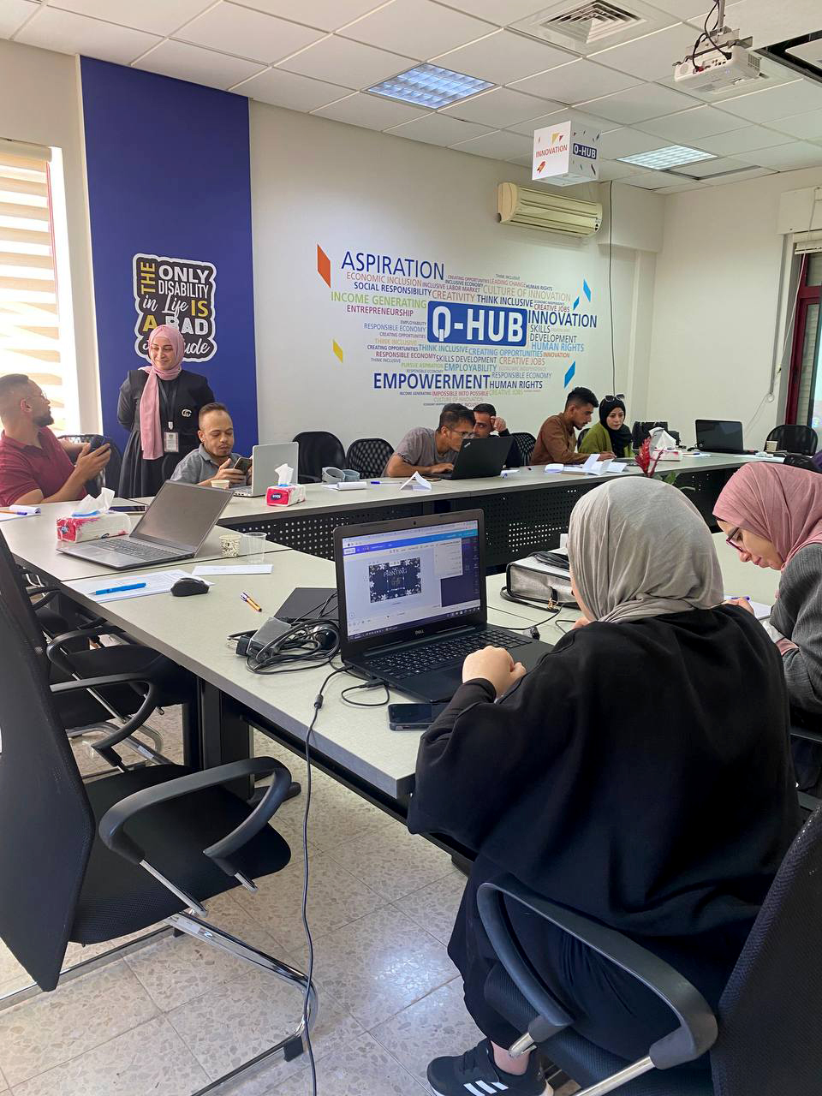
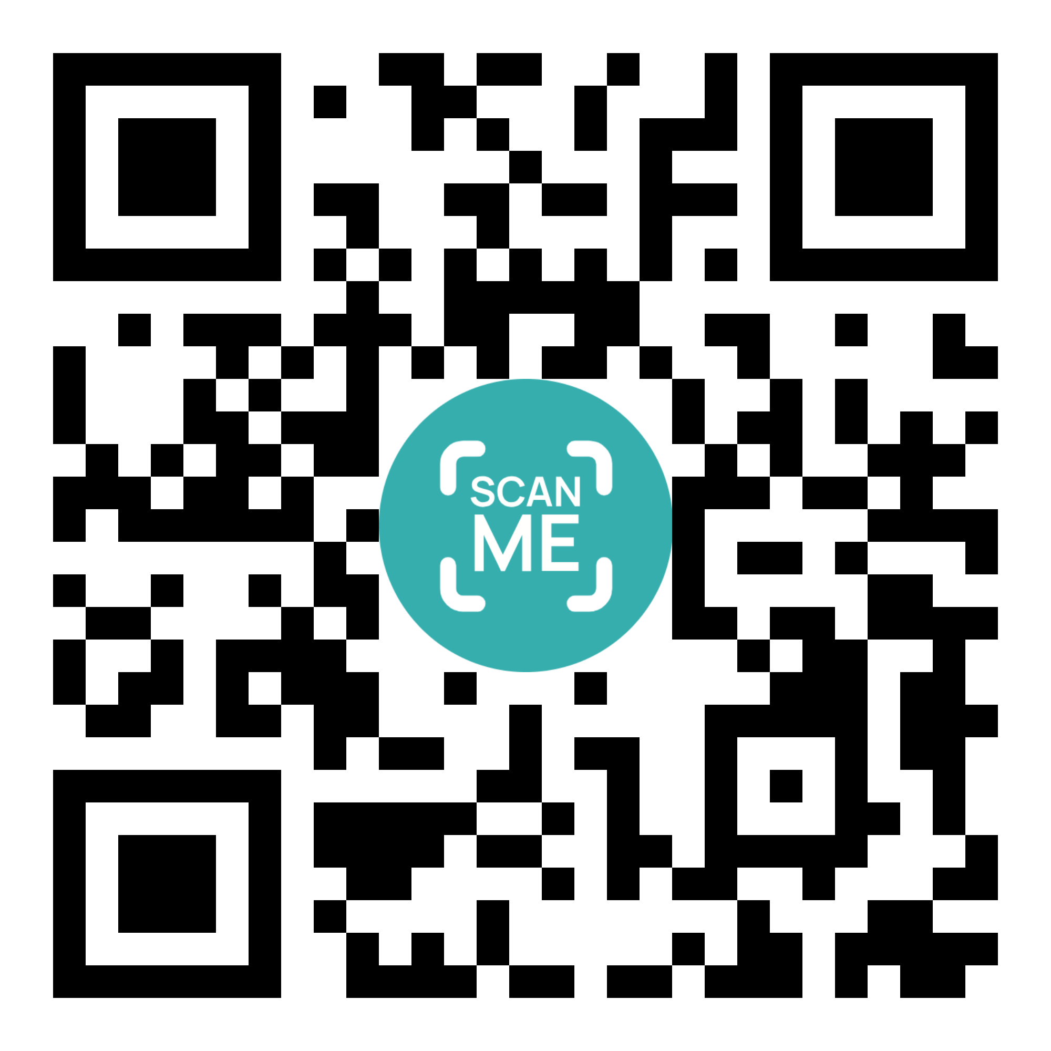
Approaches during Emergencies
Psychosocial Support and Counseling.
Mixed-Approach training Method.
Stakeholders’ Networking.
Shifting of internship/trainings opportunities.
Ongoing follow-up and on the job coaching.
QADER Platform for Economic Empowerment of Persons with Disabilities
Business help line
Notes:
This Slide outlines QADER’s approaches in empowering Persons with Disabilities during emergencies/Crisis
Economic Empowerment Program Officer; Dima Giacaman, QADER for Community Development, Palestine, Inclusive Training and Employment during Humanitarian Crises
#ZeroCon24
Friday, March 7, 2025

Slide 8
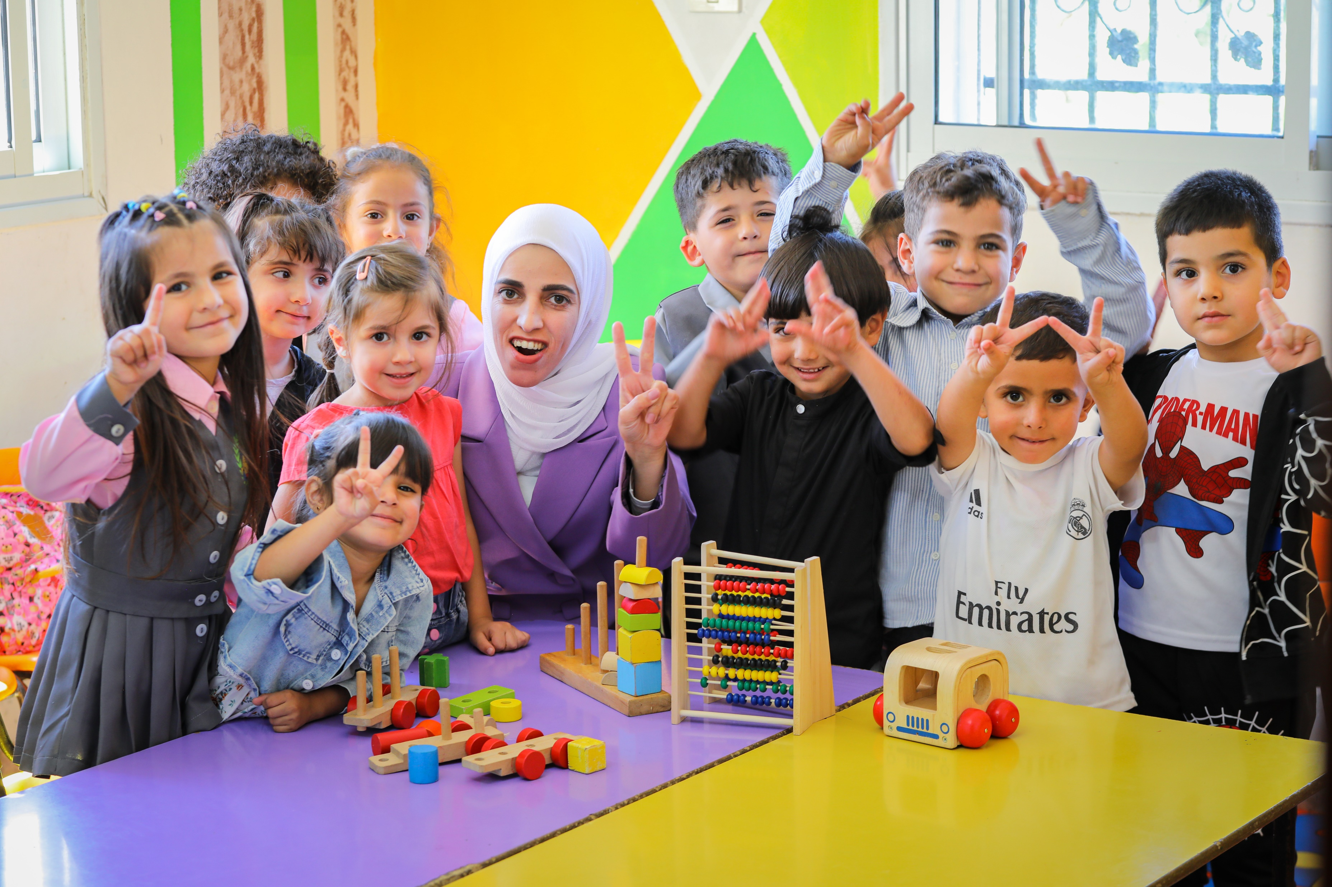
Human Stories of Change: Empowerment in Action
Nour, a 27-year-old woman from Hebron with a hearing disability, holds a BA in special education. Despite facing societal bullying, she developed a strong personality with unwavering support from her family, particularly her mother. Nour joined QADER’s economic empowerment program to enhance her entrepreneurial skills. Through this program, she developed a plan to expand her business (Kindergarten) and received support to implement it. Nour credits the program for boosting her confidence and solidifying her identity as a strong, independent businesswoman.
Notes:
Human Story of change “Nour a female with hearing disability from Hebron – Palestine who has started her small business (a kindergarten) with the support of Q-Hub”.
Economic Empowerment Program Officer; Dima Giacaman, QADER for Community Development, Palestine, Inclusive Training and Employment during Humanitarian Crises
#ZeroCon24
Friday, March 7, 2025

