Slide 1
Breaking Language Barriers
Jessy Chávez Arévalo
PEACE AND HOPE DIACONAL MINISTRY
Country: PERÚ
Methods for teaching sign language and fostering signing communities
Thursday, February 22nd 2024 13:40 - 14:40

Slide 2

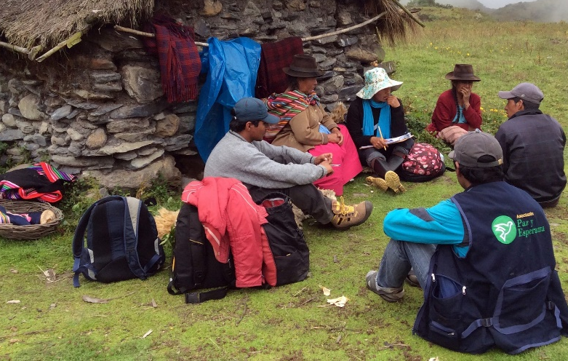
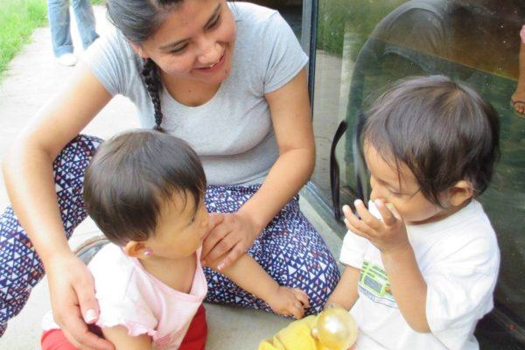
Peace and Hope works in Latin America together with people, families and communities in poverty, so that they can live with dignity free of violence and injustice.
CHILDREN AND TEENAGERS
.
ENVIRONMENTAL CARE
Notes:
IMAGEN 1--Buscamos que los niños, niñas y adolescentes afectados por la desigualdad y discriminación por razones de origen étnico, ruralidad, discapacidad, procedencia, etc. tengan las mejores oportunidades de desarrollo integral.
IMAGEN 2---Peace and Hope facilita varios proyectos que trabajan para cuidar nuestro entorno natural, conservar recursos naturales clave como el agua y los bosques, y el uso de prácticas agrícolas regenerativas.

Slide 3
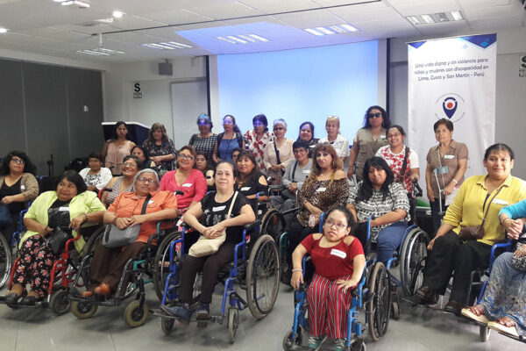
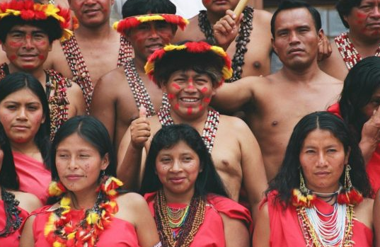
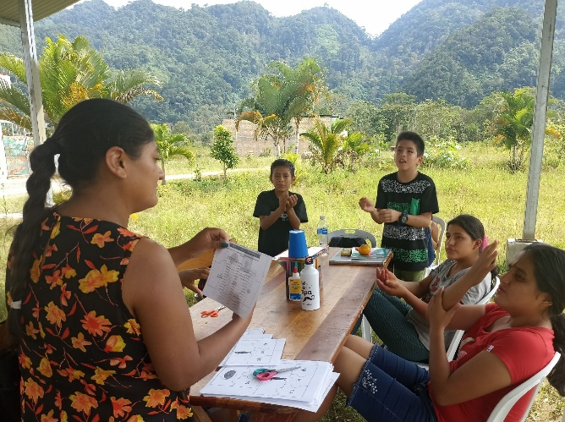
PEOPLE WITH DISABILITY
INDIGENOUS COMMUNITIES
Notes:
IMAGEN 3---Paz y Esperanza lleva a cabo proyectos para defender los derechos sobre la tierra de las comunidades indígenas.
IMAGEN 4---empodera a las personas con discapacidad en el conocimiento y ejercicio de sus derechos y contribuir al fortalecimiento de las organizaciones de personas con discapacidad.

Slide 4
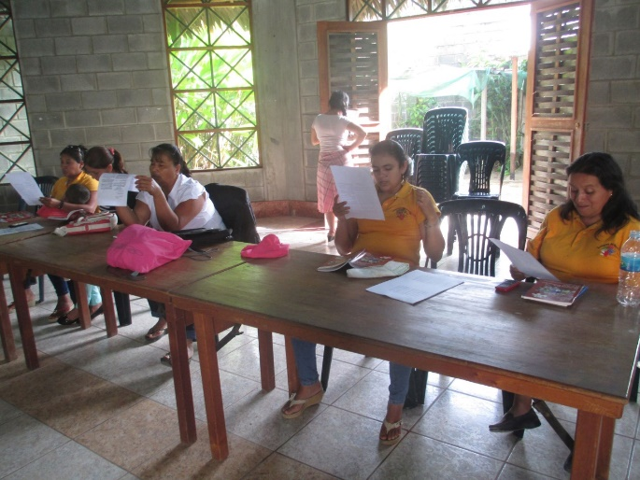
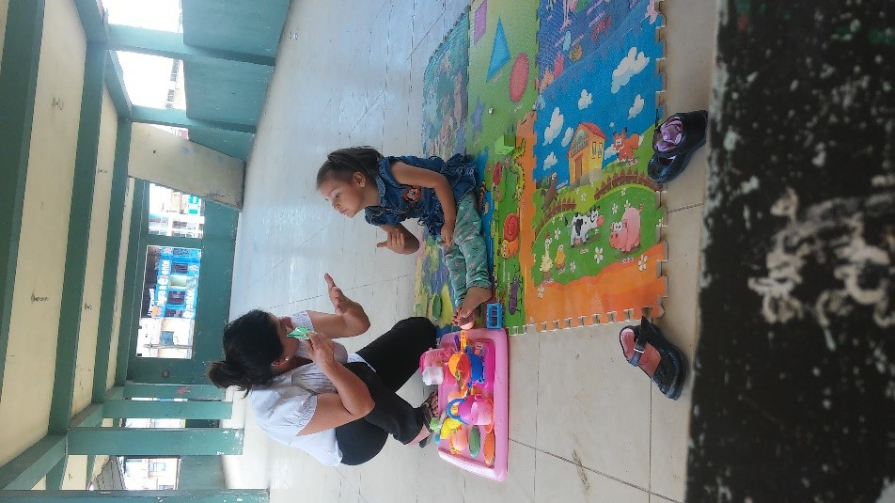
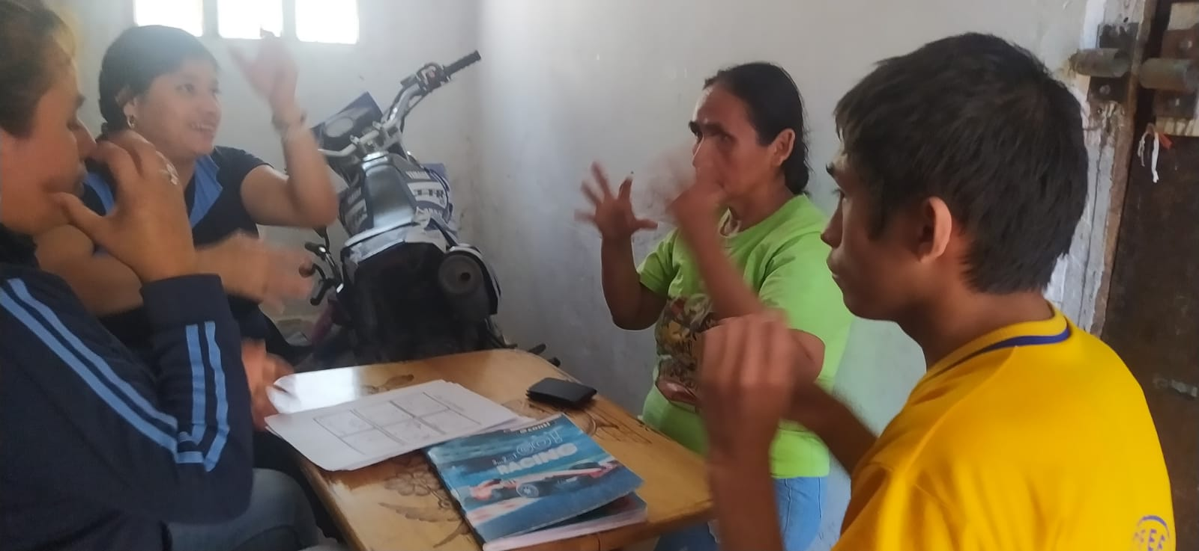
Access to Sign Language for Deaf Children and Youth in San Martín-Amazonia Region
In 2012,Peace and Hope started this project by searching and identifying families with deaf children.
Focuses on teaching Peruvian Sign Language (PSL) to the deaf as well as to their families.
Creates community and strengthens its identity and culture..
        Progressively implements other educational competencies: mathematics,science,Spanish,etc
Notes:
Antes de todo el programa buscó e identifica a familias con niños sordos en toda el área de las provincias de Moyobamba y Rioja encontrando niños y adolescentes sordos q nunca tuvieron contacto con la LSP y menos una escuela
Crea talleres para el desarrollo a una comprensión de la cultura sorda para los estudiantes y sus familias
progresivamente al paso de los años va implementando otras competencias como el español escrito, matemáticas, ciencias, arte ,deportes etc

Slide 5
Educational program for the development of Peruvian Sign Language as a first language and written Spanish in Deaf students
To guarantee access not only to their language but also to an education according to their needs and the integral development of these students by promoting learning in their sign language and in a second written language, giving them the opportunity to develop their full potential and become productive members of society.
ART
CHILDREN
ECOLOGY
SPANISH
YOUTHS
ADOLESCENTS
LITERACY
Notes:
Lugar donde se respete el uso de la LSP –esenc proyecto
Estudiantes sordos que vienen desde lejos para aprender en la escuela
Brinda un espacio seguro y acogedor para que los estudiantes sordos de las diferentes zonas rurales y urbanas puedan desarrollar su identidad cultural, aprender su idioma y establecer relaciones signiﬁcativas.

Slide 6
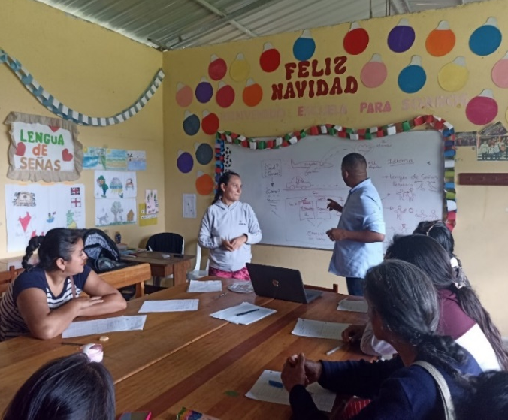
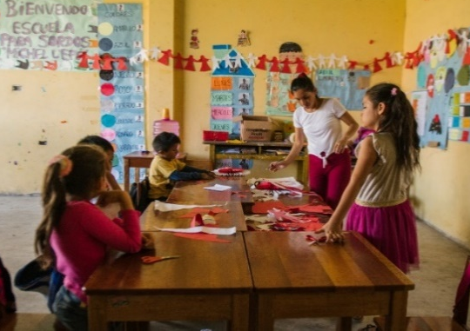
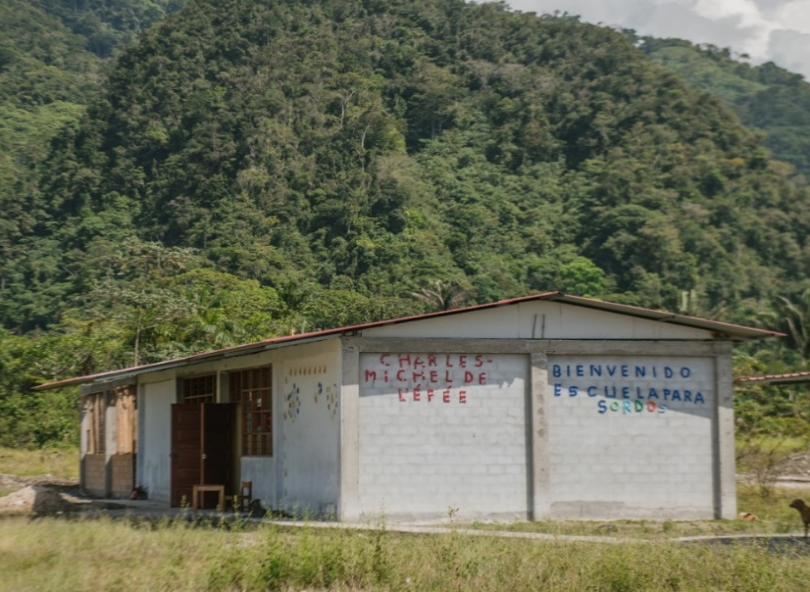
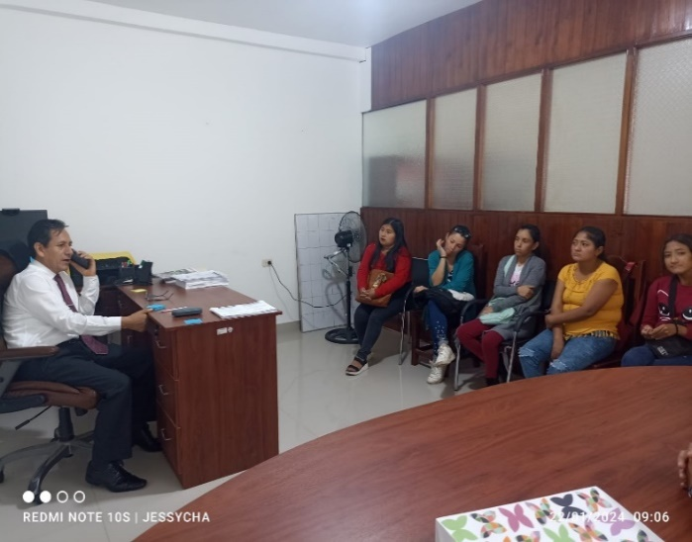
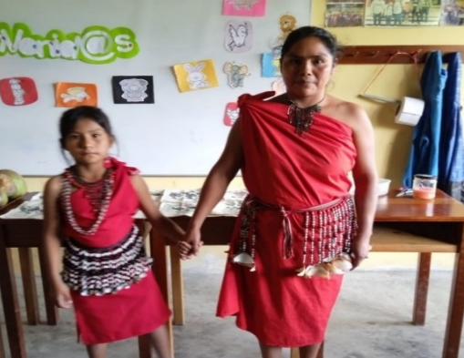
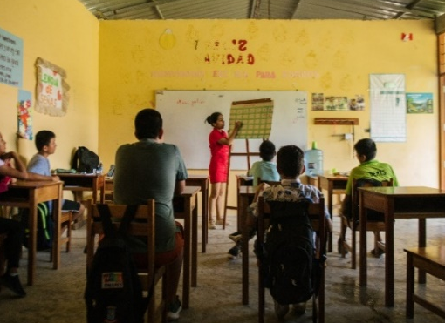
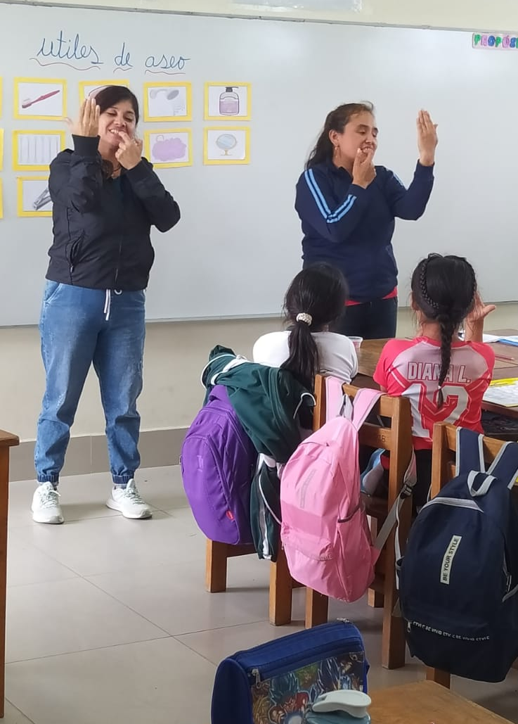
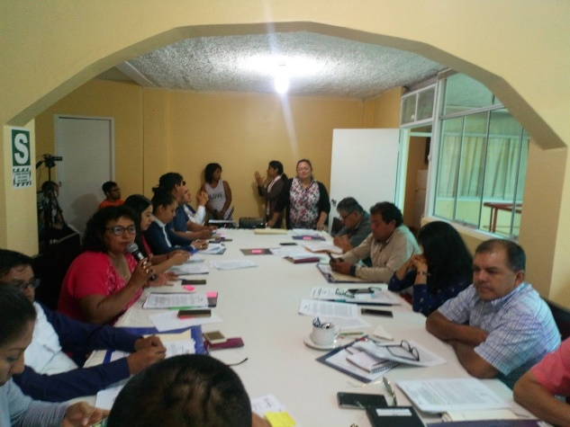
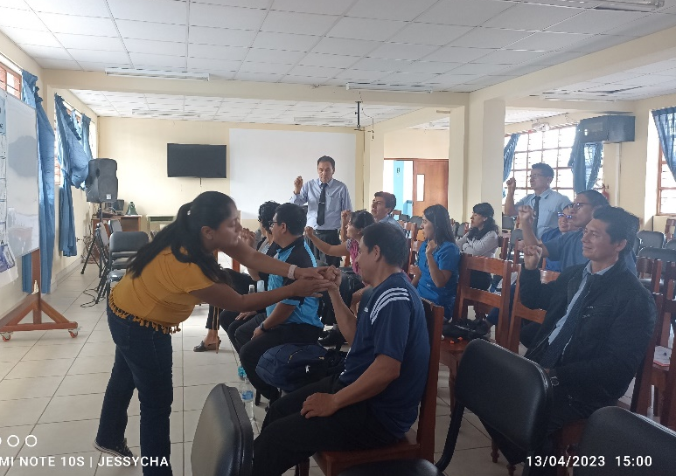
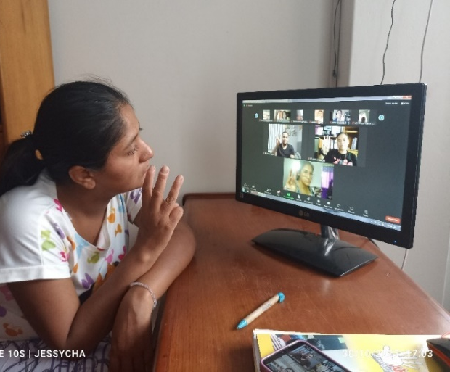
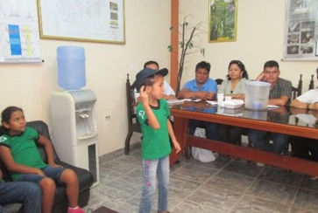
“CHARLES-MICHEL DE L ÉPÉE
COPANIJOSA ASSOCIATION
NETWORKS AND STRATEGIC ALLIANCES
PUBLIC POLICIES
Notes:
1-rompiendo barreras lingüísticas de accesibilidad a una población en alta situación de vulnerabilidad y exclusión bajo el proceso de aprendizaje de su propia lengua
2-Alberga a mas de 60 estudiantes sordos, muchos de ellos vienen de zonas urbanas y rurales muy alejados
3- PPFF,promocionan e inciden en las autoridades a la no vulneración de los DD de sus hijos sordos
4-Crea comunidades sordas empoderadas para la defensa de sus derechos -se creó la O.R Nº 011-2018-GRSM/CR para el reconocimiento y promoción de la LSP
5-Búsqueda del compromiso de las autoridades locales y de educación para la creación de la primera IE BBC en la amazonia
6-2022 el programa recibió a niños oyentes

Slide 7

LIFE STORIES
Ale, 8 yeas old, leads and supports in transmitting her language to the children of her age who have recently joined the program; she is fluent in her language, understands and tells stories in her first language, and clearly communicates her needs.
Angy, 9 years old, entered our program this year, she is an Awajun girl and to get to school she takes 1 hour to travel by motorcycle, she has adapted very well to the PSL, she already knows how to say her name and make dialogs in LSP..
Notes:
Angy, es una niña q pertence a la CN de Awajun , donde el idioma materno de sus padres no es el español

Slide 8
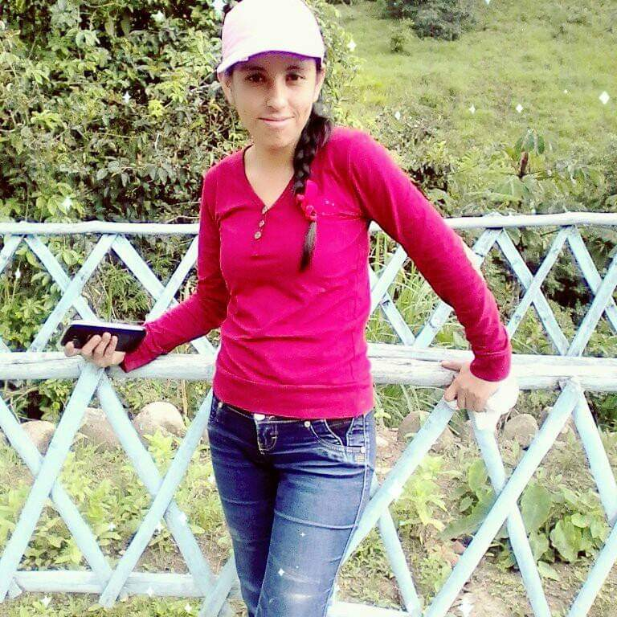
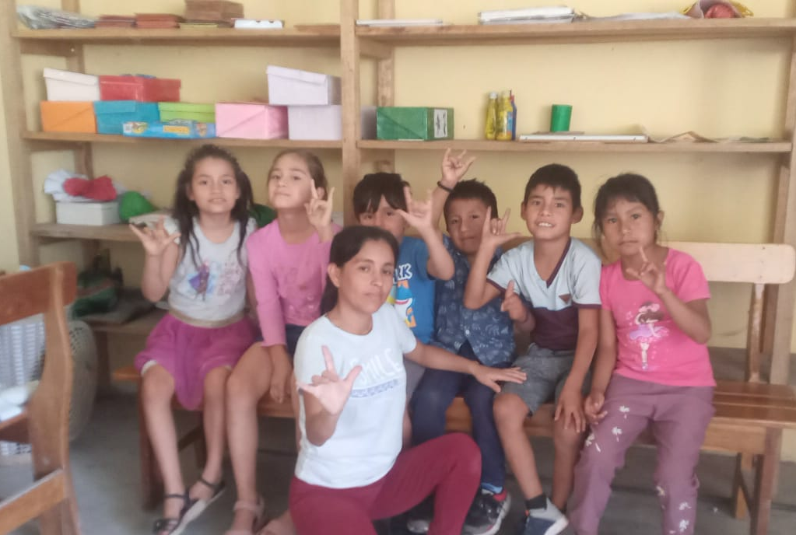
Janina Vásquez
I came to the program over 10 years ago.
I was ashamed and afraid to interact with other people because I didn't know sign language. Now I encourage my deaf friends to go to school together and learn our language.
When I went to a conventional school, the teacher’s lack of knowledge of PSL made me drop out of school due to the mistreatment by my classmates and teacher.
Now I am 34 years old and I am fulfilling my dream of being able to spread the word about PSL to other deaf people in my Amazon region, to teach them our deaf culture and identity, to fight for our rights for a bilingual bicultural education recognized and assisted by the Peruvian state..

Slide 9
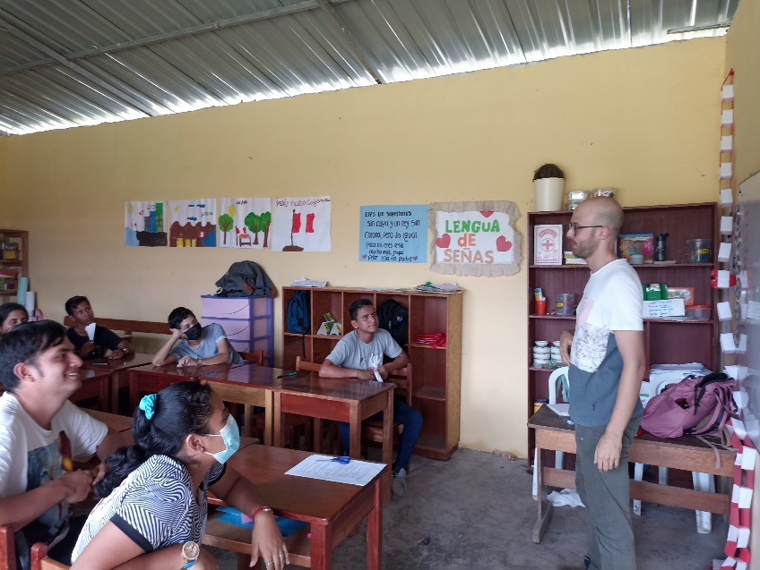
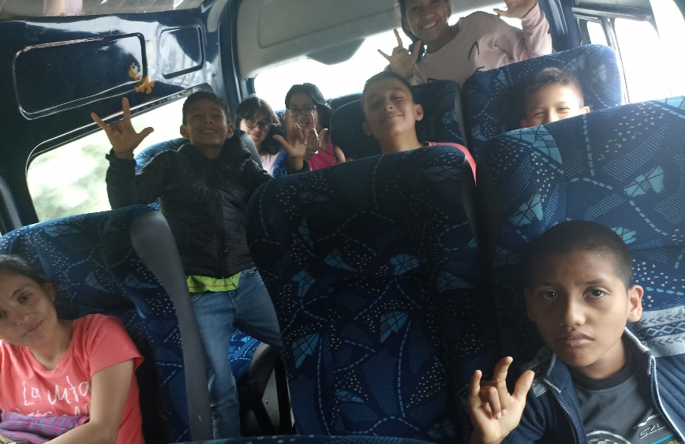
Alliances and agreements
We have reached agreements with some municipalities in the region.
Alliances with some State institutions such as the education sector and regional government.
We have received donations from foreign churches.
We have received volunteers in the program.
Notes:
1- convenios con municipalidades para pago:
sueltos de modelos linguisticos
pasaje a estudiantes sordos de lugares alejados
alianzas para recibir voluntarios

Slide 10
What comes next:
REPLICATE | IMPROVE | IMPACT
Replicate more space where deaf students can access to develop their linguistic community that strengthens their identity. Increase the budget Create bilingual schools for the deaf in the Andes and Amazonia. | Improve the curricular skills and competencies of students, in accordance with the objectives of regular basic education, in order to guarantee their right to an inclusive and quality education. | Promote the inclusion of the hearing impaired in higher technical and university education.
Notes:
Replicar la propuesta educativa ,el Estado tomé mayor interés y pueda aumentar el actual presupuesto de modo que incluya la construcción y equipamiento de colegios bilingües para NNA sordos en el conjunto del país, en especial en el Ande y Amazonia peruana.

