Slide 1

Deaf Gain at work: how employing deaf people shapes the work environment and processes
Dr. Joseph Murray
World Federation of the Deaf
ICT career paths for the deaf community
Friday 7 March 2025, 13:00 - 14:00
Notes:
Dr Joseph Murray, World Federation of the Deaf. ICT career paths for the deaf community
#ZeroCon25
Friday 7 March 2025, 13:00 - 14:00

Slide 2

The WFD’s Vision
A World Where Deaf People
Everywhere
Can Sign Anywhere
Notes:
Text of the Slide: The WFD´s Vision. “A World Where Deaf People Everywhere Can Sign Anywhere” A logo of the WFD is seen along with a ribbon forming a 70 year.
Through our advocacy work along with our 137 national organisations of deaf people, in 137 countries, we work towards our vision of a world where deaf people everywhere can sign anywhere.

Slide 3
Challenges and Barriers
PWDs: up to 80-90% unemployment rates in developing countries and up to 50-70% in the Global North
Linguistic barriers and stigma approaches contribute to the exclusion of deaf people from the labour market: underemployment is a major issue.
Attitude change is the first step towards a fair and inclusive labor market for deaf people.
Source: https://ilostat.ilo.org/blo/new-ilo-database-highlights-labour-market-challenges-of-persons-with-disabilities/
Notes:
We know the dismal statistics about disability employment and underemployment, with up to 90% unemployment rates in developing countries and up to 70% in the Global North. Deaf signing people are within the most excluded from access to employment opportunities because most employers try to avoid hiring sign language interpreters at work.
The WFD aims to promote access to an inclusive labour market with a sign language environment, with equal working conditions and salary as their peers. However, little information is known about the practical implications of such access.
What does the right to fair and inclusive employment with a sign language environment entail for deaf people?

Slide 4
Deaf Gain= Workplace Gain
The WFD represents the rights and interests of over 70 million deaf people globally, advocating for fair and inclusive labour markets.
Deaf Gain (Bauman and Murray 2014) reframes "deaf" as a form of sensory and cognitive diversity that contributes to the greater good of humanity.
Notes:
Deaf Gain is a concept that I co-developed, and is defined as reframing “deaf” as a form of sensory and cognitive diversity that contributes to the greater good of humanity.
Users of national sign languages bring new sensory and spatial perspectives to their work.

Slide 5
Innovative Inclusive Employment
Design for All
Look outside the norm, and the differences we see in deaf communities are valuable resources for all.
The WFD encourages the promotion of inclusive employment environments where both employers and employees learn national sign languages and visual communication to interact with their deaf colleagues, alongside the provision of professional SLIs
WFD's Efforts: Training and advocacy for equitable, accessible, and inclusive workplaces
Notes:
Learning and using sign languages strengthens certain cognitive abilities, such as the ability to generate and manipulate mental images. Using sign languages also strengthens your spatial memory. Deaf people’s sign language gain is a unique form of gain with untapped potential.

Slide 6
Technology and Accessibility
Deaf people have creatively used existing technologies to improve their workplace access.
Visual information access and communication technologies are used by deaf people, and should be promoted by governments, to ensure equitable access to the labor market.
Technologies that only rely on auditory signals and automatic captions are not accessible technologies and can be life-threatening.
Our work in providing consultancy and knowledge has resulted in impactful criteria and tools to improve the accessibility of public and private work environments:
https://www.accessibilityassociation.org/s/committees#Committees6
Notes:
Advances in ICT have had a positive impact on deaf people’s participation in society: (1) to access information, deaf people use visual solutions such as videos, subtitles, and images; and (2) to communicate, deaf people use text messaging and e-mail on smartphones with video conferencing technology, both with synchronous and asynchronous communication in national sign languages and the provision of remote sign language interpretation services.

Slide 7
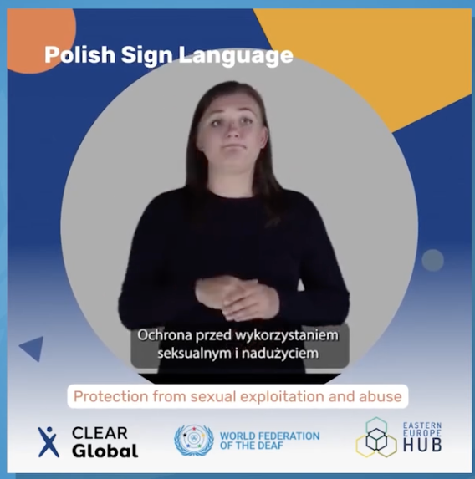


Innovation: Deaf and Sign Language ICT gains
Learning sign languages strengthens certain cognitive abilities: visual image generation and rotation, spatial memory.
Sign language gain: untapped labor market resource.
Kahne (2013) Deaf people's attention to community and collective culture can improve productivity.
Notes:
Example is our work in Ukraine, Romania, and Poland, where we developed videos with specific glossaries in each national sign language to prevent abuses during conflict situations. Images of the app interface are shown in each of the languages mentioned: Polish, Romanian and Ukranian

Slide 8
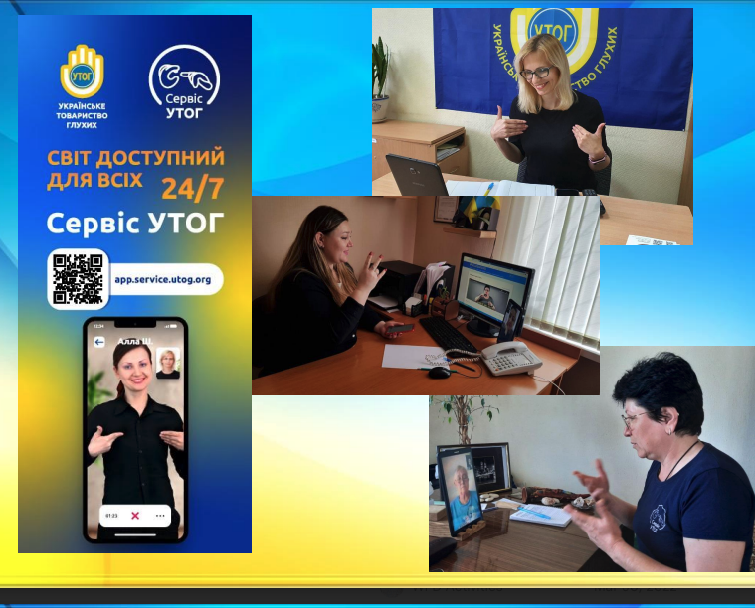
ICT
Best practices in visual ICT technologies exist.
ICT should be inclusive for the Global South: low-tech and low-data-use to ensure accessibility and use for deaf communities in all regions.
We call for innovative solutions to address needs, for example in Gaza there is no electricity and other challenges.
The WFD has experience and expertise; partner with us.
Notes:
Throughout the armed conflict in Ukraine, deaf people connected to each other and to their representative regional/national organisations through a specific phone app as both a communication device and an information channel where information translated into/produced in Ukrainian Sign Language was shared with everyone, including deaf Ukrainian people displaced into other European countries.

Slide 9
Importance of genuine co-design
AI-based ICT technologies present new challenges and opportunities. The WFD warns against inaccurate translation focused AI-solutions being implemented before they are ready.
The WFD emphasises the necessity for governments and private enterprises to comply with co-design principles: involve deaf organisations as equal co-creators from the earliest stage.
Deaf lives do not revolve around translation- harness the potential of AI from deaf-led perspectives.
The WFD is establishing a global network of experts on this issue.
Notes:
The WFD emphasises the necessity for governments and private enterprises to comply with co-design principles by: consulting with representative organisations of deaf people under Article 4.3 of the CRPD

Slide 10

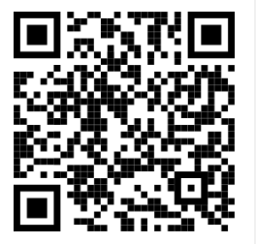
Join us!
We invite experts, donors, and partners to join us in our mission to create a more inclusive world for deaf people through innovative ICT solutions and collaborative efforts.
info@wfdeaf.org
https://wfdconference2025.org/

