Slide 1
Sign language in an inverse inclusion educational environment
Diana, Agudelo Rojas
Fundación ICAL
Colombia
Methods for teaching sign language and fostering signing communities
Thursday, 22 February 2024, 13:40 – 14:40
Notes:
Sign language in an inverse inclusion educational environment; Diana, Agudelo Rojas; Fundación ICAL, Colombia, Methods for teaching sign language and fostering signing communities
#ZeroCon24
Thursday, 22 February 2024, 13:40 – 14:40

Slide 2
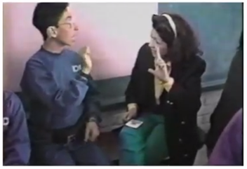
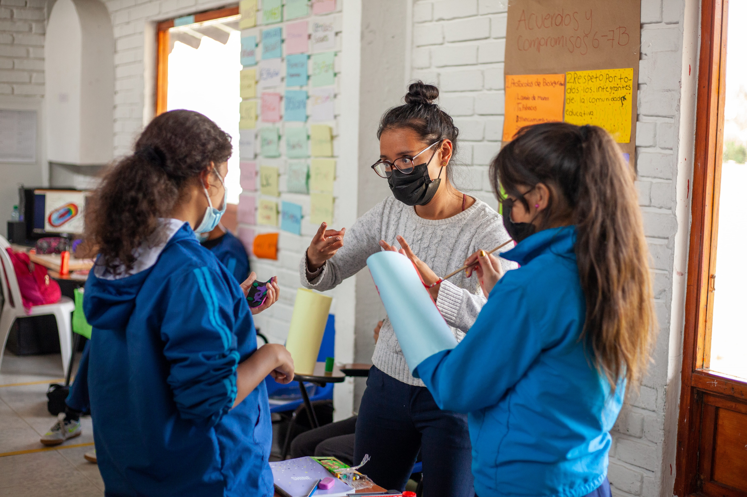
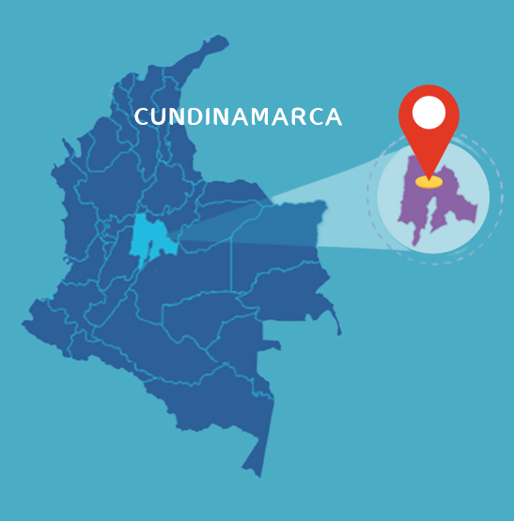
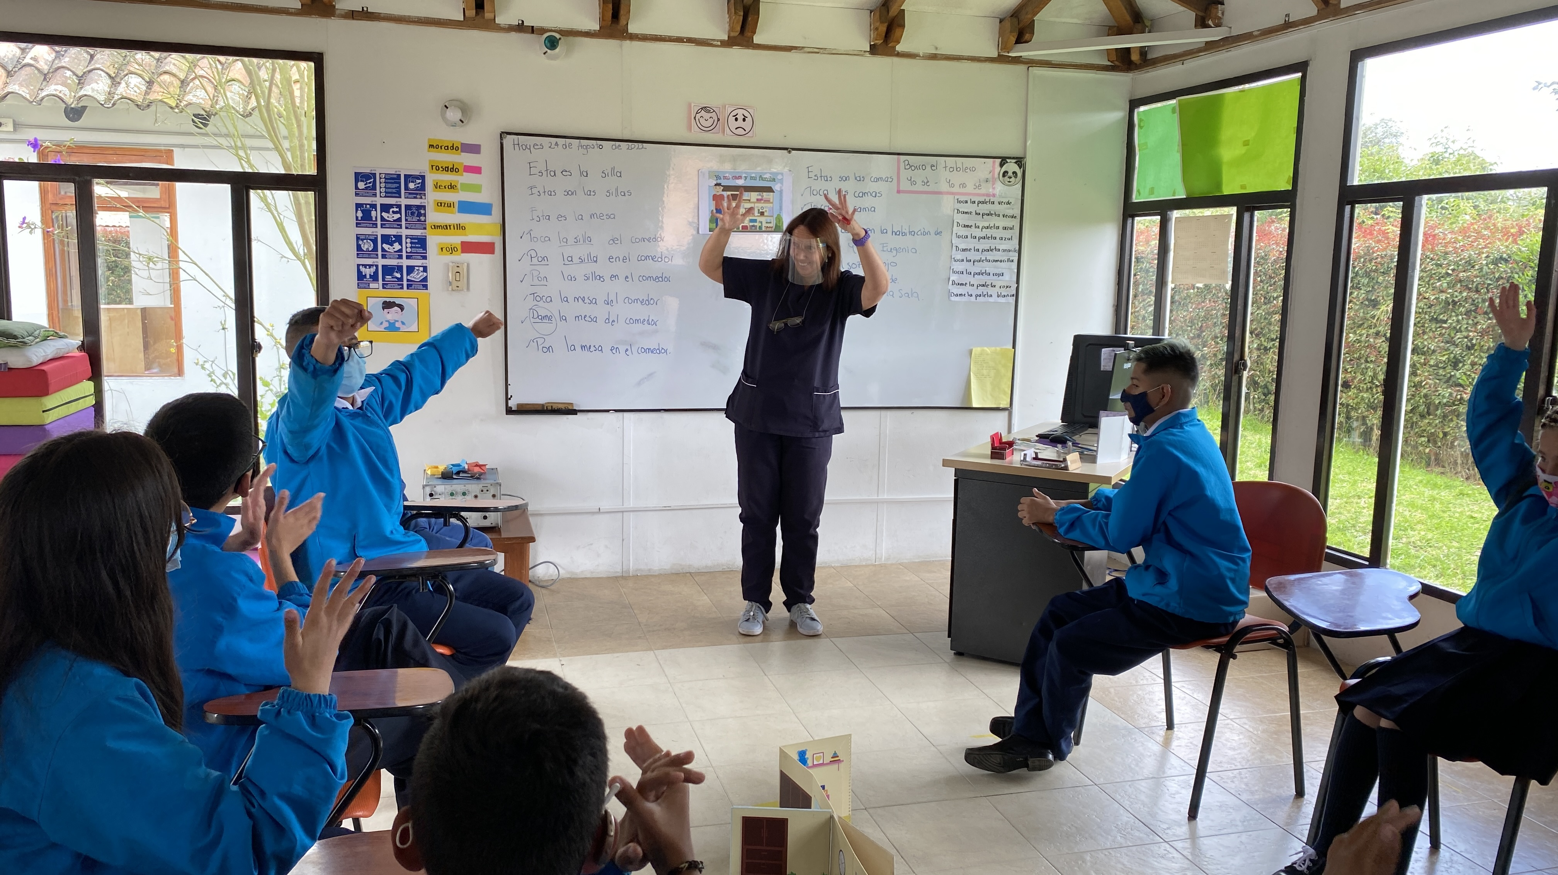
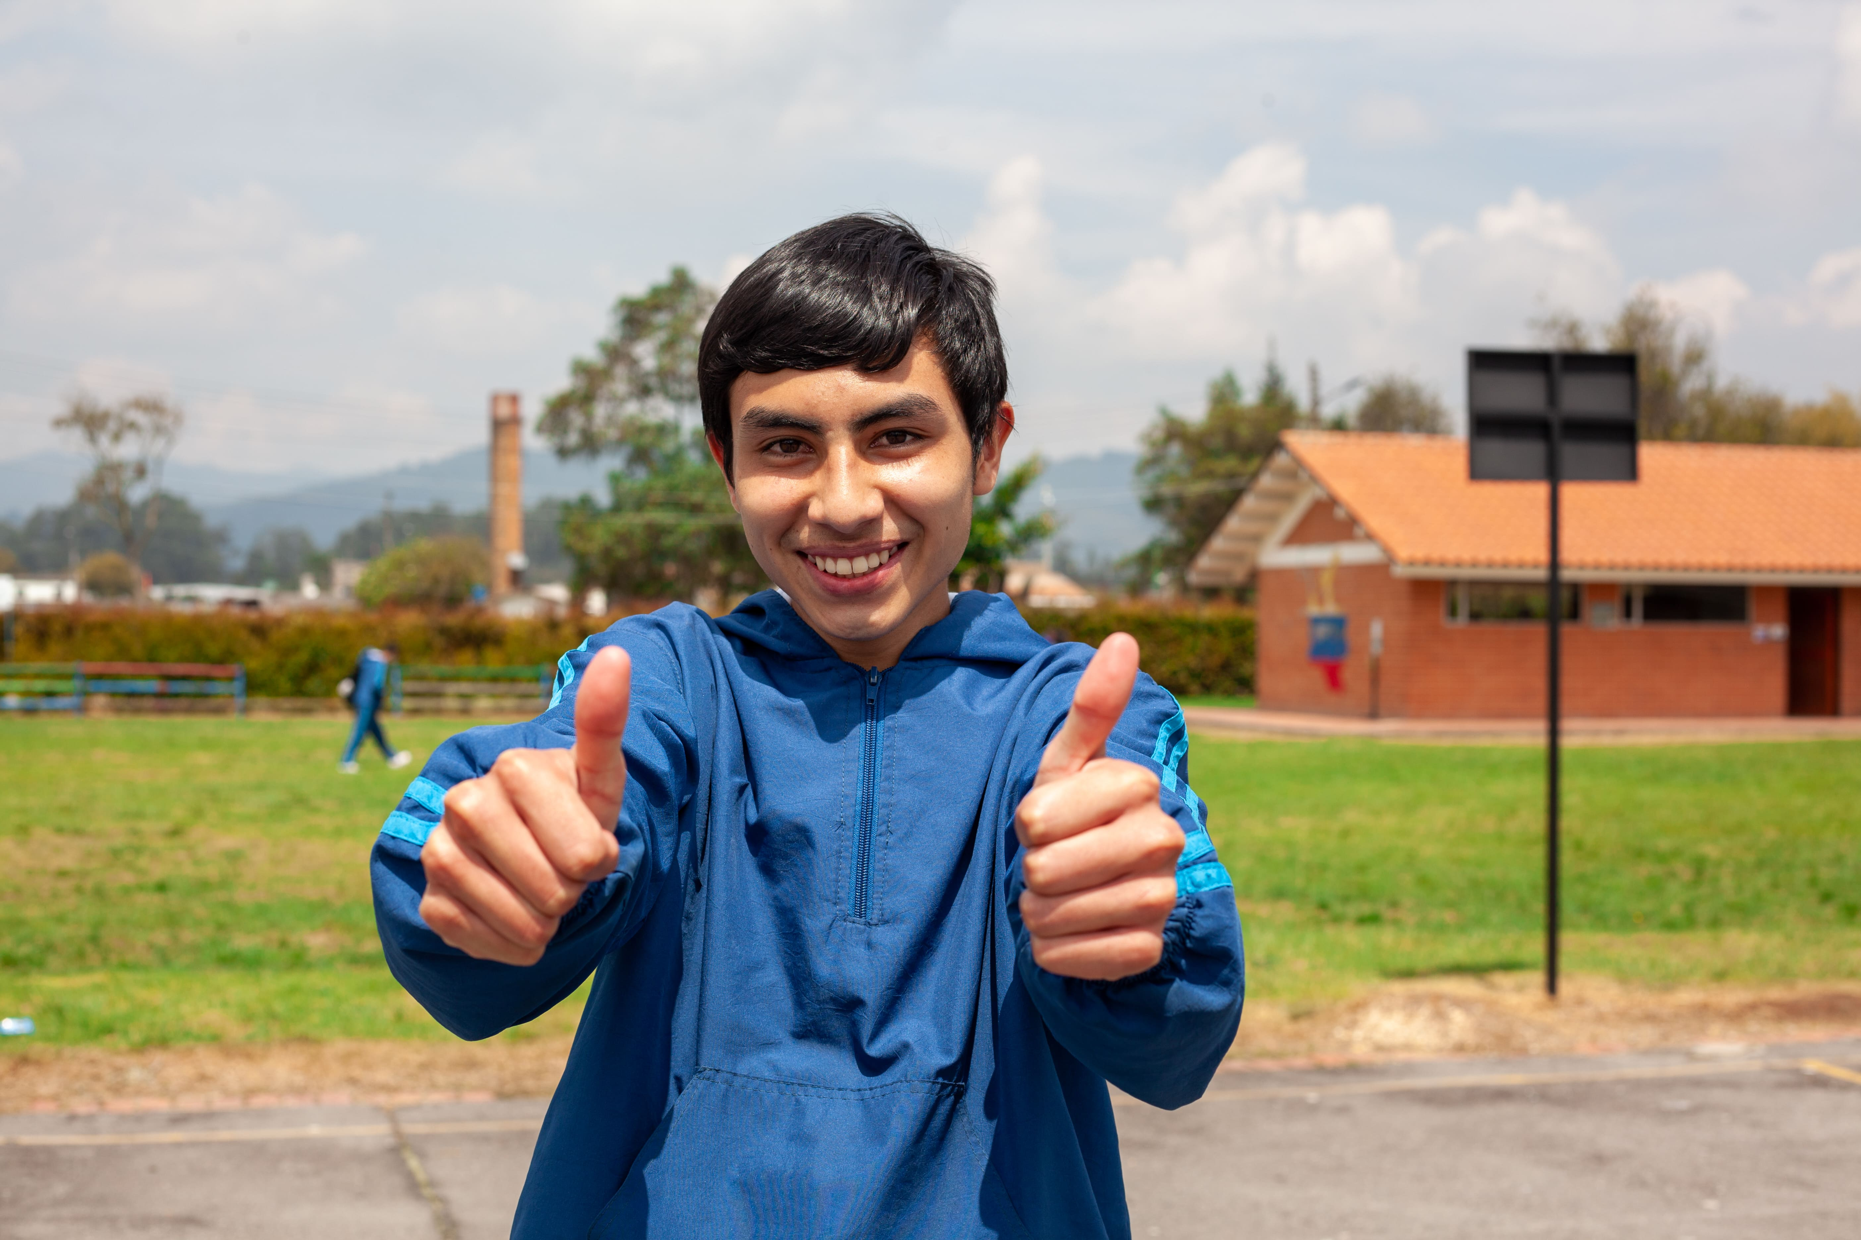
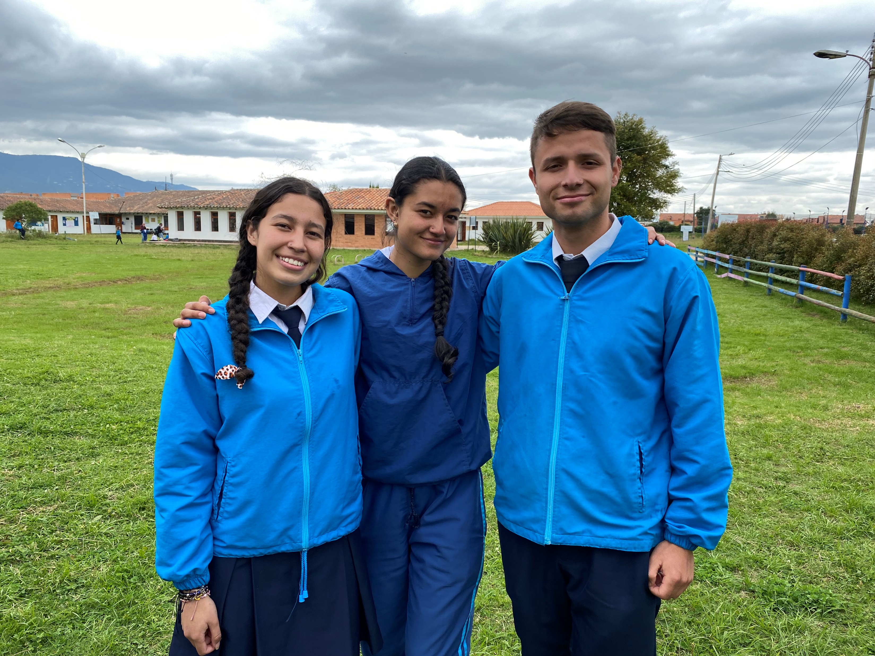
Fundación ICAL - Colombia
Notes:
Background of Fundación ICAL in images

Slide 3
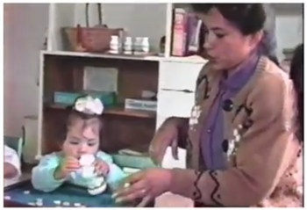
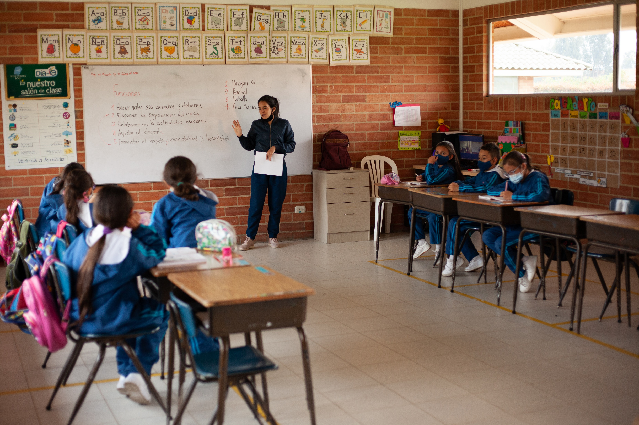
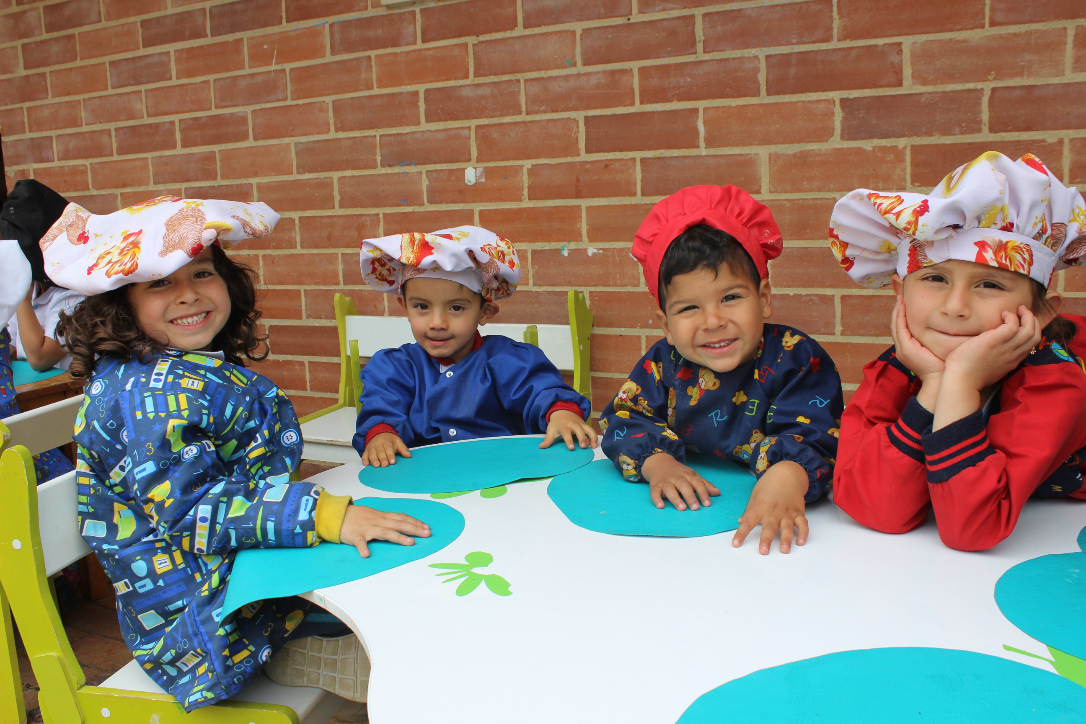
What is inverse inclusion?
  Inclusive education service delivery model
  How did all begin?
Notes:
What is inverse inclusion?
- Inclusive education service delivery model
- How did all begin?
Definition of the innovation and short story about what motivated its creation at the organization.

Slide 4
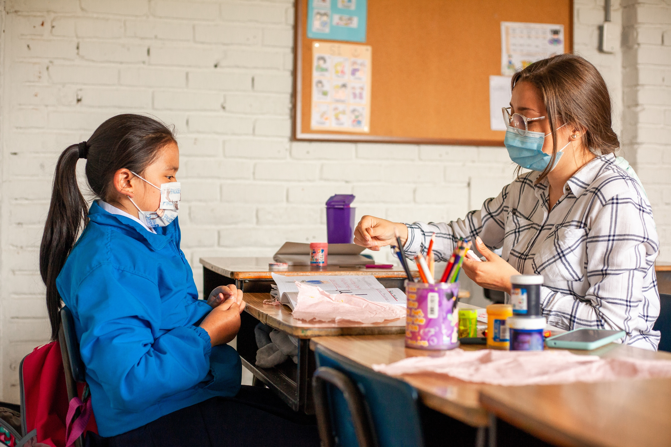
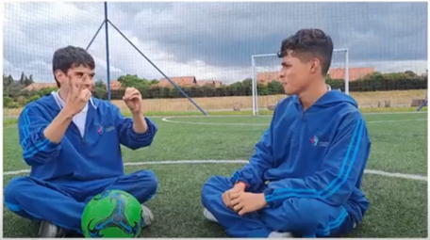
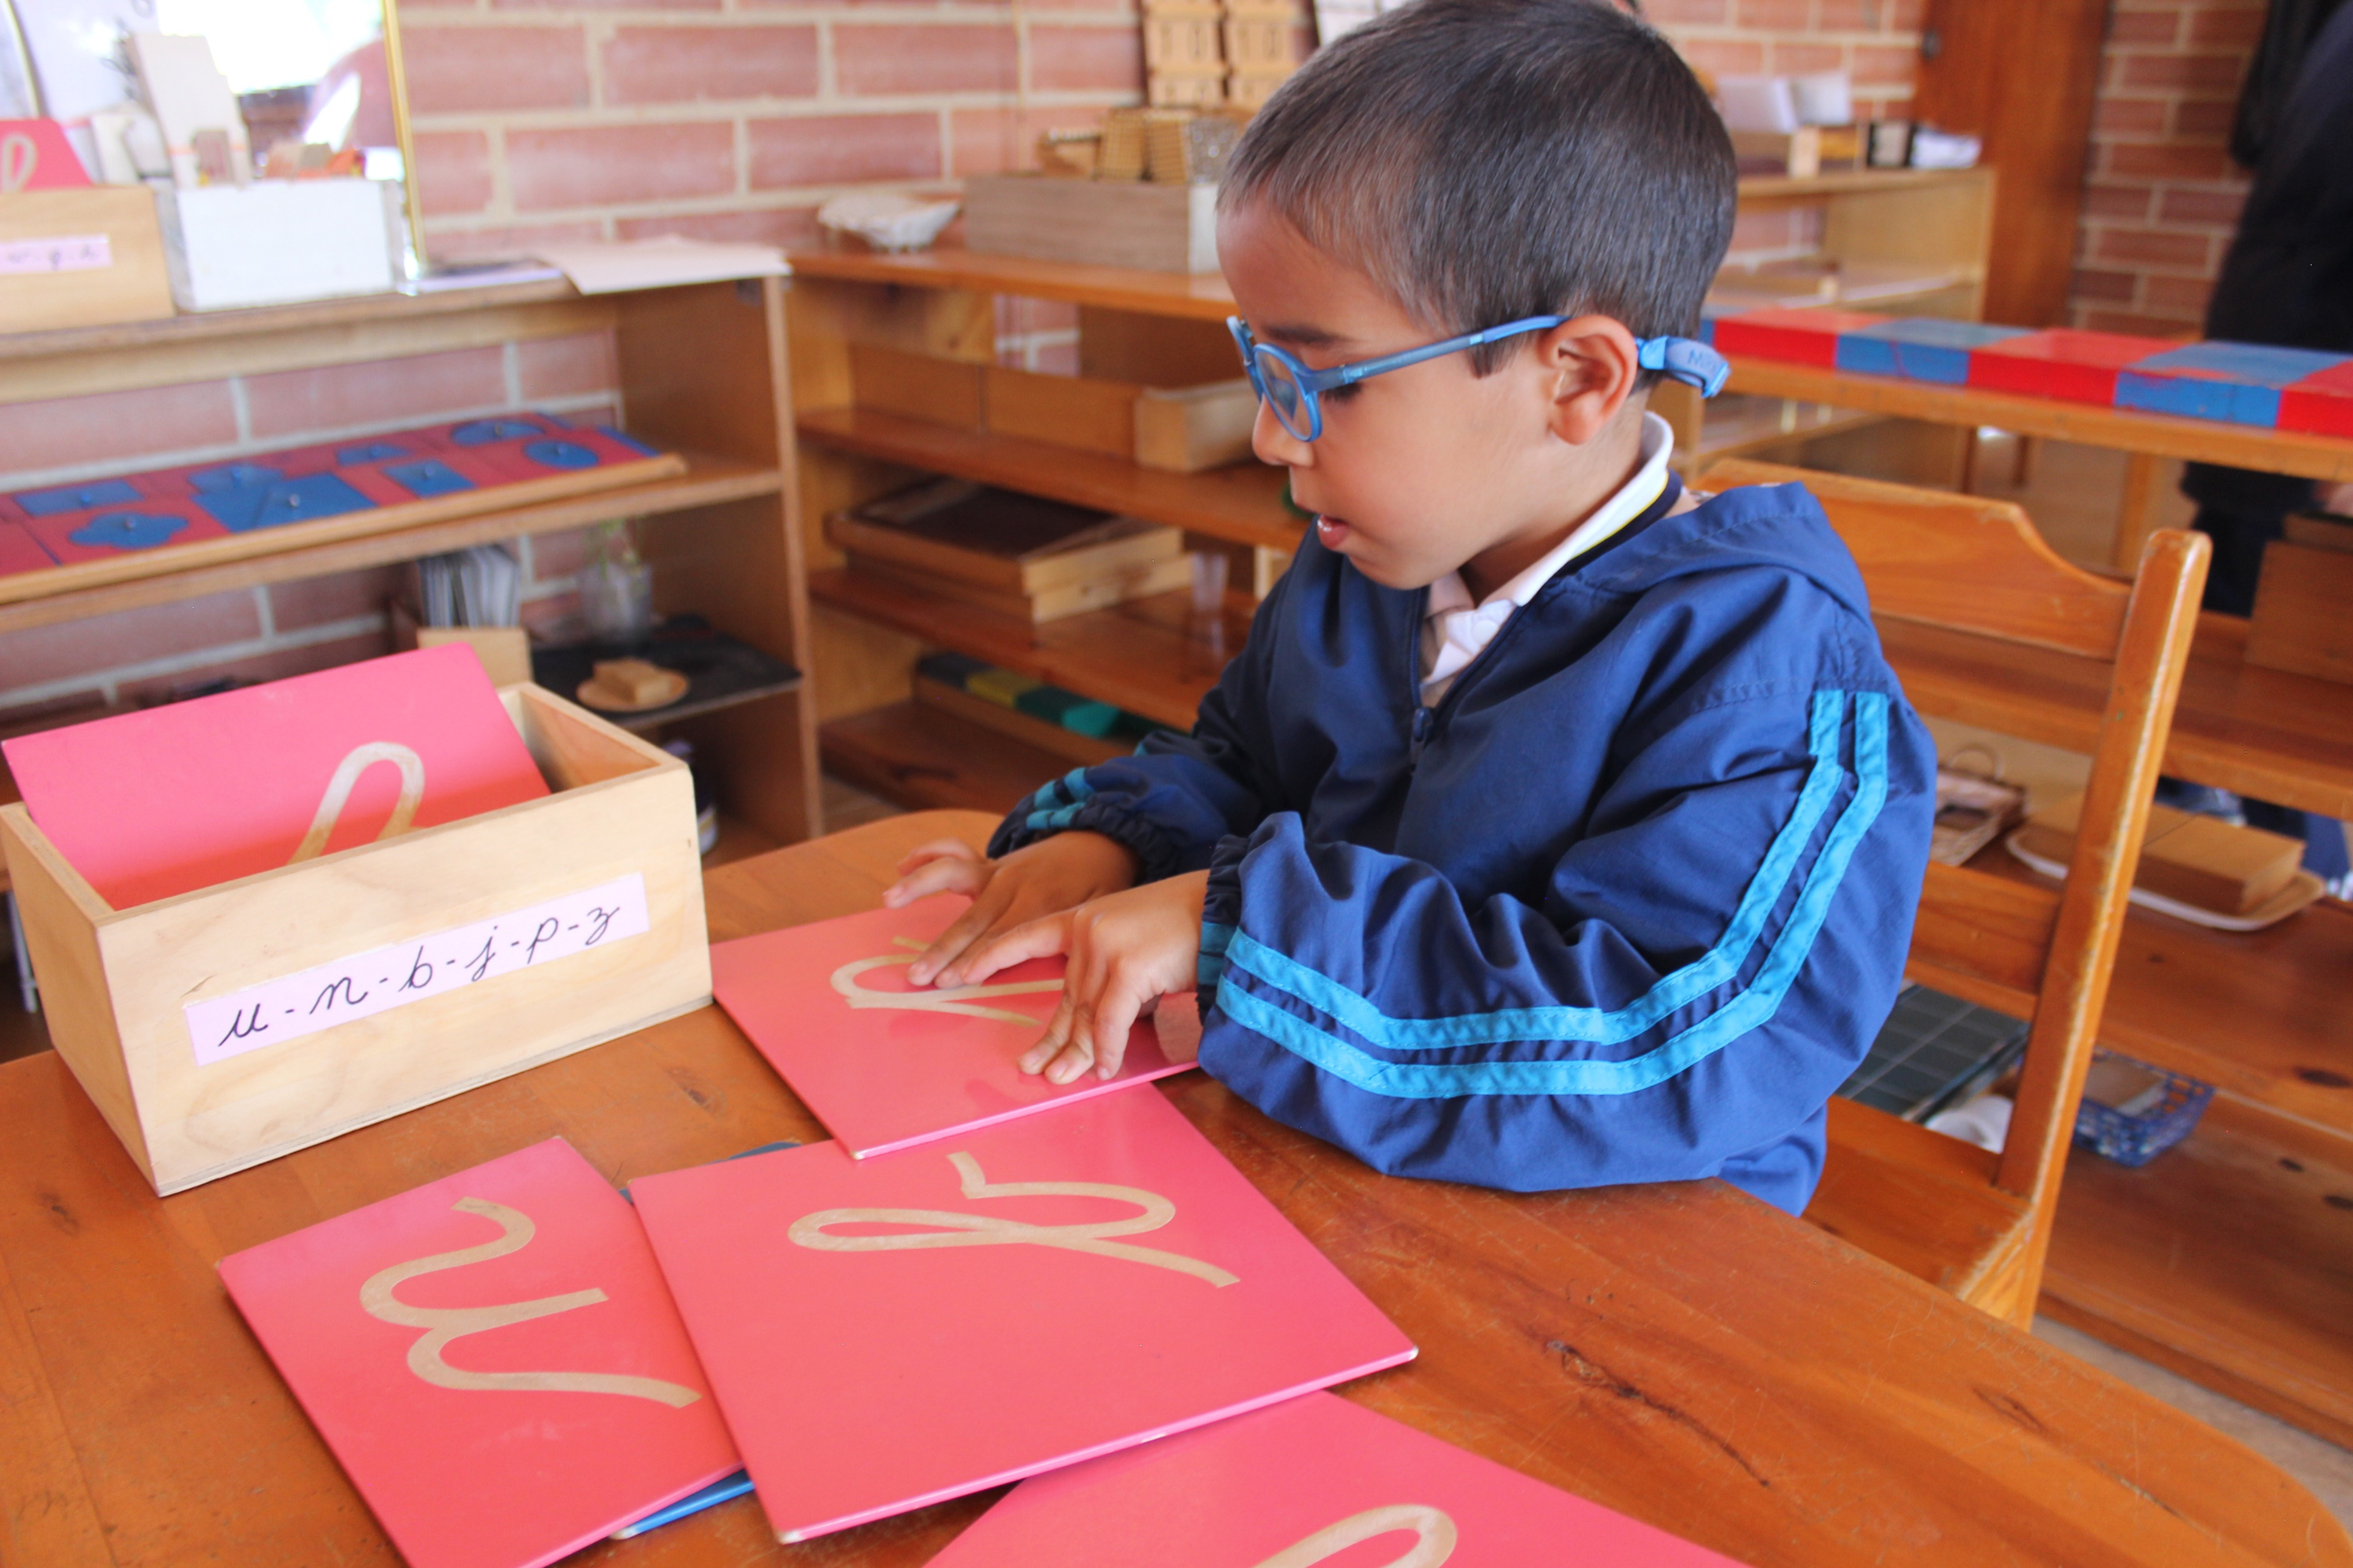
Signing communities
Who makes it up?
What connects them?
Actions and tools to foster communities
Notes:
Signing communities.
- Who makes it up?
- What connects them?
- Actions and tools to foster communities
Short description of the Foundation’s groups of beneficiaries.
Relationship between the inverse inclusion model and the present signing communities.
Actions developed at Fundación ICAL to foster signing communities.

Slide 5
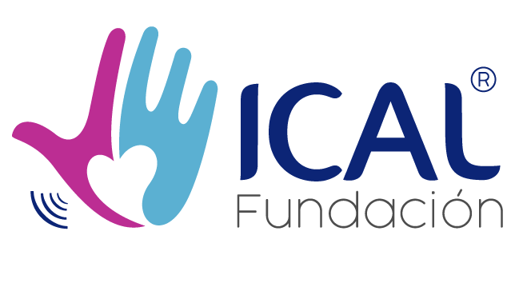
Fundación ICAL's logo
Notes:
Fundación ICAL's logo

