Slide 1


Educational and support strategies during humanitarian crises
Eva Disegna
Christian Blind Mission
Wednesday, 21st February 2024, 16:00
Notes:
Slide 1 is the title page, showing the following content:
Title: Improved access to inclusive early childhood care and education for children with and without disabilities in refugee and host communities in Kalobeyei and Camp Kakuma, Turkana (Kenya)
Name of speaker: Disegna, Eva
Name of Organization: CBM – Christian Blind Mission
Name of Country: Kenya
Name of Session: Educational and support strategies during humanitarian crises
Day and Time of Session: Wednesday, 21st February 2024, 16:00
#ZeroCon24

Slide 2
PROJECT DETAILS
Title: Improved access to inclusive early childhood care and education for children with and without disabilities in refugee and host communities in Kalobeyei and Camp Kakuma, Turkana (Kenya)
Funding: Federal Ministry for Economic Cooperation and Development (BMZ) (72,75%) and CBM (25,25%)
Implementation partner: Waldorf Kakuma Project
Governmental involvement: Ministry of Education and Ministry of Health
Location: Camp Kolobeyei and Kakuma, and host communities in Turkana West, Kenya
Volume: €1,374,536
Duration: 01.12.2021 – 31.12.2024 (37 months)
Overall objective: The quality and sustainability of inclusive education in the refugee camps of Kakuma and Kalobeyei and host communities in Turkana West has improved
#ZeroCon24
Notes:
Slide 2 presents the project details, such as the title, the funding sources, the implementation partner, the governmental involvement, the location, the volume, the duration and the overall objective.

Slide 3
THE PROJECT IN A NUTSHELL
SITUATION ON GROUND
IMPACT OF THE PROJECT:
•
Roughly 240,000 children
Accessible renovation/ adaptation of
educational
Ø
of
school
age (high influx
institutions
of refugees)
Provision of inclusive learning equipment
Inadequate school
Ø
•
Medical and
rehabilitative support (assessments)
facilities and
an
Ø
Training and coaching of
teachers
on inclusive education
insufficient number of
Ø
Sensitisation
of
parents of children with disabilities
qualified teachers
Ø
Collaboration with the county government
Drought and conflict
Ø
•
-
Support of OPDs
prone region
à
food
Ø
Awareness raising and documentation of best practices
insecure households and
Ø
malnutrition
Additional
project
for school feeding
Ø
#ZeroCon24
Notes:
Slide 3 describes the project in a nutshell, presented in a column, starting off with the situation on the ground, followed by the impact of the project. In numbers, the project intends to achieve:
26 educational institutions have made adaptations on accessibility and have been equipped with necessary resources to deliver improved inclusive education
860 children with disabilities were successfully referred to health facilities for rehabilitation and psychosocial care.
124 teachers have been trained and coached on inclusive education
1,230 parents and care givers of children with disabilities have been sensitized and report an increased understanding of their child's right to access inclusive education.
A strategy for strengthening inclusive education has been developed by the Ministry of Education at Turkana county level
Strengthening of existing OPDs
1,850 students were be supported with one hot lunch per day during drought season

Slide 4
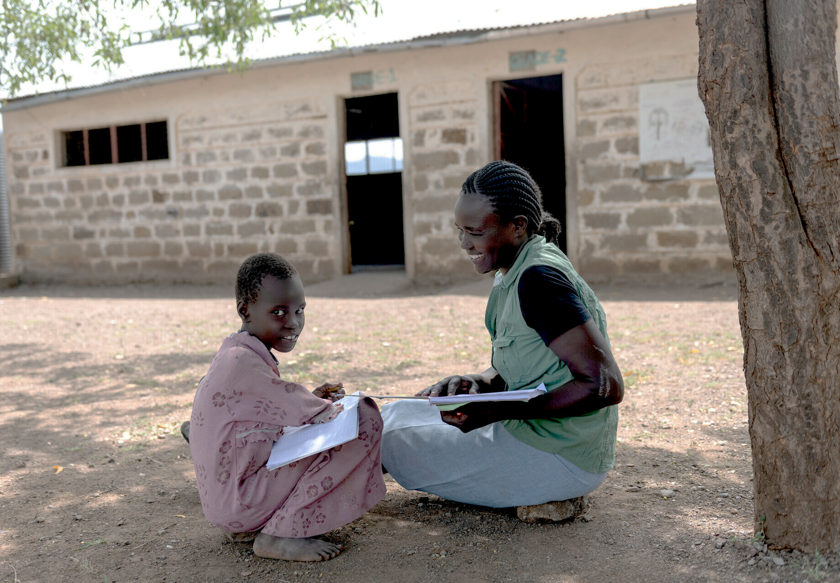
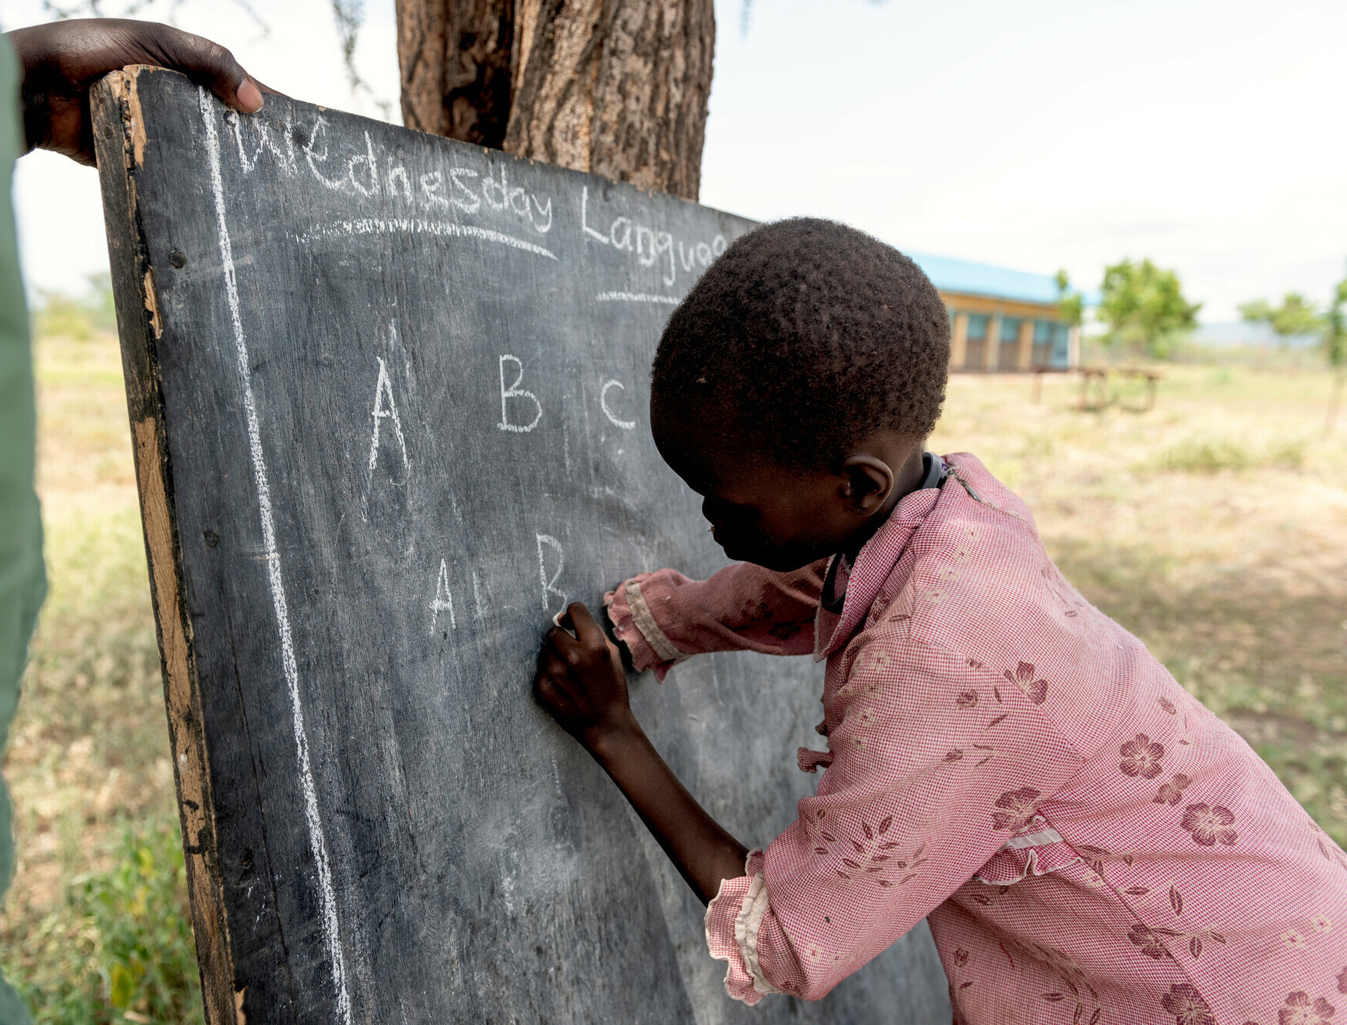
IMPRESSIONS OF THE PROJECT – INCLUSIVE EDUCATION
#ZeroCon24
Notes:
Slide 4 shows two pictures:
Picture 1 (left): Josephine (child with disability) studying with a teacher, sitting outside under the shade of a tree, enjoying the moment, both laughing.
Picture 2 (right): Again, Josephine learning how to write on a blackboard, using her left hand. She is concentrated and eager to learn. Picture taken outside under the shade of a tree.

Slide 5
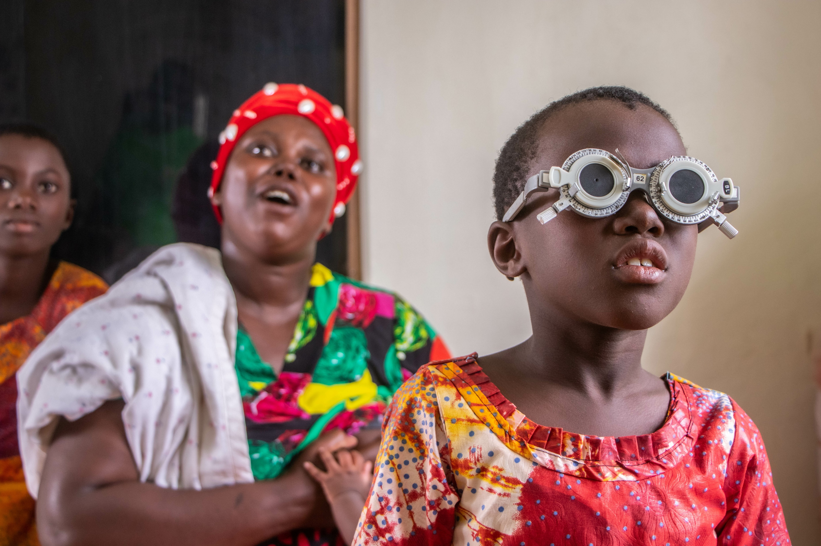
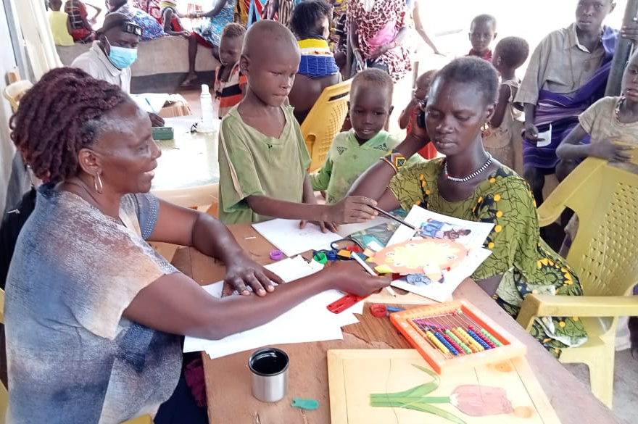
IMPRESSIONS OF THE PROJECT - ASSESSMENTS
#ZeroCon24
Notes:
Slide 5 shows two pictures:
Picture 3 (left): a child undergoing an eye test at an educational assessment resource centre (EARC), wearing testing glasses. The mother is to be seen in the background.
Picture 4 (right): A Kenya Institute of Special Education staff member (KISE) conducting an educational assessment with a child using pictures, colours and toys. The mother and other children are to be seen in the background.

Slide 6
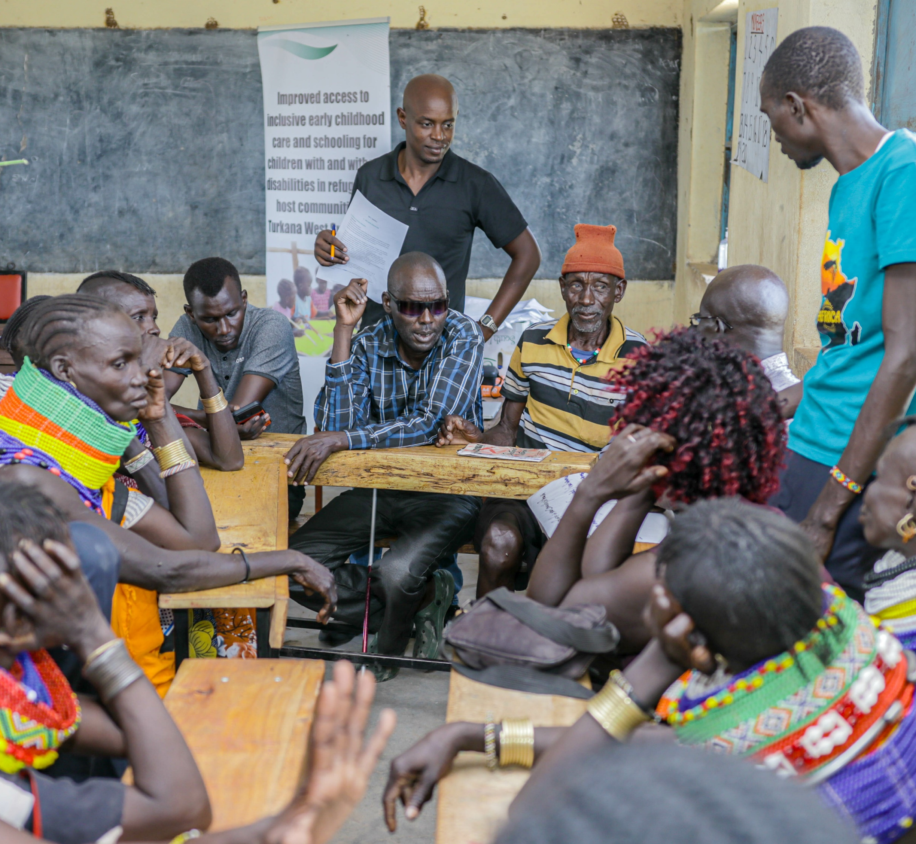
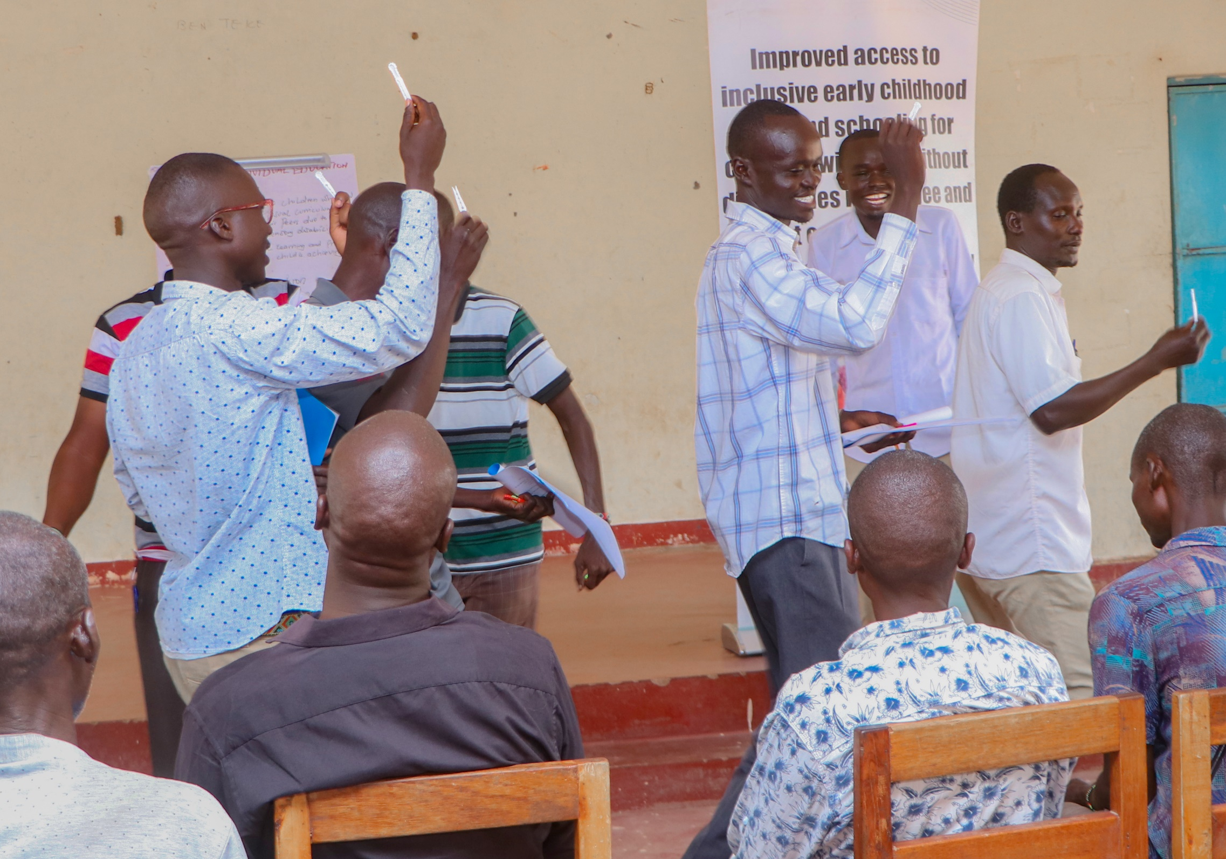
IMPRESSIONS OF THE PROJECT - TRAINING
#ZeroCon24
Notes:
Slide 6 shows two pictures:
Picture 5 (left): Blind OPD chairman participating in a group discussion at a parent's/care givers training
Picture 6 (right): Inclusion activity ongoing at a teachers training. Atmosphere is happy teachers are enjoying themselves.

Slide 7
CHALLENGES, SOLUTIONS AND OUTLOOK
CHALLENGES
Multi-layered crisis
Collaboration with other actors
OUTLOOK
Potential continuation of project
SOLUTIONS
WaSH & FSL
Safety & security
Accessibility
Involvement of county government → Roadmap
Strengthening localisation
Lessons learnt → Replication of project
Stigmatisation
Protection
Inclusive education embedded in curriculum
#ZeroCon24
Notes:
Slide 7 shows a process digramme connected with arrows and 3 fields.
Field 1 decribes challenges with the follwing bullet points:
Multi-layered crisis
WaSH & FSL
Safety & Security
Protection
Accessibility
Stigmatisation
Field 2 decribes solutions with the follwing bullet points:
Collaboration with other actors
Involvement of county government to establish a roadmap
Strengthening localisation
Field 3 decribes outlook with the follwing bullet points:
Potential continuation of project
Lessons learnt used to do a replication of project in other humanitarian settings
Inclusive education embedded in school curriculum
The Kenyan Ministry of Education is a key actor with whom CBM is collaborating. The project therefore aims to bring together the relevant governmental stakeholders and organisations of persons with disabilities in three workshops to develop strategies for a more systematic implementation of inclusive education. The aim is to develop a roadmap for strengthening inclusive education at the county level or at least having stronger budget allocations for inclusive education at county level

Slide 8
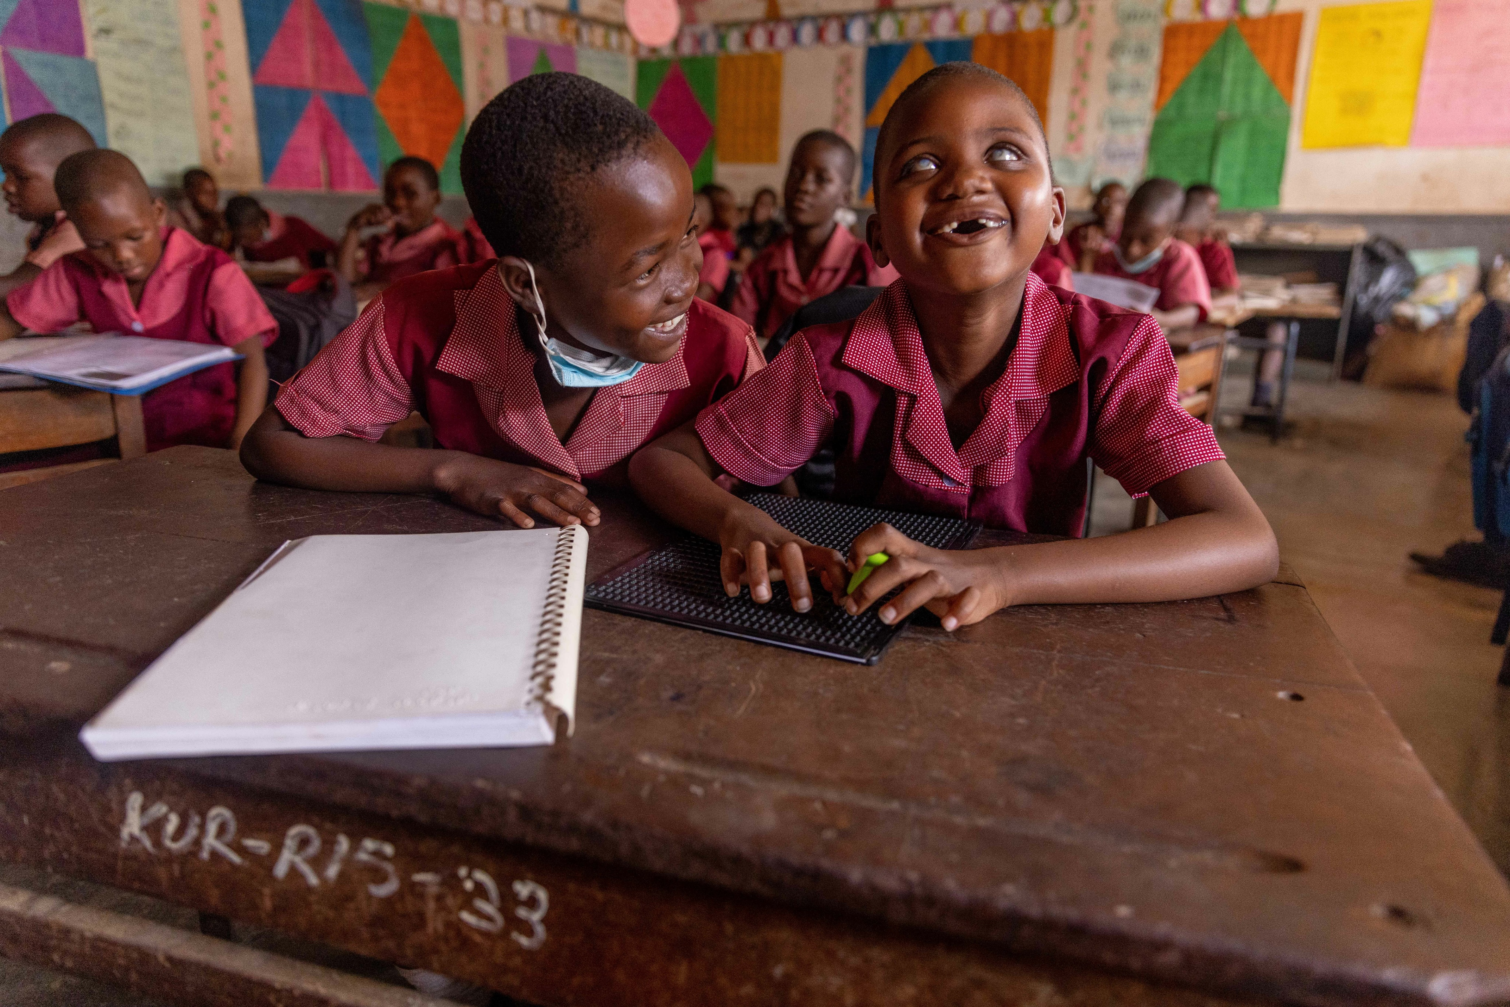
Because education is a human right!
#ZeroCon24
Notes:
Slide 8, which is the last slide shows Picture 7 (full screen): 2 girls in a classroom sitting on a desk, class in background, both laughing, 1 girl with visual impairment reading in braille
The picture is titled with: Because education is a human right!

