Slide 1
The Global Disability Summit 2025 Keynote speeches
Hans-Peter Baur, German Federal Ministry for Economic Cooperation and Development (BMZ), Germany
HRH Prince Mired Al-Hussein, Higher Council for the Rights of Persons with Disabilities, Jordan
José Viera, International Disability Alliance
22 February, 11:20-12:20
Notes:
The Global Disability Summit 2025
Keynote speeches
Hans-Peter Baur, German Federal Ministry for Economic Cooperation and Development (BMZ), Germany
HRH Prince Mired Al-Hussein, Higher Council for the Rights of Persons with Disabilities, Jordan
José Viera, International Disability Alliance
22 February, 11:20-12:20

Slide 2
Goal and Mission
Raise global attention on disability inclusive development and humanitarian action everywhere and for everyone
Build ownership and capacity of OPDs, especially in the Global South
Provide global, regional, and national stakeholders a platform to mobilise innovative, impactful, and far-reaching commitments
Showcase good practices and evidence from across the world to inspire change on disability inclusive development and humanitarian action
GDS 2018
GDS 2022
GDS 2025
United Kingdom
Norway
Germany
Kenya
Ghana
Jordan
IDA
IDA
IDA
Notes:
Goal and Mission
Raise global attention on disability inclusive development and humanitarian action everywhere and for everyone
Build ownership and capacity of OPDs, especially in the Global South
Provide global, regional, and national stakeholders a platform to mobilise innovative, impactful, and far-reaching commitments
Showcase good practices and evidence from across the world to inspire change on disability inclusive development and humanitarian action

Slide 3
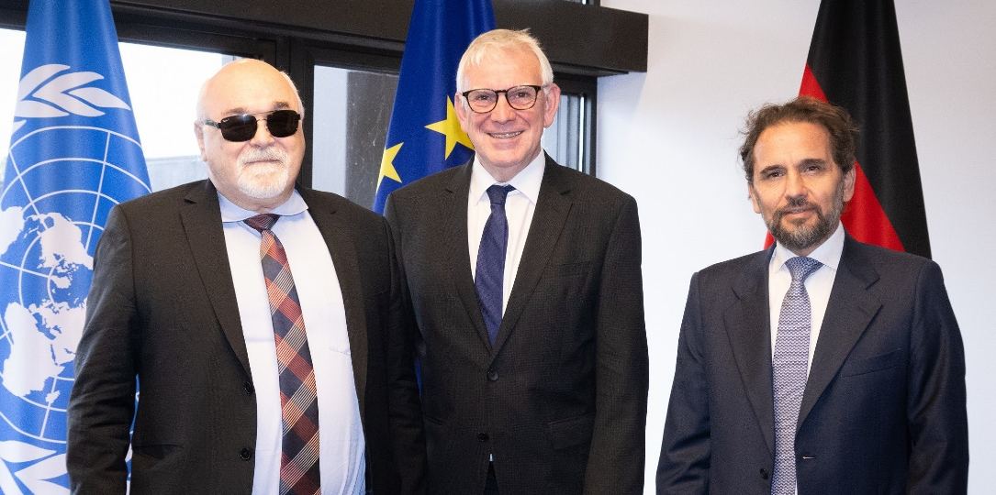
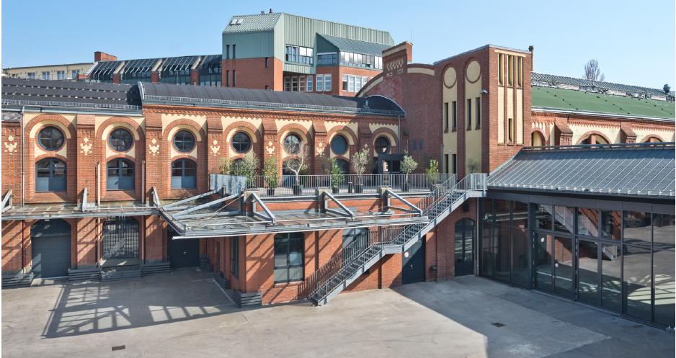
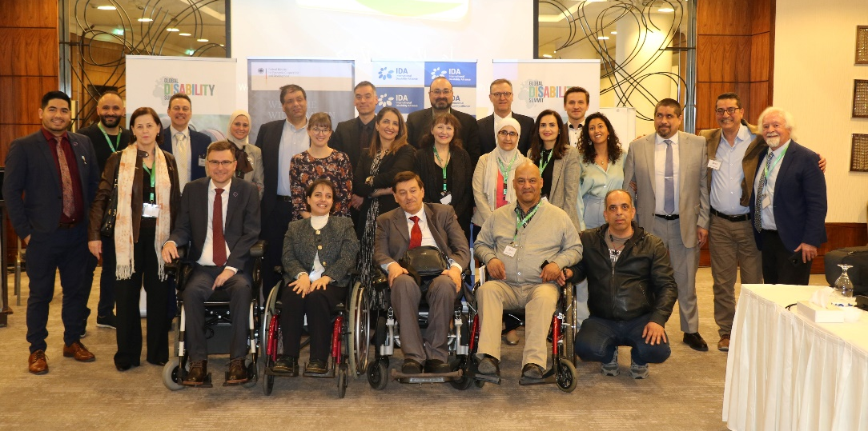
The Summit in 2025
The upcoming Global Disability Summit GDS will take place on 2-3. April 2025 in Berlin, Germany
Notes:
The Summit in 2025
The upcoming Global Disability Summit GDS will take place on 2-3. April 2025 in Berlin, Germany

Slide 4
What is the vision for GDS 2025?
Focus on implementation
Focus on rights
Focus on data and evidence
Disability inclusive develop-ment
National Owner-ship
Bridging the gap
Nothing about us without us
Objectives:
Build and expand the momentum of the previous two GDS
Amplify the GDS impact in advancing the rights and inclusion of all persons with disabilities
Notes:
What is the vision for GDS 2025?
Objectives:
The objective of the next Summit will be to build and expand the momentum of the previous two GDS, by amplifying its impact in advancing the rights and inclusion of all persons with disabilities through international cooperation.
To do this, several tracks will be explored among the co-hosts to determine the most cutting-edge and innovative approach for the GDS 2025, building on and going beyond commitments.
To do this, several key messages have been identified by the co-hosts to determine the most cutting-edge and innovative approach for the GDS 2025:
The Seven Key-Messages of GDS 2025 are:
Nothing about us without us
Focus on implementation
Focus on rights
National Ownership
Disability inclusive development
Bridging the gap
Focus on Data and Evidence

Slide 5
Panel Discussion
Rafael Teck, German Federal Ministry for Economic Cooperation and Development (BMZ), Germany
Ghadeer Alhares, Higher Council for the Rights of Persons with Disabilities, Jordan
José Viera, International Disability Alliance
22 February, 11:20-12:20
Notes:
Panel Discussion
Rafael Teck, German Federal Ministry for Economic Cooperation and Development (BMZ), Germany
Ghadeer Alhares, Higher Council for the Rights of Persons with Disabilities, Jordan
José Viera, International Disability Alliance

