Slide 1
Project Empower
Marvella Odili
Save Our Needy Organisation
Nigeria
Focus on Sub-Saharan Africa: Comprehensive teaching frameworks
February 21st 2024: 2.40pm-4.00pm
Notes:
Project Empower; Marvella, Odili; Save Our Needy Organisation, Nigeria, Focus on Sub-Saharan Africa: Comprehensive Teaching Frameworks
#ZeroCon24
February 21st 2024: 2.40pm-4.00pm

Slide 2

Background Of Organization and Project
Save Our Needy Organization is a non-governmental organization primarily focused on the empowerment of marginalized women, the promotion of girl-child education and the advancement of women’s and girls’ rights.
The organization is based in Nigeria but presently operates in Nigeria and Benin.
Save Our Needy Organisation has special consultative status with the UN Economic and Social Commission (ECOSOC) since 2017.
Project Empower is an inclusive and participatory project designed to empower and strengthen the capacity of marginalized women and girls with valuable knowledge, skills, resources and support using technology and innovative communication methods for sustainable income generation.
Notes:
Background of Save Our Needy Organisation and Project Empower.
Image is of Save Our Needy Organisation logo.

Slide 3
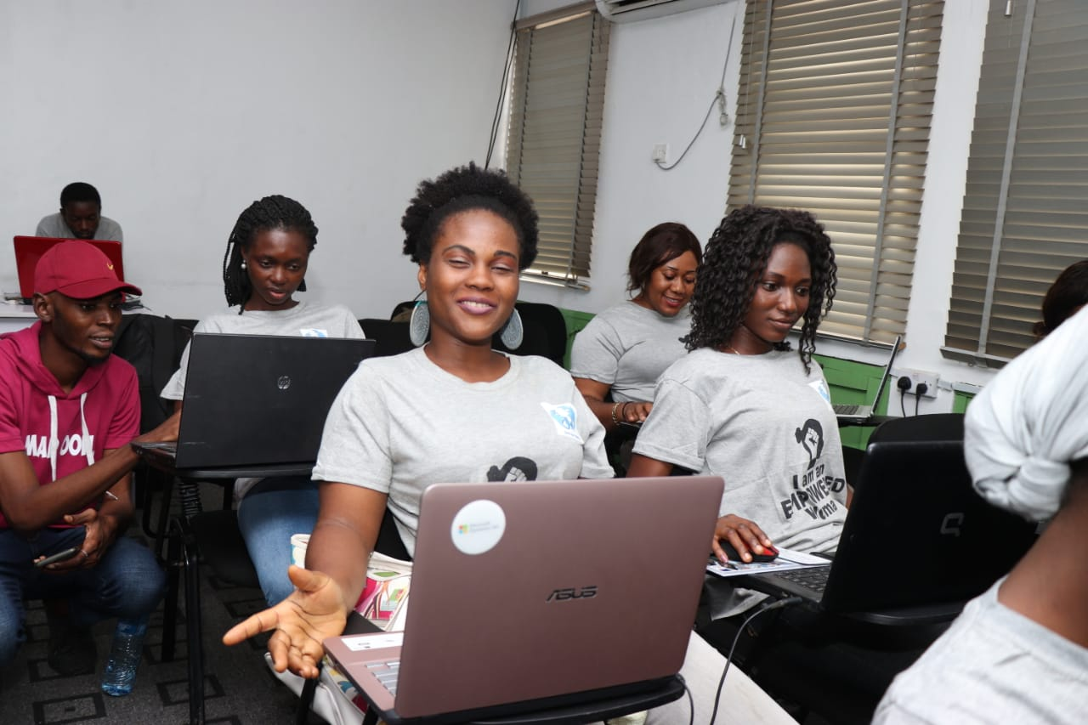
Why This Project?
Millions of women and girls particularly with disabilities in Nigeria face stigmatization, discrimination, exploitation, violence and injustice.
They lack representation and have no voice.
They lack skills and access to technology for sustainable income.
Notes:
In Nigeria, women and girls with disabilities face a lot of challenges including lack of access to technology.
Image is of women with their male trainer at a Save Our Needy Organization digital skills training session.

Slide 4
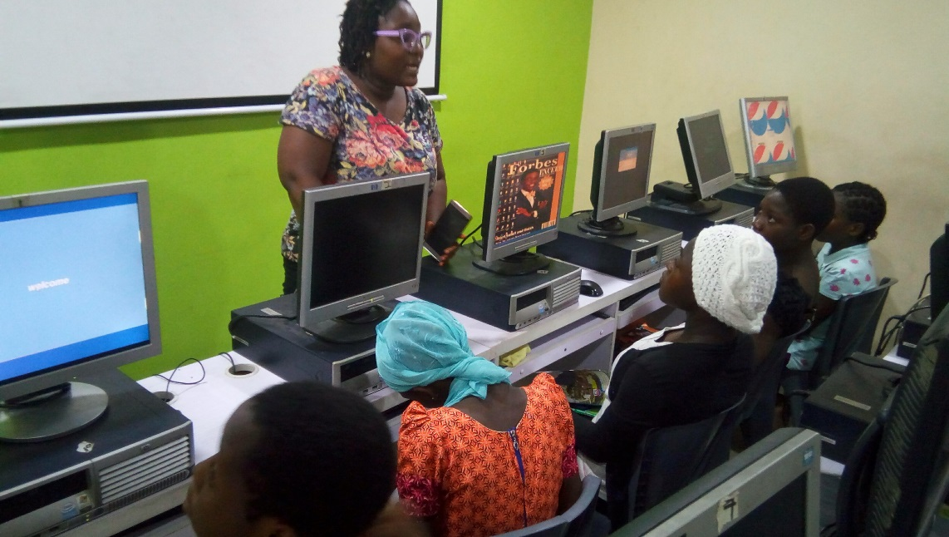
Challenges/Problems
Funding To Scale Project.
Negative attitudes towards disability.
Lack of support for women and girls with disabilities.
Mental disability not given enough attention as physical disability.
Notes:
Women and girls with disabilities in Nigeria do not have the support they need.
Image is of marginalized girls at a training session organized by Save Our Needy Organisation taking lessons from their female trainer.

Slide 5
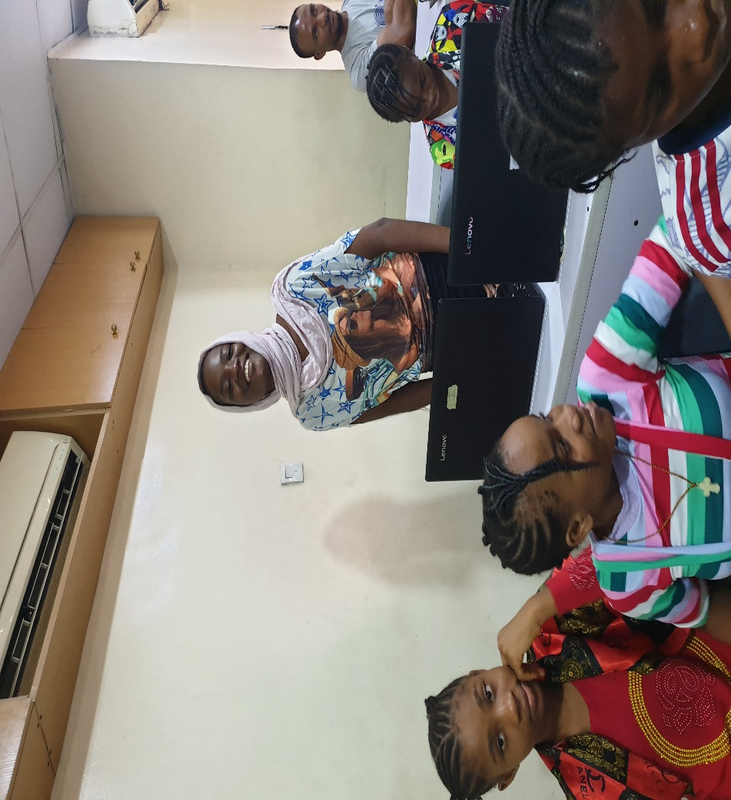
Solutions Adopted
In-person and online intensive training sessions on ICT and digital skills such as graphic design, website building, animation and coding.
Personalized mentorship sessions.
Leadership and entrepreneurship training.
Psychosocial support.
Notes:
We have adopted a number of solutions to help marginalized women and girls overcome their challenges and live better lives.
Image is of a marginalized girl in training class who stood up to answer a question.

Slide 6
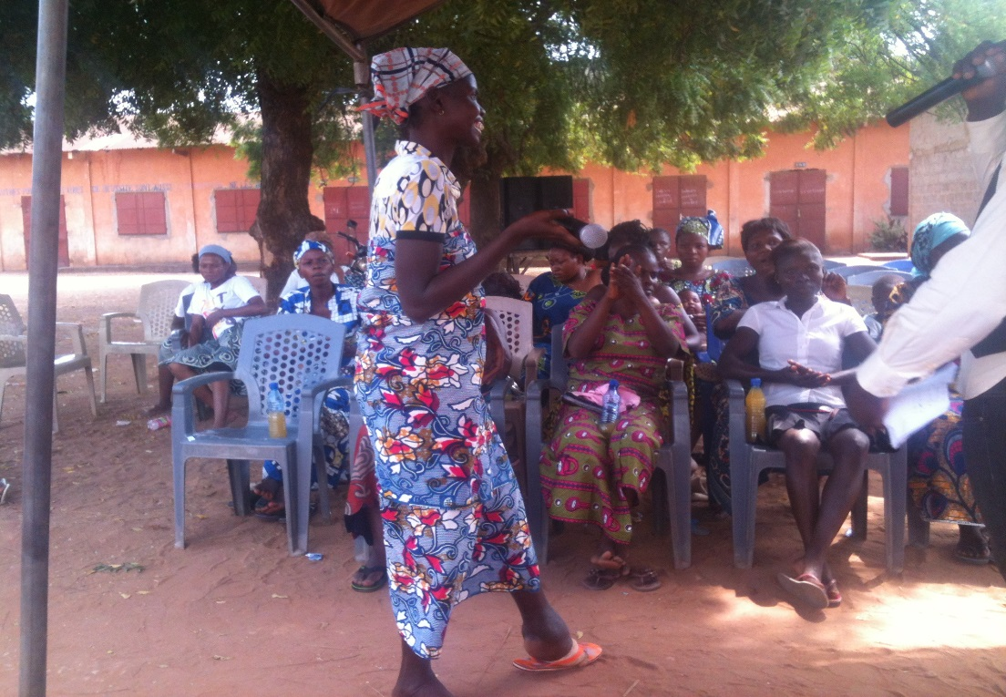
Innovation
Project focuses not only on building skills for sustainable income but also boosting the self-confidence and self-esteem of participants.
Marginalized women and girls are the torchbearers of this project.
They become Champions.
They become change agents.
Notes:
The project focuses both on building skills for sustainable income and building leadership skills of marginalized women and girls through training and support.
Image is of a marginalized woman with physical disability speaking at a community engagement in a rural area organized by Save Our Needy Organisation.

Slide 7
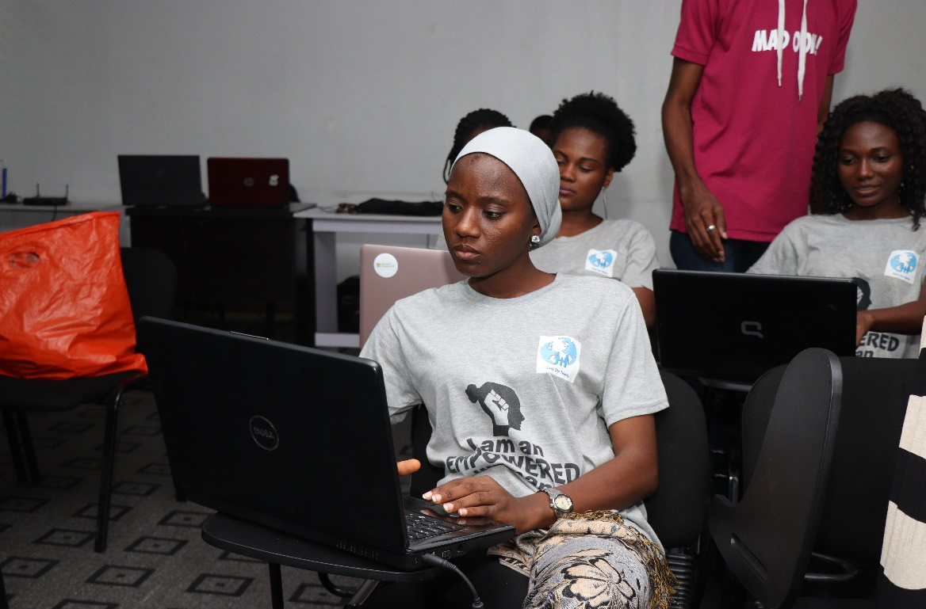
Impact
The project has led to life-changing transformative change having a ripple effect on participants families and communities.
Number of women and girls reached:
In 2020- 1,250 women and girls
In 2021 - 2,800 women and girls
- In 2022- 2,270 women and girls
Notes:
More than 6,000 marginalized women and girls have gained skills and support from this project so far.
Image is of marginalized women at a digital skills training session.

Slide 8
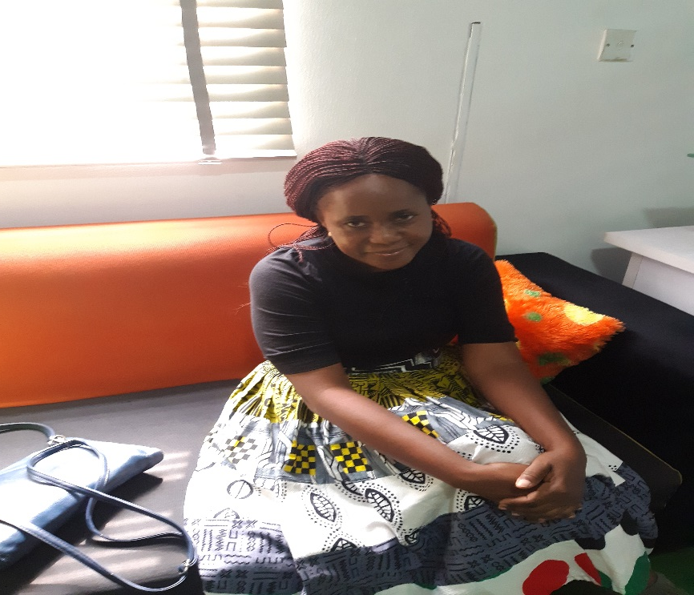
Success Stories 1
Fumbi, 28, a secondary school leaver, mother of 3 children all below the age of 5 years, cohabited with a man who never provided for the family so she was forced to do odd jobs to take care of herself and her family. She also suffered all forms of violence from her partner which took a toll on her mental health. After our skills training program and mentorship support, Fumbi started her own online graphic design business which enables her to earn a sustainable income now. She has finally taken courage to leave her abusive partner.
Notes:
Fumbi, a marginalized woman overcame all challenges to finally become a self-sufficient woman with high self-esteem.
Image is of marginalized woman, Fumbi.

Slide 9
Success Stories 2
Adesola is an adolescent orphan who lives with her guardians. She suffered sexual violence at a very young age and this affected her mental health. She had no support and could not speak about it for years. She was withdrawn and kept blaming herself for her predicament. Adesola not only gained skills in our ICT and digital skills program, she got much-needed psychosocial support which helped her focus on her strengths and abilities. Most importantly, she found a safe space to freely express herself and gain leadership skills.

Slide 10
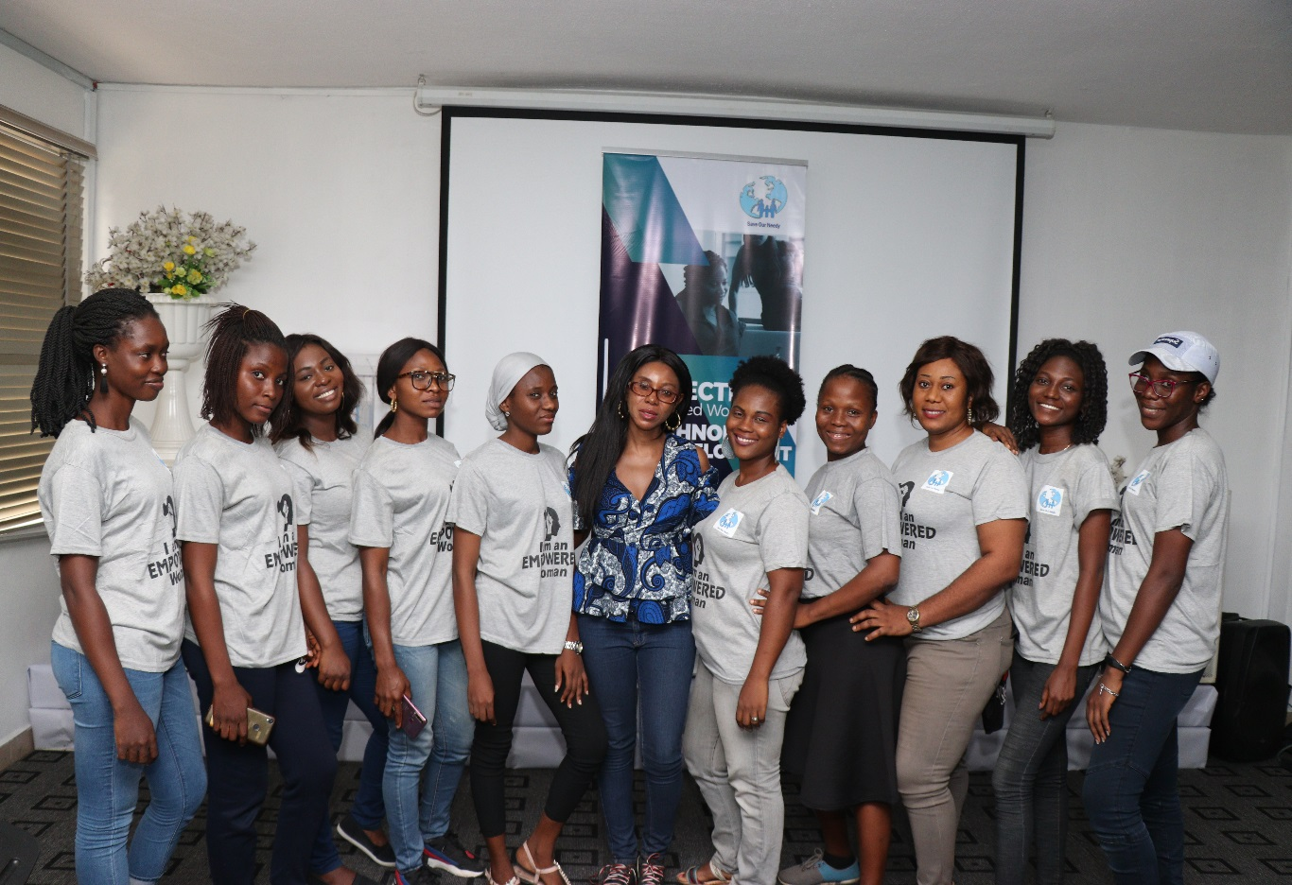
Sources of Finance
Grants – 70%
Donations – 15%
Income-generating activities – 15%
Notes:
Our main source of funding is from grants. Other sources of funding are donations and income-generating activities.
Image is of women after completion of training wearing the “I AM AN EMPOWERED WOMAN” T-shirt. Marvella Odili, the Project leader is in the middle.

Slide 11
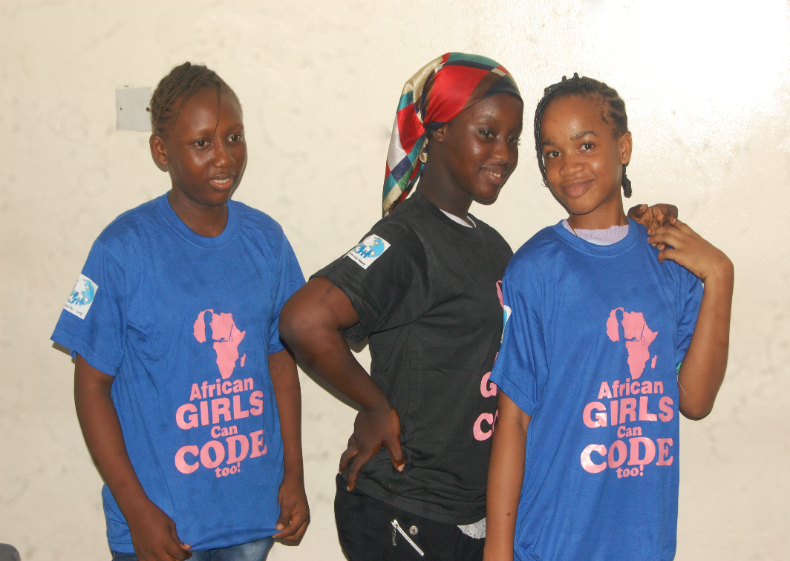
Sustainability
The communities are actively involved in the project and are given ownership of the project. This leads to continuity of project.
Participants become Champions and agents of change who empower others in their communities. This results in a multiplier effect.
Notes:
The project does not end after donor phase. Community involvement in the project leads to continuity. Participants also become Champions who drive change in their communities.
Image is of 3 marginalized girls wearing their Project branded t-shirts with inscription “African Girls Can Code Too” after training.

Slide 12
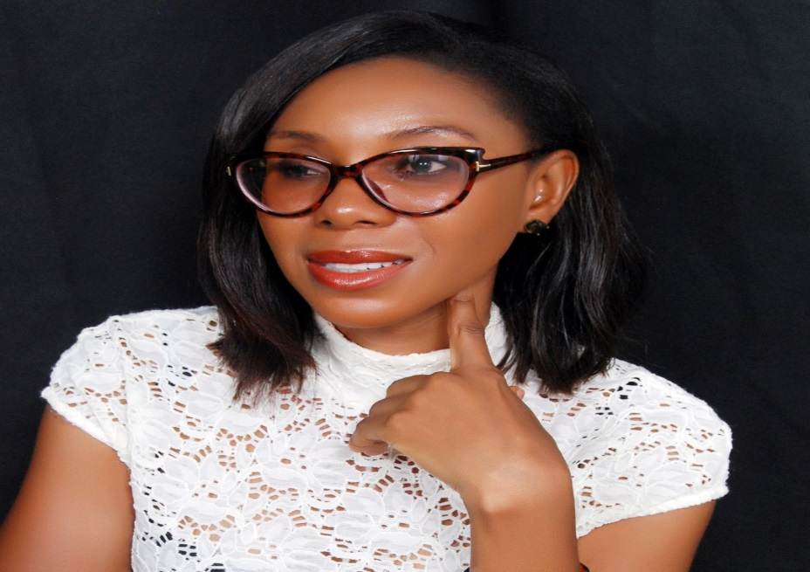
The Team
The team consists of 4 dedicated and committed women and 1 man.
All team members have years of experience in the development sector in Africa.
Marvella Odili is the Founder/CEO. She is also the Project Leader. She is a multiple award-winning social innovator, entrepreneur and humanitarian.
Notes:
We are a dedicated and committed team who always put in our best to achieve success in all projects implemented.
Image is of Marvella Odili, Founder/CEO, Save Our Needy Organisation.

