Slide 1
Accelerating Change: TOM’s Model for Scalable Innovation
Gidi (Gideon) Grinstein
TOM: Tikkun Olam Makers
USA / Israel
Session name: Funding and Accelerating Technology
Thursday, 6 March 10:00
Notes:
Please add your notes here.
Title; First name, last name of speaker(s); Name of Organization, Name of Country, Name of Session (as written in Agenda)
#ZeroCon24
Day and Time of Session

Slide 2
Mission
Mission: To create and deliver highly affordable and accessible TOM Solutions to every human “neglected problem” that can be solved anywhere around the world.
Purpose: To be the platform and process that allows for the creation and delivery of TOM Solutions.

Slide 3
Vision
Affordable
Accessible
Anyone
Anywhere
Mass-participation
Mass-creation
Mass-customization
Mass-distribution

Slide 4
Two Categories of Innovation
Technical innovation: Process of applying new ideas to practical problems by creating new products or processes, or improving existing ones.
Social / societal innovation: New ways for mobilizing and organizing people to get things done (Saul Alinsky).
TOM is primarily a social innovation: mobilizing and organizing people to help vulnerable populations through technical innovation.

Slide 5
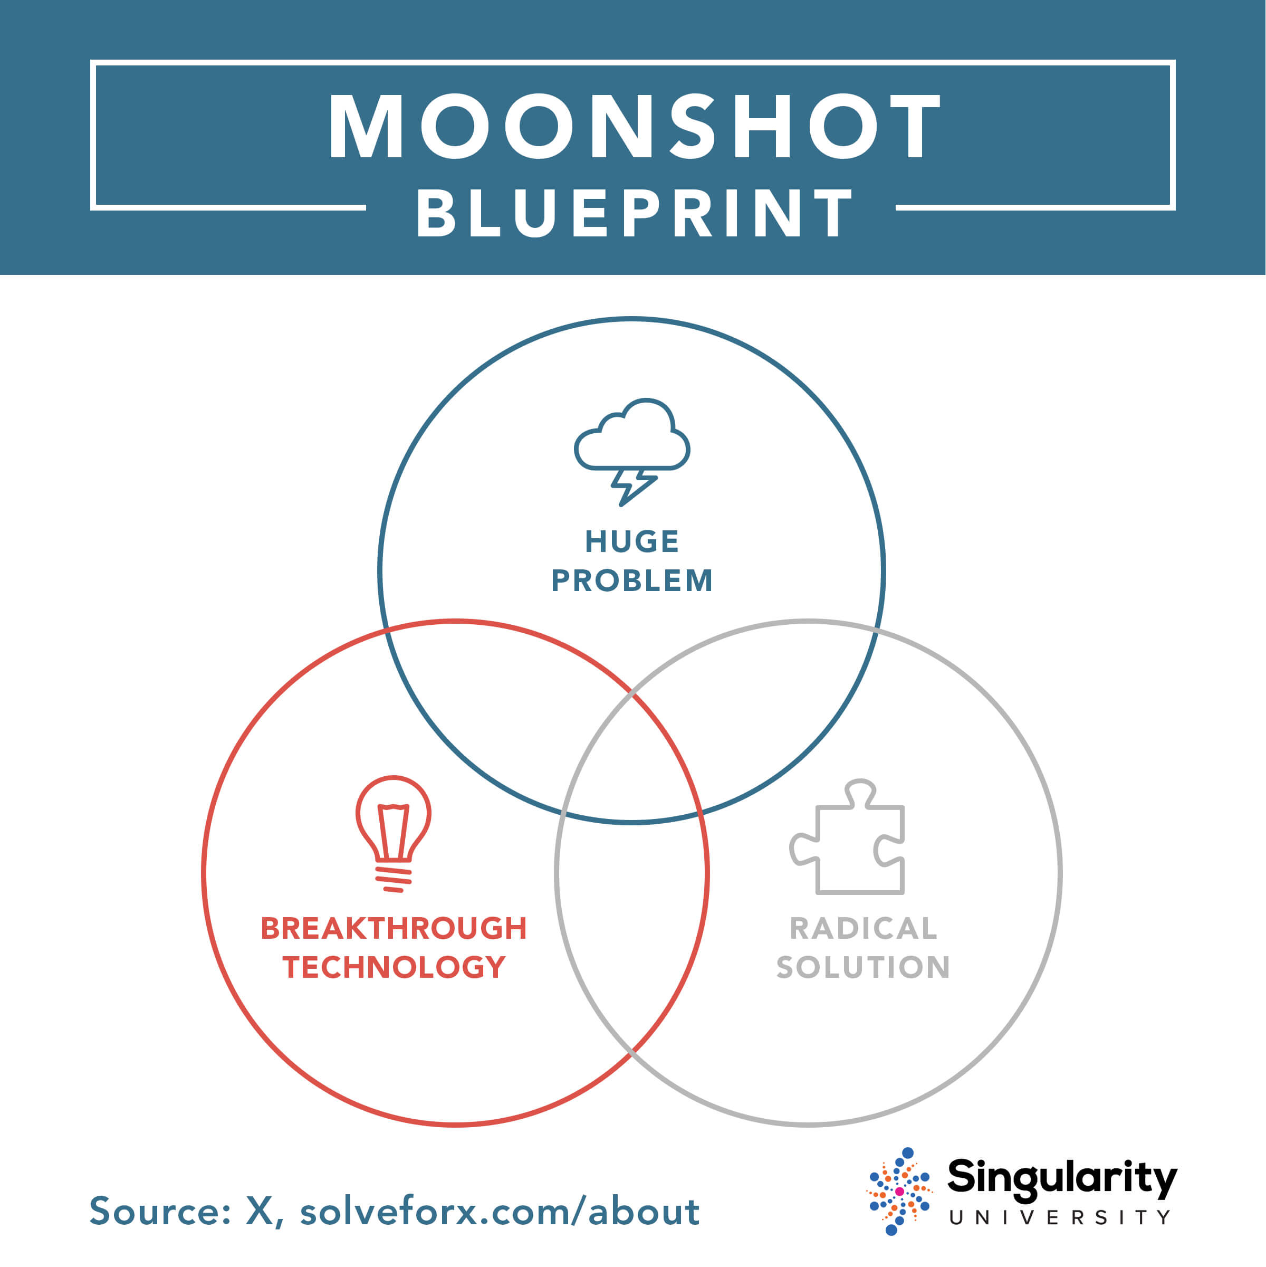
Moonshot Blueprint
Moonshot Goal: 250 Million Products delivered A huge problems: Millions of Neglected Problems
Breakthrough technology: 3D Printing, design softwares, AI for design
Radical Solution: Crowdsourcing open Innovation & distributed manufacturing

Slide 6
Strategy
Funnel of Innovation
Crowdsourcing of engineering and design talent / of makeshift solutions
A playbook for product-development
Standardization of product-development into a 5-stage TOM Process: Challenge (Level 1), Concept (L2), Working Model (L3), Prototype (L4) and Product (Level 5)
A web-platform:
Supports global open-innovation
Holds the TOM Portfolio of digital product files
All TOM Solutions are open-source / public domain IP
Funnel of distribution:
Playbook for distribution
Movement of TOM Workshops for manufacturing (in TOM Communities)
Distributed manufacturing / Crowdsourcing untapped makerspaces workshops

Slide 7
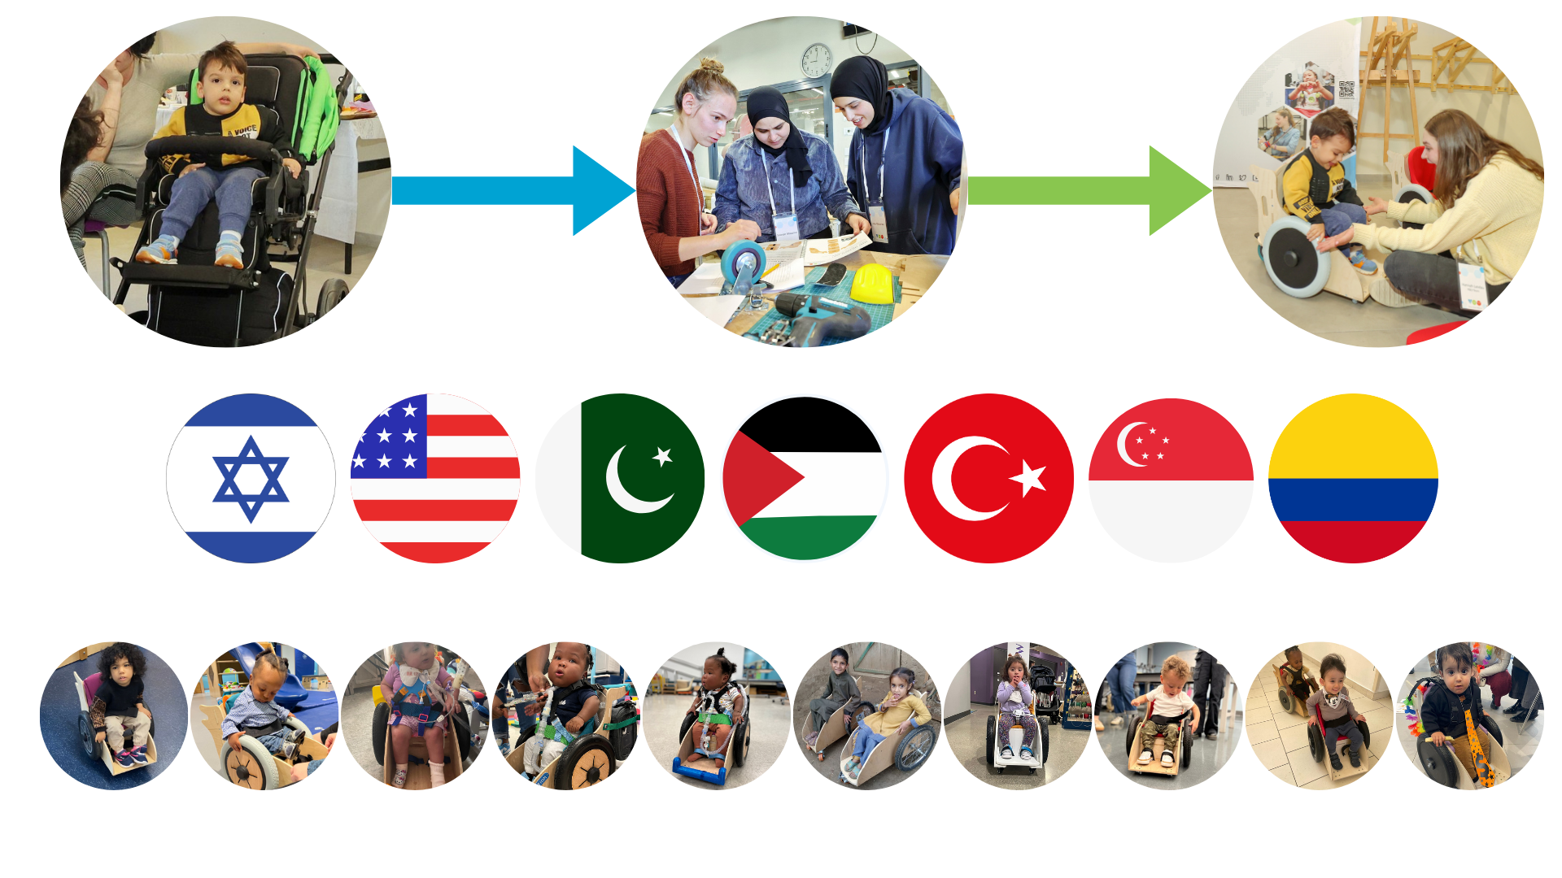
TOM’s innovation

Slide 8
TOM’s Social Innovation
Platform for crowdsourcing talent and open-innovation Standardization, covenant of open-source
Innovative end-to-end design process Human-centered, radical affordability, documentation system
Innovative platform for distributed manufacturing Crowdsourcing makerspaces / workshops

Slide 9
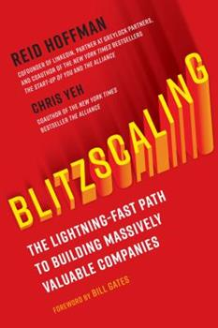
TOM Is A Scaleup
Scale-up means a venture whose logic is realized only at scale
TOM’s Decade Goals:
2,500 TOM Solutions available online for free
1,000 campuses (est potential: 8,500)
3,000 high schools (est potential: 10,000s)
1,000 of cities (est potential: 5,000 in US alone)
200 hospital rehabilitation centers (est 42,000 center in US along)
100,000s of volunteers
1,000,000s of deliveries of TOM Solutions
The largest repository of human challenges and open-source solutions

Slide 10
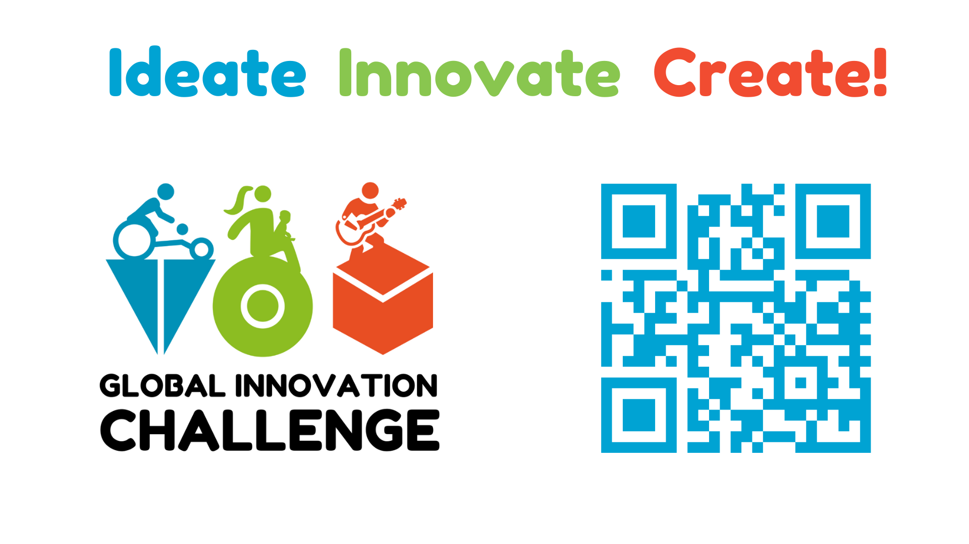
Ideate Innovate Create!

