Slide 1
Empowerment of Entrepreneurs with Disabilities
Doreen, Chizyuka
World Vision
Zambia
Entrepreneurship support programmes for persons with Disabilities
Thursday 6 March 2025, 15:40 - 16:40
Notes:
Please add your notes here.
Title; Doreen, Chizyuka; World Vision, Zambia, Name of Session Empowering of Entrepreneurs with Disabilities
#ZeroCon25
Thursday 6 March2025, 15:40- 16:40

Slide 2
BACKGROUND
World Vision Zambia (WVZ) Limited is a faith-based Organization dealing with Relief aid, Development, and Advocacy dedicated to working with children, families, and communities to overcome poverty and injustice. WVZ is part of World Vision International and serves all people regardless of religion, race, tribe , gender or social status.
Notes:
We are currently working on 38 large-scale programs in over 35 districts in Zambia.

Slide 3
PROJECT
World Vision Zambia, which is part of the global World Vision Network, in 2023 launched a project to empower businesses owned by persons with disabilities, facilitating their registration as suppliers of goods and services to world Vision Zambia.
3
Notes:
This was a sustainable way we thought could help People with disabilities and their families, as opposed to giving handouts.

Slide 4
INNOVATION
World Vision Zambia launched a project aimed at empowering persons with disabilities who produce goods, but lack access to markets and financial means
Registered businesses receive supply requests via WhatsApp, allowing them to deliver based on their financial resources. Supplied products range from food to cleaning materials, with pricing aligned to market rates and without competition
Notes:
The WhatsApp platform is secured allowing only registered entrepreneurs with disabilities see the calls for supply, preventing them from competition against huge established business operators

Slide 5
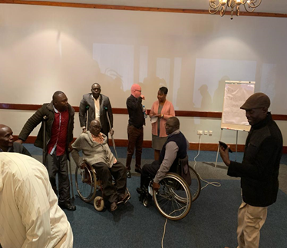
SKILLS TRAINING BEFORE REGISTRATION
Notes:
Training of Entrepreneurs with Disabilities in Business Skills and World Vision Procurement processes before Registering them and commencement of supplying

Slide 6
IMPACT
Increased income: Registered businesses owned by persons with disabilities have increase from 10 to 30 and are able access new markets and increase their income.
Poverty reduction: By increasing income and creating jobs, registering as suppliers has helped reduce poverty among persons with disabilities and their families.
Empowerment: Registering as suppliers has empowered persons with disabilities to take control of their economic lives and become active contributors to their communities.
Notes:
This initiative has short term and potential long term impact of registering businesses owned by persons with disabilities as suppliers to World Vision

Slide 7
IMPACT cont’’d……
Inclusion: By providing opportunities for businesses owned by persons with disabilities, World Vision promotes inclusion and challenging stigma and stereotypes surrounding disability.
Role modeling: Successful businesses owned by persons with disabilities are serving as role models, inspiring others to pursue entrepreneurship and economic empowerment
Market transformation: By promoting businesses owned by persons with disabilities, World Vision has contributed to a more inclusive and equitable market ecosystem.

Slide 8
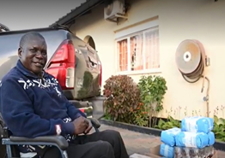

SUPPLIER 2023 2024
Notes:
2023 Picture taken ,First Supply to World Vision. 2024 Picture, Entrepreneur giving testimony of the growth of his business at a partnership meeting between world Vision and Zambia Agency for Persons with Disabilities

Slide 9
SUSTAINABILITY
Inclusive and accessible practices: The project's commitment to inclusive and accessible practices promotes social inclusion and reduces stigma and discrimination against persons with disabilities.
Revenue generation: The project's focus on empowering entrepreneurs with disabilities to start and grow their own businesses leads to increased revenue generation and financial stability.
Partnerships and collaborations: The project's partnerships with government and organizations of Persons with Disabilities provides a strong foundation for sustainability and scalability.

Slide 10
NEXT STEPS
Scaling Up
Expand to new locations: Replicate the project in other regions or countries, adapting to local contexts and needs.
Increase the number of beneficiaries: Reach more entrepreneurs with disabilities, providing them with training and support.
Learning and knowledge sharing: Document and share lessons learned, best practices, and success stories, contributing to the global knowledge base on disability inclusion and entrepreneurship.
Notes:
he sustainability of this project refers to its ability to maintain its impact and benefits over time, even after the initial support has ended. There are a number of factors that contribute to the sustainability of this project

Slide 11

Thank you

