Slide 1
Eliminating the disability employment gap
Jane Hatton
Evenbreak
United Kingdom
Digital training platforms and ecosystem building in inclusive employment
Wednesday 11.00 – 12.00
Notes:
Please add your notes here.
Jane Hatton, Evenbreak, United Kingdom, Digital training platforms and ecosystem building in inclusive employment
#ZeroCon24
Wednesday 11.00 – 12.00

Slide 2
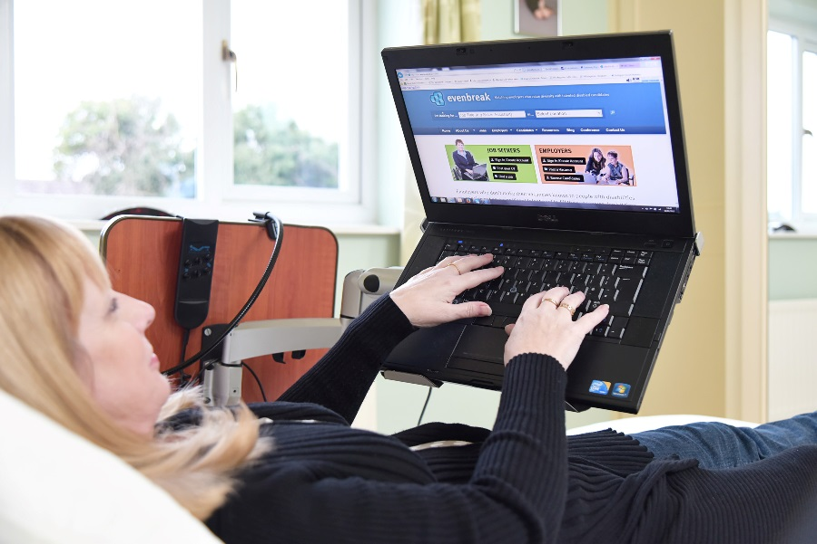

Why we exist
  Identified barriers disabled people face when looking for work
  Became disabled with spinal condition – in bed for 7 years
  Motivated to remove those barriers
  Non-profit & led by lived experience
Notes:
I was in inclusion, long before becoming disabled myself. Identified reasons for employment gap. Became disabled myself (like 83% of disabled people), and wanted to change things. Wanted Evenbreak to be non-profit, and to only employ disabled people

Slide 3
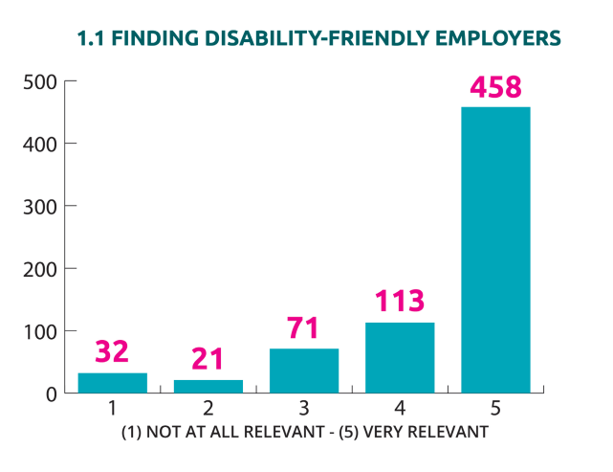
“I don’t know how to find employers who will take me seriously”
  Problem: Not knowing which employers to trust
Notes:
Research carried out by UCL – three biggest barriers. Not knowing which employer to trust was biggest. All companies describe themselves as ‘inclusive’, but not many include disability

Slide 4


Solution:
“I have confidence to apply to employers who are pro-actively looking to attract candidates with disabilities”
Global Job Board for disabled candidates and inclusive employers
Notes:
Solution – a job board just for disabled candidates, and just for those employers who see us as a pool of talent, not a source of problems

Slide 5
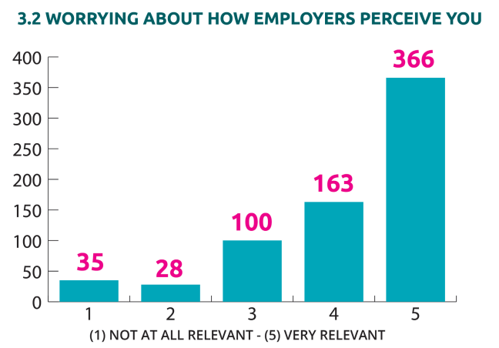
“I often start applications but get too scared to submit them”
Problem: Inaccessible/unsuitable recruitment processes
Notes:
2nd biggest barrier - Inaccessible recruitment processes – poor adverts, too reliant on CVs/resumes and interviews, pre-conceived bias from recruiters

Slide 6


Solution:
“When reviewing our recruitment practices, Evenbreak provided challenge, insight and recommendations that stems from lived experience and expertise. This is a real differentiator for us.”
Training and Consultancy for Organisations
Notes:
Solution - Support employers to remove barriers from recruitment processes – and improve inclusion and accessibility throughout organisation with training and consultancy

Slide 7
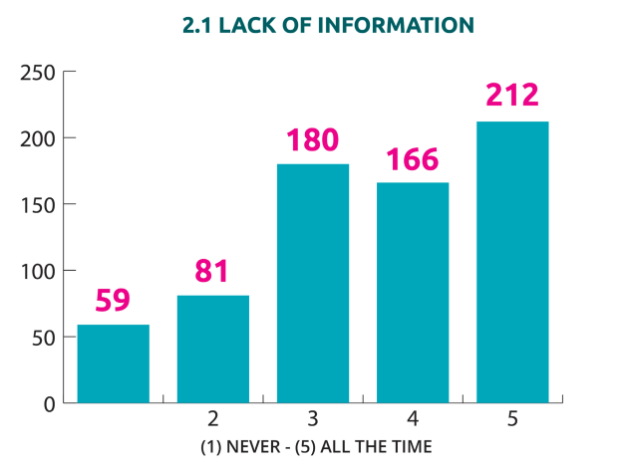
“I wish employers focused on my talent rather than my disability”
Problem: Lack of confidence
Notes:
3rd biggest barrier – Negative stereotypes –external and internal.

Slide 8


Solution:
“After trying for so long to get a role where I could really use my skills, the support I received from Evenbreak gave me the confidence to apply for my dream job – and I’m now thriving in that role”
Support for Candidates
Notes:
Solution - Educate employers, and support candidates through career hive and partnerships

Slide 9
Business Model
  Income from services sold to employers:
      Job adverts (single/bundles)
      Training and consultancy
      Membership (combination)
  Surplus funds career support for disabled candidates
Notes:
Not reliant on grants – income from employer services cover costs, and surplus funds career support

Slide 10
Impact
  Employers attract more disabled talent
  Employers improve practice
  Disabled candidates find employment and thrive
  Social value – average £47,000 per candidate
Notes:
Examples – 500,000 jobs a year advertised, law firm increased disabled applicants by 40%, removing barriers from recruitment process (eg Mars, Vodafone, Capgemini) opens doors for hundreds of thousands of disabled candidates, training line managers improves retention, thousands of candidates gain the right job for them, social value up to £93,000, with average of £47,000

Slide 11
Success Factors
  Evidence-based and co-produced
  Designed and delivered by people with lived experience of disability
  Not about pity but about talent
Notes:
All based in continuous feedback and metrics. Everything is designed and delivered by people with lived experience. Everything underpinned by social model of disability – removing disabling barriers means talent can thrive – huge business case

Slide 12
Future
  To create a world where all disabling barriers in the workplace have been removed
  Partnership working
Notes:
To reduce disability employment gap to zero, globally. Looking for partnerships – we’ll need to work together to make this happen!

