Slide 1
Global Disability Summit 2025
Bernd Schramm
GIZ (Gesellschaft für Internationale Zusammenarbeit)
Germany
Global Disability Conferences in 2025: Call to Action
March 6, 2025, 16:00 to 17:00 h
Notes:
Title: Global Disability Summit 2025, Bernd Schramm, GIZ, Germany
Session: Global Disability Conferences in 2025: Call to Action
March 6, 2025, 16:00 to 17:00 h

Slide 2

Global Disability Summit
Notes:
GDS 2025: Over a Billion Reasons to #CommitToChange
2nd - 3rd April 2025 in Berlin / Germany
High-profile political summit, co-hosted by Germany, Jordan and the International Disability Alliance (IDA)
Global conference with a commitment mechanism to advance the rights and to improve the lives of persons with disabilities
Unique opportunity for stakeholders to come together to advance the inclusion of persons with disabilities worldwide

Slide 3
Key facts
GDS 2025: Over a Billion Reasons to #CommitToChange
2nd - 3rd April 2025 in Berlin / Germany
High-profile political summit, co-hosted by Germany, Jordan and the International Disability Alliance (IDA)
Global conference with a commitment mechanism to advance the rights and to improve the lives of persons with disabilities
Unique opportunity for stakeholders to come together to advance the inclusion of persons with disabilities worldwide
Notes:
The International Disability Alliance (IDA), the Government of Germany, and the Government of Jordan will host the third Global Disability Summit (GDS). The GDS is a unique global mechanism that improves the lives of persons with disabilities, especially from the global South. It was created in 2017 to convene global, regional, and national stakeholders that share the same goal and vision for disability inclusive development and humanitarian action.

Slide 4
What to expect?
High-Level Opening by Chancellor Scholz (GER) and H.M. Abdullah II bin Al-Hussein (JOR), Amina Mohammed (UN Deputy Secretary-General) and Nawaf Kabbara, IDA President
Berlin-Amman Declaration on Global Disability Inclusion - Over 1 Billion Reasons to Sign
> 1.000 Commitments from various stakeholders
23 Side Events, 22 Fireside Chats and approx. 50 Exhibition Booths
Launch of the Resilient and Inclusive Cities Hub
Launch of the Global Disability Inclusion Report and the Disability Data Hub
Disability Data Forum
Notes:
What to expect?
High-Level Opening by Chancellor Scholz (GER) and H.M. Abdullah II bin Al-Hussein (JOR), Amina Mohammed (UN Deputy Secretary-General) and Nawaf Kabbara, IDA President
Berlin-Amman Declaration on Global Disability Inclusion - Over 1 Billion Reasons to Sign
> 1.000 Commitments from various stakeholders
23 Side Events, 22 Fireside Chats and approx. 50 Exhibition Booths
Launch of the Resilient and Inclusive Cities Hub
Launch of the Global Disability Inclusion Report and the Disability Data Hub
Disability Data Forum
Civil Society Forum

Slide 5
Main topics
Inclusive Labour Markets and Decent Work
How to Transform Education Systems to be Inclusive of and accessible to all
Accessible Infrastructure
Political Participation
Financing for Disability Inclusive Development
Disability-Inclusive Practices for Disasters and Conflict
Inclusion in digital information / communication
The Road to Inclusive Climate Action: From Berlin to Belém and Beyond
Health Equity
Notes:
Main topics:
Inclusive Labour Markets and Decent Work
How to Transform Education Systems to be Inclusive of and accessible to all
Accessible Infrastructure
Political Participation
Financing for Disability Inclusive Development
Disability-Inclusive Practices for Disasters and Conflict
Inclusion in digital information / communication
The Road to Inclusive Climate Action: From Berlin to Belém and Beyond
Health Equity

Slide 6
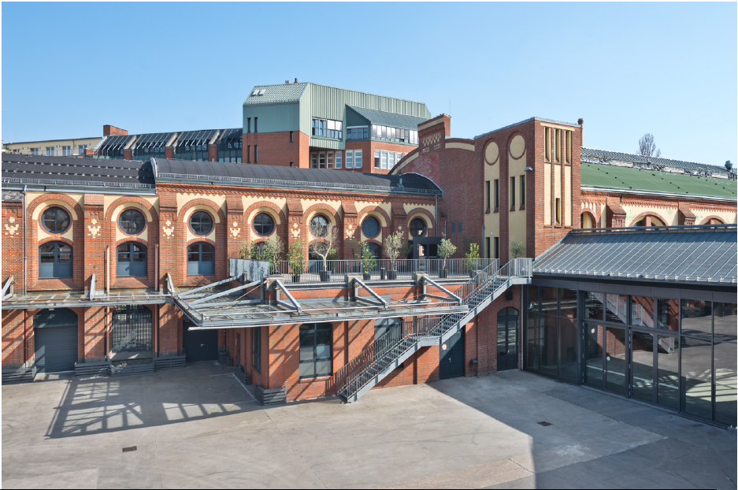

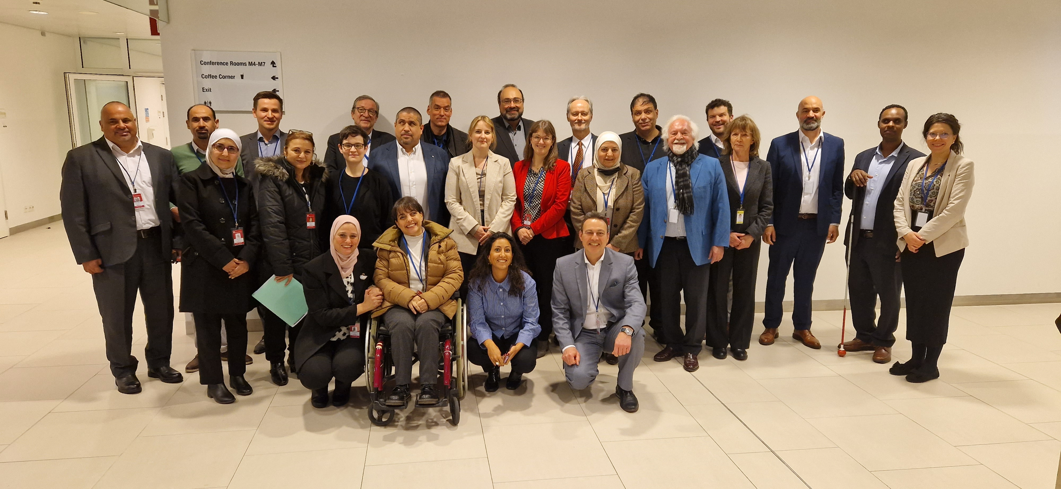
We look forward to seeing you at the Summit!
> Registration open
> Commitments portal open
> Please subscribe to our newsletter for latest information
#CommitToChange
Notes:
We look forward to seeing you at the Summit!
> Registration open
> Commitments portal open
> Please subscribe to our newsletter for latest information
#CommitToChange

Slide 7
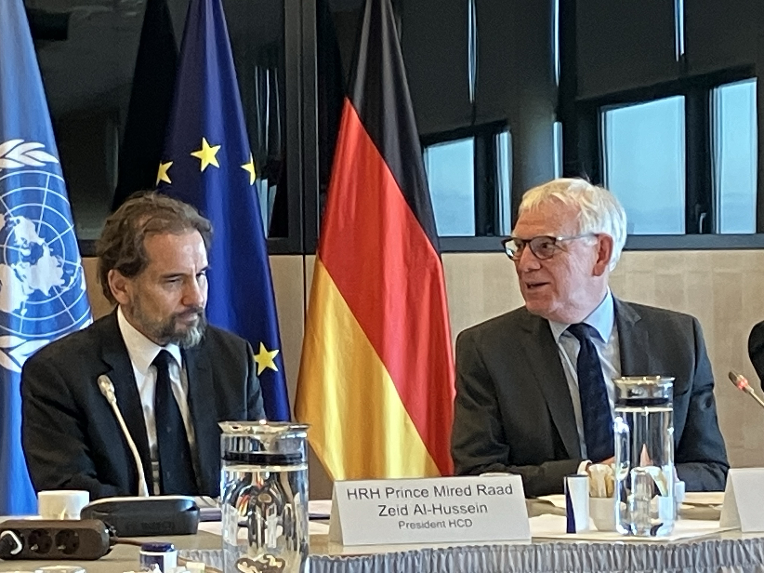
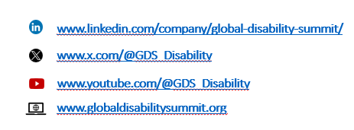
Thank you
Contact:
summit@ida-secretariat.org
Notes:
Thank you!
Contact:
summit@ida-secretariat.org

