Slide 1
Without Accessibility Art doesn’t exist
Claudia Werneck / Natália Simonete
School of People - Communication in Inclusion
Brazil
Inclusive programs in arts, dance, and music for the youth
February 22, 2024. 12:20 pm – 1:20 pm CET

Slide 2
School of People - Communication in Inclusion
More than 100 national and international acknowledgements, such as the Human Rights Award and the Cultural Merit Order, both from the Presidency of Brazil.
The most awarded latin America NGO by the Zero Project (five times).
2023 - Appointed by the Minister of Culture to join the National Commission for the Incentive of Culture.
2024 - Its accessible app VEM CA (“Come to Accessible Culture”) was included in the most important federal government program for people with disability: Living Without Limits II.

Slide 3
Without accessibility art doesn't exist.
It is during the communication process that the most severe forms of discrimination happen.
Not offering accessibility communication is also a form of social, economic and political control.
That's why we're dedicated to producing accessible and free culture.

Slide 4
1) ETA - Accessible Theater Festival - Online
Problem: During the pandemic, people with disabilities faced unprecedented exclusion, resulting in a new type of guardianship, which is difficult to denounce…
Solution: In 2020, the School of People launched a platform named Inclusive Hyperconnection, recognized by the UN, among the "400 Best Practices in the World."
Outcome: In 2023, the School of People hosted the first online “Accessible Theater Festival”, the ETA Festival, through Inclusive Hyperconnection. All activities were conducted online with sign language, closed caption, easy language, and audio description.

Slide 5
1) ETA - Accessible Theater Festival - Online
The public call for participation was announced in 14 accessible formats
24 hours of accessible theater training online
More than 25,000 popular votes from all the five Brazilian regions through the VEM CA app
10,000 Euros distributed to the winning plays
Ebook with the best plays in 07 accessible formats
Challenges and next steps: We will produce the ETA Festival in the Amazon region, in-site, in 2024.

Slide 6
2) VEM CA – Accessible Culture App
Problem: Although many cultural events with accessibility are offered in Brazil, people with disabilities are still not able to participate because they do not know where and when these activities are happening.
Solution: In 2019, we created an accessible app that connects cultural productions with at least one form of accessibility or affordability to audiences with disabilities.
Outcome: Brazil's first fully accessible app, VEM CA, resulted in a campaign that was shown on TV, reaching an audience of 12 million people.

Slide 7
2) VEM CA – Accessible Culture App
06 awards - including the Zero Project Award in 2021 and the "400 Best Practices in The World" awarded by the UN
26,000 downloads
990 registered projects
330 monthly users
24 types of online and in-person events
Finalist of the World Summit Awards (WSA) 2023

Slide 8
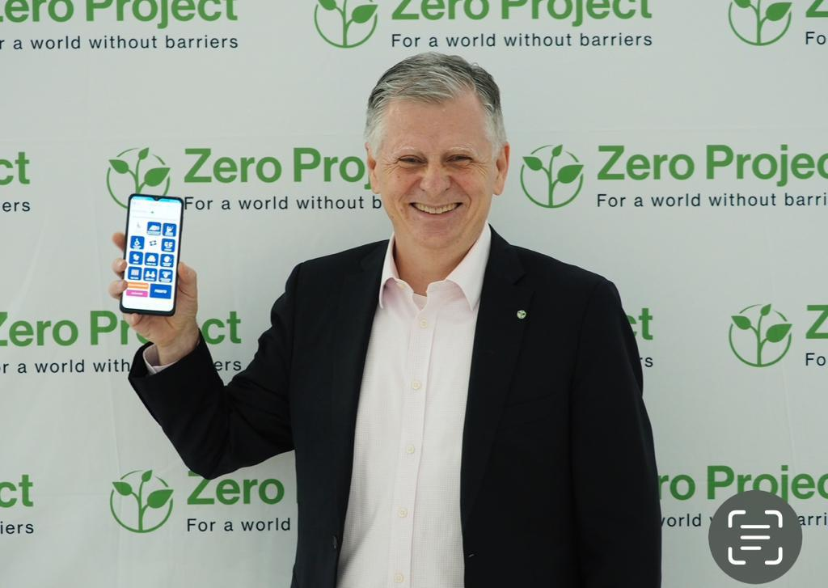
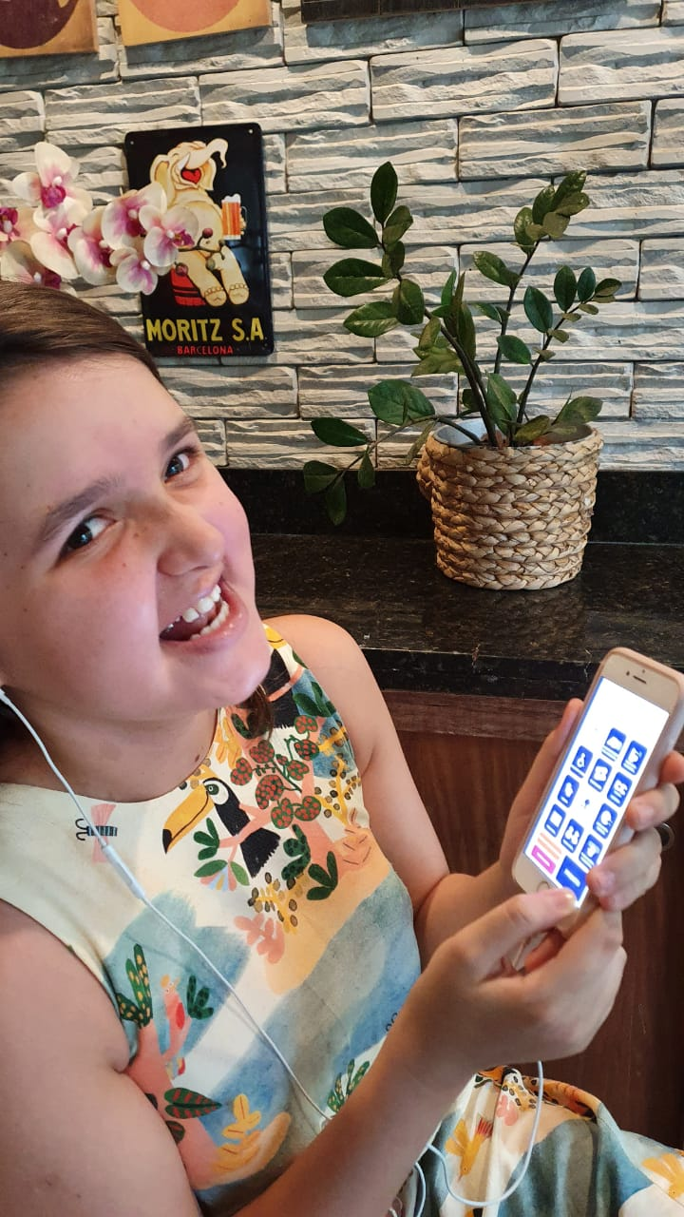
2) VEM CA – Accessible Culture App

Slide 9
2) VEM CA – Accessible Culture App
Challenges and next steps:
Maintaining the app constantly updated with new technologies
Marketing investment so that more people use the app
Enhancing the robustness and security of the app
Promoting technological integration with the platforms used by “Living Without Limits II”
Expanding VEM CA to other Portuguese-speaking nations

Slide 10
Play videos 1 & 2

